Slide 1
Review of Fundamentals of Thermodynamic
Objective: To find some useful relations among air temperature, volume, and pressure.
Review
Ideal Gas Law: PV = nRT
Pα = RdT = R’T
First Law of Thermodynamics:
đq = du + đw
W = ∫ pdα

Slide 4
Review (cont.)
Definition of heat capacity:
c_{v} = du/dT = Δu/ΔT
c_{p} = c_{v} + R
Reformulation of first law for unit mass of an ideal gas:
đq = c_{v}dT + pdα
đq = c_{p}dT − αdp

Slide 5
Review (cont.)
For an isobaric process:
đq = c_{p}dT
For an isothermal process:
đq = − αdp = pdα = đw
For an isosteric process:
đq = c_{v}dT = du
For an adiabatic process:
c_{v}dT = − pdα and c_{p}dT = αdp

Slide 6
Review (cont.)
For an adiabatic process:
c_{v}dT = − pdα and c_{p}dT = αdp
du = đw
(T/T₀) = (p/p₀)^{K}
Where K = R/c_{p} = 0.286
(T/θ) = (p/1000)^{K}
Define potential temperature:
θ = T(1000/p)^{K}
Potential temperature, θ, is a conserved quantity in an adiabatic process.

Slide 7
Review (cont.)
definition of φ as entropy.
dφ ≡ đq/T
∮ dφ = 0
Entropy is a state variable.
Δφ = c_{p}ln(θ/θ₀)
In a dry adiabatic process potential temperature doesn’t change, thus entropy is conserved.

Slide 8
Review (cont.)
Remember potential temperature:
θ = T(1000/p)^{K}
Potential temperature, θ, is a conserved quantity in a dry adiabatic process; K = 0.286
New quantity:
Equivalent Potential Temperature, θ_{e}, is conserved in both dry and saturated adiabatic ascent or descent. From Wallace and Hobbs (p. 85 ), assuming that w_{s}/T➔ 0 then θ_{e}➔ θ.
-L_{v}w_{s}/c_{p}T ≅ ln(θ/θ_{e})
θ_{e} ≅ θ exp(L_{v}w_{s}/c_{p}T)
This is a useful quantity for convective processes.

Slide 9
Thermodynamic Diagrams
Graphic representation of scientific data.
Wallace and Hobbs Ch. 3; Salby Ch. 5
GENERAL INTRODUCTION:
Thermodynamic (also called adiabatic or aerological) diagrams of various types are in use, and the earliest dates from the 19th century. They are all based on the same principles, and differences are mainly in appearance. Each chart contains five sets of lines: isobars, isotherms, dry adiabats, pseudo-adiabats & saturation moisture lines.
The calculations are based on the basic laws of thermodynamics and temperature-pressure-humidity relationships, that can be accomplished very quickly. The diagrams are such that equal area represents equal energy on any point on the diagram: this simplifies calculation of energy and height variables too when needed. For basic calculation such as condensation level, temperature of free convection, it will be enough to understand what the various sets of lines mean, and more importantly, how to use them.

Slide 10
*** THERMODYNAMIC DIAGRAMS *** Page-2 Contd…
There are four/five such diagrams called :
the Emagram
the Tephigram
the SkewT/Log P diagram (modified emagram)
the Psuedoadiabatic (or Stüve) diagram
** The emagram was devised in 1884 by H. Hertz. In this plot, the dry adiabatic lines have an angle of about 45º with the isobars; isopleths of saturation mixing ratio are almost straight and vertical. In 1947, N. Herlofson proposed a modification to the emagram which allows straight, horizontal isobars, and provides for a large angle between isotherms and dry adiabats, similar to that in the tephigram.
** The Tephigram takes its name from the rectangular Cartesian coordinates : temperature and entropy. The Greek letter 'phi' was used for entropy, hence Te-phi-gram (or T-Φ-gram). The diagram was developed by Sir William Napier Shaw, a British meteorologist about 1922 or 1923, and was officially adopted by the International Commission for the Exploration of the Upper Air in 1925.

Slide 11
*** THERMODYNAMIC DIAGRAMS *** Page-3 Contd…
** The Stüve diagram was developed ca 1927 by G. Stüve and gained widespread acceptance in the United States: it uses straight lines for the three primary variables, pressure, temperature and potential temperature. In doing so we sacrifices the equal-area requirements (from the original Clapeyron diagram) that are satisfied in the other two diagrams.
** The SkewT/Log(-P) diagram is also in widespread use in North America. This is in fact a variation on the original Emagram, which was first devised in 1884 by H. Hertz.
The area bounded by various lines is linearly proportional to useful physical quantities such as convectively available potential energy (CAPE).
We can solve Poisson’s Eq. graphically:
Where p₀^{K} is a constant.
Each dry adiabat is a straight line from
T at 1000 hPa to T = 0 at p = 0.
If we skew the isotherms to be at a 45º angle we get the Skew-T ln p diagram.

Slide 12
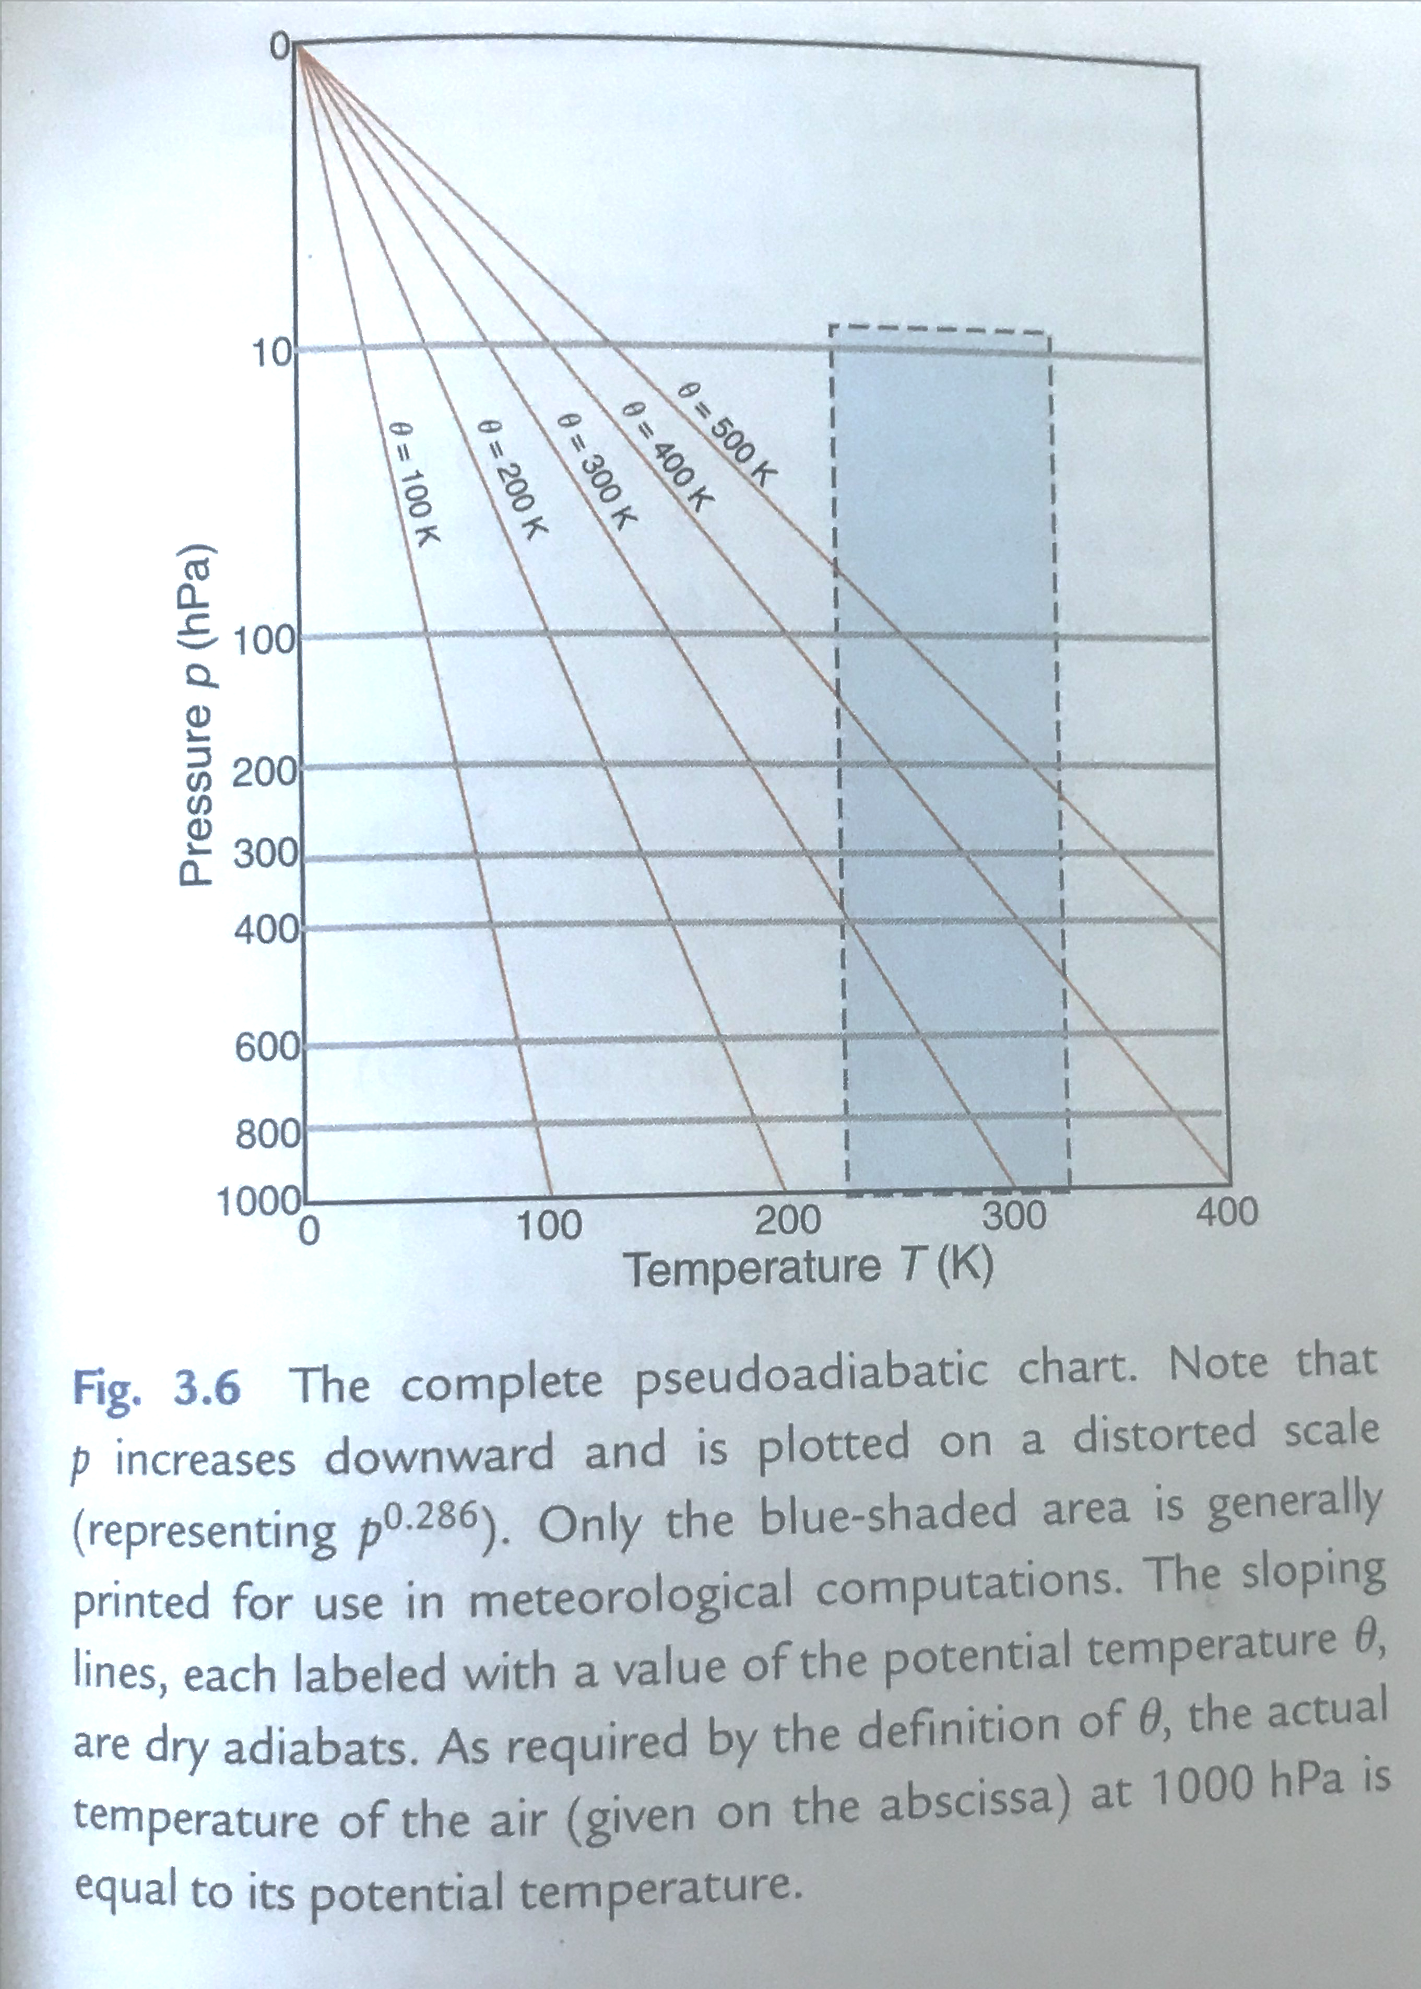
Wallace & Hobbs Chapter 3 y = p^{K} x = T
We make pressure decrease with increasing y, and use a log scale.
For any constant value of θ, we get a straight line that passes through θ = 0, Τ = 0.
These are dry adiabats.
To make it easier to read, we skew T

Slide 13
*** THERMODYNAMIC DIAGRAMS ***
the Emagram
the Tephigram
the SkewT/Log P diagram (modified emagram)
the Psuedoadiabatic (or Stüve) diagram

Slide 14
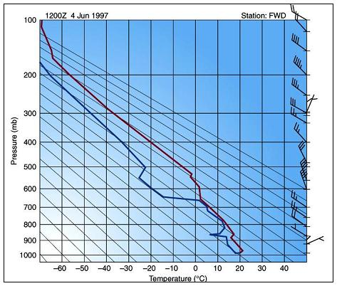
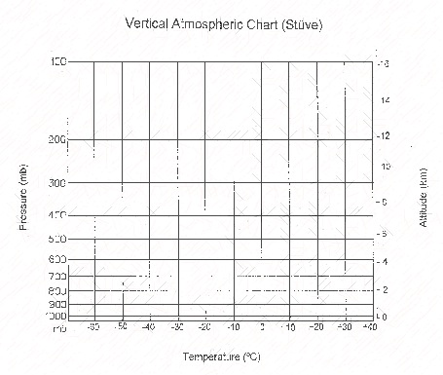
Isobars and Isotherms
Stüve Diagram. The pressure and temperature uniquely define the thermodynamic state of a dry air parcel (an imaginary balloon) of unit mass at any time. The horizontal lines represent isobars and the vertical lines describe isotherms. This is a pseudoadiabatic chart; the isotherms run vertically.

Slide 15
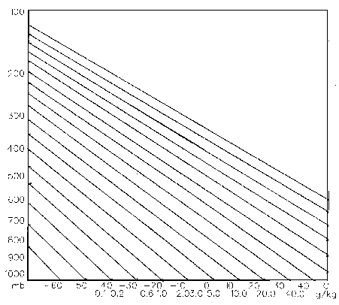
Dry Adiabatic Lines
These lines represent the change in temperature that an unsaturated air parcel would undergo if moved up and down in the atmosphere and allowed to expand or become compressed (in a dry adiabatic process) because of the air pressure change in the vertical. Linear wrt Z or ln(p).

Slide 16
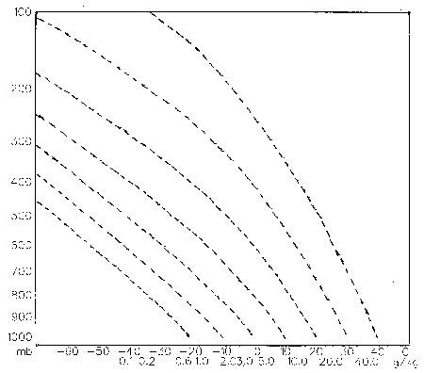
Pseudo or Wet Adiabatic Lines
These curves portray the temperature changes that occur upon a saturated air parcel when vertically displaced. Saturation adiabats appear on the thermodynamic diagram as a set of curves with slopes ranging from 0.2C°/100 m in warm air near the surface to that approaching the dry adiabats (1C°/100 m) in cold air aloft.

Slide 17
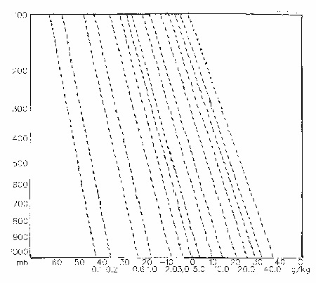
Isohume – Mixing Ratio Lines
These lines (also called saturation mixing ratio lines or isopleths) uniquely define the maximum amount of water vapor that could be held in the atmosphere (saturation mixing ratio) for each combination of temperature and pressure. These lines can be used to determine whether the parcel were saturated or not.

Slide 18
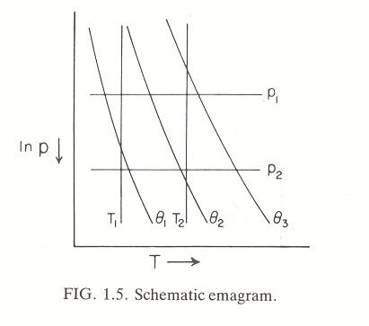
*** Emagram ***
The emagram was devised in 1884 by H. Hertz. In this, the dry adiabats make an angle of about 45º with the isobars; isopleths of saturation mixing ratio are almost straight and vertical. In 1947, Herlofson proposed a modification to the emagram which allows straight, horizontal isobars, and provides for a large angle between isotherms and dry adiabats. Area on emagram denotes total work done in a cyclic process.
Energy-per-unit-mass-diagram
∮ w = -R’∮ T dlnP
isotherms
R’lnP
isobars
T
T
A true thermodynamic diagram has Area α Energy

Slide 19
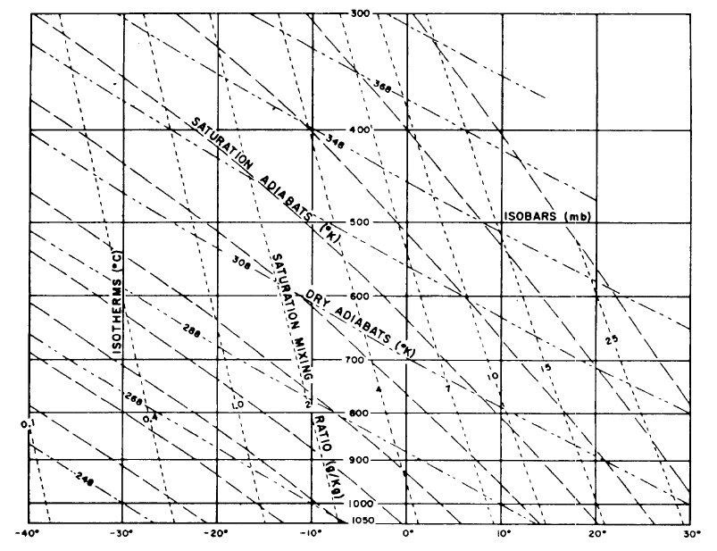
*** Emagram ***

Slide 20
Emagram

Slide 21
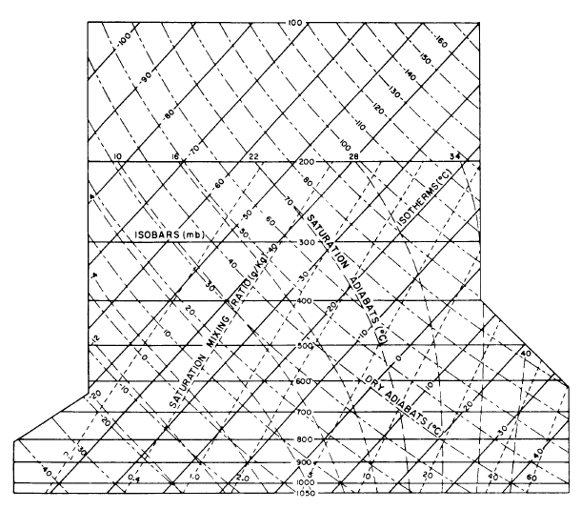
*** SkewT-LogP diagram ***
** The SkewT/Log(-P) diagram is also in widespread use in weather services. This is in fact a variation on the original Emagram, first devised in 1884 by H. Hertz.
y = -RlnP
x = T + klnP
k is adjusted to make the angle between isotherms and dry adiabats nearly 90º. Printable Skew-T:
http://www.elsevierdirect.com/companion.jsp?ISBN=9780127329512

Slide 22
Definition
Wet bulb potential temperature – the temperature an air parcel would have if cooled from it its initial state to saturation and brought 1000 hPa in a moist adiabatic process. Useful in that it is conserved in adiabatic changes. Most easily found with a thermodynamic diagram.

Slide 23
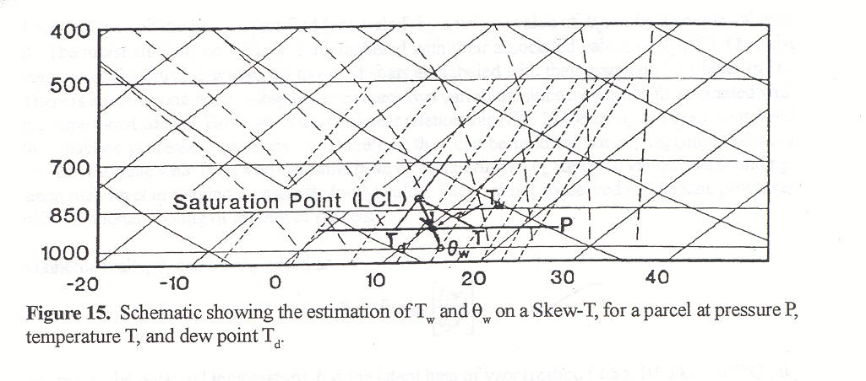
o
See R&Y, figures 2.2 and 2.3. Follow the dry adiabat up from T until it meets the mixing ratio corresponding to T_{d}; this is the T_{c}. Follow the wet adiabat down to the wet bulb temp (T_{w}) and wet bulb pot temp (θ_{w}) at 1000 hPa.

Slide 24
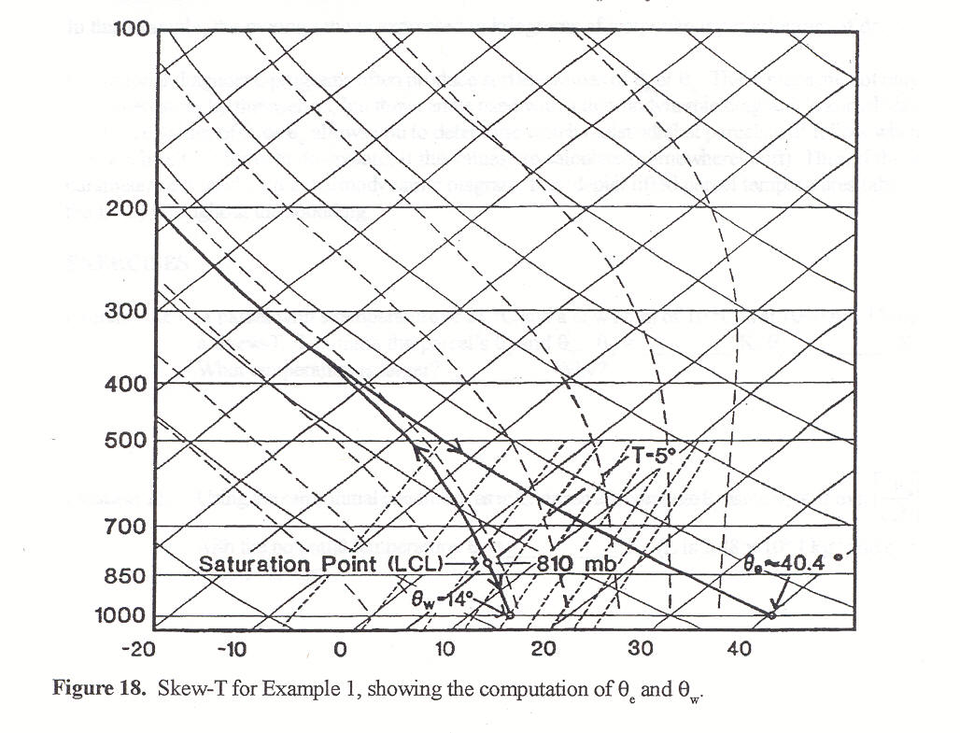

Slide 25
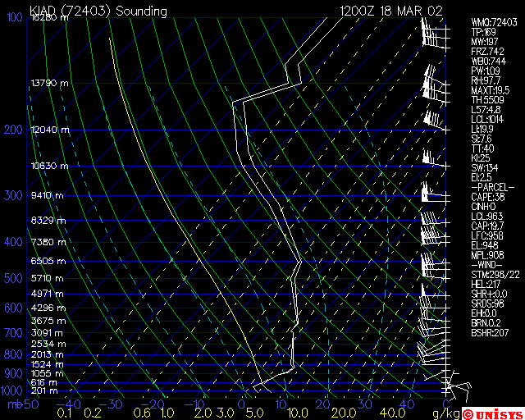

Slide 26
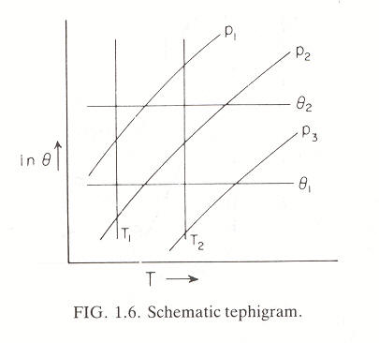
Start 9/16/14
Tephigram***
** The Tephigram takes its name from the rectangular Cartesian coordinates : temperature and entropy. Entropy is denoted by Greek letter 'phi' was used, hence Te-phi-gram (or T-Φ-gram). The diagram was developed by Sir William Shaw, a British meteorologist about 1922, and was officially adopted by the International Commission for the Exploration of the Upper Air in 1925.
An area in the Tephigram denotes total HEAT or ENERGY added to a cyclic process
∮ đq = ∮ T d φ = c_{p}∮ Tdθ /θ = c_{p}∮ Td(lnθ)
lnP
T
Dry adiabats

Slide 27
The tephigram
Allows a radiosonde profile to be analysed for stability.
Allows calculations involving moisture content (e.g., saturated adiabatic lapse rate) to be performed graphically.
Is confusing at first sight!

Slide 28
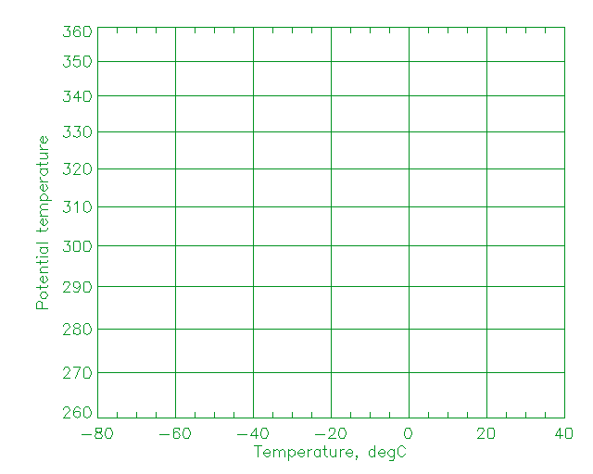
Basic idea
Plot temperature as x-axis and entropy as y
dφ = c_{p}dlnθ so we plot temperature versus lnθ

Slide 29
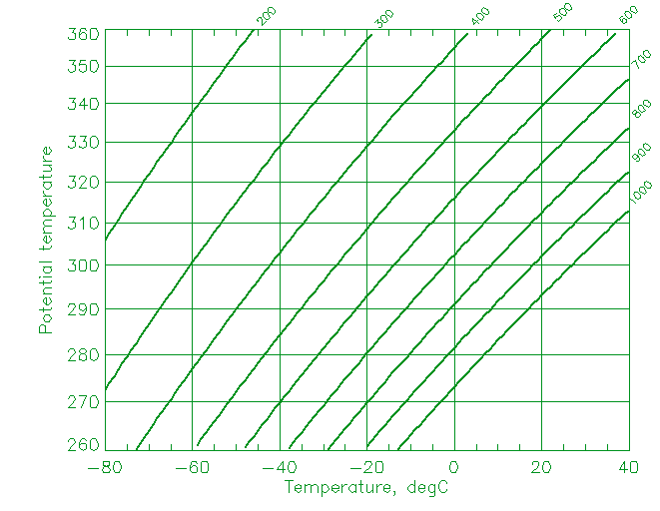
Adding pressure
Our measurements are of temperature and pressure, so we want to represent pressure on the plot.
The curved lines are isopleths of constant pressure, in hPa (mb).

Slide 30
Adding moisture information
Dew point is a measure of moisture content. The tephigram can be used to convert (T_{d},T) to mixing ratio.
Mass mixing ratio isopleths are light dashed lines. Units are g kg⁻¹
Curved lines are saturated adiabats – the path a saturated parcel of air follows on adiabatic ascent.

Slide 31
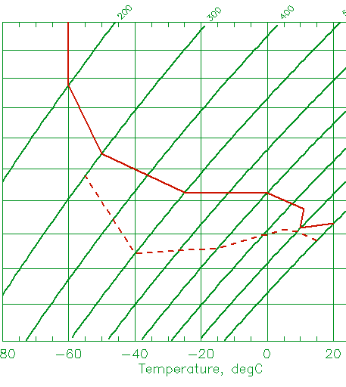
Rotating plot and plotting profile
The diagram is rotated through 45° so that the pressure lines are quasi-horizontal
Temperature and Dew point are plotted on the diagram. Dew point is simply plotted as a temperature. Here:
Pressure, mb | Temp., °C | Dew point, °C
1000 | 20 | 15
900 | 10 | 9
850 | 11 | 5
700 | 0 | -15
500 | -25 | -40
300 | -50 | -55
200 | -60
100 | -60

Slide 32
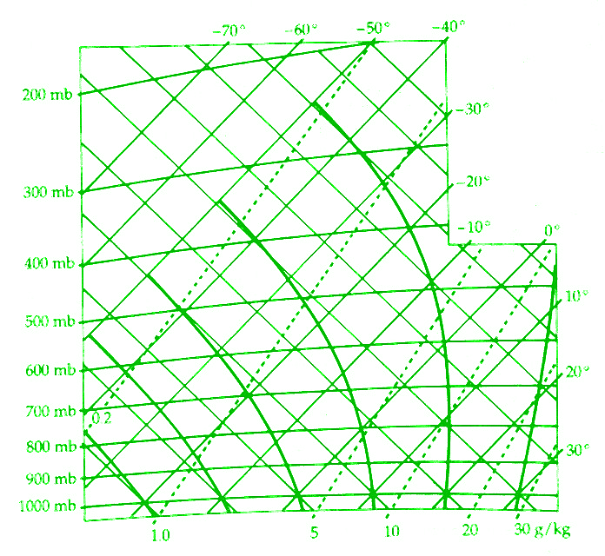
The Tephigram
Saturated adiabatic
ConstantMixing ratio

Slide 33
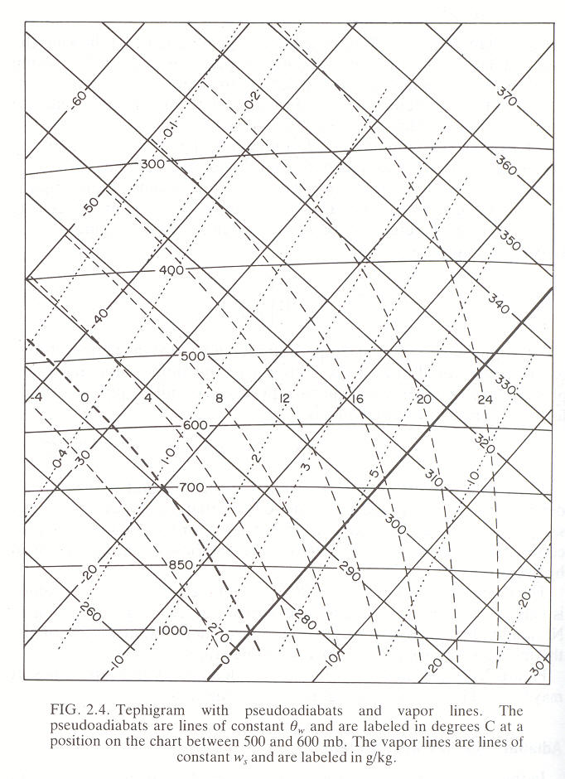
Tephigram

Slide 34
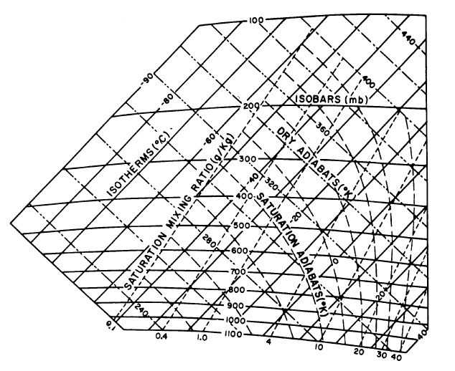
Tephigram

Slide 35
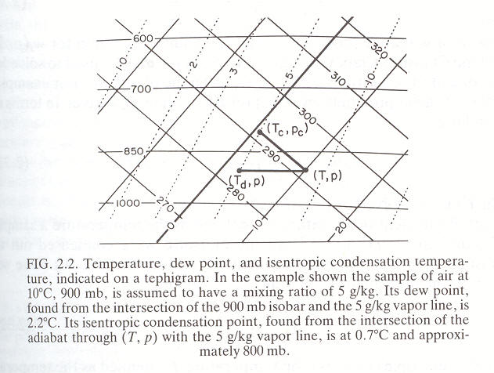
Application of Tephigram to Determine T_{d}

Slide 36
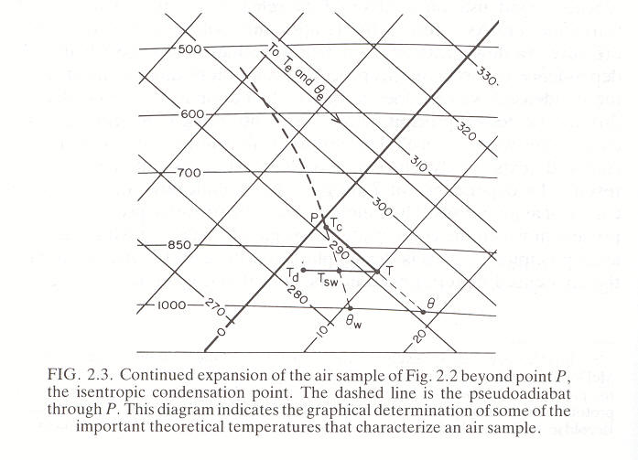
Application of Tephigram to Determine different tempertures

Slide 37
Example 1
Pressure, mb | Temp., °C | Dew point, °C
1000 | 7 | 6
920 | 7 | 7
870 | 6 | 0
840 | 3.5 | -1.5
700 | -8 | -16
500 | -27 | -36
300 | -58
250 | -67
200 | -65
Tropopause
Inversion layer
Saturated air
(T = T_{D})

Slide 38
Example 2
Pressure, mb | Temp., °C | Dew point, °C
1000 | 8.5 | 5.5
860 | 0.5 | -3
710 | -8 | -17
550 | -21.5 | -31.5
490 | -22.5 | -45
330 | -45
285 | -51
200 | -51
Tropopause
Frontal Inversion layer

Slide 39
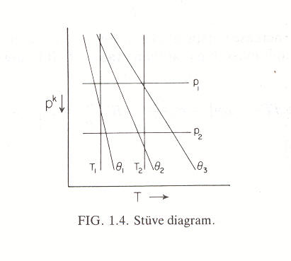
*** Stüve diagram ***
** The Stüve diagram uses straight lines for the three primary variables, pressure, temperature and potential temperature. In doing so we sacrifices the equal-area requirements (from the original Clapeyron diagram) that are satisfied in the other two diagrams. See Salby, Figure 5.5.
For an adiabatic process:
θ = T (1000/p)^{K}
The Stüve diagram is also simply called adiabatic chart

Slide 40
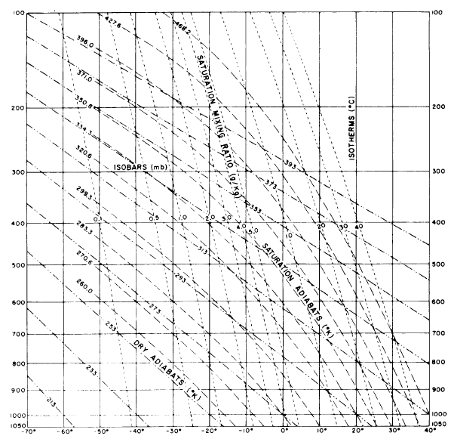
Stűve (Pseudoadiabatic)

Slide 41
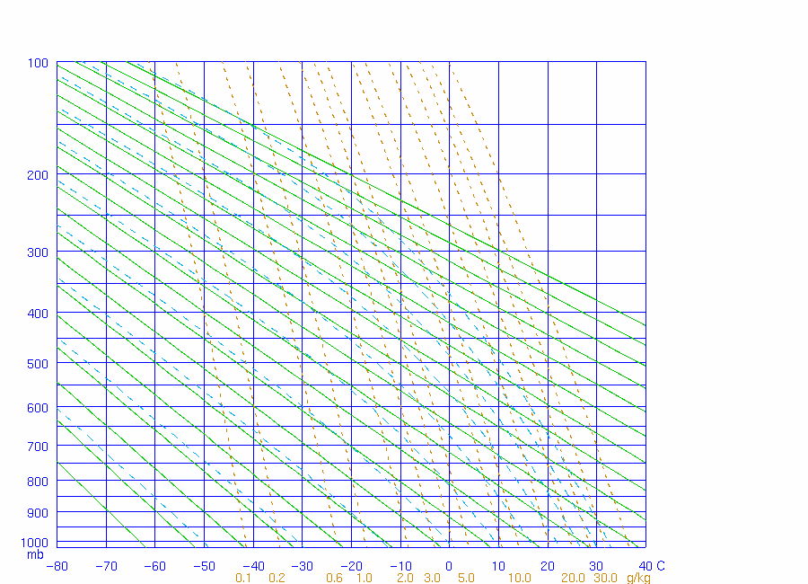
Stuve

Slide 42
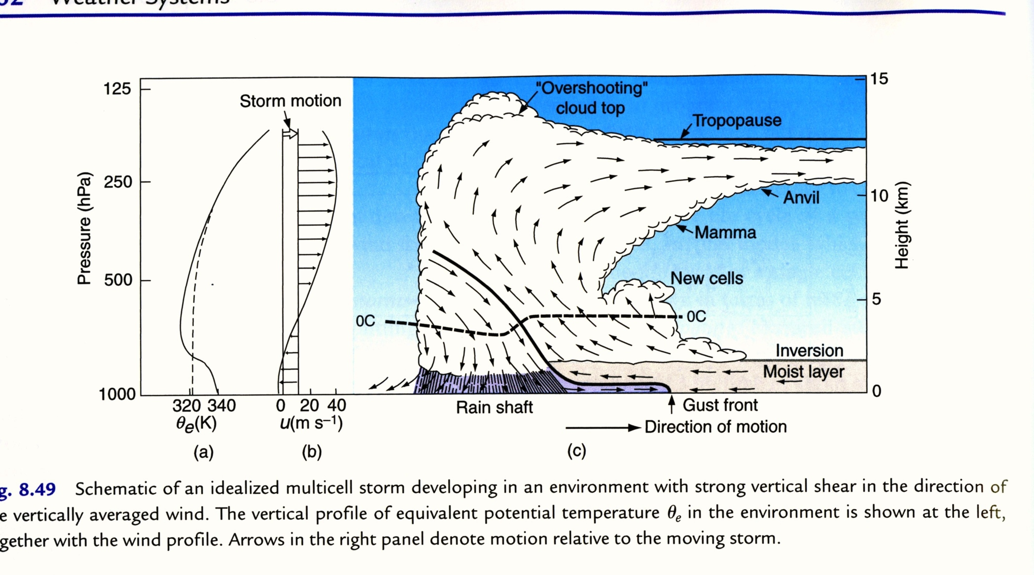
Can be wrong!
Wallace & Hobbs page 352.

Slide 43
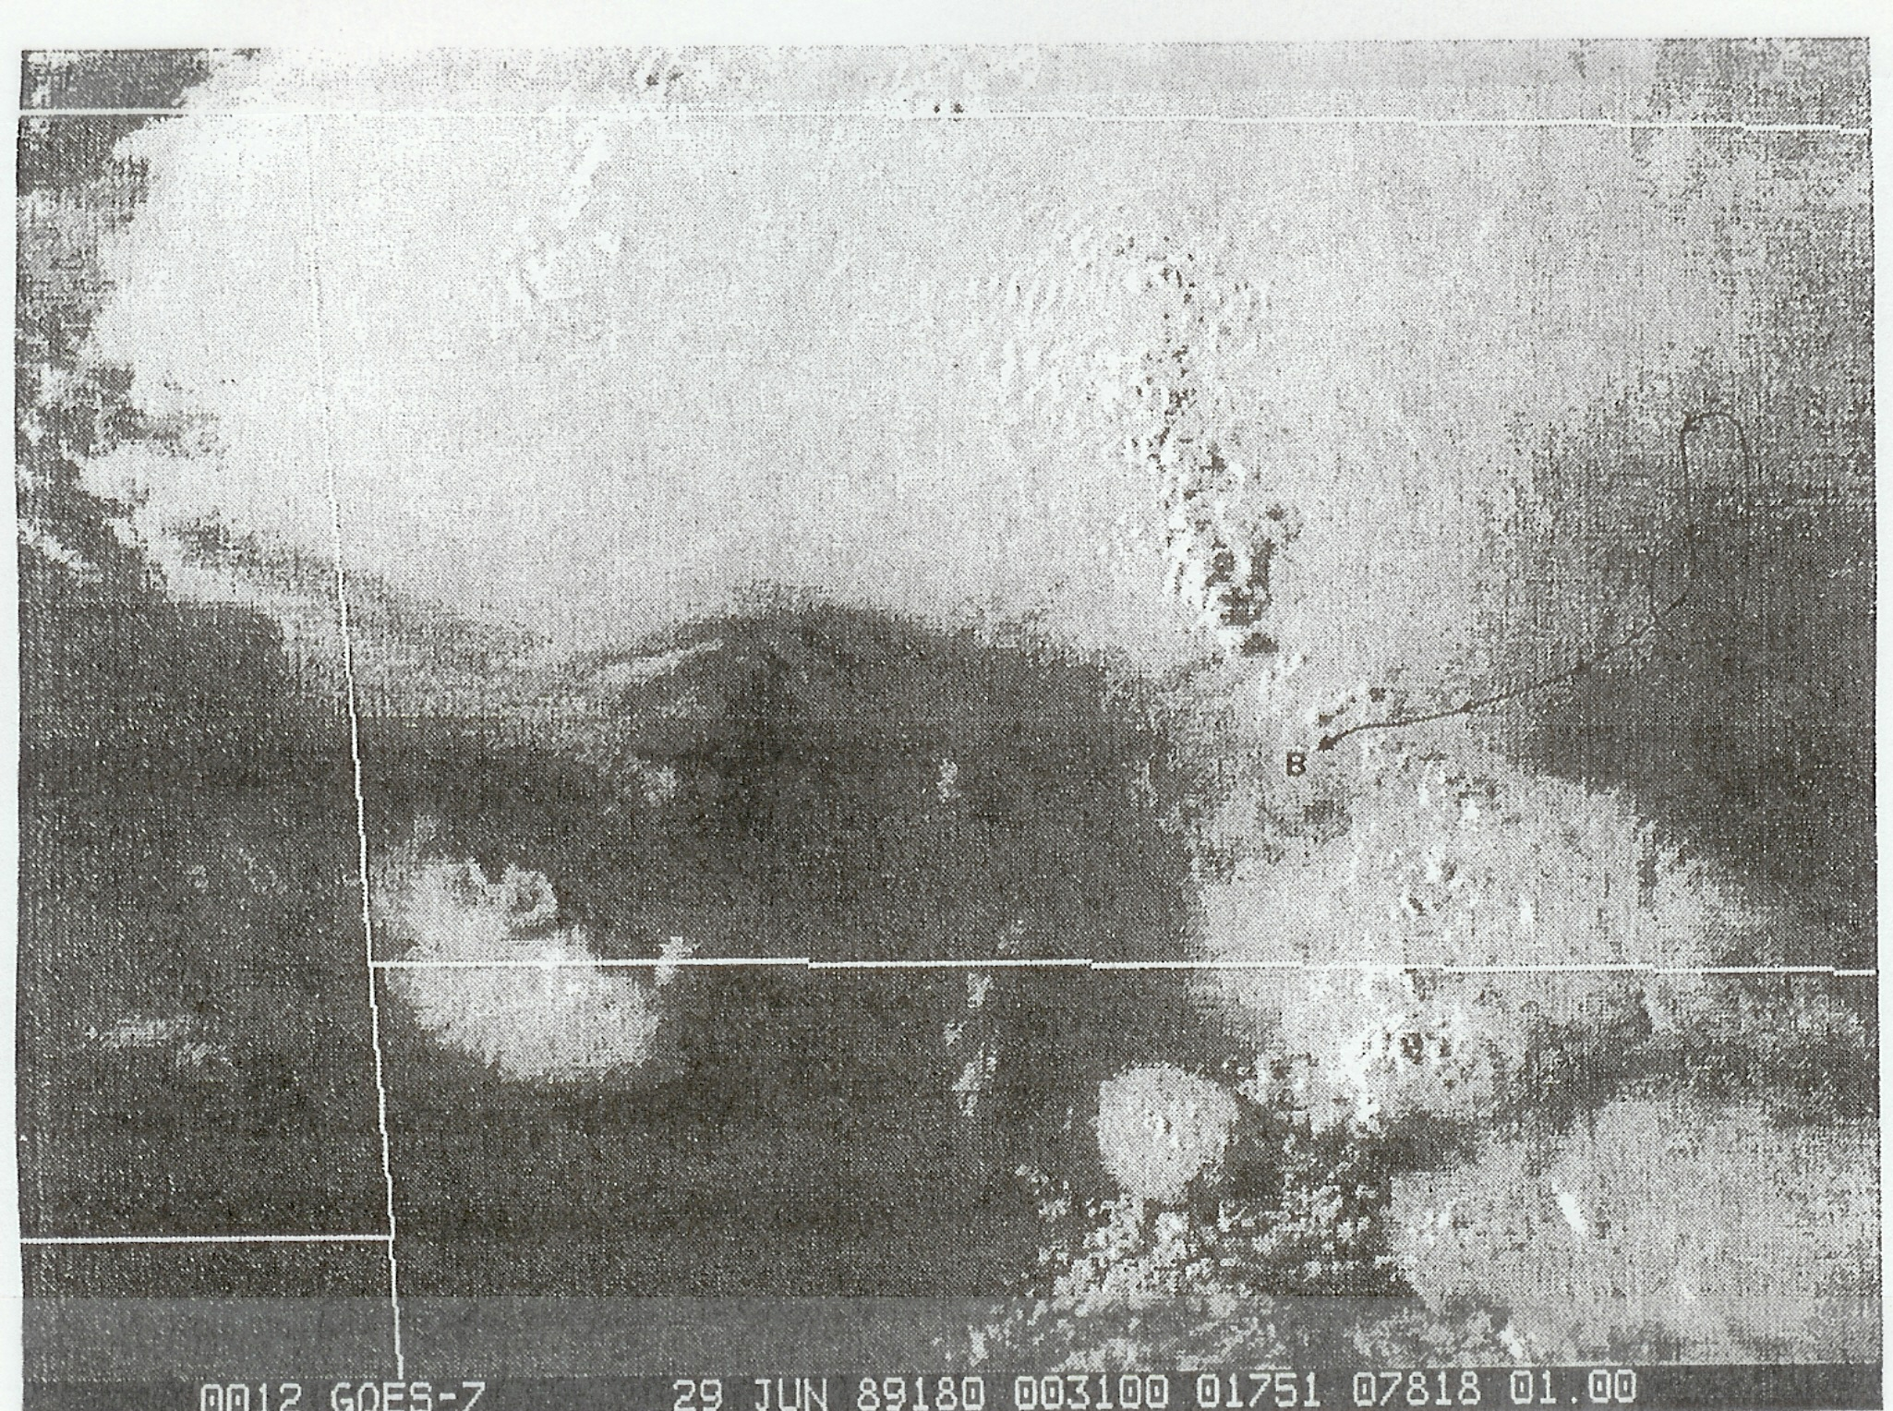
ND
SD
North Dakota Thunderstorm Experiment

Slide 44
From Poulida et al. (JGR 1996) showing T, T_{d}, ozone and Θ_{e}. If Θ_{e} is conserved, the storm should top out at ~11 km alt.

Slide 45
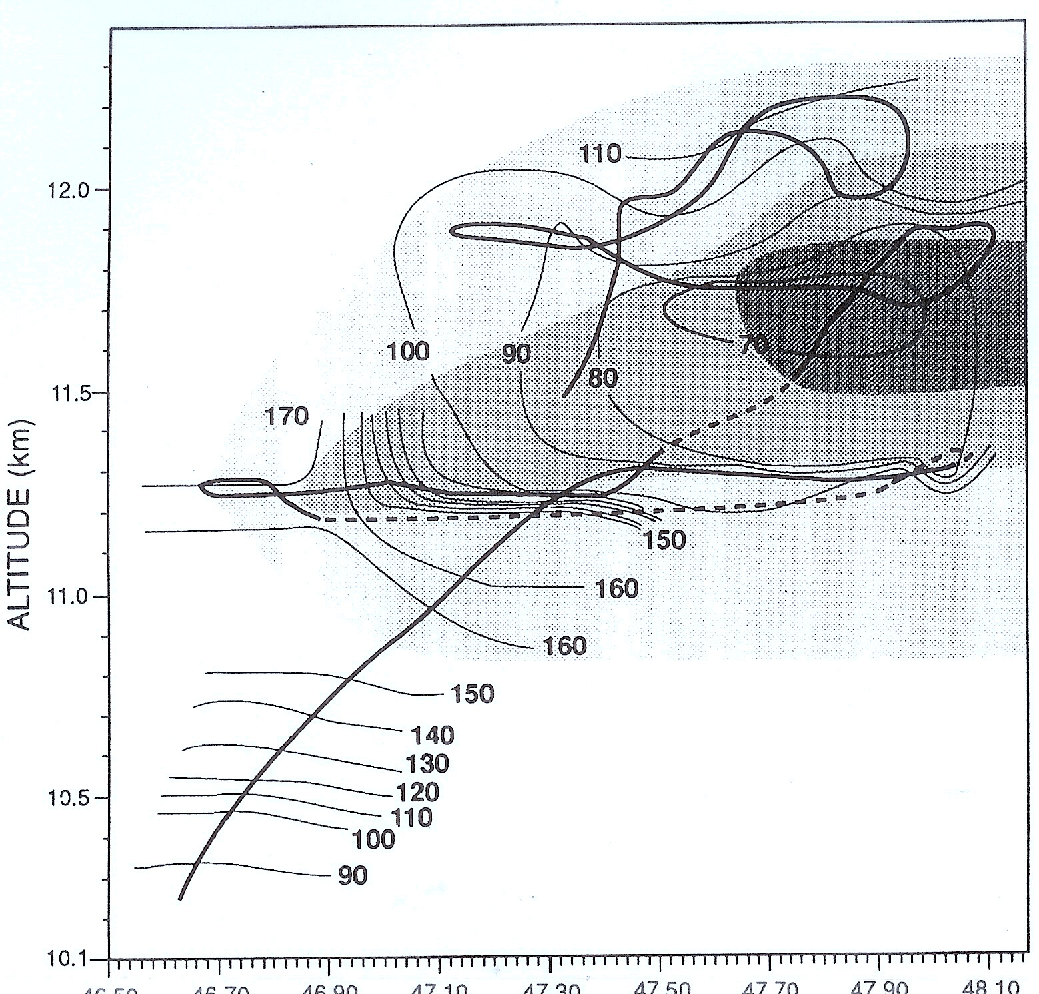
Flight thru the Cb anvil: North Dakota Thunderstorm Experiment – July 28, 1989
Ozone - thin contours
Flight track – thick contours
Shading - cloud thickness
Preconvective tropopause
Poulida et al., 1996

Slide 46
From Poulida et al. (JGR 1996) showing that ozone and Θ_{e} are conserved.

Slide 47
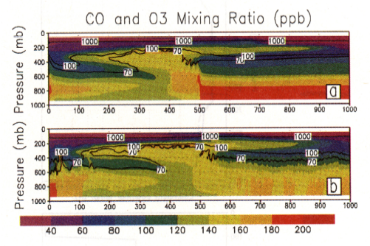
CO and O₃ Tracer Simulation for June 28, 1989 NDTP storm
CO – color scale; O₃ – isolines
(a) base simulation; (b) moist boundary condition simulation
Note downward ozone transport near
rear anvil.
Stenchikov et al. (1996)

Slide 49
Take Home Messages
Thermo diagrams are a valuable tool.
Θ_{e} is a valuable conserved tracer for convective processes.
The tropopause is not an iron lid on the troposphere.
The composition (H₂O, O₃ etc.) of the UT/LS (the coldest region of the atmosphere) is controlled by deep convective processes such as MCC’s.
Not everything you read in books is right.

Slide 50
What’s e⁹⁰⁰??
If e^{A} = 10^{B} then
ln (e^{A}) = ln (10^{B})
Aln(e) = Bln(10)
A/B = ln(10) ≅ 2.303
e⁹⁰⁰ ~ 10⁴⁰⁰. What’s a googol?
Also if the e-folding scale height is ~7 km (for whole trop) then the 10-folding scale height is ~2.3*7 = 16.1 km.

