Slide 1
Action Items
WRF/LES model coupling
Model-measurement comparison
Forward modeling activities: consistency among the models

Slide 2


Greenhouse Gas Emissions from the Baltimore-Washington Area:
Initial Results from the
WINTER 2015 flights
FLAGG-MD Meeting
Xinrong Ren
April 27, 2015

Slide 3
Outline
Winter flight overview
A typical flight on 2/20/2015 (RF5)
CO₂ and CH₄ flux estimation
Preliminary Intercomparison with Purdue’s Duchess
Summary

Slide 4
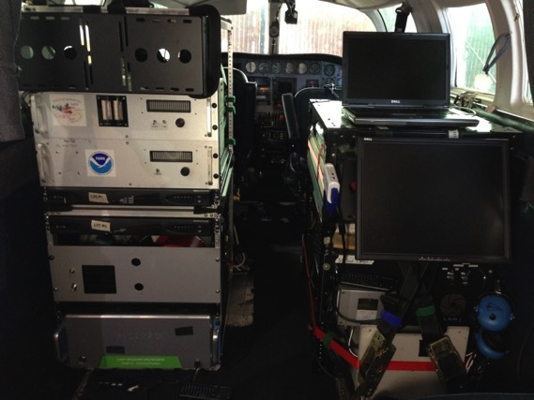
UMD Cessna 402B Research Aircraft
GPS Position (Lat, Long, Altitude)
Met (T, RH, P, wind speed/direction)
Trace gases:
O₃: UV Absorption
SO₂: Pulsed Fluorescence
CH₄/CO₂/CO/H₂O: Cavity Ringdown, Picarro
NO₂: Cavity Ring Down, Los Gatos
NO: Chemiluminescence
Aerosol Optical Properties:
Scattering: b_{scat} (@450, 550, 700 nm), Nephelometer
Absorption: b_{ap} (565 nm), PSAP
Black Carbon: Aethalometer
Data Acquisition: 1 Hz
Gas Inlet
Aerosol Inlet
Met Sensors
New Picarro CO₂/CH₄/CO/H₂O analyzer

Slide 5
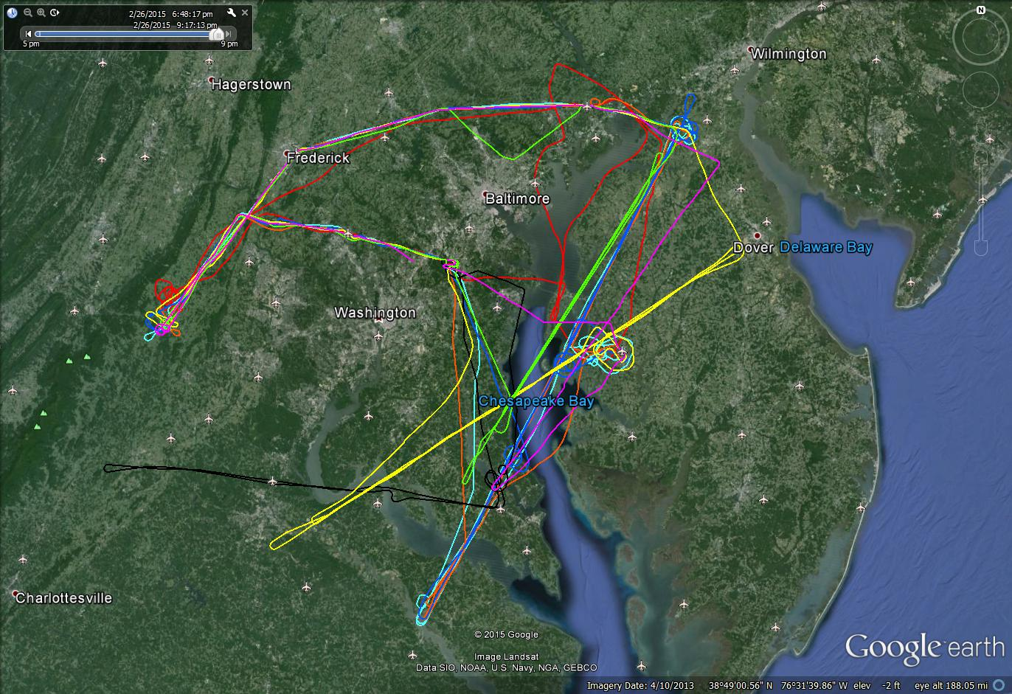
Flight Tracks, all flights

Slide 6
Flight Met Conditions
Flihgt # | Date | Takeoff (UTC) | Landing (UTC) | Met Conditions
RF1 | 02/06/15 | 19:15:40 | 22:17:37 | WSW winds, PBL H=2000 ft
RF2 | 02/13/15 | 19:09:08 | 22:37:39 | WNW winds, PBL H=5000 ft
RF3a | 02/16/15 | 16:11:50 | 19:34:28 | WNW winds, PBL H~6000 ft, with Duchess
RF3b | 02/16/15 | 20:28:38 | 20:47:54
RF4a | 02/19/15 | 16:49:04 | 18:55:38 | WNW winds, PBL H=4000 ft, with Duchess
RF4b | 02/19/15 | 19:55:51 | 22:26:16
RF5a | 02/20/15 | 16:25:32 | 18:39:35 | WNW winds, PBL H=4000 ft
RF5b | 02/20/15 | 20:01:24 | 22:39:16
RF6a | 02/23/15 | 18:08:11 | 20:14:17 | NNW winds, PBL H=4500 ft
RF6b | 02/23/15 | 21:08:59 | 23:33:04
RF7 | 02/24/15 | 16:58:13 | 19:10:42 | S winds, PBL H=3000
RF8a | 02/25/15 | 16:10:49 | 18:25:48 | W winds, PBL H=5500 ft
RF8b | 02/25/15 | 19:22:30 | 21:41:20
RF9 | 02/26/15 | 18:58:18 | 21:07:05 | NNW winds, PBL H=4000 ft

Slide 7
A typical mass balance experiment flight on 2/20/15
Missed approach
wind
VP
Missed approach
VP
VP
VP

Slide 8
A typical mass balance experiment flight on 2/20/15
VP
VP
VP
Missed approach

Slide 9
3 Downwind Vertical Profiles
Mixing layer depth ~3500 - 4000 ft

Slide 10
CO₂ Map
wind
Brandon Shores
ODESA
Dickerson
Easton
Chalk Point
Morgantown
TAPPA
Power plant plumes clearly observed on the downwind transects.

Slide 11
CH₄ Map
wind
ODESA
Brown
Station
Landfill
Easton
TAPPA
High CH₄ levels aloft at SW of the upwind leg: CH₄ emissions from fracking?

Slide 12
CH₄ vs. CO₂ colored with SO₂
[SO₂], ppbv
Landfill
Urban
Power plants
Free troposphere

Slide 13
CO₂ on 2 downwind transects along the latitude
Chalk Point
Morgantown
Brandon Shores
DC
plume
Baltimore
plume

Slide 14
CH₄ on 2 downwind transects along the latitude
DC
plume
Baltimore
plume
Much larger CH₄ enhancement in the DC plume than in the Baltimore plume.

Slide 15
Estimation of CO₂ and CH₄ Fluxes
Mass Balance Experiment (MBE) approach:
Flux
[C] : concentrations (downwind)
[C]_{b} : concentration in background
U⊥ : perpendicular wind speed
Baseline

Slide 16
Estimation of CO₂ and CH₄ Fluxes
Flight # (Date) | Flux(CH₄) (mol s⁻¹) (M tons yr⁻¹) | Flux(CO₂) (tons s⁻¹) (M tons yr⁻¹)
RF2 (2/13/2014) | 512 0.26 | 6.9 217
RF4 (2/19/2014) | 1356 0.68 | 4.8 152
RF5 (2/20/2014) | 914 0.46 | 6.0 190
RF6 (2/23/2014) | 1550 0.78 | 9.4 295
RF7 (2/24/2014) | 1100 0.56 | 9.5 300
RF8 (2/25/2014) | 1304 0.66 | 8.6 272
Mean | 1100±370 0.57±0.18 | 7.5±1.9 238±60
Note: (1) Errors in the last row are the standard deviations of fluxes.
(2) Mean concentrations at the edges of downwind transects (outside
of the urban plumes) are used as the background concentrations.
(3) Transect averaged perpendicular wind speeds are used.
(4) The population in the Balt–DC area is close to 10 million.

Slide 17
Uncertainty Associated with the MBE Approach
Mass Balance Experiment (MBE) approach:
Flux
Mixing layer height (z_{i}): ~10%
Plume width (x): ~5%
∆[C] = [C] – [C]_{b}: ~20%
Perpendicular wind speed (U⊥): ~20%
Combined uncertainty in flux estimation: ~30%

Slide 18
Cessna-Duchess Intercomparison Flight
2/16/2015

Slide 19
CO₂ and CH₄ time series
2/16/2015
side-by-side flying

Slide 20
WS and WD time series
2/16/2015
side-by-side flying

Slide 21
WS Comparison
2/16/2015

Slide 22
Summary
Successfully conducted MBE flights in the Balt-DC area in winter 2015
Preliminary estimation of GHG fluxes:
F(CH₄): 1100±370 mole s⁻¹ (or 0.57±0.18 million tons CH₄/yr)
F(CO₂): 7.5±1.9 tons s⁻¹ (or 238±60 million tons CO₂/yr)
Preliminary Cessna-Duchess intercomparison results: encouraging but need to look into reasons behind the discrepancies.
Future work will involve:
  Evaluating assumed boundary conditions.
  Using the kriging interpolation to build a concentration wall to improve flux estimation;
  Comparison with Ensemble Kalman Filter Assimilation modeling with high resolution WRF modeling.

Slide 24
Extra Slides

Slide 25
CO₂ on flight track

Slide 26
CH₄ on flight track

Slide 27
CO on flight track

Slide 28
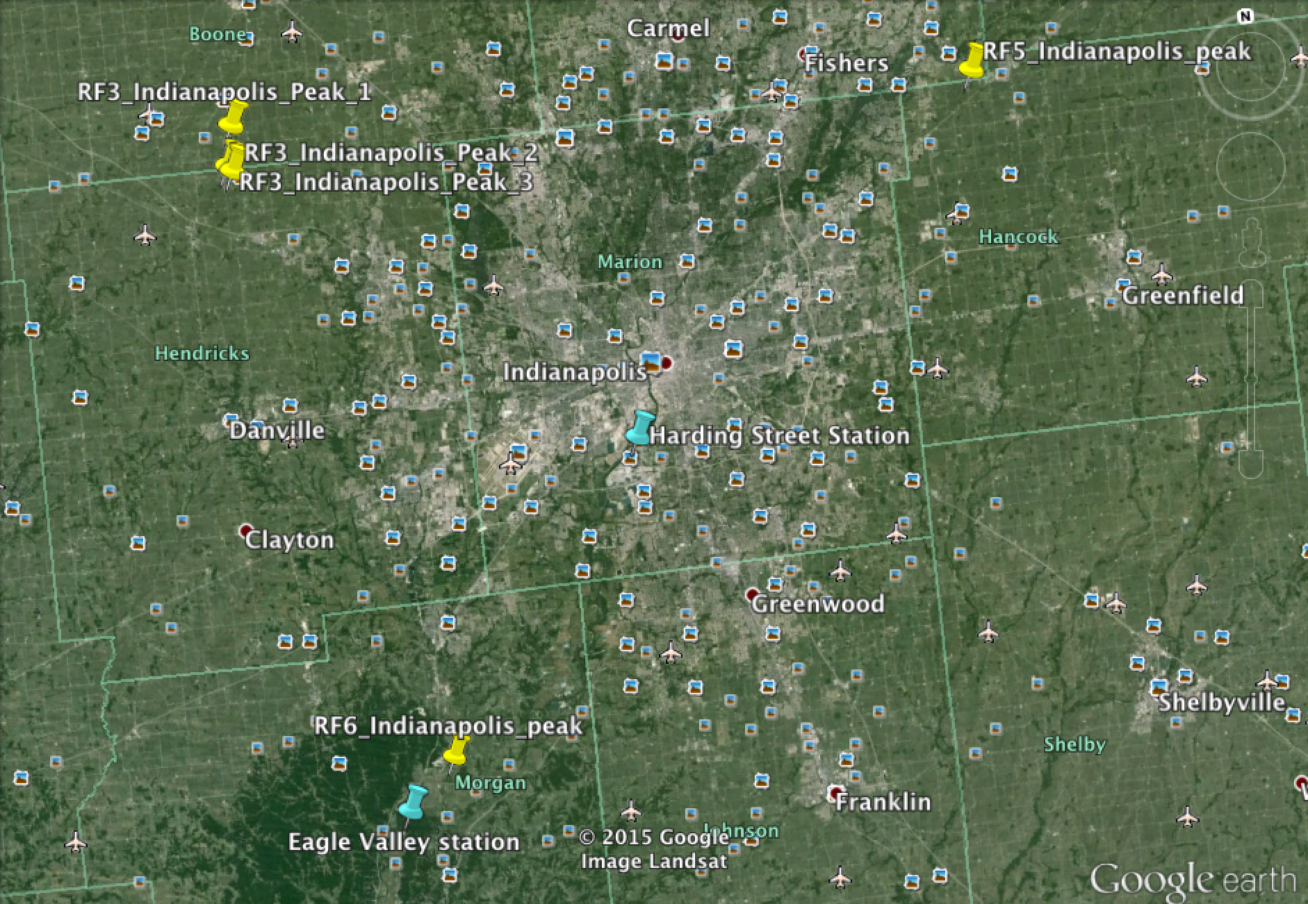
CO₂/SO₂ Peaks Observed and Nearby Power Plants in Indy 2014

Slide 29
Power Plant Emission Validation (Indy 2014):
ΔSO₂/ΔCO₂: Observed vs. Reported
Flight | Plume Source (Power Plant) | Hour (LST) | ΔSO₂/ΔCO₂ (observed) (%) | ΔSO₂/ΔCO₂ (reported) (%) | WS (m/s) | Distance from power plant (miles)
RF3_Peak 1 | Eagle Valley station | 14 | 0.09 | 0.76 | 3.1 | 28.3
RF3_Peak 2 | Eagle Valley station | 15 | 0.08 | 0.76 | 1.5 | 27.8
RF3_Peak 3 | Eagle Valley station | 16 | 0.1 | 0.76 | 4.1 | 31.6
RF5 | Harding Street station | 14 | 0.07 | 0.25 | 12.8 | 21.3
RF6 | Eagle Valley station | 13 | 0.13 | 0.79 | 12.8 | 3.3

Slide 30
Ozone and NO₂ time series
2/16/2015
side-by-side flying

