Slide 1
CHEMICAL THERMODYNAMICS
Continued
“Its water solubility makes O₃ readily absorbed by convective systems, which precipitate it to the surface where it can be destroyed….”
Modern Atmospheric Physics text.
Don’t believe everything you read.

Slide 2
Henry’s Law and the Solubility of Gases.
Aqueous phase concentrations are expressed in units of moles of solute per liter of solution or “molar concentration” represented by M.
For example if water is added to 1.0 mole (58.5 g) of salt to make 1.0 L of solution:
[NaCl] = 1.0 M
Alternatively
[Na⁺] = [Cl─] = 1.0 M
Because salt ionized in solution.

Slide 3
Henry’s Law states that the mass of a gas that dissolves in a given amount of liquid at a given temperature is directly proportional to the partial pressure of the gas above the liquid.
[X]_{aq} = H ·P_{x}
Where square brackets represent concentration in M, P_{x} is the partial pressure in atm and H is the Henry’s Law coefficient in M atm⁻¹. This law does not apply to gases that react with the liquid or ionize in the liquid.
Henry’s Law coefficients have a strong temperature dependence.
The entropy of solids is less than that of liquids so the solubility of solids increases with increasing temperature.
The entropy of gases is greater than that of liquids so the solubility of gases decreases with increasing temperature.

Slide 4
Gas | Henry’s Law Coef. M atm⁻¹ (at 298 K)
Oxygen (O₂) | 1.3 E-3
Ozone (O₃) | 1.0 E-2
Nitrogen Dioxide (NO₂) | 1.0 E-2
Carbon Dioxide (CO₂) | 3.4 E-2
Sulfur Dioxide (SO₂) | 1.3
Nitric Acid (HNO₃) (eff.) | 2.1 E+5
Hydrogen Peroxide (H₂O₂) | 1.0 E+5
Ammonia (NH₃) | 6.0 E+1
Alkyl nitrates (R-ONO₂) | 2
Methane (CH₄) | 1.4 E-3
See http://dionysos.mpch-mainz.mpg.de/~sander/res/henry.html
for an up-to-date and complete table of Henry’s Law Coefficients.

Slide 5
Temperature Dependence of Henry’s Law
From van’t Hoff’s Equation
d(lnH)/dT = ΔH/RT²
H _{T2} = H_{T1} exp [ΔH/R (1/T₁ – 1/T₂)]
Where ΔH is the heat (enthalpy) of the reaction, in this case solution.
Most values of ΔH are negative for gases so solubility goes down as temp goes up. For example ΔH for CO₂ is – 4.85 kcal mol⁻¹ .
If the temperature of surface water on Earth rises from 298 to 300 K the solubility of CO₂ sinks about 5% from 3.40 E-2 to 3.22 E-2 M/atm. This is small compared to the increase in the partial pressure of CO₂ over the past 50 yr.
Problem left to the student: prove that CO₂ is ~twice as soluble in icy cold beer as in room temp beer.

Slide 6
Henry’s Law [X]_{aq} = H∙ P_{x}
The mass of a gas that dissolves in a given amount of liquid at a given temperature is directly proportional to the partial pressure of the gas above the liquid. This law does not apply to gases that react with the liquid or ionize in the liquid.
Gas Henry's Law Constants Temperature Dependence
(M /atm at 298 K) -∆H/R (K) _______________________________________________________________________________________________
Oxygen (O₂) 1.3 x10⁻² 1500
Ozone (O₃) 1.3 x10⁻³ 2500
Nitrogen dioxide (NO₂) 1.0 x10⁻² 2500
Carbon dioxide (CO₂) 3.4 x10⁻² 2400
Sulfur dioxide(SO₂) 1.3 2900
Nitric acid (HNO₃; effective) 2.1 x10⁺⁵ 8700
Hydrogen peroxide (H₂O₂) 7.1 x10⁺⁴ 7000
Alkyl nitrates (R-ONO₂) 2 6000
Methane (CH₄) 1.4x10⁻³ 1900

Slide 7
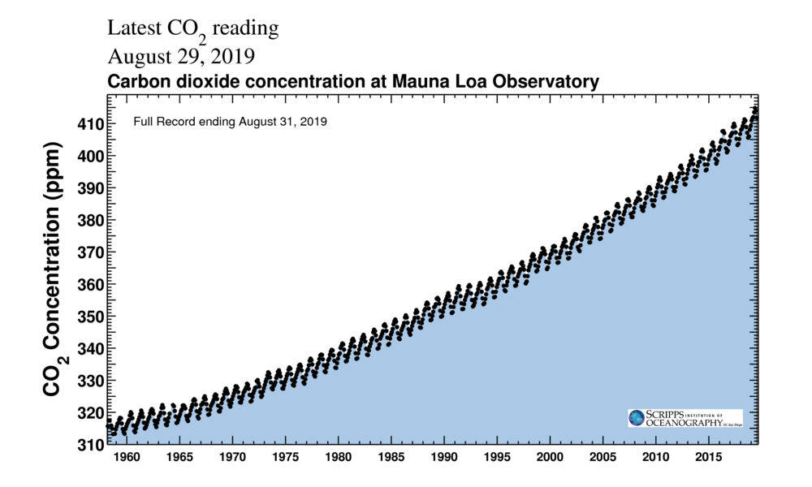
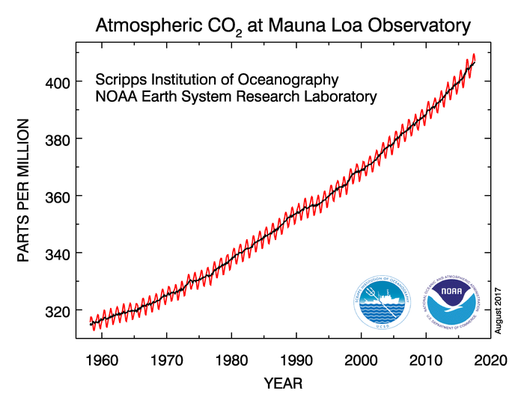
“Keeling Curve”
Updated Sept. 2017

Slide 8
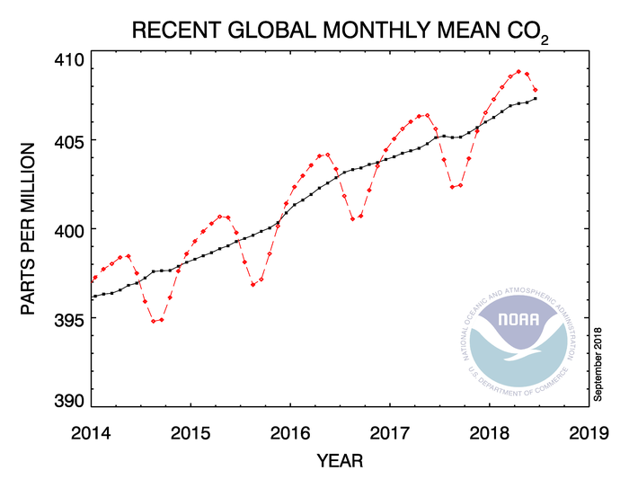

Slide 9
CO₂ & CH₄ along the flight track on 7/2/2018
Afternoon Flight (~2:30-5:30 PM)
>430
>2150
#4
#3
#2
Transect #1
Wind
Wind
Plumes of CO₂ and CH₄ downwind of NYC.

Slide 10
SO₂ on its own is not very soluble, so acid Rain results when SO₂ dissolves in a cloud and reacts with H₂O₂:
SO₂ + H₂O₂ → H₂SO₄
SO₂ is sparingly soluble, but H₂O₂ is very soluble.
H₂SO₄ → SO₄²⁻ + 2H⁺
So clouds keep eating SO₂ and H₂O₂ until one or the other is depleted. pH = -log(H⁺)

Slide 11
Remember temp dependence:
See http://dionysos.mpch-mainz.mpg.de/~sander/res/henry.html for a complete table of Henry’s Law Coefficients. The temperature dependence of Henry’s Law coefficients is usually represented with van’t Hoff’s Equation where ∆H is the enthalpy of dissolution in kcal mole⁻¹ or kJ mole⁻¹. See Seinfeld page 289 in the 2006 edition.
(∂ lnH /∂T)_{p} = ∆H/(RT²)
H = Hº exp [(∆H/R)(T_{o}⁻¹ - T⁻¹)]

Slide 12
Henry’s Law Example
What would be the pH of pure rain water in Washington, D.C. today? Assume that the atmosphere contains only N₂, O₂, and CO₂ and that rain in equilibrium with CO₂.
Remember:
H₂O = H⁺ + OH⁻
[H⁺][OH⁻] = 1 x 10⁻¹⁴
pH = -log[H⁺]
In pure H₂O pH = 7.0
We can measure:
[CO₂] = ~ 390 ppm

Slide 13
Today’s barometric pressure is 1009 hPa = 1009/1013 atm = 0.996 atm. Thus the partial pressure of CO₂ is
In water CO₂ reacts slightly, but [H₂CO₃] remains constant as long as the partial pressure of CO₂ remains constant.

Slide 14
We know that:
and
THUS
H⁺ = 2.38x10⁻⁶ → pH = -log(2.38x10⁻⁶) = 5.6
Example 2.
If fog water contains enough nitric acid (HNO₃) to have a pH of 4.7, can any appreciable amount nitric acid vapor return to the atmosphere? Another way to ask this question is to ask what partial pressure of HNO₃ is in equilibrium with typical “acid rain” i.e. water at pH 4.7.

Slide 15
This is equivalent to 90 ppt, a small amount for a polluted environment, but the actual [HNO₃] would be even lower because nitric acid ionized in solution. In other words, once nitric acid is in solution, it wont come back out again unless the droplet evaporates; conversely any vapor-phase nitric acid will be quickly absorbed into the aqueous-phase in the presence of cloud or fog water.
Which pollutants can be rained out?
See also Finlayson-Pitts Chapt. 8 and Seinfeld Chapt. 7.

Slide 16
We want to calculate the ratio of the aqueous phase to the gas phase concentration of a pollutant in a cloud. The units can be anything , but they must be the same. We will assume that the gas and aqueous phases are in equilibrium. We need the following:
Henry’s Law Coefficient: H (M/atm)
Cloud liquid water content: LWC (gm⁻³)
Total pressure: (atm)
Ambient temperature: T (K)
LET:
be the concentration of X in the aqueous phase in moles/m³
be the concentration of X in the gas phase in moles/m³
[X]_{aq} = H P_{X}
Where is the aqueous concentration in M, and is the partial pressure expressed in atm. We can find the partial pressure from the mixing ratio and total pressure.

Slide 17
For the aqueous-phase concentration:
units: moles/m³ = moles/L(water) x g(water)/m³(air) x L/g
For the gaseous content:
units: moles/m³ =

Slide 18
Notice that the ratio is independent of pressure and concentration. For a species with a Henry’s law coefficient of 400, only about 1% will go into a cloud with a LWC of 1 g/m³.
Without aqueous phase removal reactions, H must be >1000 to have efficient rainout of a trace gas.
Let’s check ozone with H = 10⁻² M/atm for 273K and 1.0 atm.
10⁻² * 1 * 22.4E-6 = 2.24E-7 It would take a million interactions with a thick cloud to rain out water. Might not be true if O₃ reacted with SO₂.

Slide 19
What is the possible pH of water in a high cloud (alt. ≃ 5km) that absorbed sulfur while in equilibrium with 100 ppb of SO₂?
In the next lecture we will show how to derive the pressure as a function of height. At 5 km the ambient pressure is 0.54 atm.
This SO₂ will not stay as SO₂•H₂O, but participate in a aqueous phase reaction, that is it will dissociate.

Slide 20
The concentration of SO₂•H₂O, however, remains constant because more SO₂ is entrained as SO₂•H₂O dissociates. The extent of dissociation depends on [H⁺] and thus pH, but the concentration of SO₂•H₂O will stay constant as long as the gaseous SO₂ concentration stays constant. What’s the pH for our mixture?
If most of the [H⁺] comes from SO₂•H₂O dissociation, then
Note that there about 400 times as much S in the form of HOSO₂⁻ as in the form H₂O•SO₂. H₂SO₃ and HSO₃⁻ are weak acids, and if the reaction stops here, the pH of cloudwater in contact with 100 ppb of SO₂ will be 4.5

Slide 21
Because SO₂ participates in aqueous-phase reactions, Eq. (I) above will give the correct [H₂O•SO₂], but will underestimate the total sulfur in solution. Taken together all the forms of S in this oxidation state are called sulfur four, or S(IV).
If all the S(IV) in the cloud water turns to S(VI) (sulfate) then the hydrogen ion concentration will approximately double because both protons come off H₂SO₄, in other words HSO₄⁻ is also a strong acid.
This is fairly acidic, but we started with a very high concentration of SO₂, one that is characteristic of urban air. In more rural areas of the eastern US an SO₂ mixing ratio of a 1-5 ppb is more common. As SO₂•H₂O is oxidized to H₂SO₄, more SO₂ is drawn into the cloud water, and the acidity continue to rise. Hydrogen peroxide is the most common oxidant for forming sulfuric acid in solution; we will discuss H₂O₂ later.

Slide 22
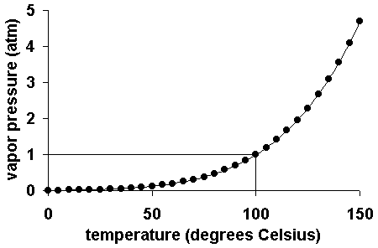
Water

Slide 23
Clausius-Clapeyron
Objective: find e_{s} = f(T) assuming L_{v} is constant. See Salby Chapt 4.
L_{v} : latent heat of vaporization; dT = dp = 0
Where e_{s} is saturation water vapor pressure,
held constant during phase change (R&Y Eq. 2.3).

Slide 24
Also assume T is constant
Combine this equation with the previous one
With the final state on the left and the initial state on the right; the combination is a constant for isothermal, isobaric change of phase.

Slide 25
Gibbs Function G for this phase change
G is a state variable and dG is an exact differential

Slide 26
This is the original form of the Clausius-Claeyron Eq.
Since density of water vapor is much lower than liquid water, i.e. α₂>>α₁ we get R&Y Eq 2.10.

Slide 27
Assuming L_{v} is constant
For T= 0ºC:
e_{s}=6.11 mb ; L_{v}=2500 J/g
Saturation water vapor pressure is

Slide 28
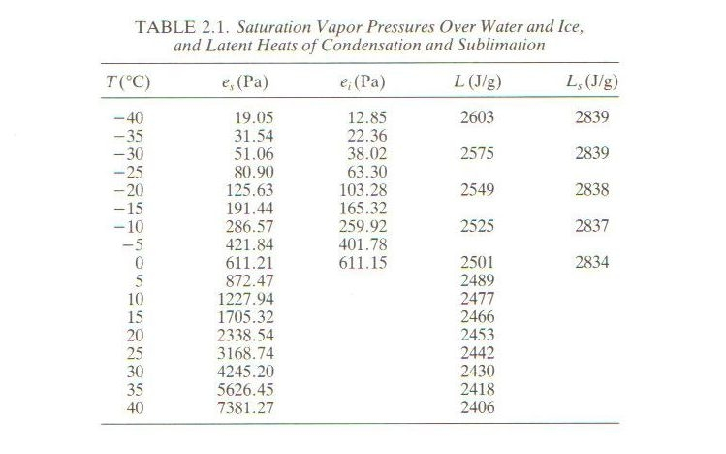

Slide 29
The heat of vaporization can be obtained from chemical thermodynamics too.
We want ΔHº for the conversion of liquid water to water vapor, i.e., for the reaction:
H₂O(l) → H₂O(v)
ΔHº_{f} (kcal/mole) ΔGº_{f} (kcal/mole)
H₂O(l) -68.315 -56.687
H₂O(v) -57.796 -54.634
----------------------------------------------------------
NET ΔHº = +10.519 kcal/mole ΔGº = +2.053 kcal/mole
10.519 * 4.18 J/cal 1/18 moles/g = 2.443 kJ/g
These values from the CRC Handbook compare well with Table 2.1 on page 16 of Rogers and Yau: 2442 J/g. Is there a temperature at which ΔG = 0? We can calculate the vapor pressure from the equilibrium constant this reaction.

Slide 30
We can calculate the vapor pressure from the equilibrium constant this reaction.
H₂O(l) → H₂O(v)
(because the condensed phase is defined as unity)
= exp (-ΔG/RT)
= exp (- 2.053E3/2*298)
= 3.19x10⁻² atm
Compare to 3169 hPa at 25ºC from Table 2.1 in Rogers and Yau.

Slide 31
Is there a temperature at which ΔG = 0?
H₂O(l) → H₂O(v)
ΔGº = ΔHº - T ΔSº
ΔSº = -(ΔGº - ΔHº )/ T
= -(2.053 - 10.519)/298
= 2.8395E-2 kcal mole⁻¹ K⁻¹
ΔG^{T} ≈ ΔHº - T ΔSº
(Remember ΔH and ΔS are nearly temperature independent.)
0 = 10.519 – T*2.8395E-2
T = 370K ≈ 100ºC
The equilibrium constant is unity at the boiling point because
K_{eq} = exp (-ΔG^{T}/RT) = exp(0) = 1.00

Slide 32
Water Vapor Variables
Vapor pressure: relative pressure of water vapor: e
Absolute humidity or vapor density: ρ_{v} (g/m³)
Mixing ratio (mass)
w = M_{v}/M_{d}=ρ_{v}/ρ_{d}= εe/(p-e) ~ εe/p
ρ_{v}= e/R_{v}T= em_{v}/R*T;
ρ_{d} = (p-e)/R_{d}T = (p-e)m_{d}/R*T
Relative humidity
f = w/w_{s}(p,T) = e/e_{s}
Specific humidity
q = ρ_{v}/(ρ_{d}+ ρ_{v}) ≈ ε e/p (mass per mass; unitless)

Slide 33


Is natural gas really better for global climate than coal?
33
Notes:
33

Slide 34
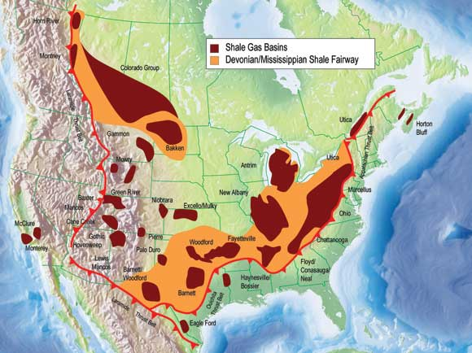
Where are the deposits?
34
Simpson et al., Nature 2012
Notes:
34

Slide 35
Is natural gas really better for global climate than coal?
35
Simpson et al., Nature 2012
Notes:
35

Slide 36


Slide 37


Slide 38


Is natural gas really better for global climate than coal?
38
Notes:
38

