Slide 1
Hydrostatic Equilibrium Salby Chapt. 6; R&Y Chapt 3, page 28
p-dp
z+dz
g : gravity
p+dp
z-dz
(one of the best approximations in meteorology)

Slide 2
Remember pressure is force per unit area so pressure per unit height is weight (m•g) per unit volume (Nm⁻² m⁻¹ = kg m s⁻² m⁻³). In this class we will usually ignore horizontal variations in thermodynamic variables (T* is virtual temp) and write the following to get an expression for geopotential, F.

Slide 3
Increment of geopotential energy.
Thus the thermodynamic coordinates -RlnP, T
yield areas proportional to energy (emagram)
Consider the case for g constant (good assumption).
Integrate the hydrostatic equation from p = p_{o} to p and z_{o} to z.

Slide 4
To find the mean virtual temperature take the weighted average:
p
-Rlnp
p_{o}
T*
Thus thermodynamic diagrams can be used to determine the geopotential thickness between pressure levels.

Slide 5
Geopotential
Define an increment of geopotential
g has a slight variation with latitude and altitude which can usually be ignored; in AOSC652 you will integrate for g = f(z). So we can define an increment of geopotential thickness, or height.
dY = dF/g_{o}; g_{o} = 9.8 m/s²
Notes:
Geopotential is the work against gravity required to raise a kg of air to Z.

Slide 6
Moisture effects on Geopotential
With w in units of g/g.

Slide 7
Pressure variation with z for “special” atmospheres
1. Constant Density r = r_{o} (Homogenous Atmosphere)
H → “Scale Height” = height of const. T (288K), homogenous
atmosphere ~ 8 km.

Slide 8
2. Constant Lapse Rate Atmosphere
Define Lapse Rate
Notes:
dp/p = -g/R’γ αmma(ln(To-gammaZ))

Slide 9
3. Isothermal Atmosphere : g = 0
The isothermal approximation is good to about 30% for the troposphere. Problem for students: What fraction of the mass of an isothermal atmosphere lies between 800 and 700 hPa?

Slide 10
Stability Criteria
Air parcel
properties
P, T, a, r, w
Environment properties
P’, T’, a’, r’, w’
Assume 1. Parcel and environment are in instantaneous
dynamic equilibrium: P = P’
2. The atmosphere is in hydrostatic equilibrium.
3. Parcel and environment do not mix.
4. No compensating motion by environment as an air parcel moves.

Slide 11
Consider a dry adiabatic displacement by an air parcel (primes are environment):

Slide 12
For Salby Page 181-195; R&Y HW 4.6
Convective Available Potential Energy: CAPE
The maximum energy available to an ascending parcel, in parcel theory.
On a thermodynamic diagram this is called positive area, and can be seen as the region between the lifted parcel process curve and the environmental sounding, from the parcel's level of free convection to its level of neutral buoyancy. Defined as
where α_{e} is the environmental specific volume profile, α_{p} is the specific volume of a parcel moving upward moist-adiabatically from the level of free convection, p_{f} is the pressure at the level of free convection, and p_{n} is the pressure at the level of neutral buoyancy. The value depends on whether the moist-adiabatic process is considered reversible or irreversible (conventionally irreversible) and whether the latent heat of freezing is considered (conventionally not). AMS Glossary of Meteorology.

Slide 13
What is the change in T for a saturated adiabatic (pseudo adiabatic)
displacement?
Note that w_{o}= f(T,P)
We want to derive dT/dz for this process using the hydrostatic equation (dp/dz = -rg)and assuming a/a’ ~ 1 and a = 1/r .
so

Slide 15
Saturated Adiabatic Lapse Rate
The table below lists values of G_{s} in K/km
pressure
 | 1000 mb | 700 mb | 500 mb
-30 C | 9.2 | 9.0 | 8.7
0 C | 6.5 | 5.8 | 5.1
20 C | 4.3 | 3.7 | 3.3
temperature
Note that G_{s} < G_{d}

Slide 16
Buoyant Force on an Air Parcel
The environment is in hydrostatic equilibrium (no acceleration)
In general, an air parcel WILL be subject to an acceleration due to density differences with the environment, so CAPE is the integral of α (from the wet adiabat) wrt p; for the parcel:

Slide 18
Stability Criteria
parcel
z_{o}
We are interested in small displacements of a parcel from its original location.
If with a small displacement we find that
The environment is said to be
Unstable
Neutral
Stable

Slide 19
For convenience, consider the parcel location z_{o} to be zero. The temperature of the environment (with prime) may be written as:
If the displacement z is sufficiently small,

Slide 20
For the parcel we may write:
G_{p} = parcel lapse rate.

Slide 21
Thus if…
For dry displacements, use G_{p}= G_{d}
For saturated displacements, use G_{p}= G_{s}

Slide 22
Since G_{s}< G_{d}, we must also consider conditions between the two stability criteria for dry and saturated.
G = parcel lapse rate g = environment lapse rate

Slide 23
Review and examples: The diel cycle of heating and cooling:
z
Subsidence
inversion
MIDDAY
1 km
Mixing
depth
NIGHT
0
MORNING
T
NIGHT
MORNING
AFTERNOON

Slide 24
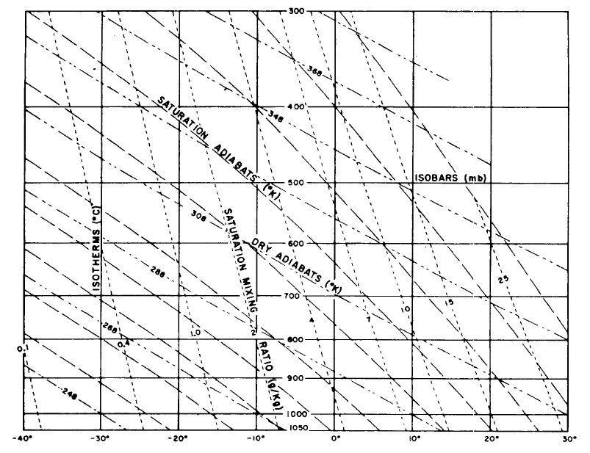
*** Emagram ***

Slide 25
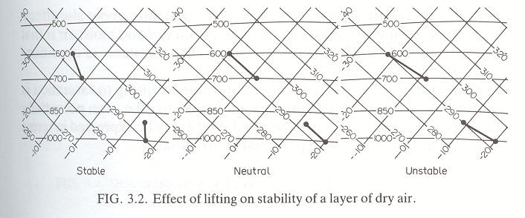
Convective Instability dry air

Slide 26
Creterion for Convective Stability

Slide 27
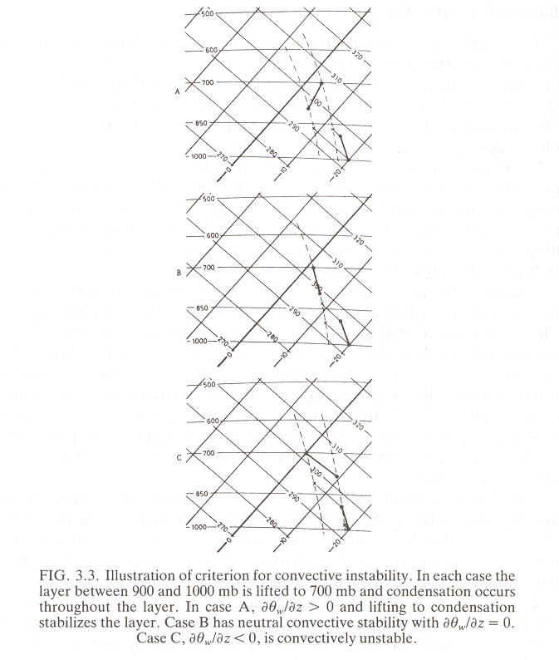
Criterion for Convective Instability
A
B
The top and bottom of the layer move along the dry adiabat until they reach saturation (immediately for case C, 900 hPa) then follow the wet adiabat to 700 and 800 hPa.

Slide 28
DIURNAL CYCLE OF SURFACE HEATING/COOLING:
z
Subsidence
inversion
MIDDAY
1 km
Mixing
depth
NIGHT
0
MORNING
T
NIGHT
MORNING
AFTERNOON

Slide 29
ATMOSPHERIC LAPSE RATE AND STABILITY
“Lapse rate” = -dT/dz
z
Consider an air parcel at z lifted to z+dz and released.
It cools upon lifting (expansion). Assuming lifting to be adiabatic, the cooling follows the adiabatic lapse rate Γ :
stable
Γ = 9.8 K km⁻¹
z
unstable
What happens following release depends on the local lapse rate –dT_{ATM}/dz:
-dT_{ATM}/dz > G e upward buoyancy amplifies initial perturbation: atmosphere is unstable
-dT_{ATM}/dz = G e zero buoyancy does not alter perturbation: atmosphere is neutral
-dT_{ATM}/dz < G e downward buoyancy relaxes initial perturbation: atmosphere is stable
dT_{ATM}/dz > 0 (“inversion”): very stable
inversion
ATM
(observed)
unstable
T
The stability of the atmosphere against vertical mixing is solely determined by its lapse rate

Slide 30
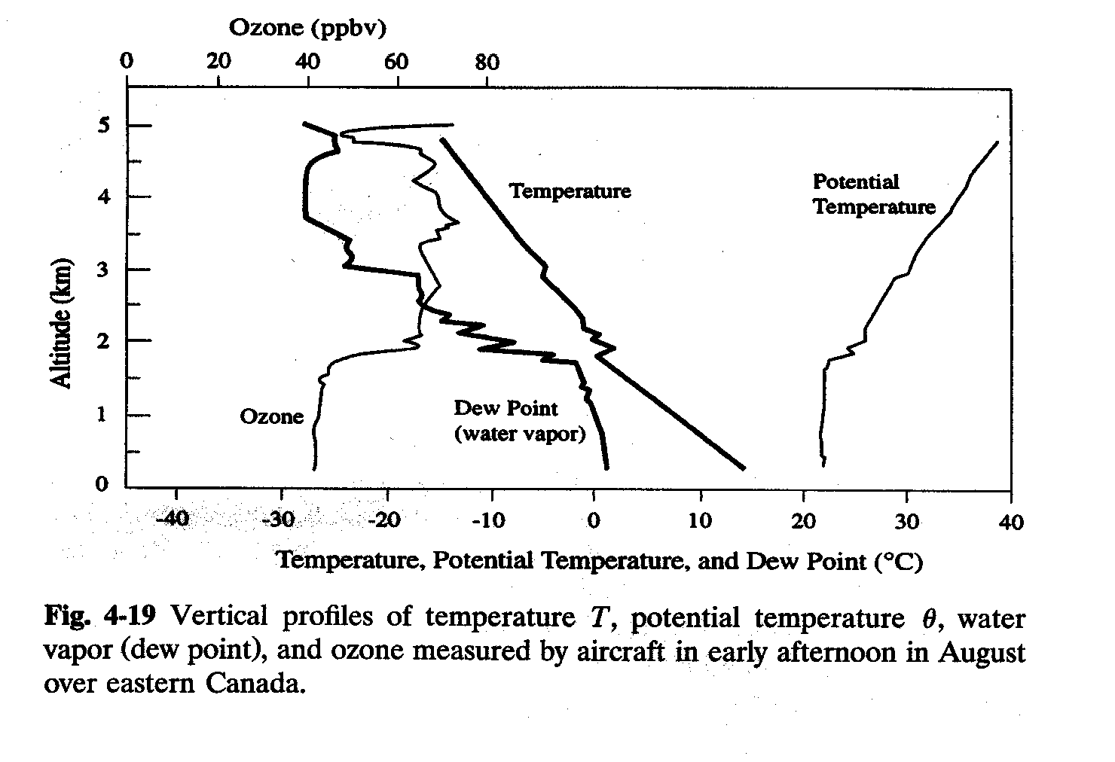
EFFECT OF STABILITY ON VERTICAL STRUCTURE

Slide 31
WHAT DETERMINES THE LAPSE RATE OF THE ATMOSPHERE?
An atmosphere left to evolve adiabatically from an initial state would eventually tend to neutral conditions (-dT/dz = Γ ) at equilibrium
Solar heating of surface disrupts that equilibrium and produces an unstable atmosphere:
z
z
z
ATM
Γ
ATM
final
Γ
Γ
initial
T
T
T
Initial equilibrium
state: - dT/dz = Γ
Solar heating of
surface: unstable
atmosphere
buoyant motions relax
unstable atmosphere to –dT/dz = G
Fast vertical mixing in an unstable atmosphere maintains the lapse rate to Γ.
Observation of -dT/dz = Γ is sure indicator of an unstable atmosphere.

Slide 33
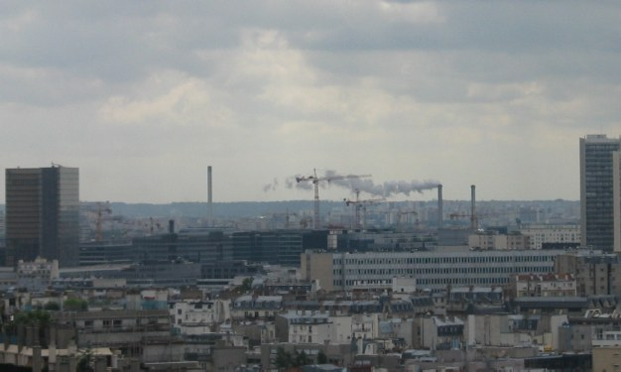

Slide 34
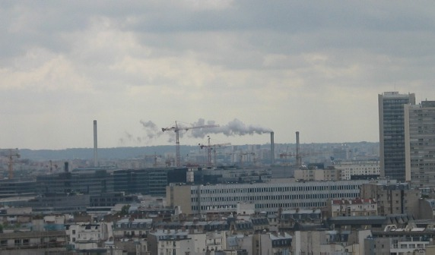

Slide 35
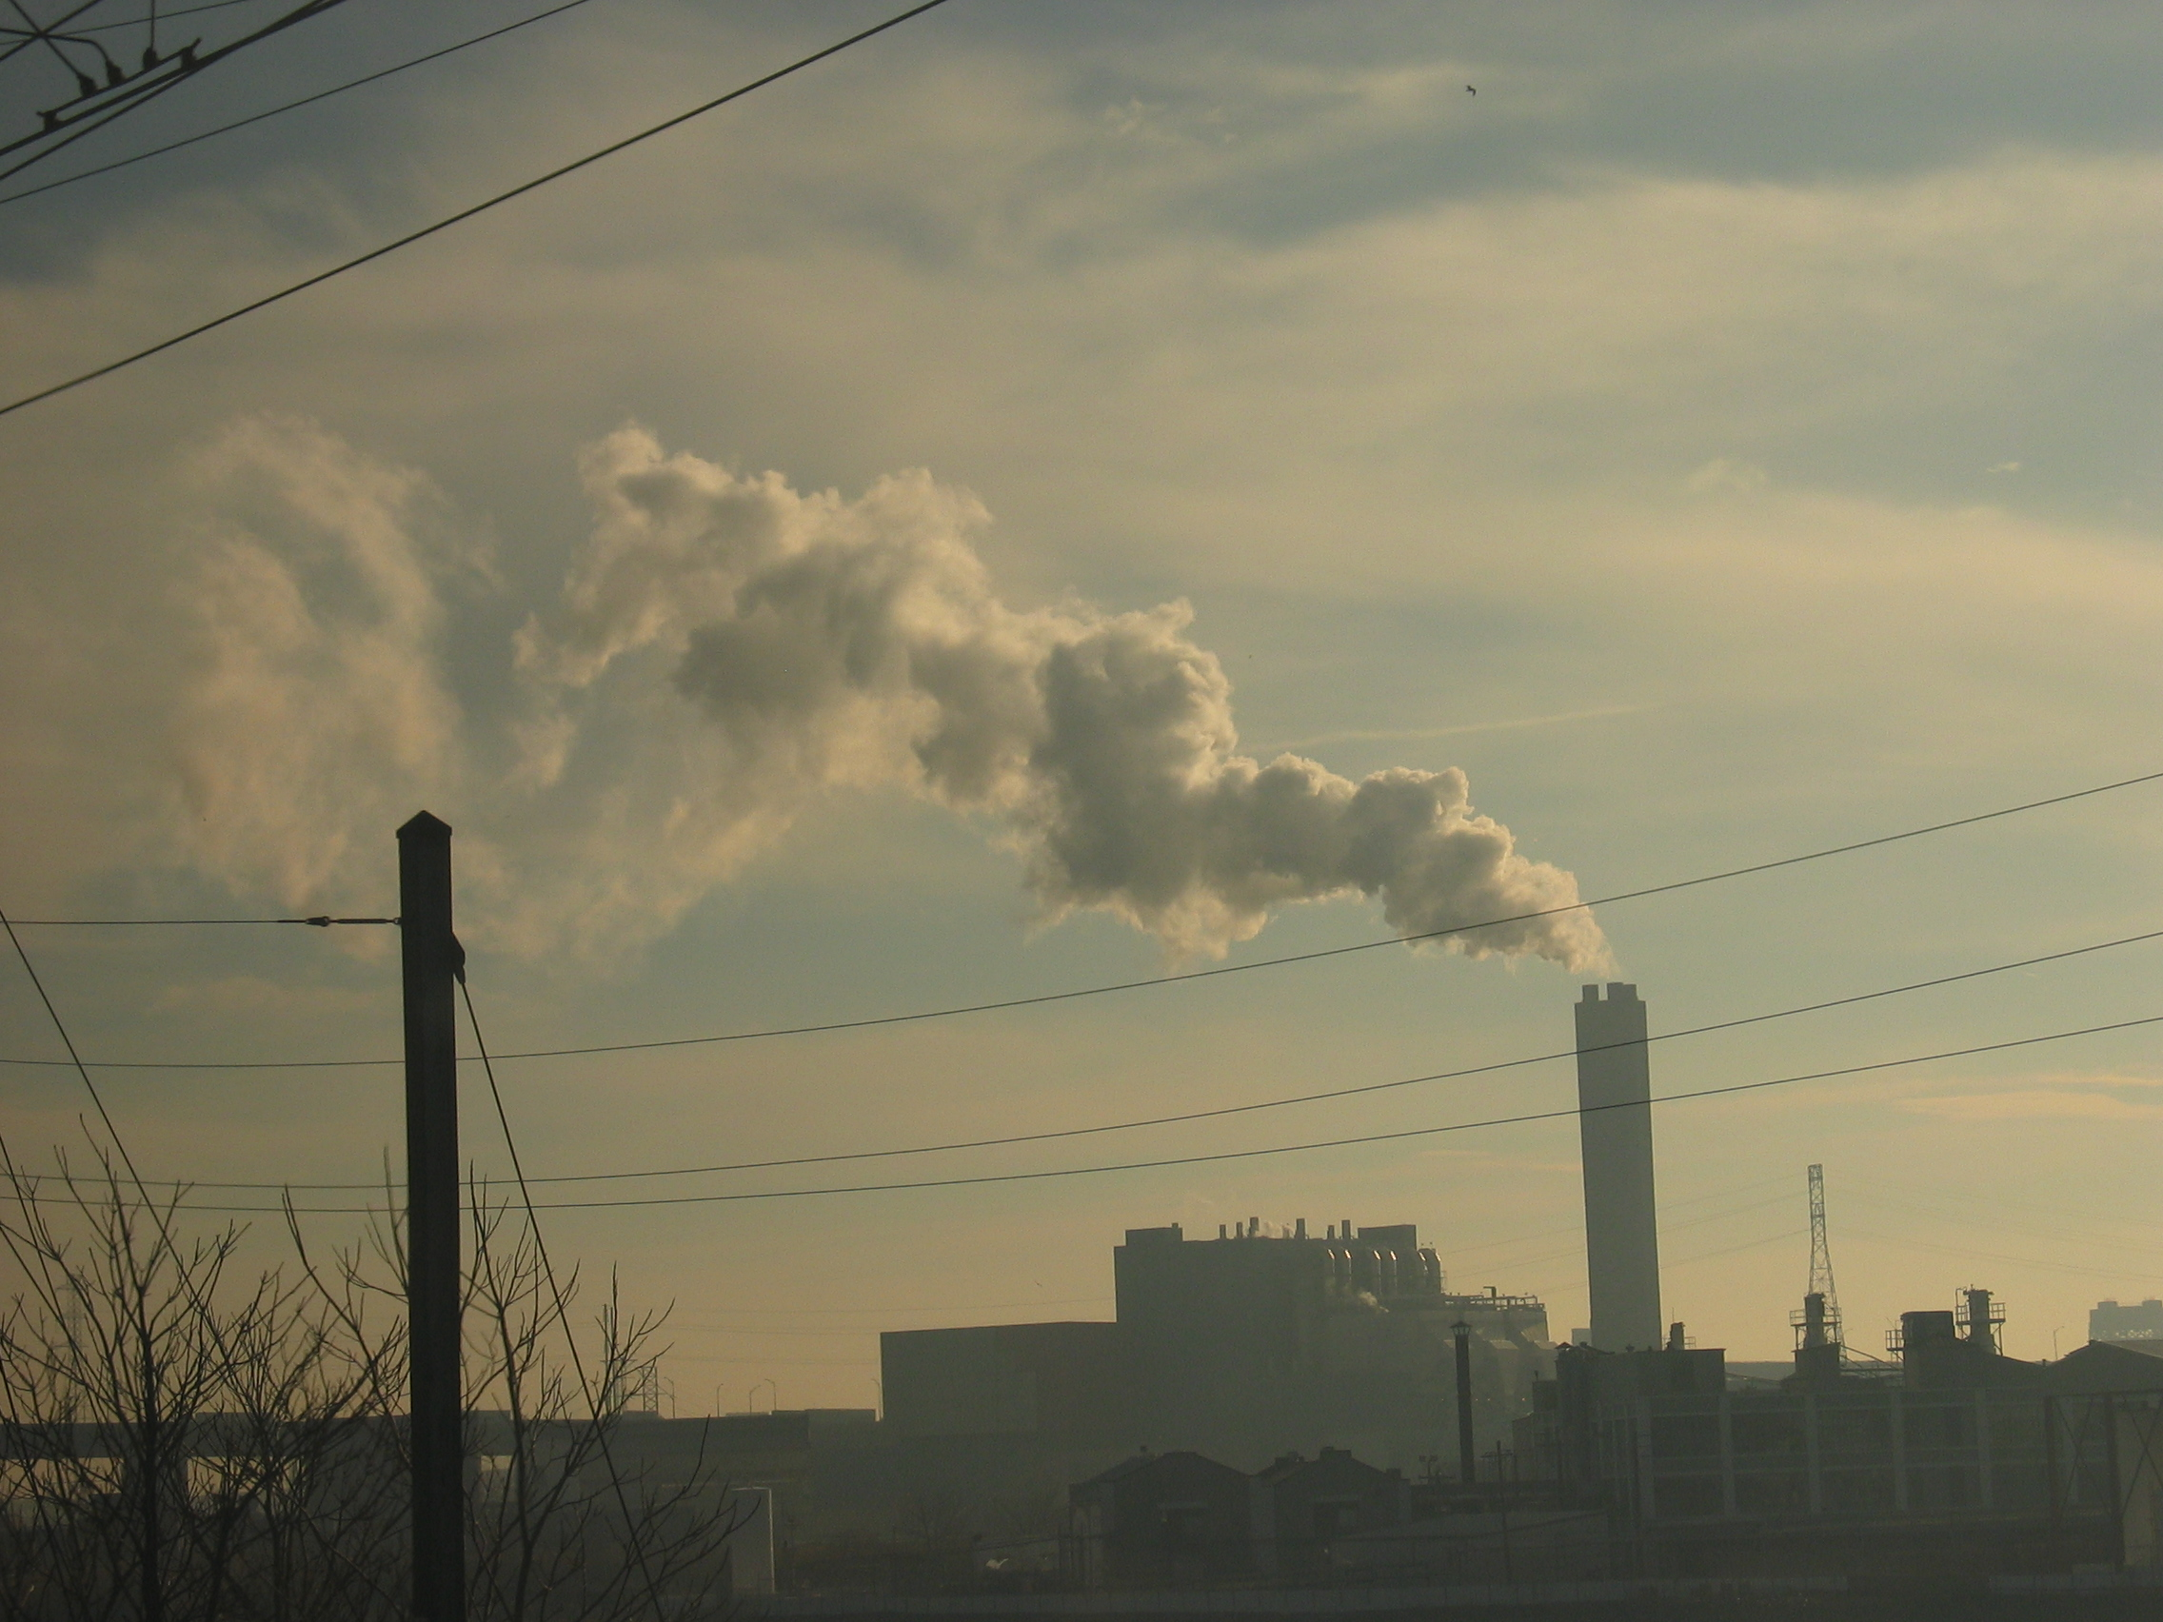
Plume looping, Baltimore ~2pm.

Slide 36
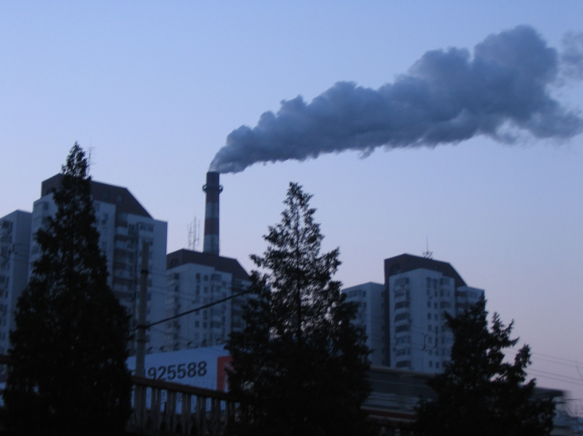
Plume Lofting, Beijing in Winter ~7am.

