Slide 1
Spectroscopy and Photochemistry
AOSC 620
R. Dickerson

Slide 2
Spectroscopy - The study of the interaction of substances with electromagnetic radiation. The energy can be very great such as that of gamma rays or relatively weak such as that of microwaves. Different substances have such differing spectra that spectroscopy is usually used for positive identification. For example when new elements were being discovered the visible emission spectra were used for confirmation.
Finlayson - Pitts, Chapters 2 & 3
McEwan & Phillips, Chapter 1
Wayne, Chapter 2.6, 3.1 - 3.3
Seinfeld, Chapt. 4.1

Slide 3
Photochemistry - The study of chemical reactions caused by the absorption of light.
Laws of Photochemistry
1. Only light absorbed by a molecule or atom can effect a chemical change.
2. Absorption of light is a one quantum process therefore the sum of the efficiencies of the primary processes must be unity.
This law holds for atmospheric processes, but not for some laboratory processes in which the photon flux is so great that a second photon can be absorbed before the energy from first photon is expelled.

Slide 4
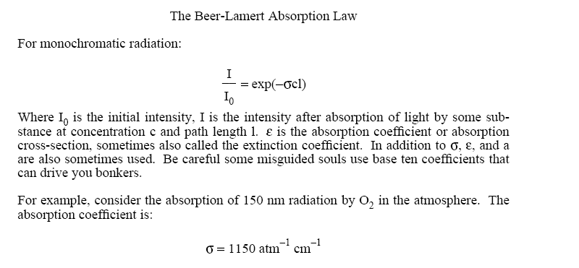

Slide 6
I/I₀ = 0.01 = exp(-1150 cl)
or
-ln(0.01)/1150 = cl = 4x10⁻³ atm cm O₂ = 2.0x10⁻² cm air at RTP.
Why do you think they call this region of the spectrum the vacuum ultraviolet?
Later we will calculate the altitude of maximum absorption of various wavelengths radiation, and we will see that 150 nm radiation is absorbed pretty high up.

Slide 7
Example - Absorption Spectroscopy
Life, as we know it, did not exist on the surface of the earth until ozone existed in the stratosphere. How much ozone is needed to protect life on the surface of the earth?
Necessary Information
1. How much UV can a single celled organism withstand?
2. What is the solar UV flux?
ln(I/I₀) = −σcl
Biomolecules, such as proteins of molecular weight ~1000, are destroyed by solar radiation at wavelengths around 280 nm. Assume that 1 g cm⁻² yr⁻¹ is the maximum allowable destruction rate.

Slide 8
The maximum allowable destruction rate of 1 g cm⁻² yr⁻¹ is the same as:
10⁻³ moles cm⁻² yr⁻¹ or 6x10²⁰ molecules/cm² yr.
If we also assume a quantum yield of unity (each photon absorbed causes a broken molecule) then the limit is: 6x10²⁰ UV photons/cm² yr.
The lethal dosage is anything greater than about:
2x10¹³ UV photons/cm² s

Slide 9
Extraterrestrial solar flux
1 erg= = 10⁻⁷ J
This is measured from space and calculated form ideal black body theory. But what is the energy of a 280 nm photon?
E = hv = hc/λ
Now we convert the solar flux at 280 nm to photons cm⁻² s⁻¹.
I₀ = 10⁻² J cm⁻² s⁻¹ /7x10⁻¹⁹ ergs/photon
1.43x10¹⁶ photons cm⁻² s⁻¹

Slide 13
Example: Photolysis of molecular oxygen.
This problem left for students.

Slide 15
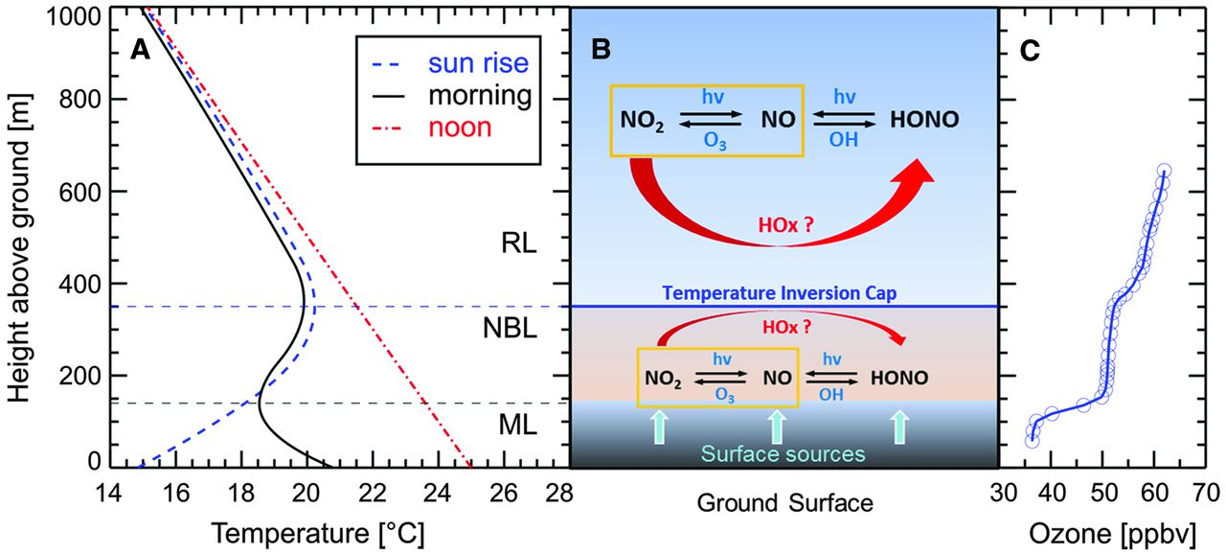

HONO is a hot topic in atmospheric chemistry – there is more of it there than
makes sense.
Missing Gas-Phase Source of HONO Inferred from Zeppelin Measurements in the Troposphere,
By: Li, Xin; Rohrer, Franz; Hofzumahaus, Andreas; et al.
SCIENCE Volume: 344 Issue: 6181 Pages: 292-296 Published: APR 18 2014

Slide 16
Steady state analysis works for O₃ and HOx, but does it always? Let’s look at an important photochemically active molecule in detail from the ground up, considering all possible reactions.
Example: Budget for Nitrous Acid, HONO
Reaction ΔHº (kJ/mole)
NO + NO₂ + H₂O ↔ 2HONO -41 (1)
NO + OH + M → HONO + M† -209 (2)
HONO + hν → HO + NO +202 (3)
O + HONO → HO + NO₂ -97 (4)
O₃ + HONO → HO + NO₂ -198 (5)
OH + HONO → H₂O + NO₂ -169 (6)
O₂ + HONO → O + HNO₃ +194 (7)
2NO₂ + H₂O (het) → HONO↑ + HNO_{3 (aq)} -1.75 (8)
We can examine each reaction in terms of thermodynamics and kinetics. Reaction 8 involves surfaces – it is a multiphase (heterogeneous) reaction and must be treated differently. Reactions such as R7 with a large positive ΔHº have a prohibitively low rate constant. Students should calculate k_{max} to prove that this is an irrelevant reaction. In general oxidation by molecular oxygen is too slow to be important in the atmosphere.

Slide 17
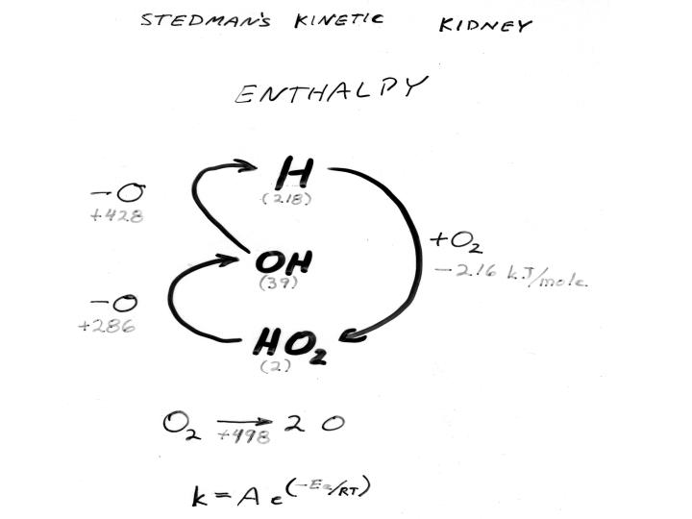
Oxidation in the atmosphere.

Slide 18
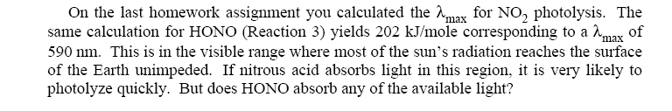

Slide 19
300 nm
400 nm

Slide 20
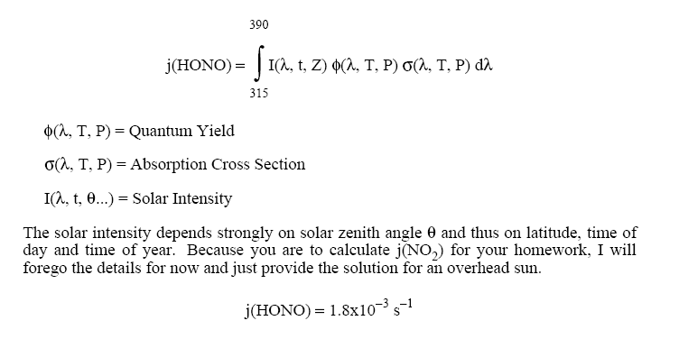

Slide 21
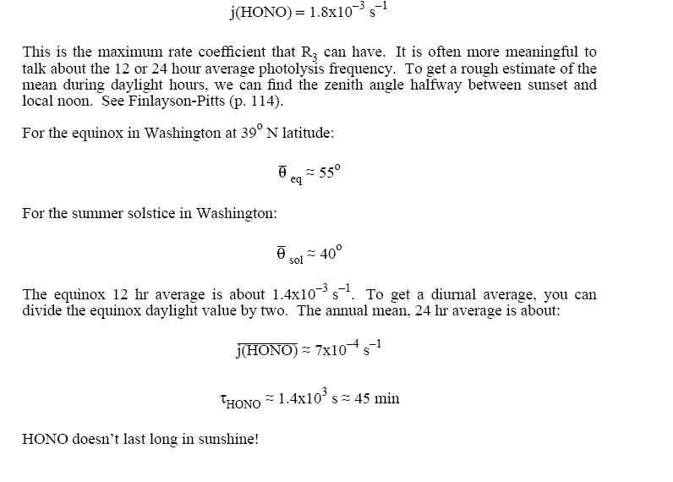

Slide 22
Are there other important HONO sinks? How do they compare to j(HONO)?
Consider attack by O atoms. We’ll compare effective first order rate constants or lifetimes with respect to each loss.

Slide 29
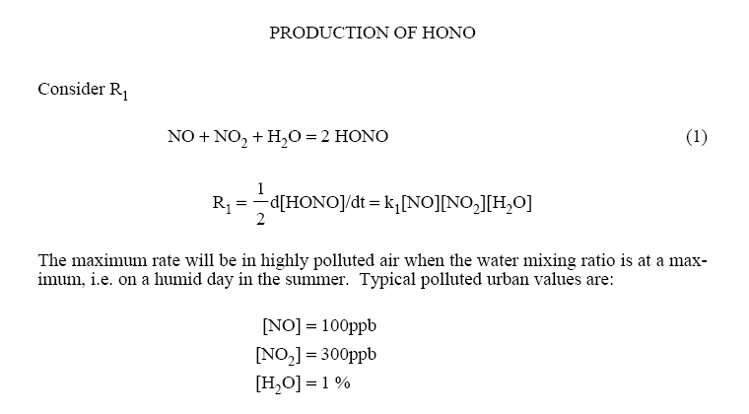

Slide 36
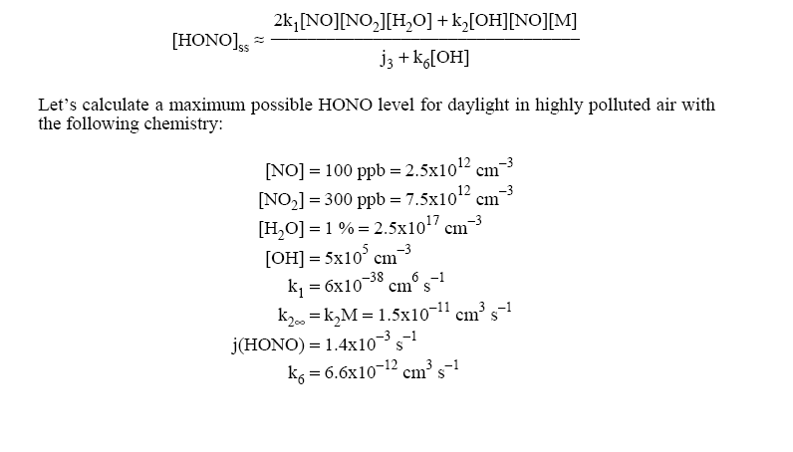

Slide 37
Stutz et al. (2004; 2009) measured a lot of HONO during the morning. They observed HONO/NO2 ratios of 2 to 9%. Concentrations were in the range of 1 ppb for NOx of 20 ppb. The homogeneous chemistry alone will not explain HONO.

Slide 38
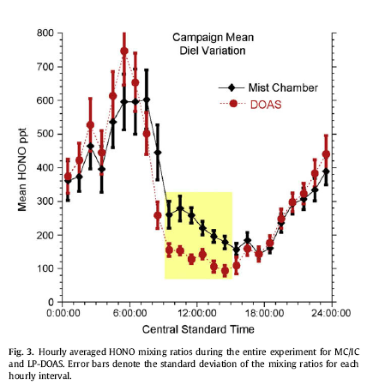
Stutz at al., Atmos. Environ., 2009.

Slide 39
From Stutz et al., (JGR, 2004)
d[HONO]/dt = γ_{NO2 →HONO} (RH) x S/V x v_{NO2}/4 x [NO₂]
      − γ_{HONO} (RH) x S/V x v_{HONO}/4 x [HONO]
      Where γ is the accommodation coefficient, S/V stands for Surface area to Volume ratio, related to the 1/PBL height; RH is relative humidity; v stands for the mean molecular velocities. This is due to just the multiphase reactions.

Slide 40
Figure 7 from Ren et al (ACP, 2013) comparing observed HONO with calculated using gas-phase reactions only.

Slide 41
Take home messages:
We can do a steady state analysis and learn a lot about the atmosphere.
Sometimes multiphase reactions dominate.
Sorgel et al. (2011) and Ren et al. (2013) say HONO photolysis leads to OH production and smog formation.
For HONO surfaces have to be wet.
The air, waters, and land are intimately linked.

