Slide 1
AOSC 620
Atmospheric Aerosols
Salby Chapter 9
F&P Chapter 9
W&H Chapter 5
“Diseases caused by pollution were responsible for an estimated 9 million premature deaths in 2015 – 16% of all deaths worldwide – three times more deaths than from AIDS, tuberculosis, and malaria combined….” Landrigan et al., The Lancet, 2018.

Slide 2
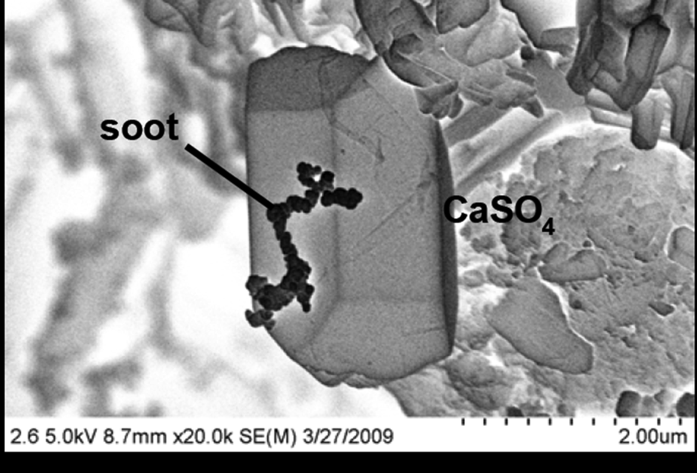
Scanning electron microscope image of particles collected in Xianghe, W of Beijing.

Slide 3
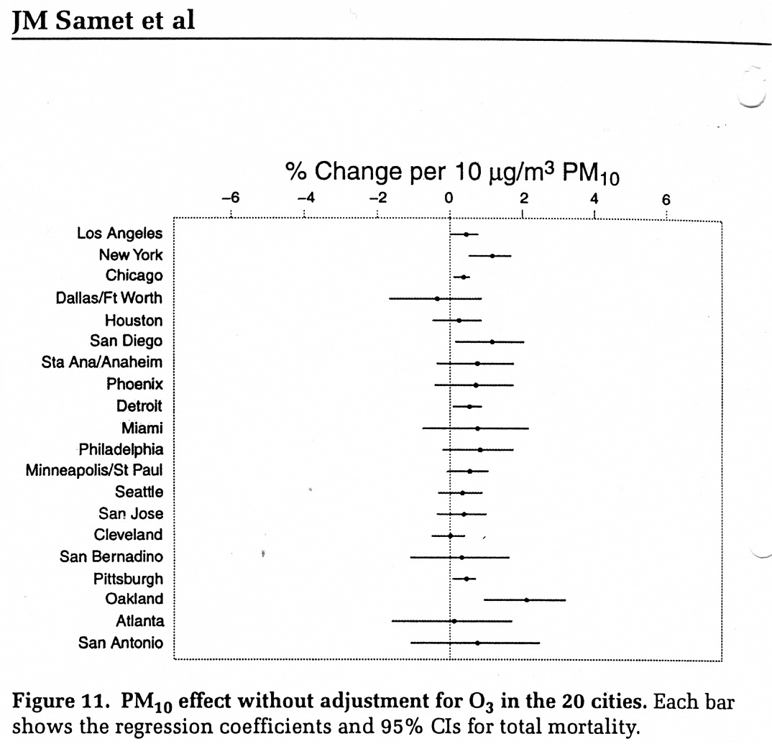
Aerosols
Motivation: Epidemiology (for mortality)
3

Slide 4
What is an aerosol?
An aerosol is a particle suspended in the atmosphere
solid: wind blown dust, volcanic ash
liquid/partially liquid: sulfates, sea spray
Natural vs. Anthropogenic
natural: mineral dust, sea spray, volcanic ash,
biogenic sources of organic material or volcanic SO_{2.}
anthropogenic: industrial dust, OC, VOC’s (SOC) and soot from internal combustion, biomass burning,
sulfates from coal combustion.
4

Slide 5
Why do we care about aerosols?
Climatic effects
aerosols scatter and absorb solar radiation (direct effect)
  reduces radiation going to the ground (cooling)
  absorbing aerosols heat the air, changing dynamics
  Limit to visibility.
aerosols modify cloud properties
  cloud droplets form on small aerosol particles called cloud condensation nuclei (CCN)
  more aerosols = possibly more CCN
  for a given amount of water vapor, if there are more CCN the cloud droplets formed are smaller and the clouds look “brighter” from space (Twomey effect, 1st indirect effect)
  smaller cloud droplets don’t coalesce efficiently to form large raindrops, so the clouds last longer (2nd indirect effect).
Do aerosol effects explain why global warming is not as bad as greenhouse gas estimates alone would lead us to expect?
5

Slide 6
Why do we care about aerosols (2)?
Chemistry
aerosols provide surface area to drive some chemical reactions (heterogeneous chemistry).
in the nighttime polar stratosphere, natural sulfate aerosols can form polar stratospheric clouds (PSCs).
  PSCs lock up Cl atoms during the polar night
  when sunlight returns, the clouds break-up, freeing the Cl (and Br), which destroys ozone.
in the troposphere, aerosols also affect the amount of UV radiation available to drive chemical reactions. (Science 1997)
6

Slide 7
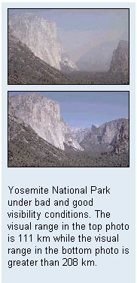
Why do we care about aerosols (3)?
Health/Environmental Concerns
Aerosols affect visibility, with aesthetic but also safety implications (e.g., dust storms causing car accidents, volcanic plumes ground aircraft).
Aerosols frequently pick up acids or even biological components hazardous to ecosystems.
Fine particulate matter (PM2.5) is regulated by the EPA
  particles smaller than 2.5 μm diameter penetrate easily to lungs
  aggravates asthma, decreases lung capacity.
7

Slide 8
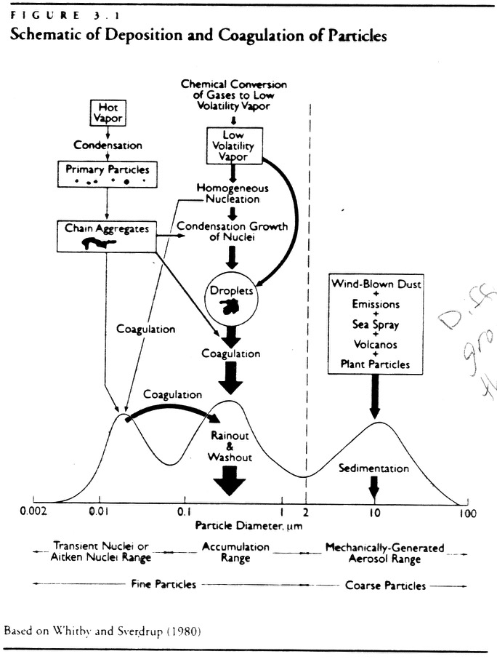
Sizes and sources of particles
Aitken mode
smallest particles (d < 0.1 μm)
formed by gas to particle conversion (homogeneous nucleation) or condensation
Accumulation mode
0.1 < d < 2.5 μm
Direct emissions (e.g., biomass burning), condensation on existing particles, or growth from Aitken mode by coagulation
Coarse mode
d > 2.5 μm
mechanically generated (e.g., dust blown up by winds)
8

Slide 9
Some concepts / terminology
Aitken particles
typically are larges # concentrations & lowest mass concentrations
Coarse mode particles
Typically smallest # concentrations & large mass concentration
Primary particles
emitted fully formed into the atmosphere (e.g., dust, soot)
Secondary particles
largely formed from gas to particle conversion (e.g., sulfates).
9

Slide 10
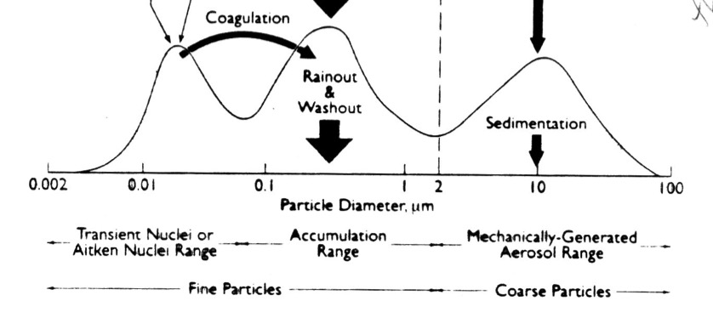
Transformation & Removal Mechanisms
Particles grow by coagulating (“sticking” to each other) or by gases condensing onto their surfaces
Particles shrink by evaporation of condensates or mechanically breaking
Particles are removed by turbulent deposition to the surface (important for smallest particles), scavenging by precipitation, or gravitational settling (important for larges particles)
10

Slide 11
Aerosol physical properties
Chemical composition
  chemical reactions
  refractive index (i.e., optics)
Shape
  light scattering, polarization
  efficiency for condensational growth
Concentration
  efficiency of transformations (e.g., coagulation goes as the number concentration²)
        dN/dt = -kN²
Size
  lifetime
  optical properties
  mobility
11

Slide 12
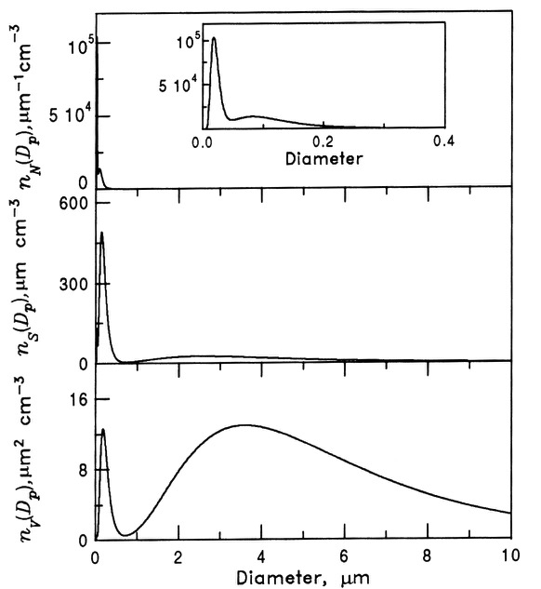
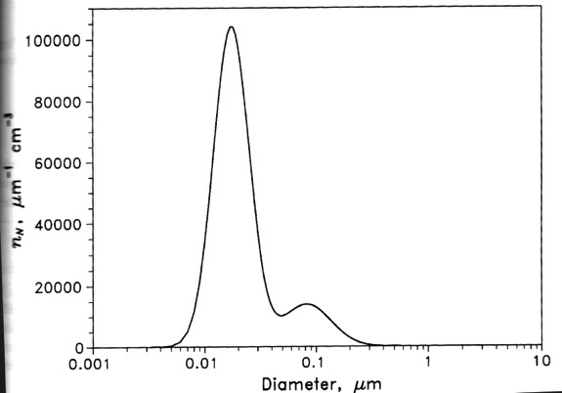
Difficult to evaluate particle size distribution on linear scale because particles cover such a wide range of size
Use a logarithmic scale on the x-axis
12

Slide 13
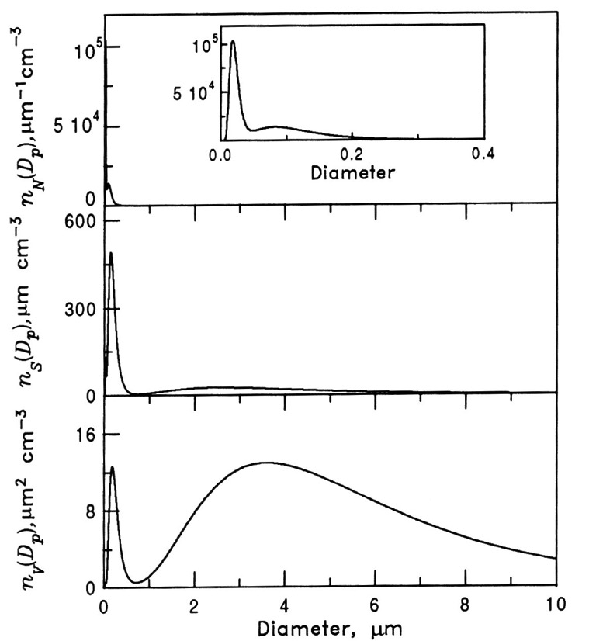
Aerosol particle size distribution
13

Slide 14
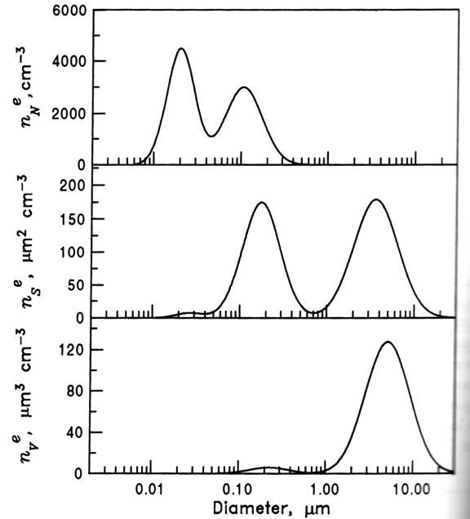
Distributions which look like Gaussian distributions (“normal” distributions) when plotted with a logarithmic x-axis are called lognormal
This size distribution has 2 lognormal modes

Slide 15
Lognormal Distributions
N = number of particles per unit volume [# cm⁻³]
dN/dr = number of particles per unit volume per unit radius with radius between r and r + dr [# cm⁻³ cm⁻¹]
For a Junge distribution β ~ 3
But area and volume distributions are usually bimodal.

Slide 16
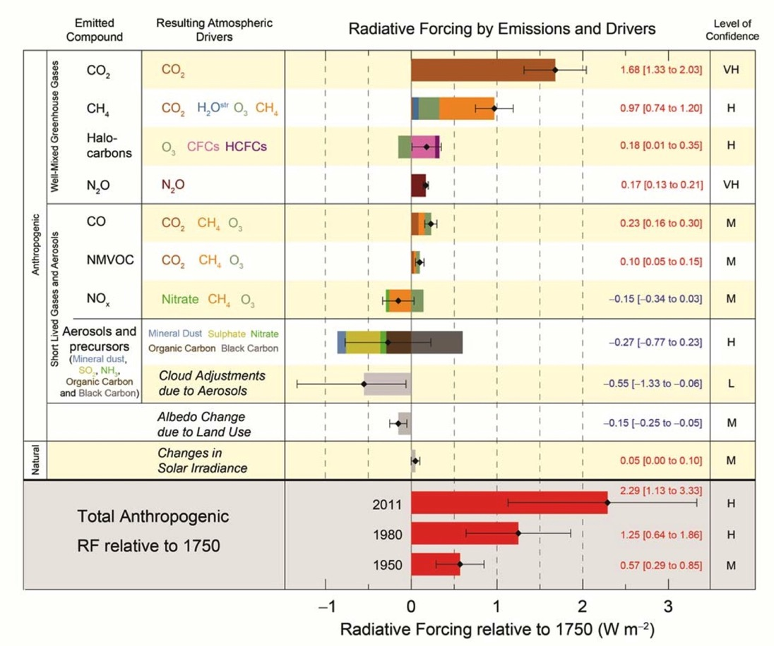
Climate forcing for atmospheric gases and aerosols IPCC
16

Slide 17
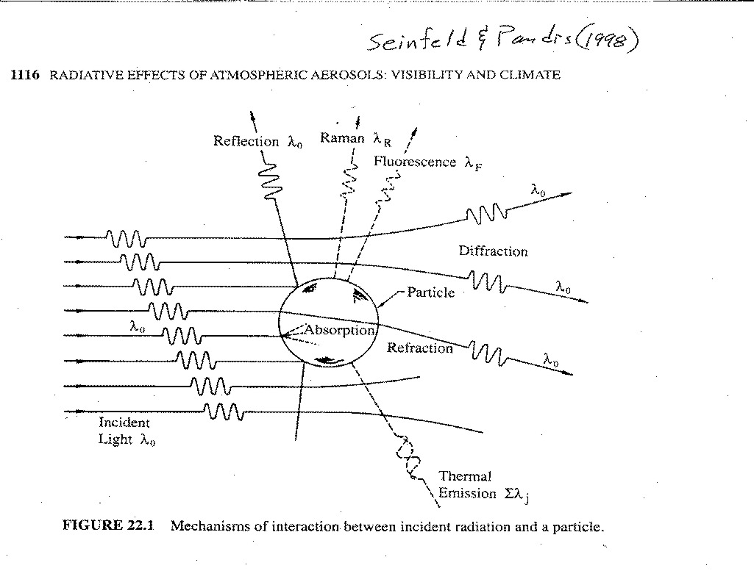
Radiation and fine particles
17

Slide 18
Optical Properties & Visibility
Change in intensity of light reflecting off an object
ΔI / I = exp(‑b_{ext} ΔX)
where: I = incident intensity of light
ΔI = change in intensity of light
b_{ext} = extinction coefficient (m^{‑1})
ΔX = distance (m)
AOD (τ) = ∫ b_{ext}(Z) dZ
18

Slide 19
Extinction Coefficient, b_{ext}
Sum of scattering and absorption coefficients:
b_{ext} = b_{scat} + b_{abs}
Decomposed further from gases and particles:
b_{abs} = b_{ag} + b_{ap}
b_{scat} = b_{sg} + b_{sp}
Where:
b_{ag} = absorption coefficient due to gases (Beer's law)
b_{ap} = absorption coefficient due to particles
b_{sg} = scattering coefficient due to gases (Rayleigh scattering, α 1/λ⁴)
b_{sp} = scattering coefficient due to particles (Mie scattering)
19

Slide 20
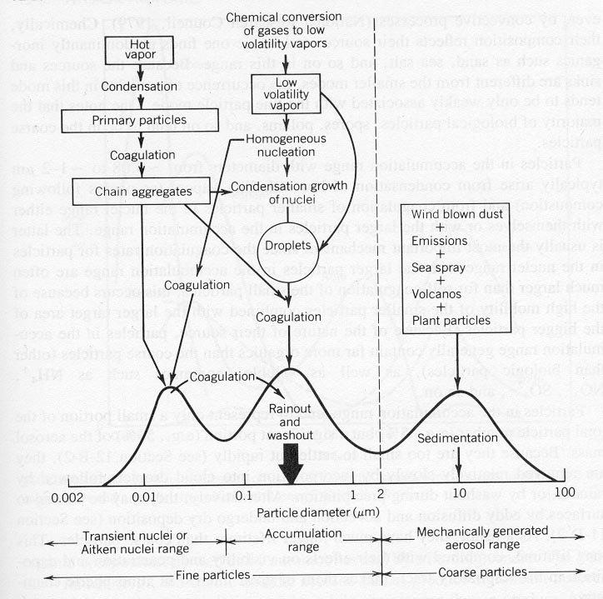
Atmospheric Aerosols
20

Slide 21
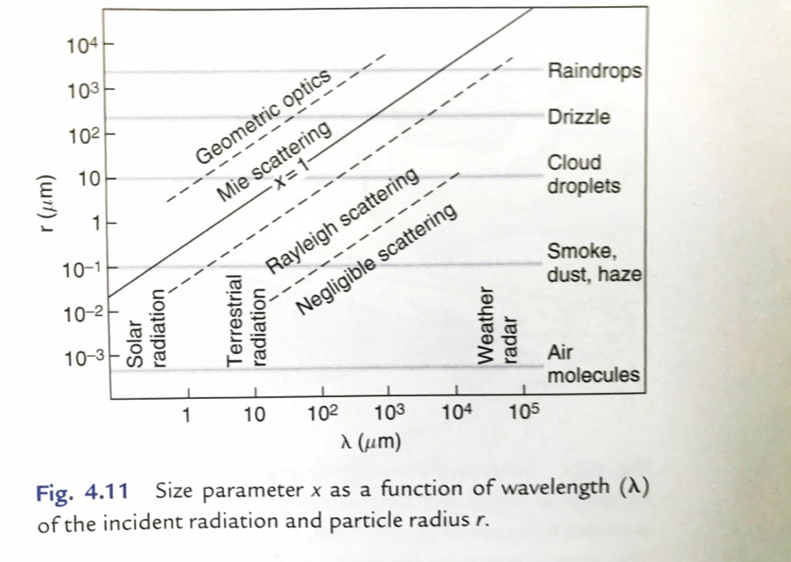
Size parameter: x = 2πr/λ
Wallace & Hobbs Chapt. 4.

Slide 22
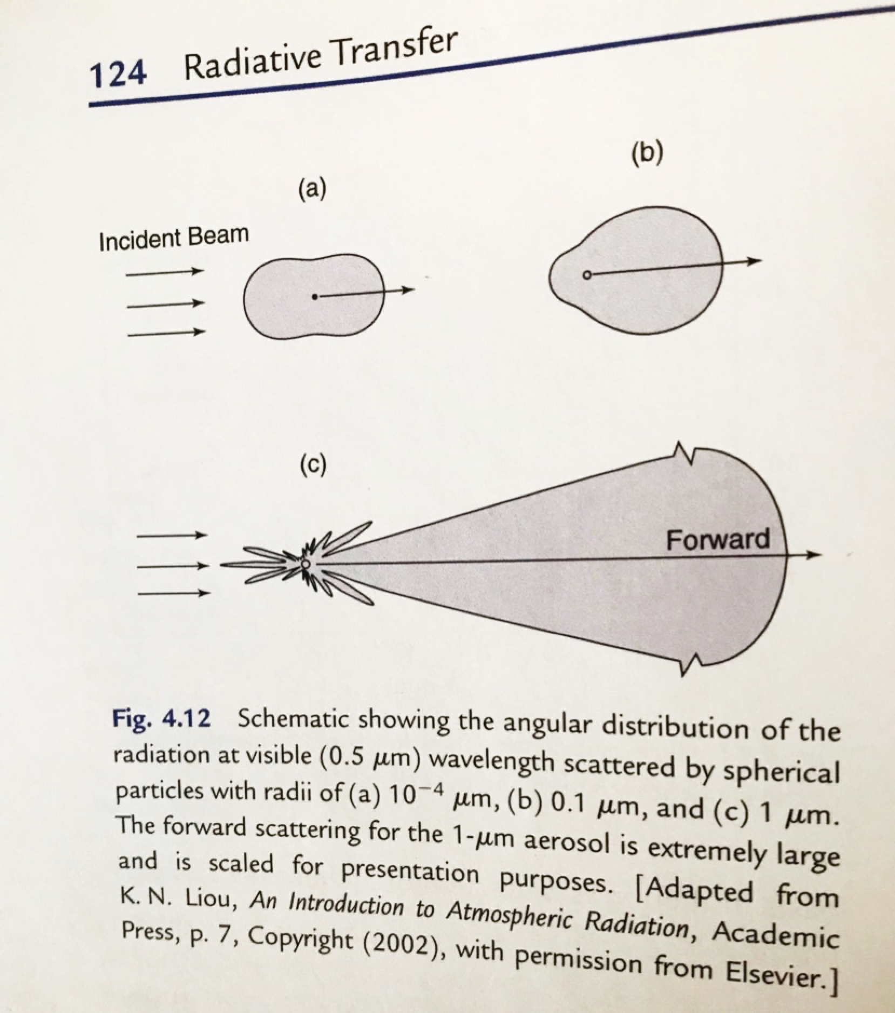
Forward or back scattering? a. Gases b. Fine particles c. Coarse particles

Slide 23
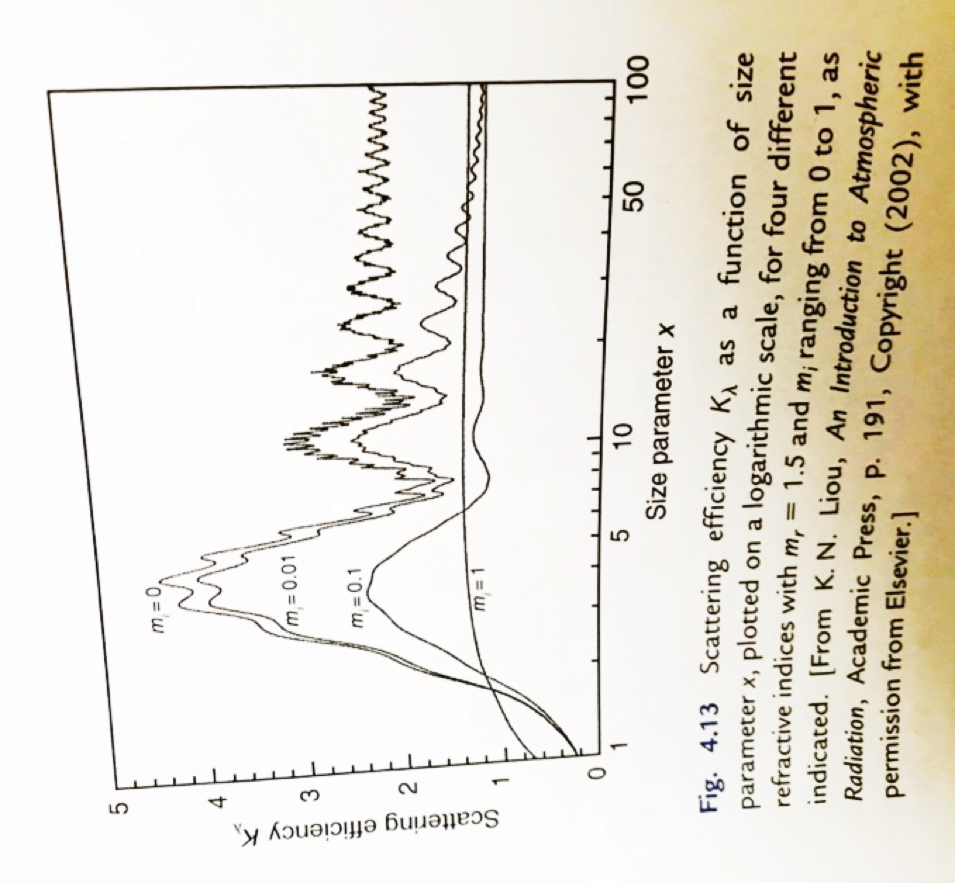
Scattering efficiency peaks when D/λ ~ l.
When the imaginary index of refraction in m = m_{r} + im_{i}
(N = n + ik in S&P) is unity, all absorption and no scattering.

Slide 24
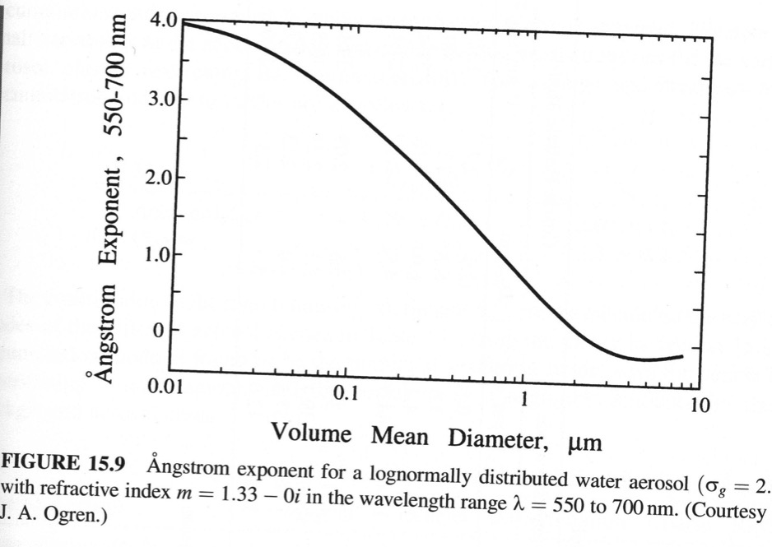
Ångström exponent (Å, or α) is an indication of ensemble aerosol size.
The greater the value of Å the smaller the particles; for classic optics Å = 0.
b_{ext} ∼ λ^{−Å}
Å ≡ - dln(b_{ext})/dln(λ)
≈ - (ln(b_{ext1}/b_{ext2}) /ln(λ₁/λ₂)
Where σ_{g} is geo stddev.
24

Slide 25


Optical Properties: Ångstrom Exponent
This formulation describes the dependency of the extinction or aerosol optical thickness (τ) on wavelength:
25

Slide 26
Visibility
The change in intensity of light reflecting off an object as a function of the scattering of light by the atmosphere.
ΔI/I = e^{(-bextΔX)}
Where I is the intensity of light, b_{ext} is the extinction coefficient with units of m⁻¹, and X is the distance in m. The limit to visibility for the human eye is a 2% change in intensity relative to the background or:
ΔI/I = 0.02
b_{ext}X = -ln(0.02) ≈ 3.9
Visual range = X = 3.9/b_{ext}
b_{ext} ≈ 5 m²g⁻¹ * [PM] g m⁻³
25 miles visibility implies 19 μgm⁻³ of aerosols.
26
26
Notes:
26

Slide 27
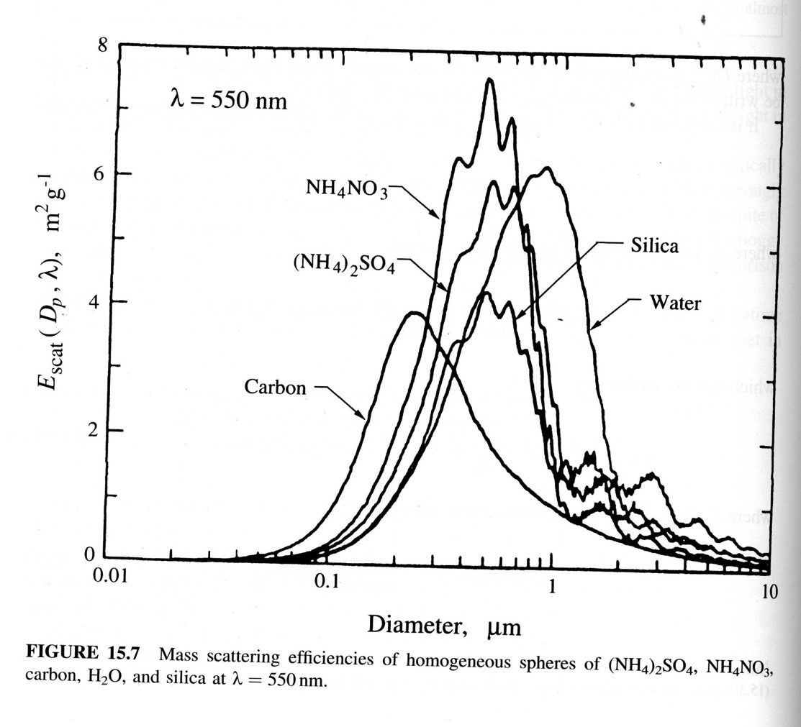
27

Slide 28
Optical Properties of Small Particles
= b_{scat}/b_{ext}
= Single scattering albedo
Unity means 100% of radiation scattered (conserved).
Remember: Index of refraction:
m = n + ik
m = complex index of refraction
n = scattering (real part)
k = absorption (imaginary part)
28

Slide 29
Refractive indices of aerosol particles at λ = 589 nm
 | m = n + iκ
Substance | n | κ
Water | 1.333 | 10⁻⁸
Ice | 1.309 | 10⁻⁸
NaCl | 1.544 | 0
H₂SO₄ | 1.426 | 0
NH₄HSO₄ | 1.473 | 0
(NH₄)₂SO4 | 1.521 | 0
SiO₂ | 1.55 | 0
Black Carbon (soot) | 1.96 | 0.66
Mineral dust | ~1.53 | ~0.006
29

Slide 30
Attenuation of light as it passes through a single particle.
Where κ is the imaginary index of refraction, D is the diameter of the particle and λ is the wavelength of light. Note the diameter/wavelength dependence. Absorbance, ln(I₀/I), approximately linear with mass concentration, assuming spherical particles.
Example: For a particle of 0.2 μm diameter and radiation of 0.589 μm, the transmission of light through a BC particle is
exp[-4π0.66(0.2/0.589)] = 0.06
or 94% absorption. Repeat for water.

Slide 31
Recent examples of state of the art experiments and models.
DISCOVER-AQ
http://discover-aq.larc.nasa.gov/2012-02Workshop/
INDOEX

Slide 32
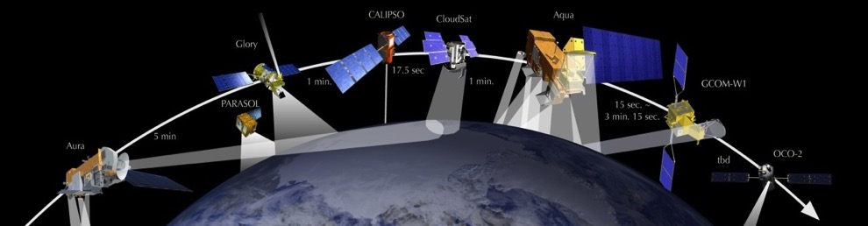
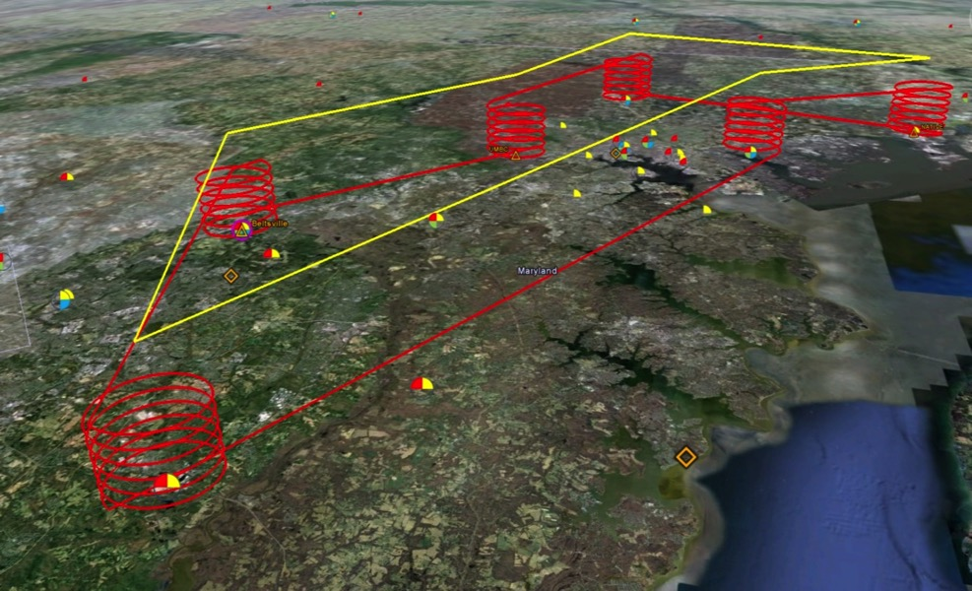
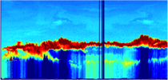

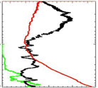
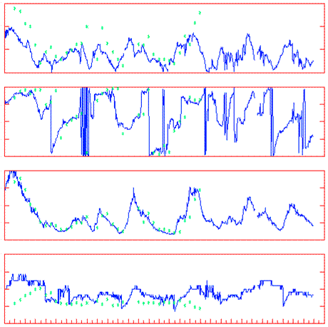
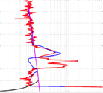
Deployment Strategy
Systematic and concurrent observation of column-integrated, surface, and vertically-resolved distributions of aerosols and trace gases relevant to air quality as they evolve throughout the day.
Three major observational components:
NASA UC-12 (Remote sensing)
Continuous mapping of aerosols with HSRL and trace gas columns with ACAM
NASA P-3B (in situ meas.)
In situ profiling of aerosols and trace gases over surface measurement sites
Ground sites
In situ trace gases and aerosols
Remote sensing of trace gas and aerosol columns
Ozonesondes
Aerosol lidar observations
Notes:
The density and simultaneity of observations from different perspectives is a key aspect of DISCOVER-AQ in creating a dataset useful for linking remote sensing and in situ observations of air quality.

Slide 33
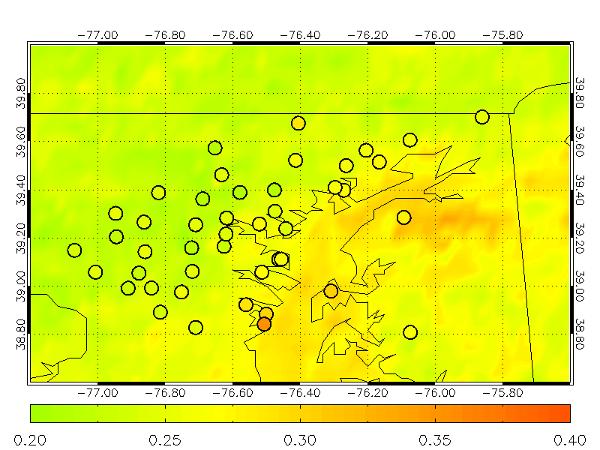
Satellite and surface-based sun photometers measure haze
GOES and DRAGON Station AOD Data (June-July 2011)

Slide 34
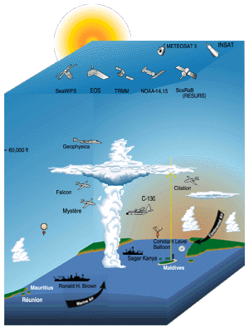
INDOEX, 1999
INDOEX: Indian Ocean Experiment
34

Slide 35
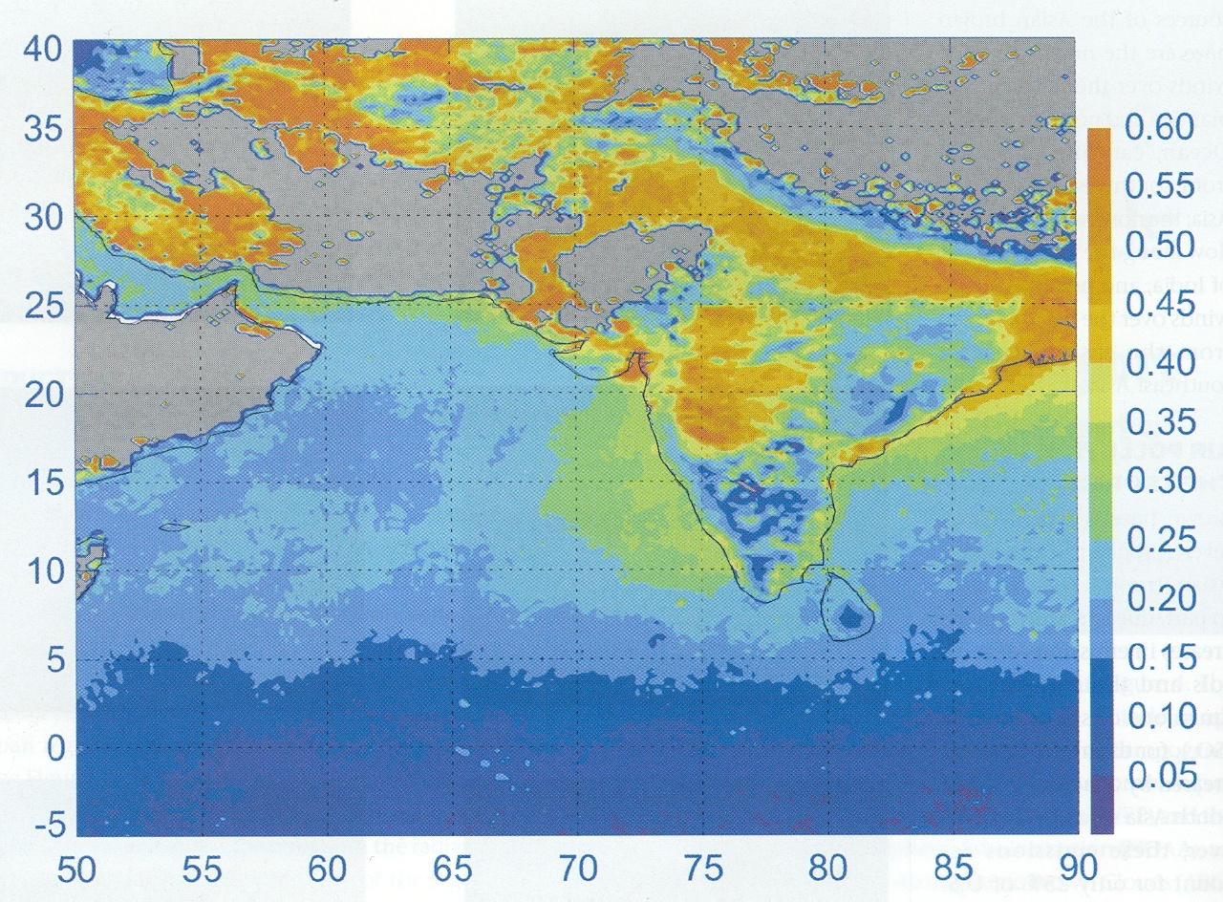
Mean Aerosol Optical Depth over INDOEX region from Dec 2001 to May 2003 from MODIS (Ramanathan & Ramana, Environ. Managers, Dec. 2003).
INDOEX
+ RV Ronald Brown
35

Slide 36
INDOEX
36
From Ramanathan 2001
0 to 3 km layer

Slide 37
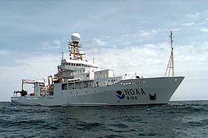
NOAA R/V Ronald Brown
37

Slide 38
Air Flow During INDOEX 1999
38

Slide 39
Aerosol Impactor

Slide 40
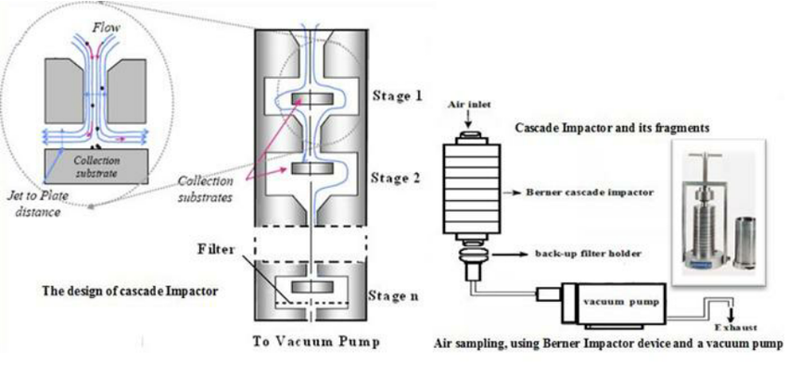

Slide 41
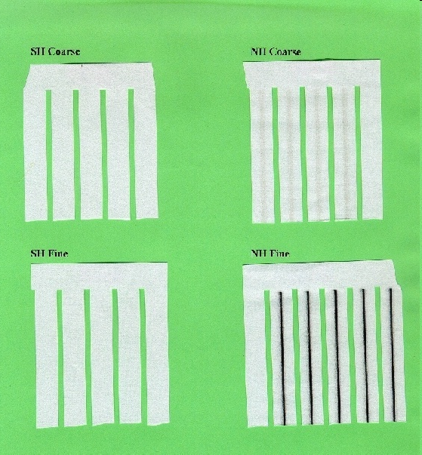
SH Coarse
NH Coarse
SH Fine
NH Fine
41

Slide 42
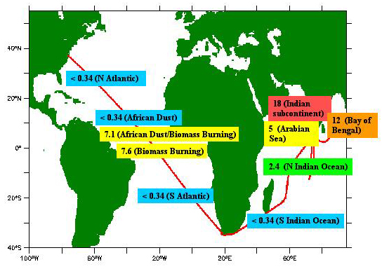
Field data showing the high variability of aerosol light absorption coefficient with latitude and longitude, measured by NOAA/PMEL scientists aboard the NOAA Research Vessel Ron Brown during the Aerosols 99 and INDOEX (Indian Ocean Experiment) cruises. The aerosol light absorption coefficient is presented in all figures in units of Mm⁻¹. Measurements are made at a wavelength of 550nm. (Courtesy of P. Quinn and T. Bates, NOAA/PMEL.)
42

Slide 43
Aerosol data collected with a six-stage impactor on a ship over the ocean, downwind of India. The “cutoff” size indicated the median aerodynamic radius collected on that stage.
Concentration (μg/m³)
Size cutoff (μm) | Ca²⁺ | Na⁺ | Cl⁻ | NO₃⁻ | SO₄²⁻ | K⁺ | NH₄⁺
0.12 | 0.051 | 0.04 | 0.13 | 0.14 | 1.81 | 0.96 | 0.73
0.24 | 0.029 | 0.03 | 0.07 | 0.07 | 1.53 | 0.62 | 0.51
0.48 | 0.042 | 0.11 | 0.15 | 0.16 | 0.43 | 0.02 | 0.18
0.74 | 0.042 | 0.17 | 0.22 | 0.29 | 0.09 | 0.005 | 0.04
1.5 | 0.142 | 0.84 | 1.23 | 1.01 | 0.18 | 0.009 | 0.07
3.6 | 0.091 | 0.48 | 0.84 | 0.54 | 0.09 | 0.006 | 0.04
43

Slide 44
Sea salt is found predominantly in the coarse mode.
Particles are generally depleted in Cl¯.
44

Slide 45
Calcium comes from wind blown mineral dust and is seen in the coarse mode.
Nitrate originating from nitric acid (HNO₃) sticks to alkaline mineral dist or sea salt particles.
45

Slide 46
Secondary particles composed of (NH₄)₂SO₄ are among fine particles in the accumulation mode.
46

Slide 47
Potassium might originate from mineral dust, but downwind of India it comes from biofuel combustion.
47

Slide 48
Sulfate
Wavelength (nm) | 350 | 550 | 1000 |  | Angstrom 350/550 | Angstrom 550/1000
bsp (m⁻¹) | 6.50E-04 | 2.90E-04 | 9.60E-05 |  | 1.79 | 1.85
bap (m⁻¹) | 4.00E-06 | 1.70E-06 | 8.00E-07 |  | 1.89 | 1.26
bext (m⁻¹) | 6.54E-04 | 2.92E-04 | 9.68E-05 |  | 1.79 | 1.85
Single Scatt Alb | 0.994 | 0.994 | 0.992
AOD | 1.308 | 0.5834 | 0.1936
48

Slide 49
Mineral Dust
Wavelength (nm) | 350 | 550 | 1000 |  | Angstrom 350/550 | Angstrom 550/1000
bsp (m⁻¹) | 3.10E-04 | 2.19E-04 | 1.38E-04 |  | 0.769 | 0.772
bap (m⁻¹) | 5.85E-05 | 2.01E-05 | 9.70E-06 |  | 0.236 | 0.122
bext (m-1) | 3.69E-04 | 2.39E-04 | 1.48E-04 |  | 0.957 | 0.806
Single Scatt. Alb | 0.841 | 0.916 | 0.934
AOD | 0.737 | 0.4782 | 0.2954
49

Slide 50
Soot (STUDENT fill in the blanks)
Wavelength (nm) | 350 | 550 | 1000 |  | angstrom 350/550 | angstrom 550/1000
b_{sp} (m⁻¹) | 2.19E-04 | 9.00E-05 | 2.80E-05
b_{ap} (m⁻¹) | 5.50E-05 | 2.17E-05 | 5.90E-06
b_{ext} (m⁻¹)
Single Scatt Albedo
AOD*
*Assume a mixed layer of 2000 m depth.
50

Slide 51
From MODIS (IPCC, 2007)

Slide 52
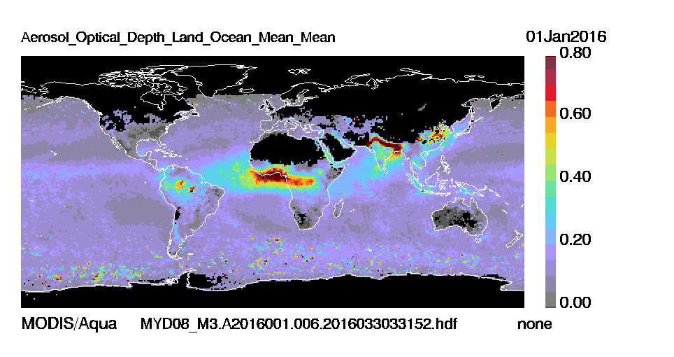

Slide 53
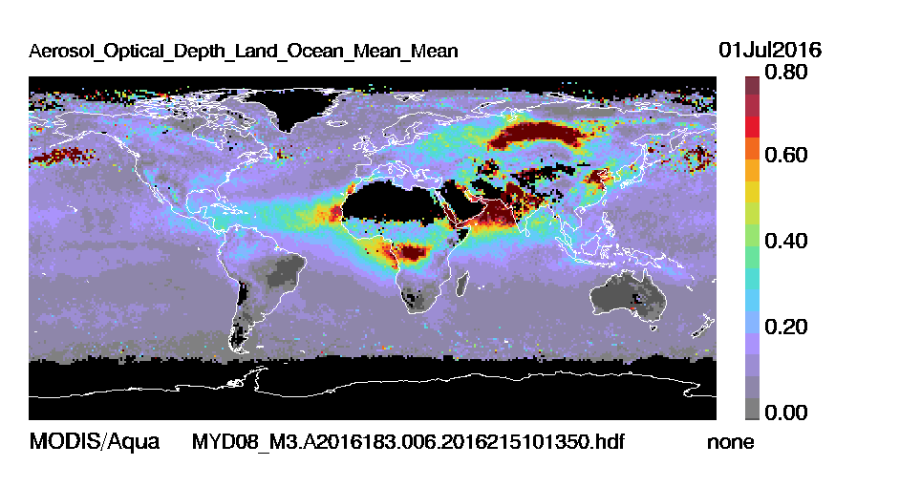

Slide 54
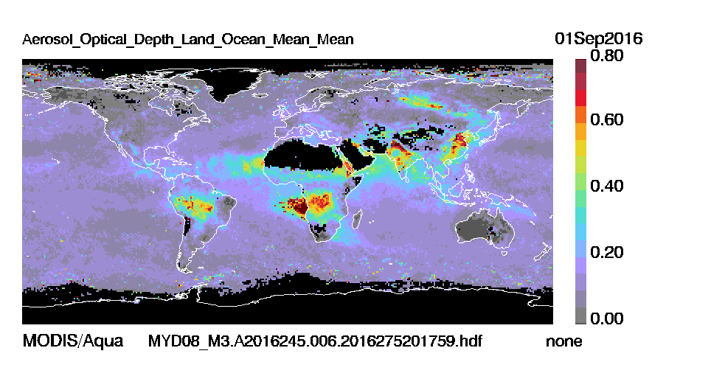

Slide 55
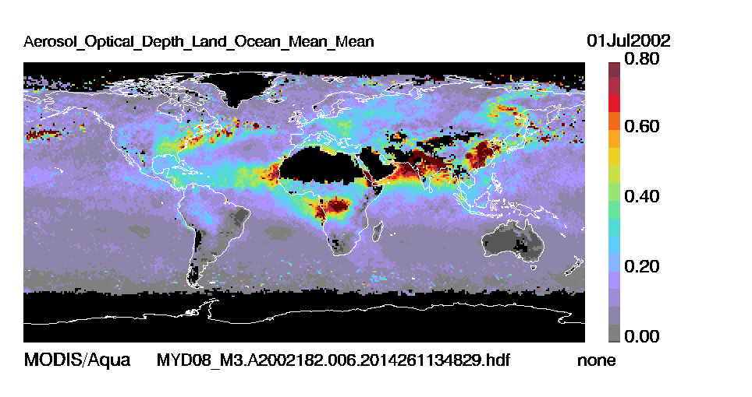
Difference between summers
2002 and 2016.

Slide 56
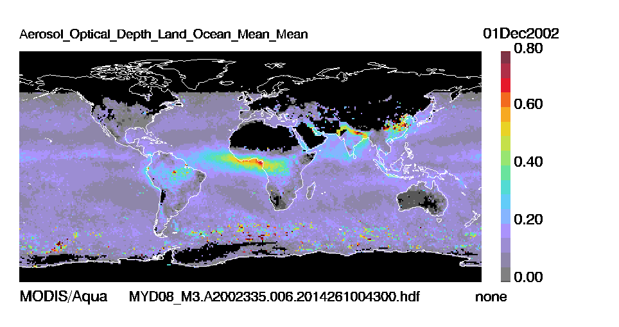
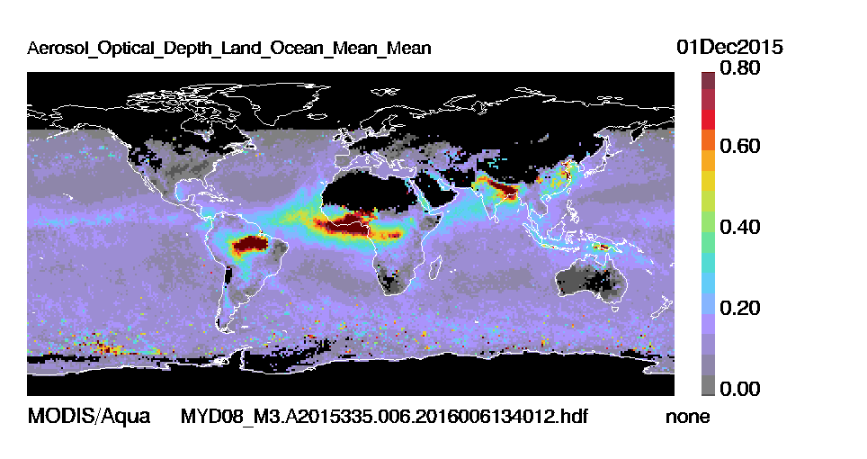
Difference between winters
2002 and 2015.

Slide 57
Summary of Aerosol Physics & Chemistry
“How big are atmospheric particles?” Answer depends on which effect interests you.
  CCN – number (r < 0.1 μm)
  Radiative transfer & health – surface area (0.1 < r < 1.0 μm)
  Biogeochemical cycles – mass (r > 0.5 μm).
Composition varies with size.
For exams you should be able to calculate: Single scattering albedo, Angstrom exp., visibility from extinction and absorption.

Slide 58
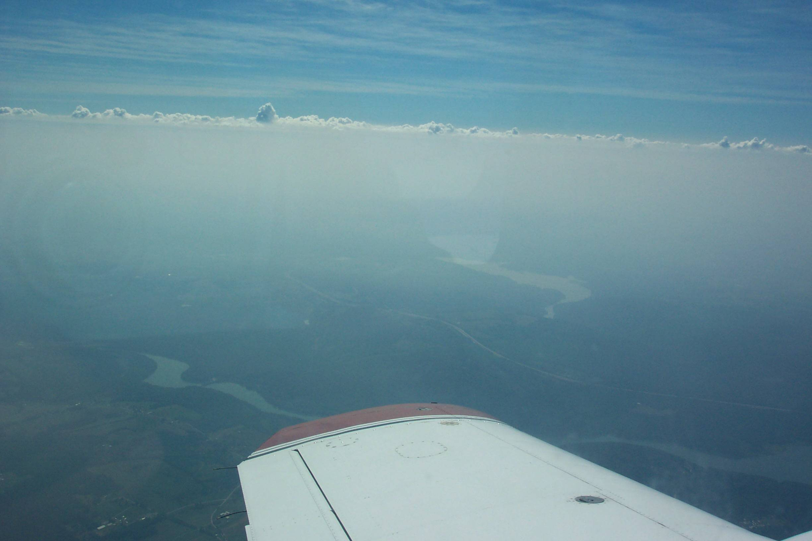

Cessna Data over Maryland
Thursday Afternoon 21 July 2011
The University of Maryland
Supported by MDE, DNR, NOAA, and NASA
Notes:
Shows Nick’s OMI average SO2 amounts and areas of study.

Slide 60
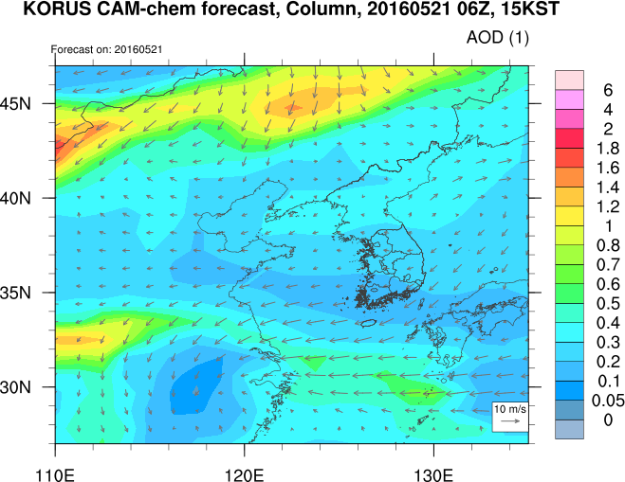
Flight Track Y12
Y12 observed 200Mm⁻¹ in a layer 2000 m deep = AOD = ~0.4, min 0.3, max 0.6.

Slide 61
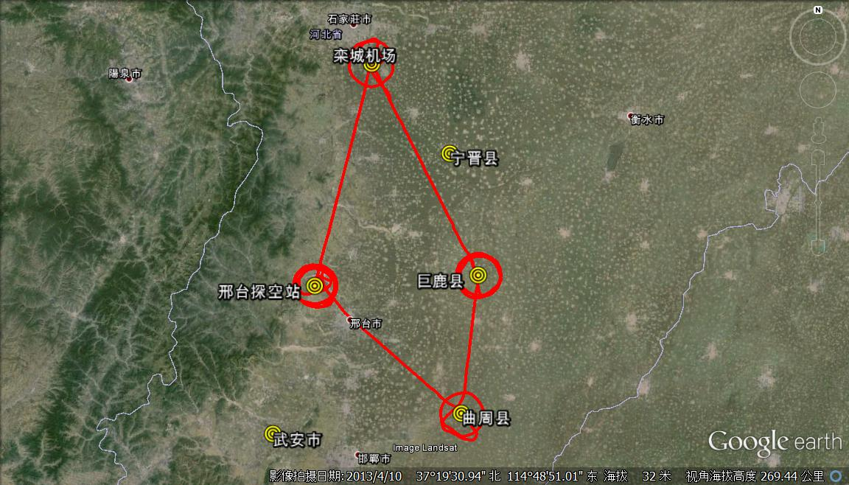
RF1 on May 08, 2016
Luancheng
Airport
Xingtai
Julu
栾城
巨鹿
邢台
曲周
Quzhou

Slide 62
Three Vertical Profiles over Xingtai
AOD = 2500m*0.4x10⁻⁴m⁻¹ = 0.1
PBL top
H ~ 1200 m

Slide 63
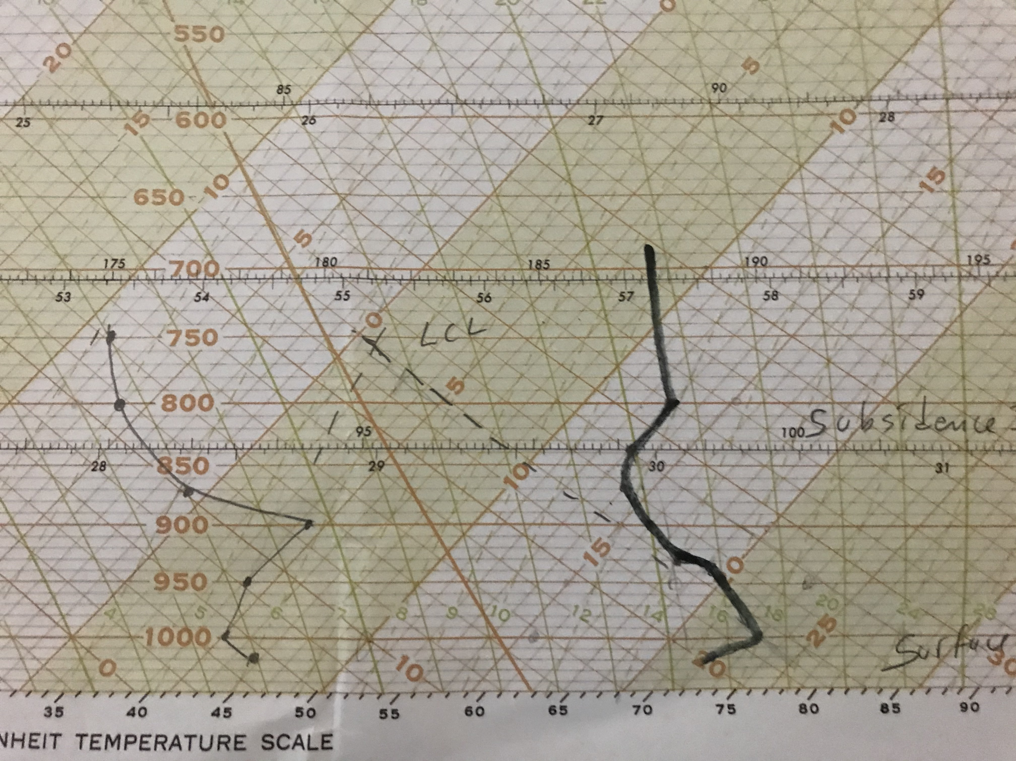

Slide 64
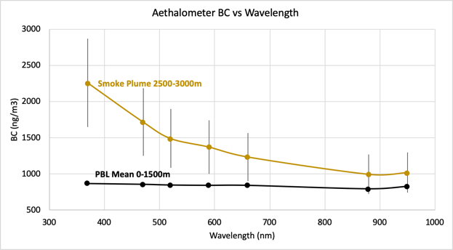
Measurements in and below a wildfire plume: flight over NYC Aug. 15-17, 2018.

Slide 65
Extra slides

Slide 66
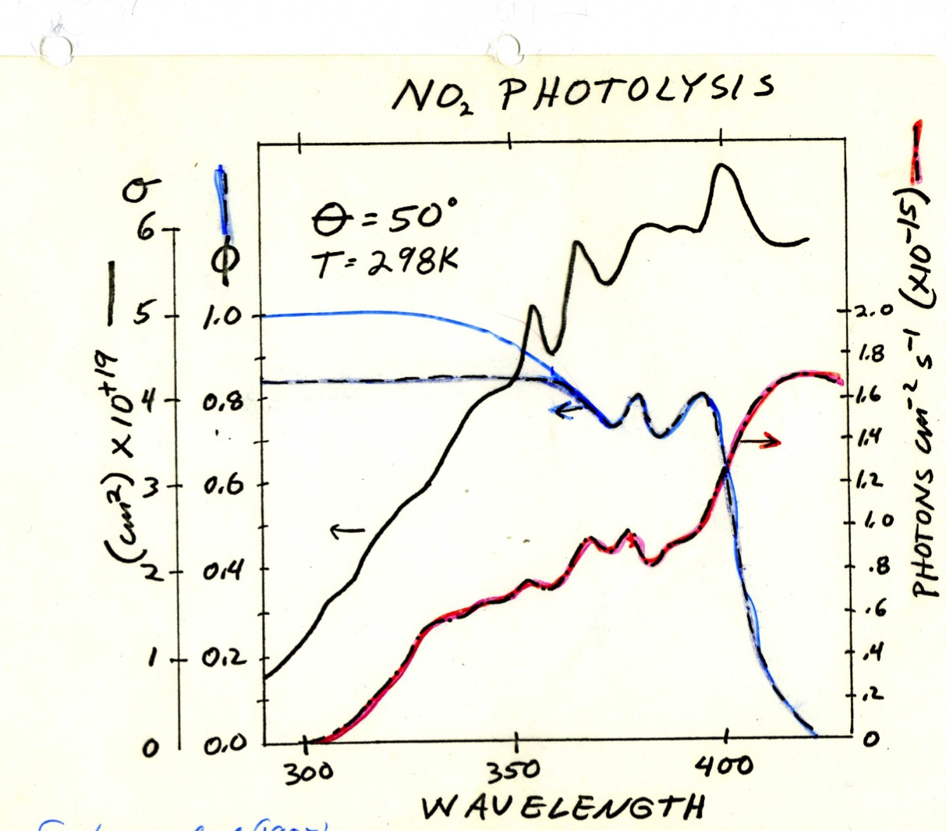

Slide 67
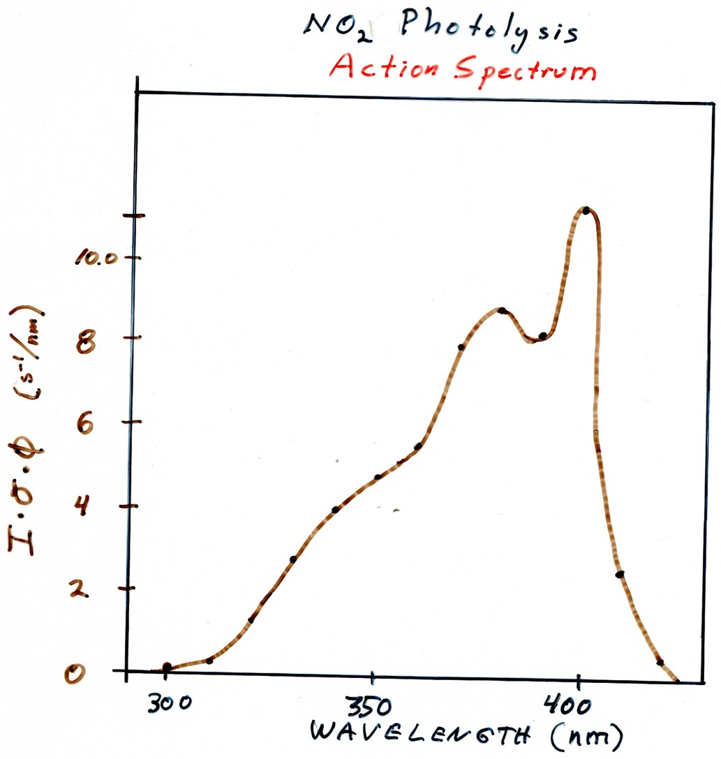

Slide 68
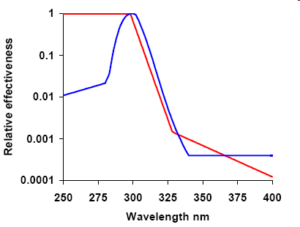
Erythema Action Spectrum (red)
Human squamous cell carcinoma (blue)

Slide 69
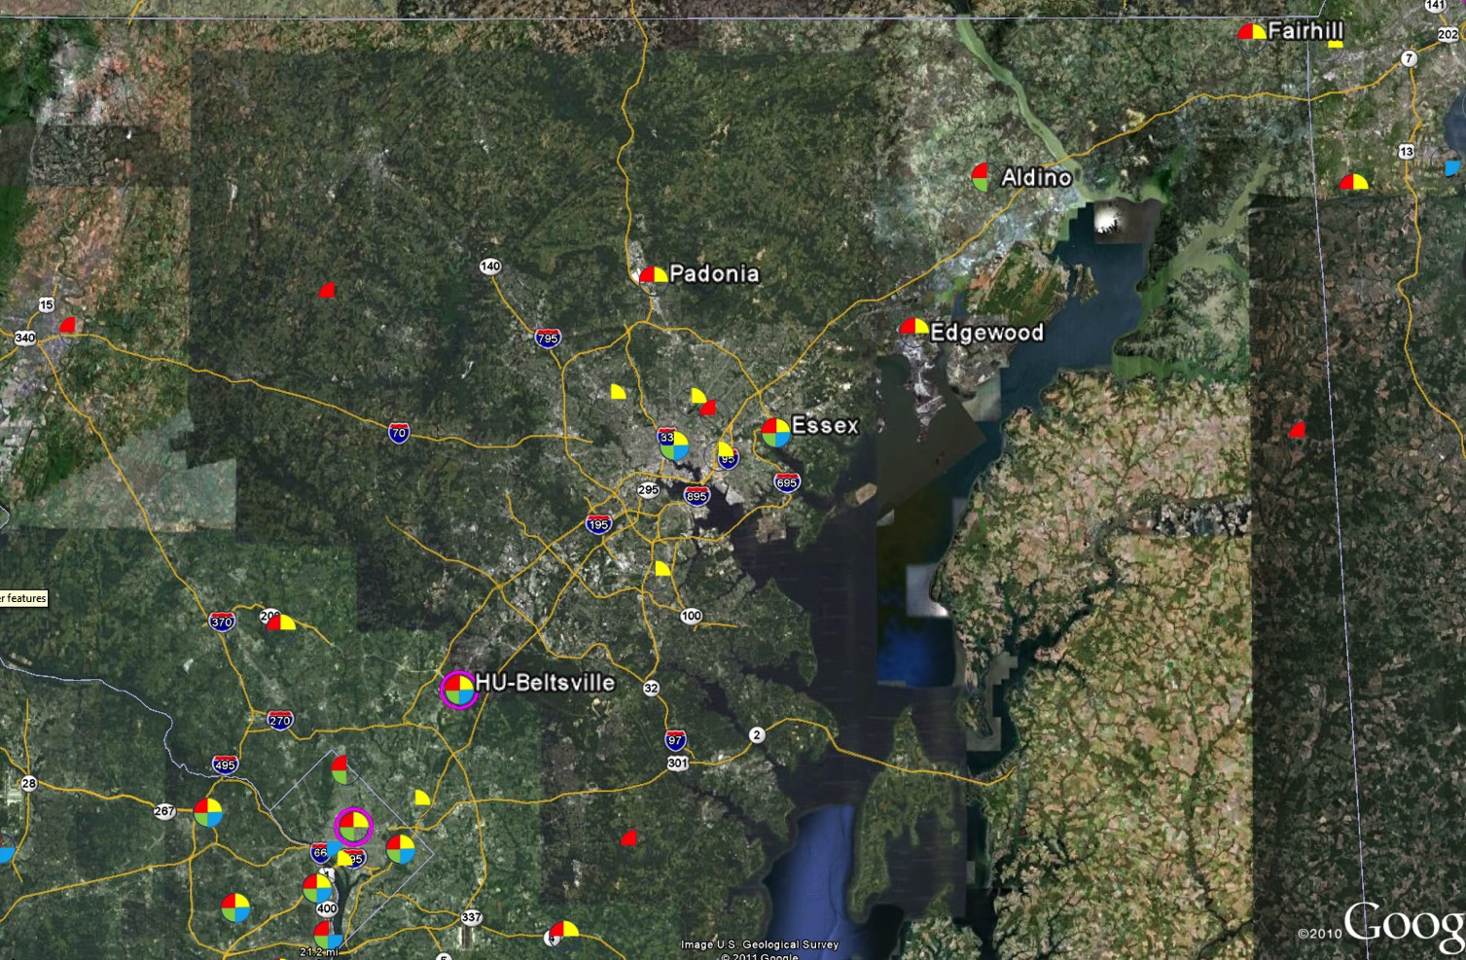
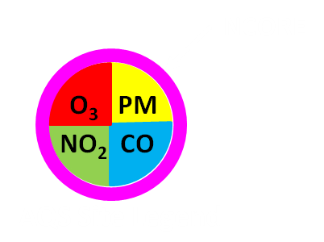
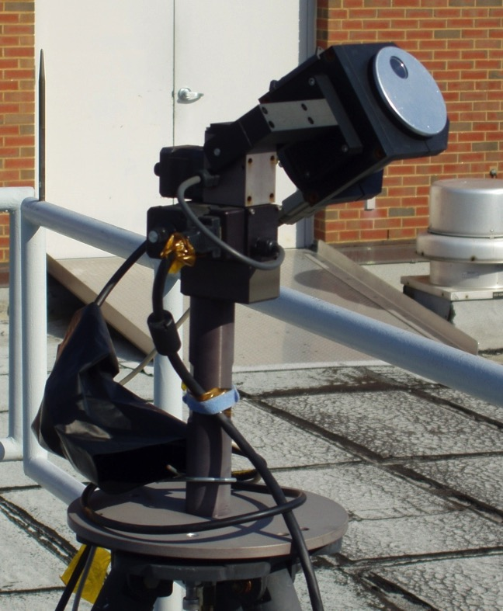
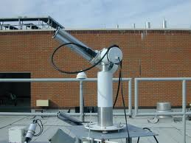
MDE sites form the backbone of the DISCOVER-AQ sampling strategy
Pandora spectrometer
Jay Herman, UMBC
Each site augmented with aerosol and trace gas remote sensors
Aeronet sunphotometer
Brent Holben, NASA GSFC
MDE Anchor Sites

Slide 70
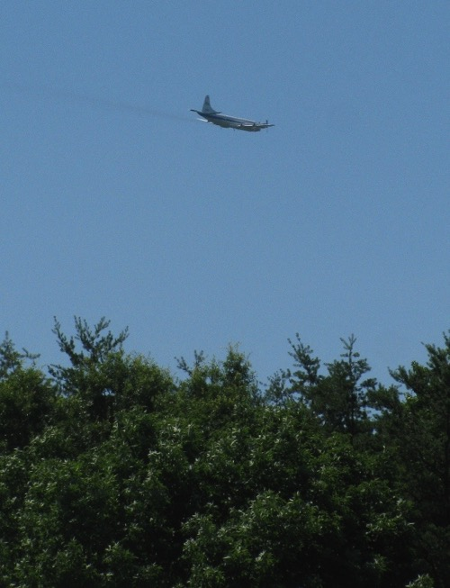
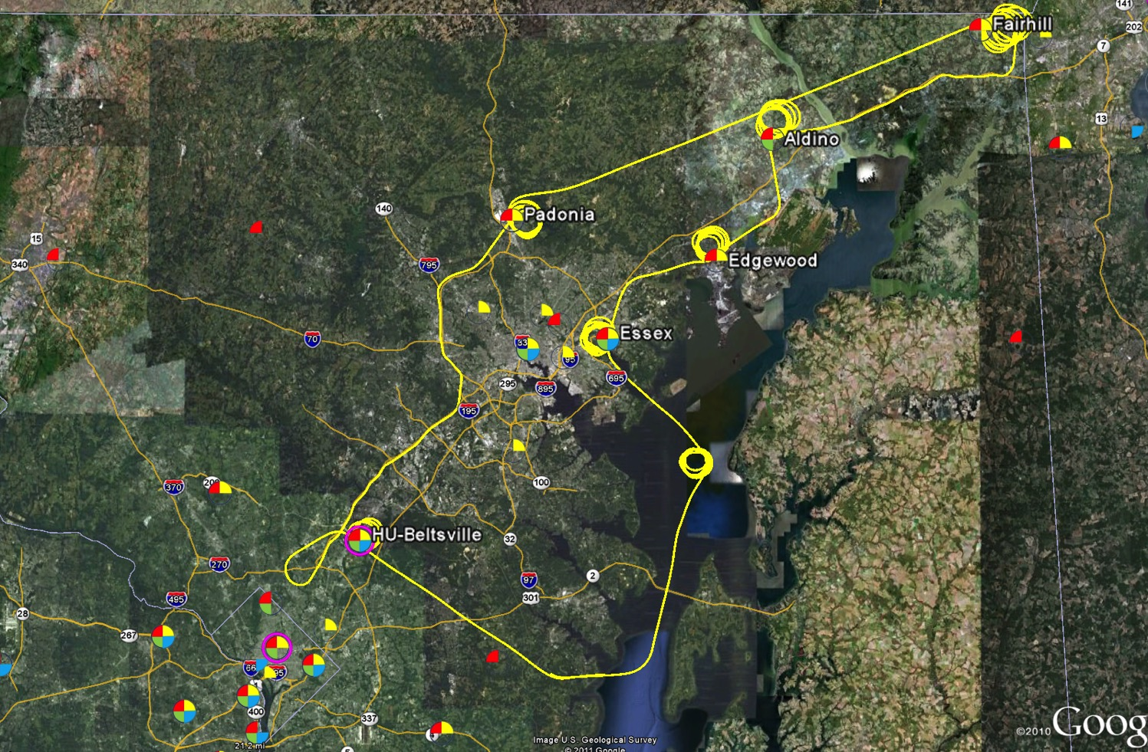



P-3B flights spiral over MDE sites
(typically 3 times per day, 2 hours apart)
P-3B In Situ Airborne Measurements
Bruce Anderson, NASA LaRC | aerosol optical, microphysical, and chemical properties
Andrew Weinheimer, NCAR | O₃, NO₂, NO, NO_{y}
Ronald Cohen, UC Berkeley | NO₂, ANs, PNs, HNO₃
Alan Fried, NCAR | CH₂O
Glenn Diskin, NASA LaRC | H₂O, CO, CH₄
Stephanie Vay, NASA LaRC | CO₂
Armin Wisthaler, Innsbruck | Non-methane hydrocarbons

Slide 71






UC-12 flies over ground sites 4-6 times per day
High Spectral Resolution Lidar (HSRL)
Chris Hostetler and Rich Ferrare, NASA LaRC
Airborne Compact Atmospheric Mapper (ACAM)
Scott Janz, NASA GSFC

