Slide 1
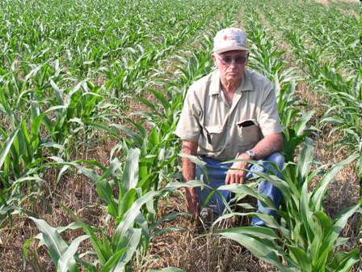
AOSC 620
The Global Biogeochemical Cycle of Nitrous Oxide, N₂O
Russell Dickerson
2019
History & Importance
Sources
Atmospheric Chemistry
Trends
Climate forcing
Societal significance
References.
1

Slide 2
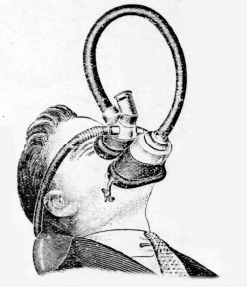
History of N₂O
Joseph Priestley in 1775 synthesized N₂O and called it phlogisticated nitrous air.
In the 1790’s, Humphry Davy and a group of friends including Samuel Taylor Coleridge inhaled the gas. They found that nitrous oxide dulls pain.
A. Adel (Astrophys J., 1939; 1941) was apparently the first to use the IR spectrum to discover and estimate the concentration of N₂O in the atmosphere.
In 1946 (Science) Adel suggested that escape from soil might be a main source of atmospheric N₂O.
He suggested in 1950 (Science) that the sink is photolysis to N₂, O₂, and NO at λ < 200 nm in the upper atmosphere. (The NO was a lab artifact.)
2
Notes:
Day after day, day after day,
We stuck, nor breath nor motion;
As idle as a painted ship
Upon a painted ocean.
Water, water, everywhere,
And all the boards did shrink;
Water, water, everywhere,
Nor any drop to drink.

Slide 3
History of N₂O, continued
Paul Crutzen 1970 suggested that N₂O is the main source of NO in the stratosphere where it destroys ozone.
Cicerone (JGR, 1989) “There are major unanswered questions about the sources of atmospheric N₂O.”
Prather et al. (2001) established that N₂O is almost 300 times more effective in climate forcing than an equivalent mass of CO₂.
Crutzen, P. J.: The influence of nitrogen oxides on the atmospheric ozone content, Q. J. Roy. Meteor. Soc., 96, 320–325, 1970.
3
Notes:
Saved the world for the first time.

Slide 4
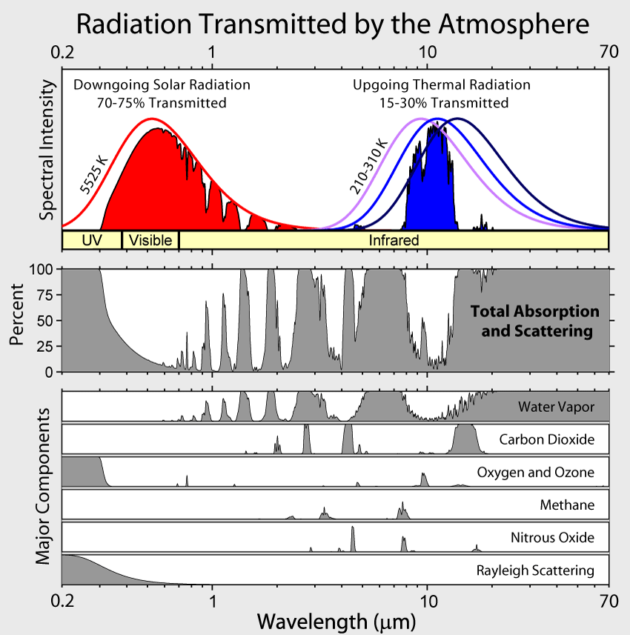
N₂O absorbs in the window region between CO₂ and H₂O.
4

Slide 5
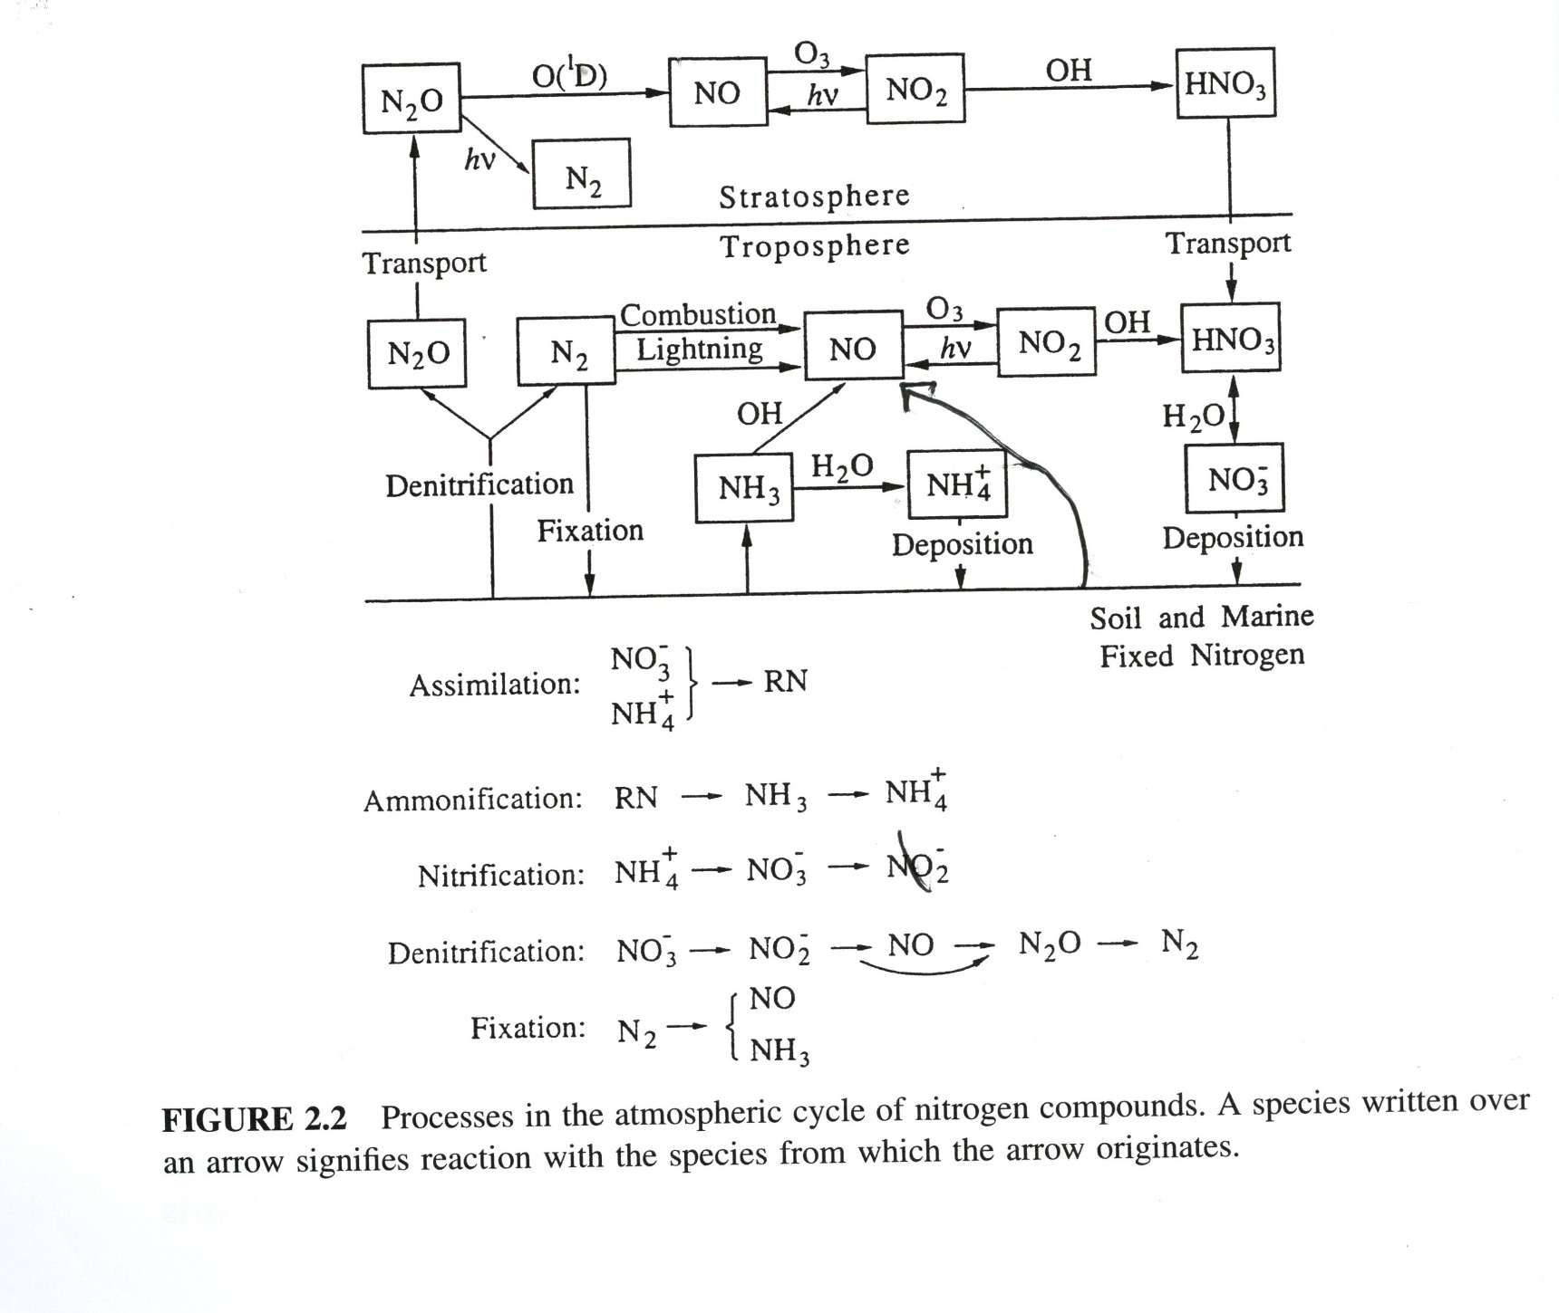
↑
→ NO↑ → NO₂¯ → NO₃¯
↑
↑
↑
From Seinfeld who got it from Stedman and Shetter.
Note error, nitrification goes from nitrite to nitrate.
5

Slide 6
Sources of N₂O
Denitrification proceeds primarily in anoxic (wet) soils. Thoroughly waterlogged soils release N₂ (the major source of molecular nitrogen in the atmosphere), but less wet soils release N₂O.
A small amount (<1%) of N applied as fertilizer is emitted directly into the atmosphere as N₂O. Another 3% arises as N is cycled through various media. Soil microbiology plays a major role. Fertilizers also inhibit the consumption of CH₄ by soils.
Conclusion: Fertilizer is essential for food production, but has far reaching adverse effects; wetlands are good for the Earth’s environment.
6

Slide 7
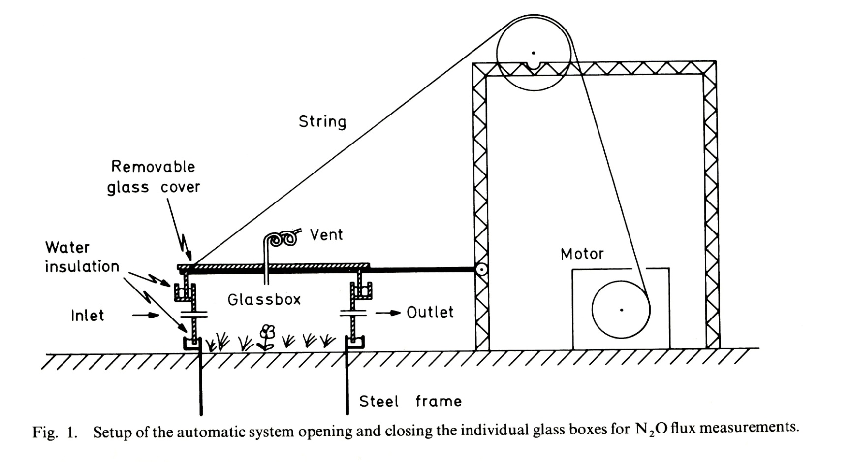
Measurement of direct emissions of N₂O from fertilized soils (Conrad et al., 1983)
Gas chromatography with e⁻ capture detection.

Slide 8
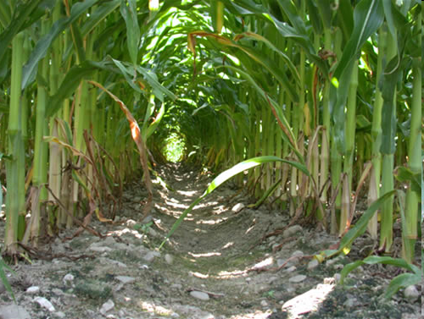
Conventional tillage no- till technique
Through the N cascade of air/land/water, ~4% of applied N fertilizer is released as N₂O and another 3% as NO.
No-tillage ag reduces CH₄, NO, and CO₂ emissions for soils, but increases N₂O emissions, at least in the short run.
Mosier et al., Nature, 1991; Civerolo and Dickerson, Ag. Forest Meteorol., 1998; Six, etal., Global Change Bio., 2004.
8

Slide 9
From IPCC (2007)

Slide 11
11

Slide 12
Sources of N₂O
How do we know that internal combustion cannot produce N₂O but biomass combustion can?
2N₂ + O₂ → 2N₂O (1)
2NO → N₂O + 1/2 O₂ (2)
Can either of these reactions proceed at combustion temperature?
ΔG₁ = 24.76 kcal/mole
ΔH₁ = 19.49 kcal/mole
ΔG₁ = ΔH₁ –TΔS₁
The formation of N₂O from air involves a decrease in entropy
(ΔS₁ = – 0.0177 kcal/moleK) so ΔG becomes more positive at higher temps.
Lets try Reaction 2
ΔG₂ = 24.76 - (2x20.72) = -16.68 kcal/mole
ΔH₂ = 19.49 - (2x21.60) = -23.71 kcal/mole
ΔS₂ = -0.136 kcal/mole
Even starting with a lot of NO doesn’t help.
12

Slide 13
Sources of N₂O
Can biofuel combustion produce N₂O?
Fossil fuel contains little organic N, but in plants N is tied up as proteins, roughly equivalent to CH₃-NH₂
2CH₃-NH₂ + 5O₂ → N₂O + 2CO₂ + 5H₂O (3)
ΔG₃ = 24.76 – 2*(94.26) – 5*(54.64) – 2*(6.6) = – 450.16 kcal/mole
ΔH₃ = 19.49 – 2*(94.05) – 5*(57.8) –2(-6.7) = –444.21 kcal/mole
The formation of N₂O from organic nitrogen involves an increase in entropy so ΔG becomes more negative at higher temps.
CO₂ uptake offset by N₂O release?
13

Slide 14
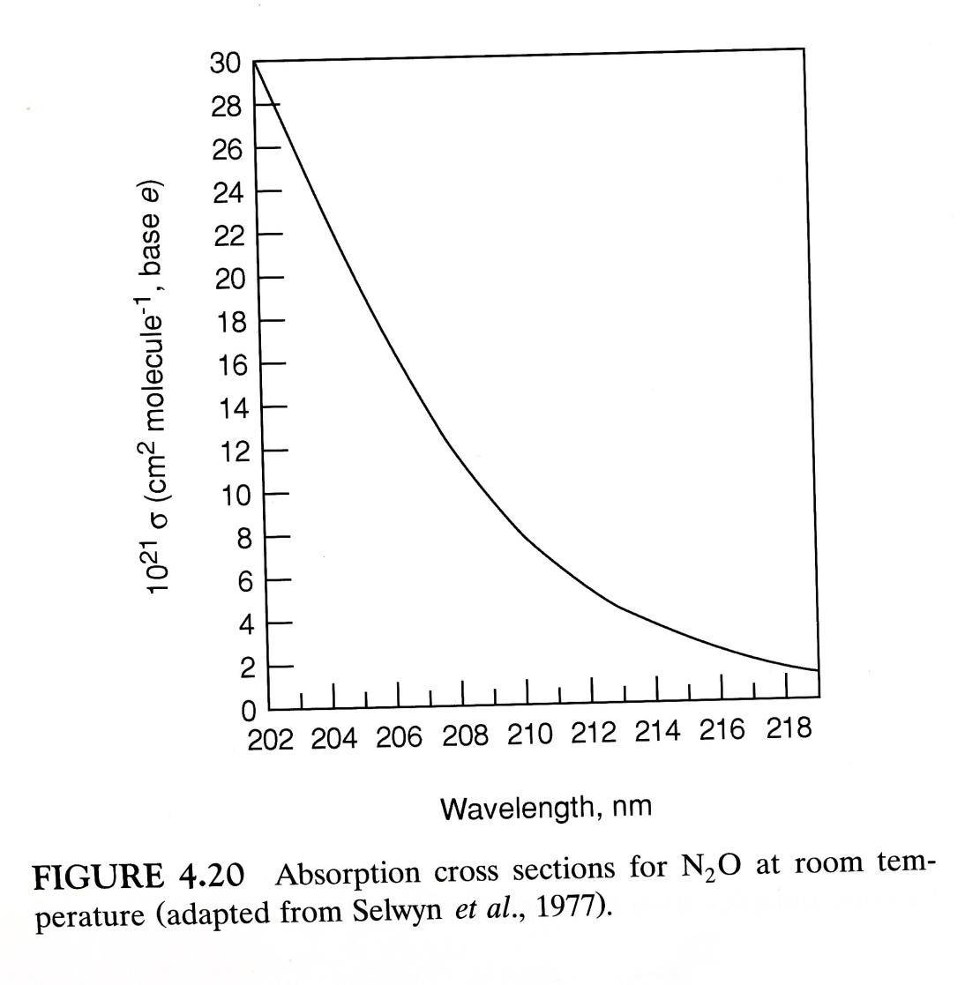
Atmospheric Chemistry of N₂O
Troposphere: None!
[N₂O] ~ 300 ppb
Northern Hemispheric N₂O ~1 ppb > Southern Hemispheric N₂O.
Stratosphere:
1. Photolysis N₂O + hν → N₂ + O(¹D)
Only energetic UV radiation can photolyze N₂O.
14

Slide 15
Atmospheric Chemistry of N₂O
Stratosphere:
Photolysis N₂O + hν → N₂ + O(¹D)
Oxidation N₂O + O(¹D) → 2NO (a)
        → N₂ + O₂ (b)
What is the yield (Φ) of NO?
Production of NO/N₂O molecule = 2R_{2a} /(R₁+R_{2a}+R_{2b})
Φ_{NO} = 2k_{2a}[O¹D]/(j_{N2O} + (k_{2a}+k_{2b})[O¹D])
Yield is about 0.11 molecules NO per molecule of N₂O.
Main source of O(¹D) is ozone photolysis O₃ + hν → O₂ + O(¹D)
The steady state concentration of O(¹D) establishes the lifetime of N₂O reported in the literature as120 yr.
15

Slide 16
Atmospheric Chemistry of N₂O
Main source of O(¹D) is ozone photolysis
3. O₃ + hν → O₂ + O(¹D)
The steady state concentration of O(¹D) establishes the lifetime of N₂O.
The transition from O(¹D) to O(³P) is spin forbidden, therefore O(¹D) has a long lifetime wrt photo emission. The main sink is quenching by N₂ or O₂.
4. O(¹D) + M → O(³P) + M
The steady state concentration of O(¹D) is determined by the balance of these production and loss terms, where square brackets represent molecular number density.
[O(¹D)]_{ss} ≈ (j₃[O₃]) / (k_{4O2}[O₂]+k_{4N2}[N₂])
16

Slide 17
Atmospheric Chemistry of N₂O
The steady state concentration of O(¹D) establishes the lifetime of N₂O.
[O(¹D)]_{ss} = (j₃[O₃]) / (k_{4O2}[O₂]+k_{4N2}[N₂])
At 45º N and 30 km altitude j_{N2O} ≈ 5 x 10⁻⁸ s⁻¹ and j_{O3} ≈ 1.5 x 10⁻⁴ s⁻¹.
[O(¹D)]_{ss} ≈ 45 cm⁻³
The lifetime of N₂O at 30 km altitude, at noon on the equinox is
1 / (j_{N2O}+ k₂ * [O(¹D)]_{ss}) = 1 / {(5 * 10⁻⁸ + 11.6x10⁻¹¹)*[45]}
= 1.81x10⁷ s =1/2 yr.
Using 24 hr averages yields ~1.0 yr. Only about 1% of the atmosphere is above 30 km, so the full atmospheric lifetime is ~100 yr.
17

Slide 18
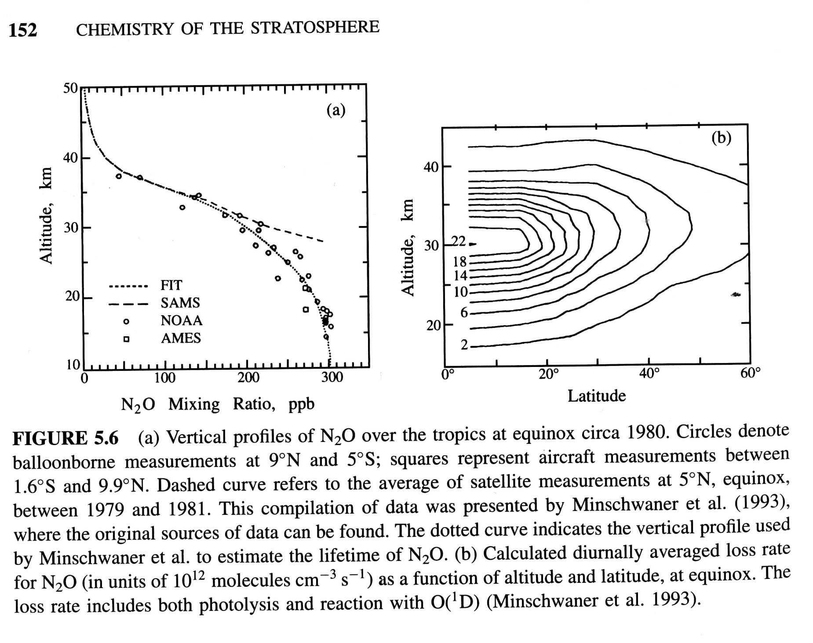
18

Slide 19
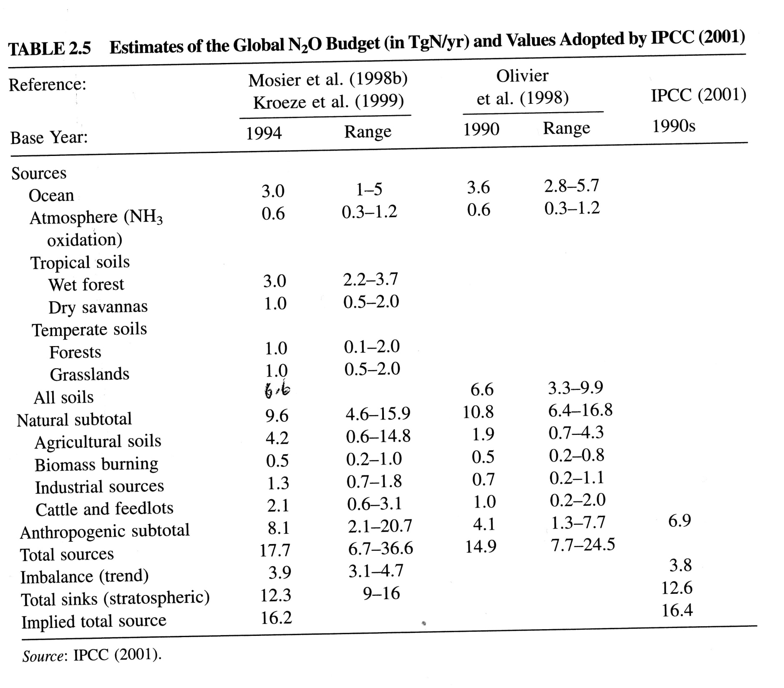
6.0
19

Slide 20
N₂O sources (IPCC, 2007)

Slide 21
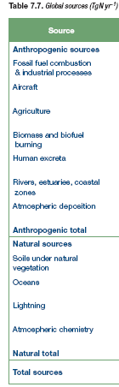
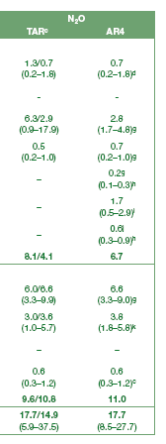
From IPCC, 2007

Slide 22
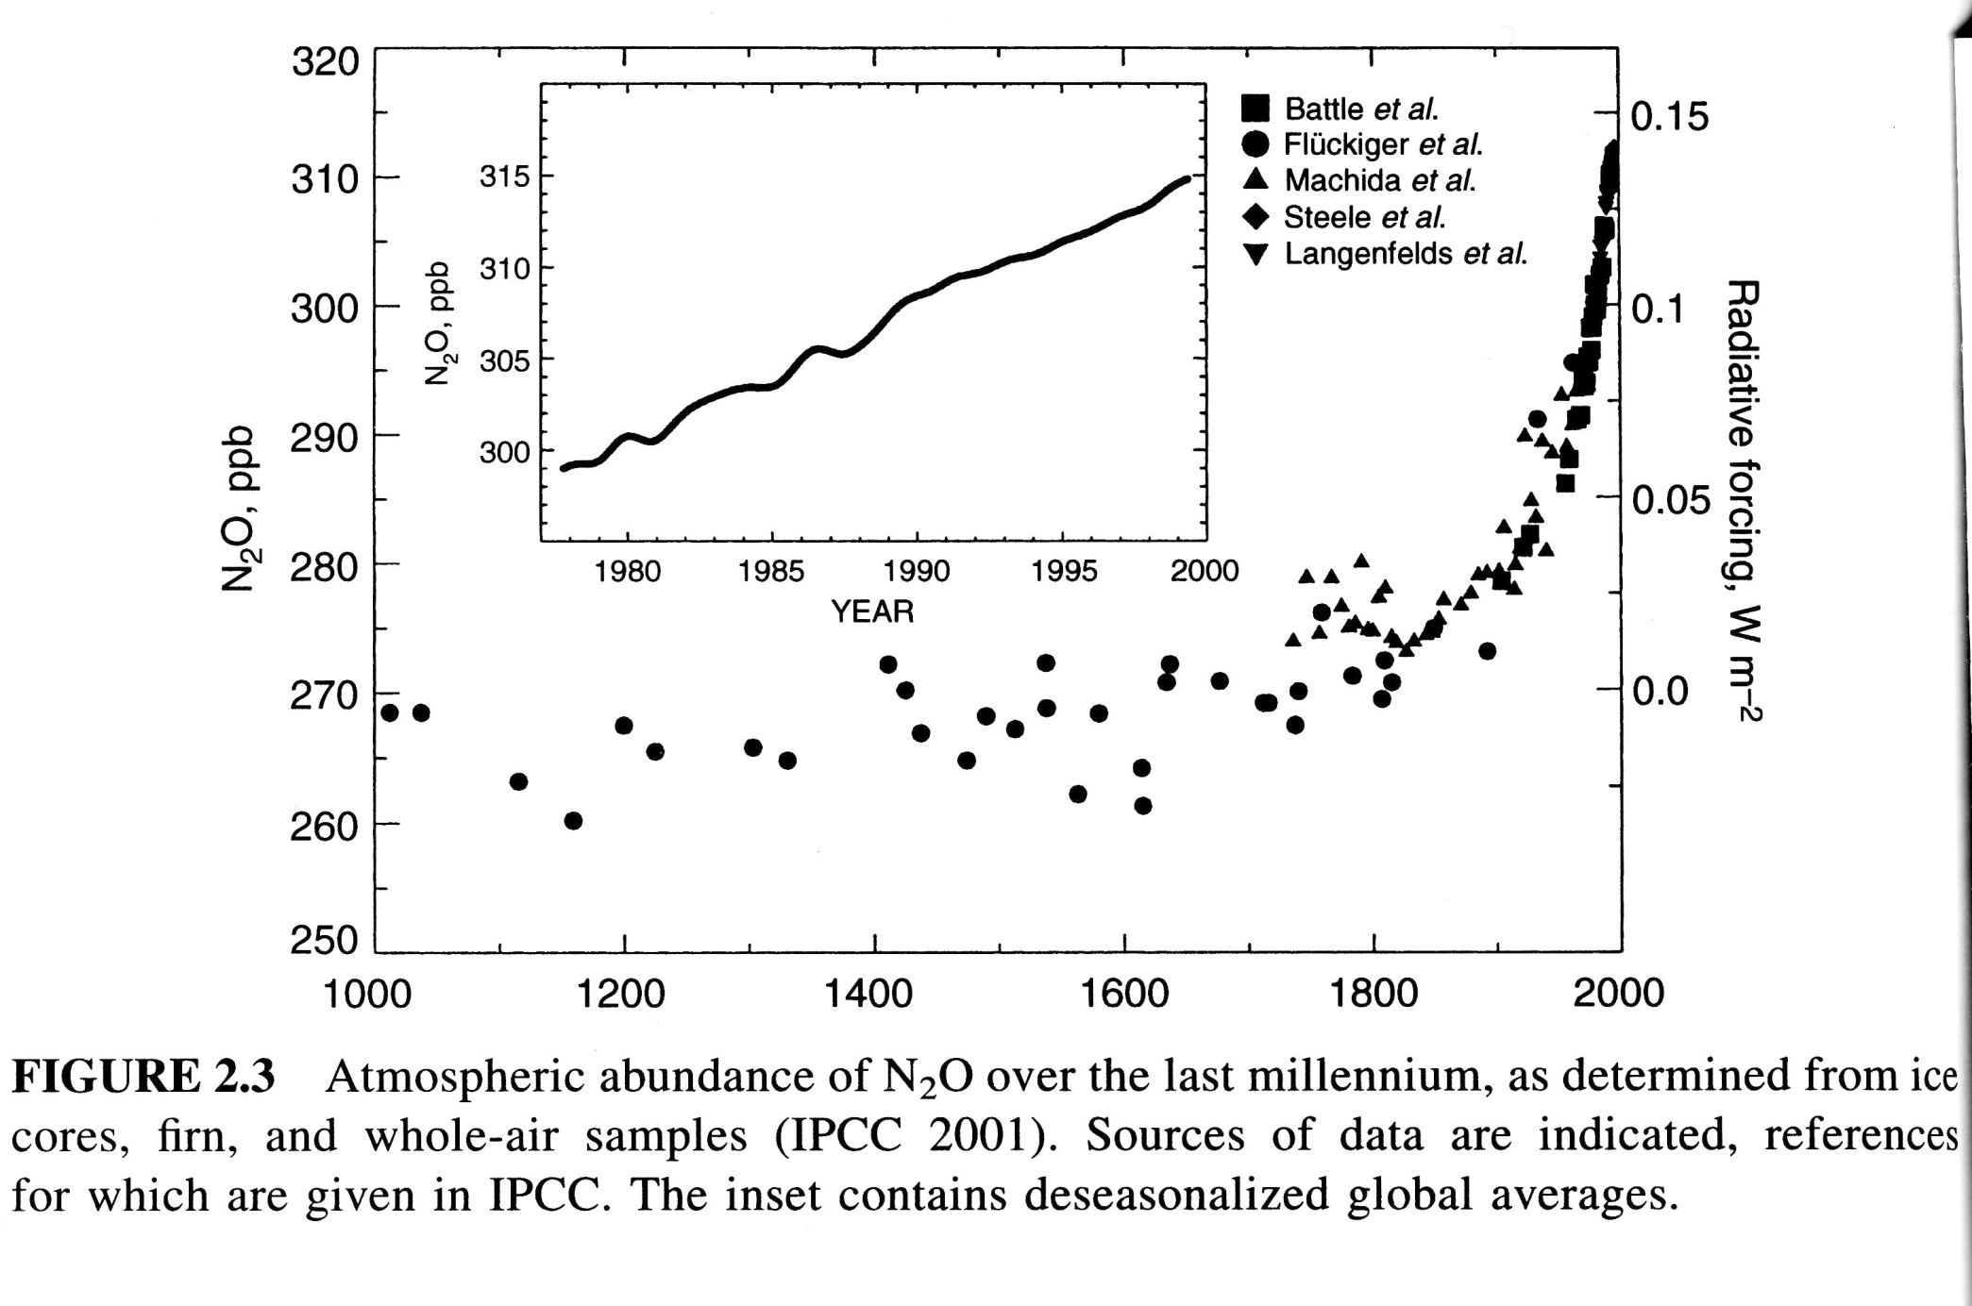
22

Slide 23
Societal Impacts
Crutzen et al. (Atmospheric Chemistry and Physics, 2008) suggest, through a mass balance argument, that 3-5% of N applied as fertilizer to agricultural soils ends up as N₂O.
This negates any benefit from biodiesel in terms of climate forcing.
Serious dilemma – food or climate?
23

Slide 24
References
Wallace and Hobbs Chapter 5.
Finlayson-Pitts and Pitts Chapters 4 & 12
Seinfeld and Pandis Chapters 2 & 5
Crutzen, P. J., A. R. Mosier, K. A. Smith, and W. Winiwarter (2008), N₂O release from agro-biofuel production negates global warming reduction by replacing fossil fuels, Atmospheric Chemistry and Physics, 8, 389-395.
Duce, R. A., et al., (2008), Impacts of atmospheric anthropogenic nitrogen on the open ocean, Science, 320, 893-897.
The Evolution and Future of Earth's Nitrogen Cycle, Canfield, D.E.; Glazer, A. N.; Falkowski, P. G. SCIENCE, 330(6001), 192-196, 2010.
Non-CO₂ greenhouse gases and climate change. Montzka, S. A.; Dlugokencky, E. J.; Butler, J. H. NATURE,476(7358), 43-50, 2011.
Nitrous oxide emission from denitrification in stream and river networks Beaulieu, Jake J.; Tank, Jennifer L.; Hamilton, Stephen K.; et al. PROCEEDINGS NATIONAL ACADEMY OF SCIENCES OF THE UNITED STATES OF AMERICA ,108, 1, 214-219, 2011.
Paustian, K. et al. Climate-smart soils NATURE 2016.

