Slide 1
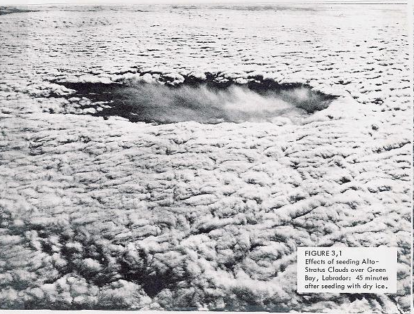
AOSC 620
Cloud Nucleation
Russell Dickerson
2019
Rogers and Yau, Chapt. 6
Salby Ch. 9 (thin)

Slide 2
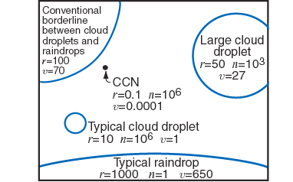
Let’s get quantitative.
r = radius in 𝜇m v = fall velocity cm/s n = No/liter

Slide 3
Phase Change &
Nucleation Process
(inhibited by surface tension)
Condensation
Vapor
Liquid
Evaporation
Deposition
Vapor
Solid
Sublimation
Freezing
Liquid
Solid
Melting

Slide 4
Condensation
In theory, a cloud droplet may not be formed until pure water vapor is over saturated by a few hundreds per cent.
In nature, super-saturation rate rarely exceeds a few tenths per cent.
The reason lies in the presence of plentiful of water cloud nuclei.

Slide 5
Deposition
In theory, a cloud droplet may be frozen at a temperature at 0 ºC.
In nature, super-cooled water droplets of temperature well below the freezing point are often observed.
The reason lies in the lack of ice water cloud nuclei.

Slide 6
The coverage of this lecture
Derivation of equilibrium water vapor pressure for a small droplet of pure water vs. pure bulk water;
-Homogenous nucleation
Derivation of equilibrium water vapor pressure for a small droplet of solution water vs. pure water.
-Heterogeneous nucleation
Aerosols and CCN

Slide 7
Questions to be addressed:
How is an embryonic cloud droplet formed and maintained?
Why do cloud droplets have a narrow range in size?
How can a cloud exist for certain period of time?

Slide 8

* Surface tension (𝜎) = work required to increase surface area by one unit.
* Store potential energy.
* Volume of liquid tends to assume minimum area-to-volume.
* Small masses → Spherical droplets.
Homogeneous Nucleation
For a droplet to form by condensation from the vapor, the surface tension, σ, must be overcome by a strong gradient of vapor pressure.
The Clausius-Claperon equation describes the equilibrium condition for bulk water and its vapor; this does not apply to small droplet.

Slide 9
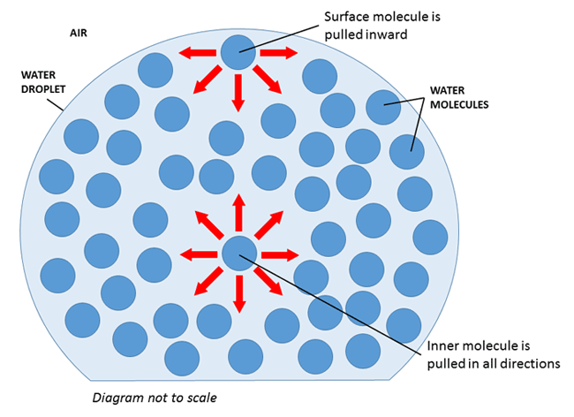
Surface tension

Slide 10
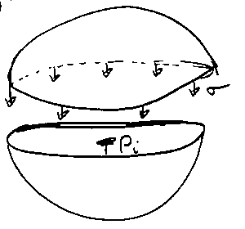

Slide 12
Surface tension causes internal pressure
The surface tensions for a solute is lower than that of pure water by up to one-third – attributed to dissolved organics or ions.

Slide 13
Derivation of the Kelvin (1870) Equation
- Curvature effect on saturation
Surface energy associated with curved surface has impact on equilibrium vapor pressure and rate of evaporation.
Let equilibrium vapor pressure over a flat surface be e_{s}.
And over a curved surface be e_{sr}.
Consider droplet in equilibrium with environment, temperature = T and vapor pressure = e_{c}

Slide 14
Remember
dq = du + pdv

Slide 19
Kelvin’s Equation, R&Y Eq 6.1; Salby 9.8

Slide 20
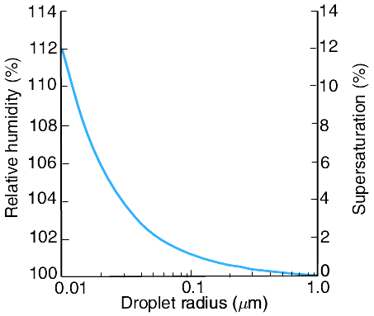

The relative humidity and supersaturation (both with respect to a plane surface of pure water) for pure water droplets.

Slide 21
An embryonic cloud droplet (molecular cluster) can be formed by collision of water vapor molecules. Once it exists, it may grow or decay depending on ambient water vapor pressure.
S = e/e_{s}(∞).
e>e_{sr,} the droplet tends to grow,
e<e_{sr,} the droplet tends to decay.
So, the droplet must be big enough for it to endure.
We will show (Salby Eq. 9.9) that the critical radius (S is supersaturation) is:

Slide 22
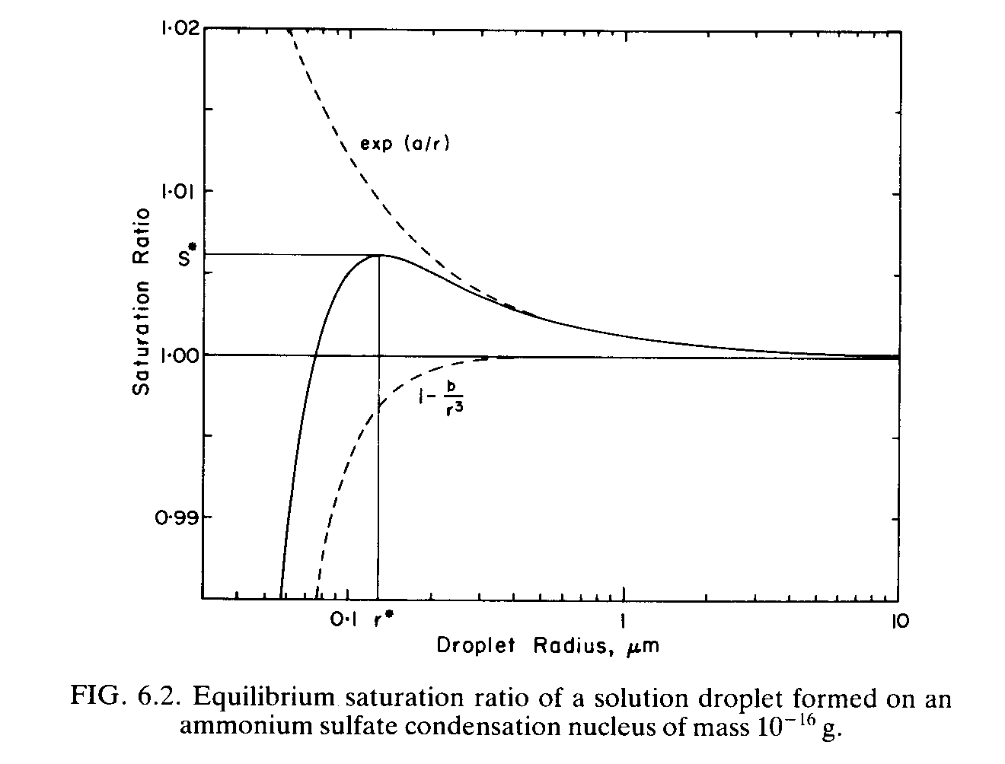
Kelvin Curve➔
Köhler curve
S* - critical saturation ratio
r* - critical radius
Haze ←
→ Activated nucleus

Slide 23

Fair Weather Cumulus
Fair weather cumulus
1 pm EST July 7, 2007,
a smoggy day

Slide 24
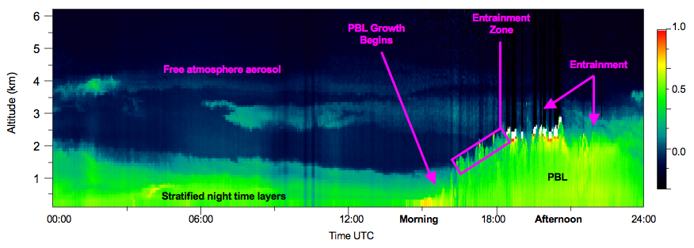
MPLNET Level 1 Signals: GSFC May 3, 2001
Uncalibrated Attenuated Backscatter (km sr)-1
1.0
0.5
0.0

Slide 25
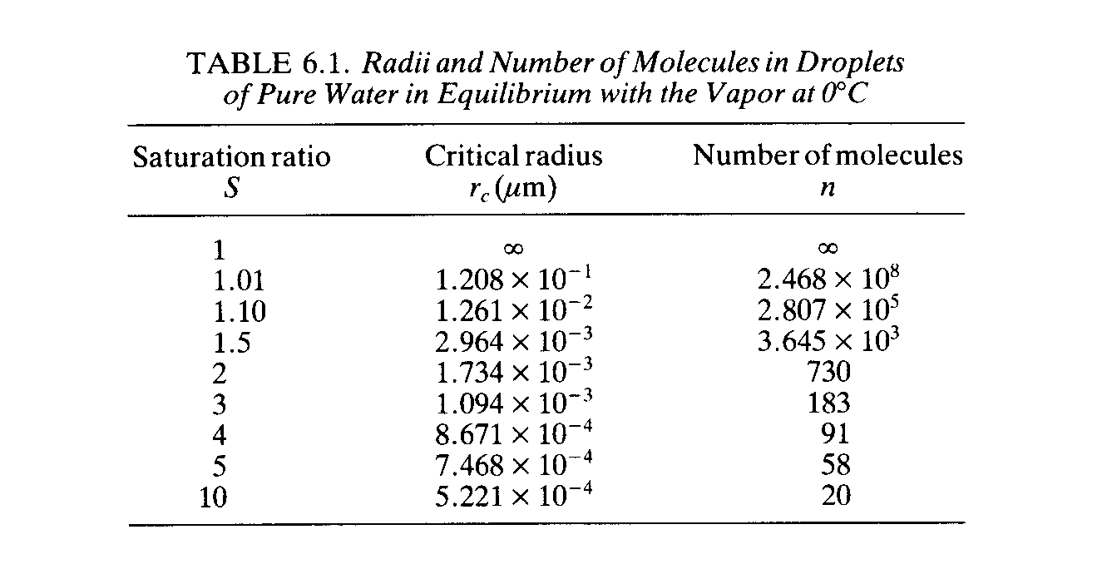

Slide 27
Köhler Equation -
soluble

Slide 28
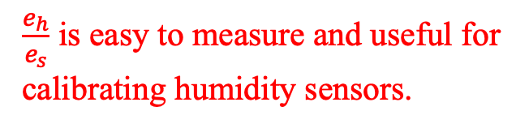
$\frac{e_{h}}{e_{s}}$ is easy to measure and useful for
calibrating humidity sensors.

Slide 29
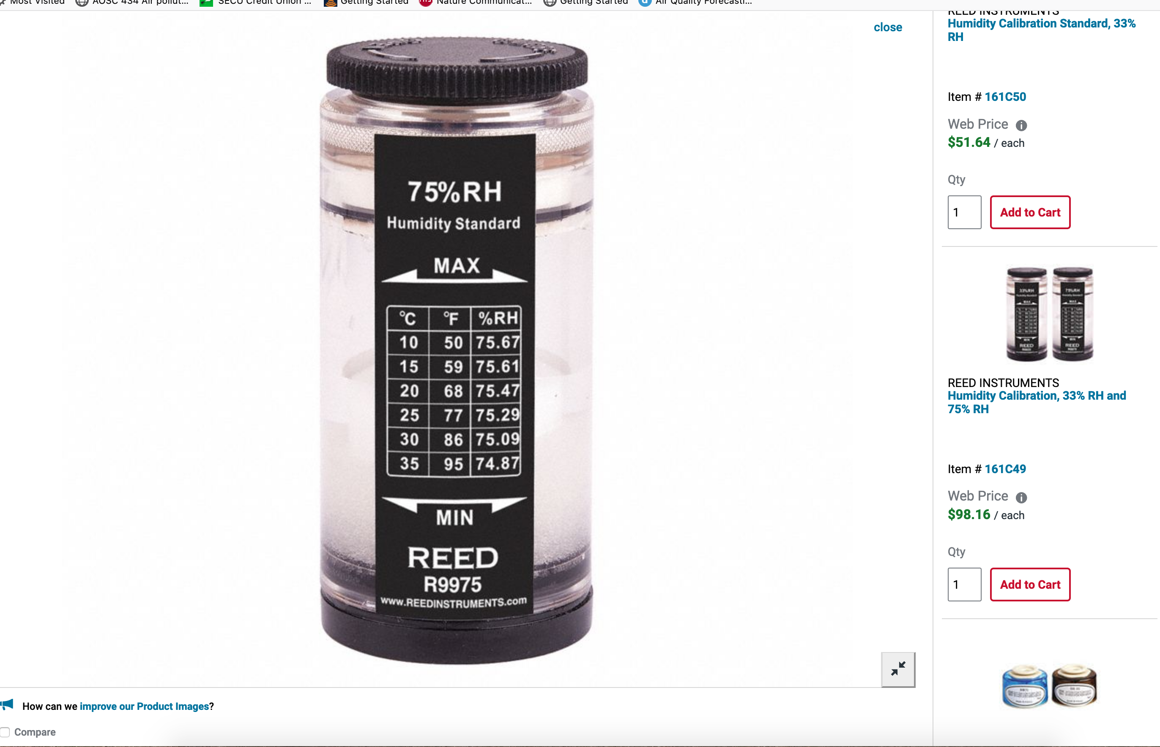

Slide 30
Eq vap press plane soln/
Eq vap press pure water

Slide 31
M* Mole fraction of water in the solution

Slide 32
i = 2 for NaCl, 3 for H₂SO₄ etc.

Slide 33
For salt water at 35 g/L
M* ~ 0.98

Slide 34
For a sphere
𝜌 salt water = 1.024 g cm ⁻³

Slide 35
K

Slide 37
Kelvin Curve
Köhler Curve

Slide 39
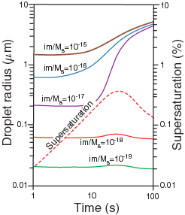
Theoretical computations of the growth of cloud condensation nuclei by condensation in a parcel of air rising with a speed of 60 cm s⁻¹. A total of 500 CCN cm⁻³ was assumed with im/Ms values as indicated; m the mass of material dissolved in the droplet, M_{s} the molecular weight of the material, and i its van't Hoff factor. Note how the droplets that have been activated (brown, blue and purple curves) approach a monodispersed size distribution after just 100 s.
From W&H Ch. 6.
Notes:
i = van’t Hoff factor is the number of ions formed.
m = mass

Slide 41


Slide 42
Questions on the Effects of Aerosols on Clouds and Precipitation
● Why do many people think aerosols inhibit deep convective cloud formation?
Copyright © 2010 R. R. Dickerson & Z.Q. Li
42

Slide 43
Opposing Effects of Aerosols on Clouds and Precipitation
● How do radiative and micro-physical effects of aerosols compete?
How does suppression of precp change buoyancy?
How does freezing change buoyancy?
Copyright © 2010 R. R. Dickerson & Z.Q. Li
43

Slide 44
Opposing Effects of Aerosols on Clouds and Precipitation
● How do radiative and micro-physical effects of aerosols compete?
How does suppression of precp change buoyancy?
negative impact.
How does freezing change buoyancy?
a) if normal precp then freezing enhances buoyancy.
b) If suppressed precp (too many ccn) then freezing generates even more buoyancy.
Copyright © 2010 R. R. Dickerson & Z.Q. Li
44

Slide 45
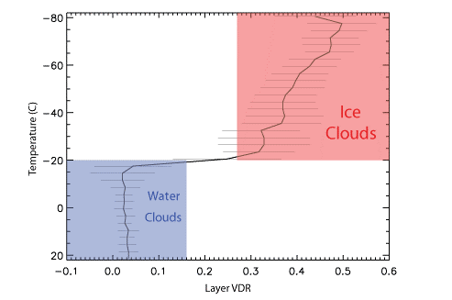
Liquid Water Cloud VDR Yorks et al., 2011
Notes:
VDR between 0.03 and 0.07 (theoretically should be 0.0)
Cross-talk from CPL receiver system induces error
VDR only changes by 0.04 over 40 C

Slide 46
Opposing Effects of aerosols on Clouds and Precipitation
(Rosenfeld et al., Science 2008)
Radiative Effects:
● Aerosols aloft shield the Earth’s surface from radiation and stabilize the atmosphere wrt convection and the moisture is advected away. (Park et al., JGR, 2001; Ramanathan et al., Science, 2001)
● Increased numbers of CCN slow the conversion of droplets into raindrops and inhibit precipitation, but ingestion of large particles such as sea salt appears to enhance precip. (Radke et al., Science, 1989; Rosenfeld et al., Science, 2002)
● Total water vapor is conserved so suppression of precip here means more rain there.

Slide 47
The Rain according to Rosenfeld (microphysical effects)
● The extra CCN in hazy air make for more, smaller droplets in the early stages of a convective cloud.
● The smaller droplets travel higher and more reach colder levels where they are more likely to release latent heat of freezing and increase buoyancy – haze means more instability for the same amount of rain.
● Even though aerosols slow the conversion of cloud droplets into rain drops, convection is eventually invigorated.
● With cold-based clouds (< 0 ºC) most of the water is frozen already and there is no enhancement of precip.

Slide 48
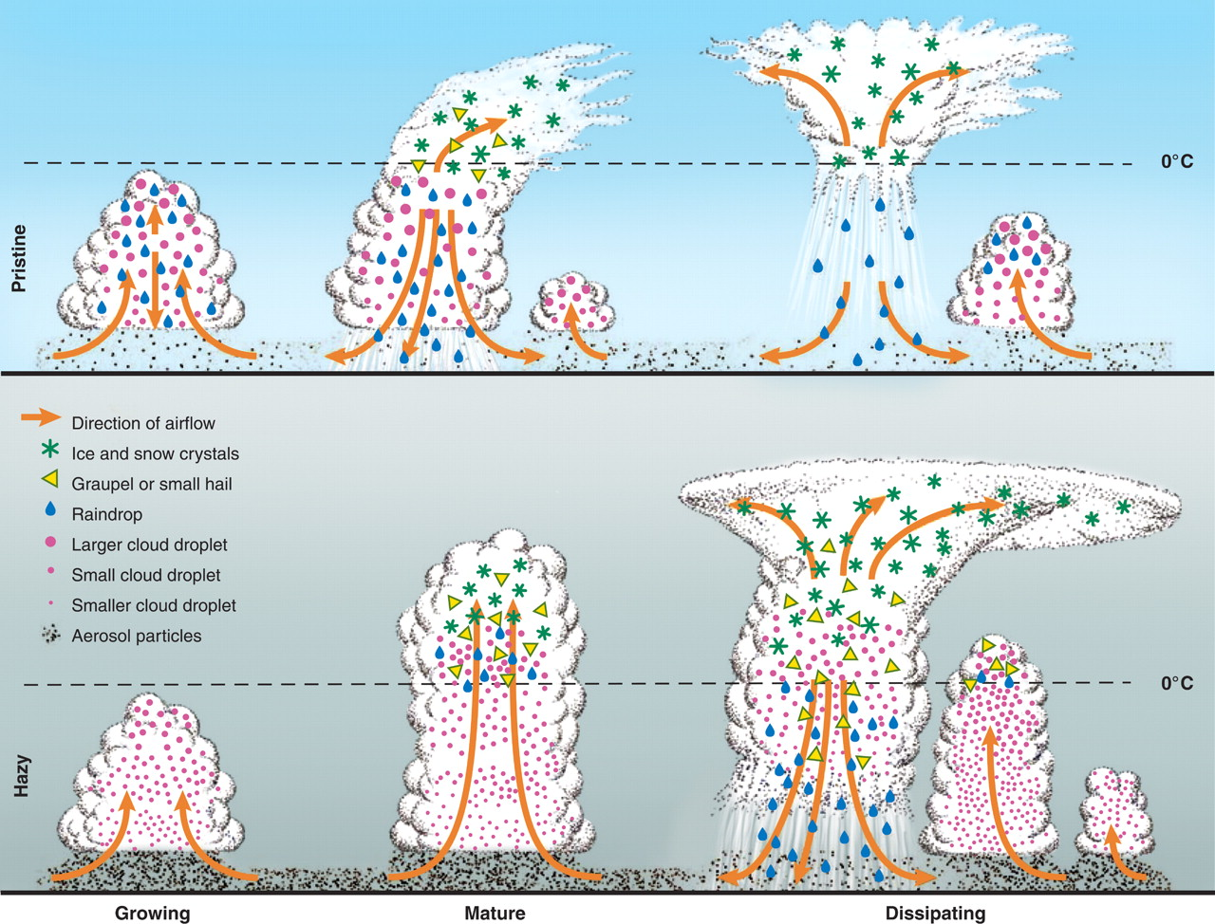

Fig. 2. Evolution of deep convective clouds developing in the pristine (top) and polluted (bottom) atmosphere
Published by AAAS
D. Rosenfeld et al., Science 321, 1309 -1313 (2008)
Notes:
Fig. 2. Evolution of deep convective clouds developing in the pristine (top) and polluted (bottom) atmosphere. Cloud droplets coalesce into raindrops that rain out from the pristine clouds. The smaller drops in the polluted air do not precipitate before reaching the supercooled levels, where they freeze onto ice precipitation that falls and melts at lower levels. The additional release of latent heat of freezing aloft and reabsorbed heat at lower levels by the melting ice implies greater upward heat transport for the same amount of surface precipitation in the more polluted atmosphere. This means consumption of more instability for the same amount of rainfall. The inevitable result is invigoration of the convective clouds and additional rainfall, despite the slower conversion of cloud droplets to raindrops (43). [View Larger Version of this Image (344K JPEG file)]

Slide 49
Wet (Pseudo-Adiabatic) Parcel Theory (no mixing).
● If all the water in excess of the saturation vapor pressure immediately condenses and precipitates out, then buoyancy is zero all the way up; this is the reference for CAPE calculations.
● If all the water is held in the cloud, then buoyancy becomes more negative with altitude.
● If all the water in excess of the saturation vapor pressure immediately condenses and freezes at T < – 4ºC then buoyancy is enhanced.
● If precip is suppressed until the parcel reaches T = – 4ºC then buoyancy is enhanced further.
The following figure shows an example with the LCL at 960 hPa and 22ºC.

Slide 50
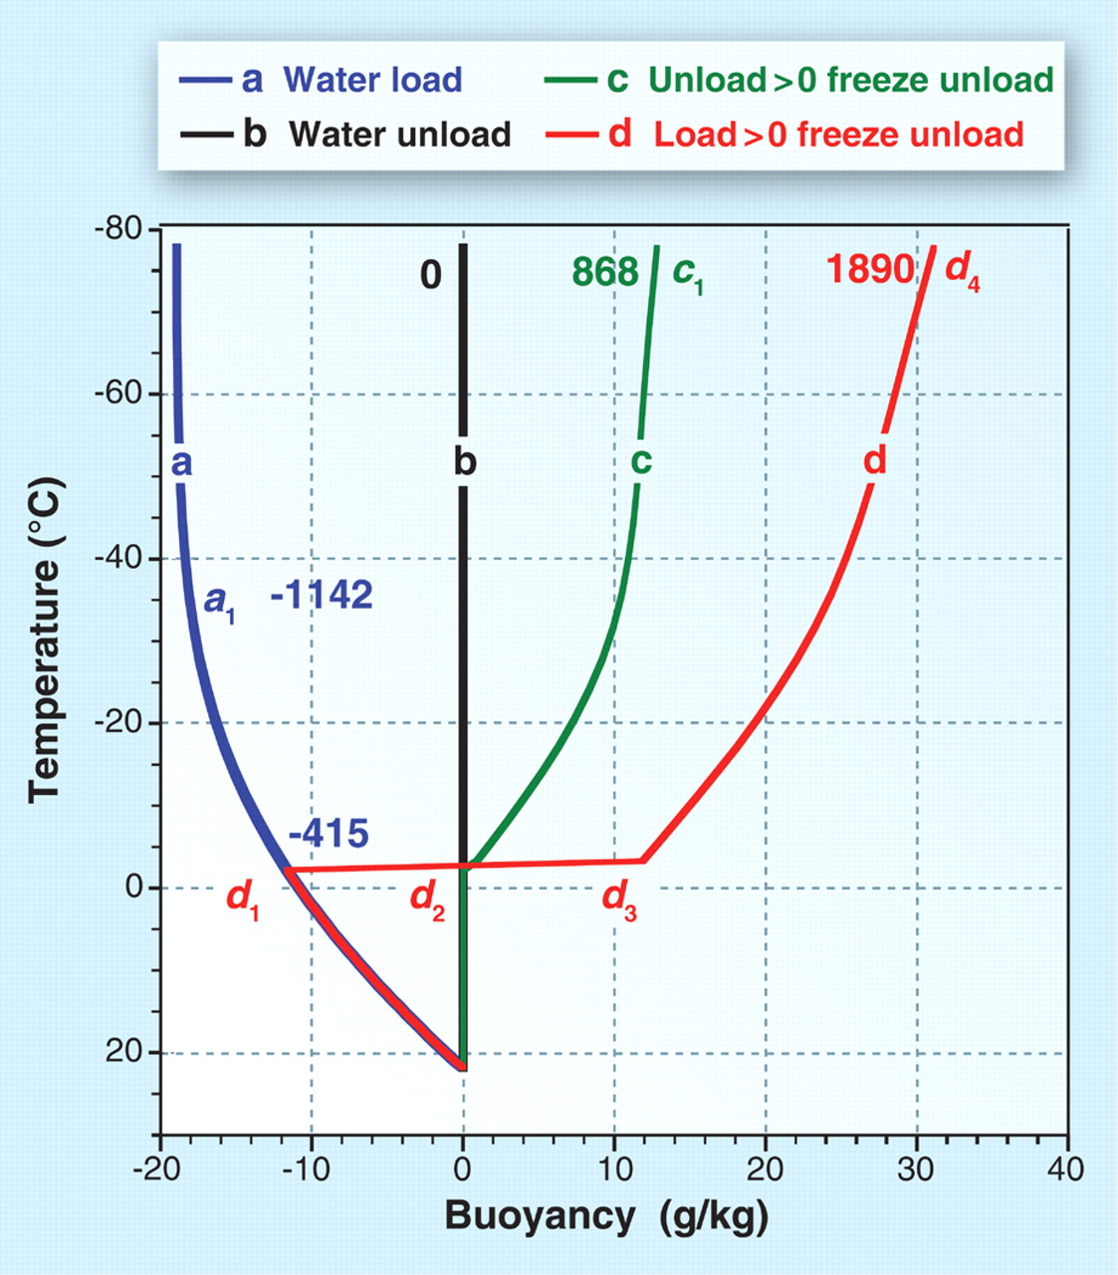
Fig. 3. The buoyancy of an unmixed adiabatically raising air parcel
Energy released in J kg⁻¹.
no precp.→
⬅All precp frozen
suppressed precp.→
←Cloud base
Published by AAAS
D. Rosenfeld et al., Science 321, 1309 -1313 (2008)
Notes:
Fig. 3. The buoyancy of an unmixed adiabatically raising air parcel. The zero-buoyancy reference is the standard parcel: liquid water saturation, immediately precipitating all condensates without freezing (vertical line b). Cloud base is at 22°C and 960 hPa. The buoyancy of the following scenarios is shown: (a) suppressing rainfall and keeping all condensed water load, without freezing; (b) precipitating all condensed water, without freezing; (c) precipitating all condensates, with freezing at T < –4°C; (d) Suppressing precipitation until T = –4°C, and then freezing and precipitating all condensed water above that temperature. The released static energy (J kg–1) with respect to reference line b is denoted by the numbers. Too many ccn causes parcel to follow red track d.

Slide 51
Who wins – radiation or microphysics?
Particles in the accumulation mode with a diameter around 500 nm are most effective at increasing AOT, but CCN can be almost any size – it is the number that matters.
Does CCN correlate with AOT?

Slide 52
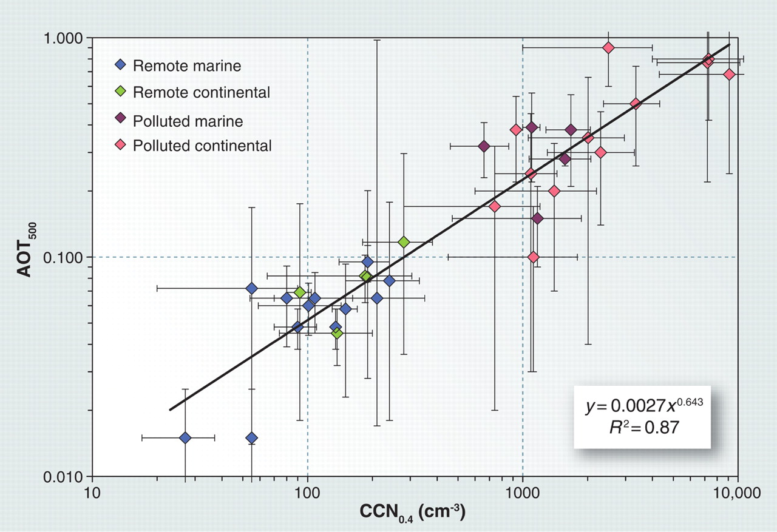
Fig. 1. Relations between observed aerosol optical thickness at 500 nm and CCN concentrations at supersaturation of 0.4% from studies where these variables have been measured simultaneously, or where data from nearby sites at comparable times were available
Published by AAAS
D. Rosenfeld et al., Science 321, 1309 -1313 (2008)
Notes:
Fig. 1. Relations between observed aerosol optical thickness at 500 nm and CCN concentrations at supersaturation of 0.4% from studies where these variables have been measured simultaneously, or where data from nearby sites at comparable times were available. The error bars reflect the variability of measurements within each study (standard deviations or quartiles). The equation of the regression line between aerosol optical thickness (y) and CCN0.4 (x) is given by the inset expression; R is the correlation coefficient. The aerosols exclude desert dust. [Adapted from (Andreae, 2008)]

Slide 53
Who wins – radiation or microphysics?
● From this empirical relationship we can estimate the number of CCN as a function of AOT.
● If the count of CCN is 10⁴ cm⁻³ then AOT ~ 1.0 and radiation reaching the Earth’s surface is reduced by an e-folding.
● CAPE reaches a maximum at CCN ~ 1200 cm⁻³ (AOT ~ 0.25) ; adding more aerosols will inhibit convection.
Bell (GSFC) et al., (JGR, 2008; “Why do tornados and hailstorms rest on weekends?” 2011) showed a weekday/weekend effect.

Slide 54
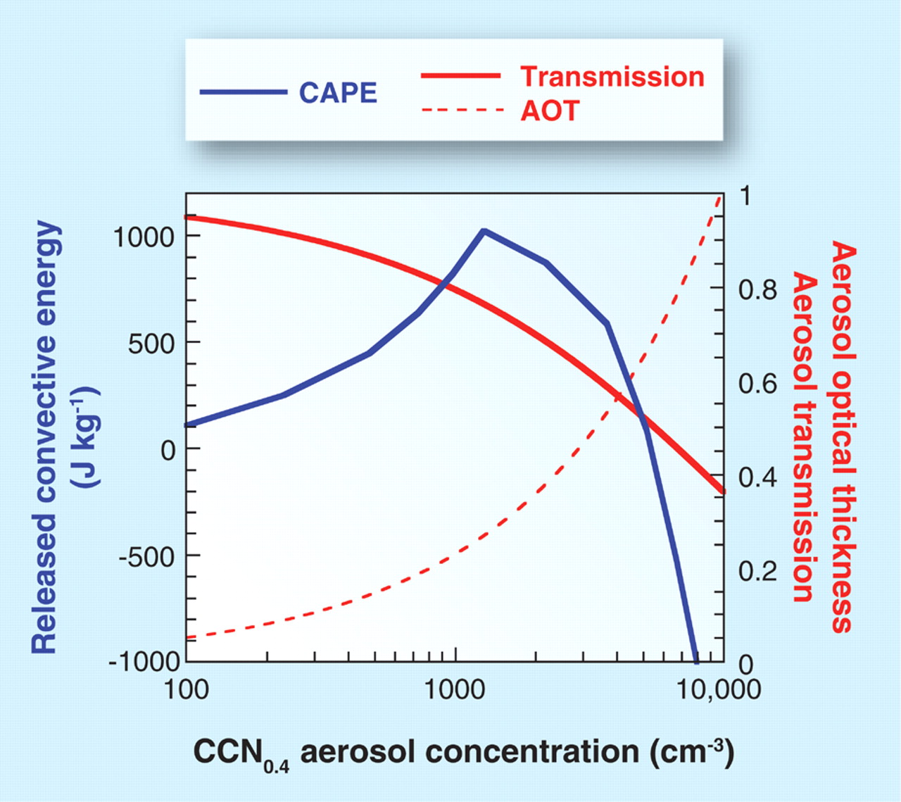
Fig. 4. Illustration of the relations between the aerosol microphysical and radiative effects
D. Rosenfeld et al., Science 321, 1309 -1313 (2008)
Published by AAAS
Notes:
Fig. 4. Illustration of the relations between the aerosol microphysical and radiative effects. The aerosol optical thickness (AOT) is assumed to reach 1 at CCN0.4 = 10⁴ cm^{–3} (dashed red line), which corresponds to nucleation of 2000 cloud drops cm^{–3}. The related transmission of radiation reaching the surface is shown by the solid red line. The vigor of the convection is shown by the blue line, which provides the released convective available potential energy (CAPE) of a cloud parcel that ascends to the cloud top near the tropopause. The calculation is based on the scheme in Fig. 3, with respect to curve c as the zero reference. Note that a maximum in CAPE occurs at CCN0.4 1200 cm–3, which corresponds to the maximum cloud invigoration according to curve d of the scheme in Fig. 3. The AOT corresponding to the CCN0.4 at the microphysical optimum is only 0.25. Adding aerosols beyond this point substantially decreases the vigor of the cloud because both microphysical and radiative effects work in the same direction: smaller release of convective energy aloft and less radiative heating at the surface.

Slide 55
Who wins – radiation or microphysics?
● From this empirical relationship we can estimate the number of CCN as a function of AOT.
● If the count of CCN is 10⁴ cm⁻³ then AOT ~ 1.0 and radiation reaching the Earth’s surface is reduced by an e-folding.
● CAPE reaches a maximum at CCN ~ 1200 cm⁻³ (AOT ~ 0.25) ; adding more aerosols will inhibit convection.
Bell (GSFC) et al., (JGR, 2008) showed a weekday/weekend effect.

Slide 56
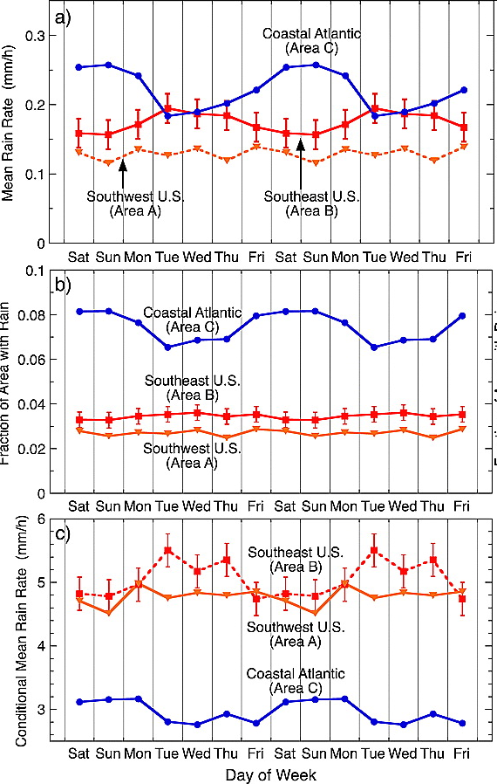
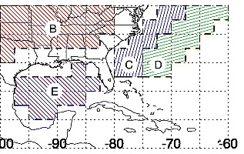

Slide 57
From Rosenfeld and Bell, 2011

