Slide 1
Lecture
AOSC/CHEM 637
Atmospheric Chemistry
R. Dickerson
The Global Nitrogen Cycle
Reading: Finlayson-Pitts Ch 14; Seinfeld and Pandis Chapters 2, 7 & 10. [Cicerone, 1989; Mosier and Kroeze, 1998; Dentener and Crutzen, 1994; Galloway, et al., 2004; Mosier, et al., 1998; NRC, 2003; EPA 2011]

Slide 2
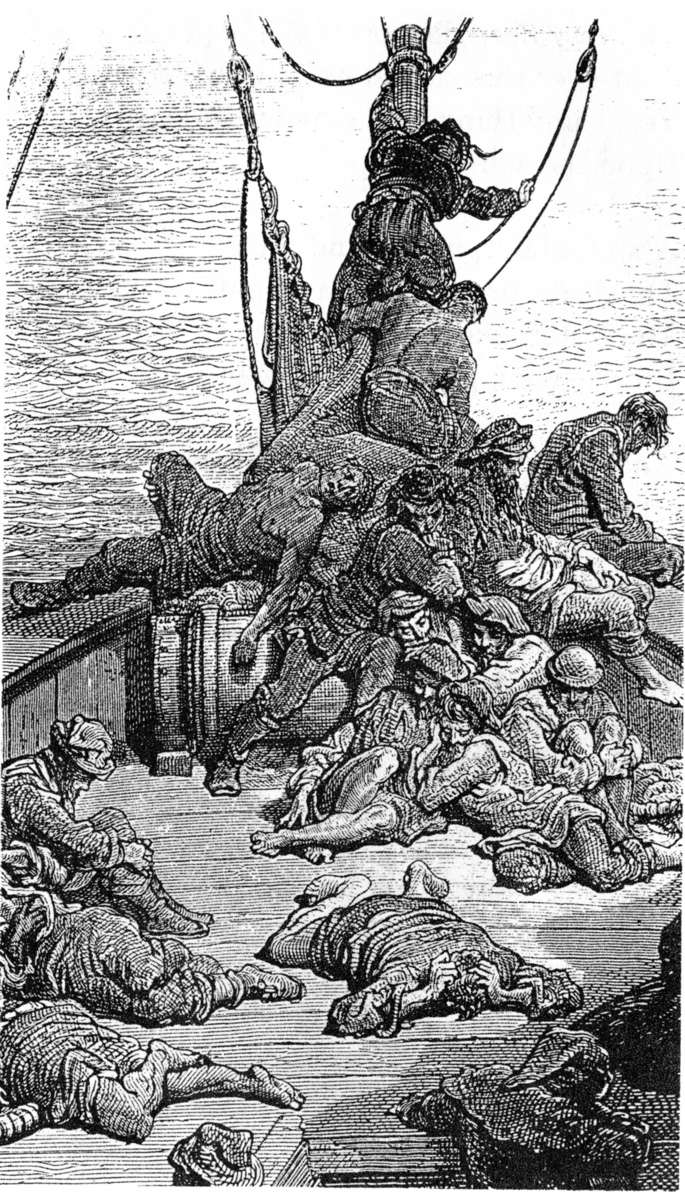
Nitrogen: A Story of Food, Feed and Fuel
Water, water everywhere,
And how the boards did shrink.
Water, water everywhere,
Nor any drop to drink.
Rime of the Ancient Mariner
Samuel Taylor Coleridge
From the EPA SAB
Integrated Nitrogen Committee
James Galloway, Chair

Slide 3
Nitrogen: Setting the Stage
Earth has >10,000,000 biological species
  they all need nitrogen to survive
Good news: 78% of the atmosphere is nitrogen
Bad News: only 1,000 species (0.01%) can convert N₂ to a useable form (reactive N, Nr).
So N is the limiting nutrient to many ecosystems
  Many crop lands do not have enough
N₂ is naturally converted to Nr primarily by lightning and biological nitrogen fixation (BNF), those 1000 species.
N₂ is converted to Nr by humans by
  fossil fuel combustion,
  the Haber Bosch process,
  cultivation-induced BNF.

Slide 4
Nitrogen: A ‘Wicked’ Element
There is not universal agreement on what the problem is – different stakeholders define it differently.
There is no defined end solution, the end will be assessed as “better” or worse”.
The problem changes over time.
There is no clear stopping rule – stakeholders, political forces and resource availability will make that determination on the basis of “judgments”.
The problem is associated with high uncertainty of both components and outcomes.
Values/societal goals are not shared by those defining the problem or those attempting to make the problem better.
Batie 2008; Kreuter et al. 2004

Slide 5
The Main Topics
Nr creation through time
  Including a most important invention (Feed the World)
Nr fate during energy and food production
  By accident and on purpose.
The Nitrogen Cascade
  One thing leads to another.
From Science to Solution
  Integrated Nr management (Protect the Environment)
Are your feet's too big?
  A metric to determine your N footprint.

Slide 6
Timeline of Global Nr Creation by Human Activity 1850 to 2005
1898: where did 1.6 billion people get their nitrogen……
Nitrogen Sources
  Natural creation
    lightning
    BNF
  Anthropogenic Mining
    guano
    nitrate deposits
  Anthropogenic creation
    cultivation
    other
Nr Creation, Tg N yr⁻¹
Legumes
Galloway et al., 2003
Notes:
1899--Construction begins on a new capitol building in Phoenix

Slide 7
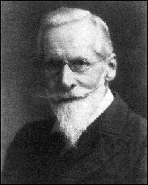
Timeline of Global Nr Creation by Human Activity 1850 to 2005
1898: A challenge to the chemists of the world………
“England and all civilised nations stand in deadly peril of not having enough to eat. As mouths multiply, food resources dwindle.
Land is a limited quantity, and the land that will grow wheat is absolutely dependent on difficult and capricious natural phenomena... I hope to point a way out of the colossal dilemma.
It is the chemist who must come to the rescue of the threatened communities.
It is through the laboratory that starvation may ultimately be turned into plenty... The fixation of atmospheric nitrogen is one of the great discoveries, awaiting the genius of chemists.”
— Sir William Crookes
Presidential Address to the British Association for the Advancement of Science 1898. Published in Chemical News, 1898, 78, 125.
The world is running out of N
Legumes
Galloway et al., 2003

Slide 8
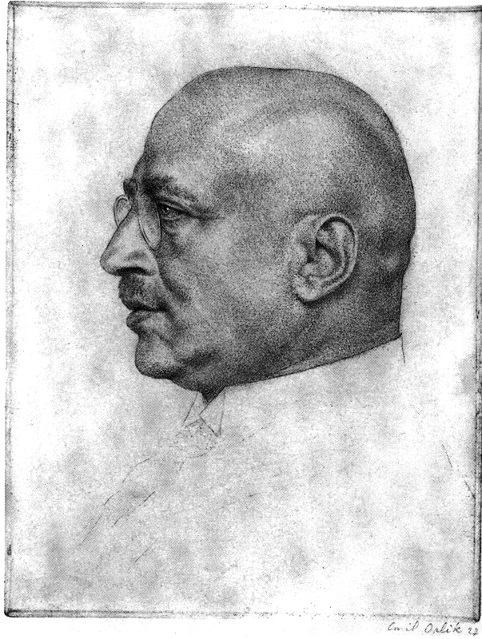
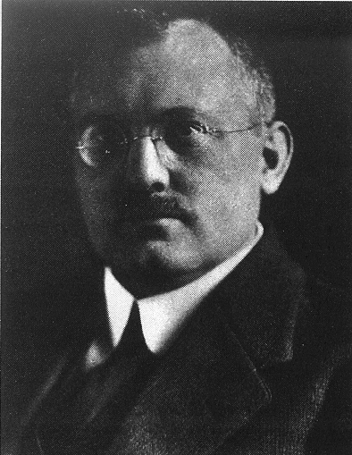
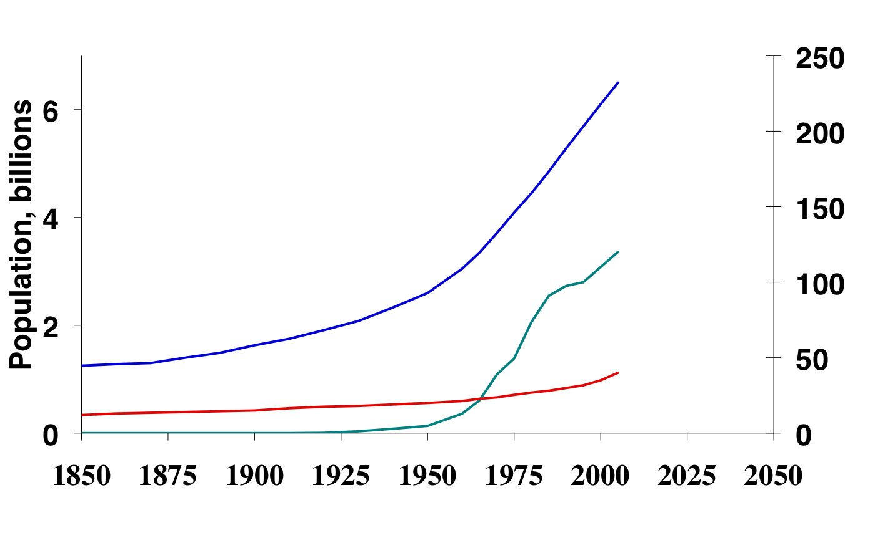
Timeline of Global Nr Creation by Human Activity 1850 to 2005
1908: Fritz Haber and Carl Bosch rose to the challenge.
N₂ + 3H₂ ➔2NH₃
Nr Creation, Tg N yr⁻¹
Haber Bosch
Legumes
Galloway et al., 2003

Slide 9
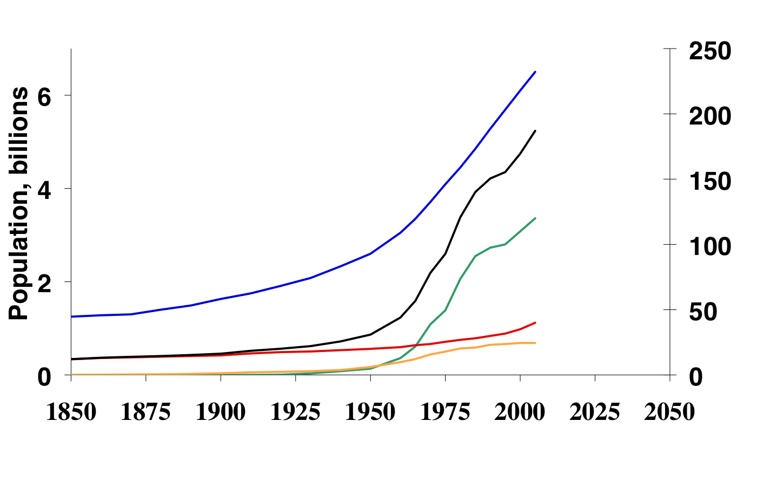
Timeline of Global Nr Creation by Human Activity 1850 to 2005
In 2005 ~190 Tg Nr were created by humans.
Total Nr Production
Fossil fuel combustion, 25 Tg N yr⁻¹
Cultivation-induced BNF, 40 Tg N yr⁻¹
Haber-Bosch process
  Fertilizer 100 Tg N yr⁻¹
  Industrial feedstock 23 Tg N yr⁻¹
Total
Nr Creation, Tg N yr⁻¹
Haber Bosch
{
Natural Range,
terrestrial
Legumes
Fossil Fuel

Slide 10
Take Away Message #1
For most populated regions of the world, humans create more reactive nitrogen through food and energy production than all the other biological species combined.
Haber-Bosch process was arguably the most important invention human society has ever had.
The world would be a very different place if the Haber-Bosch process was not invented 100 years ago.
Now let’s examine Nr fate during energy and food production with time

Slide 11
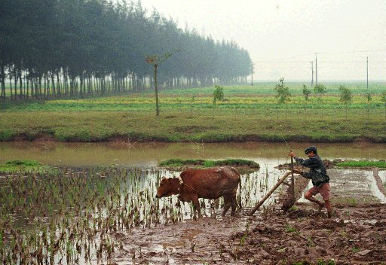
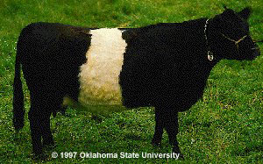
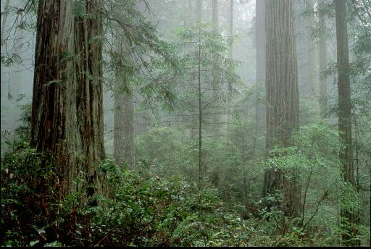
Nitrogen Drivers in 1860
Grain
Production
Meat
Production
Energy
Production

Slide 12
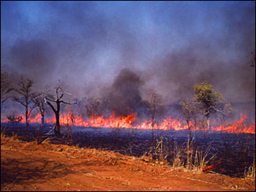
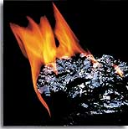
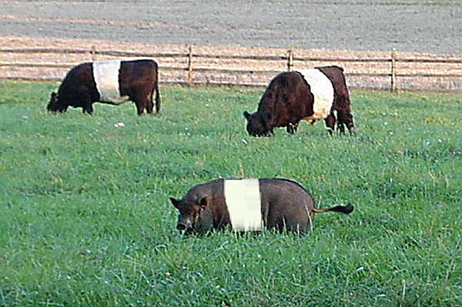
The Global Nitrogen Budget in 1860 and mid-1990s, TgN/yr
NO_{y}
5
N₂
6
NH_{x}
8
6
9
1860
120
7
15
11
8
6
0.3
27
Galloway et al., 2004

Slide 13
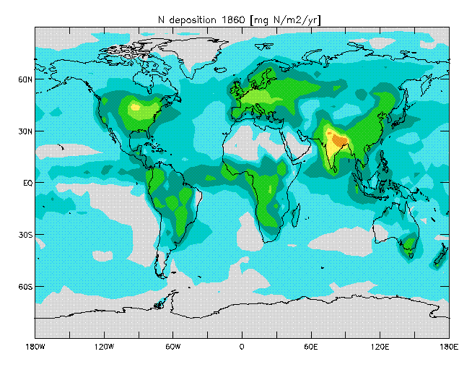
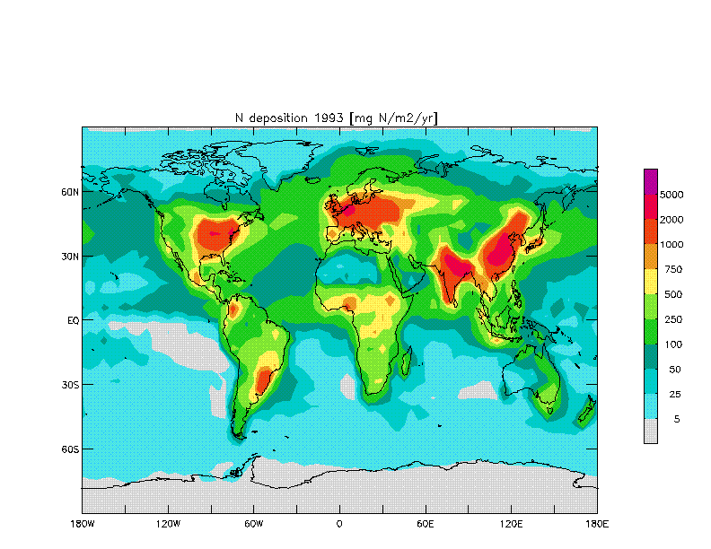
Nitrogen Deposition mg N/m²/yr
5000
2000
1000
750
500
250
100
50
25
5
1860
Nitrogen is emitted as NOx to the atmosphere by fossil fuel combustion
Nitrogen is emitted as NH₃ and NOx from food production.
Once emitted, it is transported and deposited to ecosystems.
In 1860, human activities had limited influence on N deposition.
Galloway et al., 2004

Slide 14
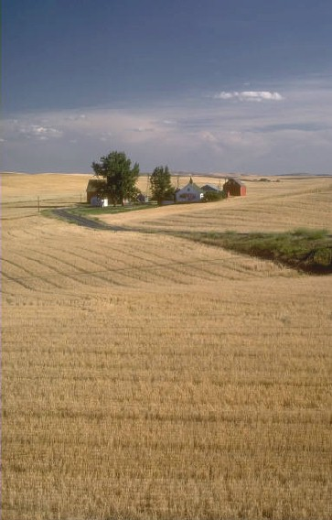
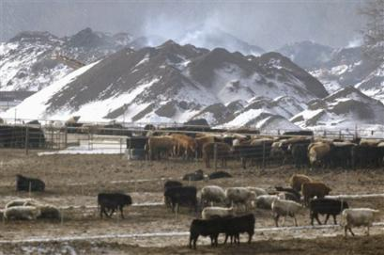
Nitrogen Drivers in 1860 & Now
Grain
Production
Meat
Production
Energy
Production

Slide 15
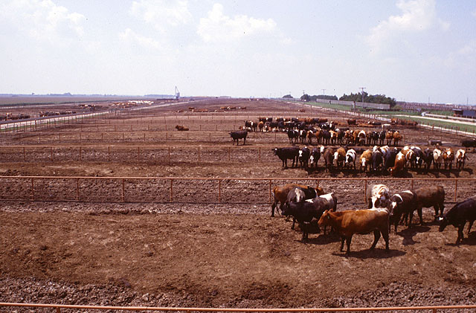
The Global Nitrogen Budget in 1860 and mid-1990s, TgN/yr
NO_{y}
5
N₂
6
NH_{x}
8
6
9
1860
120
7
15
11
8
6
0.3
27
5
N₂
6
NO_{y}
NH_{x}
mid-1990s
16
33
23
26
18
21
25
110
100
39
25
N₂ + 3H₂
48
2NH₃
Galloway et al., 2004

Slide 16
Nitrogen Deposition mg N/m²/yr
5000
2000
1000
750
500
250
100
50
25
5
1860
2000
Nitrogen is emitted as NOx to the atmosphere by fossil fuel combustion
Nitrogen is emitted as NH₃ and NOx from food production.
Once emitted, it is transported and deposited to ecosystems.
In 1860, human activities had limited influence on N deposition.
By 2000, the picture had changed.
Galloway et al., 2004

Slide 17
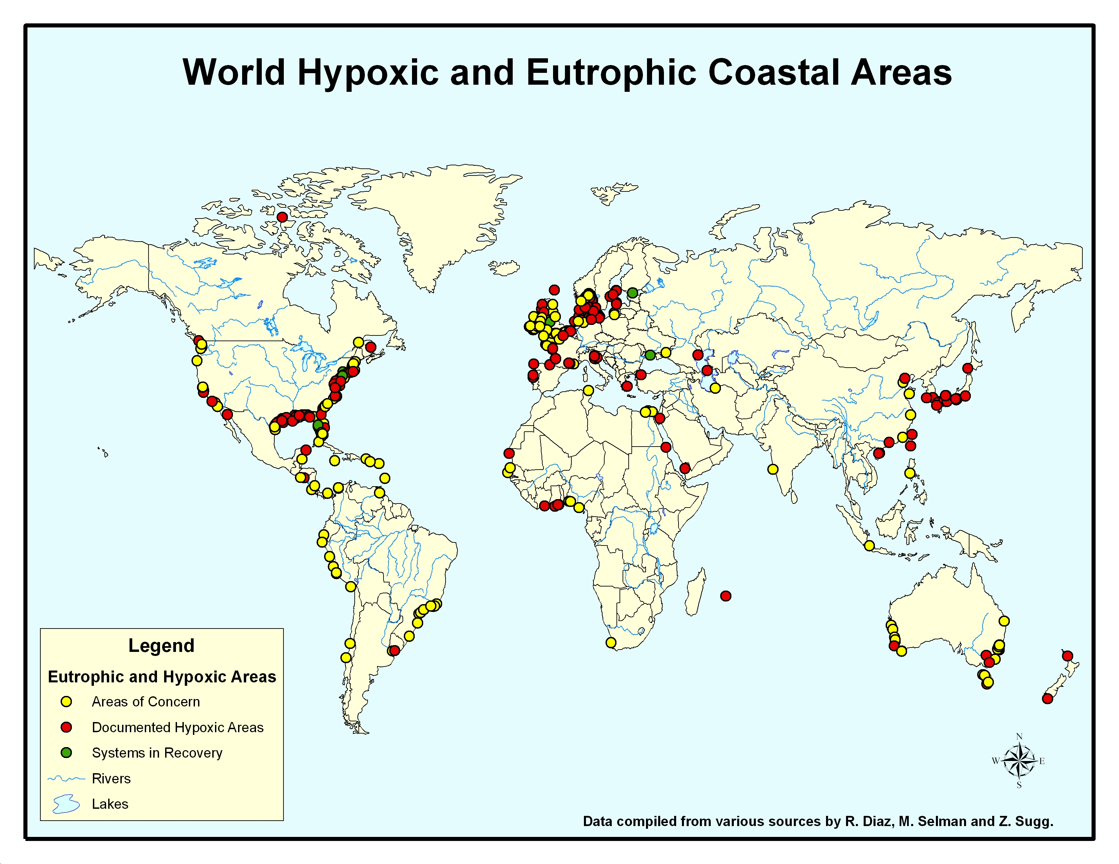
xxxxxx

Slide 18
Sidebar on Nr Distribution
Anthropogenic Nr is formed on continents, used there, and distributed to the global environment after its use.
An emerging issue on Nr distribution
  Nature vs. the global economy

Slide 19
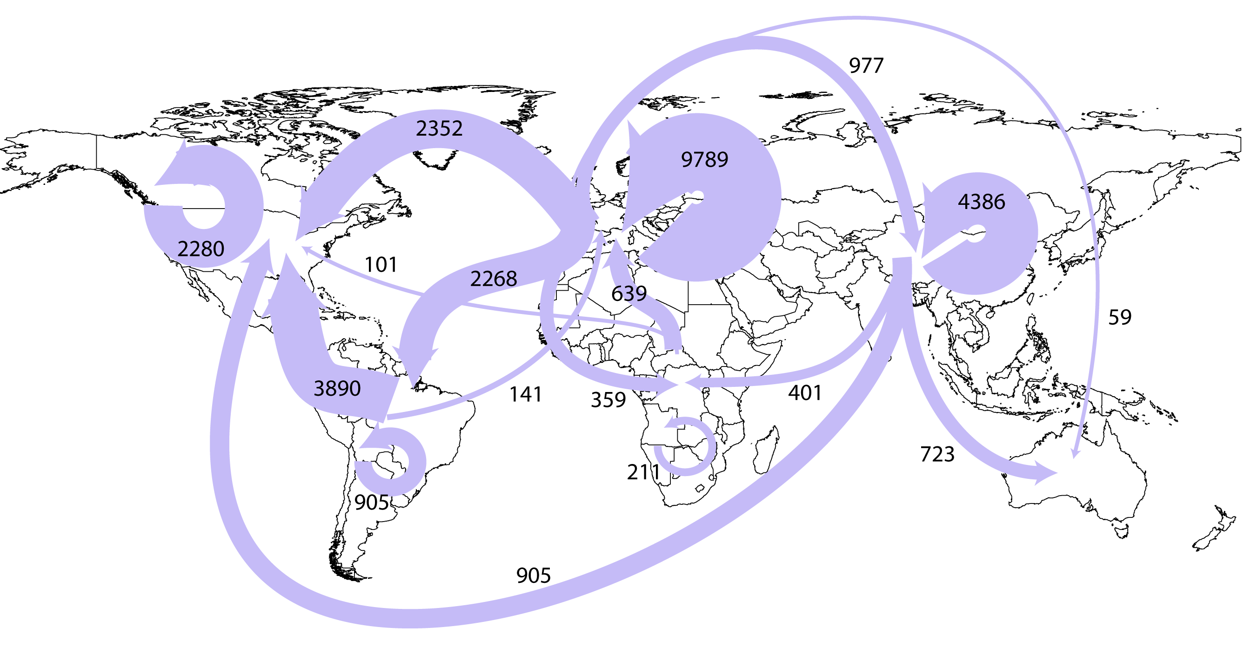
Nitrogen in Internationally Traded Fertilizer, Grain and Meat
Fertilizer, 31 Tg N

Slide 20
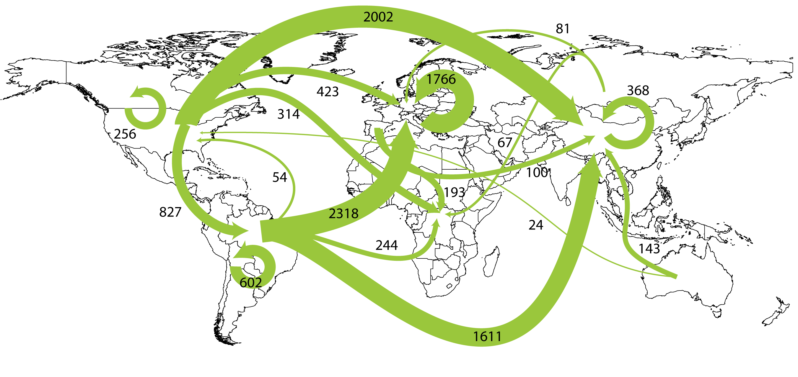
Nitrogen in Internationally Traded Fertilizer, Grain and Meat
Fertilizer, 31 Tg N
Grain, 11 Tg N

Slide 21
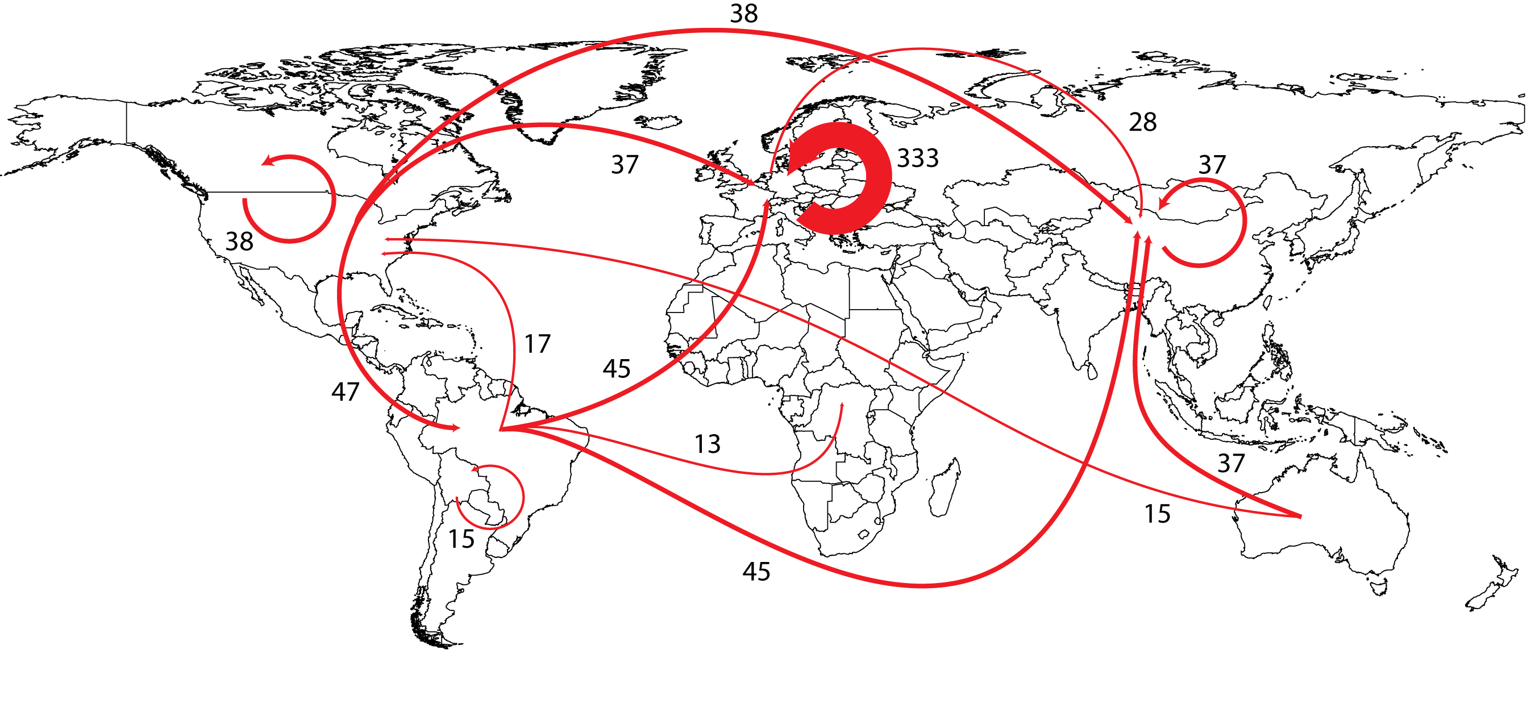
Nitrogen in Internationally Traded Fertilizer, Grain and Meat
Fertilizer, 31 Tg N
Grain, 11 Tg N
Meat, 0.7 Tg N

Slide 22
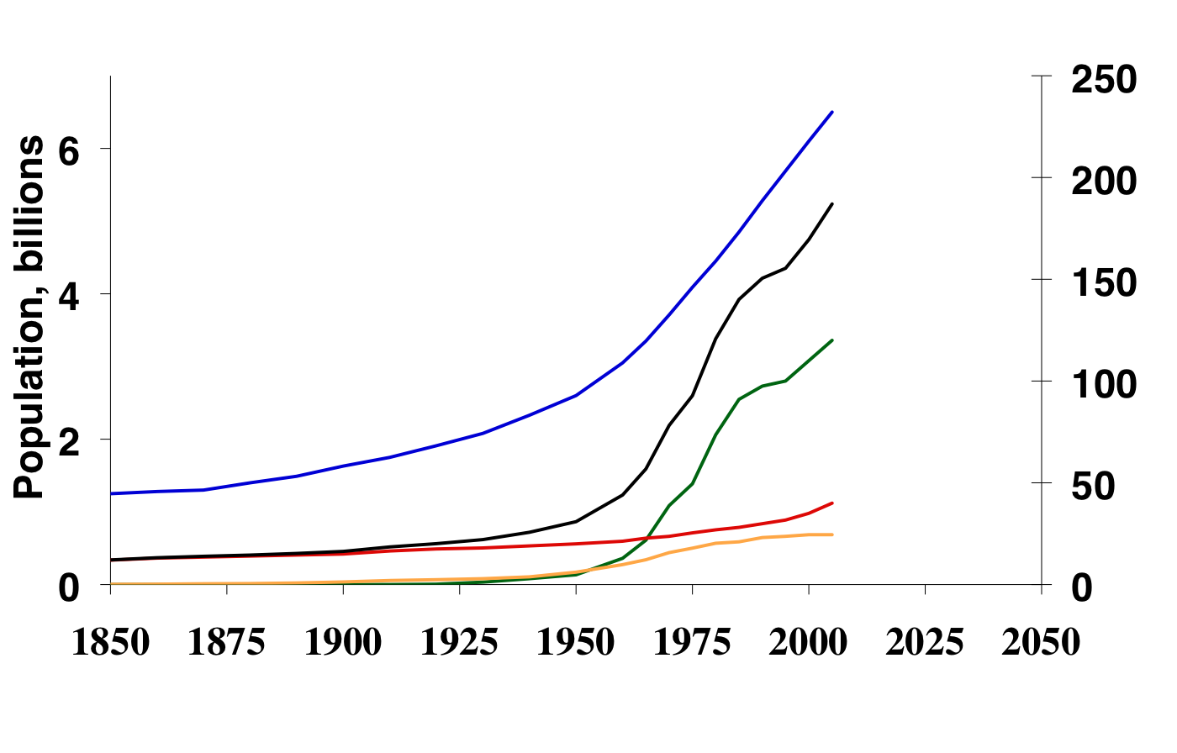
Timeline of Global Nr Creation by Human Activity 1850 to 2005
140 Tg Nr is created from N₂ each year to produce food
But People only need 13 Tg N.
And they consume 30 Tg N.
Why do we create 140 Tg N?
Total
Nr Creation, Tg N yr⁻¹
Haber Bosch
Legumes
Fossil Fuel

Slide 23
Nitrogen: A Very Leaky Element
Atmosphere
NH₃ N₂O NO_{X} N₂
20%
Consumed Crops
N inputs:
N fertilizer
& BNF
Crop production: - Crop type - Cropped area - Management
Agriculture
NH₄⁺ NO₃⁻ DON N_{part}
NH₄⁺ NO₃⁻ DON N_{part}
Groundwater & surface waters
Oenema, 2009

Slide 24
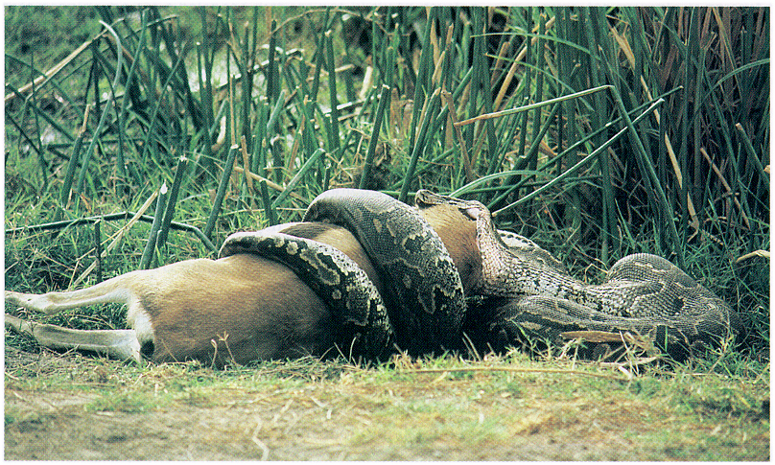
And What About Meat?

Slide 25
Nitrogen: A Very Leaky Element
Atmosphere
NH₃ N₂O NO_{X} N₂
NH₃ N₂O NO_{X} N₂
NH₃ N₂O NO_{X} N₂
20%
Consumed Crops
N inputs:
N fertilizer
& BNF
Crop production: - Crop type - Cropped area - Management
Animal production: - Animal species - Animal number - Management
10%
Consumed Animal Products
feed
Agriculture
NH₄⁺ NO₃⁻ DON N_{part}
NH₄⁺ NO₃⁻ DON N_{part}
Groundwater & surface waters
Oenema, 2009

Slide 27
American NOx Emissions
Total = 15 Tg as NO₂
g(NO₂ ) ● 14/46 = g(N)

Slide 28
Global NOx Emissions ~2005
Source | Magnitude Tg(N)/yr | Comments | Reference
Fossil Fuel Combustion | 28 | Surface source > 95% NH | IPCC (1995) Martin et al. (2006)
Soils both natural and agricultural | 7 | Continental surface source | Yienger and Levy (1995)
Biomass Burning | 8 | Tropical surface source | IPCC (1995) Duncan et al. (2003)
Lightning | 9 | Upper troposphere source | Allen and Pickering (2002)
NH₃ Oxidation | ~1 |  | EPA (2011)
Aircraft | 0.85 | Upper trop. | Koffi et al., (2010)
Transport from Stratosphere | 0.1 (0.6 NOy) | Free trop | IPCC (19995)

Slide 29
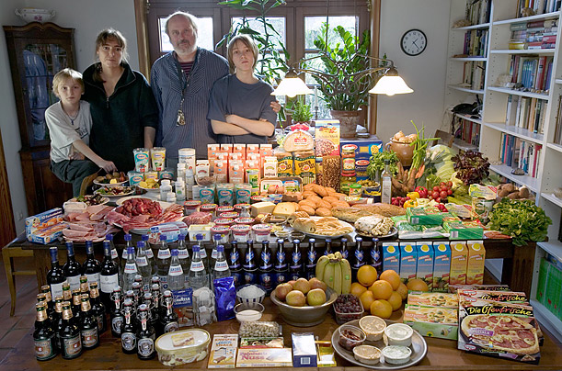
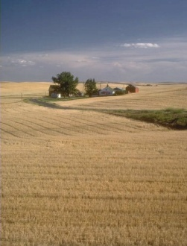
E
N
V
I
R
O
N
M
E
N
T
Food
Production
Nr
N₂
Menzel & D'Aluisio, 2005
Nr

Slide 30
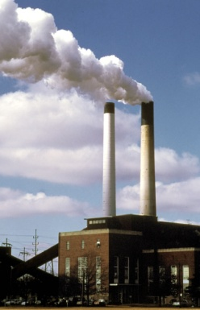
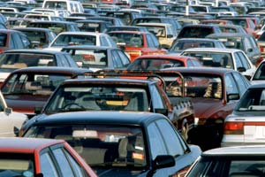
Energy
Production
E
N
V
I
R
O
N
M
E
N
T
N₂
Nr
Food
Production
Nr
N₂
Menzel & D'Aluisio, 2005
Nr

Slide 31
Take Away Message #2
Essentially all the reactive N created is lost to the environment, where some portion accumulates in soils, waters, biomass and the atmosphere.
Meat production is growing regionally and globally,and has a profound impact on Nr creation.
International transport of N-commodities is more efficient at distributing N globally than air or water.
Now, let’s look at impact of Nr on environment

Slide 32
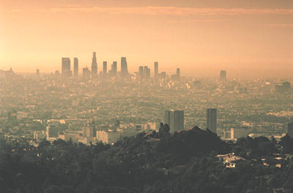
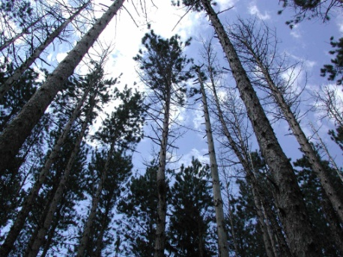

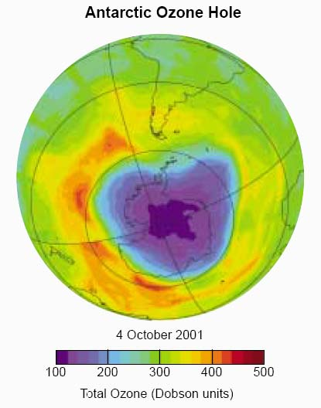
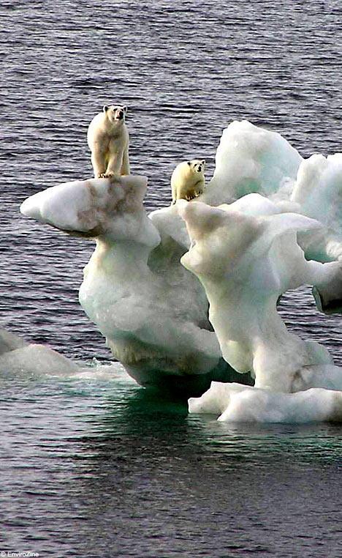
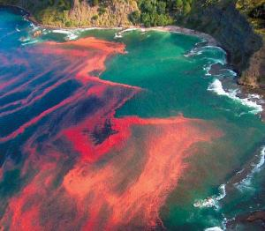
E
N
V
I
R
O
N
M
E
N
T
Too Much Nitrogen; Too Many Consequences
John Aber
Smog, Haze
Forest Die-back
Acidification
Ozone Hole
Global Warming
Eutrophication

Slide 33
E
N
V
I
R
O
N
M
E
N
T
Too Much Nitrogen: In a Cascade
John Aber
Smog, Haze
Forest Die-back
Acidification
Ozone Hole
Global Warming
Eutrophication

Slide 34
Take Away Message #3
In addition to feeding about half of the world, anthropogenic reactive nitrogen
  increases tropospheric ozone and particulate matter,
  increases the acidity of soils, streams and lakes,
  changes the ecosystem productivity,
  increases tropospheric global warming potential,
  decreases stratospheric ozone.
One nitrogen atom can contribute to each of these environmental changes, in sequence.
These changes have profound consequences for ecosystem and human health.
Now, what can be done--can the science support a solution?

Slide 35
From Science to Solution
The over all goal is to optimize nitrogen’s benefits while minimizing its problems.
  Produce food with minimal Nr loss to environment
  Produce energy with no Nr loss to environment
Strategy
  Be clear about the science
  Identify control points at both ends of Nr stream
  Take advantage of existing instruments
  Link to broader issues.
Global Case Study

Slide 36

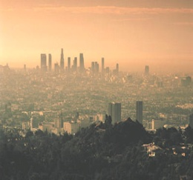

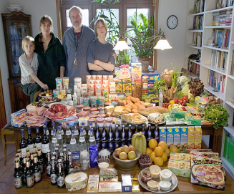

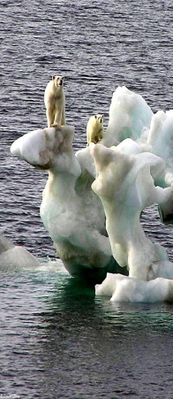

Nitrogen: The Good, the Bad, and the Difficult
E
N
V
I
R
O
N
M
E
N
T
N₂
Nr
Nr
N₂
Nr
Control Fossil Fuel Combustion
Increase N Uptake Efficiencies in Crops & Animals
manage manure
Improve Sewage Treatment

Slide 37
Nitrogen: The Good, the Bad, and the Difficult
E
N
V
I
R
O
N
M
E
N
T
N₂
Nr
Nr
N₂
Nr
Control Fossil Fuel Combustion
Increase N Uptake Efficiencies in Crops & Animals
Manage manure
Improve Sewage Treatment

Slide 38
Nitrogen: The Good, the Bad, and the Difficult
E
N
V
I
R
O
N
M
E
N
T
N₂
Nr
Nr
N₂
Nr
Control Fossil Fuel Combustion
Increase N Uptake Efficiencies in Crops & Animals
Manage manure
Improve Sewage Treatment

Slide 39
Take Away Message #4
For the US, there are several actions that can be taken to decrease both Nr creation, and Nr losses to the environment.
  fossil fuel combustion
  fertilizer uptake
  feed retention
  manure management
  sewage treatment
If all were taken, there would be a 25% decrease in Nr loss to environment.
Now let’s scale down from a global perspective to a personal perspective.

Slide 40

Engaging the Public
Human action controls Nr introduction into the environment.
Added Nr has positive impacts for human health--food production.
Added Nr increases the risk to both human and ecosystem health--N cascade.
Challenge is how do we achieve positive benefits at acceptable risk.
And how do we do this in an integrated fashion?
  Calculate nitrogen footprints!

Slide 41




An Introduction to the
Nitrogen Calculator
A tool to estimate Nr loss to the environment due to food, energy and materials consumption that will….

Slide 42
An Introduction to the
Nitrogen Calculator
A tool to estimate Nr loss to the environment due to food, energy and materials consumption that will….
Communicate the importance of N
Calculate an entity’s contribution to N losses, through resource consumption (N Calculator)
Assess the resulting contribution to environmental impacts

Slide 43

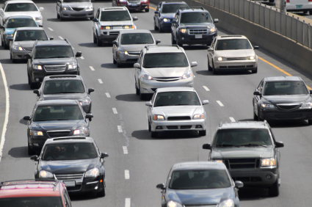
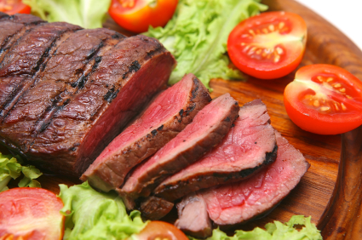
The Average US N Footprint
N-Calculator based on a country’s averages
  User answers questions, and the country’s averages are scaled
Output graphs describe the following 3 areas:
  Food Consumption
  Resource Use
  Food Production

Slide 44
Annual US per capita N Footprint

Slide 45
Annual US per capita N Footprint
The average adult consumes 5 kg N/yr but needs to consume only
3 kg N/yr

Slide 46
Per capita N footprint comparison
of the United States, Netherlands, & Germany
?

Slide 47

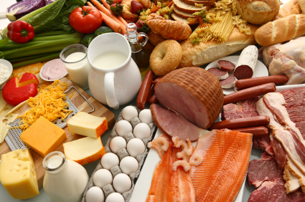

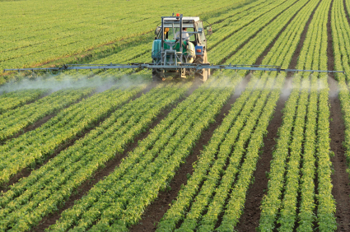
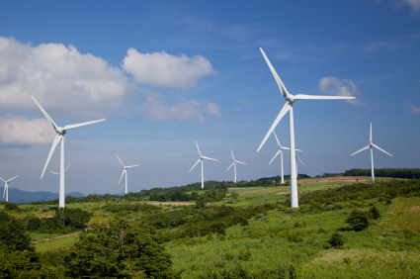
The Average Personal Nitrogen Footprint
of Selected Countries
United States
41 kg N/yr
Netherlands
24 kg N/yr
Germany
27 kg N/yr
India
13 kg N/yr
Preliminary

Slide 48
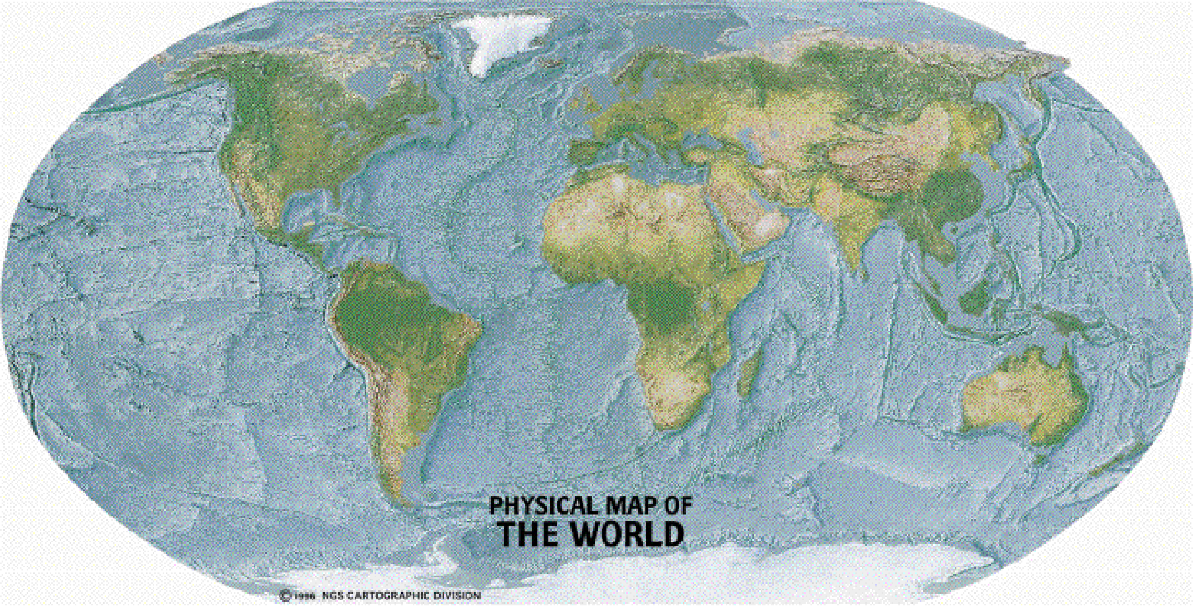
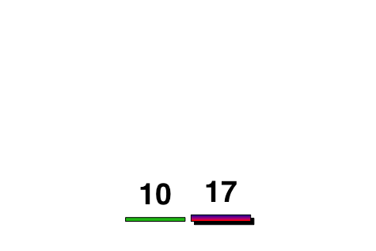
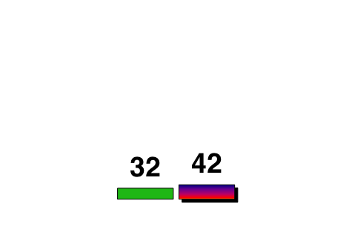
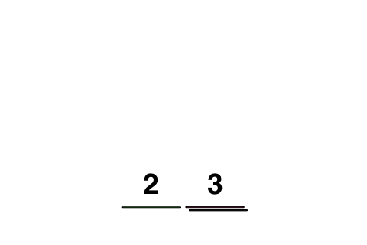
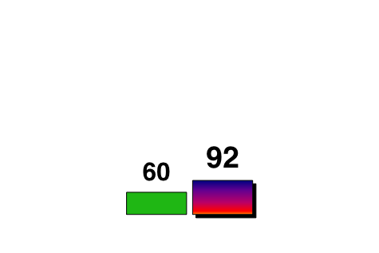
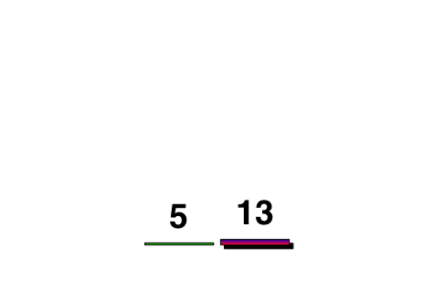
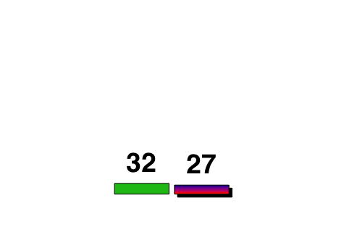
Nr Creation Rates
1995 (left) and 2050 (right)
TgN/yr
2050 rates scaled by:
-> population increase relative to 1995
after Galloway and Cowling, 2002

Slide 49
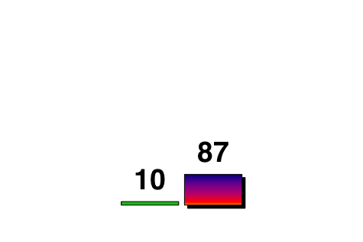
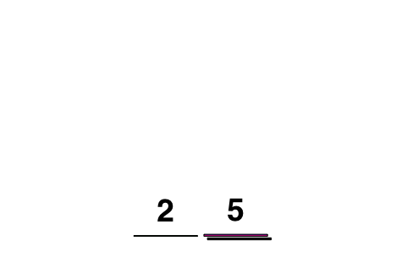
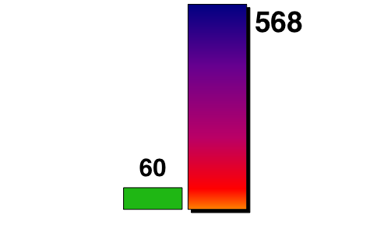


Nr Creation Rates
1995 (left) and 2050 (right)
TgN/yr
2050 rates scaled by:
-> population increase relative to 1995
-> N. Amer. percapita Nr creation in 1995
after Galloway and Cowling, 2002

Slide 50
Another Aspect of N-Related Problems in the Environment
Lots of Water (salt)
Not the Right Type (fresh)
Menzel & D'Aluisio, 2005
One week’s worth of food

Slide 51

Another Aspect of N-Related Problems in the Environment
Lots of Water (salt)
Not the Right Type (fresh)
Lots of Nitrogen (N₂)
Not the Right Type (Nr)
Menzel & D'Aluisio, 2005
The other side of the nitrogen problem,
Too little nitrogen in too many regions

Slide 52
Concluding Thoughts
Humans now dominate Nr introduction into environment.
There is a rapid rate of environmental change that is magnified by the N cascade.
There are large parts of the world that suffer from N deficiency.
There are actions that can be taken now to address nitrogen-related issues in the environment; additional actions are required.
A key challenge is to communicate the issues of N to the stakeholders—consumers, producers, governments

Slide 53







Nitrogen: Time to Diminish the Cascade

Slide 54

(2006 cover of The Economist)

Slide 55
US per capita Food N Footprint
Current situation
Current situation
Food consumption
Food production

Slide 56
US per capita Food N Footprint
Current situation vs. USDA nutritional target
Current situation
Food consumption
Food production
USDA nutritional target
Food consumption
Food production

Slide 57


And then there’s this
World ethanol and biodiesel production
Source: OECD and FAO

Slide 58
USA per capita N Footprint
USA per capita N footprint: 39 kg N/yr
  Food (28 kg N/yr)
    Consumption: 5.2 kg N/yr
    Production, pre-consumption (virtual): 22.8 kg N/yr
  Other
    Housing, mobility, goods, and services: 11 kg N/yr
In contrast, the average adult needs to consume only
2-3 kg N/yr
Almost all of the ‘other’ is driven by fossil fuel combustion

