Slide 1

The Ensemble of Data Assimilations
Massimo Bonavita
massimo.bonavita@ecmwf.int
Contributions from:
Lars Isaksen, Elias Holm, Mike Fisher, Laure Raynaud

Slide 2
Outline
KF, EKF, Reduced-rank KF, EnKF
Hybrid methods
The Ensemble of Data Assimilations (EDA) method
Applications of the EDA

Slide 3
The EDA method
For a linear system the data assimilation update is:
_{x}k
= x + K (y − H x )
k k
k
a
b k
k b
_{x}k +1 _{= M x}k
b k a
Under the assumptions of statistically independent background (P^{b}), observation (R) and model errors (Q), the evolution of the system error covariances is given by:
= (I − K H )P (I − K H ) + K R K
_{P}a
b
T
T
k
k k k
k k k k k
_{P}b
= M Pª M^{T} + Q
k +1
k k k
k

Slide 4
The EDA method
Consider now the evolution of the same system where we perturb the observations and the forecast model with random noise drawn from the respective error covariances:
~_{x} k
= x + K ( − H x )
~ ~
k
k k
y + η
a
b k
k
k b
~x ^{k +1} = M ~x ^{k} + ζ
b k a k
where η_{k}~N(0,R), ζ_{k}~N(0,Q).
If we define the differences between the perturbed and
unperturbed state ε_{a} ≡ ~x_{a} − x_{a}
~
and ε_{b} ≡ x_{b} − x_{b}, their evolution is
obtained by subtracting the unperturbed state evolution equations from the perturbed ones:
_{ε}k
= ε + K ( − H ε )
k k
η
a
b k k
k b
ε^{k +1} = M ε^{k} + ζ
b k a
k

Slide 5
The EDA method
_{ε}k
= ε + K ( − H ε )
k k
η
a
b k k
k b
ε^{k +1} = M ε^{k} + ζ
b k a k
i.e., the perturbations evolve with the same update equations of the state (Kalman gain and model operator).
What about the errors?
If we take the statistical expectation of the outer product of the perturbations:
ε (ε )
T
ε (ε ) (
= (I − K H )
₎T
T
I − K H ) + K R K
a a
b b
T
T
k k
k k
k k
k k k k k
_{ε}b
(ε
b
= M ε ( )
T
a a
k k k
ε M^{T} + Q
k +1 k +1
k
k

Slide 6
(ε ) = ( ) ( ) (
₎T
The EDA method
T
T
a a
ε I − K H )
T
ε
I − K H ε
b b
K R K
T
k k
k k
k k
k k
k k k
_{ε}b
(ε = M ε ( )
T
b
a a
k k k
ε M^{T} + Q
k +1 k +1
k
k
These are the same equations for the evolution of the system error covariances:
= (I − K H )P (I − K H ) + K R K
_{P}a
b
T
T
k
k k k
k k k k k
_{P}b
= M Pª M^{T} + Q
k +1
k k k
k
provided that:
1. The applied perturbations η_{k}, ζ_{k} have the right covariances (R, Q);
2. At some stage in time
ε (ε )
T
b b
= P
b k
k k

Slide 7
The EDA method
What does all this mean in practice?
We can use an ensemble of perturbed assimilation cycles to simulate the errors of our reference assimilation cycle;
The ensemble of perturbed DAs should be as similar as possible to the reference DA (i.e., same or similar K matrix)
The applied perturbations η_{k}, ζ_{k} must have the required error covariances (R, Q);
There is no need to explicitly perturb the background x_{b}

Slide 8
The EDA method
25 ensemble members using 4D-Var assimilations at reduced resolution
T399 outer loop, T95/T159 inner loops. (Reference DA: T1279 outer loop, T159/T255/T255 inner loops)
Observations randomly perturbed according to their estimated errors
SST perturbed with climatological error structures
Model error represented by stochastic methods (SPPT, Leutbecher, 2009)

Slide 9
The EDA method
_{ε1}m
X₁^{b}(t_{k}) y+ε₁º
Boundary pert. 1
4DVAR
Forecast
X₁^{b}(t )
X₁ª(t_{k})
k+1
_{ε2}m
X₂^{b}(t_{k}) y+ε₂º
Boundary pert. 2
4DVAR
Forecast
X₂^{b}(t )
X₂ª(t_{k})
k+1
………………………………………………………….

Slide 10
Applications of the EDA
The EDA simulates the error evolution of the 4DVar analysis cycle. As such it has two main applications:
  Provide a flow-dependent estimate of analysis errors to initialize the ensemble prediction system (EPS)
  Provide a flow-dependent estimate of background errors for use in 4D-Var assimilation

Slide 11
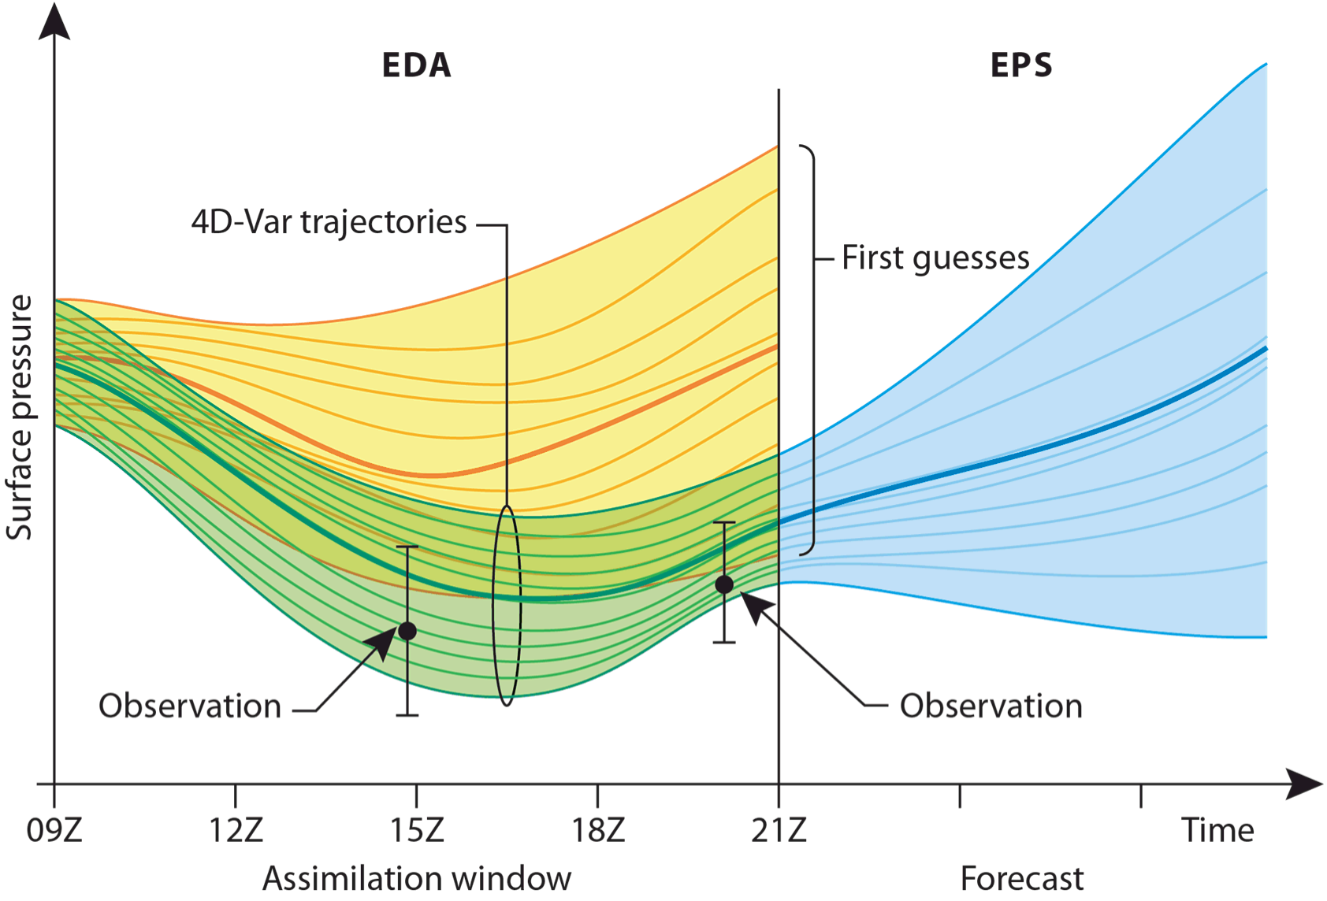
Applications of the EDA

Slide 12
Applications of the EDA
Note that the EDA impacts the EPS in two distinct ways:
  Directly, by providing a flow-dependent estimate of the initial perturbations of the ensemble prediction system (EPS)
  Indirectly, through the provision of a flow-dependent estimate of background errors for use in the 4D-Var deterministic (HRES)
assimilation cycle: this improves the deterministic analysis around which the EPS initial perturbations are re-centered

Slide 13
Applications of the EDA
Directly, by providing a flow-dependent estimate of the initial perturbations of the ensemble prediction system (EPS)
Indirectly, through the provision of a flow-dependent estimate of background errors for use in the 4D-Var deterministic (HRES) assimilation cycle: this improves the deterministic analysis around which the EPS initial perturbations are re-centered
The second effect is arguably the more important:
“… the main reason for the better performance of the EC-EPS in terms of the RMS, PAC, ROC and Brier Skill Score measures is the superiority of the ECMWF data assimilation (and perhaps numerical forecast modelling) system, and not necessarily the strategy used to simulate initial value and model related uncertainties in the EC-EPS.” Buizza et.al., 2005

Slide 14
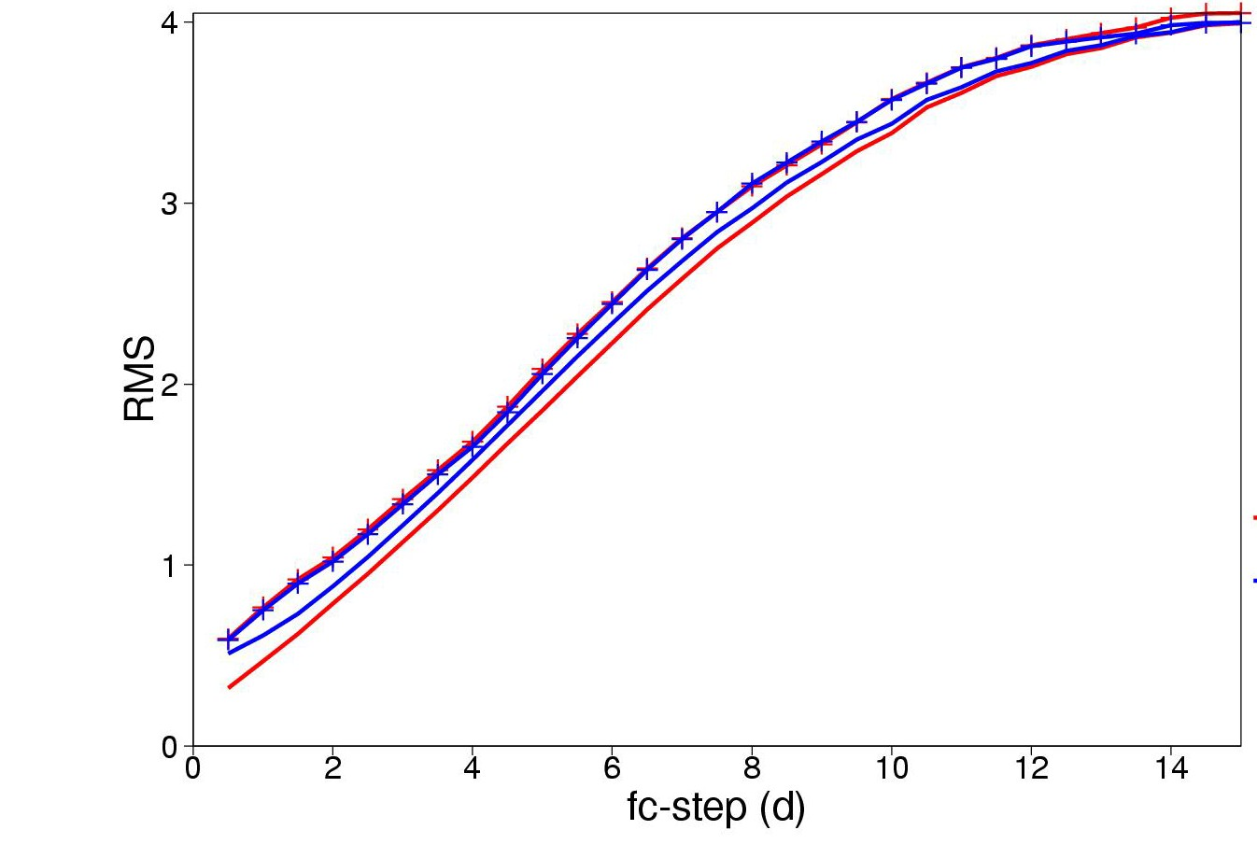
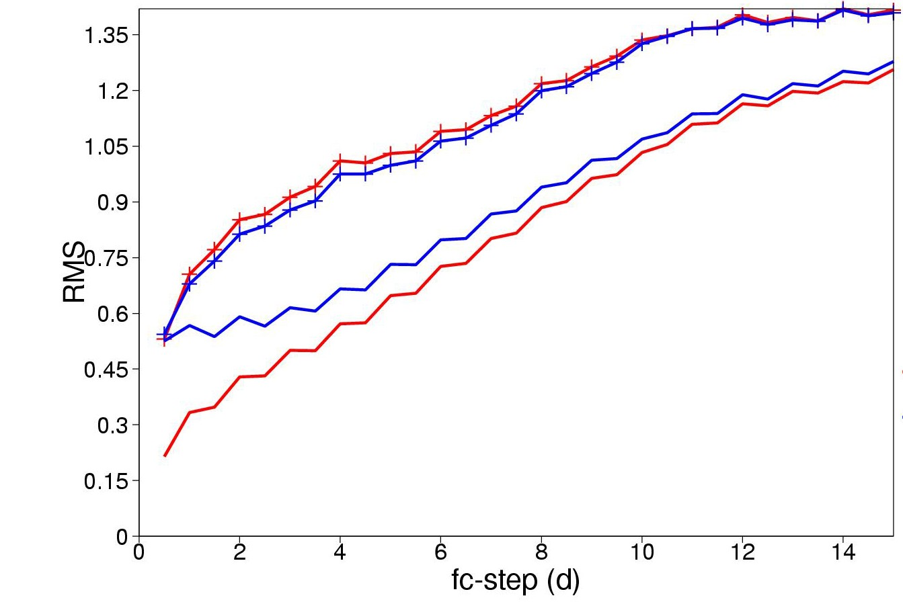
Applications of the EDA
Improving Ensemble Prediction System by including EDA perturbations for initial uncertainty (implemented June 2010)
The Ensemble Prediction System (EPS) benefits from using EDA based perturbations. Replacing evolved singular vector perturbations by EDA based perturbations improve EPS spread, especially in the tropics.
The Ensemble Mean has slightly lower error when EDA is used.
Massimo Bonavita – DA Training Course 2014 -
N.-Hem.
Tropics
EVO-SVINI EDA-SVINI
EVO-SVINI EDA-SVINI
EDA Slide 14
Ensemble spread and Ensemble mean RMSE for 850hPa T

Slide 15
Applications of the EDA
The EDA simulates the error evolution of the 4DVar analysis cycle. As such it has two main applications:
  Provide a flow-dependent estimate of analysis errors to initialize the ensemble prediction system (EPS)
  Provide a flow-dependent estimate of background errors for use in 4D-Var assimilation

Slide 16
Hybrids: EDA
In the ECMWF 4D-Var, the B matrix is defined implicitly in terms of a transformation from the background departure (x-x_{b}) to a control variable χ:
(x-x_{b}) = Lχ
So that the implied B=LL^{T}.
In the current wavelet formulation (Fisher, 2003), the variable transform can be written as:
(x − x ) = T Σ
ψ ⊗ [ χ ]
−1 1/ 2
b ∑ j
C (λ,φ )
1/ 2
b
j j
j
T is the balance operator, i.e. the operator that links the control variables to the model variables
Σ_{b} is the gridpoint variance of background errors
C_{j}(λ,φ) is the vertical covariance matrix for wavelet index j
ψ_{j} are the set of radial basis function that define the wavelet transform.

Slide 17
ψ ⊗ [C (λ,φ )χ ]
Hybrids: EDA
(x − x ) = T Σ
b b ∑ j j j
−1 1/ 2
1/ 2
j
C_{j}(λ,φ) are full vertical covariance matrices, function of (λ,φ). They
determine both the horizontal and vertical background error correlation structures;
In standard 4D-Var T and C_{j} are computed off-line using a climatology of EDA perturbations.
Σ_{b} is computed by random sampling of the static B matrix (randomization procedure, Fisher and Courtier, 1995)
How do we make this error covariance model flow-dependent?
We look for flow-dependent EDA estimates of Σ_{b} and C_{j}(λ,φ)

Slide 18

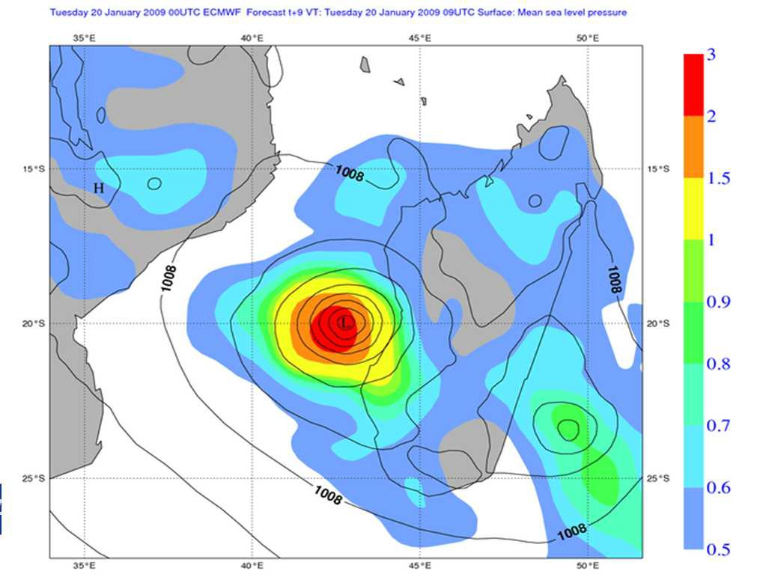
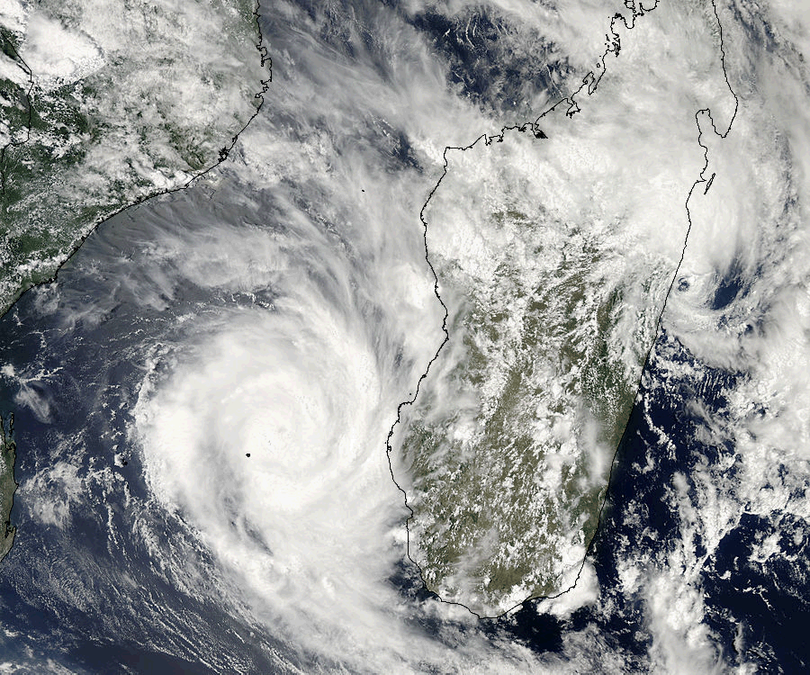
Applications of the EDA
We want to use EDA perturbations to simulate 4DVar flow- dependent background error covariance evolution
We start with the EDA flow-dependent estimates of background error variances (diagonal of the B matrix, Σ_{b})
EDA based background error variance for surface pressure
A Slide 18
Massimo Bonavita – DA Training Course 2014 - E
D

Slide 19
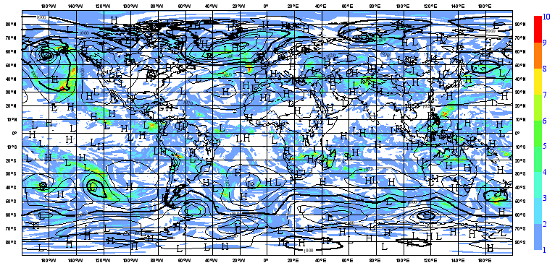
Applications of the EDA
What do raw ensemble variances look like?
Spread of Vorticity t+9h 500hPa

Slide 20
Applications of the EDA
Noise level is due to sampling errors: 25 member ensemble
EDA is a stochastic system: error variance of variance estimator
~ 1/N_{ens}
We need a system to effectively filter out noise from first guess ensemble forecast variances: Reduce the random component of the estimation error

Slide 21
Applications of the EDA
Mallat et al.: 1998, Annals of Statistics, 26,1-47
Define G^{e}(i) as the random component of the sampling error in the estimated ensemble variance at gridpoint i:
G (i) ≡ B − E[B ]
~ ~
e
ii ii
Then the covariance of the sampling noise can be shown to be a simple function of the expectation of the ensemble-based covariance matrix:
2
(E[ ]
E[G ( ]=
~
)
2
e
i)G ( j)
(1)
e
^{B}ij
N −1

Slide 22
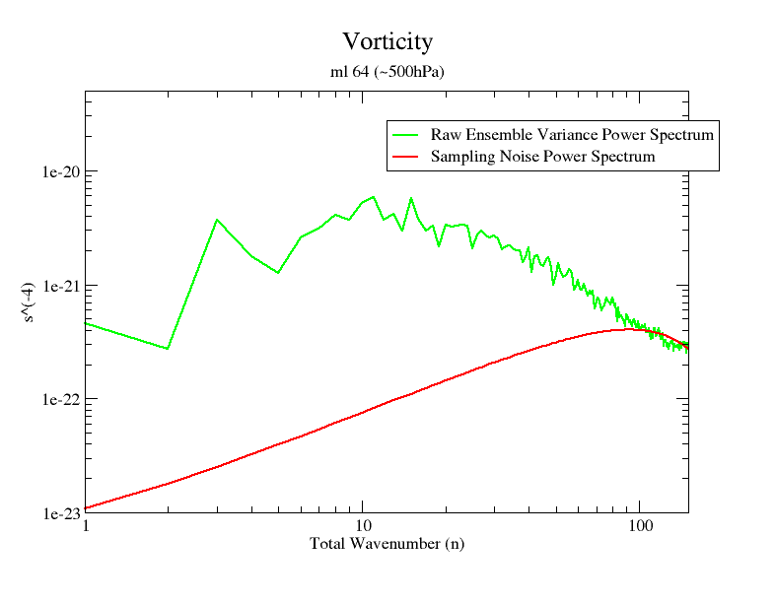
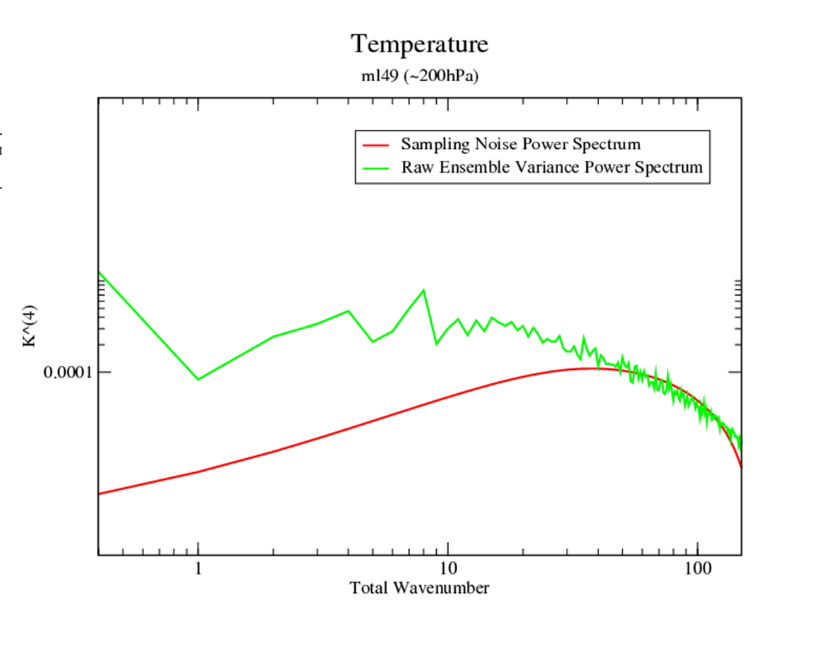
Applications of the EDA
We can use a spectral filter to disentangle noise from signal
Truncation wavenumber is determined by maximizing signal- to-noise ratio of filtered variances (Raynaud et al., 2009; Bonavita et al., 2011)

Slide 23
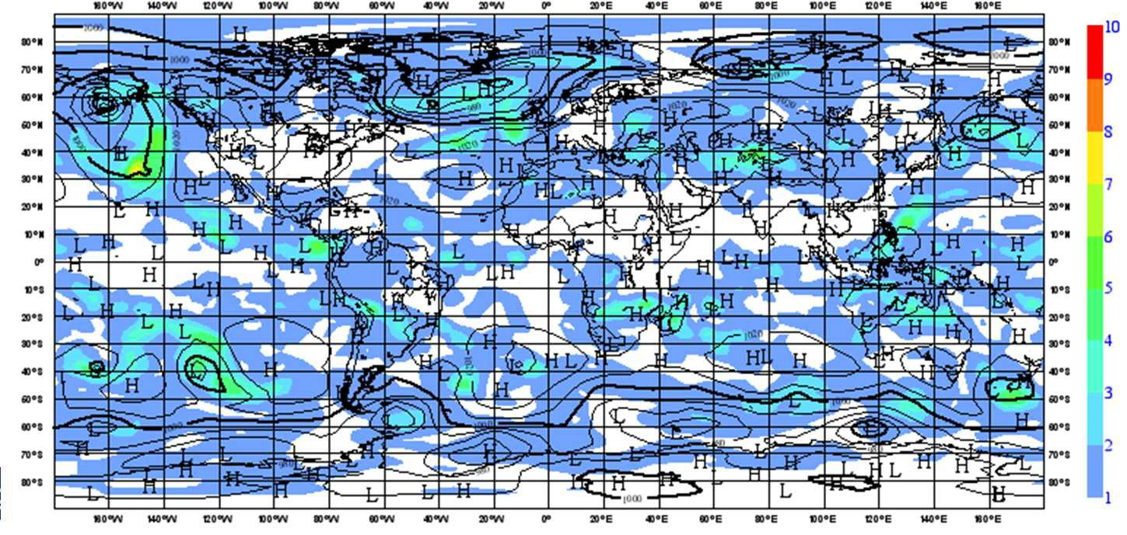
Applications of the EDA
Raw EDA StDev Vorticity 500 hPa
Course 2014 - EDA
Filtered EDA StDev Vorticity 500 hPa
Massimo Bonavita – DA Training

Slide 24
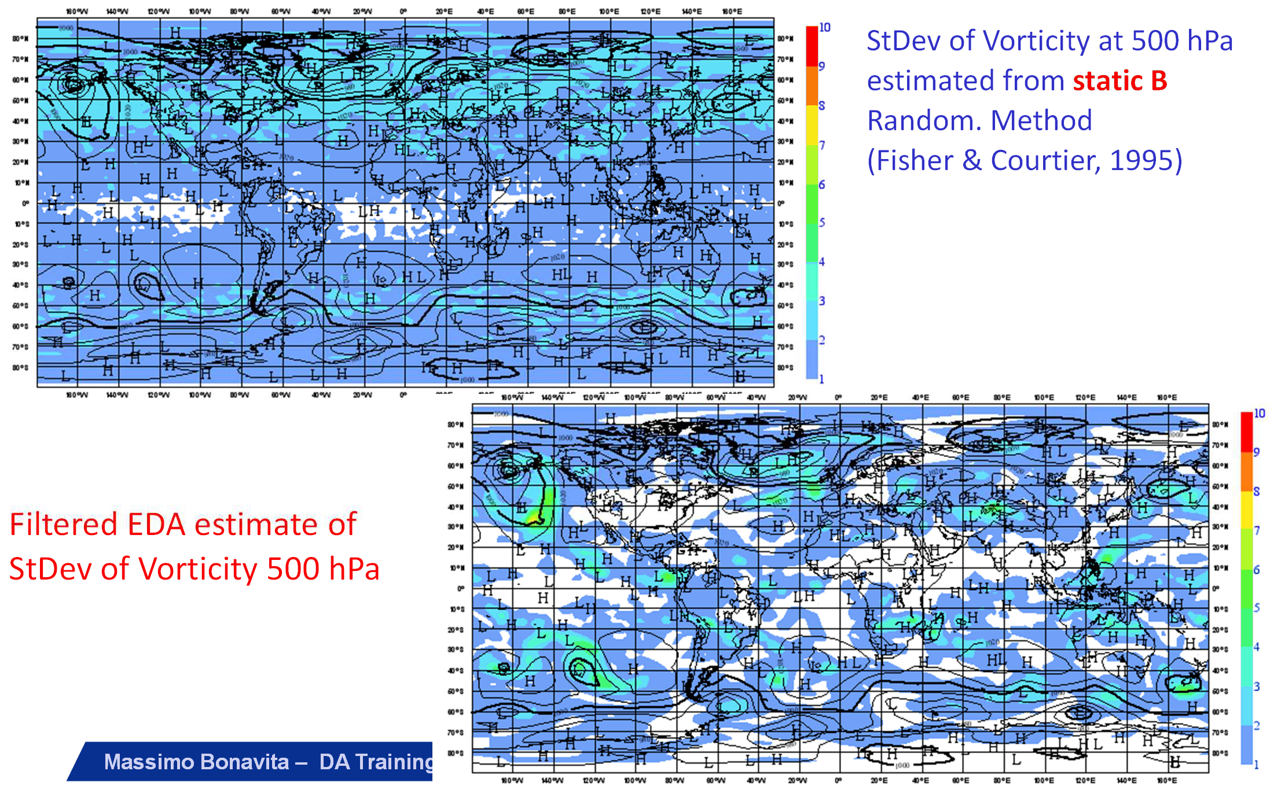
Applications of the EDA
StDev of Vorticity at 500 hPa estimated from static B Random. Method
(Fisher & Courtier, 1995)
Filtered EDA estimate of
StDev of Vorticity 500 hPa
Massimo Bonavita – DA Training Course 2014 - EDA

Slide 25
Applications of the EDA
Is there also a systematic error in our EDA sampled variances?
A statistically consistent ensemble satisfies:
(1-1/N _{n} )⁻¹<Ens_Var> = (1+1/N
)⁻ <Ens_Mean_Square_Error>
1
e
s
e
n
s

Slide 26
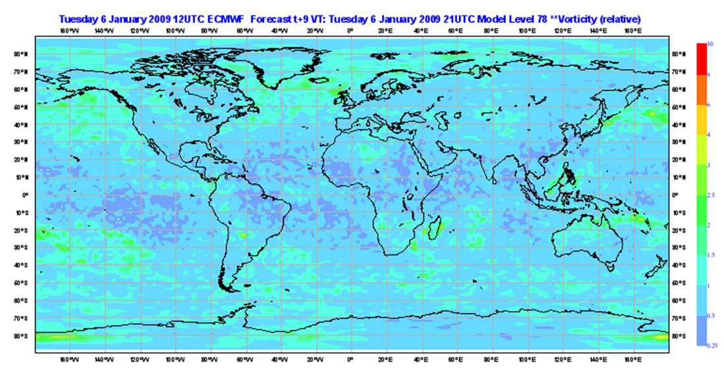
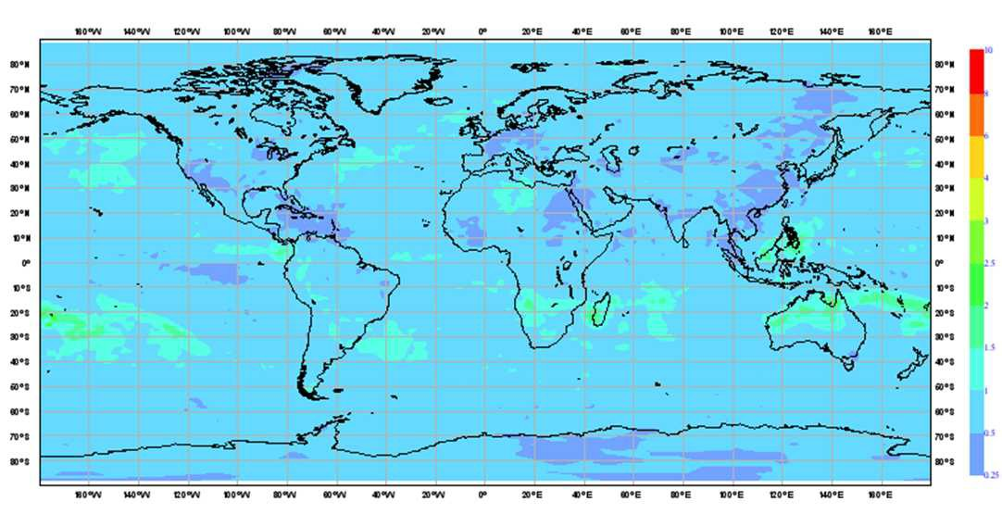
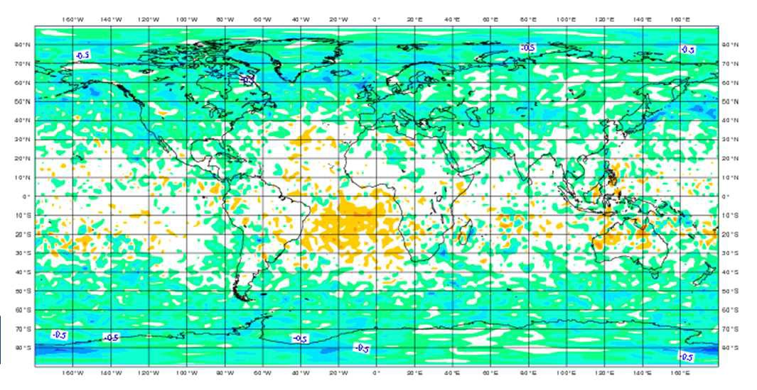
Applications of the EDA
Vorticity ml 78 (~850hPa)
Ensemble Error
Ensemble Spread
Slide 26
Spread - Error

Slide 27
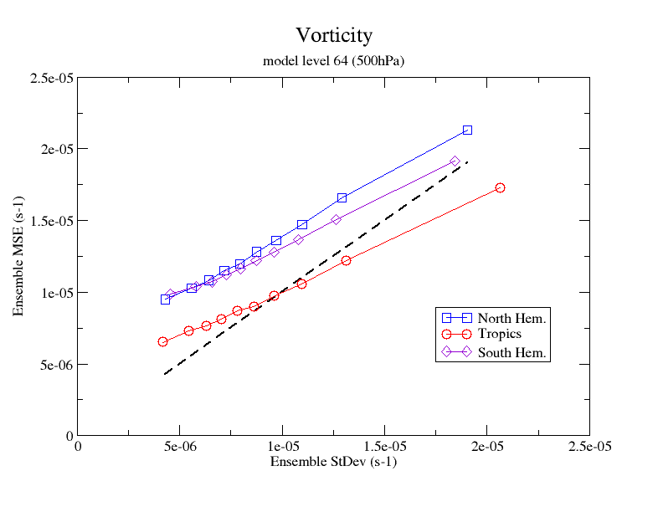
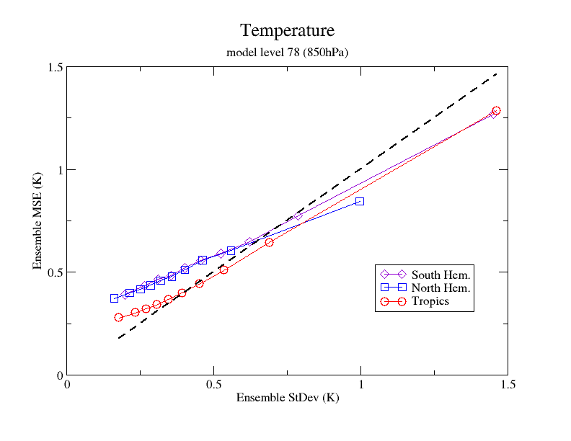
Applications of the EDA
To get statistically consistent EDA variances we need to perform an online calibration (Ensemble Variance Calibration; Kolczynsky et al., 2009, 2011; Bonavita et al., 2011)
Calibration factors are also state-dependent, i.e. depend on the size of the expected error
Need to perform calibration of variances reflects underlying problem in Q and R models, system non-linearities, ensemble size
Massimo Bonavita – DA Training Course 2014 - EDA

Slide 28

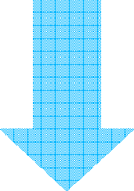




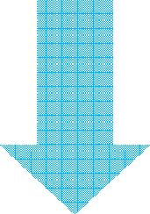

EDA Cycle
x +ε_{i} y+ε
SST+ε
b
b
x +ε
f
i
x +ε_{i}
f
o
a
a
i=1,2,…,10
i
Analysis
Forecast
i
S
S
T
Variance post-process
ε_{i}^{f} raw variances
Variance Rescaling
Variance Filtering
EDA scaled
variances
4DVar Cycle
_{x}b
EDA scaled Var
Analysis
_{x}a
Forecast
_{x}f

Slide 29
Use of EDA variances in 4DVar
How does the flow-dependent structure of the EDA variances affect the 4DVar analysis?
Two mechanisms:
  Inside 4DVar EDA variances change the shape and size of analysis increments
  Before 4DVar they affect the observation quality control decisions

Slide 30
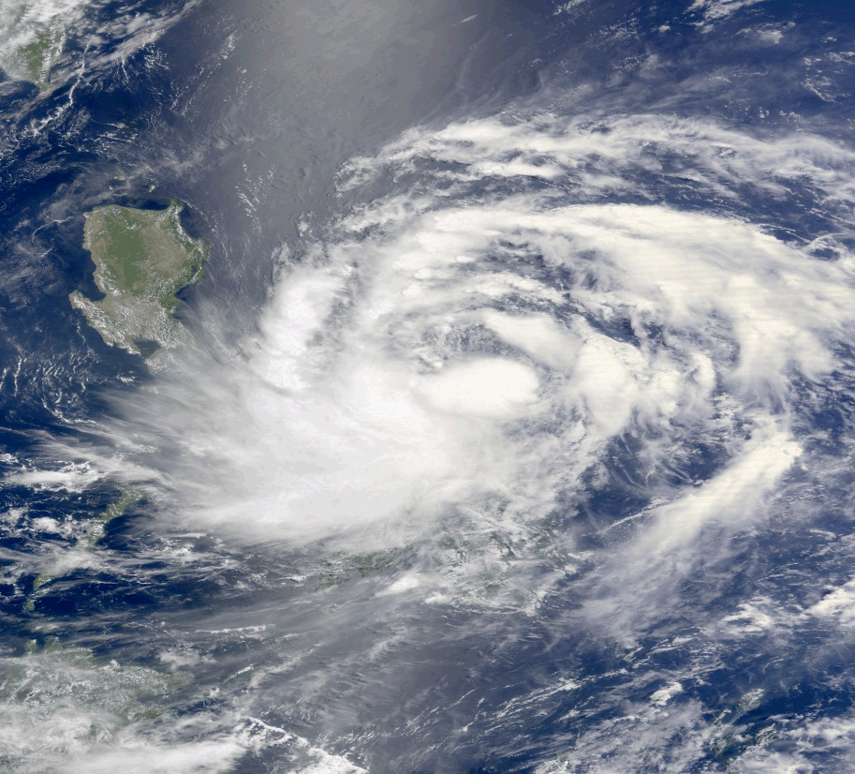
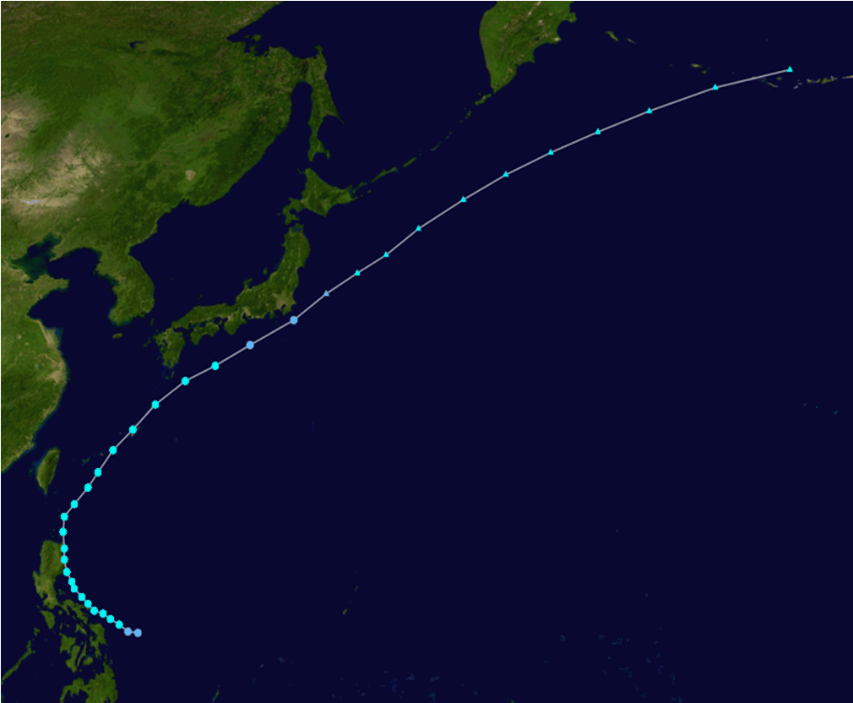
Use of EDA variances in 4DVar
1. Inside 4DVar EDA variances change the shape and size of analysis increments
Tropical Cyclone Aere, Philippines 8-9 May 2011.

Slide 31
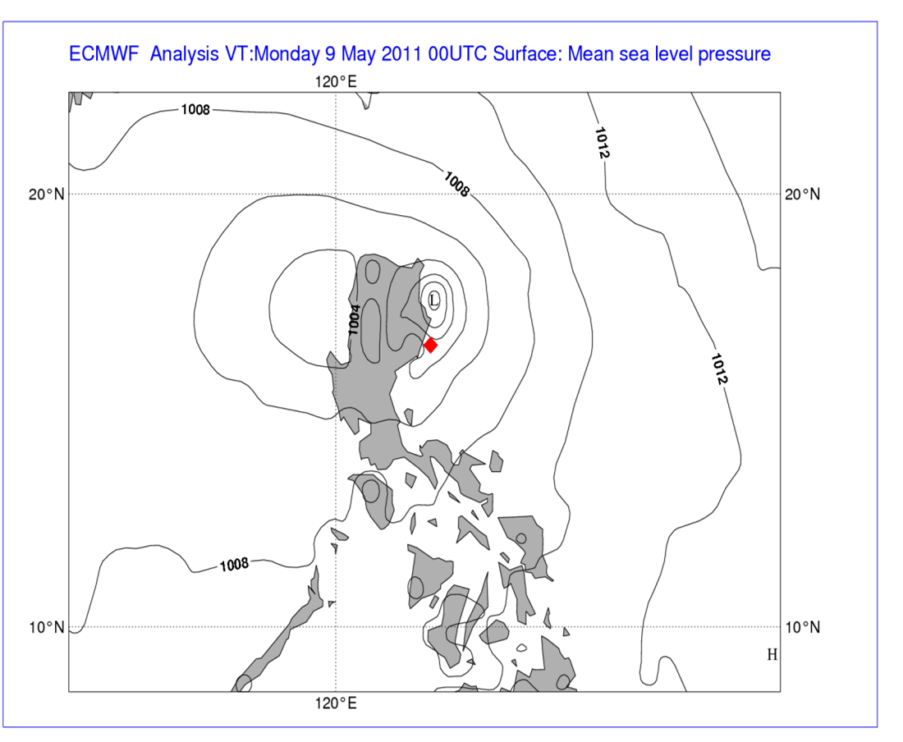
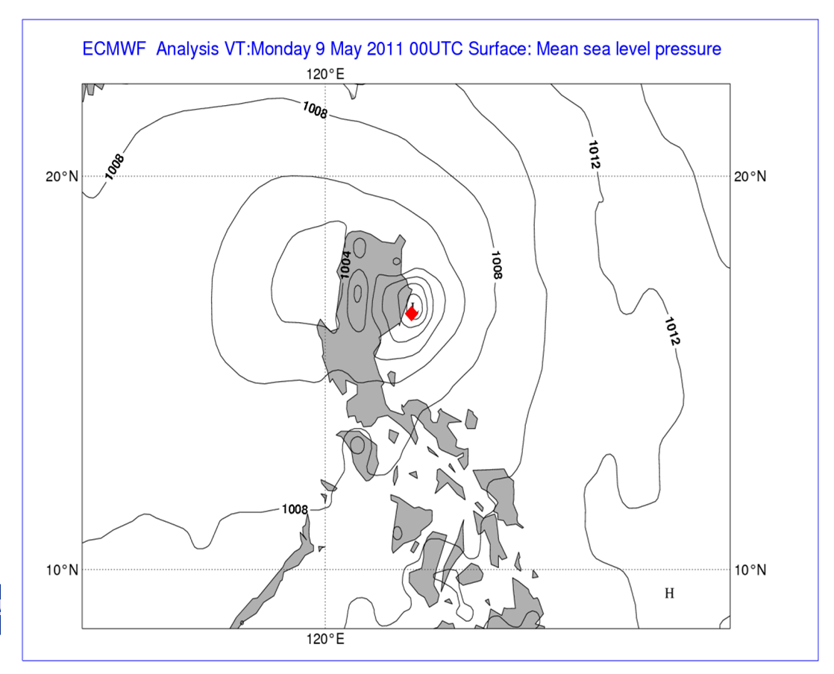
Use of EDA variances in 4DVar
1. Inside 4DVar EDA variances change the shape and size of analysis increments
Significant operational analysis error, corrected by 4DVar with EDA variances
4DVar with Static errors 4DVar with EDA errors
Massimo Bonavita – DA Training Course 2014 - EDA

Slide 32
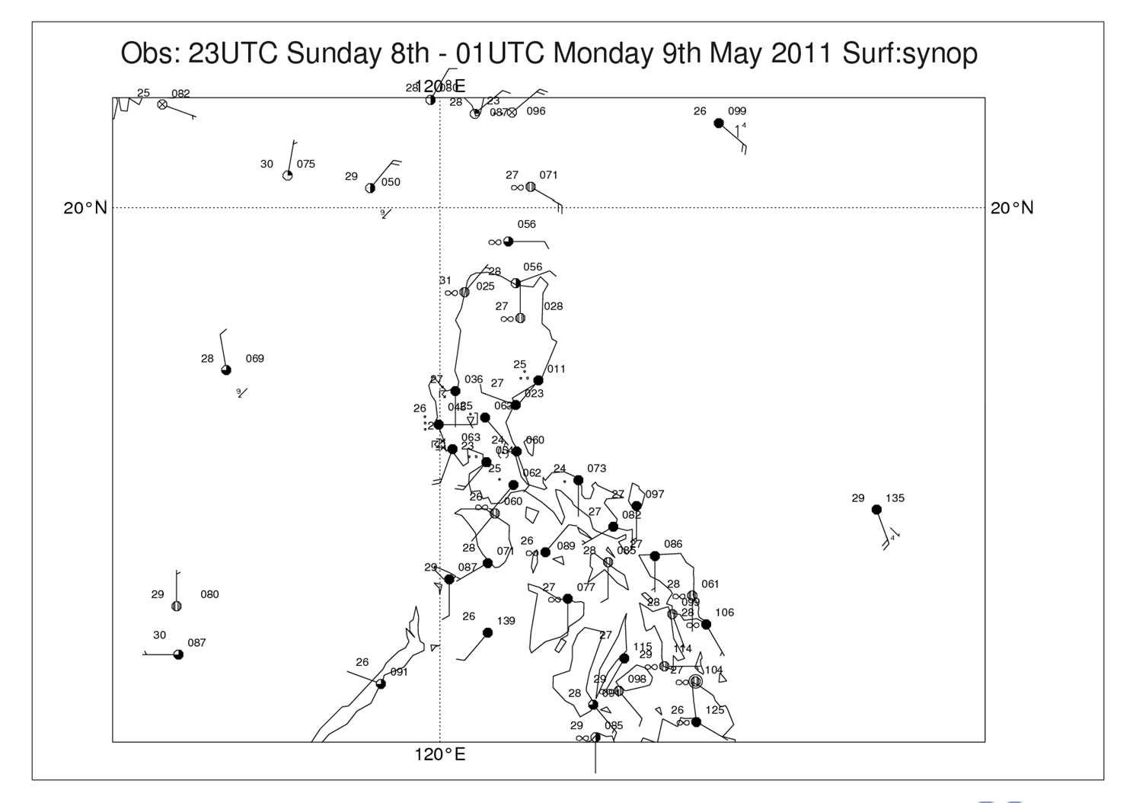
Use of EDA variances in 4DVar
1. Inside 4DVar EDA variances change the shape and size of analysis increments
Slide 32

Slide 33
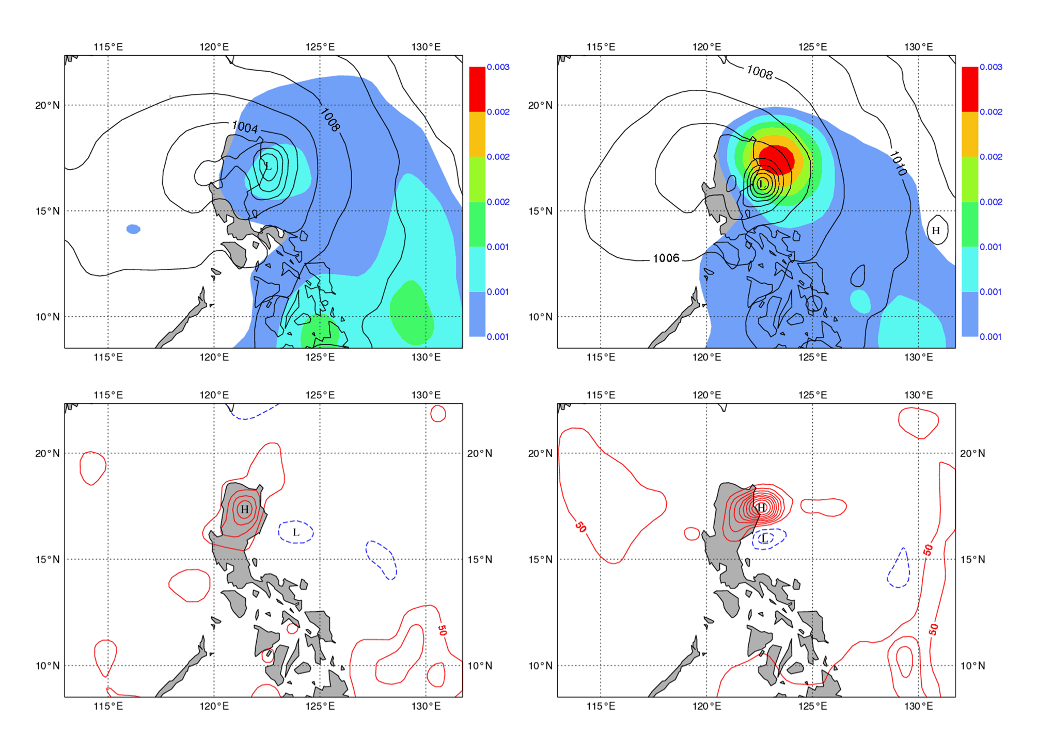
log(P_{s}) EDA errors
log(P_{s}) Static errors
Massimo Bonavita – DA Training Course 2014 - EDA
Static mslp ana incr.
EDA mslp ana incr.

Slide 34
Use of EDA variances in 4DVar
Flow-dependent EDA errors have been used operationally since May 2012 (CY37R2)
The effect of using flow-dependent EDA estimated errors is large on average skill scores
Massimo Bonavita – DA Training Course 2014 - EDA
Slide 34

Slide 35
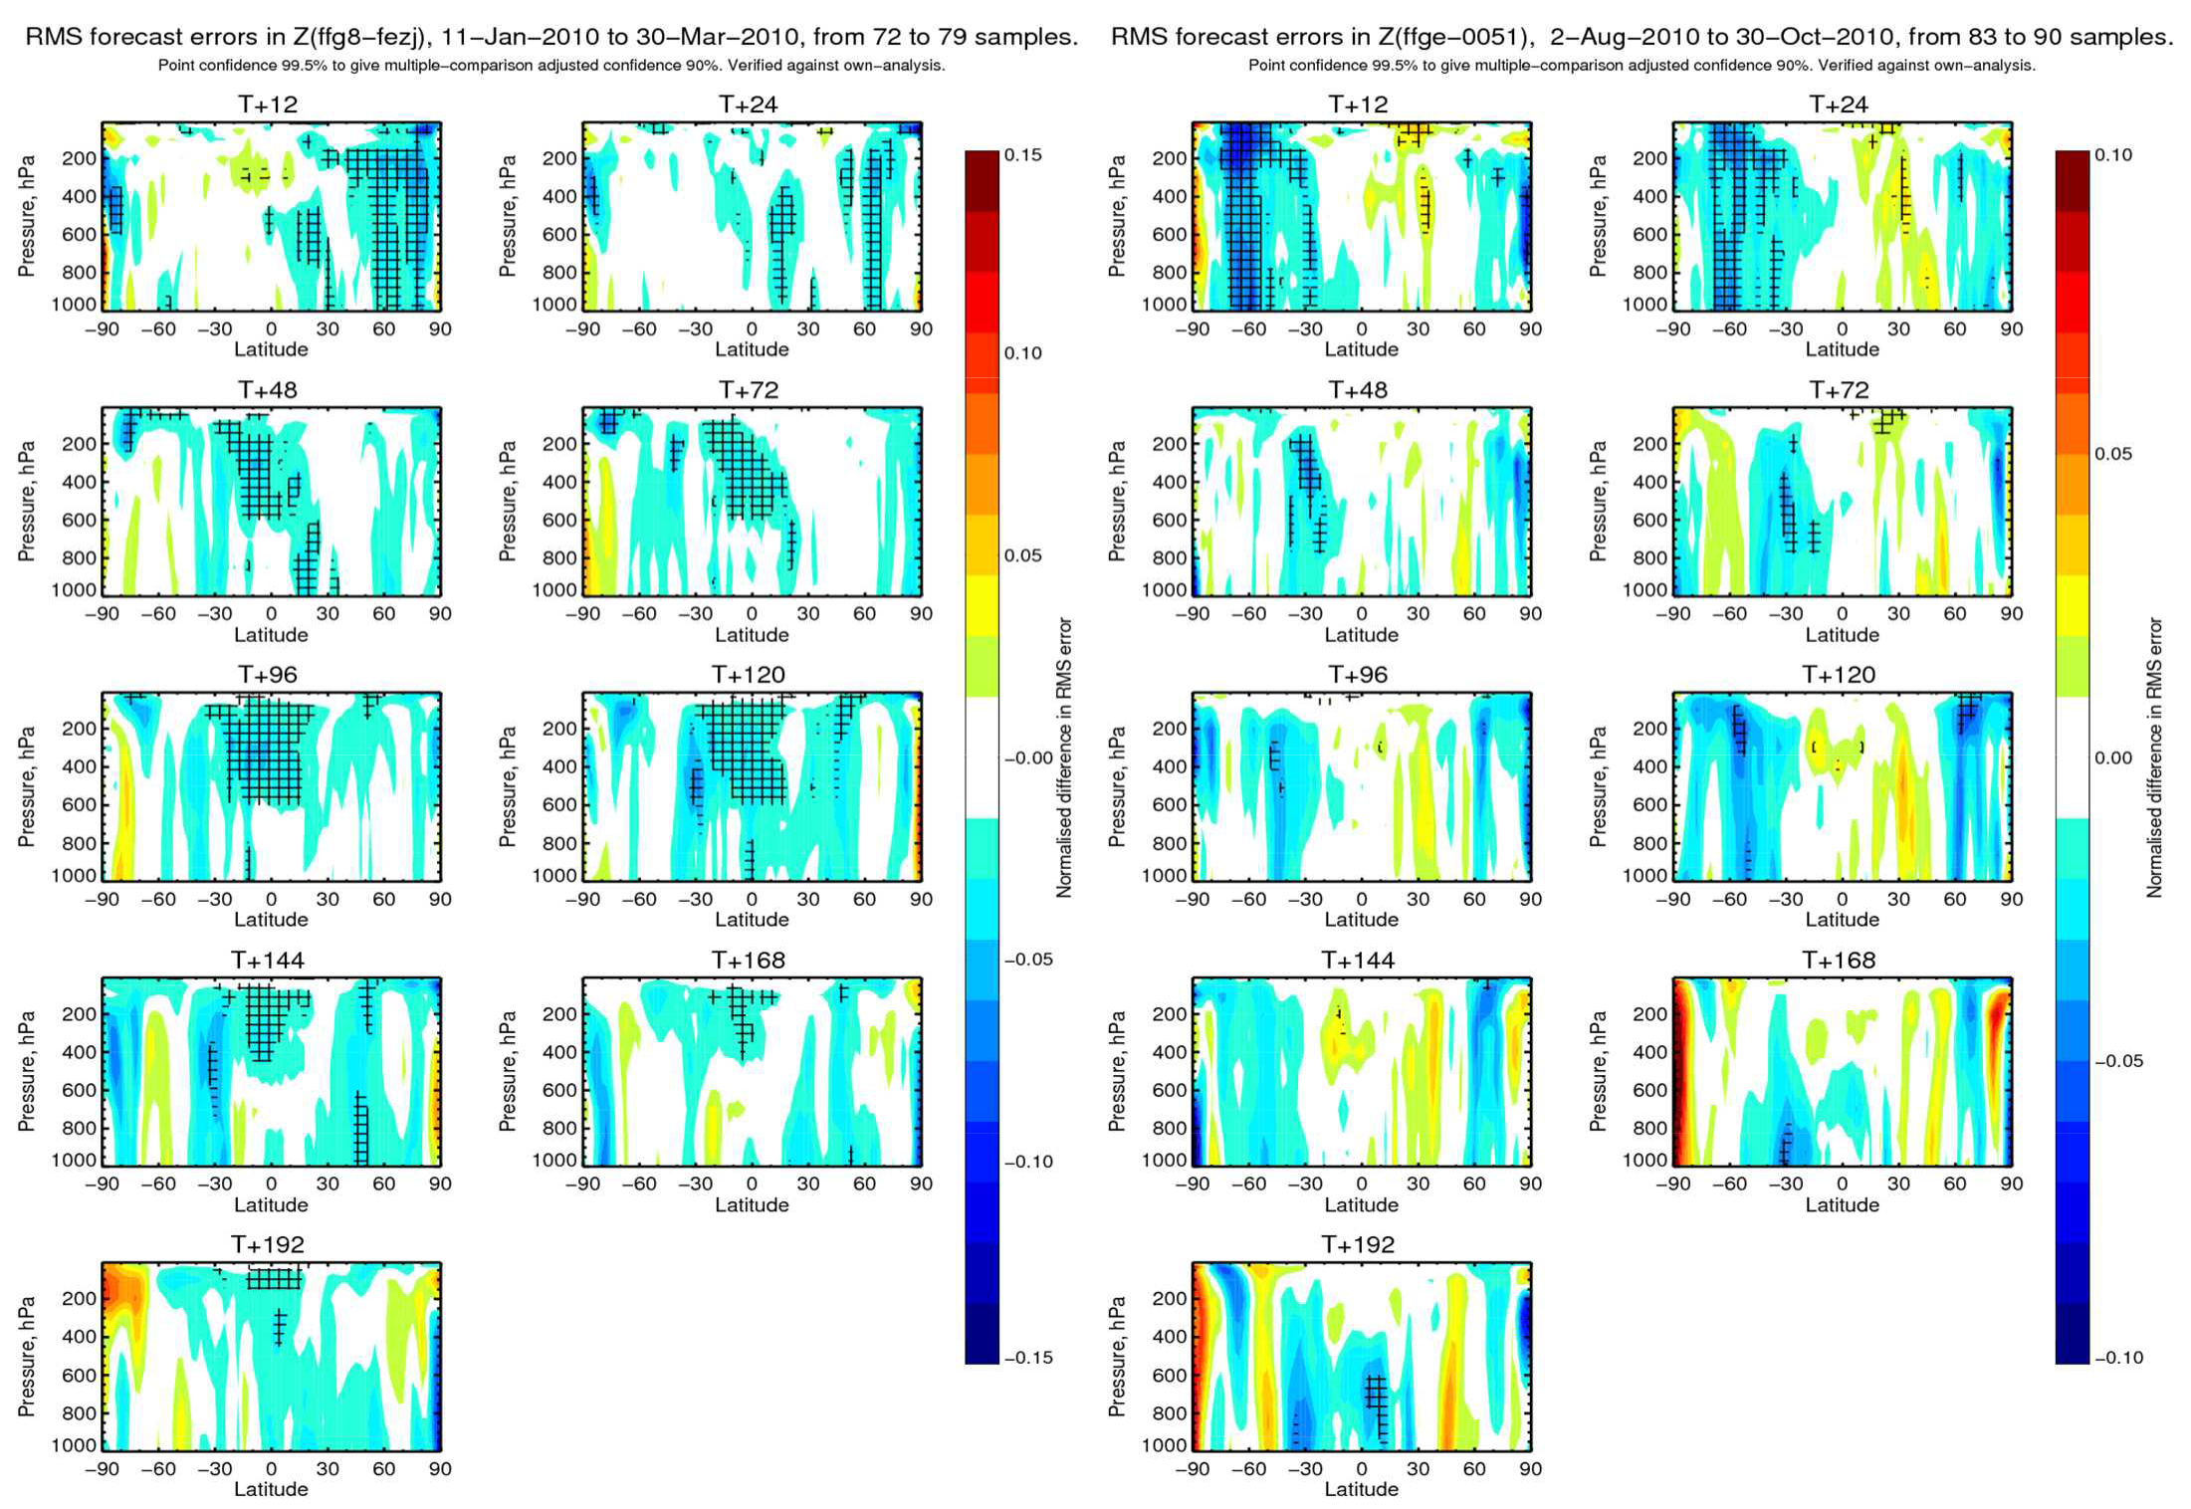
Geopotential RMSE reduction
Massimo Bonavita – DA Training Course 2014 - EDA Slide 35
winter
summer
Blue=☺

Slide 36
ψ ⊗ [ χ ]
Use of EDA covariances in 4DVar
(x − x ) = T Σ
−1 1/ 2
b ∑ j
C (λ,φ )
1/ 2
b
j j
j
T is the balance operator
Σ_{b} is the gridpoint variance of background errors
C_{j}(λ,φ) is the vertical covariance matrix for wavelet index j
ψ_{j} are the set of radial basis function that define the wavelet transform
C_{j}(λ,φ) are fields of full vertical covariance matrices, defined for each wavelet band. They determine both the horizontal and vertical background error correlation structures.
In order to get flow-dependent error covariances we need flow-dependent estimates of C_{j}(λ,φ).

Slide 37

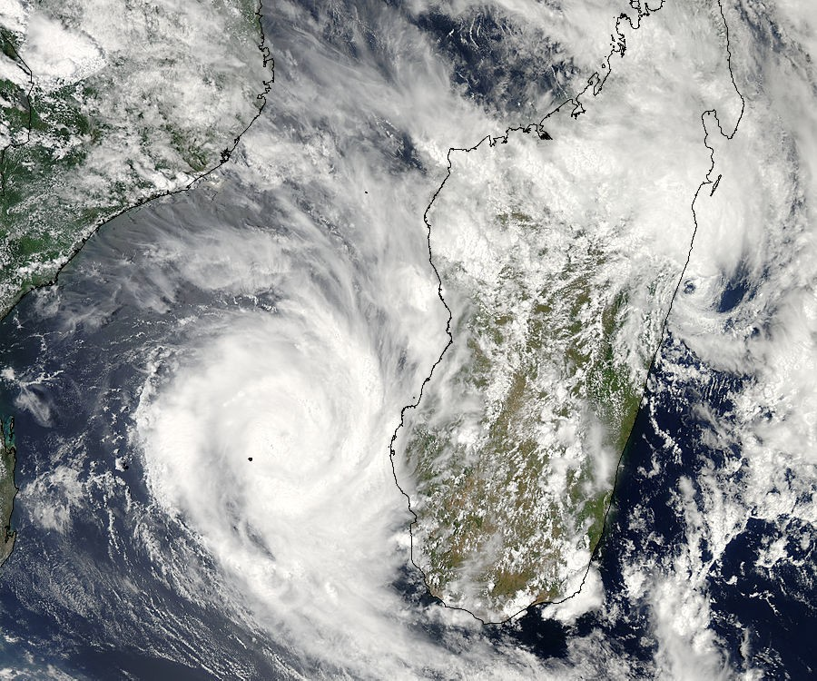
Use of EDA covariances in 4DVar
Diagnosing the Background Error Correlation Length-Scales
ρ(r )
L ≡ −
∂² ρ (r )/ ∂r ²
r =0
Hurricane Fanele 20 January 2009

Slide 38
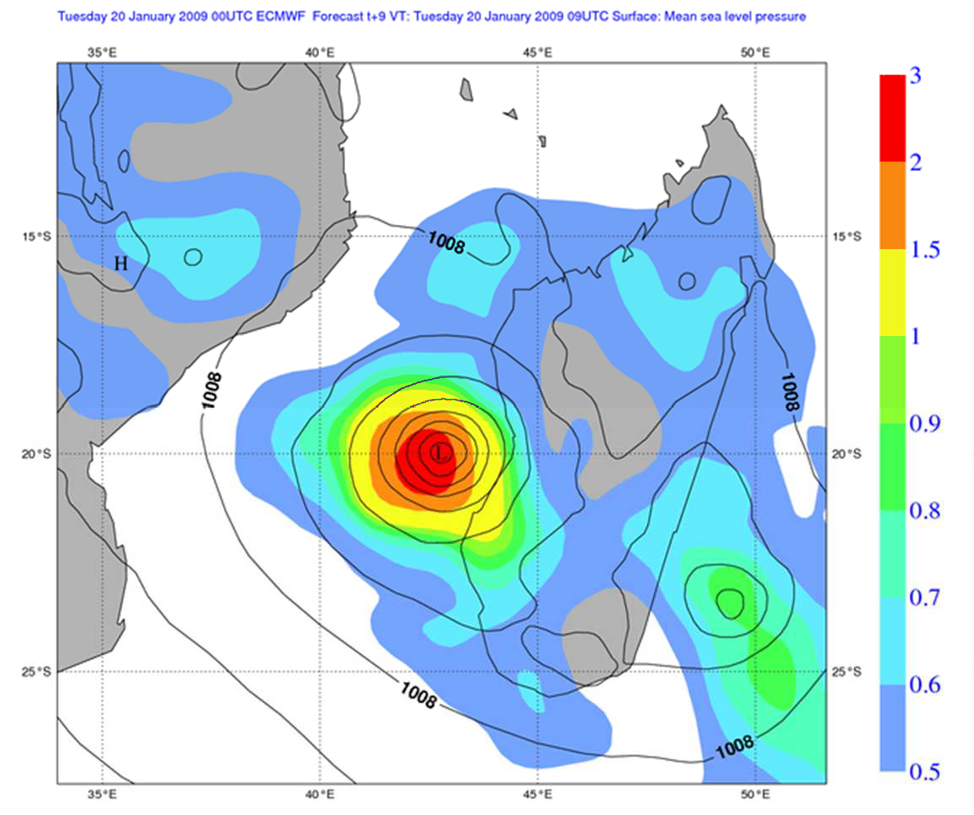
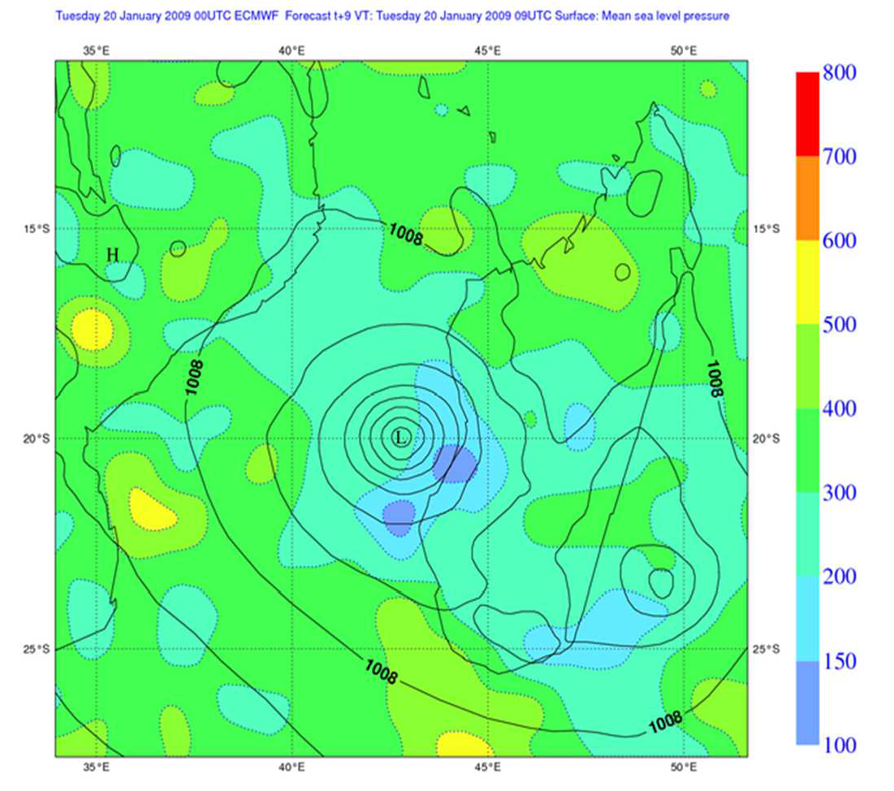
Use of EDA covariances in 4DVar
20 member EDA
Surf. Press. Background Err. St.Dev.
Surf. Press. BG Err. Correlation L. Scale

Slide 39
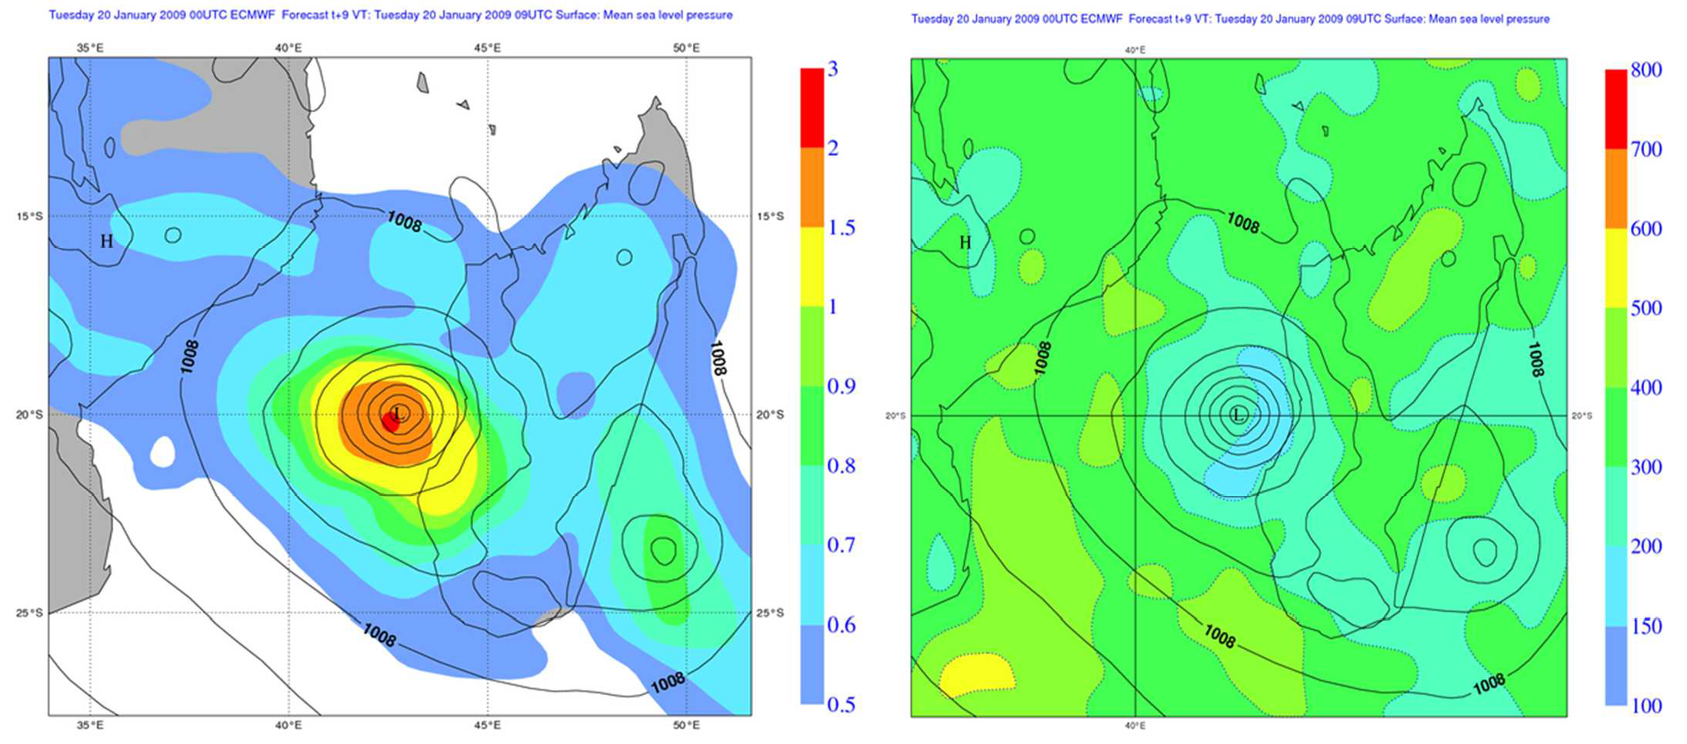
Use of EDA covariances in 4DVar
50 member EDA
Surf. Press. Background Err. St.Dev.
Surf. Press. BG Err. Correlation L. Scale

Slide 40
Use of EDA covariances in 4DVar
From November 2013 (CY40R1) background error covariances (wavelet JB) are computed online, i.e. they are updated at every assimilation time (00, 12 UTC)
EDA perturbations from the past 12 days are used, with an exponential decay factor (i.e., reduce noise at the cost of losing some flow-dependent detail)
Continuously updated JB is used in High Resolution 4D- Var

Slide 41
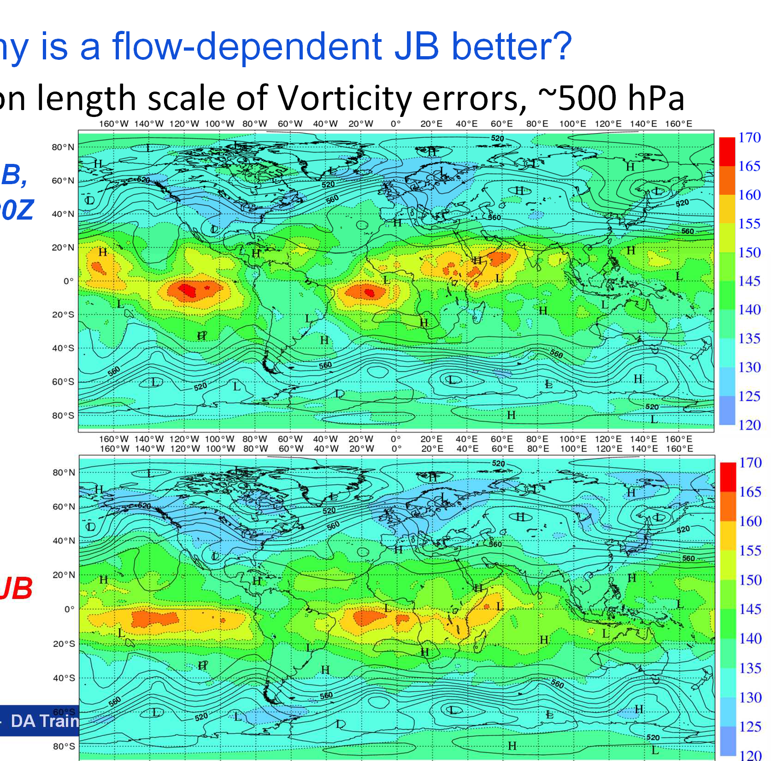
Correlati
hy is a flow-dependent JB better?
on length scale of Vorticity errors, ~500 hPa
B, 0Z
W
Online wavelet J valid 20120110 0
B
DA Training Course 2014 - EDA
Static wavelet J
Massimo Bonavita –

Slide 42
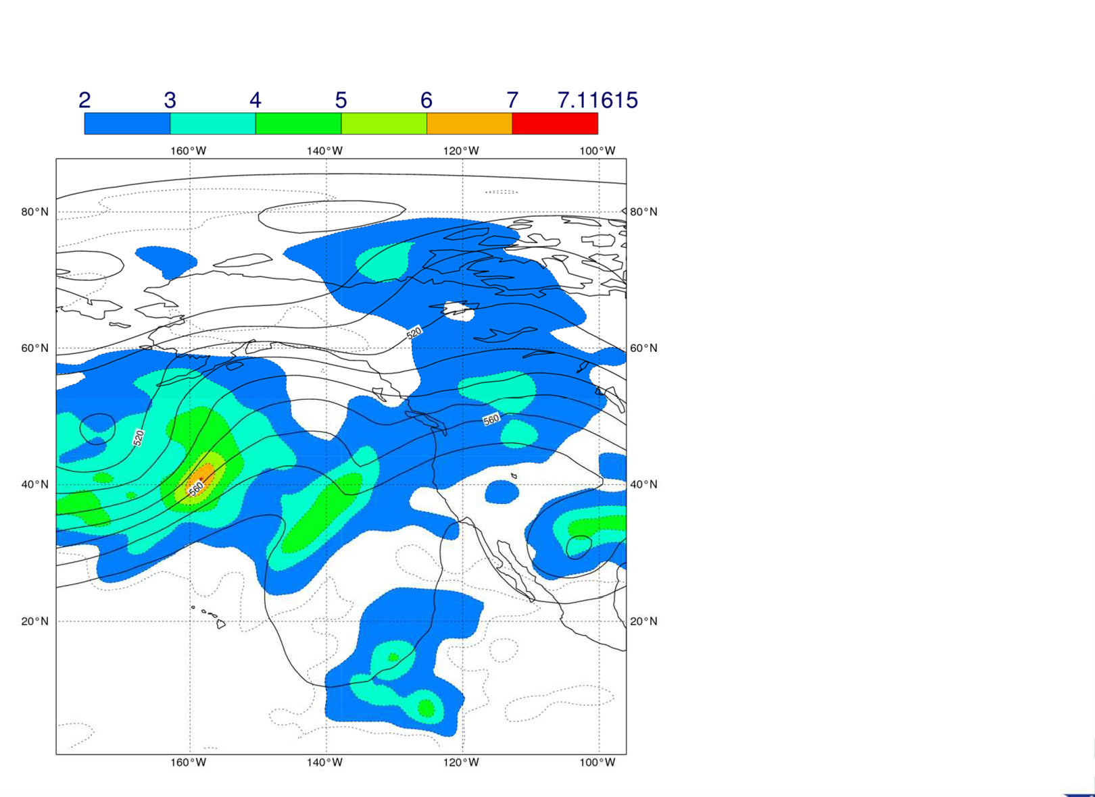
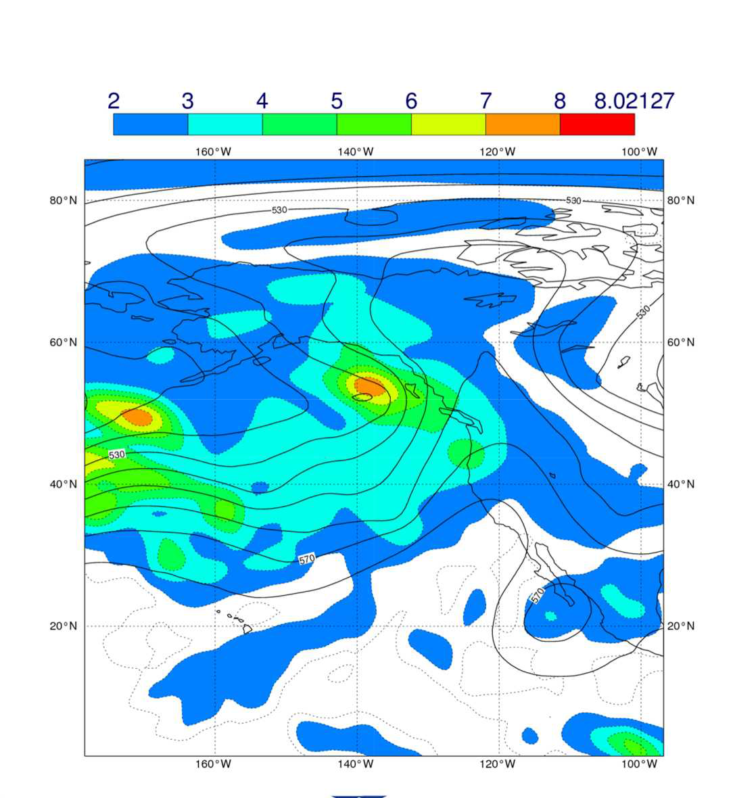
Why is a flow-dependent JB better?
2012-01-01 00Z
2012-02-01 00Z
Massimo Bonavita – DA Training Course 2014 - EDA

Slide 43
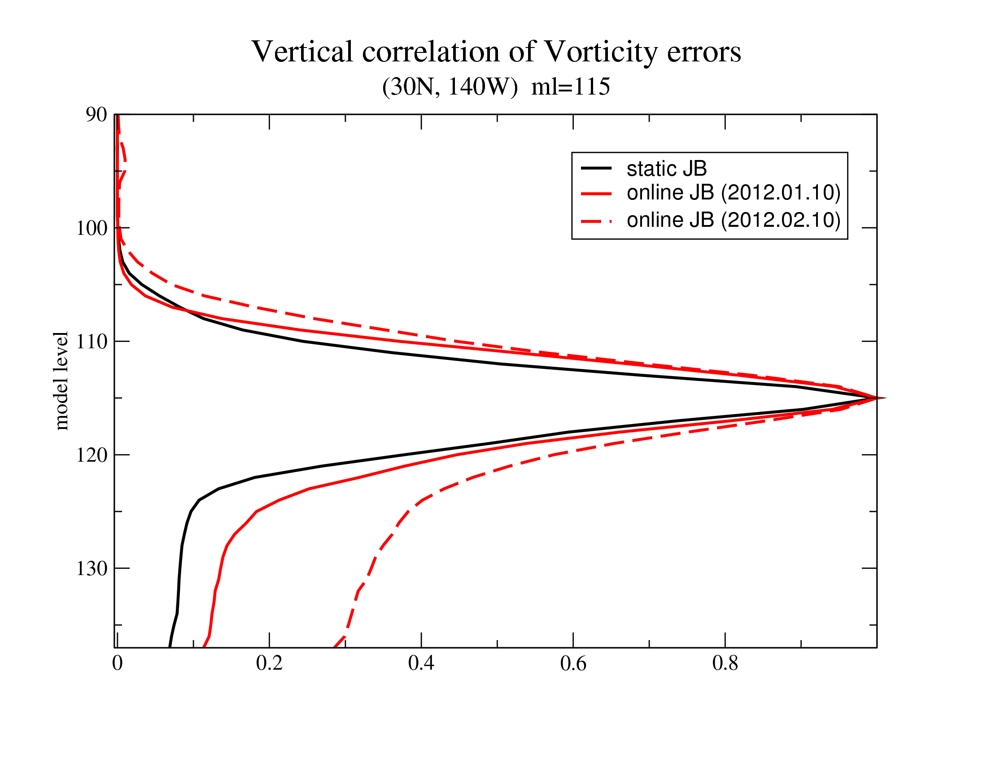
Why is a flow-dependent JB better?

Slide 44

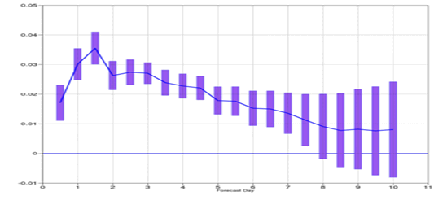
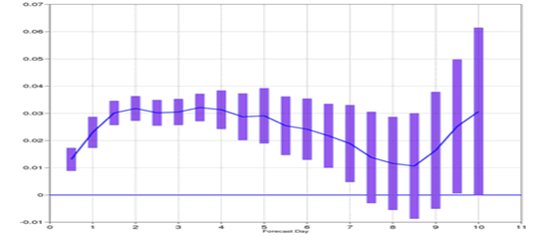
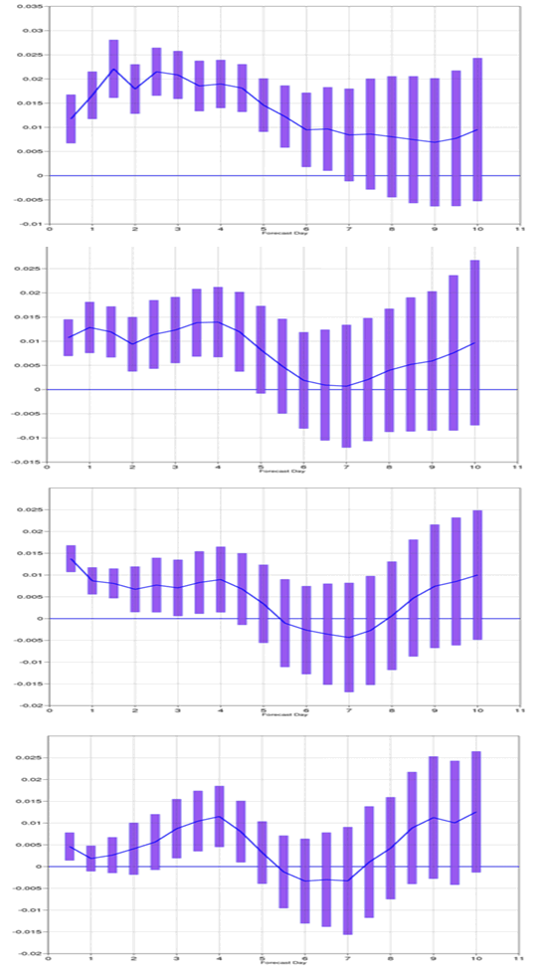
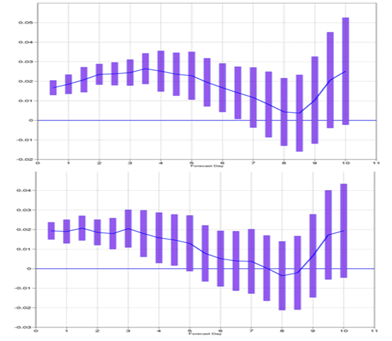
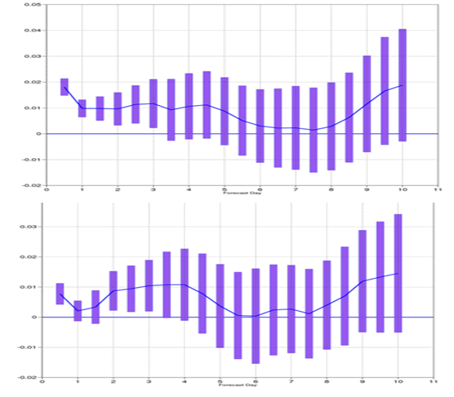
Impact of online JB
Reduction in Geopotential RMSE - 95% confidence
NH
SH
50 hPa
Period: Feb - June 2012
T511L91, 3 Outer Loops (T159/T255/T255)
Verified against operational analysis
100 hPa
200 hPa
500 hPa
1000 hPa

Slide 45
Summary
The EDA is the best available tool at ECMWF to estimate analysis and background errors of the ECMWF analysis
The EDA derived analysis errors contribute to the estimation of initial perturbations of the Ensemble Prediction System (EPS)
The EDA background perturbations provide flow-dependent estimates of background errors variances and covariances for use in the High-Resolution 4DVar analysis

Slide 46
Summary
The use of EDA background perturbations in a variational analysis is currently done in two ways:
  adding an ensemble, flow-dependent component to the static B used in 4D-Var (UK MetO, NCEP; alpha control variable method: Lorenc, 2003)
  using EDA perturbations to get an on-line, flow- dependent estimate of parameterised B (ECMWF, Meteo France; EDA approach)

Slide 47
Summary
Flow-dependent background errors from EDA variances have been used in ECMWF 4D-Var since April 2011 (Cycle 37R2)
They benefit the analysis and forecast skill by:
  changing the weight given to observations near dynamically active zones;
  introducing a level of flow-dependency in the analysis increments
  Allowing a state and flow-dependent QC of observations
Increase in ensemble size will benefit the system allowing less aggressive filtering of raw variances (Bonavita et al., 2011)

Slide 48
Summary
Flow-dependent background error covariances (B) estimated from EDA perturbations has been implemented recently (CY40R1, November 2013)
They also have an important effect on the analysis by providing flow-dependent, non homogeneous, correlation structures
The introduction of flow-dependent background errors and covariances estimated from the EDA has been one of the largest source of improvement in recent years in the analysis and forecast skill of the IFS

Slide 49
References
Anderson, J.L., 2007: An adaptive covariance inflation error correction algorithm for ensemble filters. Tellus, 59A, 210–224.
Bishop, C. H., and D. Hodyss, 2007: Flow adaptive moderation of spurious ensemble correlations and its use in ensemble-based data assimilation. Quart. J. Roy. Meteor. Soc., 133, 2029–2044.
Bishop, C. H., and D. Hodyss, 2009a: Ensemble covariances adaptively localized with ECO-RAP, Part 1: Tests on simple error models. Tellus, 61, 84–96.
Bonavita M., L. Raynaud and L. Isaksen, 2010: Estimating background-error variances with the ECMWF Ensemble of Data Assimilations system: the effect of ensemble size and day-to-day variability. Q. J. R. Meteorol. Soc., 137: 423–434.
Bonavita M., L. Isaksen and E. Holm, 2012: On the use of EDA background error variances in the ECMWF 4D-Var. Q. J. R. Meteorol. Soc.. Early Online Release, doi: 10.1002/qj.1899
R. Buizza, P. L. Houtekamer, Z. Toth, G. Pellerin, M. Wei & Y. Zhu, 2005: A comparison of the ECMWF, MSC and NCEP Global Ensemble Prediction Systems. Mon. Wea. Rev., 133, 5, 1076-1097.
Burgers, G., P. J. van Leeuwen, and G. Evensen, 1998: Analysis scheme in the ensemble Kalman filter. Mon. Wea. Rev., 126, 1719-1724.
Campbell, William F., Craig H. Bishop, Daniel Hodyss, 2010: Vertical Covariance Localization for Satellite Radiances in Ensemble Kalman Filters. Mon. Wea. Rev., 138, 282–290.
Evensen, G., 1994: Sequential data assimilation with a nonlinear quasi-geostrophic model using Monte Carlo methods to forecast error statistics. J. Geophys. Res., 99, 10143-10162.

Slide 50
References
Evensen, G., 2003: The Ensemble Kalman Filter: theoretical formulation and practical implementation. Ocean Dynamics 53: 343–367
Fisher M, Leutbecher M, Kelly GA. 2005 On the equivalence between Kalman smoothing and weak- constraint four-dimensional variational data assimilation. Q. J. R. Meteorol. Soc. 131 3235–3246.
Fisher, M., 2003: Background error covariance modelling. Proceedings of the ECMWF Seminar on recent developments in data assimilation for atmosphere and ocean, ECMWF, pages 45–63. (Available from: http://www.ecmwf.int/publications/)
Fisher, M. and Courtier, P., 1995: Estimating the covariance matrices of analysis and forecast error in variational data assimilation. ECMWF Technical Memorandum 220. (Available from: http://www.ecmwf.int/publications/)
Isaksen, L., M. Bonavita, R. Buizza, M. Fisher, J. Haseler, M. Leutbecher and Laure Raynaud, 2010: Ensemble of data assimilations at ECMWF. ECMWF Technical Memorandum No. 636. (Available from: http://www.ecmwf.int/publications/)
Kolczynski W. C., Jr., D. R. Stauffer, S. E. Haupt, A. Deng, 2009: Ensemble Variance Calibration for Representing Meteorological Uncertainty for Atmospheric Transport and Dispersion Modeling. J. Appl. Meteor. Climatol., 48, 2001-2021.
Kolczynski W. C., Jr., D. R. Stauffer, S. E. Haupt, N. S. Altman, A. Deng, 2011: Investigation of Ensemble Variance as a Measure of True Forecast Variance. Mon. Weather Rev., Early Online Release, doi: 10.1175/MWR-D-10-05081.1
Leutbecher, M., 2010: Diagnosis of ensemble forecasting systems. Proceedings of the ECMWF Seminar on Diagnosis of Forecasting and Data Assimilation Systems, 7-10 September 2009, ECMWF, pages 235-
266. (Available from: http://www.ecmwf.int/publications/)

Slide 51
References
Liu C, Xiao Q, Wang B. 2008. An ensemble-based four-dimensional variational data assimilation scheme. part i: Technical formulation and preliminary test. Mon. Weather Rev. 136: 3363–3373.
Lorenc, A.C.,2003: The potential of the ensemble Kalman filter for NWP—A comparison with 4D-VAR. Q. J. R. Meteorol. Soc., 129: 3183–3203.
Mallat, S., G. Papanicolau, and Z. Zhang, 1998: Adaptive Covariance Estimation of Locally Stationary Processes. Annals of Statistics, 26,1,1-47.
Ott E, Hunt BR, Szunyogh I, Zimin AV, Kostelich EJ, Corazza M, Kalnay E, Patil DJ. 2004. A local ensemble Kalman filter for atmospheric data assimilation. Tellus 56A: 415–428.
Raynaud, L., L. Berre, and G. Desroziers, 2008: Spatial averaging of ensemble-based background-error variances. Q. J. R. Meteorol. Soc., 134, 1003–1014.
Snyder, C, 2012: Particle filters, the “optimal” proposal and high-dimensional systems. Proceedings of the ECMWF Seminar on Data assimilation for atmosphere and ocean, 6-9 September 2011, ECMWF, pages 161-170. (Available from: http://www.ecmwf.int/publications/)
Thepaut, J.-N., Courtier, P., Belaud, G. and Lemaıtre, G., 1996: Dynamical structure functions in a four- dimensional variational assimilation: A case study. Q. J. R. Meteorol. Soc., 122, 535–561
Van Leeuwen, P.J., 2012: Nonlinear large-scale data assimilation: the potential of particle filters. Proceedings of the ECMWF Seminar on Data assimilation for atmosphere and ocean, 6-9 September 2011, ECMWF, pages 171-187. (Available from: http://www.ecmwf.int/publications/)
Wikle, C. K., & Berliner, L. M., 2007: A Bayesian tutorial for data assimilation. Physica D: Nonlinear Phenomena, 230(1), 1-16.

Slide 52
Additional Slides

Slide 53
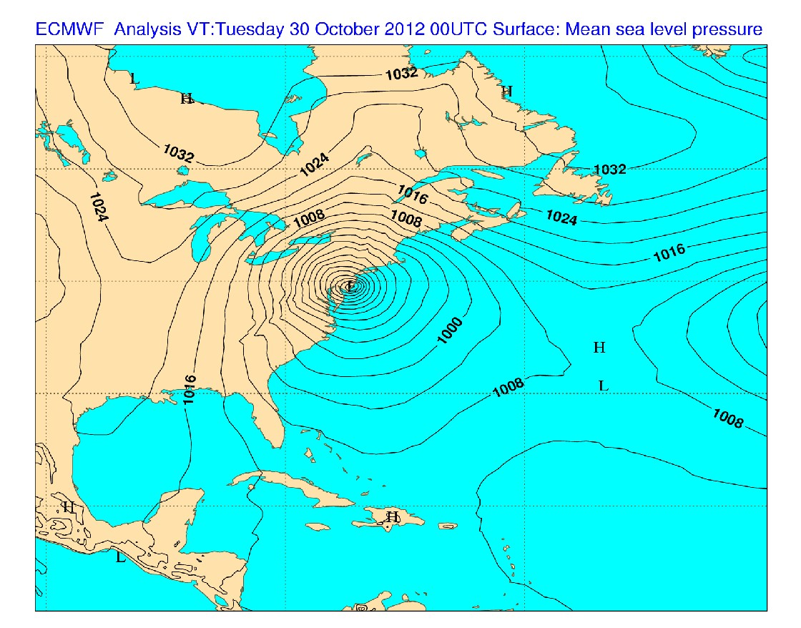
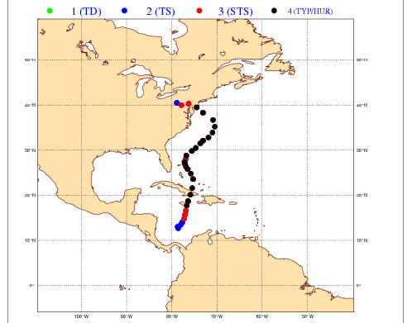
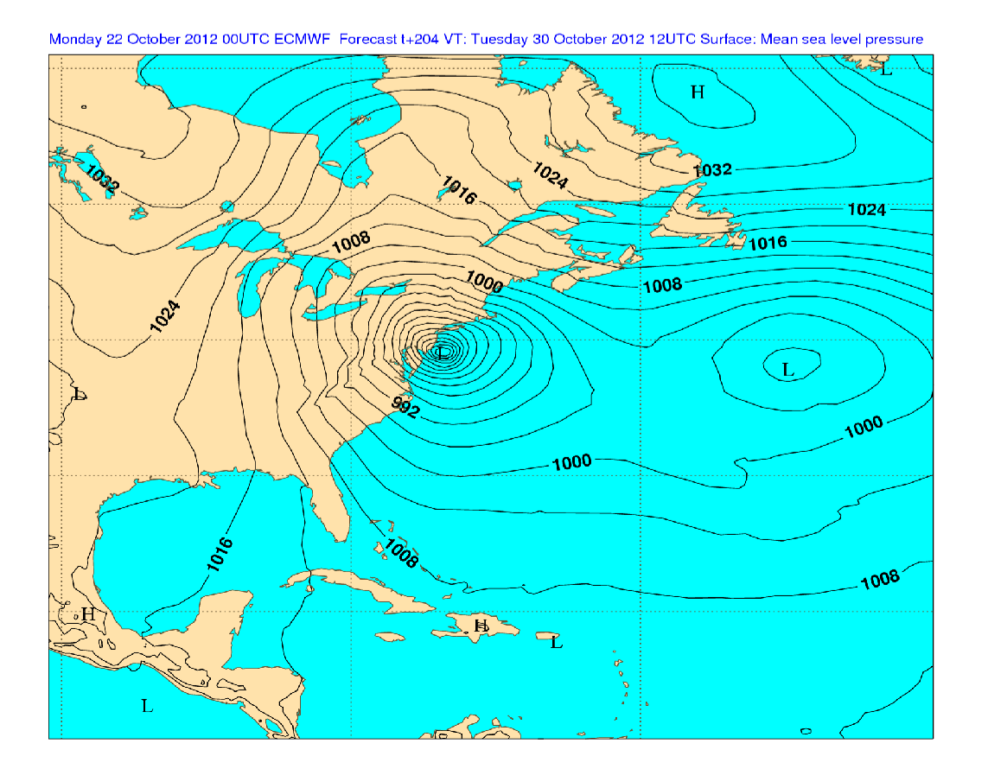
Use of EDA variances in 4DVar
2. Before 4DVar they affect the observation quality control decisions
Super Storm Sandy
Mslp Ana 30/10/2012
00UTC
DA Slide 53
Mslp t+204h Fcst valid at 30/10/2012
00UTC
Massimo Bonavita – DA Training Course 2014 - E

Slide 54
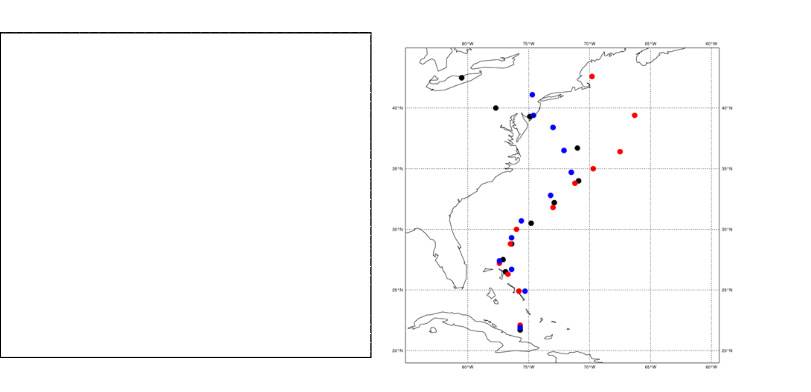
Use of EDA variances in 4DVar
What happens if we withhold polar-orbiters observations (i.e., approx. 90% of obs. counts)?
The forecast performance is obviously degraded, and only 5 days before landfall the system recovers the correct track
Sandy’s forecast tracks 25 Oct 2013 00UTC
Operational forecast
Forecast from HRES assimilation cycle without polar orbiters and errors from operational EDA
Forecast from HRES assimilation cycle and EDA both without polar orbiters data
EDA
Massimo Bonavita – DA Training Course 2014 -

Slide 55
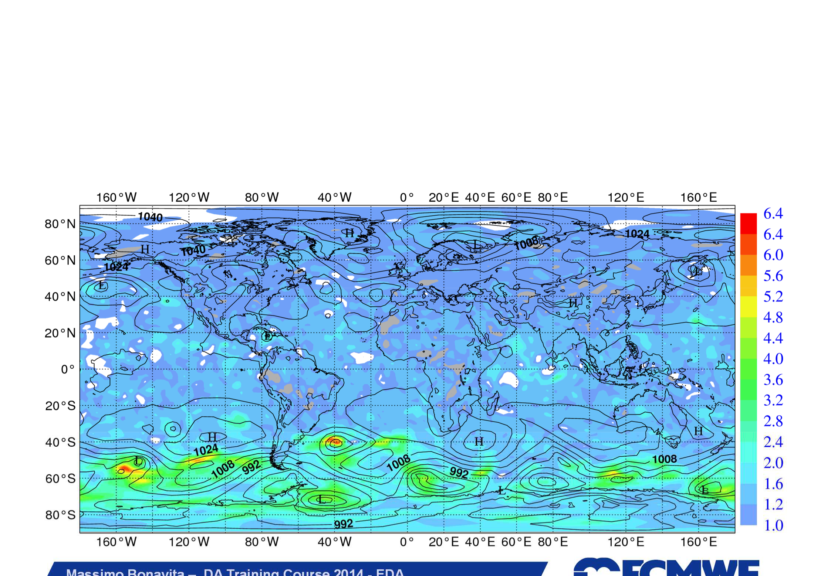
Use of EDA variances in 4DVar
EDA without polar orbiters’ data has larger spread than operational EDA EDA spread for u-wind component at 850 hPa: No-Polar/Oper ratio
Massimo Bonavita – DA Training Course 2014 - EDA

Slide 56
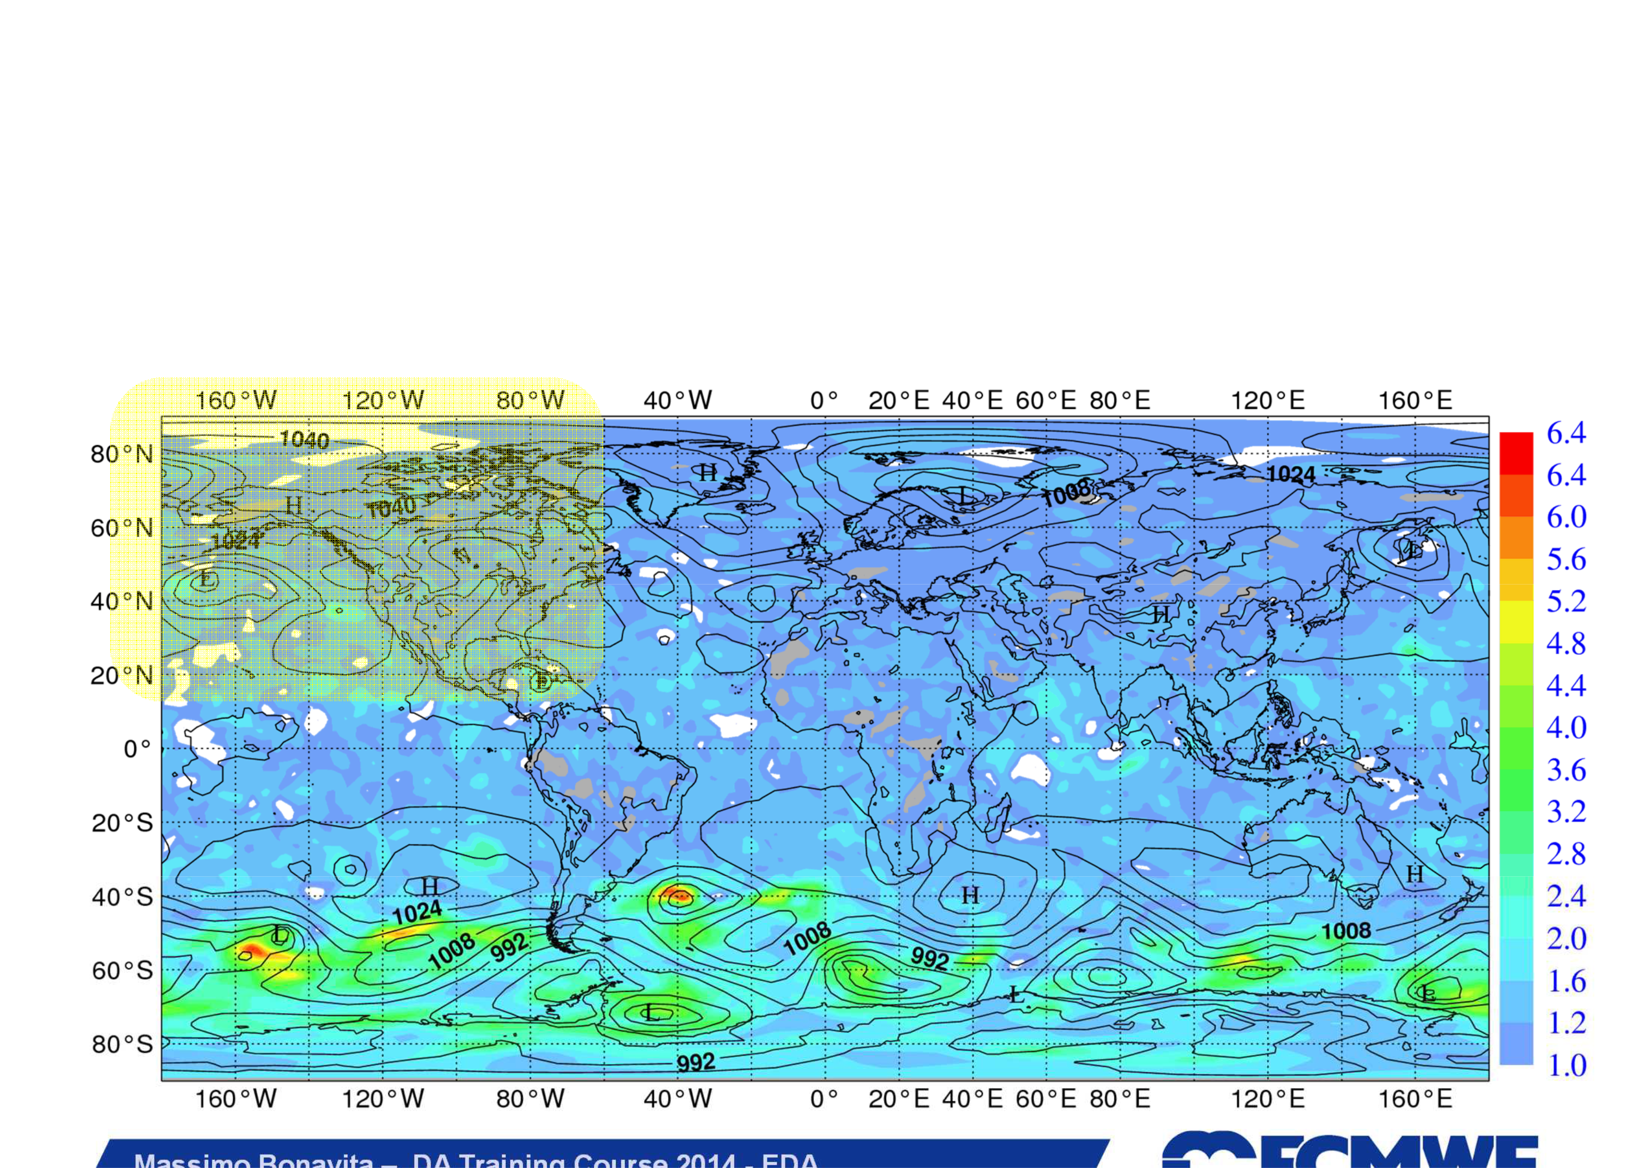
Use of EDA variances in 4DVar
EDA without polar orbiters’ data has larger spread than operational EDA EDA spread for u-wind component at 850 hPa: No-Polar/Oper ratio
Massimo Bonavita – DA Training Course 2014 - EDA

Slide 57
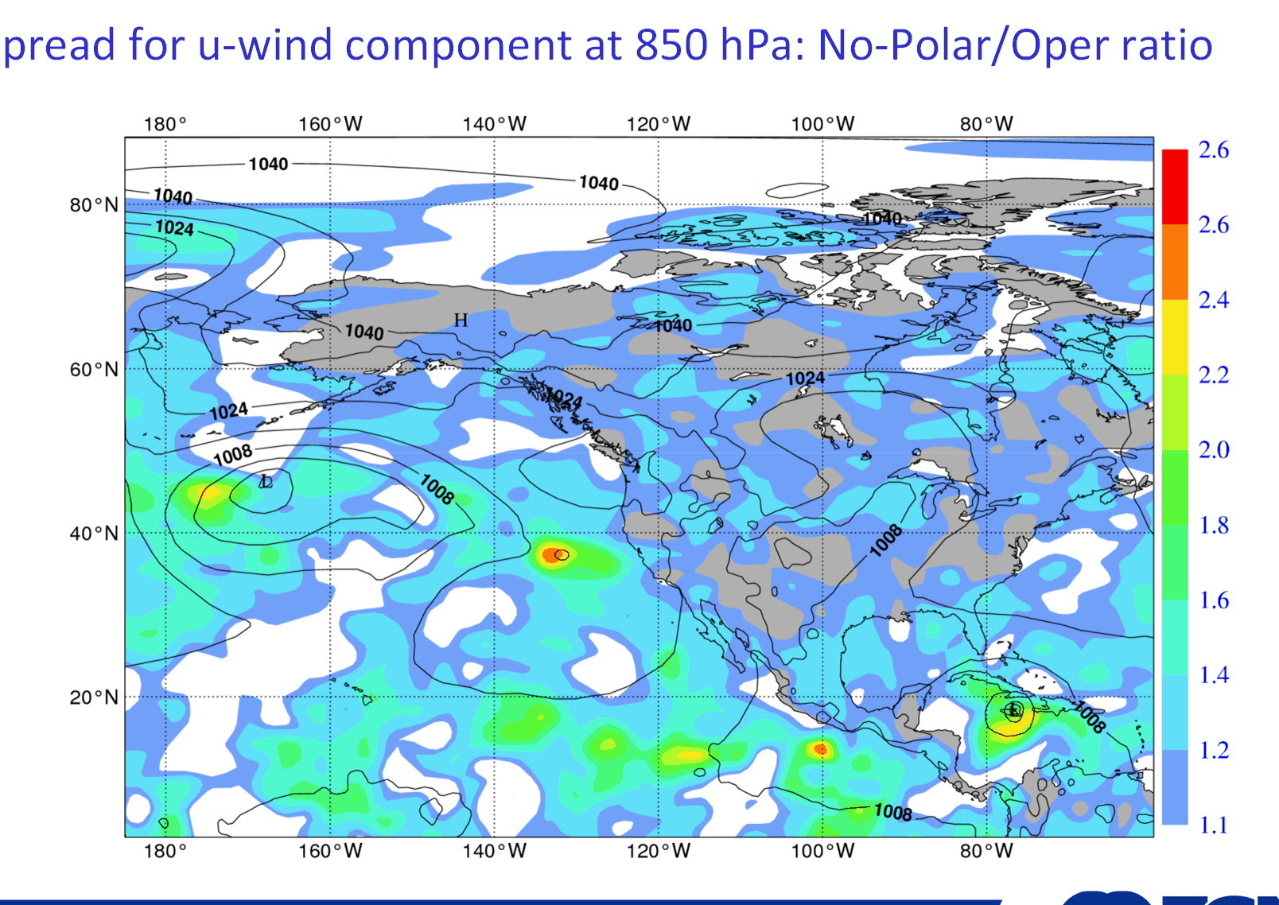
Use of EDA variances in 4DVar
EDA without polar orbiters’ data has larger spread than operational EDA
EDA s
pread for u-wind component at 850 hPa: No-Polar/Oper ratio

Slide 58
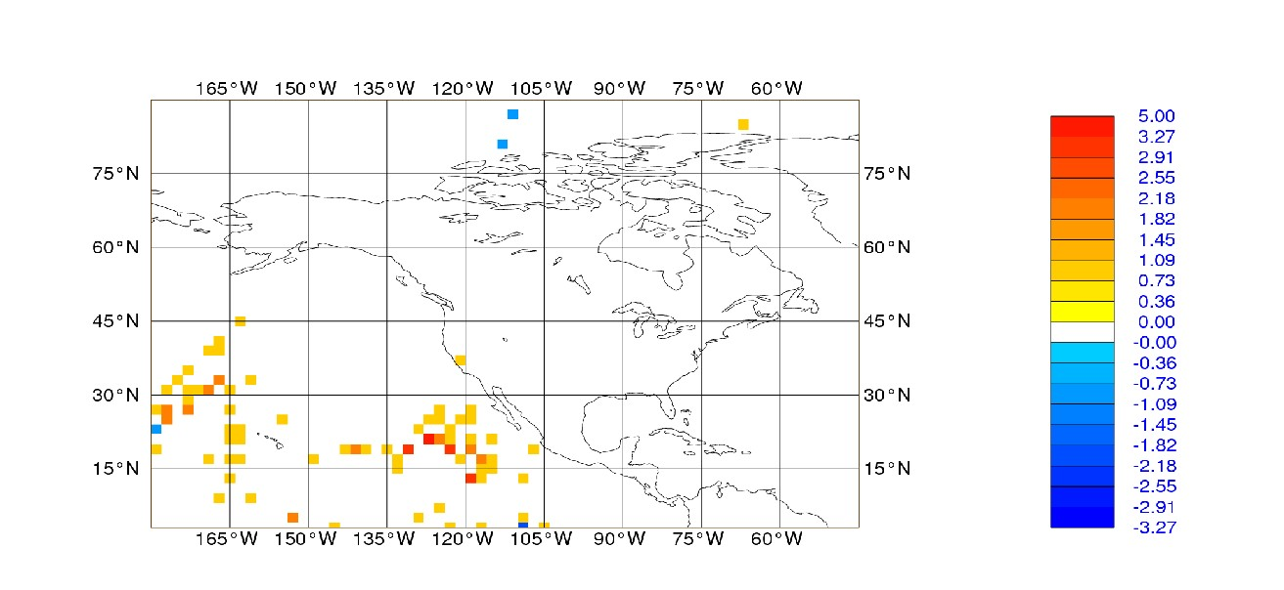
Use of EDA variances in 4DVar
EDA without polar orbiters’ data has larger spread than operational EDA
This has two effects: a) Observations are more closely fit and b) More observations pass first guess quality control: (y-H(x))² ≤ α(σ ²+ σ ²)
b o
In this case more AMVs from geostationary satellites are assimilated
raining Course 2014 - EDA Slide 58
Massimo Bonavita – DA T

Slide 59
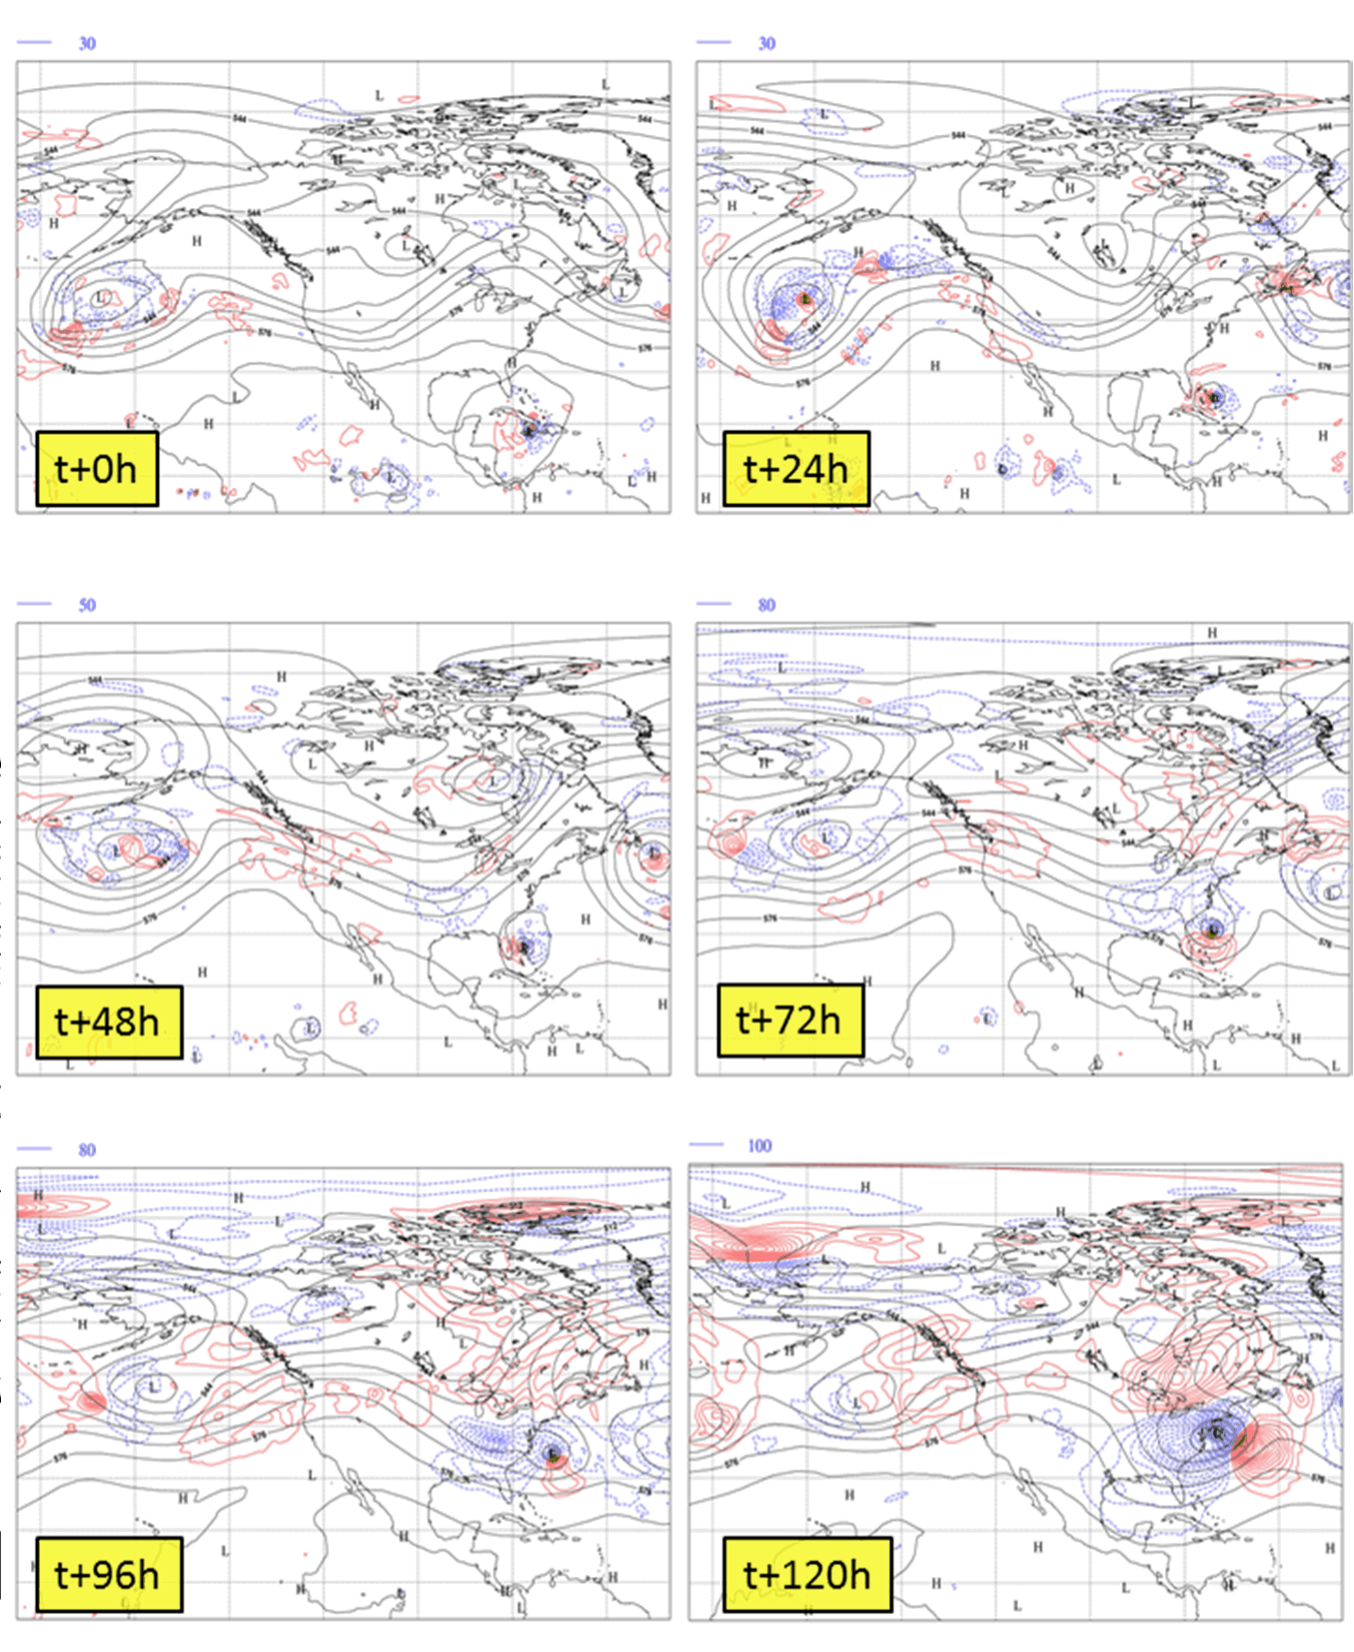
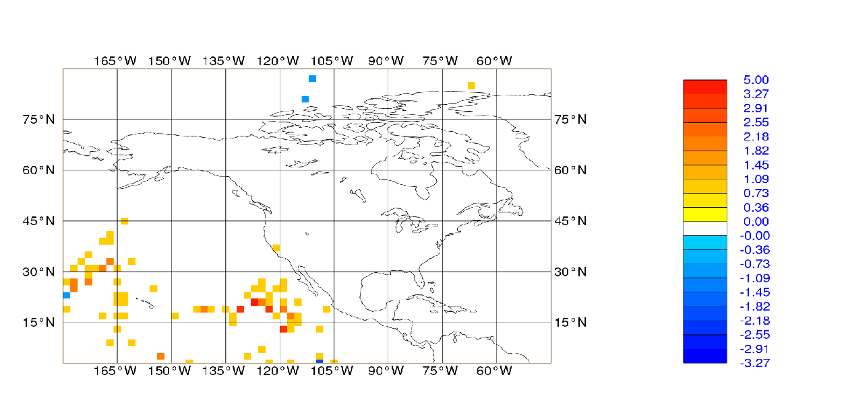
In this case more AMVs from geostationary satellites are assimilated
urse 2014 - EDA Slide 59
Massimo Bonavita – DA Training Co

