Slide 1

Kalman Filter Methods
Massimo Bonavita
massimo.bonavita@ecmwf.int
Based on Mike Fisher lecture notes

Slide 2
Outline
The standard Kalman Filter and its extensions
Kalman Filters for large dimensional systems
The Ensemble Kalman Filter
Hybrid Variational–EnKF algorithms

Slide 3
Standard Kalman Filter
In a previous lecture it was shown that the linear, unbiased analysis equation had the form:
_{x}a
b b
_{k} = x _{k} + K_{k} (y_{k}- H_{k}(x _{k}))
a = analysis; b = background k = time index (t=0,1,…,k,…)
It was also shown that the best linear unbiased analysis (a.k.a. Best Linear Unbiased Estimator, BLUE) is achieved when the matrix K_{k} (Kalman Gain Matrix) has the form:
K_{k} = P^{b} H^{T} (H P^{b}
_{H}T
+ R )⁻¹ = ((P^{b} )⁻¹ + H^{T}
_{R} -1 _{H )}-1 _{H}T _{R} -1
k k k k k k k k k
k k k
P^{b} = covariance matrix of the background error
R = covariance matrix of the observation error
Here “best” means the minimum error variance analysis
An expression for the covariance matrix of the analysis error was also found:

Slide 4
Standard Kalman Filter
An expression for the covariance matrix of the analysis error was also found:
_{P}a
b T T
_{k} = (I – K_{k}H_{k})P _{k} (I – K_{k}H_{k}) + K_{k}R_{k}K_{k}
In most application of data assimilation we want to update our estimate of the state and its uncertainty at later times, as new observations come in: we want to cycle the analysis
For each analysis in this cycle we require a background x^{b} (i.e. a prior
k
estimate of the state at time t_{k})
Our best prior estimate of the state at time t_{k} is given by a forecast from the preceding analysis:
_{x}b
(xª )
k ^{= M}t_{k-1}→t_{k} k-1
What is the error covariance matrix associated with this background?

Slide 5
Standard Kalman Filter
What is the error covariance matrix associated with this background?
_{x}b
(xª )
k ^{= M}t_{k-1}→t_{k} k-1
Subtract the true state x* from both sides of the equation:
k
_{ε}b
(xª ) - x*
k ^{= M}t_{k-1}→t_{k} k-1
k
Since xª
= x* + εª
we have:
k-1
k-1
k-1
_{ε}b
k ^{= M}t_{k-1}→t_{k} k-1
(x* + εª ) - x* =
k-1 k
^{Mt}k-1^{→t}k
(x* ) + M
_{ε}a
- x* =
k-1
^{t}k-1^{→t}k
k-1
k
^{Mt}k-1^{→t}k
_{ε}a
k-1 ^{+ η}k
Where we have defined the model error η = M
•
•
*
*
k
k t →t
(x ) - x
k-1 k
k-1
We will also assume that < εª > = < η > = 0 => < ε^{b} >
k-1 k k
The background error covariance matrix will then be given by:

Slide 6


Standard Kalman Filter
<ε^{b} (ε^{b} )^{T}> = P^{b} = <(M
_{ε}a _{ε}a
+ η )^{T}> =
k k k
^{t}k-1^{→t}k
+ η ) (M
k-1 k
^{t}k-1^{→t}k
k-1
k
^{Mt}k-1^{→t}k
<εª (εª )^{T}> (M
)^{T} + <η (η )^{T}> =
k-1
k-1
a
^{t}k-1^{→t}k
k k
M
P (M
)^{T} + Q
t →t
k-1
t →t
k
k-1 k
k-1 k
Here we have assumed < εª
(η )^{T}> = 0 and defined the model error
k-1 k
covariance matrix Q_{k} = <η_{k} (η_{k})^{T}>
We now have all the equations necessary to propagate and update the state and its error estimates:
b a
_{k} =
t_{k} k-1 ⁽
_{k} = _{k} + _{k} ( _{k}- _{k}( _{k}))
_{k k}) +
t_{k} k-1⁾
x
M
^{t}k-1
(
x
→
P
b
_{k} =
M
P
a
M
)^{T} +
Q
^{t}k-1
→
^{t}k-1
→
t_{k}
k
x
a
x
b
K
y
H
x
b
a
_{k} = ( –
_{k} =
b
T
T
k k k
-1
P
I
K
H
_{k}) _{k} (I –
P
K
H
K
R
K
k
b T
k
K
P
H
_{k}(
H
b T
k k
_{k} + _{k})
P
H
R

Slide 7


Standard Kalman Filter
b a
_{k} =
t_{k} k-1⁾
x
M
^{t}k-1
(
x
→
b
_{k} =
a
)^{T} +
P
t_{k} k-1 ⁽
_{k} = _{k} + _{k} (
M
^{t}k-1
→
P
M
^{t}k-1
→
t_{k}
Q
k
a
b
b
x
x
K
y
_{k}- _{k}( _{k})) _{k k}) +
H
x
a
b
T
T
k k k
-1
P
_{k} = ( – _{k}) _{k} ( –
_{k} =
I
K
H
P
I
K
H
K
R
K
k
b T
k
K
P
H
_{k}(
H
b T
k k
_{k} + _{k})
P
H
R
Under the assumption that the model M_{tk-1→tk} and the observation operator H_{k} are linear, the Kalman Filter produces an optimal sequence of analysis
The analysis xª is the best (minimum variance) estimate of the state
k
at time t_{k} , given x^{b} and all observations up to time t (y ,y ,…,y ).
0 k 0 1 k
Note that Gaussianity of errors is not required. If errors are Gaussian the KF provides the exact conditional probability estimate,
i.e. p(xª | x^{b} ; y ,y ,…,y )
k 0 0 1 k

Slide 8
Standard Kalman Filter
If model and/or observation operators are “slightly” nonlinear a modified version of the KF can be used: the Extended Kalman Filter
The state update and prediction steps use the nonlinear operators:
_{x}b
(xª )
k ^{= M}t_{k-1}→t_{k} k-1
_{x}a
b b
_{k} = x _{k} + K_{k} (y _{k}- H_{k}(x _{k}))
The covariance update and prediction steps use the Jacobians of the model and observation operators, linearized around the analysed/predicted state, i.e.:
aM
M = (xª )
t →t
k-1
k-1 k ax
aH ax
b
H =
(x )
k
k
The EKF is thus a first order linearization of the KF equations around the current state estimates. As such it is as good as the linearization is a good approximation of the full nonlinear system.

Slide 9
Kalman Filters for Large Dimensional Systems
The Kalman Filter is impractical for large dimensional systems
Assuming our state is O(10⁸) (which is the order of magnitude of the analysis state in ECMWF 4DVar) the KF requires us to store and evolve in time state covariance matrices (P^{a/b}) of O(NxN)
  The World’s fastest computers can sustain ~ 10¹⁵ operations per second
  An efficient implementation of matrix multiplication of two 10⁸X10⁸ matrices requires ~10²² operations: about 4 months on the fastest computer!
Evaluating P^{b} = M
_{P}a
(M )^{T} + Q requires N~10⁸
k
^{t}k-1^{→t}k ^{t}k-1^{→t}k
k-1
k
model integrations.
A range of approximate Kalman Filters has been developed for use with large systems.
All of these methods rely on a low-rank approximation of the covariance matrices of background and analysis error.

Slide 10

Kalman Filters for Large Dimensional Systems
Assume (big assumption!!) that P^{b} has rank M<<N (e.g. M 100).
•
•
k
Then we can write P^{b} = X^{b} (X^{b} )^{T}, where X^{b} is N x M.
k k k k
The Kalman Gain then becomes:
K_{k} = P^{b} H^{T} (H P^{b}
_{H}T
+ R )⁻¹ =
k k k k k k
_{X}b b T T
b b T T
-1
_{k}(X _{k}) H _{k}(H_{k} X _{k}(X _{k}) H _{k} + R_{k}) =
b
_{k} (
b T
b
b T
-1
X
H
X
_{k}) (
H
X
_{k}(
H
X
_{k}) + _{k})
k
k
k
R
Note that, to evaluate K, we apply H_{k} to the M columns of X^{b}
rather
k
than to the N columns of P^{b} .
k
The N x N matrices P^{a/b} have been eliminated from the computation!
k
In their place we have N x M (X^{b} ) and L x M (H X^{b} ) matrices (L =
k k k
number of observations)

Slide 11
Kalman Filters for Large Dimensional Systems
The analysis error covariance matrix becomes:
_{P}a
b T T
_{k} = (I – K_{k}H_{k})P _{k} (I – K_{k}H_{k}) + K_{k}R_{k}K_{k} =
= (I - K_{k}H_{k})P^{b} = (I - K H ) X^{b} (X^{b} )^{T} =
k k k k k
_{X}b b T
b b T
_{k}(X _{k}) - K_{k}H_{k} X _{k}(X _{k})
Both terms in this expression for Pª contain an initial X^{b} and a final
k k
(X^{b} )^{T} so that Pª = X^{b} W (X^{b} )^{T} for some M x M matrix W
k k k k k k
Finally the covariance matrix is propagated by:
_{P}b
= M P
a
k-1
(M
)^{T} + Q =
k
t →t
t →t
k
k-1 k
k-1 k
M
b
b T
)^{T} + Q =
t →t
X W (X ) (M
k-1 k
k k k
t →t
k
k-1 k
M
b
_{X}b T
t →t
X W (M
_{k}) + Q_{k}
k k t →t
k-1 k k-1 k
This requires only M integrations of the linearized model M_{t}
•
→t
k-1 k
Q_{k} can be approximated by a suitable projection on M-dim subspace

Slide 12
Kalman Filters for Large Dimensional Systems
The algorithm described above is called Reduced-rank Kalman Filter
All these gains in computational efficiency have a price, however ☹
•
_{x}a
The analysis increment is a linear combination of the columns of X^{b} :
k
b b b b T b b T -1
_{k} - x _{k} = K_{k} (y_{k} – H_{k}(x _{k})) = X _{k} (H_{k}X _{k}) ((H_{k}X _{k})(H_{k}X _{k}) + R) (y_{k} – H_{k}(x_{b}))
Thus the increments are confined to the subspace spanned by X^{b} ,
k
which has at most rank M << N.
The severe reduction in rank manifests itself in two forms:
  There are too few degrees of freedom available to fit the ~10⁷ observations: the analysis is too “smooth”;
  The low-rank approximations of the covariance matrices suffer from spurious long-distance correlations. These cause spurious increments in regions where there are no observations.

Slide 13
Kalman Filters for Large Dimensional Systems
There are two ways around the rank deficiency problem:
  Domain localization (e.g. Evensen 2003; Ott et al. 2004);
Domain localization solves the analysis equations independently for each gridpoint, or for each of a set of regions covering the domain.
Each analysis uses only observations that are local to the gridpoint (or region) and the observations are usually weighted according to their distance from the analysed gridpoint (e.g., Hunt et al., 2007)
This guarantees that the analysis at each gridpoint (or region) is not influenced by distant observations.
In effect, the method acts to vastly increase the dimension of the sub-space in which the analysis increment is constructed.
However, performing independent analyses for each region is not optimal, e.g. poor analysis of the large scales, and difficulties in producing balanced analyses.

Slide 14
Kalman Filters for Large Dimensional Systems
There are two ways around the rank deficiency problem:
2. Covariance localization (e.g. Houtekamer and Mitchell 2001).
Covariance localization is performed by element wise (Schur) multiplication of the error covariance matrices with a predefined covariance matrix representing a decaying function of distance.
In this way spurious long range correlations in P^{a/b} are suppressed.
•
k
As for domain localization, the method acts to vastly increase the dimension of the sub-space in which the analysis increment is constructed.
Choosing the product function is non-trivial. It is easy to modify P^{a/b}
k
in undesirable ways. In particular, balance relationships may be adversely affected.

Slide 15
Ensemble Kalman Filters
Ensemble Kalman Filters (EnKF, Evensen, 1994; Burgers et al., 1998) are Monte Carlo implementations of the Reduced-rank KF
In EnKF error covariances are constructed as sample covariances from an ensemble of background/analysis fields, i.e.:
_{P}a/b
1 _{Σ}
(x^{b} - <x >) (x - <x >) =
k,m k,m k,m k,m
^{k =} M-1
m=1,M-1
b b b T
= X^{b} (X^{b} )^{T}
k k
is the N x M matrix of background perturbations, i.e.:
•
_{X}b
k
_{X}b
_{k} =
1
((x^{b} - <x^{b} >), (x^{b} - <x^{b} >), .., (x^{b} - <x^{b} >))
M-1
k,1 k,m k,2 k,m k,M k,m
Note that the full covariance matrix is never formed explicitly: The error covariances are usually computed locally for each gridpoint in the M x M ensemble space

Slide 16
Ensemble Kalman Filters
In the (extended) KF the error covariances are explicitly propagated using the tangent linear and adjoint of the model and observation operators, i.e.:
K_{k} = P^{b} H^{T} (H P^{b}
_{H}T
+ R )⁻¹
k k k k k k
_{P}b
a
k-1 t →t k
= M P
(M
)^{T} + Q
k t →t
k-1 k k-1 k
In the EnKF the error covariances are implicitly propagated in time through the ensemble forecasts and the observation operators linearizations are computed as:
_{P}b T _{= X}b b T T b b T
k^{H}k
_{k}(X _{k}) H_{k} = X _{k}(H_{k} X _{k}) =
1 _{Σ}
(x^{b} - <x^{b}
>) (x^{b}
- <H(x^{b}
)>)^{T}
M-1
m=1,M-1 k,m
k,m
k,m
k,m
H_{k}P^{b} H ^{T}= H X^{b} (H X^{b} )^{T} =
k k k k k k
1 _{Σ}
(x^{b} - <H(x^{b} )>) (x^{b} - <H(x^{b} )>)^{T}
M-1
m=1,M-1 k,m k,m k,m k,m
Not having to code TL and ADJ operators is a major advantage!

Slide 17
Ensemble Kalman Filters
The Ensemble Kalman Filter requires us to generate a sample {x^{b} ;
k,m
m=1,..,M} drawn from the p.d.f. of background error: how to do this?
We can generate this from a sample {xª ; m=1,..,M} from the p.d.f.
k-1,m
of analysis error for the previous cycle:
_{x}b
(xª ) + η
k,m ^{= M}t_{k-1}→t_{k} k-1,m k,m
where η_{k,m} is a sample drawn from the p.d.f. of model error.
The question is then: How do we generate a sample from the analysis p.d.f.? Let us look at the analysis update again:
xª = x^{b} + K (y – H(x^{b})) = (I-KH) x^{b} + Ky
If we subtract the true state x* from both sides (and assume y*=Hx*) eª = (I-KH) e^{b} + Keº
i.e., the errors have the same update as the state; note that this holds also for suboptimal K

Slide 18
Ensemble Kalman Filters
Consider now an ensemble of analysis where all the inputs to the analysis have been perturbed according to their error p.d.f.:
xª’ = (I-KH) x^{b}’ + Ky’
If we subtract the unperturbed analysis xª = (I-KH) x^{b} + Ky
εª = (I-KH) ε^{b} + Kεº
Note that the observations (during the update step) and the model (during the forecast step) are perturbed explicitly.
The background is implicitly perturbed , i.e.:
_{x}b
(xª ) + η
k,m ^{= M}t_{k-1}→t_{k} k-1,m k,m
Hence, one way to generate a sample drawn from the p.d.f. of analysis error is to perturb the observations with perturbations characteristic of observation error.
The EnKF based on this idea is called Perturbed Observations EnKF
(Houtekamer and Mitchell, 1998). It is also the basis of ECMWF EDA

Slide 19
Ensemble Kalman Filters
Another way to construct the analysis sample without perturbing the observations is to make a linear combination of the background sample:
_{X}a b
_{k}=X _{k}T
where T is a M x M matrix chosen such that:
_{X}a a T
b b T a b
_{k}(X _{k}) = (X _{k}T) (X _{k}T) = P _{k} = (I-K_{k}H_{k})P _{k}
Note that the choice of T is not unique: Any orthonormal transformation Q (QQ^{T}=Q^{T}Q=I) can be applied to T and give a valid analysis sample
Implementations also differ on the treatment of observations (i.e., local patches, one at a time)
Consequently there are a number of different, functionally equivalent, implementations of the Deterministic EnKF (ETKF, Bishop et al., 2001; LETKF, Ott et al., 2004, Hunt et al., 2007; EnSRF, Whitaker and Hamill, 2002; EnAF, Anderson, 2001;…)

Slide 20
Ensemble Kalman Filters
How does the EnKF compare with standard 4DVar?
The short answer: It depends!

Slide 21
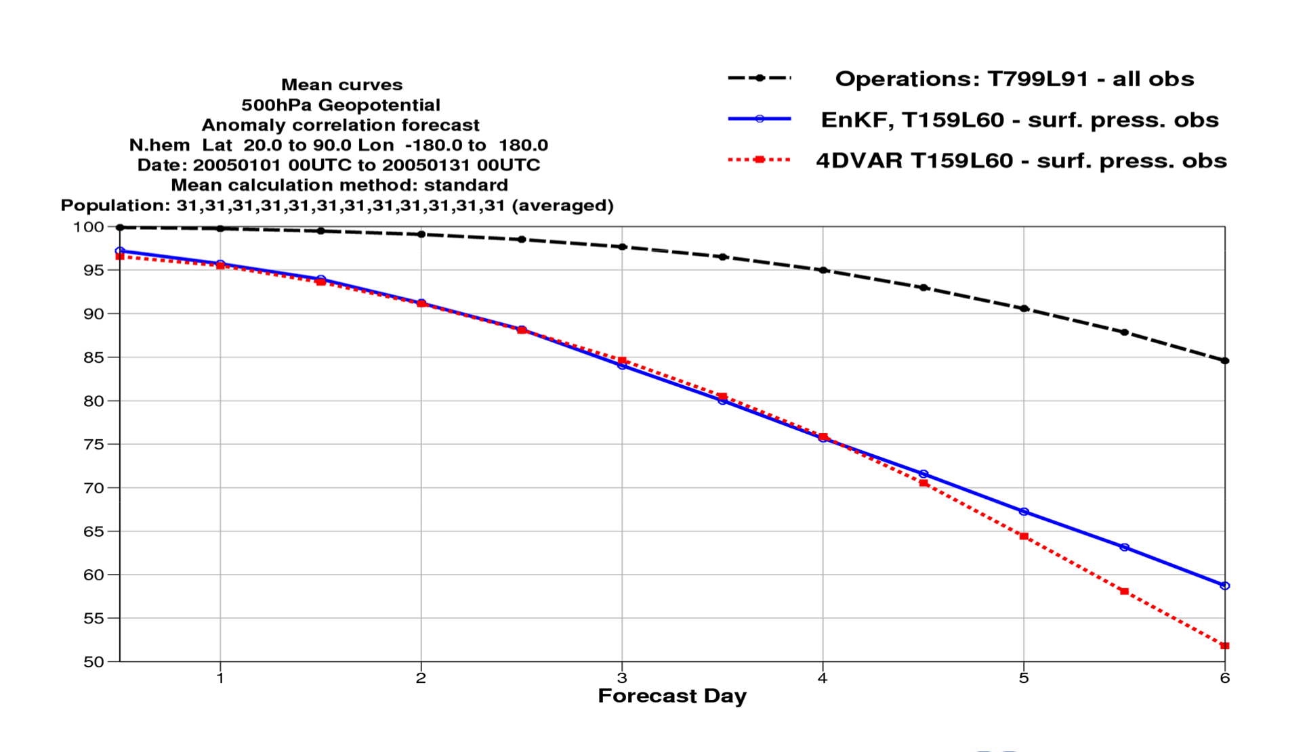
EnKF vs 4DVar
Surface Pressure observations only
N.Hem. 500 hPa AC

Slide 22
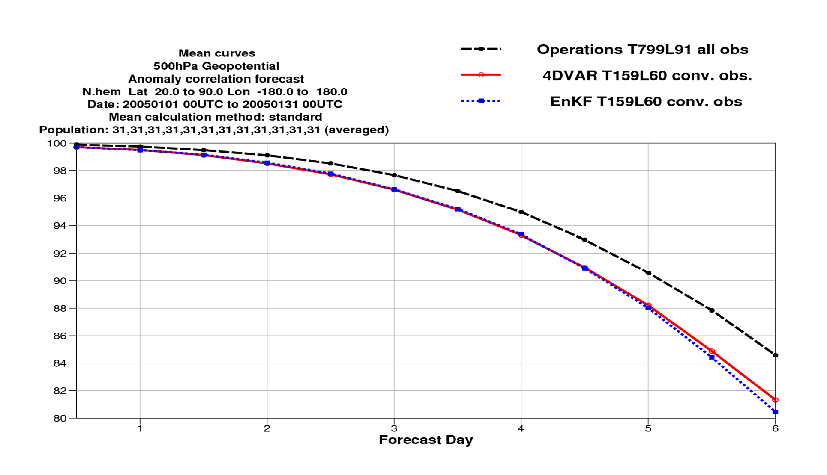
EnKF vs 4DVar
Conventional observations only
N.Hem. 500 hPa AC

Slide 23
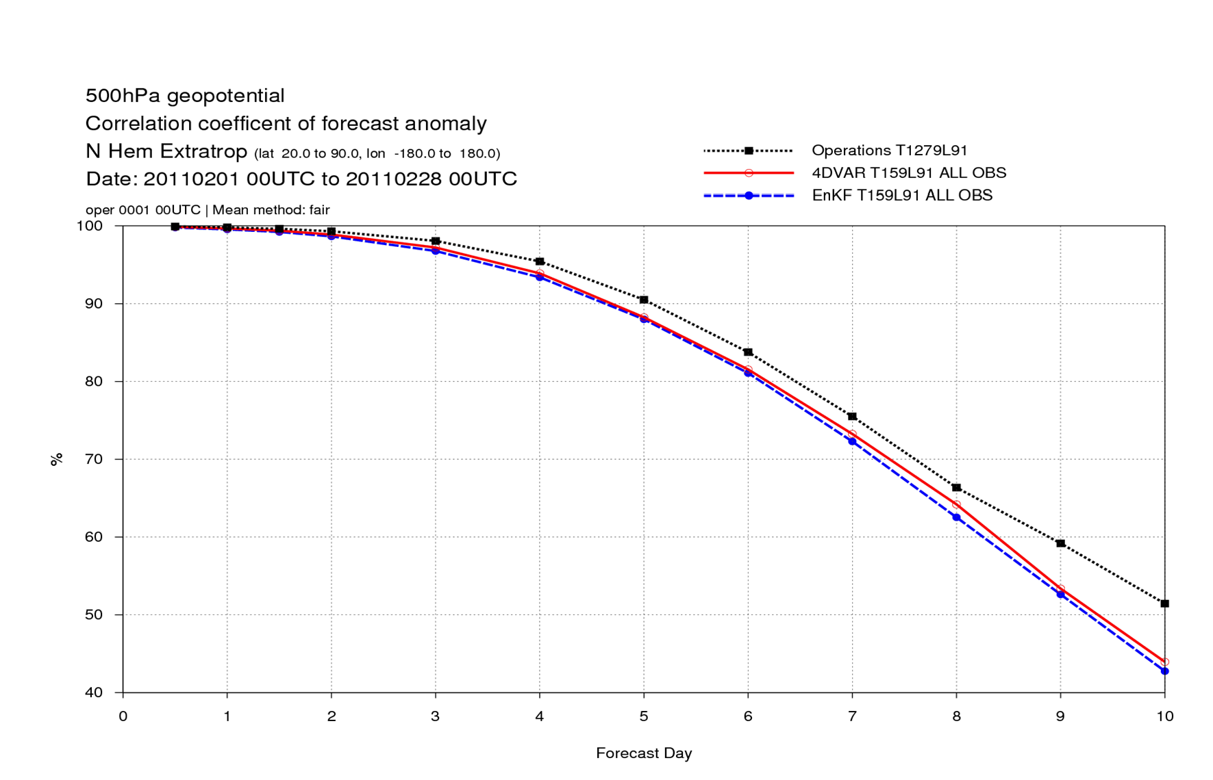
EnKF vs 4DVar
All observations
N.Hem. 500 hPa AC

Slide 24
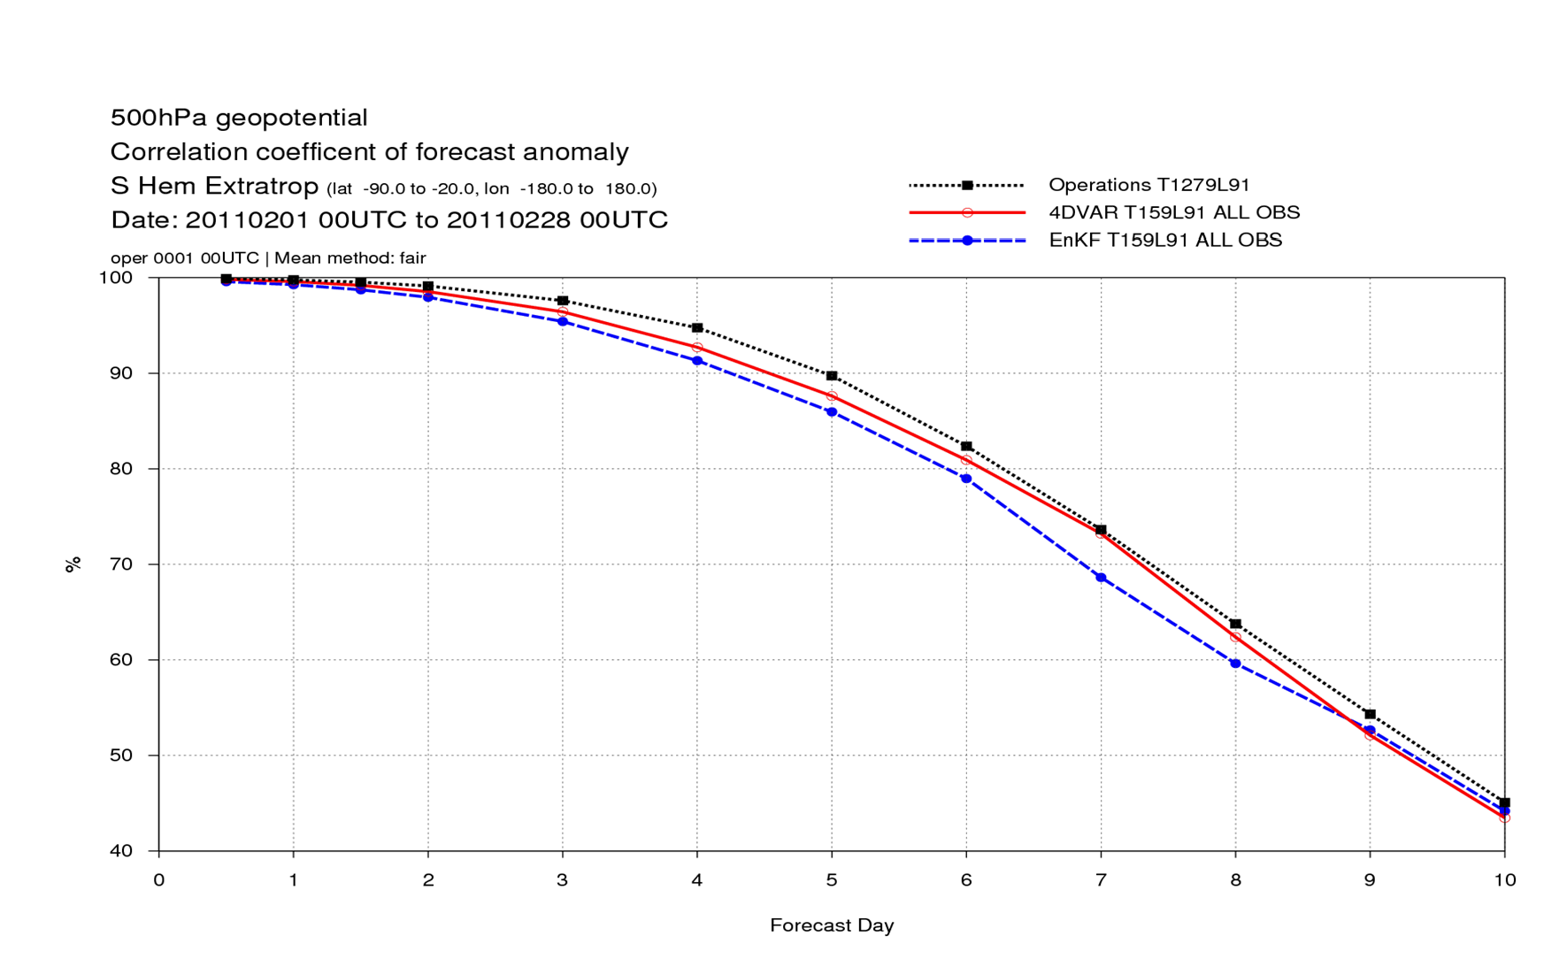
EnKF vs 4DVar
All observations
S.Hem. 500 hPa AC

Slide 25
Ensemble Kalman Filters
The rank deficiency of the sampled error covariances is not an issue when the observations are few, i.e. of the order of ensemble size
The rank deficiency of the sampled error covariances becomes problematic when the observations are orders of magnitude more than the ensemble size
In this latter case, careful localization of sampled covariances becomes crucial: This is an on-going research topic for EnKF
Note how covariance localization becomes conceptually and practically more difficult for observations (satellite radiances) which are non-local by nature (Campbell et al., 2010)

Slide 26
Hybrid Variational–EnKF algorithms
4D Variational methods
If we neglect model error (perfect model assumption) the problem of finding the model trajectory that best fits the observations over an assimilation interval (t=0,1,…,T) given a background state x_{b} and its error covariance P^{b} can be solved by finding the minimum of the cost function:
J (x ) = (x − x ) (P ) (
T
T
−1
x − x )+ (y − H M
(x )) R ( (x ))
T
b
b o ∑ t t =0
−1
y − H M
0 b o
t 0→t 0
t t
t 0→t 0
This is equivalent, for the same x_{b}, P^{b} , to the Kalman filter solution at the end of the assimilation window (t=T) (Fisher et al., 2005).

Slide 27
Hybrid Variational–EnKF algorithms
4D Variational methods
The 4D-Var solution implicitly evolves background error covariances over the assimilation window (Thepaut et al.,1996) with the tangent linear dynamics:
P^{b}(t) ≈ MP^{b}M^{T}

Slide 28
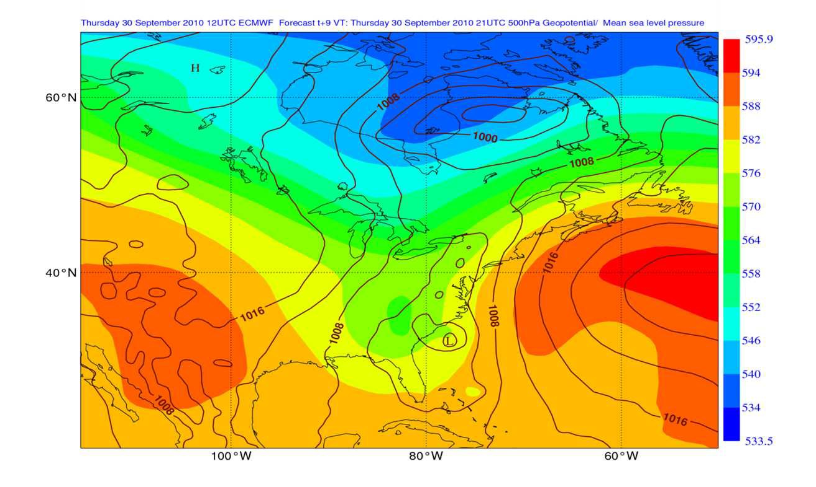
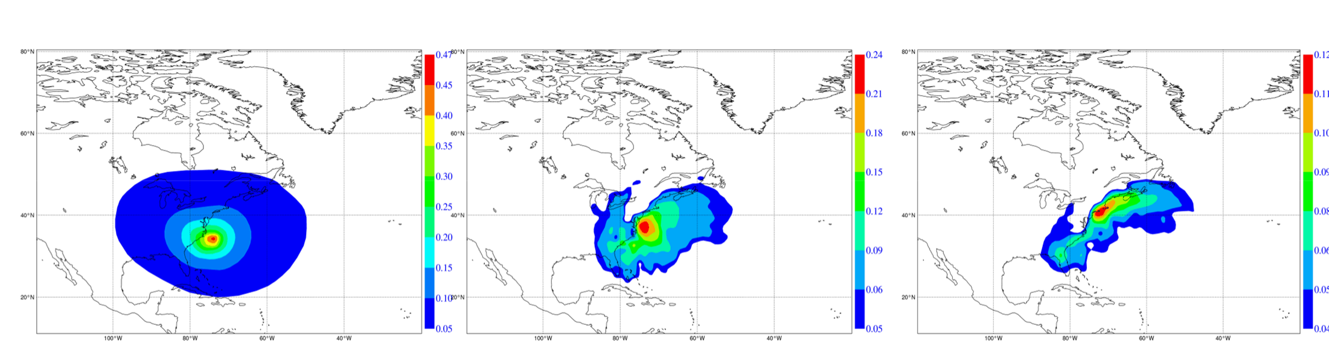
MSLP and 500 hPa Z (shaded) background fcst
Variational vs Ensemble
Temperature analysis increments for a single temperature observation at the start of the assimilation window: xª(t)-x^{b}(t) ≈ MP^{b}M^{T}H^{T}(y-Hx)/(σ_{b}² + σ_{o}²)
t=+0h
t=+3h
t=+9h

Slide 29
Hybrid Variational–EnKF algorithms
4D Variational methods
The 4D-Var solution implicitly evolves background error covariances over the assimilation window with the tangent linear dynamics:
P^{b}(t) ≈ MP^{b}M^{T}
But it does not propagate error information from one assimilation cycle to the next: P^{b} is not evolved according to KF equations ( i.e., P^{b} = MPªM^{T} + Q) but is reset to a climatological, stationary estimate at the beginning of each assimilation window.
Only information about the state (x_{b}) is propagated from one cycle to the next.

Slide 30
Hybrid Variational–EnKF algorithms
What if we pushed back the start of the assimilation window ‘enough’ so that the filter solution at the end of the window would no longer depend on the specified initial P^{b}?
How long is enough? 3-5 days in the troposphere for current NWP models, longer in the stratosphere
Time series curves
500hPa Geopotential
Root mean square error forecast
S.hem Lat -90.0 to -20.0 Lon -180.0 to 180.0 T+120
all obs all obs
120
110
100
90
80
70
60
50
40
30
15
16
17
18
19
20
21
22 23 24
AUGUST 2005
25
26
27
28
29
30
31

Slide 31
Hybrid Variational–EnKF algorithms
4D Variational methods
For assimilation windows > 12h it is not accurate to assume the model to be perfect over the assimilation window. For long windows we have to add a model error term to our cost function (Weak-constraint 4D-Var):
J( ) ( ) (P )
−1
(x −x )+
T
T
( ( )) ( ( ))
T
b o ∑ t t t t t t t
x ,x ,...,x = x −x
b
y − H x R
−1
y − H x +
0 1
T
b o
t=0
T
(x − M
T
∑ t t=0
(x )) Q (x − M
(x ))
−1
t−1−>t t−1
t t t− −>
1 1 t−1
Two caveats:
Problem is shifted from estimation of P^{b} to estimation of Q: this is not any easier!
It is difficult in the variational framework to produce good estimates of Pª: this is important for ensemble prediction!

Slide 32
Hybrid Variational–EnKF algorithms
Quick recap:
Kalman Filter is computationally unfeasible for large dimensional systems (e.g., operational NWP);
Variational (4D-Var) do not cycle state error estimates: work well for short assimilation windows (6-12h). Longer windows, where Q is required, have proved more difficult;
Reduced rank KF (EnKF) cycle reduced-rank estimates of state error covariances: need for spatial localization to combat rank deficiency, degrades dynamical balance, problematic for non- local observations (radiances);
….
Hybrid approach: Use cycled, flow-dependent state error estimates (from an EnKF/Ensemble DA system) in a 3/4D-Var analysis algorithm

Slide 33
Hybrid Variational–EnKF algorithms
Hybrid approach: Use cycled, flow-dependent state error estimates (from an EnKF/EDA system) in a 3/4D-Var analysis algorithm
This solution would:
Integrate flow-dependent state error covariance information into a variational analysis
Keep the full rank representation of P^{b} and its implicit evolution inside the assimilation window
More robust than pure EnKF for limited ensemble sizes and large model errors
Allow consistent localization of ensemble perturbations to be performed in state space (advantageous for radiances);
Allow for flow-dependent QC of observations

Slide 34
Hybrid Variational–EnKF algorithms
In operational use (or under test), there are currently three main approaches to doing hybrid DA in a VAR context:
Alpha control variable method (Met Office, NCEP/GMAO, CMC)
4D-Ens-Var
Ensemble of Data Assimilations method (ECMWF, Meteo France)

Slide 35

Hybrids: α control variable
1. Alpha control variable method (Barker, 1999; Lorenc, 2003) Conceptually add a flow-dependent term to the model of P^{b} (B):
B = β B
2 2
β P □ C
c c e e
loc
B_{c} is the static, climatological covariance
P_{e} ○ C_{loc} is the localised ensemble sample covariance
In practice this is done through augmentation of the control variable:
1
'
δx = β B v + β X □ α
2
c c e
and introducing an additional term in the cost function:
J = ¹ v^{T} v + ¹ α^{T} C ⁻¹ α + J + J
2 2
loc
o
c
from: A.Clayton

Slide 36
Hybrids: α control variable
1. Alpha control variable method
1
2
'
δx = β B v + β
X □ α = δx
δx
c c e
c lim ens
The increment is now a weighted sum of the static B component and the flow-dependent, ensemble based B
The flow-dependent increment is a linear combination of ensemble perturbations X’, modulated by the α fields
If the α fields were homogeneous δx_{ens} could only span N_{ens}-1 degrees of freedom; α fields are then smoothly varying fields, which effectively increases the degrees of freedom
C_{loc} is a covariance (localization) model for the flow-dependent increments: it controls the spatial variation of α

Slide 37
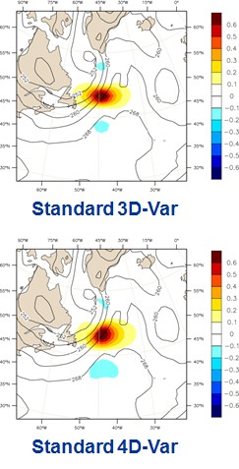
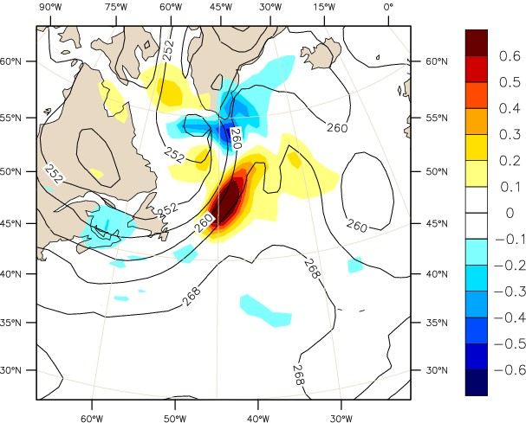
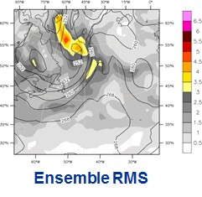
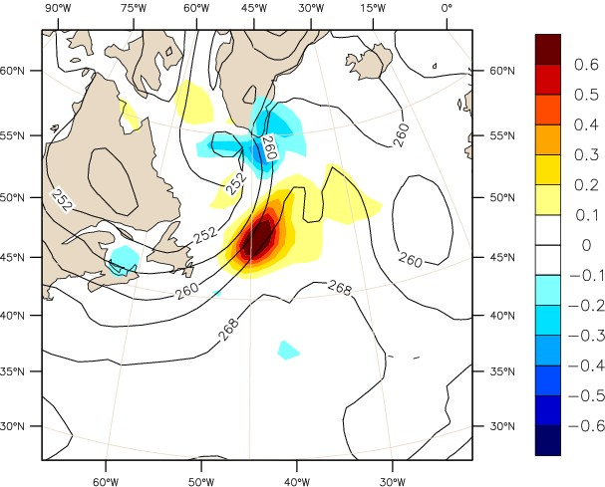

Hybrids: α control variable
u response to a single u observation at centre of window
Pure ensemble 3D-Var
from: A.Clayton
50/50 hybrid 3D-Var

Slide 38
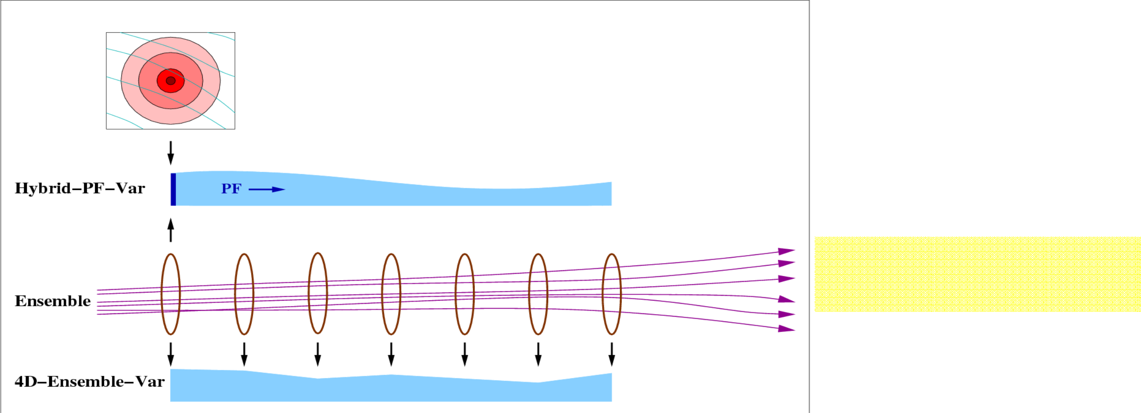
Hybrids: 4D-Ens-Var
2. 4D-Ensemble-Var method (Liu et al., 2008)
In the alpha control variable method one uses the ensemble perturbations to estimate P^{b} only at the start of the 4DVar assimilation window: the evolution of P^{b} inside the window is due to the tangent linear dynamics (P^{b}(t) ≈ MP^{b}M^{T})
In 4D-Ens-Var P^{b} is sampled from ensemble trajectories throughout the assimilation window:
navita – DA Training Course 2014 - EnKF Slide 38
from: D. Barker
Massimo Bo

Slide 39
Hybrids: 4D-Ens-Var
2. 4D-Ensemble-Var method (Liu et al., 2008)
The 4D-Ens-Var analysis is thus a localised linear combination of ensemble trajectories perturbations: conceptually very close to a pure EnKF
While traditional 4DVar requires repeated, sequential runs of M, M^{T}, ensemble trajectories from the previous assimilation time can be pre-computed in parallel
Developing and maintaining the TL and Adjoint models requires substantial resources and it is technically demanding: 4D-Ens-Var does not need them
Slide 39

Slide 40




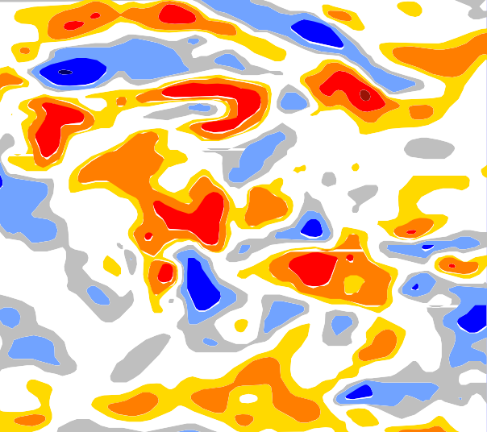
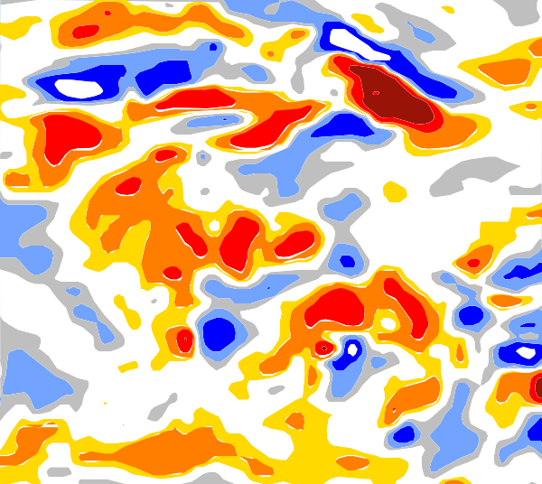

Hybrids: 4D-Ens-Var
However 4D-Ens-Var requires all ensemble trajectories to be stored in memory: increasingly difficult for larger ensemble sizes/resolutions
It is typically more accurate to evolve an initial estimate of P^{b} by the model TL dynamics than sampling it from an ensemble of trajectories
M_{0,t}(x_{a})-M_{0,t}(x_{b}) M_{0,t}(x_{a}-x_{b})
Non-linear finite difference
12
12
TL
integration
8
8
4
4
2
1
2
1
0.5
-0.5
0.5
-0.5
-1
-1
-2
-2
-4
-4
-8
-8
-12
-12
Slide 40
from: M. Janiskova

Slide 41
Hybrids: EDA method
3. Ensemble of Data Assimilations method
To be continued…

Slide 42
References
Anderson, J. L., 2001. An ensemble adjustment Kalman filter for data assimilation. Mon. Wea. Rev. 129, 2884–2903.
Bishop, C. H., Etherton, B. J. and Majumdar, S. J., 2001. Adaptive sampling with ensemble transform Kalman filter. Part I: theoretical aspects. Mon. Wea. Rev. 129, 420–436.
Burgers, G., Van Leeuwen, P. J. and Evensen, G., 1998. On the analysis scheme in the ensemble Kalman filter. Mon. Wea. Rev. 126, 1719–1724.
Campbell, W. F., C. H. Bishop, and D. Hodyss, 2010: Vertical covariance localization for satellite radiances in ensemble Kalman Filters. Mon. Wea. Rev.,138,282–290.
Evensen, G., 1994. Sequential data assimilation with a nonlinear quasi-geostrophic model using Monte Carlo methods to forecast error statistics. J. Geophys. Res. 99(C5), 10 143–10 162.
Evensen, G . 2004 . Sampling strategies and square root analysis schemes for the EnKF . No.: 54 . p.: 539-560 . Ocean Dynamics
Fisher, M., Leutbecher, M. and Kelly, G. A. 2005. On the equivalence between Kalman smoothing and weak-constraint four-dimensional variational data assimilation. Q.J.R. Meteorol. Soc., 131: 3235–3246.

Slide 43
References
Houtekamer, P. L. and Mitchell, H. L., 1998. Data assimilation using an ensemble Kalman filter technique. Mon. Wea. Rev. 126, 796–811.
Houtekamer, P. L. and Mitchell, H. L., 2001. A sequential ensemble Kalman filter for atmospheric data assimilation. Mon. Wea. Rev. 129, 123–137.
Hunt, B. R., Kostelich, E. J. and Szunyogh, I., 2007. Efficient data assimilation for spatiotemporal chaos: a local ensemble transform Kalman filter. Physica D, 230, 112–126.
Liu C, Xiao Q, Wang B. 2008. An ensemble-based four-dimensional variational data assimilation scheme. part i: Technical formulation and preliminary test. Mon. Weather Rev. 136: 3363–3373.
Lorenc, A.C.,2003: The potential of the ensemble Kalman filter for NWP—A comparison with 4D-VAR. Q. J. R. Meteorol. Soc., 129: 3183–3203.
Ott, E., Hunt, B. H., Szunyogh, I., Zimin, A. V., Kostelich, E. J. and co-authors. 2004. A local ensemble Kalman filter for atmospheric data assimilation. Tellus 56A, 415–428.
Thépaut, J.-N., Courtier, P., Belaud, G. and Lemaître, G. 1996. Dynamical structure functions in a four-dimensional variational assimilation: A case-study. Q. J. R. Meteorol. Soc., 122, 535–561
Whitaker, J. S. and Hamill, T. M., 2002. Ensemble data assimilation without perturbed observations. Mon. Wea. Rev. 130, 1913–1924.

