Slide 1
Development, testing, and implementation of hybrid 4DEnVar for the GFS
Daryl Kleist*
University of Maryland
Department of Atmospheric and Oceanic Science
* With many contributions from collaborators, in particular Rahul Mahajan, Cathy Thomas, Jeff Whitaker, Lili Lei, Dave Parrish, Kayo Ide, Deng-Shun Chen, and many others

Slide 2
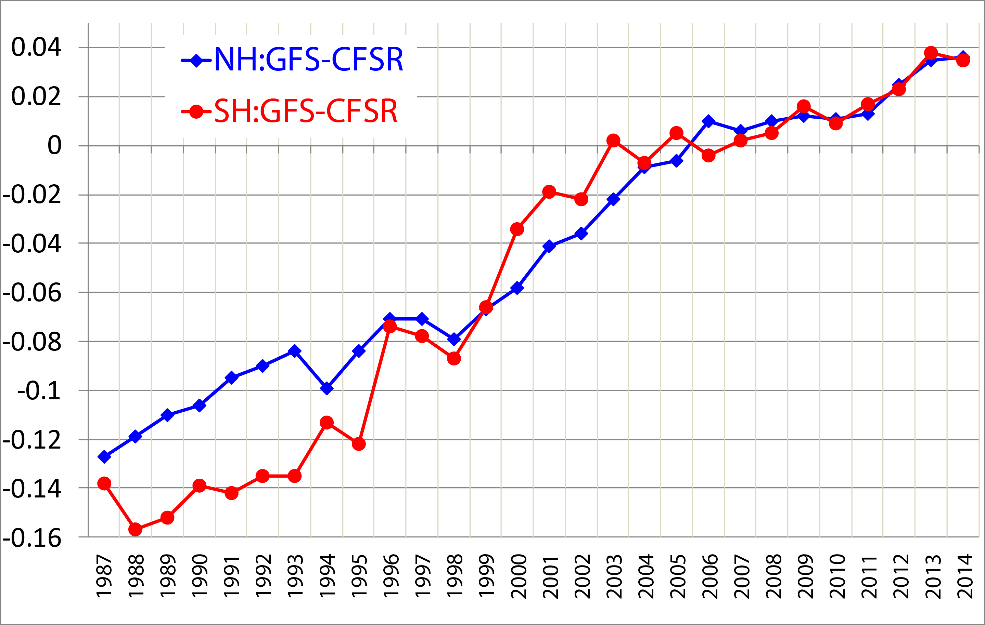
Historical Context: Annual Mean Day5, 500 hPa AC versus CFSR (2005 DA/modeling); courtesy F. Yang
Resolution Increase
Data Assimilation Upgrades

Slide 3
Hybrid/EnVar Nomenclature (Following Lorenc 2013):
Hybrid – blended covariance (ensemble and climatological)
EnVar – variational method using ensemble covariances
4DEnVar – ensemble covariance at observation time, no TL/AD, “propagation” performed a-prior by nonlinear model
(Hybrid or En) 4DVar – propagation is performed during optimization using TL/AD
Also 4DVar-Ben, 4DVar-Benkf
http://www.wcrp-climate.org/WGNE/BlueBook/2013/individual-articles/01_Lorenc_Andrew_EnVar_nomenclature.pdf

Slide 4
Hybrid 3DEnVar (no preconditioning)
β_{c} & β_{e}: weighting coefficients for clim. (var) and ensemble covariance respectively
x_{t}’: (total increment) sum of increment from fixed/static B (x_{c}’) and ensemble B
y_{o}’: observation departures
a: extended control variable; :ensemble perturbations
- analogous to the weights in the LETKF formulation
T: transformation/interpolation for dual-resolution capability
L: correlation matrix [effectively enforces localization in model space]

Slide 5
Hybrid with Preconditioned Double Conjugate Gradient
The NCEP data assimilation code has multiple minimization algorithm options, but default has been double CG (Derber and Rosati 1989)
Utilizes full B preconditioning (not square root). Installed by Parrish and Kleist.
More details on specifics can be found in Wang (2010).

Slide 6
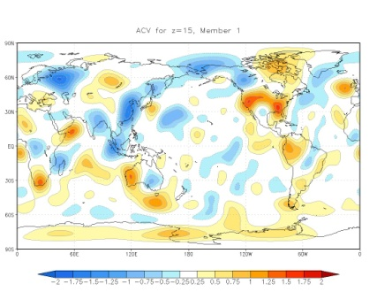
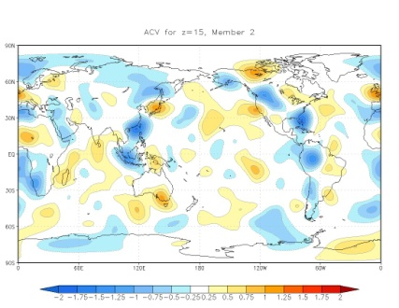
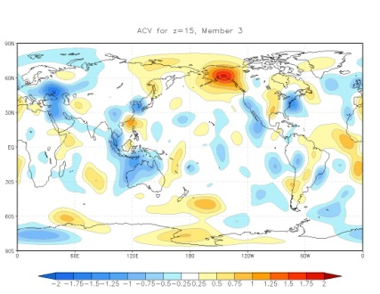
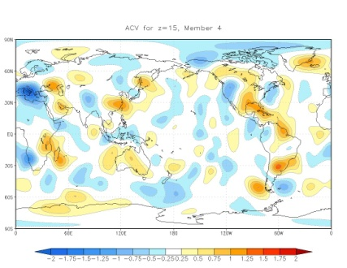
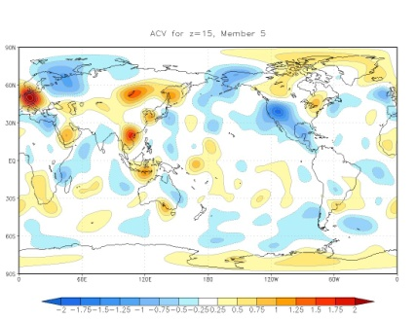
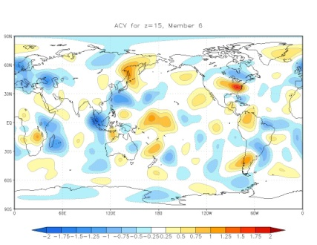
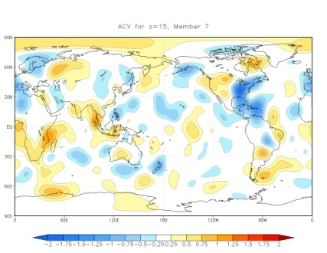
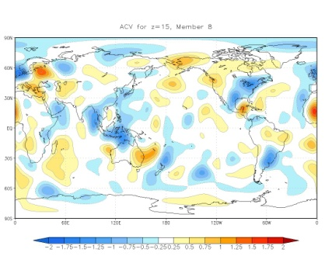
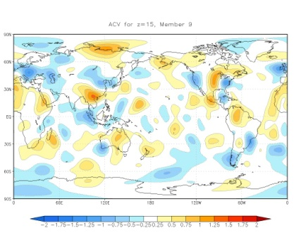
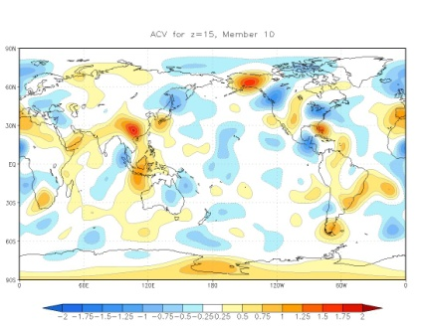
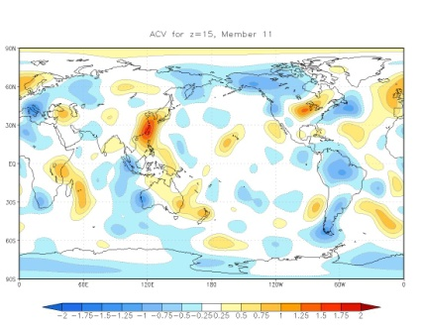
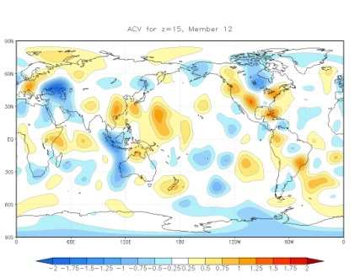
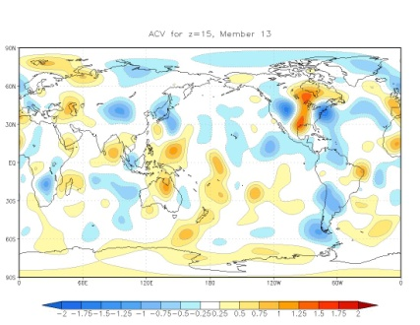
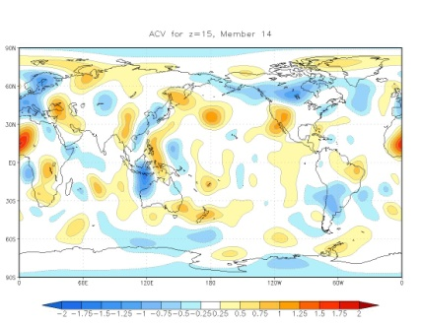
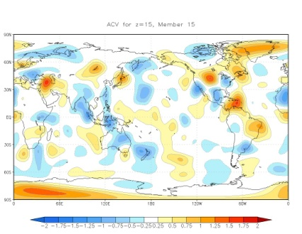
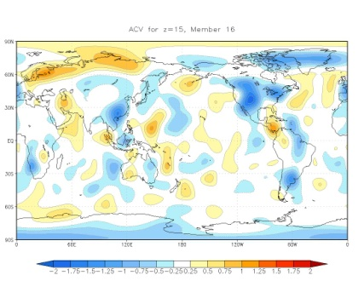
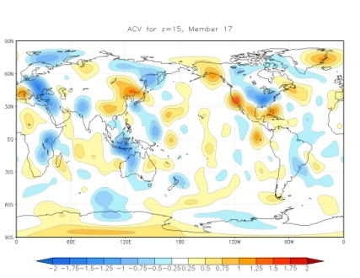
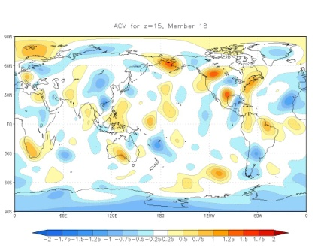
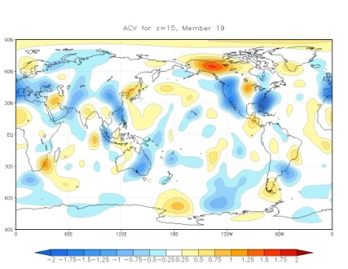
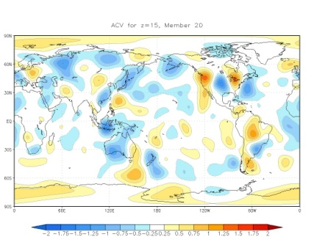
Control Variable Example (2012012212, z=15, 20 members) *Note in 4D, we assume this is valid for whole window

Slide 7
Hybrid GSI details
Localization:
Horizontal: Spectral operator to enforce Gaussian (not yet doing spectral/waveband/scale-dependent localization of Beuhner)
Vertical: Recursive filter
Ensemble variables: Can be different than standard control variable for Bc (Default u, v, T, ps, q_{wv}, q_{oz}, q_{cw})
Dual Resolution: If ensemble at lower resolution, interpolation (and adjoint) between ensemble/analysis grids*
Initialization: Option for Tangent Linear Normal Mode Constraint

Slide 8
Hybrid Assimilation Workflow
member 1
forecast
Generate new ensemble perturbations given the latest set of observations and first-guess ensemble
member 1
analysis
T574L64
member 2
forecast
EnKF
member update
member 2
analysis
recenter analysis ensemble
member M
analysis
member M
forecast
Ensemble contribution to background error covariance
Replace the EnKF ensemble mean analysis
and inflate
GSI
Hybrid EnVar
T1534L64
high res
forecast
high res
analysis
Previous Cycle
Current Update Cycle
8

Slide 9
Ensemble Details
80 member EnSRF (Whitaker and Hamill 2002)
GSI serves as observation operator (e.g. 80 calls to observer). Can assimilate all operationally available observations.
For radiances, uses approximate peak of weighting function to assign vertical position for localization
Lower resolution than deterministic GFS
Originally included combination of multiplicative (Relaxation to Prior Spread, RTPS) and additive (pseudo-random lagged forecast pairs) inflation as described in Whitaker and Hamill 2012
Assimilates fewer observations by design
Slightly coarser satellite data thinning, spread reduction data selection on the fly
Ensemble mean replaced with interpolated hybrid analysis each cycle (recentering). So-called “two-way coupling”.

Slide 10
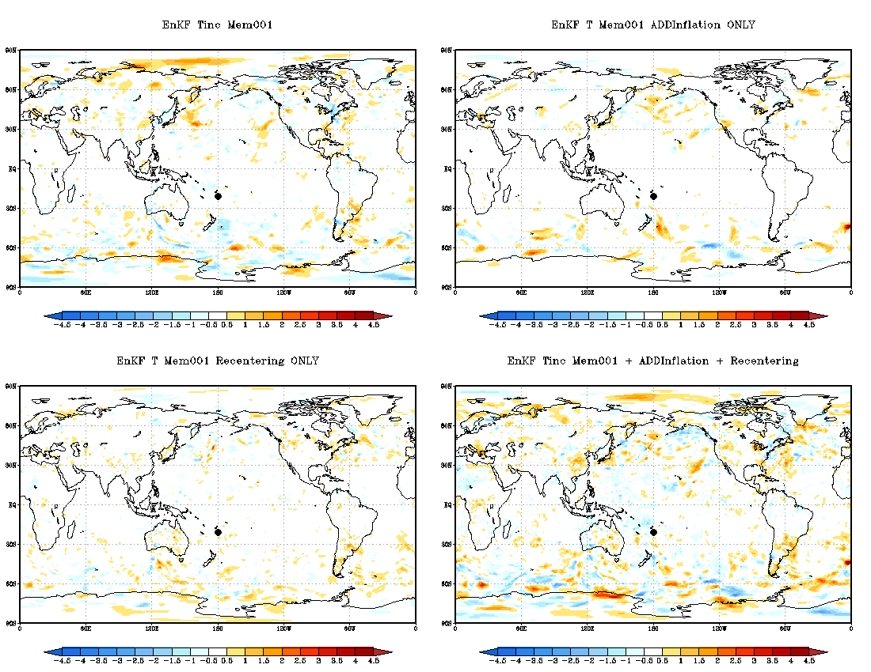
Member 1 increments, single cycle

Slide 11
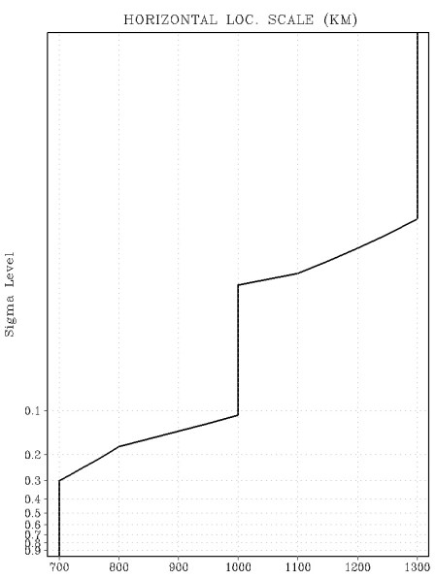
Hybrid 3DEnVar Operational Configuration and Testing Implemented: May 2012
T574L64 Deterministic (Eulerian dynamics)
T254L64 EnKF, 80 members
75% ensemble, 25% climatological for hybrid increment
Level dependent horizontal localization (divide by 0.38 to convert to GC zero distance)
0.5 scale heights in vertical

Slide 12
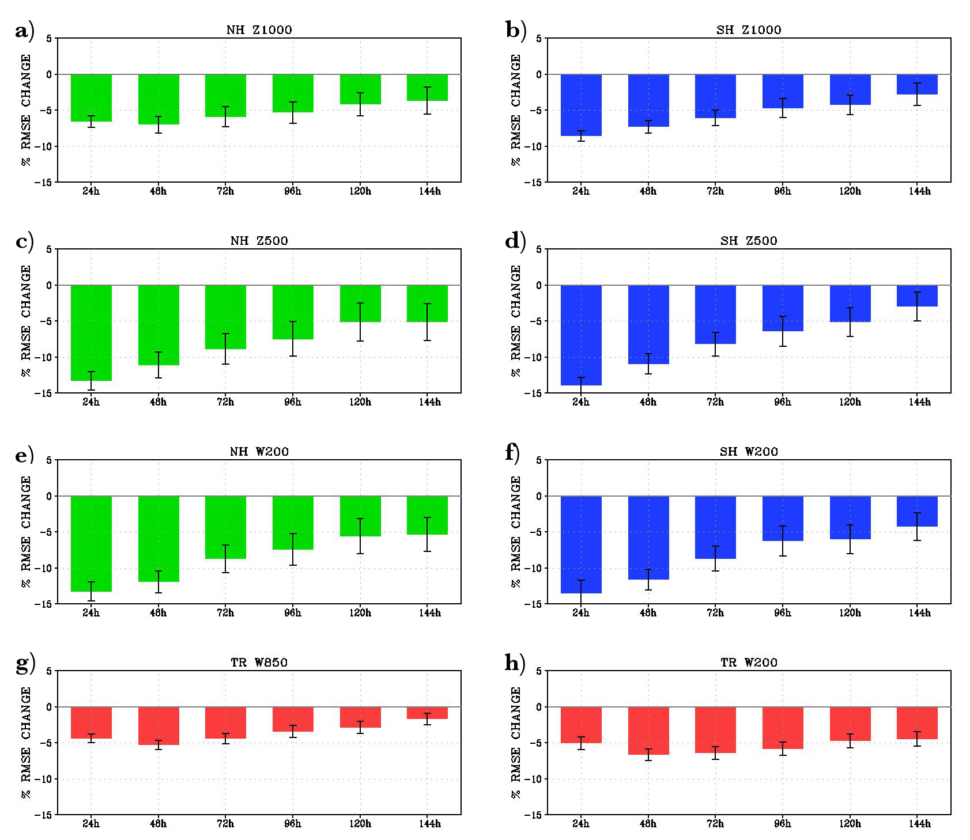
Impact from pre-implementation trials (% change RMSE, self-analysis)
Z1000
NH
SH
TR
Z500
W200
W850(L)
W200(R)
48h 96h 144h
48h 96h 144h
Experiment minus operational for period spanning 01 February 2012 through 15 May 2012.

Slide 13
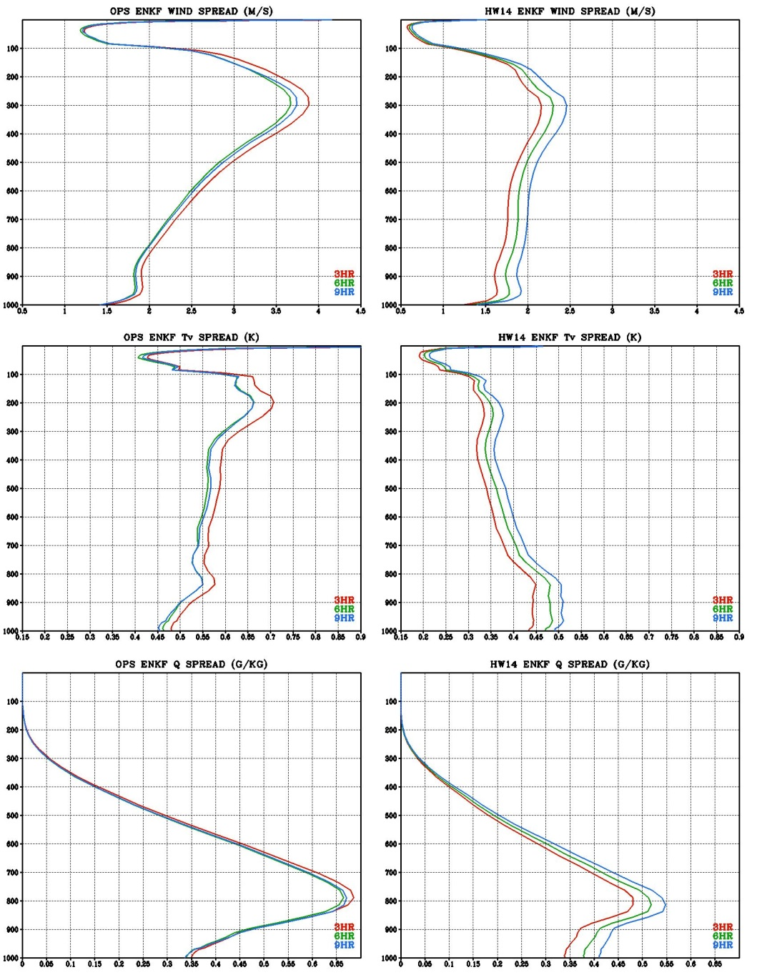
Behavior of ensemble spread in assimilation window
Global mean spread from single EnKF-based forecast
2014020400
Significant decay from 3-hr to 6-hr
Recovery and slight growth from 6-hr to 9-hr
Wind
Pressure (hPa)
3HR
6HR
9HR
Temp.
q_{wv}
Pressure (hPa)

Slide 14
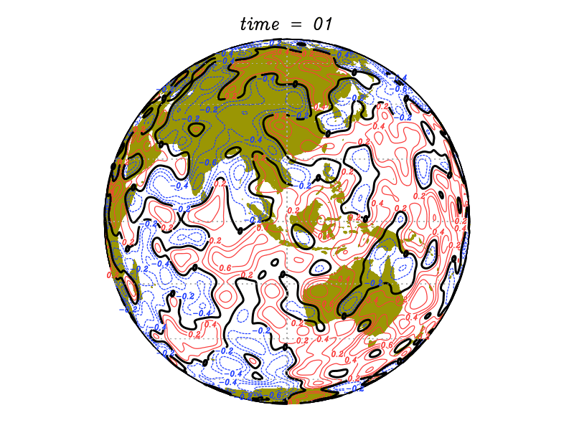
Replacement for additive inflation
Following the lead of ECMWF, pursued the use of “stochastic physics”
SPPT: Stochastically Perturbed Physics Tendencies
SKEB: Stochastic Kinetic Energy Backscatter
SHUM: Stochastically perturbed boundary layer HUMidity
All use stochastic random pattern generators to create spatially and temporally correlated noise.

Slide 15
Additive Inflation Off, Stoch. Physics On
Wind
Pressure (hPa)
3HR
6HR
9HR
Temp.
q_{wv}
Pressure (hPa)

Slide 16
January 2015 GFS Upgrade (Resolution)
Resolution was increased to T1534 (deterministic) and T574 (EnKF-based ensemble)
Semi-Lagrangian replaced Eulerian dynamic core
Data Assimilation:
Reduced weights on climatological to 12.5% (87.5% ensemble) for hybrid 3DEnVar
Reduced localization length scales
Replaced additive inflation with stochastic physics
Increment resolution kept at T574 effective resolution (same as ensemble)
Updated radiance bias correction scheme
Some observation changes

Slide 17
Temporal distribution of observations (NASA MERRA) Courtesy of Will McCarty (NASA GMAO)

Slide 18
Hybrid 4DEnVar
Jo term divided into observation “bins” as in 4DVAR
Where the 4D increment is prescribed through linear combinations of the 4D ensemble perturbations plus static contribution, i.e. it is not itself a model trajectory
Here, static contribution is time invariant. C represents TLNMC balance operator. No TL/AD in Jo term (M and M^{T}). Linear H used in cost function.

Slide 19
4D Hybrids (Courtesy UKMO)
4DEnVar uses ensemble instead of PF, but much more IO required.
Each iteration ~8 times faster with 200 members.
Analysis consists of two parts:
A 3DVar-like analysis based on the climatological covariance B_{c}
A 4D analysis consisting of a linear combination of the ensemble perturbations.
Localisation is currently in space only: same linear combination of ensemble perturbations at all times.
Hybrid-4DVar uses PF model to propagate B implicitly
Ensemble is used to help prescribe background error covariance at beginning of window

Slide 20
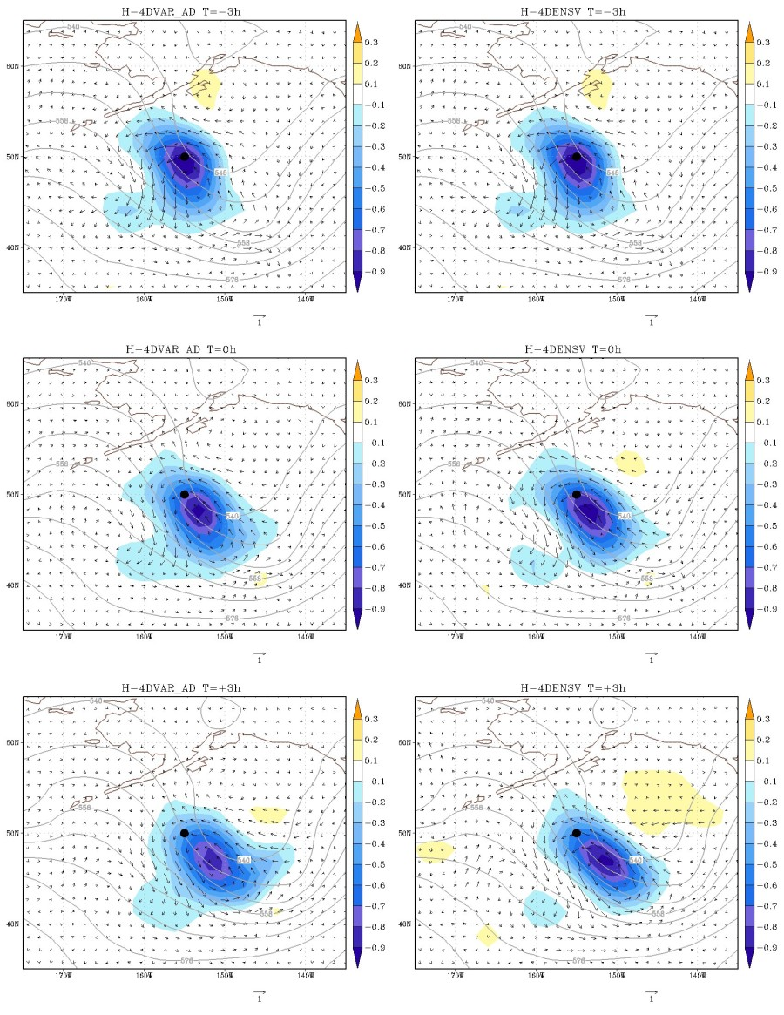
Single Temperature Observation (-3h) Example From Kleist and Ide (2015)
t=-3h
Solution at beginning of window identical
Evolution of increment qualitatively similar between dynamic and ensemble specification
** Current linear and adjoint models in GSI are computationally unfeasible for use in 4DVAR other than simple single observation testing at low resolution
t=0h
t=+3h
H-4DVAR
H-4DEnVar

Slide 21
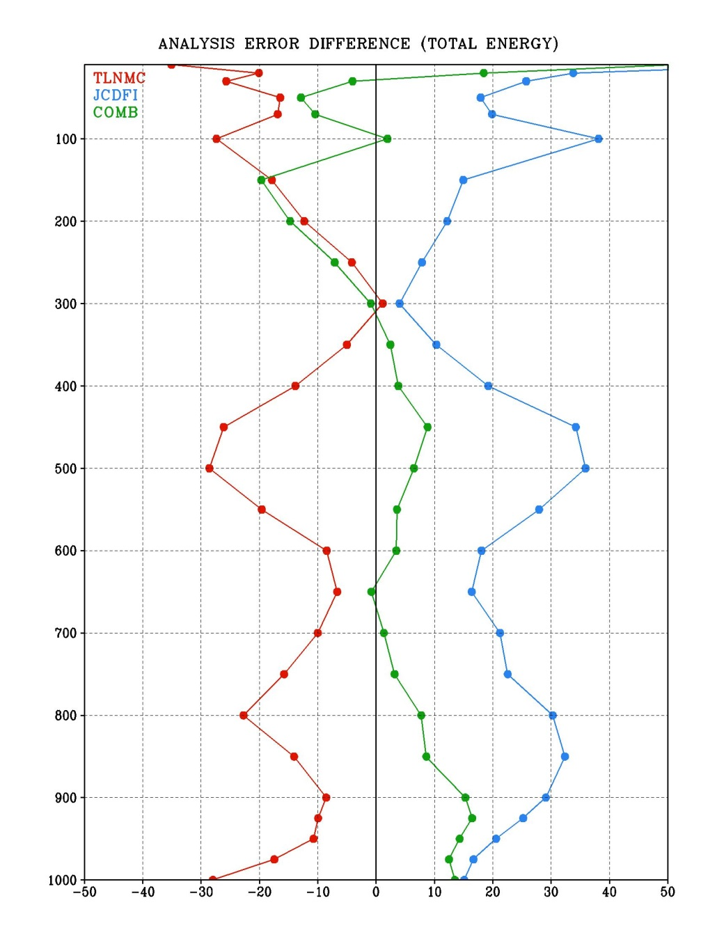
Impact of various constraints on analysis error (OSSE) Kleist and Ide 2015
Control (zero) is 4D hybrid without constraint/initialization
6 week trial
Time mean change in analysis error (total energy) relative to 4D hybrid EnVar experiment that utilized no constraints at all
TLNMC universally better
Combined constraint mixed
JcDFI increases analysis error (for configuration tested with hourly states)
Pressure (hPa)
Relative Analysis Error

Slide 22
Hybrid 4DEnVar Trials and Configuration Details
Hybrid weights kept the same, EnKF unchanged, hourly binning for observations
Change from 3- to 1- hr for FGAT
Localization unchanged
Based on OSSE work and status of IAU, configuration includes TLNMC and full field DFI
Deterministic analysis increment kept at ensemble resolution

Slide 23
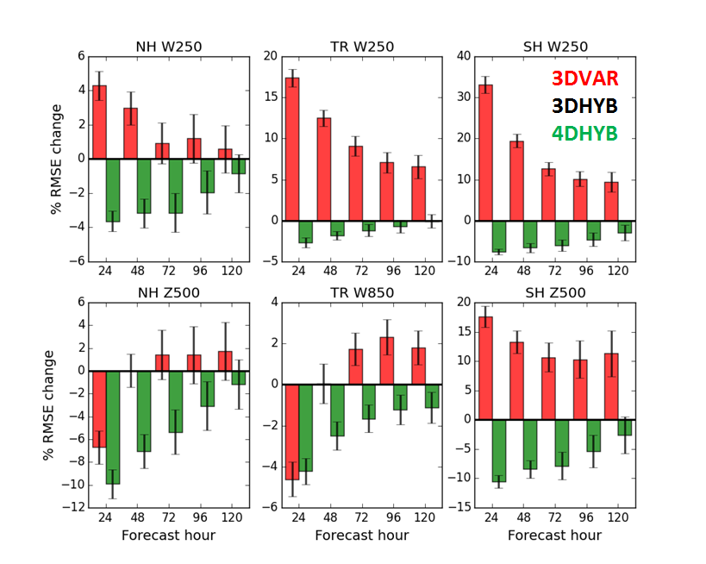
T670L64/T254L64 Prototype Trials Self-Analysis RMSE %Change, July-October 2013
Kleist et al., Manuscript in prep (Fig. courtesy R. Mahajan)

Slide 24
Low Resolution Summary
Clean tests of T670/T254 configuration
Was built as prototype of current operations. No additive inflation. Tuned stochastic physics.
Parameters between 3D/4D hybrid identical except those relevant to 4D aspects
Hybrid 3DEnVar significant impacts in tropics and winter hemisphere
Hybrid 4DEnVar significantly (and consistently) improves extratropics

Slide 25
May 2016 GFS Upgrade
Hybrid 4DEnVar
As previous described
Model fix specific to land surface issue
Other data assimilation changes:
Initial all-sky MW capability for AMSU-A (Zhu et al., revised version under review)
Aircraft temperature bias correction
Additional, small observation changes

Slide 26
Pre-Implementation Trials (Operational Resolution) Courtesy: V. Tallapagrada (NCEP)
GCWMB real time (pr4devb)
period: 2015070100 - real time
GCWMB 2015 summer retrospective (pr4devbs15) period: 2015041500 - 2015120100 (230 days)
GCWMB 2013 summer retrospective (pr4devbs13) period: 2013041500 - 2013120100 (230 days)
NCO 2013-2014 winter retrospective period: 2013110100 - 2014060100 (212 days)
NCO 2014 summer retrospective period: 2014050100 - 2014120100 (214 days)
GCWMB 2014-2015 winter retrospective (pr4devbw14) period: 2014110100 - 2015070100 (242 days)
GCWMB Special retrospective for H. Sandy
period: 2012101700 - 201213100 (15 days)
Subjective Evaluation Overview
Smaller analysis increments
Very significant improvement to short term forecast (<72 hours)
Significant improvement to medium range (72-144 h) for most periods
Significant improvements to winds and smaller scales
Implementation Day Today!
http://www.nws.noaa.gov/os/notification/tin16-11gfs_gdasaaa.htm

Slide 27
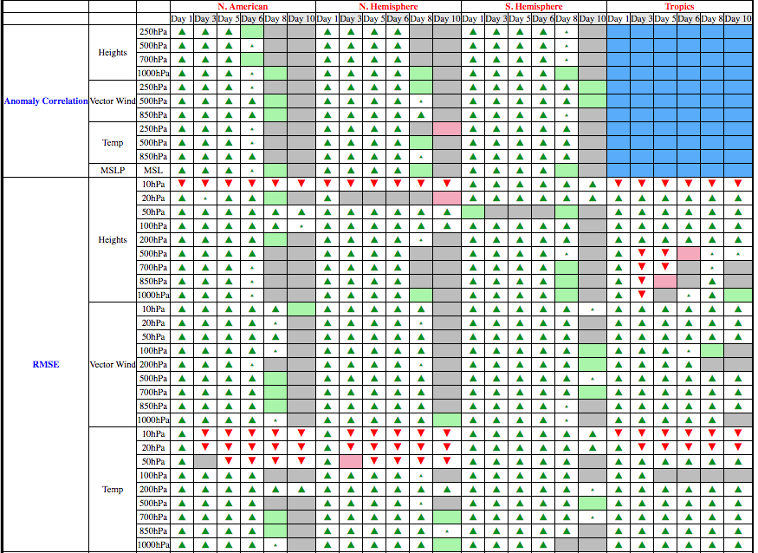
Summary Scorecard (20130501-20160228) 4DEnVar Package versus Operational GFS

Slide 28
Current work in progress or future directions
Replace full field digital filter with 4D incremental analysis update (similar to UKMO and CMC systems)
Explore spectral (waveband) and/or scale-dependent localization
Particularly keen to see if this can help with moisture and clouds
More generalized hybrid weights and/or scale-(waveband-) dependent weights
Use of outer loop within 4D EnVar (or weak constraint?)
Time evolving static covariance and localization without full TL/PF
Coupled assimilation and planning for CFSv3

Slide 29
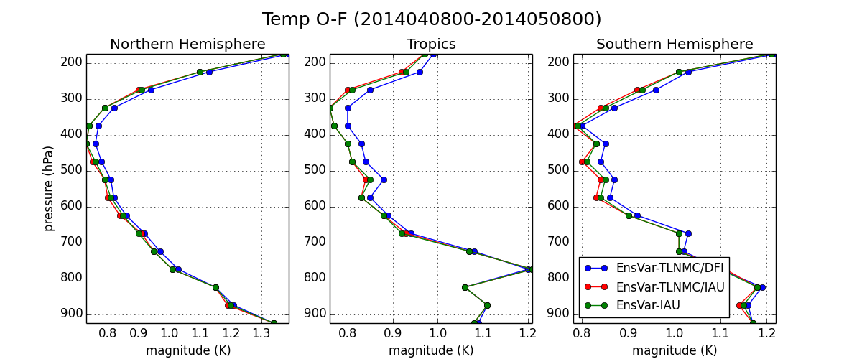
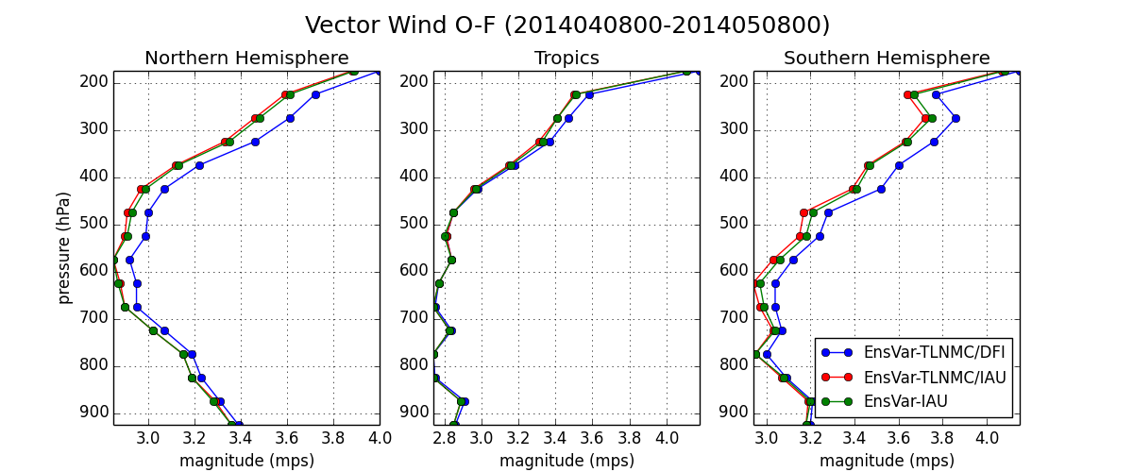
Impact of 4DIAU versus DFI in 4DEnVar context
DFI worst performing
TLNMC + 4DIAU best performing

Slide 30
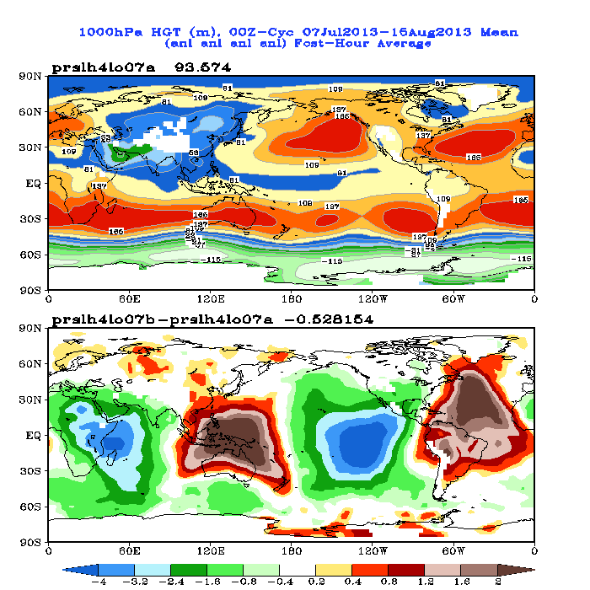
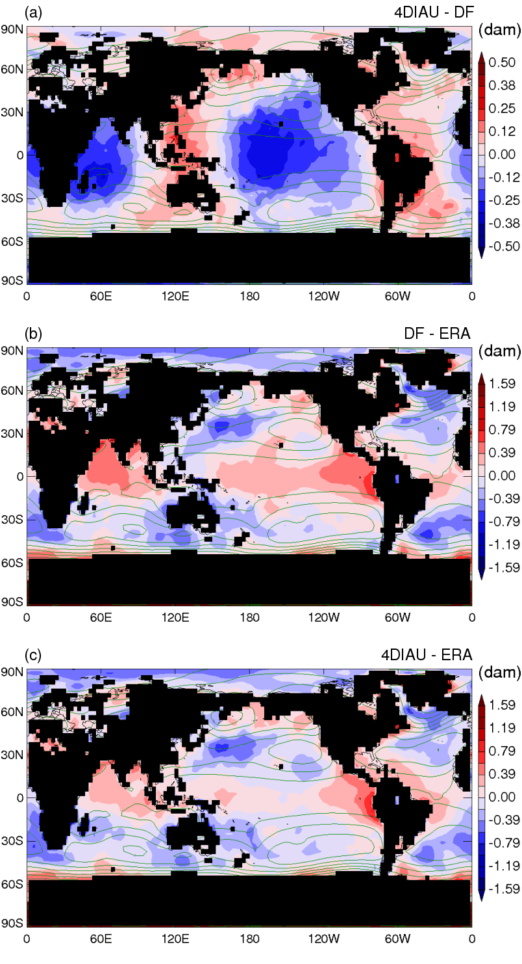
Impact of DFI on ps/1000 hPa heights
GFS 4D Hybrid IAU-DFI at 00 UTC
Buehner et al. (2015)

Slide 31
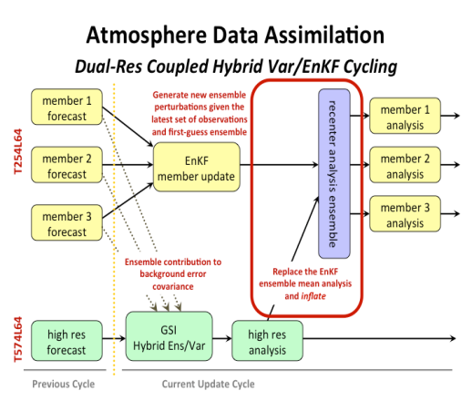
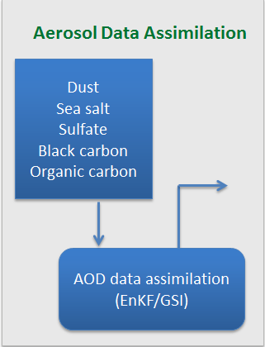
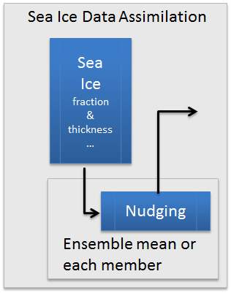
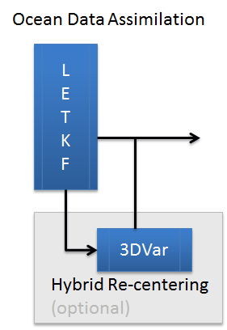
NCEP Coupled Hybrid Data Assimilation and Forecast System
Saha et al.
NEMS
NEMS
ATMOS
AERO
LAND
WAVE
SEA-ICE
ATMOS
AERO
LAND
WAVE
OCEAN
SEA-ICE
OCEAN
Coupled Model Ensemble Forecast
Coupled Model Ensemble Forecast
Coupled Ensemble Forecast (N members)
Ensemble Analysis (N Members)
INPUT
OUTPUT

Slide 32
References
Buehner, M., and Coauthors, 2015: Implementation of deterministic weather forecasting systems based on ensemble-variational data assimilation at Environment Canada. Part I: The global system. Mon. Wea. Rev., 143, 2532-2559 [DOI: 10.1175%2FMWR-D-14-00354.1].
Kleist, D.T., 2011: Assimilation of tropical cyclone advisory minimum sea level pressure in the NCEP global data assimilation system. Wea. Forecasting, 26, 1085-1091 [DOI: 10.1175/WAF-D-11-00045.1].
Kleist, D.T., and K. Ide, 2015: An OSSE-based evaluation of hybrid variational-ensemble data assimilation for the NCEP GFS, Part II: 4D EnVar and hybrid variants. Mon. Wea. Rev., 143, 452-470 [DOI: 10.1175/MWR-D-13-00350.1].
Kleist, D. T., D. F. Parrish, J. C. Derber, R. Treadon, R. M. Errico, and R. Yang, 2009: Improving incremental balance in the GSI 3DVar analysis system. Mon. Wea. Rev., 137, 1046-1060 [DOI: 10.1175/2008MWR2623.1].
Lei, L., and J. Whitaker, 2016: A four-dimensional incremental analysis update for the ensemble Kalman filter. Mon. Wea. Rev., in press [DOI: 10.1175/MWR-D-15-0246.1].
Lorenc, A.C., 2013: Recommended nomenclature for EnVar data assimilation methods. Research Activities in Atmospheric and Oceanic Modeling. WGNE, 2pp, URL: http://www.wcrp-climate.org/WGNE/BlueBook/2013/individual-articles/01_Lorenc_Andrew_EnVar_nomenclature.pdf)

Slide 33
References (continued)
Lorenz, E., 2005: Designing chaotic models. J. Atmos. Sci., 62, 1574-1587 [DOI: 10.1175%2FJAS3430.1].
Temperton, C., 1989: Implicit normal mode initialization for spectral models. Mon. Wea. Rev., 117, 436-451 [DOI: 10.1175/1520-0493(1989)117<0436%3AINMIFS>2.0.CO%3B2].
Wang, X., 2010: Incorporating ensemble covariance in the Gridpoint Statistical Interpolation (GSI) variational minimization: a mathematical framework. Mon. Wea. Rev., 138, 2990-2995 [DOI: 10.1175/2010MWR3245.1].
Wang, X., D. Parrish, D. Kleist, J. Whitaker, 2013: GSI 3DVar-Based Ensemble–Variational Hybrid Data Assimilation for NCEP Global Forecast System: Single-Resolution Experiments. Mon. Wea. Rev., 141, 4098–4117 [DOI: 10.1175/MWR-D-12-00141.1].
Whitaker, J. S., and T. M. Hamill, 2002: Ensemble data assimilation without perturbed observations. Mon. Wea. Rev., 130, 1913-1924 [DOI: 10.1175/1520-0493(2002)130<1913:EDAWPO>2.0.CO%3B2].
Whitaker, J. S. and T. M. Hamill, 2012: Evaluating methods to account for system errors in ensemble data assimilation. Mon. Wea. Rev., 140, 3078-3089 [DOI: 10.1175/MWR-D-11-00276.1].

