Slide 1
Exploring the Impact of Tropical Cyclone Relocation for the Operational NCEP GFS/GDAS
Daryl Kleist¹, Michael Brennan²,Kate Howard³, Sharanya Majumdar⁴,Rahul Mahajan³
¹University of Maryland - Dept. of Atmospheric and Oceanic Science
²NOAA/NWS/NCEP National Hurricane Center
³NOAA/NWS/NCEP Environmental Modeling Center
⁴University of Miami - RSMAS Dept. of Atmospheric Sciences

Slide 2
Background & Motivation
Continued improvement in TC track and intensity guidance important due to high societal impact
Resolution and complexity of global numerical models continues to increase, making vortex initialization ever more important
Complicated by fact that few observations within TC region are assimilated
Representativeness, scattering (clouds/precipitation), etc.
Process for initializing TCs in operational NWP suite is complicated and differs by modeling system
NCEP/EMC fields many questions about the process in the GFS/GDAS

Slide 3
TC Initialization at NCEP
For the operational GFS / GDAS, there is always some component from outside of the actual assimilation of real observations involved:
“Tracker” is run on GDAS forecast
If storm found in forecast/background, mechanical relocation of vortex
If not found, bogus observations are generated (winds are assimilated)
Advisory minimum sea-level pressure observations are then assimilated with other observations regardless of (1)

Slide 4
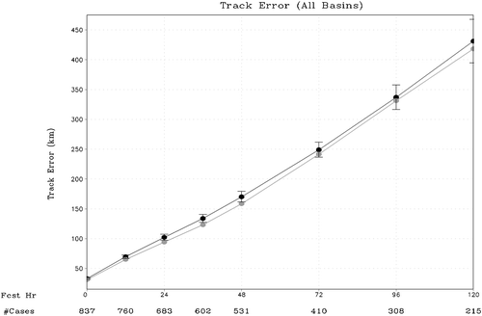
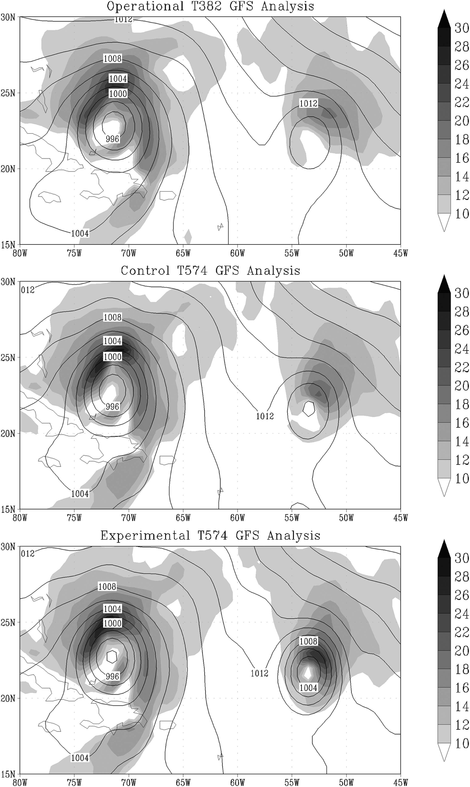
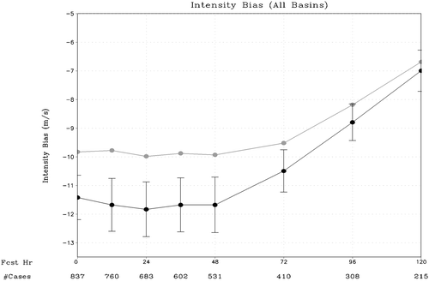
Advisory MinSLP in GDAS/GFS (Kleist 2011)
Then-Ops
Track Error
Control
MinSLP
Hanna
(ob: 989 mb)
Ike
(ob: 956 mb)
Control
Intensity Bias
Control
MinSLP
w/ MinSLP
00 UTC 4 September 2008

Slide 5
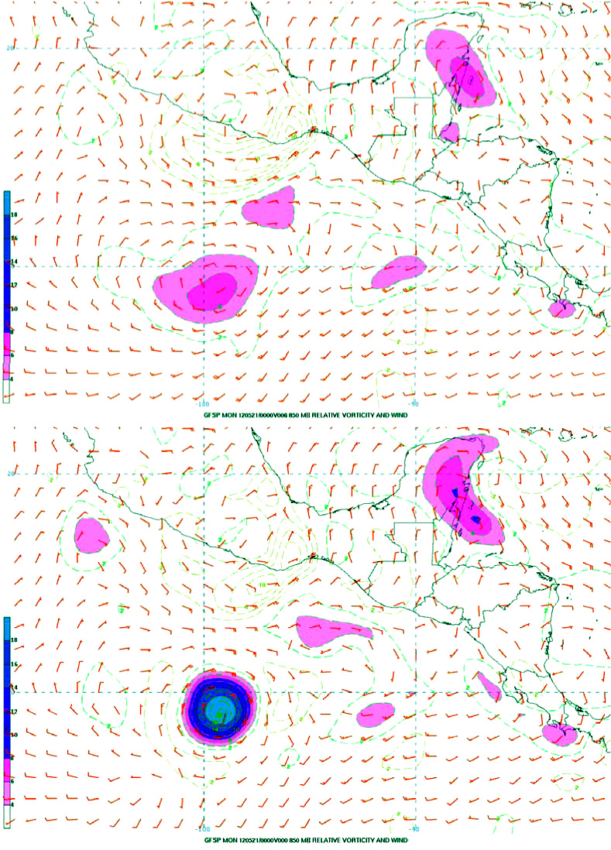
Example of Bogus Wind Assimilation Generally rare in operations, Occurs mainly in genesis situation
GFS 06 Hr Fcst
Valid:2012051200
Automated tracker “failed” to find coherent vortex to relocate This can happen because:
Distance from observation too large
Too much tilt
Parameters used to find position misaligned
Nothing there
GFS Analysis
Valid:2012051200
For Bud, tracker “failed” and resultant analysis had radically different vortex due to assimilation of bogus winds (and advisory minSLP)

Slide 6
How does Mechanical Relocation Work?
Locate tropical cyclone vortex in short forecast/background
Automated tracker on post-processed regular grid (grib files)
Abort process if storm center over major land mass, if terrain >500m, or if relocation distance is too large
Separate vortex from “environment” (GFDL Filter)
Move vortex to advisory position
This then serves as background for assimilation
Assimilate observations including advisory minSLP

Slide 7
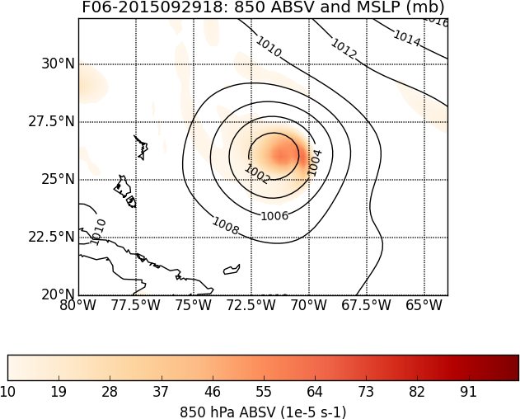
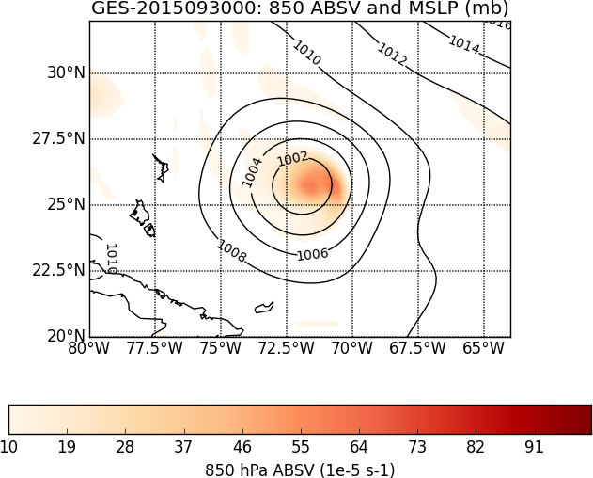
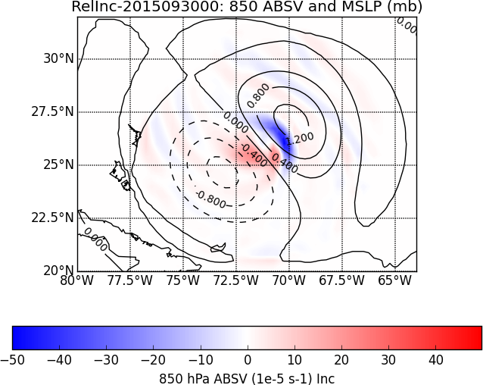
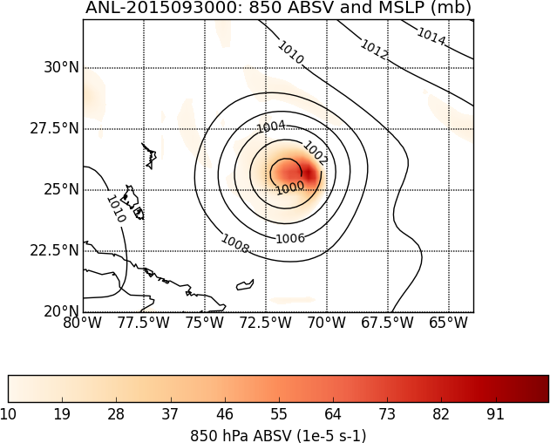
Impact of Relocation on Joaquin (2015093000) Move Storm SW by ~0.5 degrees
Original
F06
Relocated
F06
(Background)
Relocation
Increment
Final Analysis
Notes:
About 0.5 degree displacement toward the southwest

Slide 8
Initial Motivation Came From 2012 Hybrid Initial Tests (small sample)
Mostly September Cases (AL 07-16, EP 10-12, WP 10-14):
average track errors (NM) FOR HOMOGENEOUS SAMPLE
00 12 24 36 48 72 96 120
3DVAR(REL) 18.4 33.1 50.2 70.1 83.5 124.0 171.6 195.1
3DHYB(REL) 17.5 33.0 46.9 60.3 72.4 113.7 175.1 186.5
3DHYB(NO) 22.9 32.7 43.6 59.7 68.6 108.6 159.0 177.7
#CASES 73 67 58 49 42 30 24 17
Experiments were initially run *without* vortex relocation (eventually turned back on and still operational).
Signs that mechanical vortex relocation in GFS hurts forecast despite seemingly better initial positions (compare red versus green beyond 12h).

Slide 9
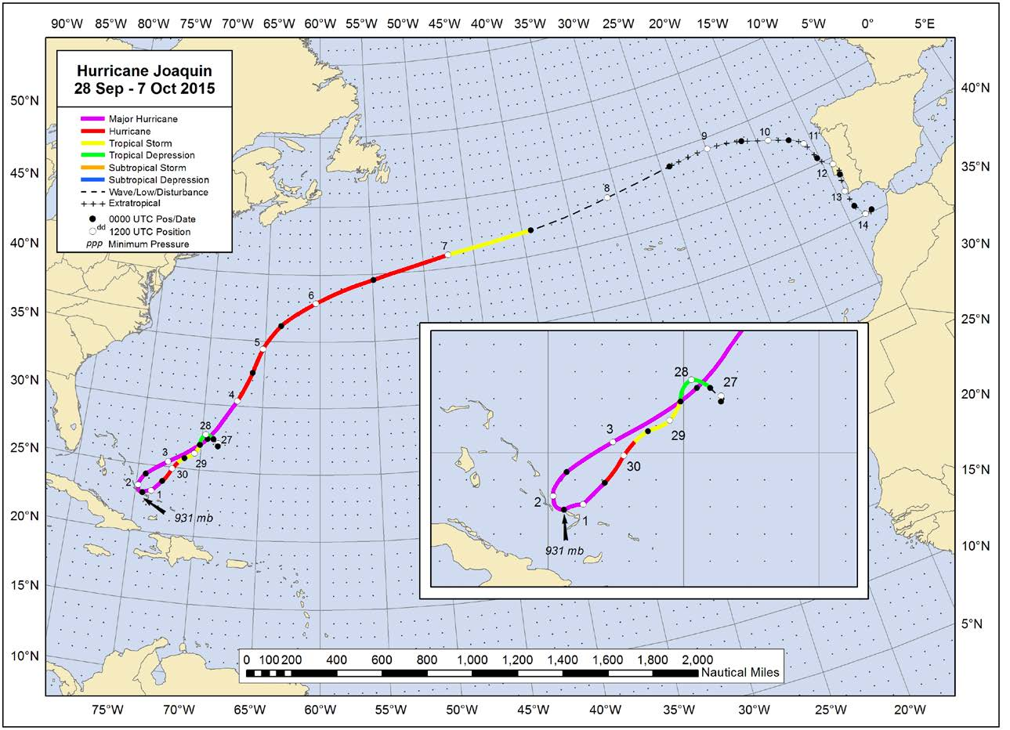
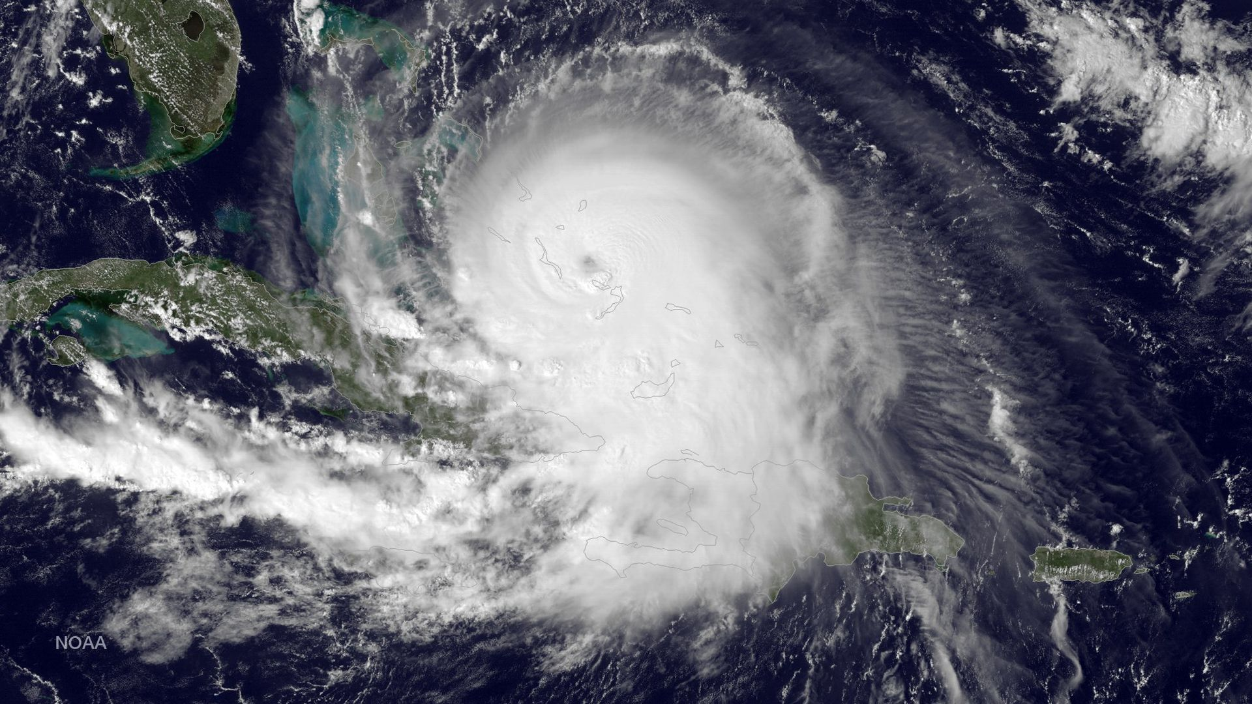
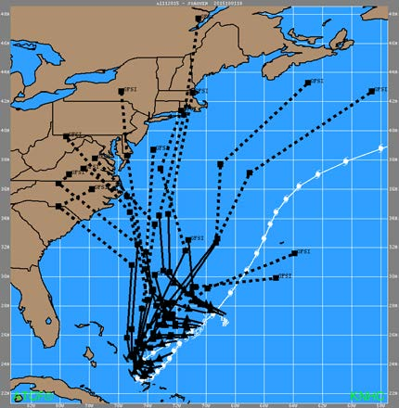
Hurricane Joaquin (2015)
Operational GFS
High Impact in Bahamas
Some guidance (GFS/HWRF) during early cycles advertised potential U.S. coastal impacts
Figures courtesy NHC TC Report

Slide 10
Joaquin (2015) Experiment
Fully-cycled (early and late cut-off) T1534L64 GFS with 80 member EnKF-based ensemble for hybrid data assimilation (3D EnVar)
Control (with relocation) and Experiment (without) started prior to classification of Joaquin as depression
For experiment without relocation the effect is cumulative – we are not evaluating the impact of relocation on any individual operational forecast
Bogus winds were never generated in operations, control, or experiment
Advisory MinSLP assimilated into hybrid and EnKF for control and experiment
Notes:
Relocation turned off for all TCs

Slide 11
Relocation in Control for Joaquin
During depression and TS phase, relocation distance larger than when storm reached hurricane status
These are approximate – the tracker operates on quarter degree output and relocation is estimated to precision of tenths of degrees
Also important to keep in mind that NHC analysis position has uncertainty about it as well

Slide 12
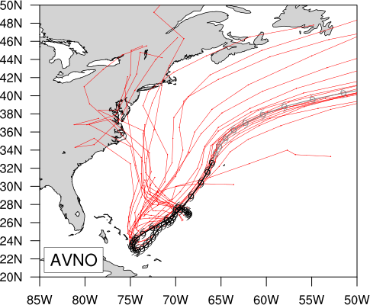
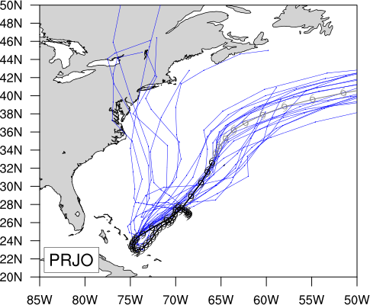
Track Summary for Experimental Period
Oper.
Expt.
With Relocation
Without Relocation
Figures courtesy Andrew Penny/NHC

Slide 13
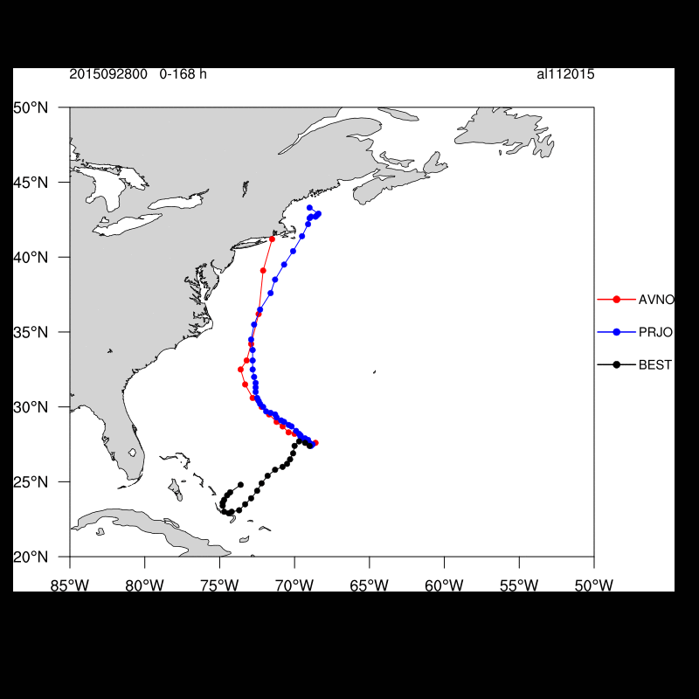
Joaquin Individual Tracks
No-relocation runs generally better beyond 24 hours
093000-100200 – Forecast to 3 days better in no-relocation experiment
Captures initial SW track toward Bahamas that operational GFS does not
093000-100200 – Forecasts considerably better in no-relocation experiment
This despite slightly larger initial errors
092918 exception as both bring storm to Carolina Coast
100206 and beyond – similar with NE track well predicted
Operational
No Relocation Best Track
Figures courtesy Andy Penny/NHC

Slide 14
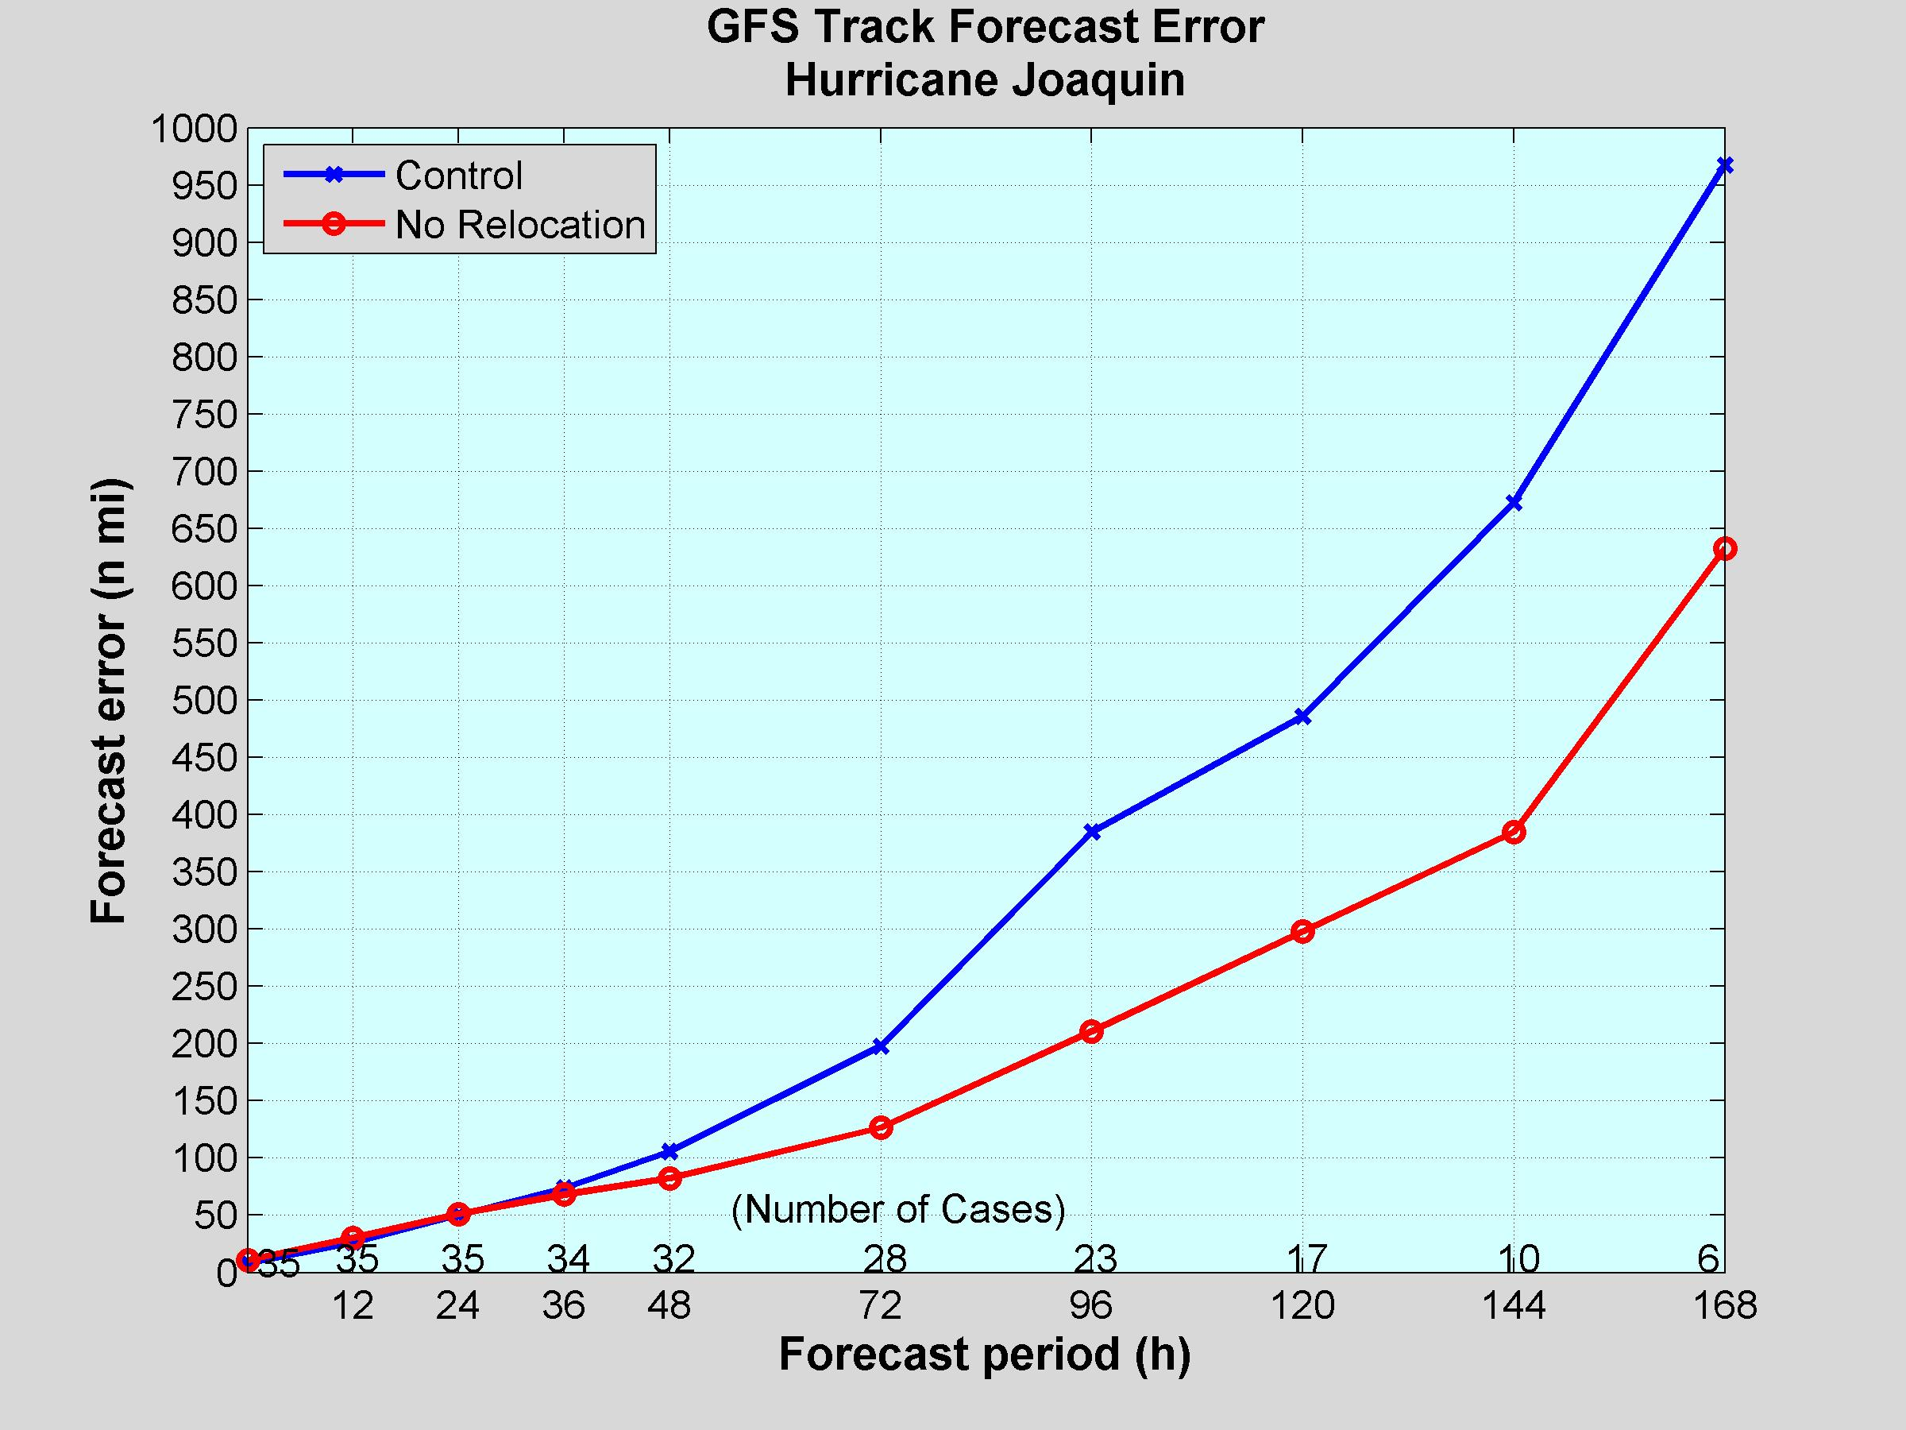
Joaquin Mean Track Errors w/ and w/out relocation
35%
Operational No Relocation
43%
39%
45%
36%
22%
7.9%
-2.2%
-15.7%

Slide 15
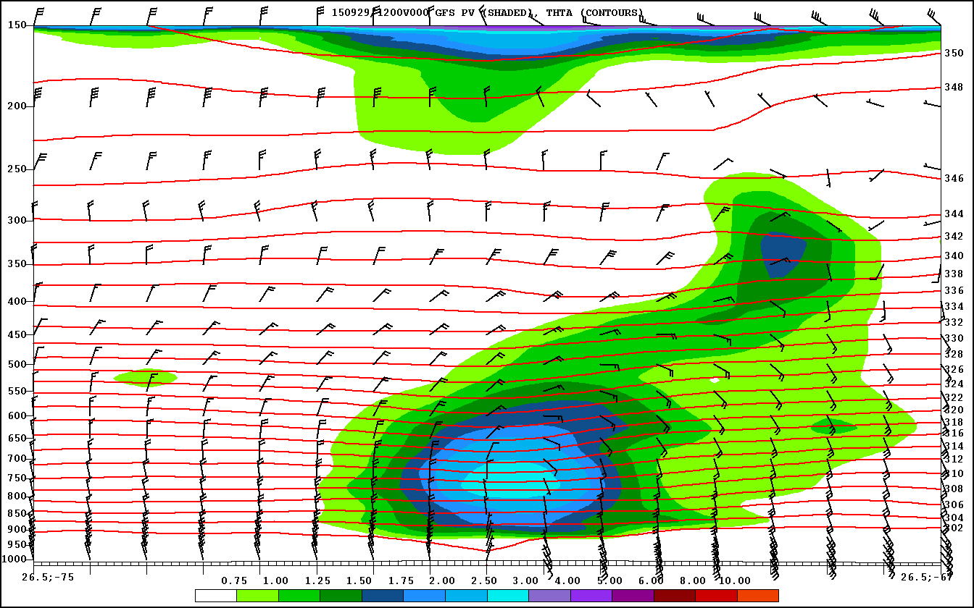
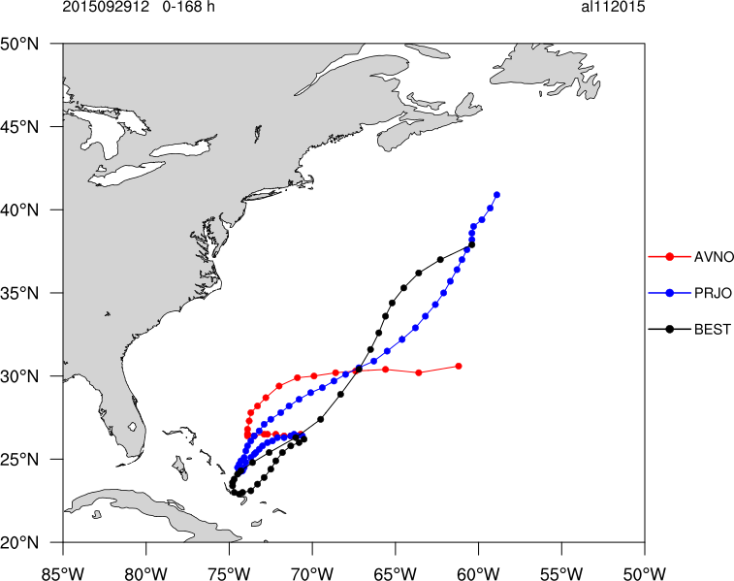
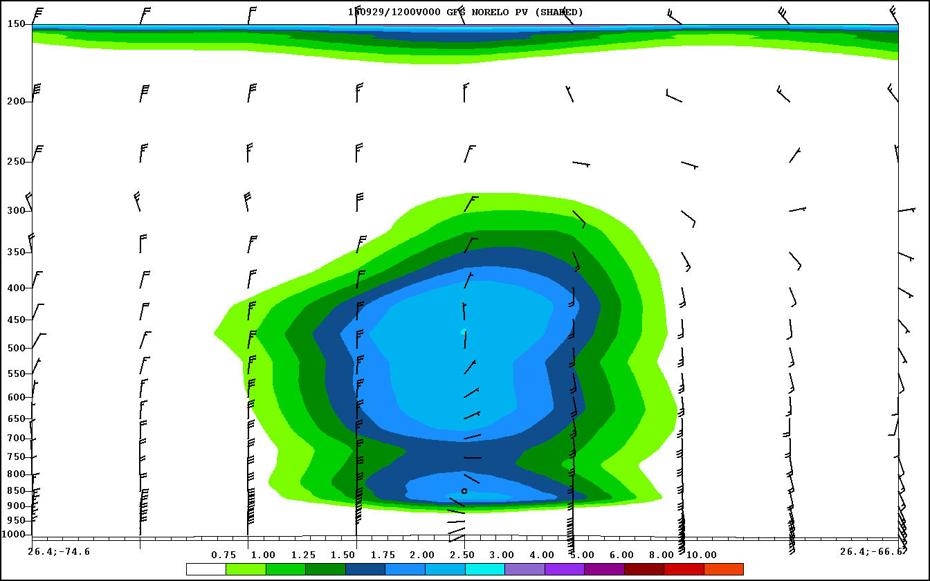
29 September 1200 UTC Cycle
Operational
No Relocation Best Track

Slide 16
Joaquin Summary and Next Steps
Operational GFS/GDAS utilizes complex combination of bogusing, vortex relocation, and advisory minSLP assimilation for TC initialization
However, case study reveals that current vortex relocation scheme detrimental to Joaquin forecasts
Post-genesis period: no-relocation run better captured SW movement
During intensification period, no-relocation run much better predicting eastward track (aside from one particular cycle)
After 2 October 0600 UTC, experiment and control similar
Need more evaluation to better understand why

Slide 17
Longer Term Solutions
Test more period(s) at operational resolution to quantify this sensitivity
This work was motivated by results of similar tests performed as part of hybrid DA development that showed similar results
If warranted, turn off relocation scheme in operations
Fixes to relocation?
Apply on the model native grid
Filtering options
Only apply when distance exceeds (or is within) thresholds
Alternatives within the data assimilation itself
Position assimilation directly in the hybrid-variational solver*
Position assimilation in the EnKF to improve covariance representation*
Feature Calibration and Alignment (FCA) in GSI*
Notes:
Do in a way consistent with the way other observations are assimilated.

Slide 18
Thanks!
The first author is supported through NOAA/NWS R2O funding on grant NA15NWS4680017

Slide 19
Continuation of Work by Ota Application of “Relocation” to EnKF
TCs in EnKF ensemble used as part of EnVar solver can sometimes have issues do to lack of TC relocation
MinSLP assimilated in EnKF and EnVar, but relocation only in EnVar
TC relocation of EnKF first guess ensemble has been proposed by Ota
Compromise of methods of position assimilation and mechanical relocation
Algorithm already developed with preliminary tests completed.
Not yet implemented for technical reasons
As part of R2O project, will resurrect and continue this development path
Has significant potential for position assimilation in EnVar through improved TC covariances
Implications for use of EnKF ensemble in GEFS as well

Slide 20
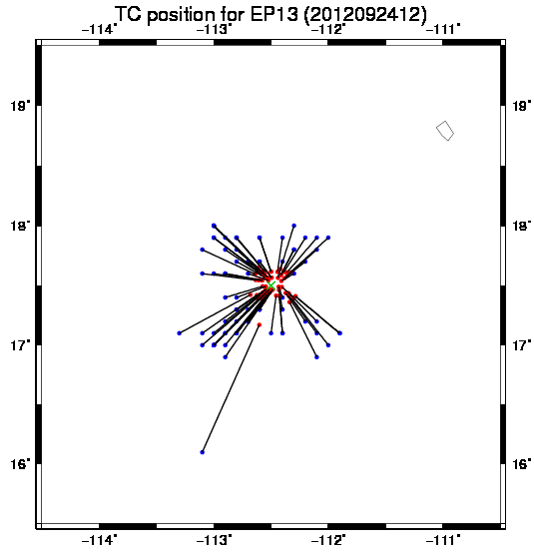
TC relocation to the EnKF ensembles (From Ota)
Apply TC relocation used in deterministic analysis to each ensemble member, but allowing TC structure perturbations and some TC position spread.
Update TC center position (latitude and longitude) by the EnKF
Use updated positions as inputs to the TC relocation
Apply this procedure before the EnKF analysis and GDAS analysis
The idea is to separate linear problem (TC location space) and nonlinear problem (actual relocation of fields).
Blue: first guess position Red: Updated position Green: TC vital position

Slide 21
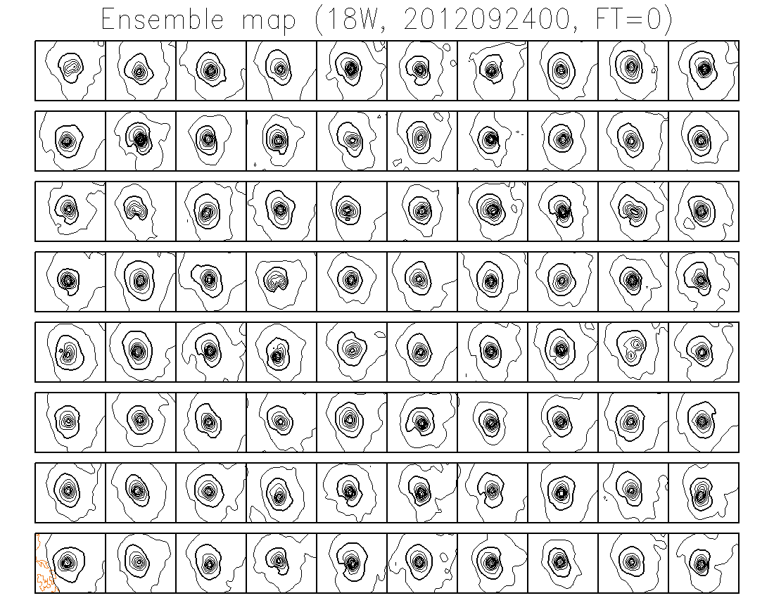
18W: 00UTC Sep. 24 EnKF analysis (no relocation)

Slide 22
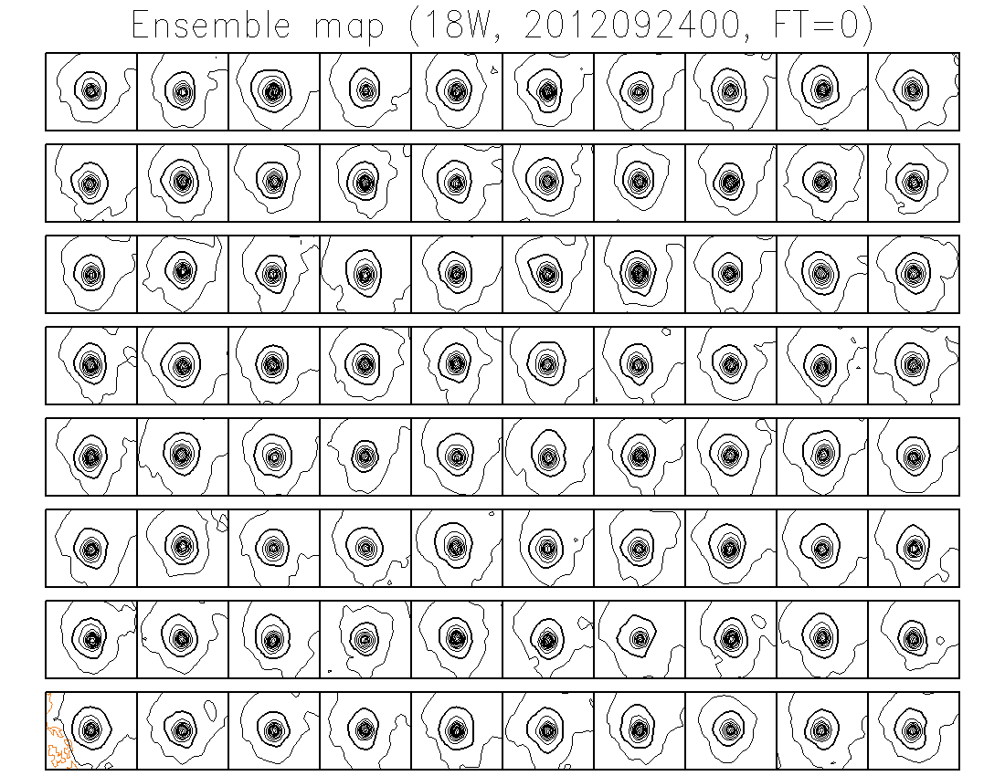
18W: 00UTC Sep. 24 EnKF analysis (with relocation)

Slide 23
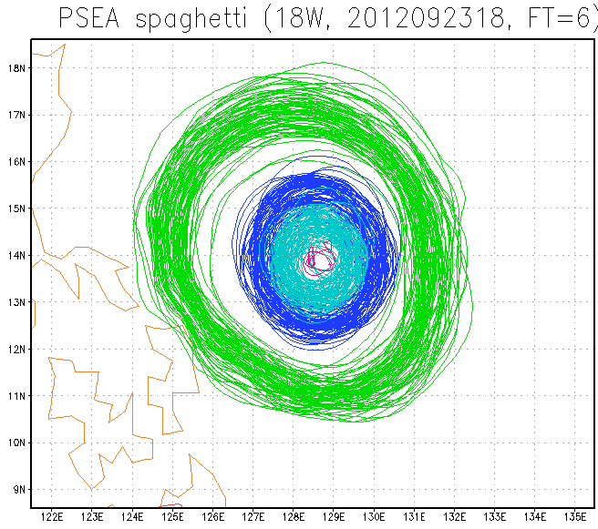
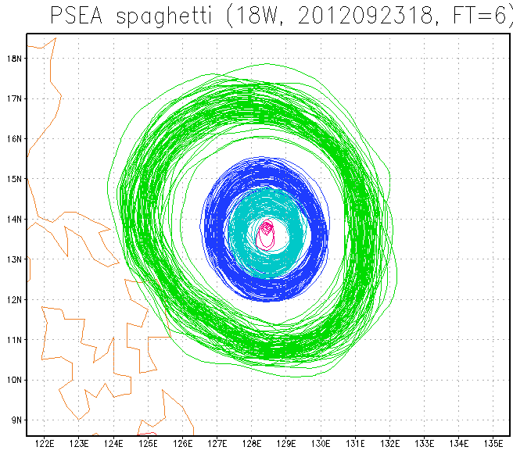
Example: spaghetti diagram From Ota
Before relocation
After relocation
TC relocation of this method can reduce the uncertainty on the TC position, maintaining the TC structure perturbations and some of the position uncertainty.

Slide 24
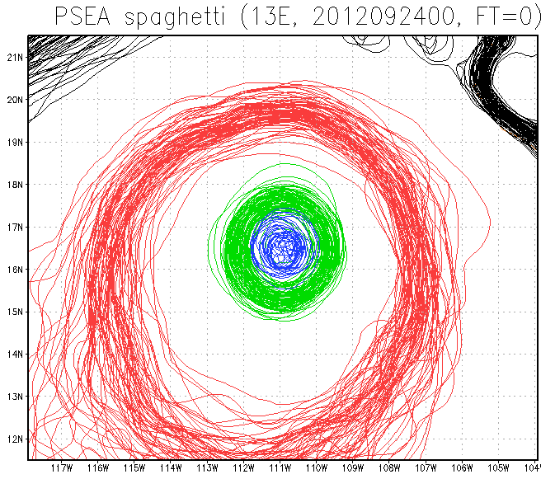
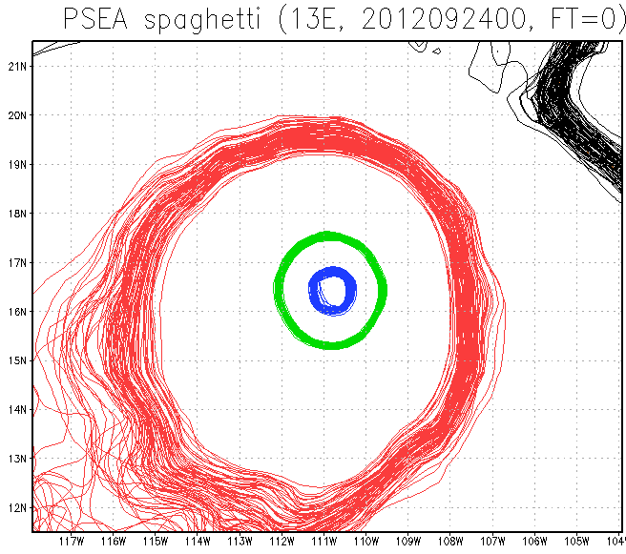
Comparison with GEFS TC relocation (from Ota)
EnKF analysis with TC relocation
EnKF 6 hour forecast perturbation + GEFS TC relocation
GEFS operational TC relocation scheme destroyed almost all initial position uncertainty and create very small spread around TC.

