Slide 1
Using “advanced data assimilation” to improve operational predictions from the NCEP GFS model
Daryl Kleist*
University of Maryland
Department of Atmospheric and Oceanic Science
* With many contributions from collaborators

Slide 2

NCEP Global Forecast System (and GDAS)
Operational global NWP model run by US National Weather Service
Deterministic and ensemble forecasts four times daily (00, 06, 12, 18 UTC) out to 15 days
Two DA cycles per initialization time
Deterministic: T1534 Semi-Lagrangian (~13km in tropics), 64 layers, full field digital filter
Ensemble: 20 member T574, 64 layers
No TL/AD

Slide 3
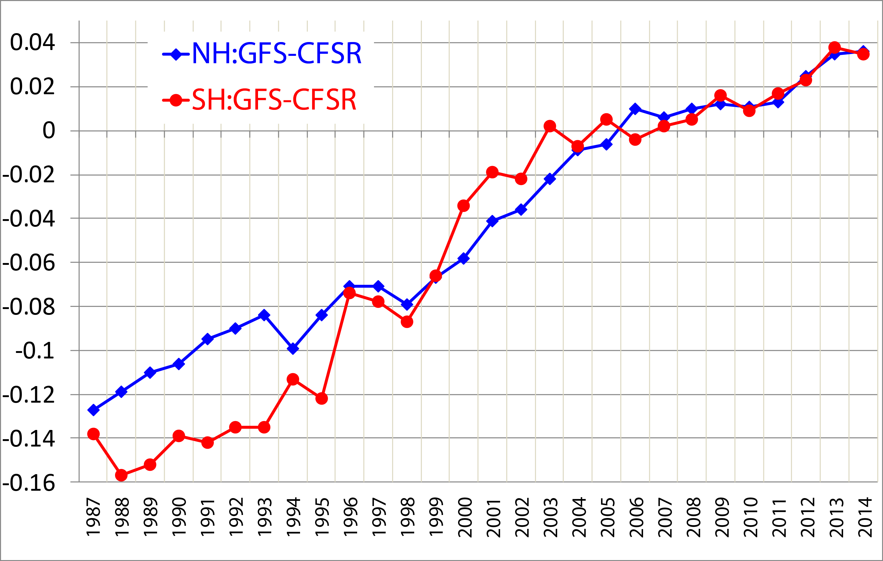
Historical Context: Annual Mean Day5, 500 hPa AC versus
CFSR (2005 DA/modeling)
Resolution Increase
Data Assimilation Upgrades

Slide 4
Hybrid/EnVar Nomenclature (Following Lorenc 2013):
Hybrid – blended covariance (ensemble and climatological)
EnVar – variational method using ensemble covariances
4DEnVar – ensemble covariance at observation time, no TL/AD, “propagation” performed a-prior by nonlinear model
(Hybrid or En) 4DVar – propagation is performed during optimization using TL/AD
  Also 4DVar-Ben, 4DVar-Benkf
http://www.wcrp-climate.org/WGNE/BlueBook/2013/individual-articles/01_Lorenc_Andrew_EnVar_nomenclature.pdf

Slide 5
Hybrid 3DEnVar (no preconditioning)
β_{c} & β_{e}: weighting coefficients for clim. (var) and ensemble covariance respectively
x_{t}’: (total increment) sum of increment from fixed/static B (x_{c}’) and ensemble B
y_{o}’: observation departures
a: extended control variable; :ensemble perturbations
- analogous to the weights in the LETKF formulation
T: transformation/interpolation for dual-resolution capability
L: correlation matrix [effectively enforces localization]

Slide 6
Hybrid with Preconditioned Double Conjugate Gradient
The NCEP data assimilation code has multiple minimization algorithm options, but default has been double CG (Derber and Rosati 1989)
Utilizes full B preconditioning (not square root). Installed by Parrish and Kleist.
More details on specifics can be found in Wang (2010).

Slide 7
Hybrid GSI details
Localization:
  Horizontal: Spectral operator to enforce Gaussian (not yet doing spectral/waveband/scale-dependent localization of Beuhner)
  Vertical: Recursive filter
Ensemble variables: Can be different than standard control variable for Bc (Default u, v, T, ps, q_{wv}, q_{oz}, q_{cw})
Dual Resolution: If ensemble at lower resolution, interpolation (and adjoint) between ensemble/analysis grids*
Initialization: Option for Tangent Linear Normal Mode Constraint

Slide 8
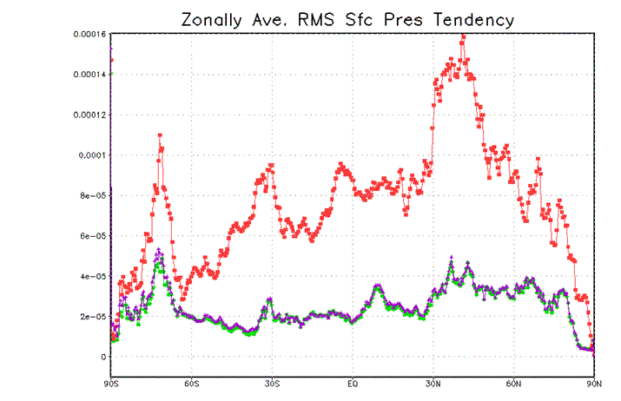
Tangent Linear Normal Mode Constraint
Kleist et al. (2009)
Background No Constraint
TLNMC
C – correction after incremental NMI procedure (based on Temperton 1989)
Requires incremental tendencies, projection onto vertical modes, and spherical harmonics (and adjoint thereof)
Implemented as “strong constraint” on increment
Since operating on increment, single iteration (within each loop of minimization) found sufficient
RMS Sum of Analysis Incremental Tendencies in Spectral Space
(total, projections onto gravity modes, and percentage)
 | S_{uf} | S_{uf_g} | %_g
NOINIT | 1.45x10⁻⁷ | 1.34x10⁻⁷ | 92.4
TLNMC | 2.04x10⁻⁸ | 6.02x10⁻⁹ | 29.5

Slide 9
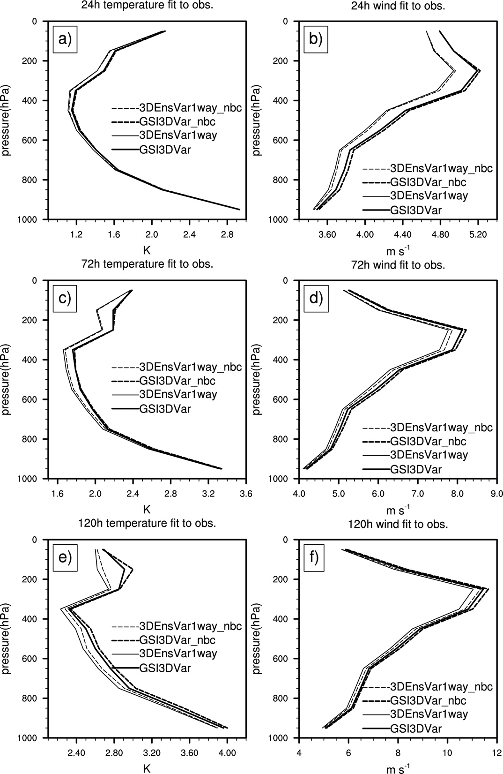
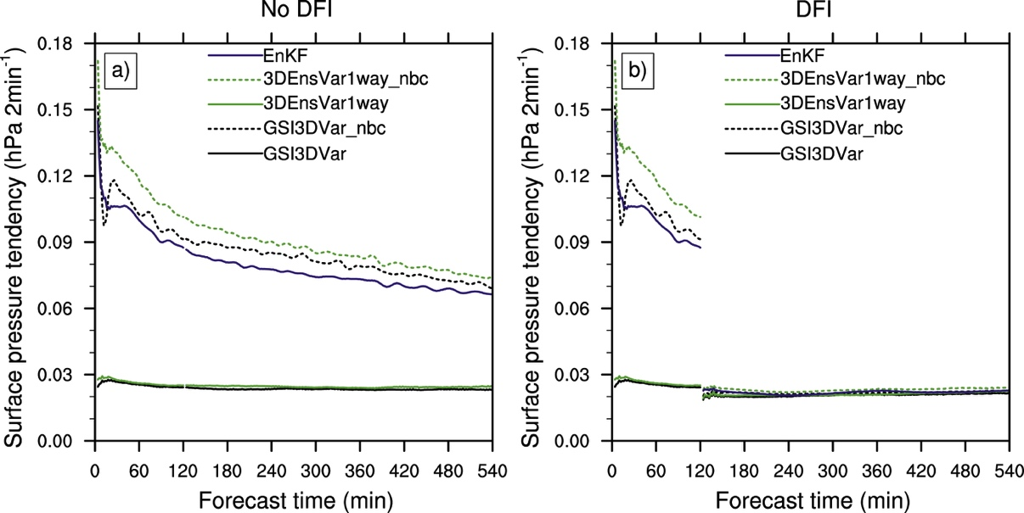
TLNMC impact on hybrid
Wang et al. (2013)
Forecast Impact (Obs)
Surface Pressure Tendency (single forecast) for various configurations
TLNMC results in better forecasts in 3DVAR and hybrid 3DEnVar
TLNMC improves balance
EnVar has larger tendencies (more imbalance) in 3DEnVar than 3DVar (localization?)

Slide 10
Hybrid Assimilation Workflow
member 1
forecast
Generate new ensemble perturbations given the latest set of observations and first-guess ensemble
member 1
analysis
T574L64
member 2
forecast
EnKF
member update
member 2
analysis
recenter analysis ensemble
member M
analysis
member M
forecast
Ensemble contribution to background error covariance
Replace the EnKF ensemble mean analysis
and inflate
GSI
Hybrid EnVar
T1534L64
high res
forecast
high res
analysis
Previous Cycle
Current Update Cycle
10

Slide 11
Ensemble Details
80 member EnSRF (Whitaker and Hamill 2002)
  GSI serves as observation operator (e.g. 80 calls to observer). Can assimilate all operationally available observations.
  For radiances, uses approximate peak of weighting function to assign vertical position for localization
  Lower resolution than deterministic GFS
  Originally included combination of multiplicative (Relaxation to Prior Spread, RTPS) and additive (pseudo-random lagged forecast pairs) inflation as described in Whitaker and Hamill 2012
  Assimilates fewer observations by design
    Slightly coarser satellite data thinning, spread reduction data selection on the fly
  Ensemble mean replaced with interpolated hybrid analysis each cycle (recentering). So-called “two-way coupling”.

Slide 12
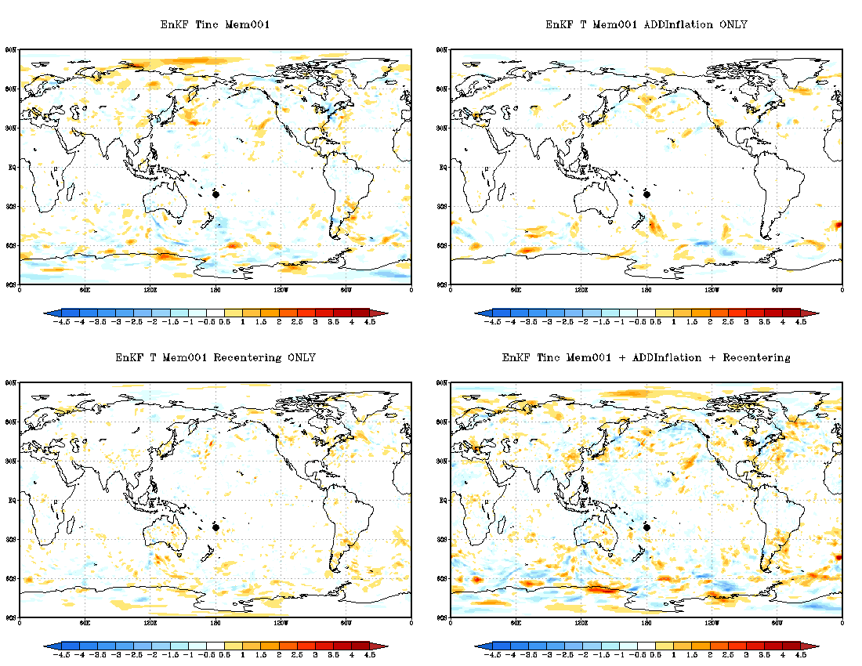
Member 1 increments, single cycle

Slide 13
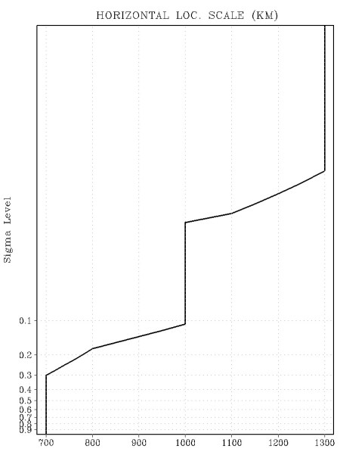
Hybrid 3DEnVar Operational Configuration and Testing
Implemented: May 2012
T574L64 Deterministic (Eulerian dynamics)
T254L64 EnKF, 80 members
75% ensemble, 25% climatological for hybrid increment
Level dependent horizontal localization (divide by 0.38 to convert to GC zero distance)
0.5 scale heights in vertical

Slide 14
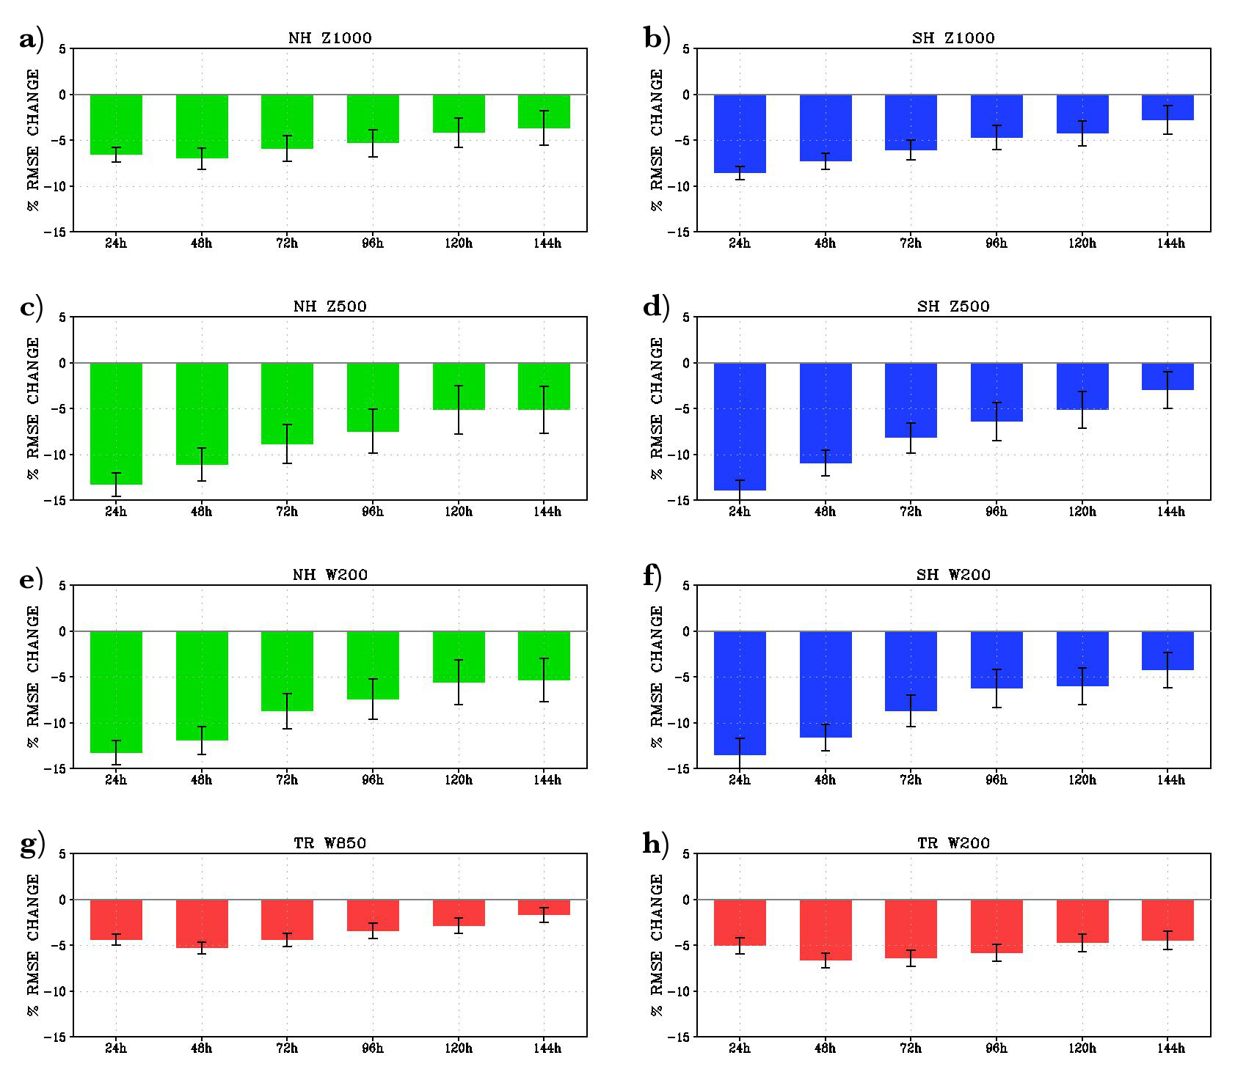
Impact from pre-implementation trials
(% change RMSE, self-analysis)
Z1000
NH
SH
TR
Z500
W200
W850(L)
W200(R)
48h 96h 144h
48h 96h 144h
Experiment minus operational for period spanning 01 February 2012 through 15 May 2012.

Slide 15
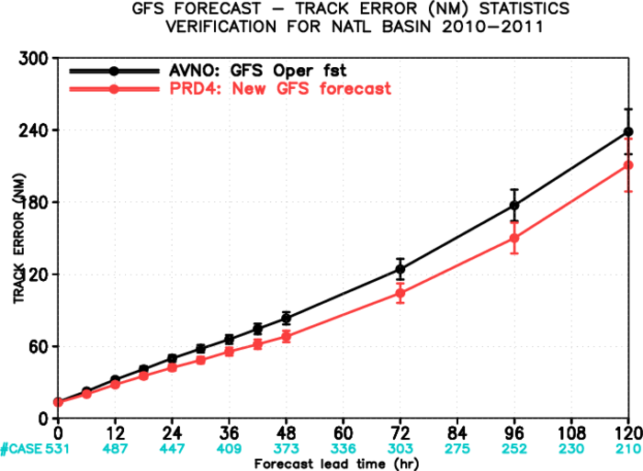
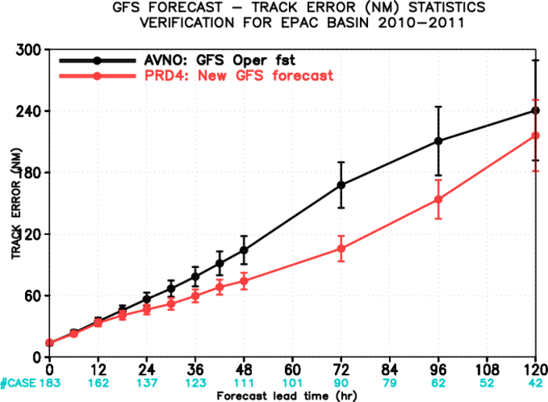
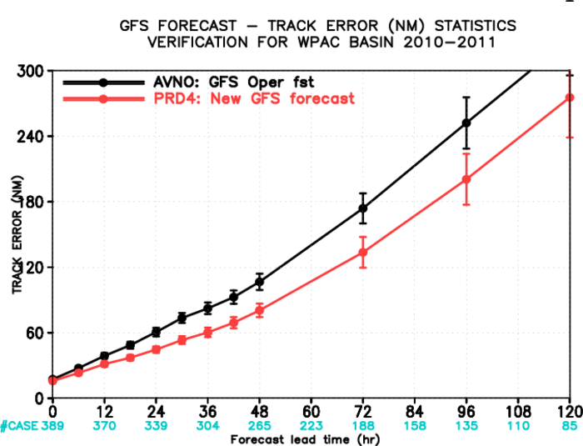
Impact from pre-implementation trials
(Mean TC Track Errors, 3 Basins)
ATL
EPAC
WPAC

Slide 16
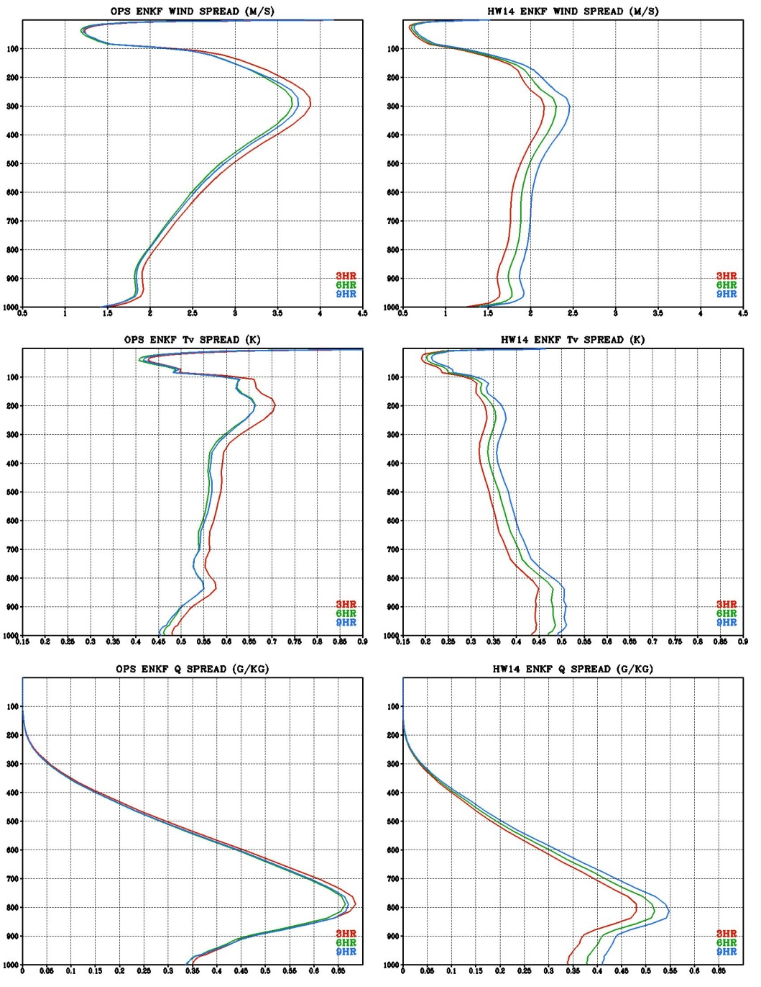
Behavior of ensemble spread in assimilation window
Global mean spread from single EnKF-based forecast
  2014020400
Significant decay from 3-hr to 6-hr
Recovery and slight growth from 6-hr to 9-hr
  Wind
Pressure (hPa)
  3HR
  6HR
  9HR
  Temp.
  q_{wv}
Pressure (hPa)

Slide 17
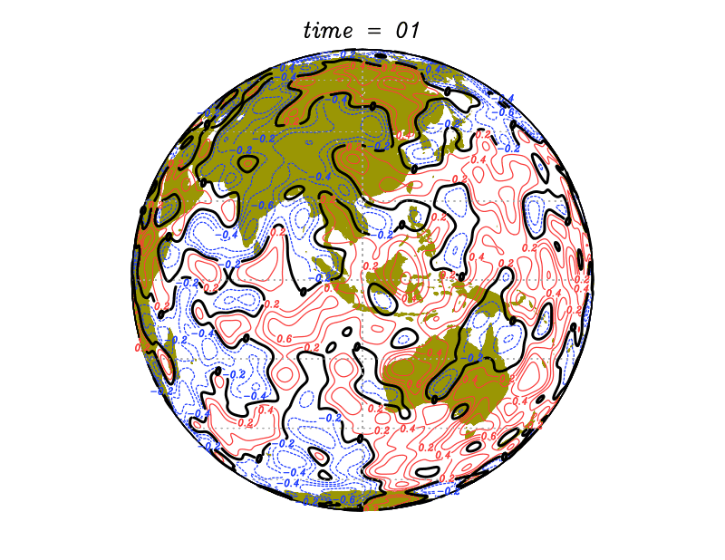
Replacement for additive inflation
Following the lead of ECMWF, pursued the use of “stochastic physics”
  SPPT: Stochastically Perturbed Physics Tendencies
  SKEB: Stochastic Kinetic Energy Backscatter
  SHUM: Stochastically perturbed boundary layer HUMidity
All use stochastic random pattern generators to create spatially and temporally correlated noise.

Slide 18
Additive Inflation Off, Stoch. Physics On
  Wind
Pressure (hPa)
  3HR
  6HR
  9HR
  Temp.
  q_{wv}
Pressure (hPa)

Slide 19
January 2015 GFS Upgrade (Resolution)
Resolution was increased to T1534 (deterministic) and T574 (EnKF-based ensemble)
Semi-Lagrangian replaced Eulerian dynamic core
Data Assimilation:
  Reduced weights on climatological to 12.5% (87.5% ensemble) for hybrid 3DEnVar
  Reduced localization length scales
  Replaced additive inflation with stochastic physics
  Increment resolution kept at T574 effective resolution (same as ensemble)
  Updated radiance bias correction scheme
  Some observation changes

Slide 20

Temporal distribution of observations (NASA MERRA)
Courtesy of Will McCarty (NASA GMAO)

Slide 21
Hybrid 4DEnVar
Jo term divided into observation “bins” as in 4DVAR
Where the 4D increment is prescribed through linear combinations of the 4D ensemble perturbations plus static contribution, i.e. it is not itself a model trajectory
Here, static contribution is time invariant. C represents TLNMC balance operator. No TL/AD in Jo term (M and M^{T}). Linear H used in cost function.

Slide 22
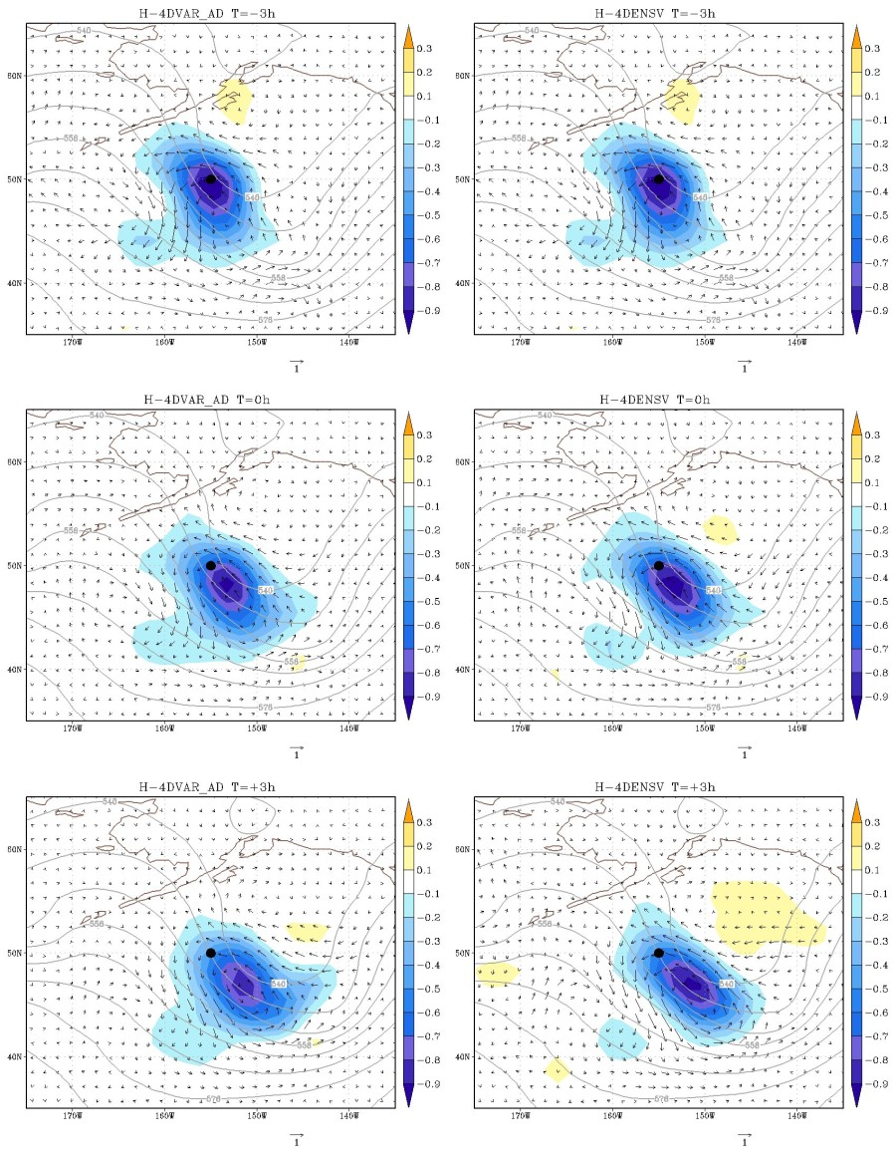
Single Temperature Observation (-3h) Example
From Kleist and Ide (2015)
t=-3h
Solution at beginning of window identical
Evolution of increment qualitatively similar between dynamic and ensemble specification
** Current linear and adjoint models in GSI are computationally unfeasible for use in 4DVAR other than simple single observation testing at low resolution
t=0h
t=+3h
H-4DVAR
H-4DEnVar

Slide 23
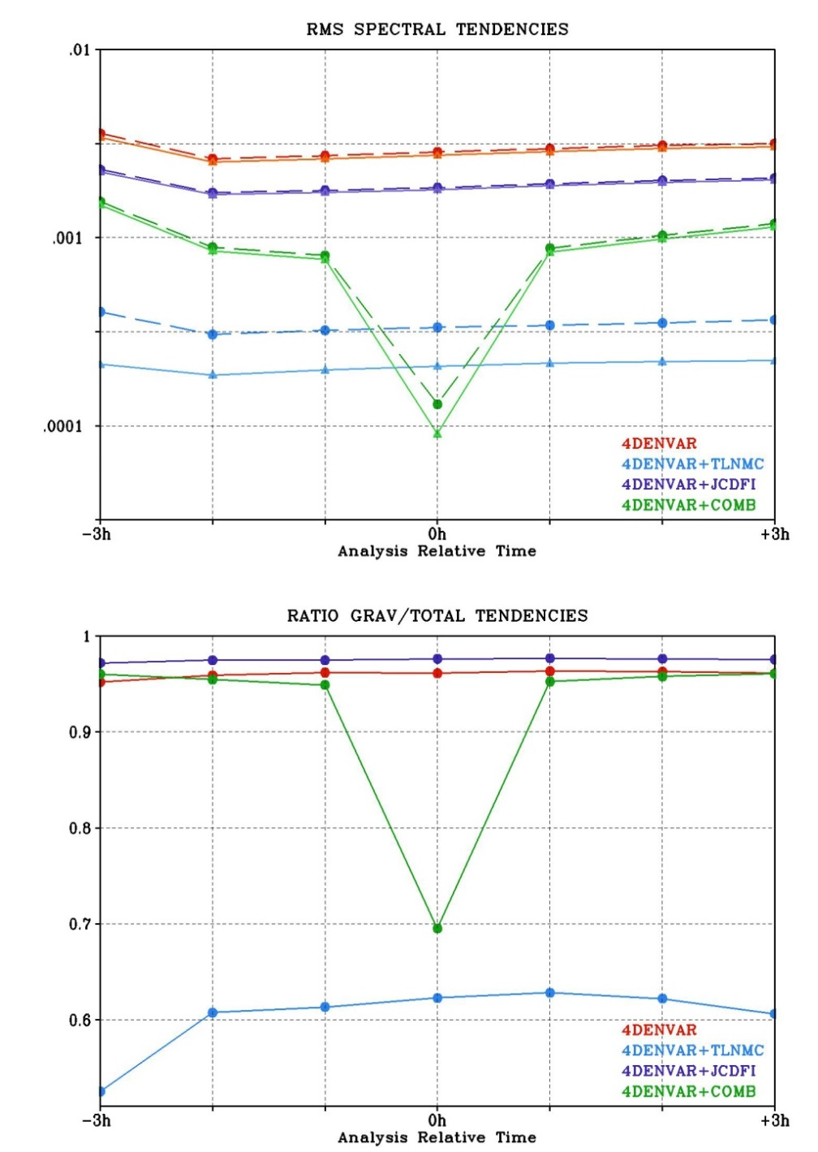
Initialization within context of 4DEnVar
In addition to TLNMC, developed and tested weak constraint DFI
For single analysis, tendencies and ratio as function of observation bin:
  Dashed: Total tendencies
  Solid: Gravity mode tendencies
    All constraints reduce incremental tendencies
Impact on ratio of gravity mode/total tendencies
  JcDFI increases ratio of gravity mode to total tendencies
  TLNMC most effective

Slide 24
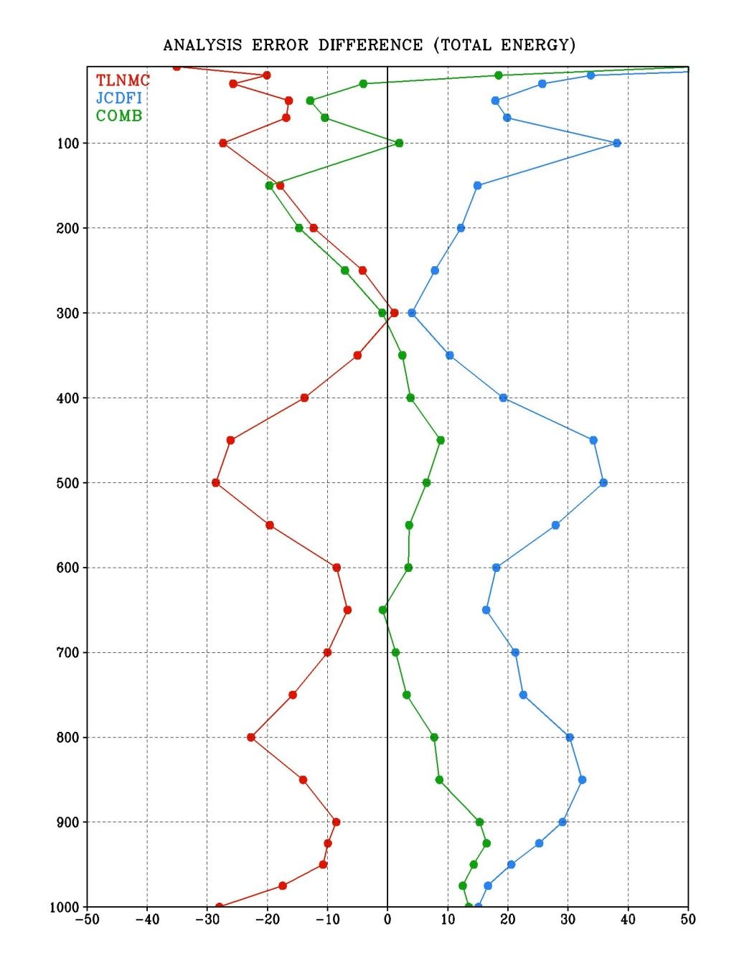
Impact on analysis error (OSSE)
Kleist and Ide 2015
Control (zero) is 4D hybrid without constraint/initialization
6 week trial
Time mean change in analysis error (total energy) relative to 4D hybrid EnVar experiment that utilized no constraints at all
  TLNMC universally better
  Combined constraint mixed
  JcDFI increases analysis error
Pressure (hPa)
Relative Analysis Error

Slide 25
Hybrid 4DEnVar Trials and Configuration Details
Hybrid weights kept the same, EnKF unchanged, hourly binning for observations
  Change from 3- to 1- hr for FGAT
Localization unchanged
Based on OSSE work and status of IAU, configuration includes TLNMC and full field DFI
Deterministic analysis increment kept at ensemble resolution

Slide 26
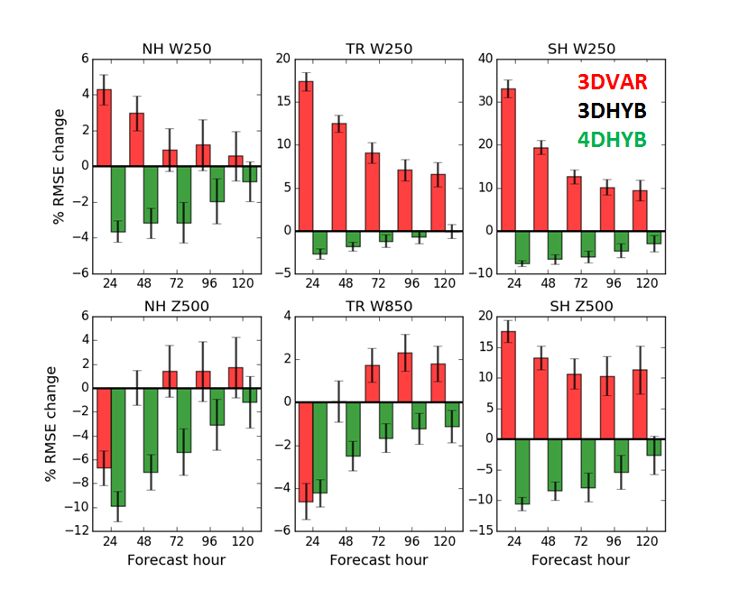
T670L64/T254L64 Prototype Trials
Self-Analysis RMSE %Change, July-October 2013
Kleist et al., Manuscript in prep (Fig. courtesy R. Mahajan)

Slide 27
Low Resolution Summary
Clean tests of T670/T254 configuration
  Was built as prototype of current operations. No additive inflation. Tuned stochastic physics.
  Parameters between 3D/4D hybrid identical except those relevant to 4D aspects
Hybrid 3DEnVar significant impacts in tropics and winter hemisphere
Hybrid 4DEnVar significantly (and consistently) improves extratropics

Slide 28
May 2016 GFS Upgrade
Hybrid 4DEnVar
  As previous described
Model fix specific to land surface issue
Other data assimilation changes:
  Initial all-sky MW capability for AMSU-A (Zhu et al., revised version under review)
  Aircraft temperature bias correction
  Additional, small observation changes

Slide 29
Pre-Implementation Trials (Operational Resolution)
Courtesy: V. Tallapagrada (NCEP)
GCWMB real time (pr4devb)
period: 2015070100 - real time
GCWMB 2015 summer retrospective (pr4devbs15)
period: 2015041500 - 2015120100 (230 days)
GCWMB 2013 summer retrospective (pr4devbs13)
period: 2013041500 - 2013120100 (230 days)
NCO 2013-2014 winter retrospective
period: 2013110100 - 2014060100 (212 days)
NCO 2014 summer retrospective
period: 2014050100 - 2014120100 (214 days)
GCWMB 2014-2015 winter retrospective (pr4devbw14)
period: 2014110100 - 2015070100 (242 days)
GCWMB Special retrospective for H. Sandy
period: 2012101700 - 201213100 (15 days)
Subjective Evaluation Overview
Smaller analysis increments
Very significant improvement to short term forecast (<72 hours)
Significant improvement to medium range (72-144 h) for most periods
Significant improvements to winds and smaller scales
Implementation Day: May 11, 2016!
  http://www.nws.noaa.gov/os/notification/tin16-11gfs_gdasaaa.htm

Slide 30
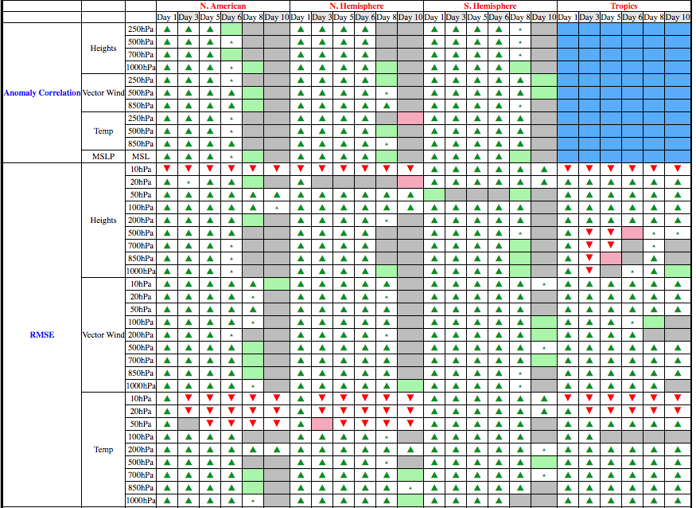
Summary Scorecard (20130501-20160228)
4DEnVar Package versus Operational GFS

Slide 31
Example Summary Plot (4D Package minus Current Ops)
4DHYB

Slide 32
Current work in progress or future directions
Replace full field digital filter with 4D incremental analysis update (similar to UKMO and CMC systems)
Explore spectral (waveband) and/or scale-dependent localization
  Particularly keen to see if this can help with moisture and clouds
More generalized hybrid weights and/or scale-(waveband-) dependent weights
Use of outer loop within 4D EnVar (or weak constraint?)
Time evolving static covariance and localization without full TL/PF
Coupled assimilation and planning for CFSv3

Slide 33
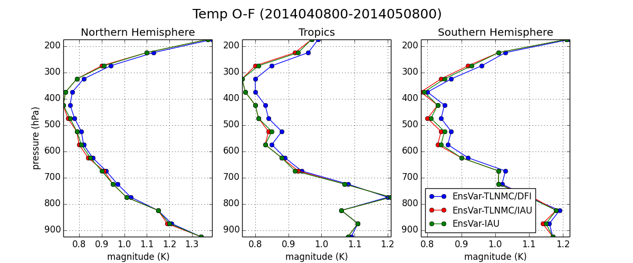
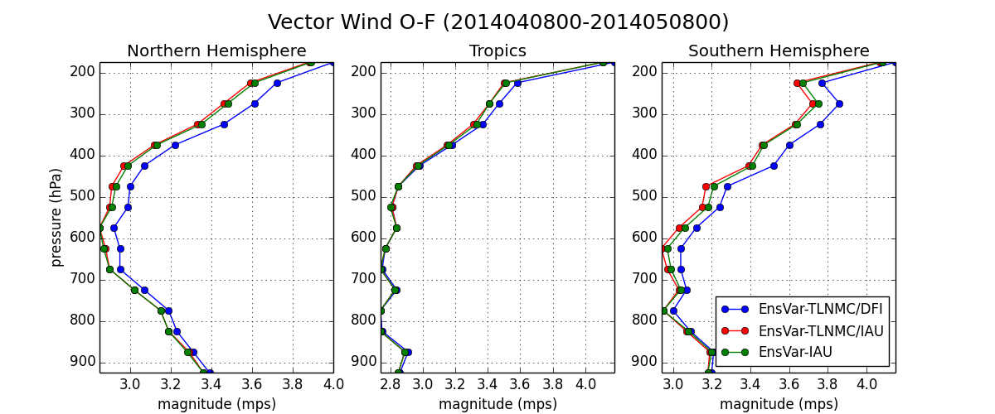
Impact of 4DIAU versus DFI in 4DEnVar context
DFI worst performing
TLNMC + 4DIAU best performing

Slide 34
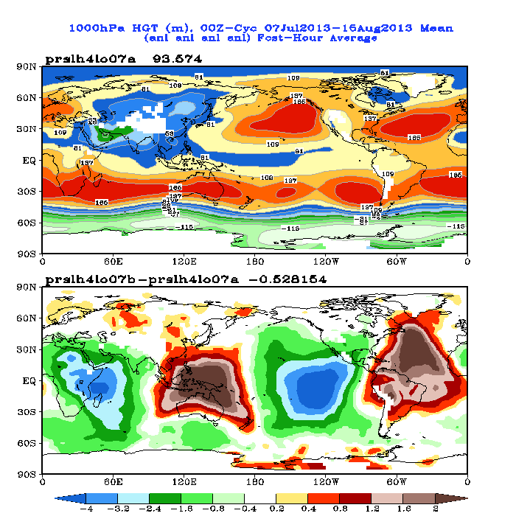
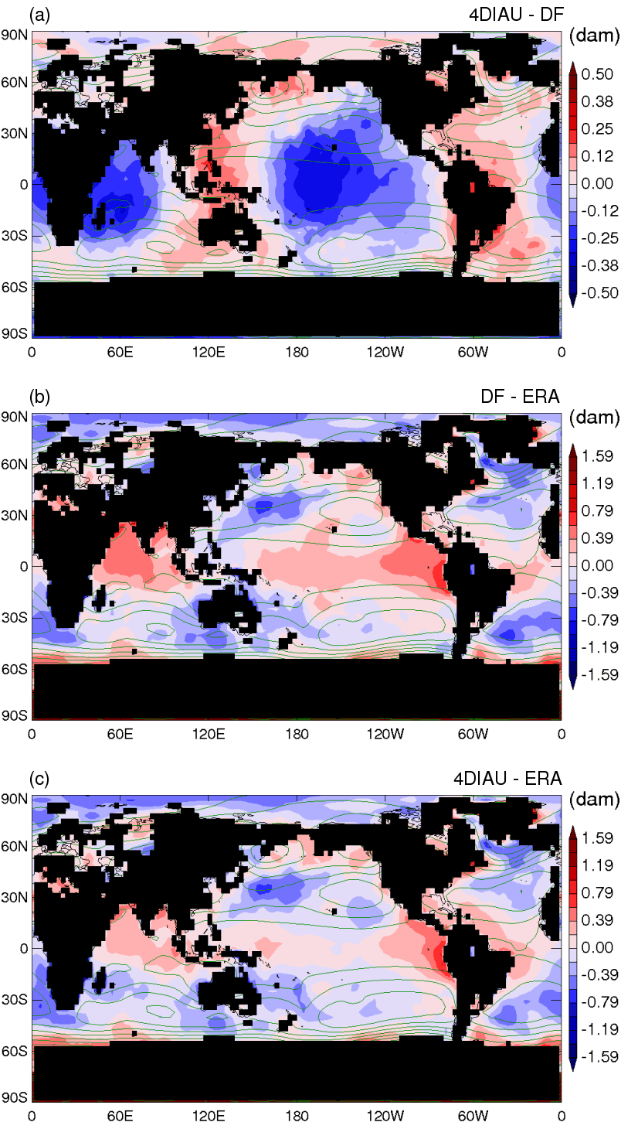
Impact of DFI on ps/1000 hPa heights
GFS 4D Hybrid IAU-DFI at 00 UTC
Buehner et al. (2015)

Slide 35
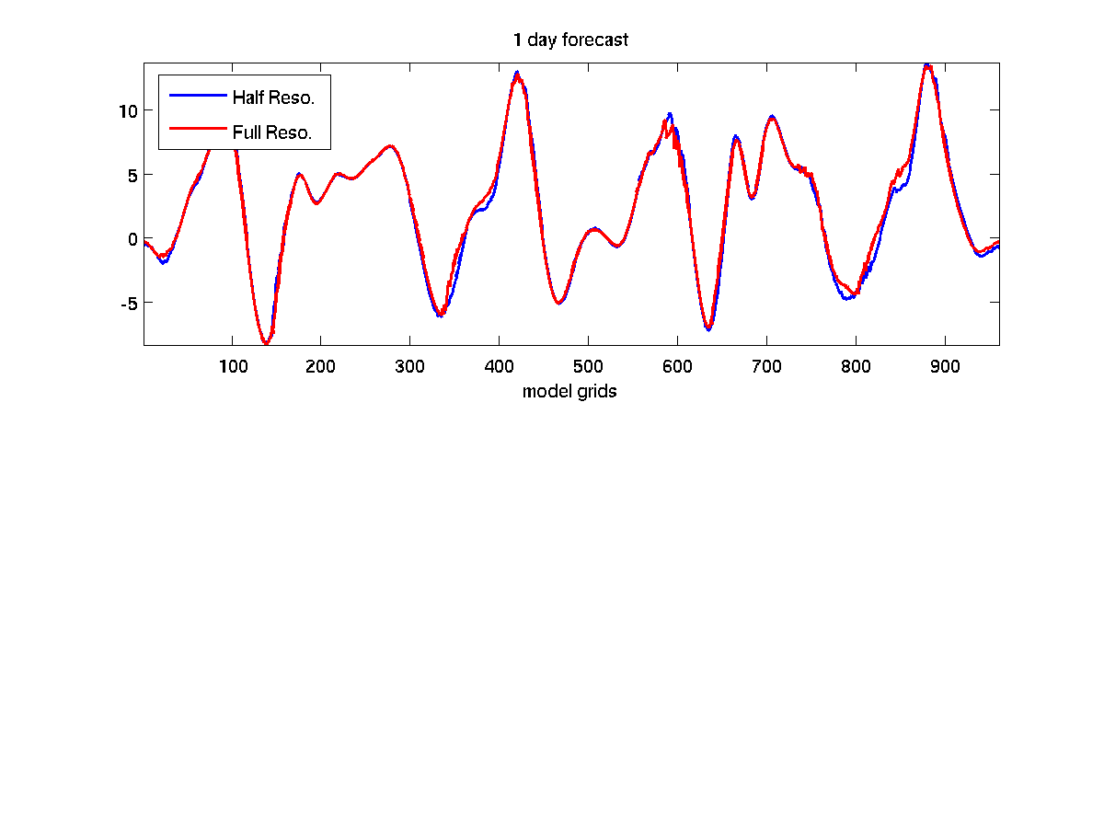
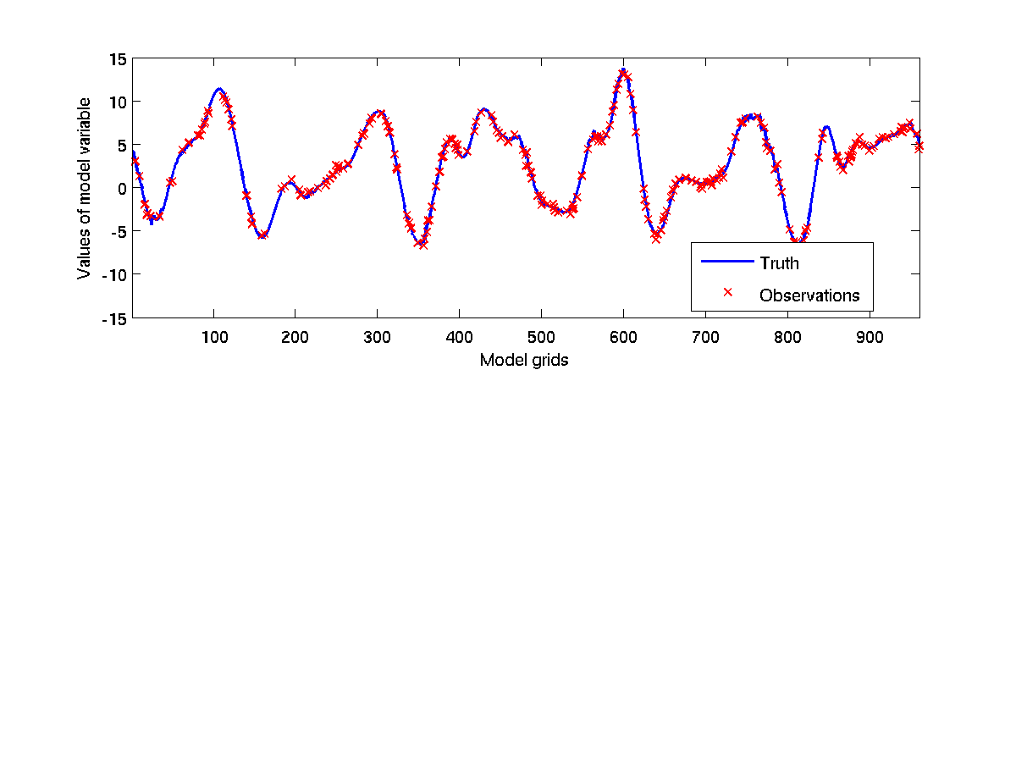
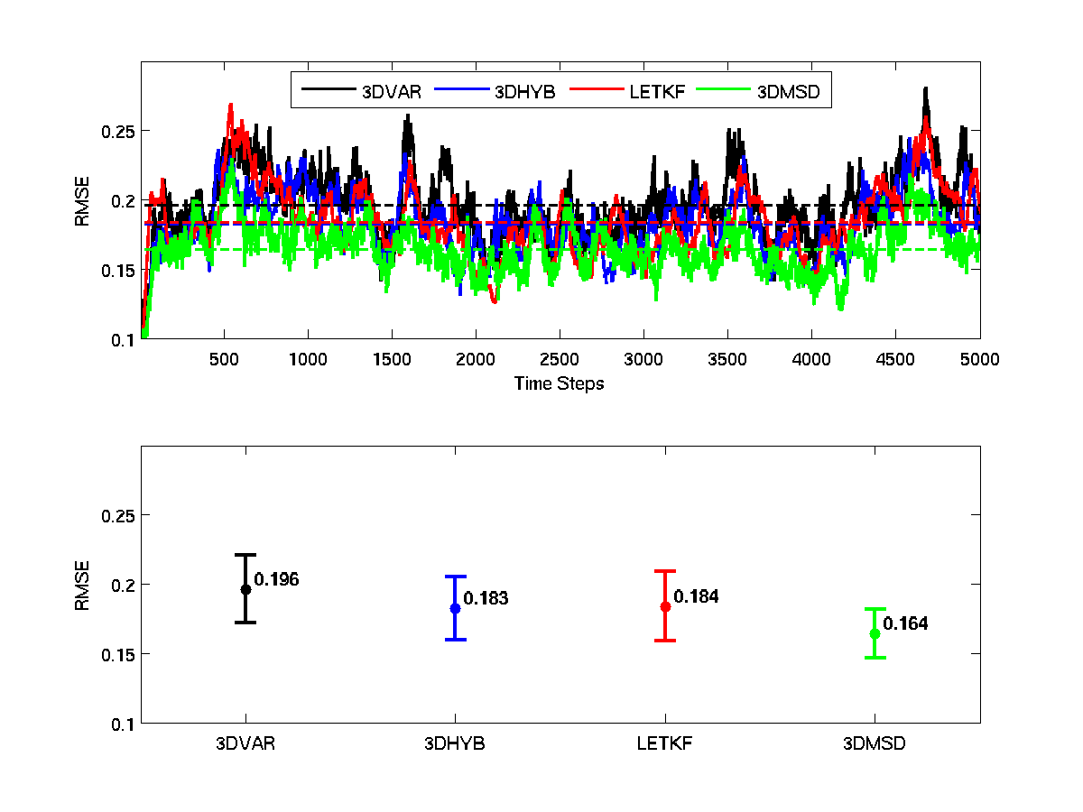
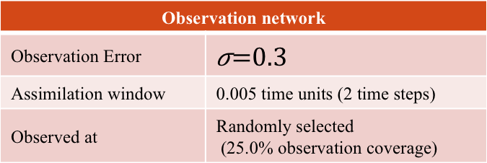
Testing of scale-dependence with toy model
Lorenz (2005) multi-scale model
 | Main | Ensemble
Model Type | Model III (Two-tier) | Model III (Two-tier)
Resolution(N) | 960 grid points | 480 grid points
Smoothing Parameter(K) | 32 | 16
Forcing Constant(F) | 14 | 14
Coupling parameters(I) | 12 | 6
Snapshot
Observation network
Observation Error
Assimilation window | 0.005 time units (2 time steps)
Observed at | Randomly selected (25.0% observation coverage)
Settings for Hybrid 3DEnVar
1/β_{f} | 0.25
1/β_{e} | 0.75
Courtesy: Deng-Shun Chen (NCU/CWB)

Slide 36
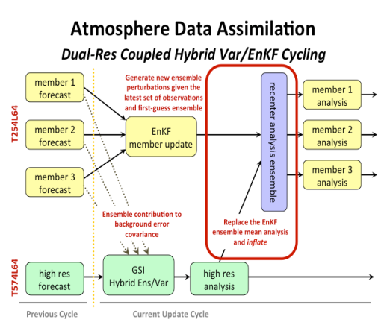
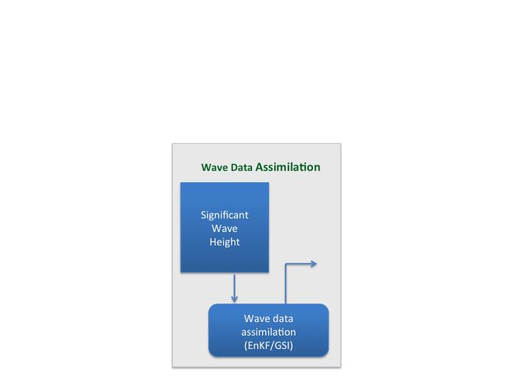
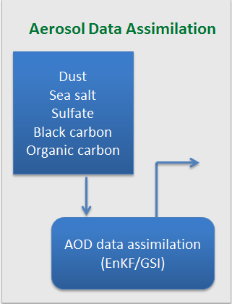
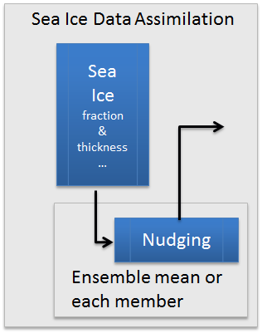
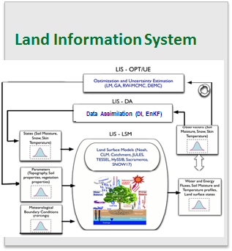
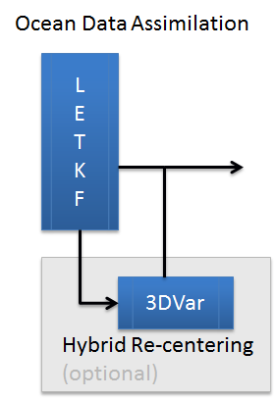
NCEP Coupled Hybrid Data Assimilation and Forecast System
Saha et al.
NEMS
NEMS
ATMOS
AERO
LAND
WAVE
SEA-ICE
ATMOS
AERO
LAND
WAVE
OCEAN
SEA-ICE
OCEAN
Coupled Model Ensemble Forecast
Coupled Model Ensemble Forecast
Coupled Ensemble Forecast (N members)
Ensemble Analysis (N Members)
INPUT
OUTPUT

Slide 37

Thanks to Rahul Mahajan, Dave Parrish, Wan-shu Wu, Jeff Whitaker, Lili Lei, Cathy Thomas, Kayo Ide, Mike Brennan, Sharan Majumdar, Kate Howard, Deng-Shun Cheng, and many others for their collaboration and support
Thanks to NOAA/NWS for financial support and allowing me to continue working on many things that were ongoing when I joined the University of Maryland:
  General DA development for GFS: NOAA/NWS Disaster Relief Appropriations on grant NA14NWS NA14NWS4830019
  TC Initialization: NOAA/NWS R2O funding on grant NA15NWS4680017

Slide 38
References
Buehner, M., and Coauthors, 2015: Implementation of deterministic weather forecasting systems based on ensemble-variational data assimilation at Environment Canada. Part I: The global system. Mon. Wea. Rev., 143, 2532-2559 [DOI: 10.1175%2FMWR-D-14-00354.1].
Kleist, D.T., 2011: Assimilation of tropical cyclone advisory minimum sea level pressure in the NCEP global data assimilation system. Wea. Forecasting, 26, 1085-1091 [DOI: 10.1175/WAF-D-11-00045.1].
Kleist, D.T., and K. Ide, 2015: An OSSE-based evaluation of hybrid variational-ensemble data assimilation for the NCEP GFS, Part II: 4D EnVar and hybrid variants. Mon. Wea. Rev., 143, 452-470 [DOI: 10.1175/MWR-D-13-00350.1].
Kleist, D. T., D. F. Parrish, J. C. Derber, R. Treadon, R. M. Errico, and R. Yang, 2009: Improving incremental balance in the GSI 3DVar analysis system. Mon. Wea. Rev., 137, 1046-1060 [DOI: 10.1175/2008MWR2623.1].
Lei, L., and J. Whitaker, 2016: A four-dimensional incremental analysis update for the ensemble Kalman filter. Mon. Wea. Rev., in press [DOI: 10.1175/MWR-D-15-0246.1].
Lorenc, A.C., 2013: Recommended nomenclature for EnVar data assimilation methods. Research Activities in Atmospheric and Oceanic Modeling. WGNE, 2pp, URL: http://www.wcrp-climate.org/WGNE/BlueBook/2013/individual-articles/01_Lorenc_Andrew_EnVar_nomenclature.pdf)

Slide 39
References (continued)
Lorenz, E., 2005: Designing chaotic models. J. Atmos. Sci., 62, 1574-1587 [DOI: 10.1175%2FJAS3430.1].
Temperton, C., 1989: Implicit normal mode initialization for spectral models. Mon. Wea. Rev., 117, 436-451 [DOI: 10.1175/1520-0493(1989)117<0436%3AINMIFS>2.0.CO%3B2].
Wang, X., 2010: Incorporating ensemble covariance in the Gridpoint Statistical Interpolation (GSI) variational minimization: a mathematical framework. Mon. Wea. Rev., 138, 2990-2995 [DOI: 10.1175/2010MWR3245.1].
Wang, X., D. Parrish, D. Kleist, J. Whitaker, 2013: GSI 3DVar-Based Ensemble–Variational Hybrid Data Assimilation for NCEP Global Forecast System: Single-Resolution Experiments. Mon. Wea. Rev., 141, 4098–4117 [DOI: 10.1175/MWR-D-12-00141.1].
Whitaker, J. S., and T. M. Hamill, 2002: Ensemble data assimilation without perturbed observations. Mon. Wea. Rev., 130, 1913-1924 [DOI: 10.1175/1520-0493(2002)130<1913:EDAWPO>2.0.CO%3B2].
Whitaker, J. S. and T. M. Hamill, 2012: Evaluating methods to account for system errors in ensemble data assimilation. Mon. Wea. Rev., 140, 3078-3089 [DOI: 10.1175/MWR-D-11-00276.1].

Slide 40
Backup Slides

Slide 41
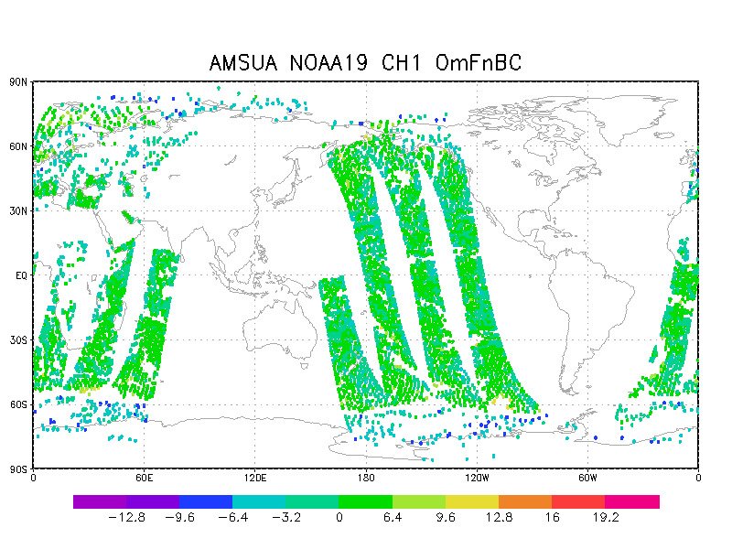
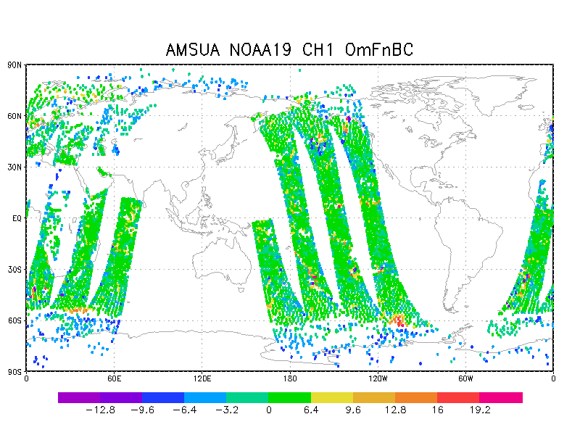
All-Sky MW AMSU-A Radiances
Courtesy: Y. Zhu, E. Liu, and A. Collard
Clear-sky OmF All-sky OmF
AMSUA NOAA19 CH1 00Z 2013-10-29

Slide 42
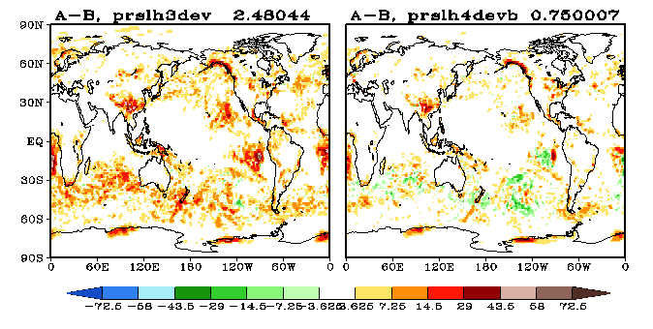
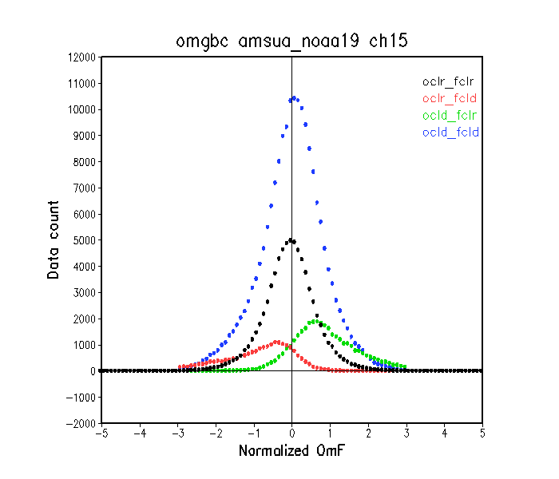
Clear Sky v/s All Sky CLW Increment
Courtesy Y. Zhu, E. Liu, and A. Collard
ClrSky CLW Increment
AllSky CLW Increment
Notes:
Magnitude of global mean increment is much smaller in all-sky relative to clear sky
Draw attention to west coast of SA.

Slide 43
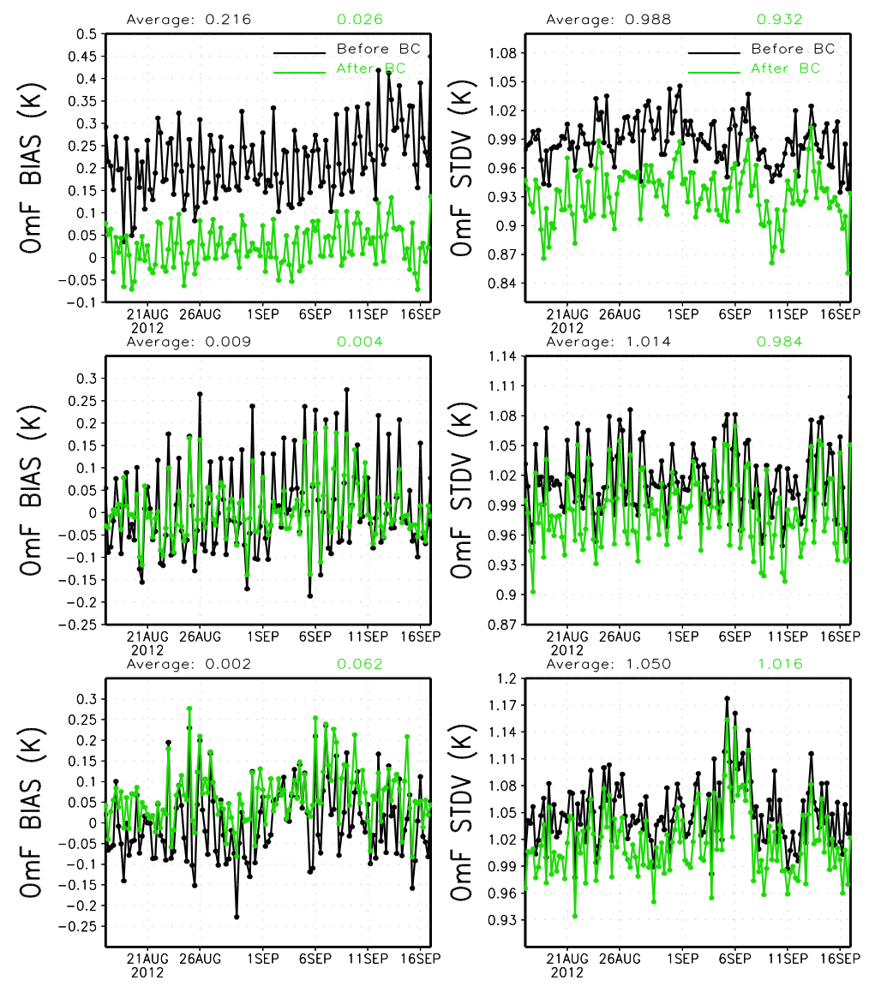
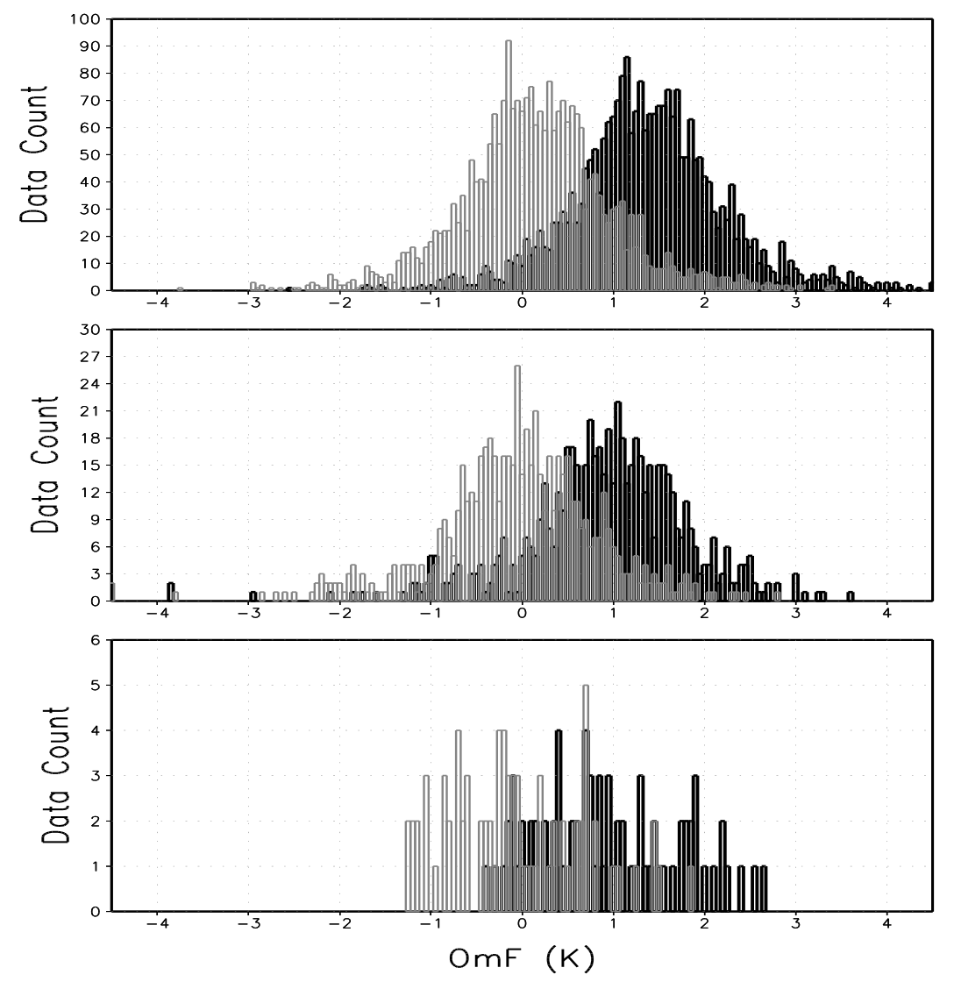
Aircraft Bias Correction
Courtesy: Yanqiu Zhu
Remove warm bias (approx. 200hPa) from aircraft temperature data
Also bias correct ascending and descending legs
OmF Bias
OmF StdDev
OmF Histograms
Before BC
After BC
cruise level
Before BC
After BC
ascent
descent

Slide 44
TC initialization for the GDAS/GFS
For the operational GFS / GDAS, there is always some component from outside of the actual assimilation of real observations involved:
  “Tracker” is run on GDAS forecast
    If storm found in forecast/background, mechanical relocation of vortex
    If not found, bogus observations are generated (winds are assimilated)
  Advisory minimum sea-level pressure observations are then assimilated with other observations regardless of (1), Kleist 2011

Slide 45
How does mechanic relocation work?
Locate tropical cyclone vortex in short forecast/background
  Automated tracker on post-processed regular grid (grib files)
  Abort process if storm center over major land mass, if terrain >500m, or if relocation distance is too large/small
Separate vortex from “environment” (GFDL Filter)
Move vortex to advisory position
  This then serves as background for assimilation
Assimilate observations including advisory minSLP

Slide 46
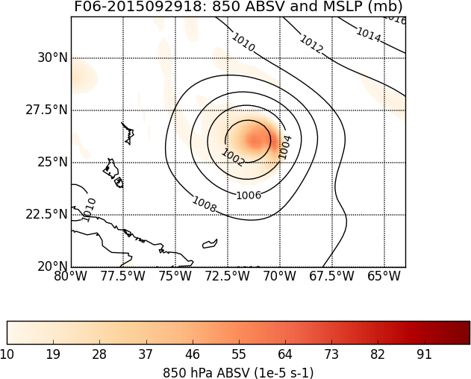
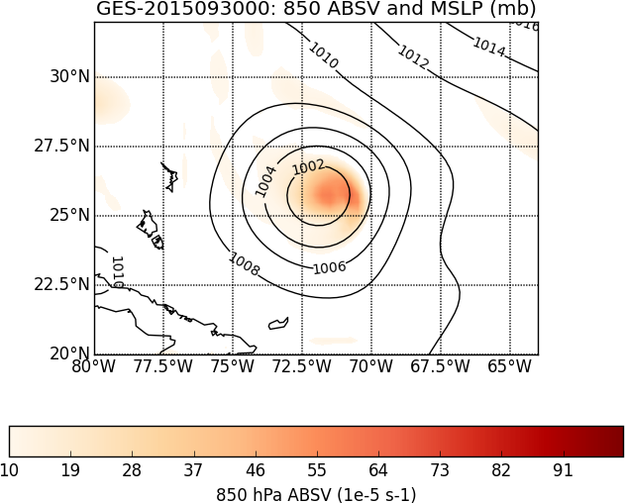
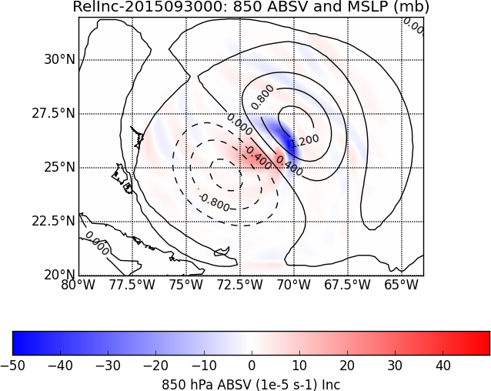
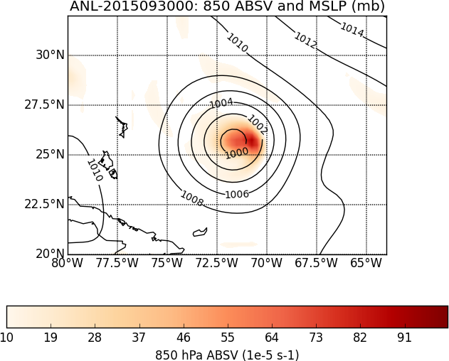
Relocation example for Joaquin (2015093000) sea level pressure (contour) & 850 hPa vorticity (filled)
Original
F06
Relocated
F06
(Background)
Relocation
Increment
Final Analysis
Relocate vortex to SW prior to assimilation

Slide 47
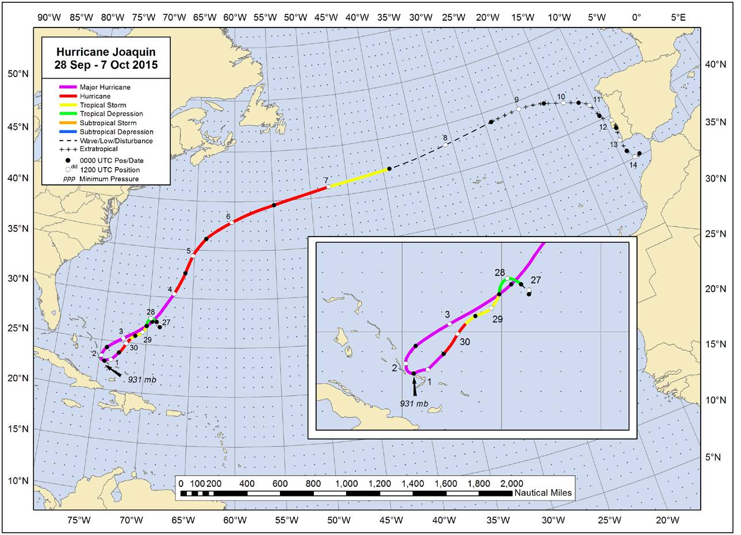
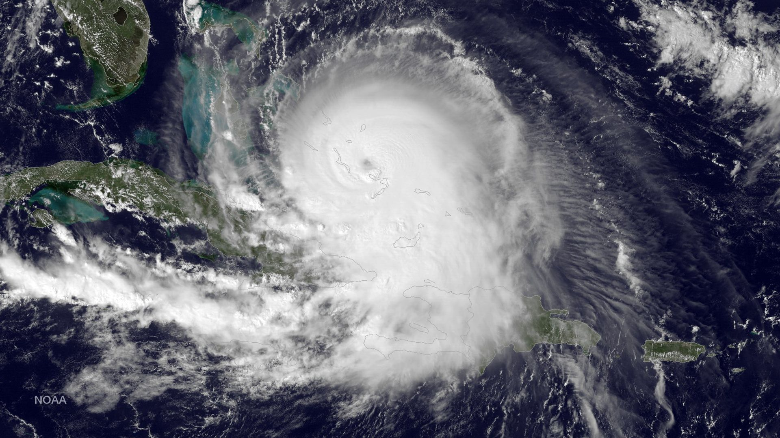
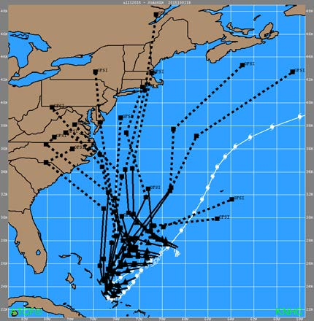
Hurricane Joaquin (2015)
  High Impact in Bahamas
  Some guidance (GFS/HWRF) during early cycles advertised potential U.S. coastal impacts

Slide 48
Joaquin Relocation Experiment Design
Fully-cycled (early and late cut-off) T1534L64 GFS with 80 member EnKF-based ensemble for hybrid data assimilation (3D EnVar)
Control (with relocation) and Experiment (without) started prior to classification of Joaquin as depression
  For experiment without relocation the effect is cumulative – we are not evaluating the impact of relocation on any individual operational forecast
Bogus winds were never generated in operations, control, or experiment
Advisory MinSLP assimilated into hybrid and EnKF for control and experiment
Collaboration with Mike Brennan (NHC), Sharan Majumdar (U-Miami), Kate Howard (EMC)

Slide 49
Relocation distance in control
During depression and TS phase, relocation distance larger than when storm reached hurricane status
These are approximate – the tracker operates on quarter degree output and relocation is estimated to precision of tenths of degrees
Also important to keep in mind that NHC analysis position has uncertainty

Slide 50
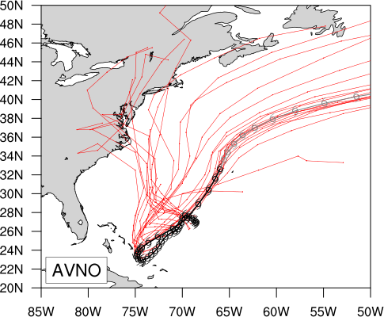
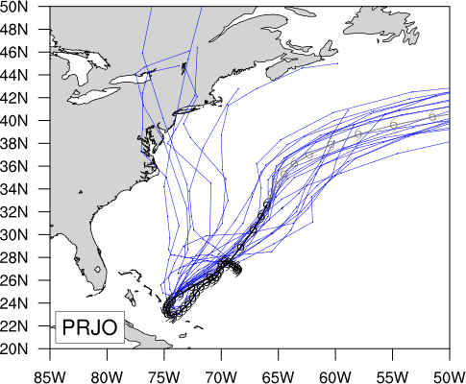
Track Summary
With Relocation
Without Relocation
Figures courtesy Andrew Penny/NHC

Slide 51
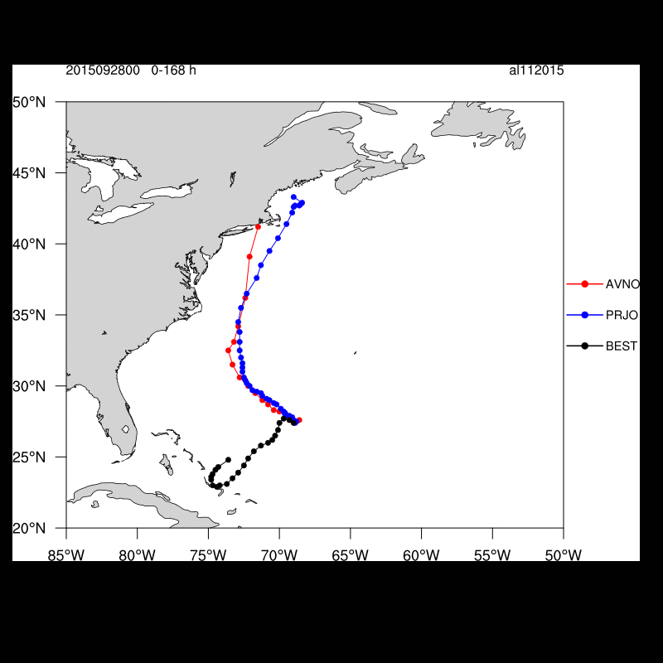
Individual Tracks
No-relocation runs generally better beyond 24 hours
092800-092912 – Forecast to 3 days better in no-relocation experiment
  Captures initial SW track toward Bahamas that operational GFS does not
093000-100200 – Forecasts considerably better in no-relocation experiment
  This despite slightly larger initial errors
100206 and beyond – similar with NE track well predicted

Slide 52
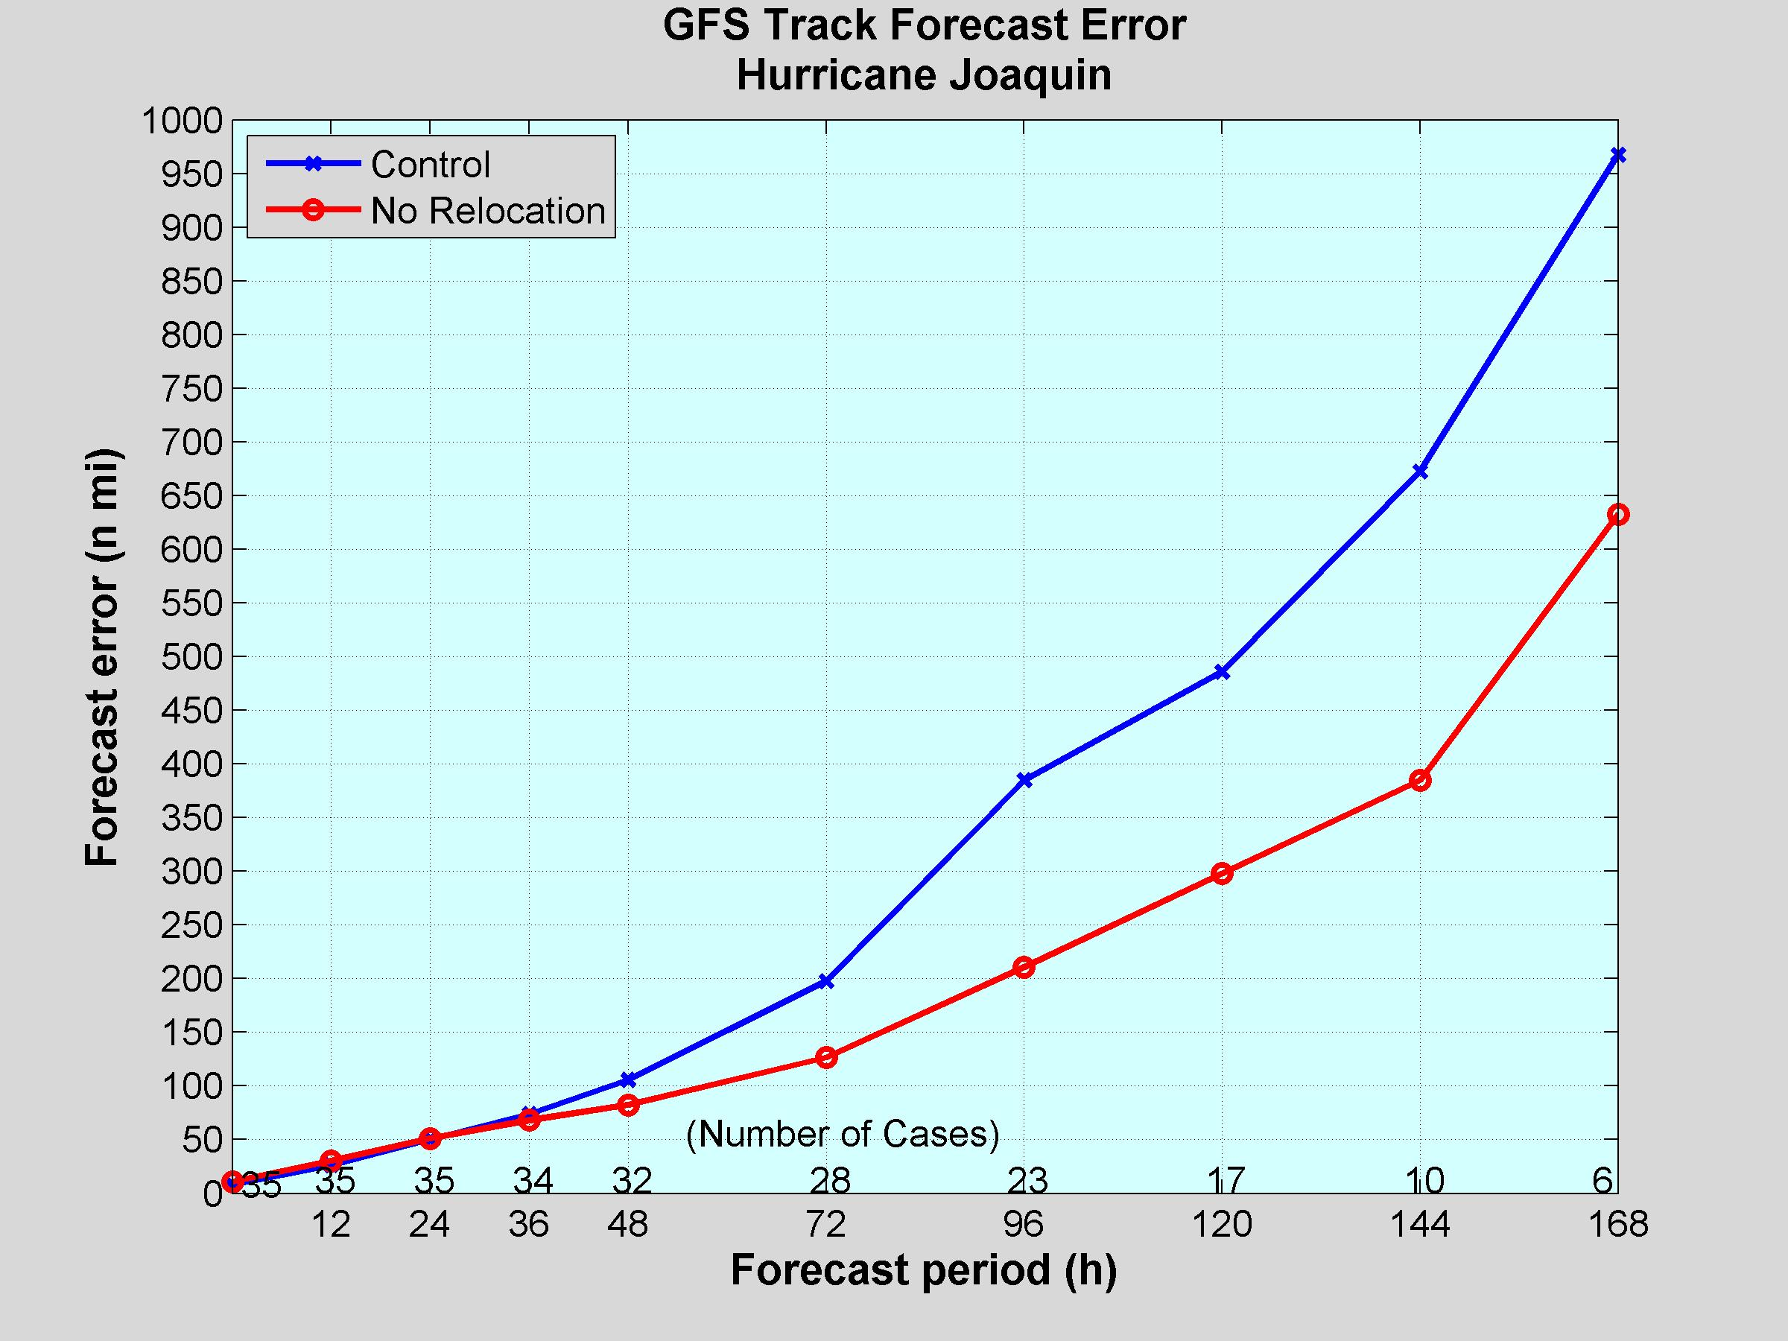
Mean Track Errors (small sample)
35%
43%
39%
45%
36%
22%
7.9%
-2.2%
-15.7%

Slide 53
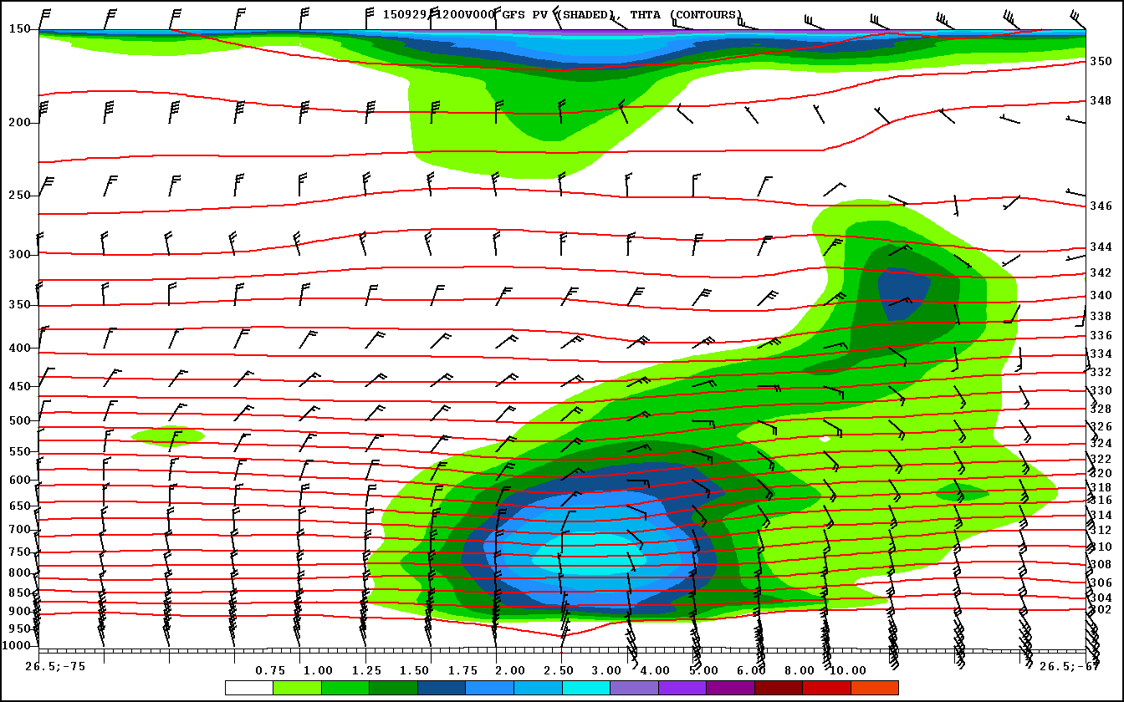
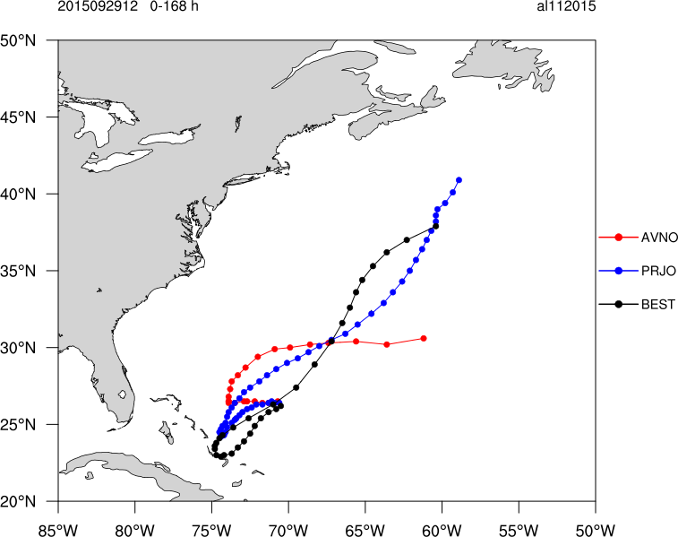

1200 UTC 29 September Cycle

Slide 54
Next Steps
More cases/periods
Further evaluation of Joaquin case to assign attribution
Short term solutions being pursued
  Turn off altogether
  Adjust filter domain and minimum distance threshold
  Move everything including tracker to native grid
Longer term
  Position assimilation directly in the hybrid-variational solver
  Position assimilation in the EnKF to improve covariance representation
  Feature Calibration and Alignment (FCA) in GSI

