Slide 1
Ensemble Forecasting and its Verification
AOSC630 Guest Class
March 30, 2016
Malaquías Peña
Environmental Modeling Center, NCEP/NOAA
Material comprises Sects. 6.6, 7.4 and 7.7 in Wilks (2nd Edition). Additional material and notes from Zoltan Toth (NOAA) and Yuejian Zhu (NOAA), Renate Hagedorn (ECMWF), and Laurence Wilson (EC)

Slide 2
Outline
Key concepts
  Uncertainty in NWP systems
  Ensemble Forecasting
Probabilistic forecast verification
  Attributes of forecast quality
  Performance metrics
Post-processing ensembles

Slide 3
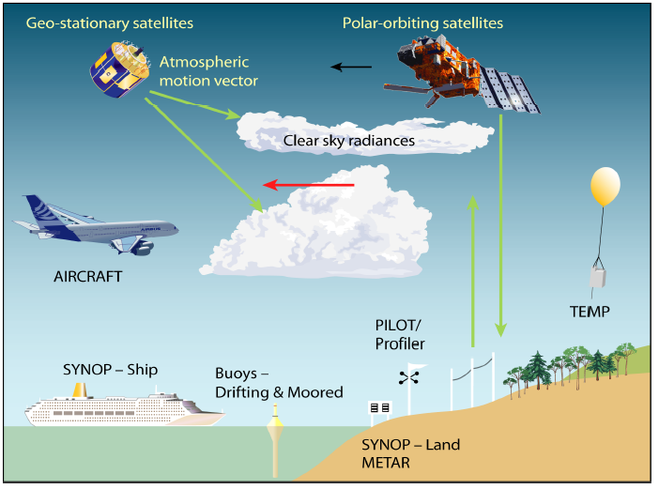
Uncertainties in NWP
Initial state of the atmosphere
Errors in the observations
Precision errors
Bias in frequency of measurements,
Representativeness errors,
Reporting errors,
Random errors
Conversion errors, etc.

Slide 4
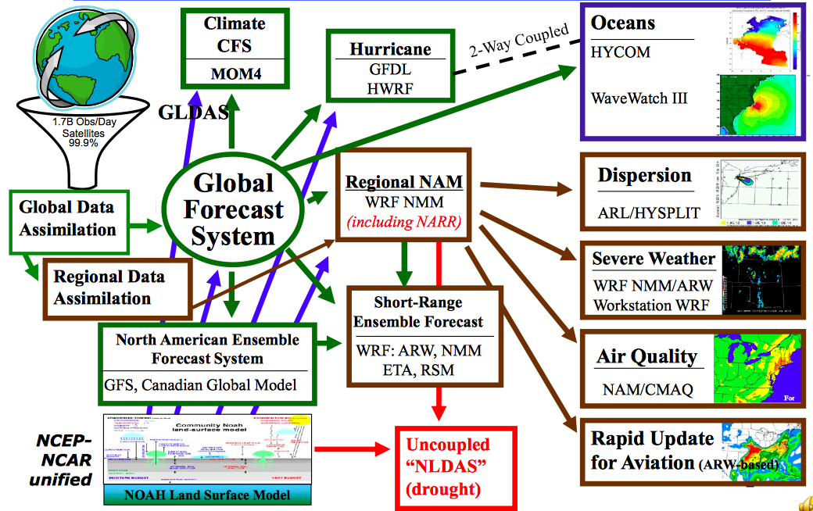
Uncertainties in NWP
Initial state of the atmosphere
Bias in the first guess
Deficient representation of relevant physical processes
Truncation errors
Limited approach for data QC: incorrect good vs bad data discrimination
Computer program bugs!

Slide 5
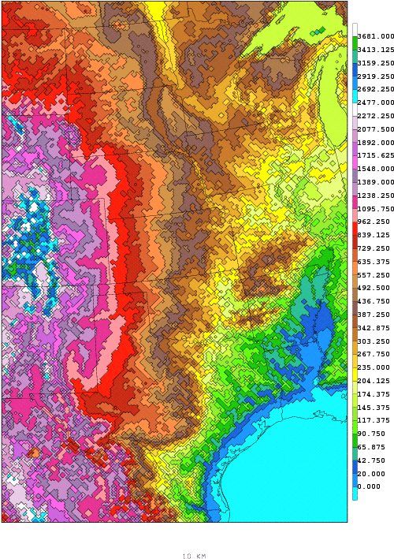
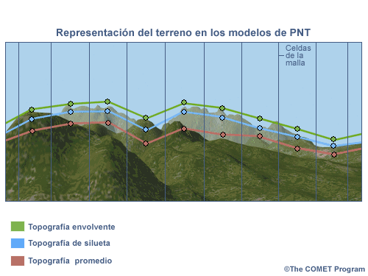
Uncertainties in NWP
Representing the physical processes in the atmosphere
Insufficient spatial resolution, truncation errors in the dynamical equations, limitations in parameterization, etc.

Slide 6
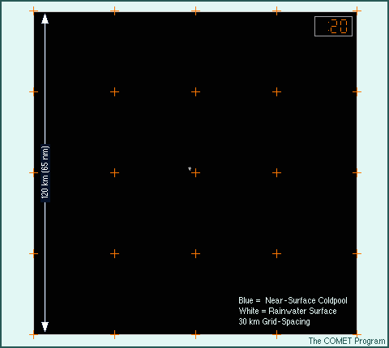
Uncertainties in NWP
Model errors: Uncertainty describing the evolution of the atmosphere
Sources: ad hoc parameterization, average errors, coding errors!, bias in frequency of initialization, etc.
Any process occurring between grid points will go unnoticed by the model

Slide 7
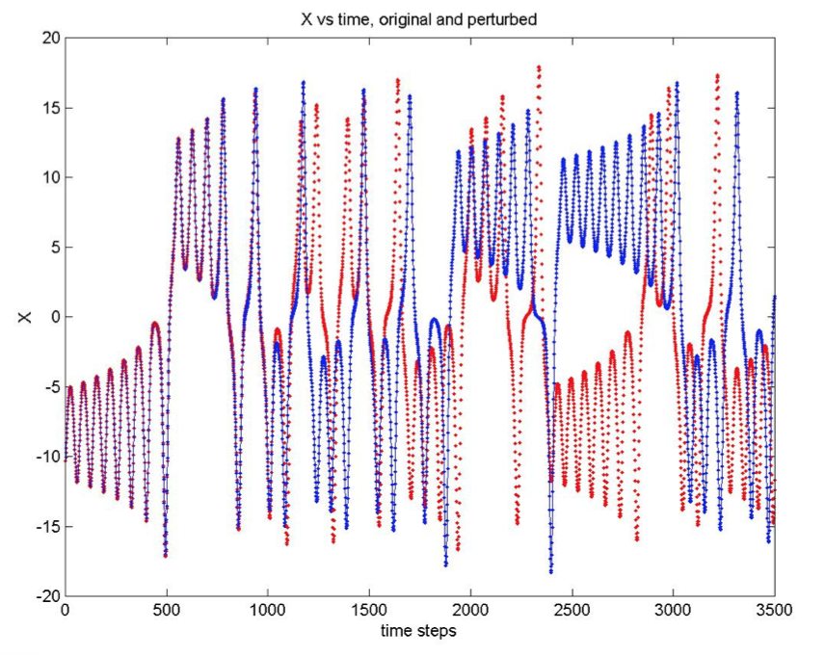
Uncertainties in NWP
Butterfly effect: The solution of the equations in the NWP systems are sensitive to initial conditions
Even if initial errors were largely reduced, any small deviation will render completely different solutions after several integration time steps.

Slide 8
Ensemble forecast
A collection of two or more forecasts verifying at the same time
Ensemble forecasting: propagate into de future the probability distribution function reflecting the uncertainty associated with initial conditions and model limitations
Practical approach: running a set of deterministic runs whose initial conditions sample the initial PDF
nature
Deterministic model forecast
PDF_{verifying}
PDF_{initial}
Initial
Forecast time
Verifying Time

Slide 9
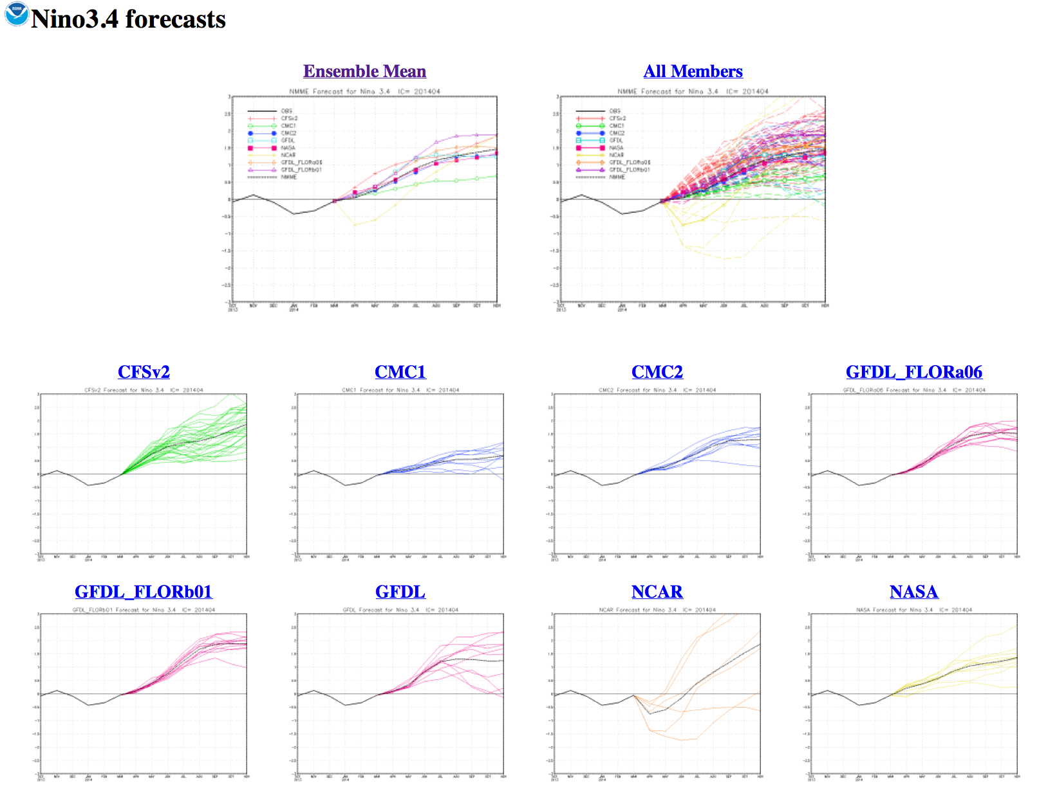
Visualization of Ensembles
Multi-model Ensemble
NCEP displays Nino 3.4 index forecasts from ensemble seasonal prediction systems.

Slide 10
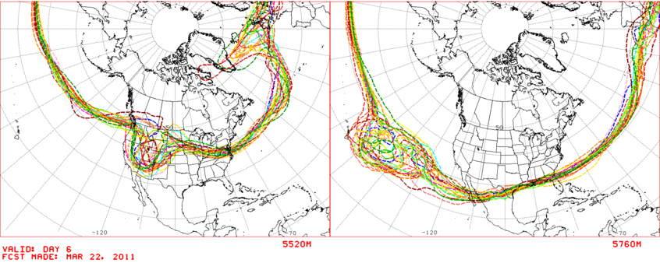
Visualization of Ensembles
Spaghetti Plots
Large uncertainty
Contours of ensemble forecasts at specific geopotential heights at 500hPa
Visualizing the amount of uncertainty among ensemble members
  High confidence of the forecast in regions where members tend to coincide
Advantages over mean-spread diagrams: keeps features sharp, allows identifying clustering of contours (e.g., bi-modal distributions)

Slide 11
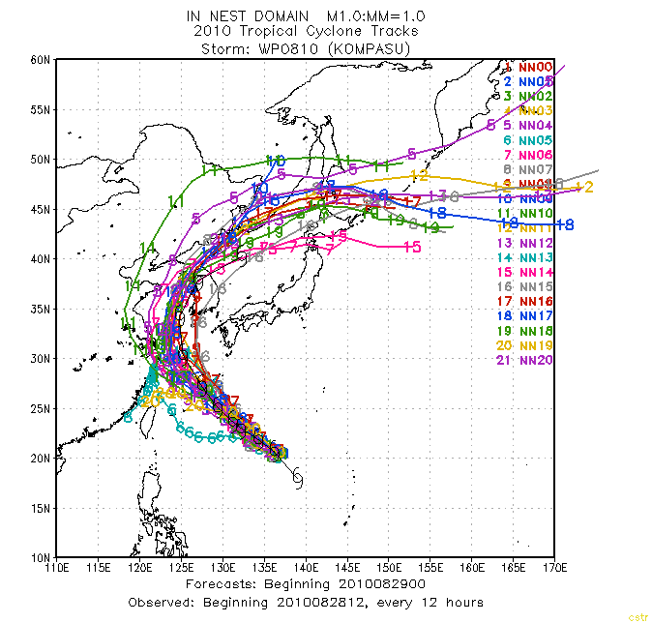
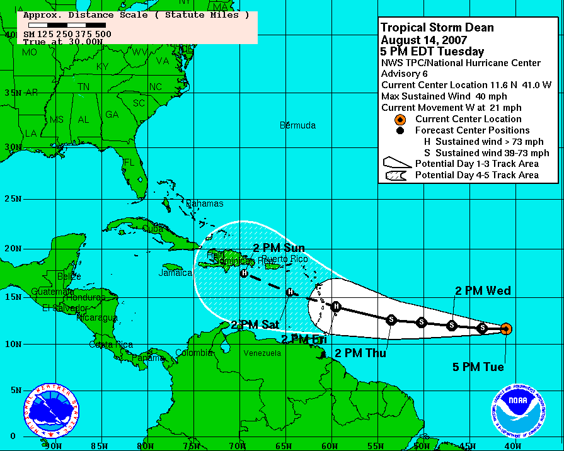
Visualization of Ensembles
Hurricane Tracks
Based on historical official forecast errors over a 5-year sample.
Forecast runs from slightly different initial conditions
Can you tell advantages and disadvantages of each approach?

Slide 12
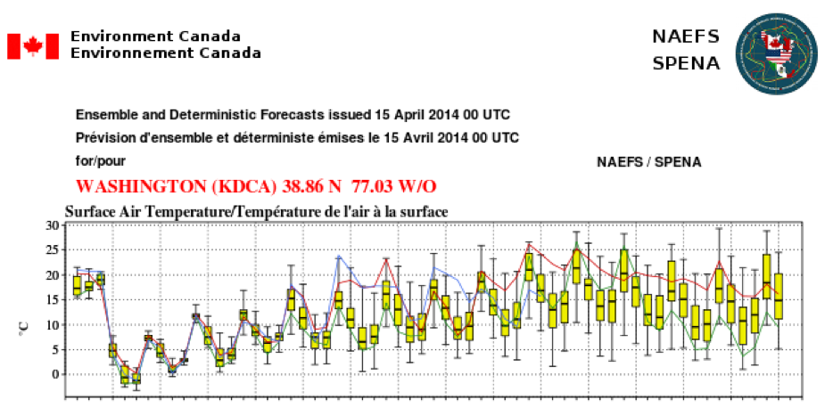
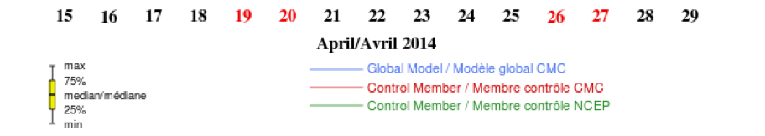
Visualization of Ensembles
EPS-gram

Slide 13
Quantitative description: The Mean
Approach to convert from probabilistic to deterministic and simplify the interpretation and the evaluation of ensemble. The PDF described by the ensemble is then reduced into a single number
Example: Forecast ensemble mean of the geopotential height at a model grid point (λ,θ)
What assumption was made to replace the mean by an average?
Average removes short-lived variations retaining slowly-varying patterns
Median or mode could also work to reduce the full PDF into a single number

Slide 14
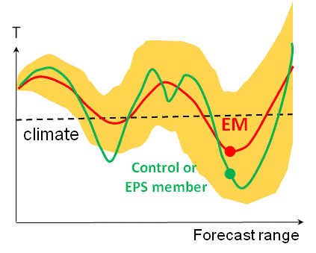
Quantitative description: The Spread
A measure of the separation among ensemble members. It is the Standard Deviation with respect to the Ensemble Mean
  In principle, small spread implies less uncertain forecast
s
Example: Forecast ensemble spread of the geopotential height at a model grid point (λ,θ)
If the distribution created by 100 members ensemble were normally distributed around the ensemble mean, approximately how many members on average would fall outside the (orange shade in the above schematic) spread line?

Slide 15
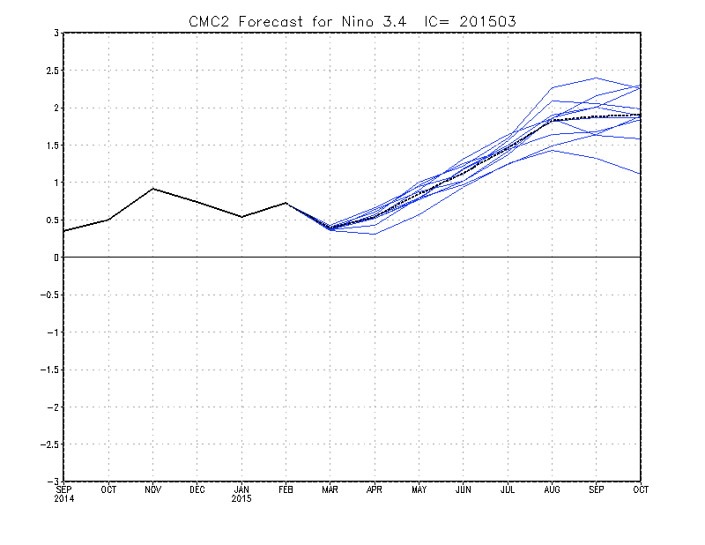
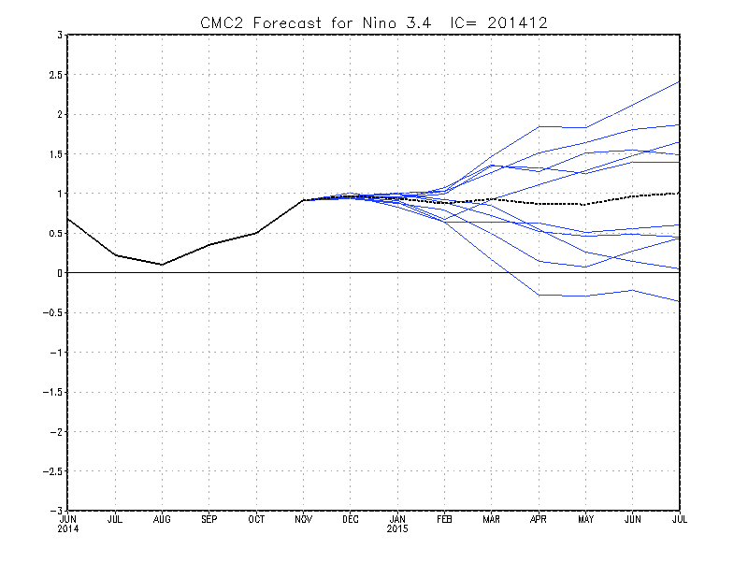
Predictability estimates
Ensemble members
Ensemble mean
The variance of the ensemble mean is a measure of the signal variability:
Variability of the ensemble spread is a measure of the noise. Define the variance of individual members wrt the ensemble mean (squared spread):
Then, the Signal to Noise Ratio for a particular initial condition is given as:
Large SNR
Small SNR

Slide 16
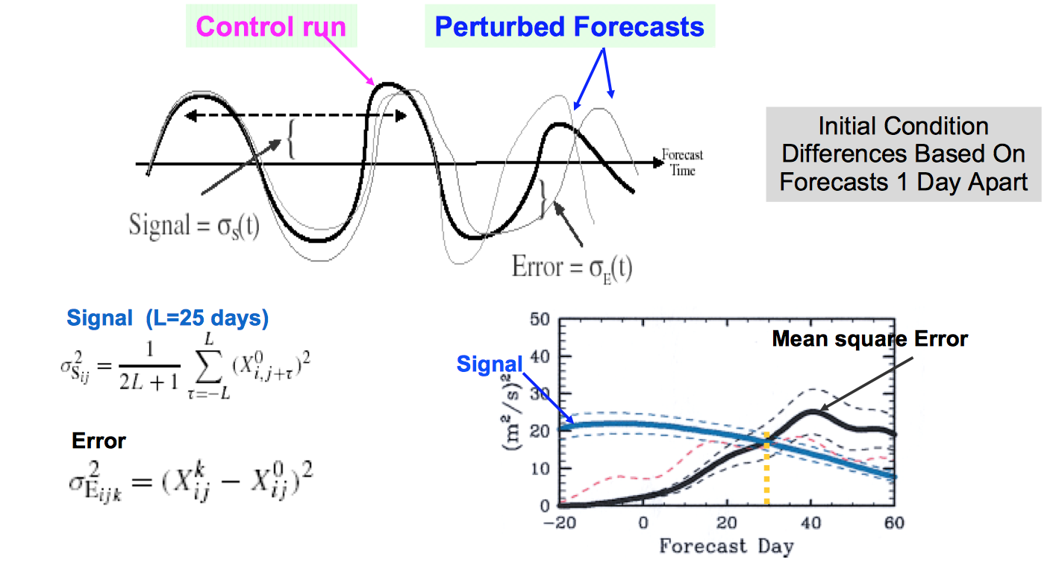
Example of use of SNR: MJO signal
Duane et al 2003 QJRM

Slide 17
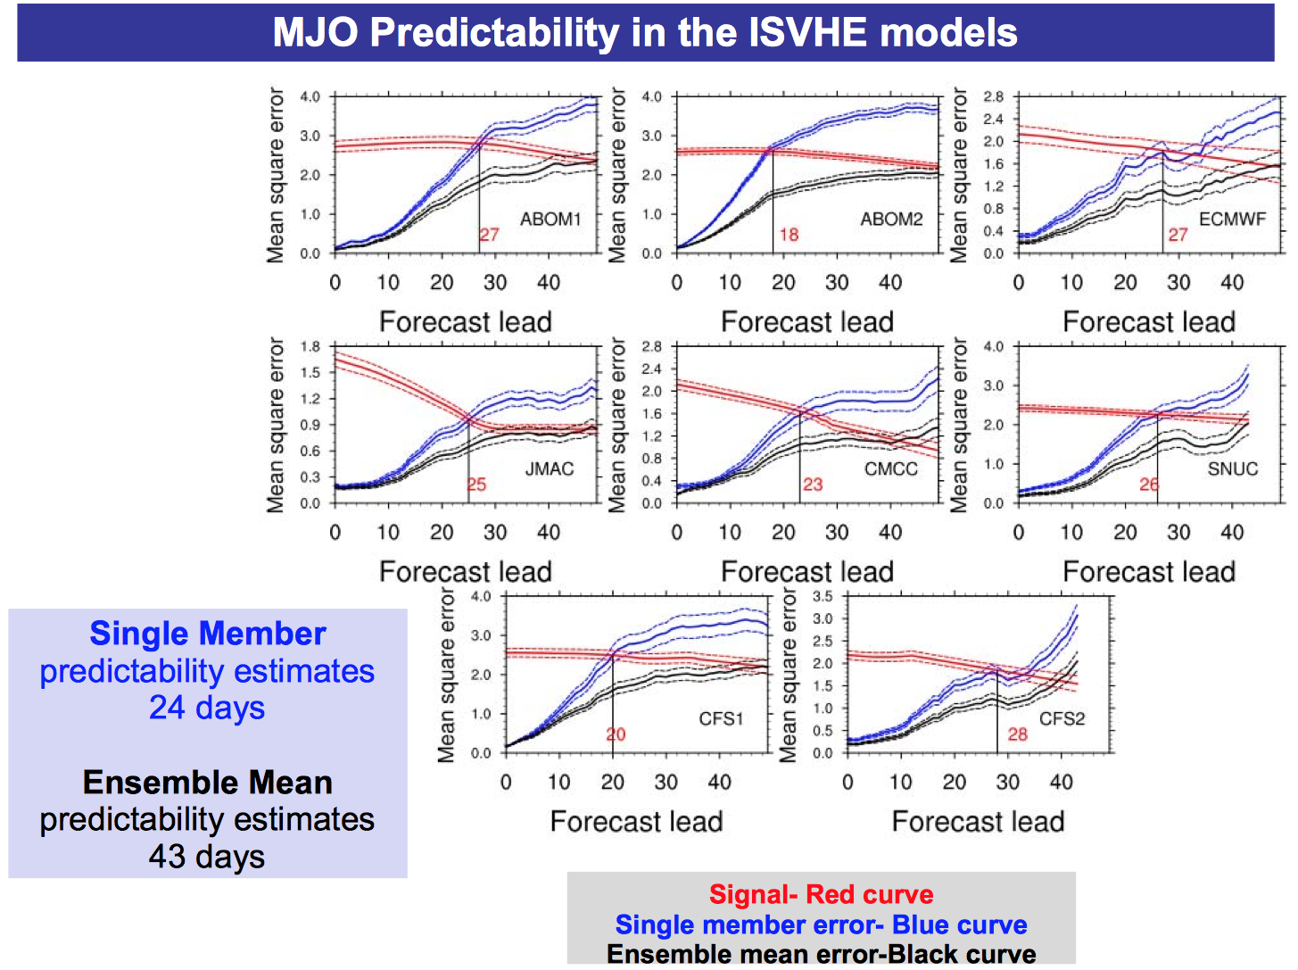
Example of use of SNR: MJO signal
Waliser et al

Slide 18
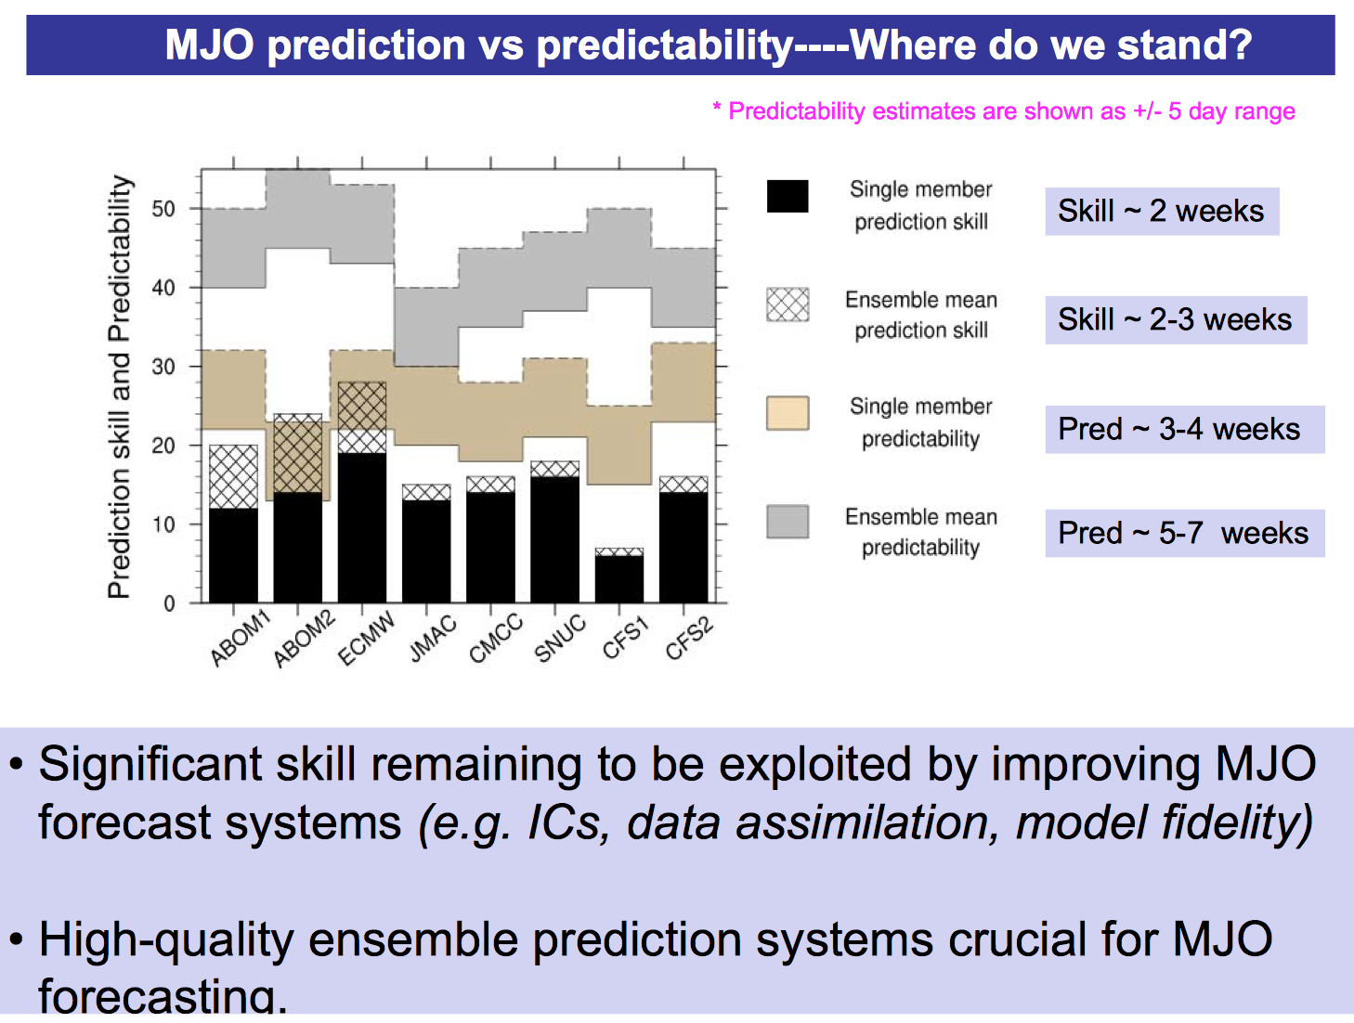
Example of use of SNR: MJO signal
Waliser et al

Slide 19
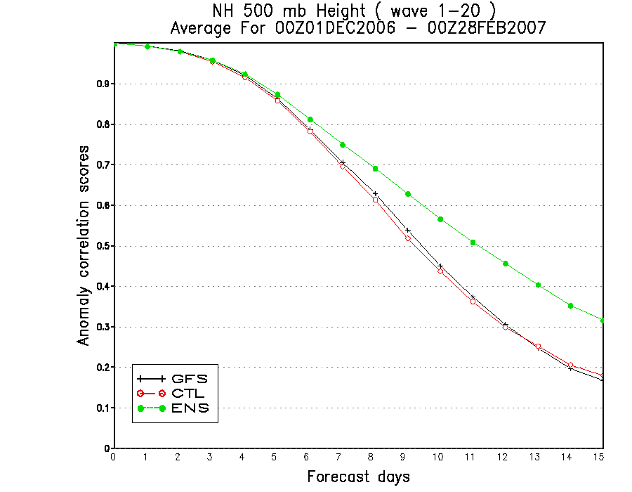
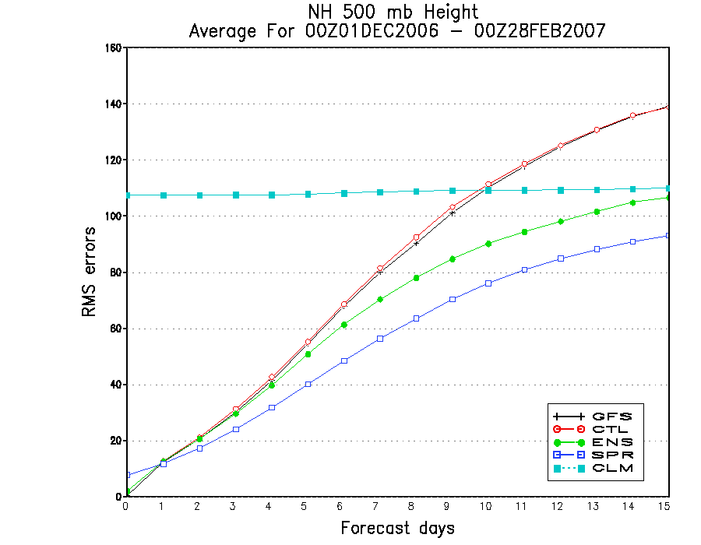
Ensemble Mean Performance
Anomaly Correlation Score
Root Mean Square Error
Ensemble mean (green) more skillful than single forecasts after day 4
At long leads, the RMSE of the ensemble mean (green) approach climatology (cyan). RMSE of individual forecast members (red and black) grow much faster.

Slide 20
Quantitative description
Assume each deterministic forecast in the ensemble is an independent realizations of the same random process
Forecast probability of an event is estimated as the fraction of the forecasts predicting the event among all forecasts considered (relative frequency of occurrence)
n_{t} = ensemble size
n_{x} = number of ensemble members that predict an event x
P(x) = probability that event x will happen

Slide 21
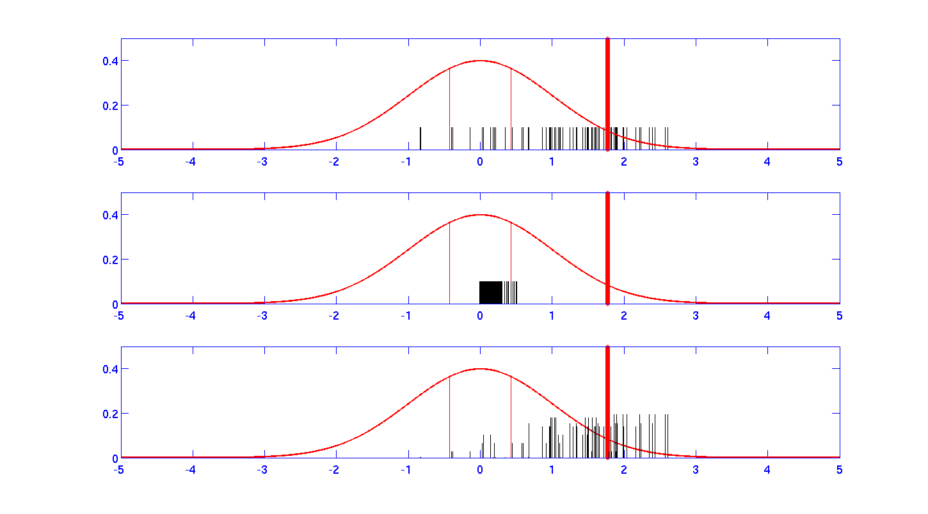
Quantitative description
Example: An 81-members ensemble forecast is issued to predict the likelihood that a variable will verify in the upper tercile of the historical distribution (variable’s climate). Let’s call this event x. Looking at the diagram below we simply count the number of members falling in that tercile.
observation
3/81
11/81
67/81
Forecasts
Observed climate

Slide 22
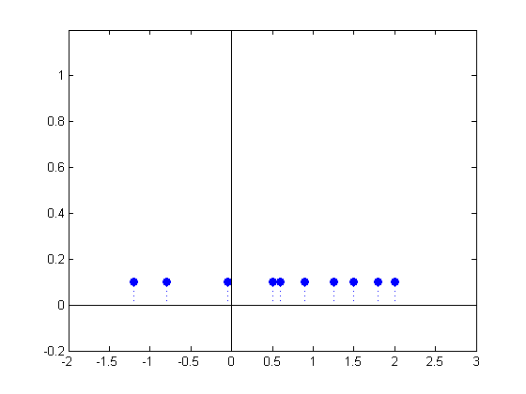
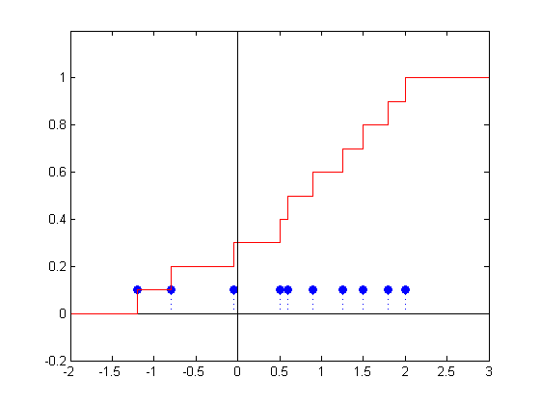
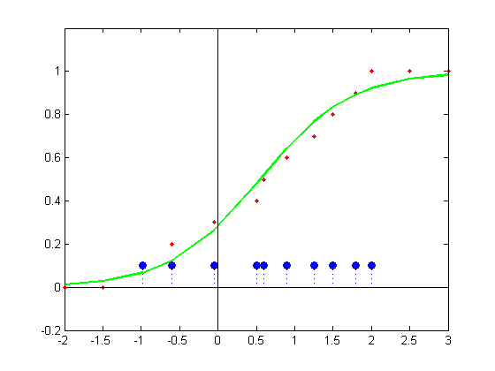
Cumulative Distribution Function
Consider a 10-members ensemble, each with equal (1/10) likelihood of occurrence.
A CDF can be constructed using a discrete (left) or a continuous (right) function
x
Discrete
Continuous (e.g. Logistic fit)
cdf
cdf
P (x) < X
P (x) < X
x
x
Notes:
Not clear whether the crosses in the third panel (logistic fit) are related to the 10 memberes. Id the histogram related to the 10 members?

Slide 23
Continuous CDF
Advantages:
For extreme event prediction, to estimate centile thresholds
Assists with the ROC computation
Simple to compare ensembles with different numbers of members
Many ways to construct a CDF →
From L. Wilson (EC)

Slide 24
Questions
Provide examples where observations can be accurate but representativeness errors are large
When is ensemble mean = ensemble average? Why it is used indistinctly for ensemble weather forecasts?
Why does the ensemble mean forecast tend to have smaller RMSE than individual members?
What are common approaches in numerical modeling to deal with uncertainties in the initial conditions? What are common approaches to deal with errors due to model limitations?

Slide 25
Outline
Background
  Uncertainty in NWP systems
  Ensemble Forecasting
Probabilistic forecast verification
  Attributes of forecast quality
  Performance metrics
Post-processing ensembles

Slide 26
Types of forecast
Categorical | Probabilistic
Yes/No | Assigns values between 0 and 100%
Verified with one single event | Requires many cases in which forecasts with X% probability are issued to be verified
Example: Tomorrow’s Max T will be 70F in College Park. | Example: There is a 30% chance of precipitation for tomorrow in College Park

Slide 27
Definition of probabilistic forecasts
An event are phenomena happening:
    At a location (point, area, region).
    Over a valid time period.
    Can be defined with threshold values.
    Can be defined with ranges of values.
The definition of events is important:
  To avoid confusion in forecasts.
  For verification purposes.
Notes:
But what is an event.? It is important to define what we call event first to make sure that forecasts are understood properly and second for verification purposes. An event is « something » happening « somewhere » over a given time period. Where the phenomena is happening can be a point, a city, a location, an area or a forecast region. But all these must be well defined. The phenomena can be defined with threshold values (more than 25 mm of precipitation or temperature below 0°C for examples), with ranges of values (winds 15 to 30 km/h for example).

Slide 28
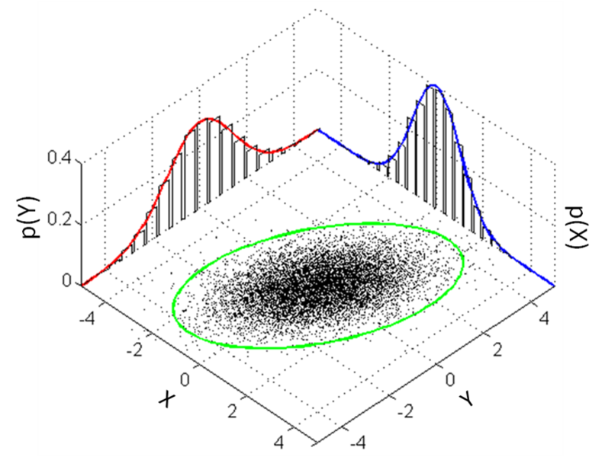
Probabilistic forecast verification
Comparison of a distribution of forecasts to a distribution of verifying observations
Y –(Marginal) Forecast distribution
X –(Marginal) Observation distribution
(X,Y) Joint distribution

Slide 29
Attributes of Forecast Quality
Accuracy: Was the forecast close to what happened?
Reliability: How well the a priori predicted probability forecast of an event coincides with the a posteriori observed frequency of the event
Resolution: How much the forecasts differ from the climatological mean probabilities of the event, and the systems gets it right?
Sharpness: How much do the forecasts differ from the climatological mean probabilities of the event?
Skill: How much better are the forecasts compared to a reference prediction system (e.g., chance, climatology, persistence)?
Notes:
Accuracy refers to the closeness of a measured value to a standard or known value. For example, if in lab you obtain a weight measurement of 3.2 kg for a given substance, but the actual or known weight is 10 kg, then your measurement is not accurate. In this case, your measurement is not close to the known value.
Precision refers to the closeness of two or more measurements to each other. Using the example above, if you weigh a given substance five times, and get 3.2 kg each time, then your measurement is very precise. Precision is independent of accuracy. You can be very precise but inaccurate, as described above. You can also be accurate but imprecise.

Slide 30
Typical performance measures
Brier Score
Brier Skill Score (BSS)
Reliability Diagrams
Relative Operating Characteristics (ROC)
Rank Probability Score (RPS)
Continuous RPS (CRPS)
CRP Skill Score (CRPSS)
Rank histogram (Talagrand diagram)
Notes:
Evaluation can help figure out what works and what does not. Evaluation takes time and is costly. Performance Measurement on the other hand is less time-consuming and can provide information in time for day to day decisions. While both evaluation and performance measurement are necessary they each have their own advantages and disadvantages. A con of performance measurement is that the validity of the results can be questioned and it is not clear as to whether or not positive outcomes were due to a specific cause.
In meteorology. In other engineering scientific areas:

Slide 31
Performance measures and Forecast attributions
Measures | Attributes
Brier Score, Brier Skill Score (BSS) | Accuracy
Reliability Diagram, Area of skill | Reliability, Resolution, Sharpness
Relative Operating Characteristic (ROC) | Discrimination
Rank Probability Score, Continuous Rank Probability Score (CRPS) | Integrated accuracy over the full PDF
Rank (Talagrand) Histograms | Spread assessment (outliers, biases)

Slide 32
The Brier Score
Mean square error of a probability forecast
where N is the number of realizations, p_{i} is the probability forecast of realization i. O_{i} is equal to 1 or 0 depending on whether the event (of realization i) occurred or not.
Measures Forecast accuracy of Binary Events.
Range: 0 to 1. Perfect=0
Weighs larger errors more than smaller ones

Slide 33
Components of the Brier Score
Decomposed into 3 terms for K probability classes and a sample of size N:
reliability resolution uncertainty
If for all occasions when forecast probability p_{k} is predicted, the observed frequency of the event is
then the forecast is said to be reliable. Similar to bias for a continuous variable
The ability of the forecast to distinguish situations with distinctly different frequencies of occurrence.
The variability of the observations. Maximized when the climatological frequency (base rate) =0.5
Has nothing to do with forecast quality! Use the Brier skill score to overcome this problem.
The presence of the uncertainty term means that Brier Scores should not be compared on different samples.

Slide 34
Brier Skill Score
Skill: Proportion of improvement of accuracy over the accuracy of a reference forecast (e.g., climatology or persistence)
Brier Skill Score
If the sample climatology is used, BSS can be expressed as:
Range: -Inf to 1; No skill beyond reference=0; Perfect score =1

Slide 35
Brier Score and Brier Skill Score
Measures accuracy and skill respectively
Cautions:
  Cannot compare BS on different samples
  BSS – Takes care of underlying climatology
  BSS – Takes care of small samples

Slide 36
Reliability
A forecast system is reliable if:
  statistically the predicted probabilities agree with the observed frequencies, i.e. taking all cases in which the event is predicted to occur with a probability of x%, that event should occur exactly in x% of these cases; not more and not less.
  Example: Climatological forecast is reliable but does not provide any forecast information beyond climatology
A reliability diagram displays whether a forecast system is reliable (unbiased) or produces over-confident / under-confident probability forecasts
A reliability diagram also gives information on the resolution (and sharpness) of a forecast system

Slide 37
Reliability Diagram
Take a sample of probabilistic forecasts:
e.g. 30 days x 2200 GP = 66000 forecasts
How often was event (T > 25) forecasted with X probability?
FC Prob. | # FC | OBS-Frequency (perfect model) | OBS-Frequency (imperfect model)
100% | 8000 | 8000 (100%) | 7200 (90%)
90% | 5000 | 4500 ( 90%) | 4000 (80%)
80% | 4500 | 3600 ( 80%) | 3000 (66%)
…. | …. | …. | ….
…. | …. | …. | ….
…. | …. | …. | ….
10% | 5500 | 550 ( 10%) | 800 (15%)
0% | 7000 | 0 ( 0%) | 700 (10%)
25
25
25
R. Hagedorn, 2007

Slide 38
Reliability Diagram
Take a sample of probabilistic forecasts:
e.g. 30 days x 2200 GP = 66000 forecasts
How often was event (T > 25) forecasted with X probability?
FC Prob. | # FC | OBS-Frequency (perfect model) | OBS-Frequency (imperfect model)
100% | 8000 | 8000 (100%) | 7200 (90%)
90% | 5000 | 4500 ( 90%) | 4000 (80%)
80% | 4500 | 3600 ( 80%) | 3000 (66%)
…. | …. | …. | ….
…. | …. | …. | ….
…. | …. | …. | ….
10% | 5500 | 550 ( 10%) | 800 (15%)
0% | 7000 | 0 ( 0%) | 700 (10%)
100
•
•
•
OBS-Frequency
•
•
0
0 100
FC-Probability
R. Hagedorn, 2007

Slide 39
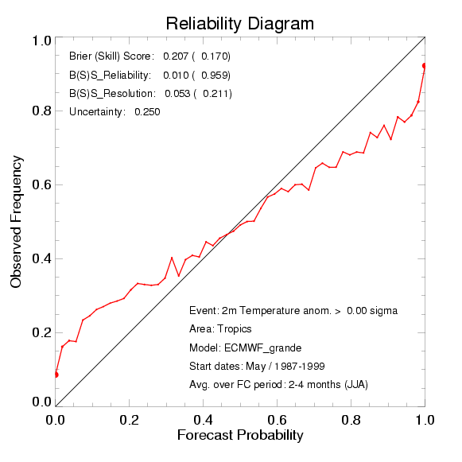
Reliability Diagram
over-confident model
perfect model
R. Hagedorn, 2007

Slide 40
Reliability Diagram
under-confident model
perfect model
R. Hagedorn, 2007

Slide 41
Reliability Diagram
1
skill
Reliability: How close to diagonal
(the lower the value the better)
1
Obs. frequency
0
Observed frequency
0
1
Forecast probability
Resolution: How far to horizontal (climatology) line
climatology
# fcsts
1
0
P_{fcst}
0
Forecast probability
1
Obs. frequency
clim
0
Sharpness diagram
0
1
Forecast probability

Slide 42
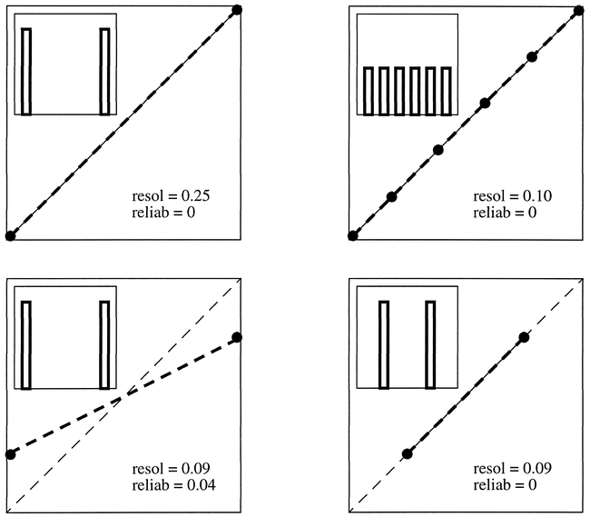
Examples of Reliability Diagram
(a)
(b)
Atger, 1999
(c)
(d)
Typical reliability diagrams and sharpness histograms (showing the distribution of predicted probabilities). (a) Perfect resolution and reliability, perfect sharpness. (b) Perfect reliability but poor sharpness, lower resolution than (a). (c) Perfect sharpness but poor reliability, lower resolution than (a). (d) As in (c) but after calibration, perfect reliability, same resolution.
Notes:
Maybe show this twice (after 31)

Slide 43
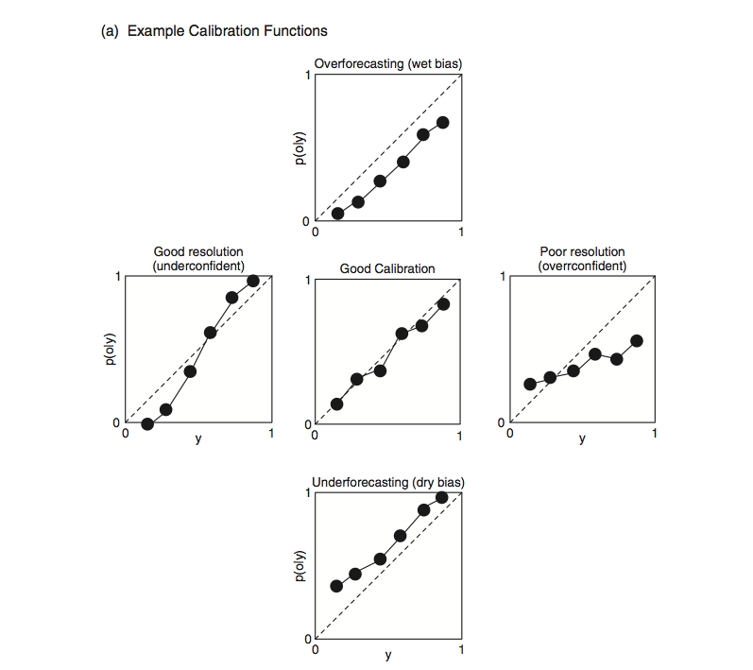
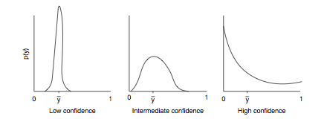
Examples of Reliability Diagram
Most forecasts close to the average
Many forecasts are either 0 or 100%
Wilks (2006)

Slide 44
Brier Skill Score & Reliability Diagram
• How to construct the area of positive skill?
perfect reliability
line of no skill
Observed Frequency
climatological frequency (line of no resolution)
area of skill (RES > REL)
Forecast Probability
R. Hagedorn, 2007

Slide 45
Reliability diagram: Construction
Decide number of categories (bins) and their distribution:
  Depends on sample size, discreteness of forecast probabilities
  Should be an integer fraction of ensemble size
  Don’t all have to be the same width – within bin sample should be large enough to get a stable estimate of the observed frequency.
Bin the data
Compute observed conditional frequency in each category (bin) k
  obs. relative frequency_{k} = obs. occurrences_{k} / num. forecasts_{k}
Plot observed frequency vs forecast probability
Plot sample climatology ("no resolution" line) (The sample base rate)
  sample climatology = obs. occurrences / num. forecasts
Plot "no-skill" line halfway between climatology and perfect reliability (diagonal) lines
Plot forecast frequency histogram to show sharpness (or plot number of events next to each point on reliability graph)

Slide 46
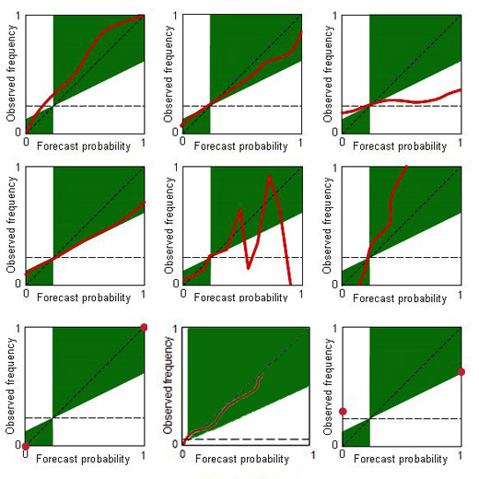
Reliability Diagram Exercise
Identify diagram(s) with:
Categorical forecast
Underforecast
Overconfident
Underconfident
Unskillful
Not sufficiently large sampling
From L. Wilson (EC)

Slide 47
Reliability Diagrams - Comments
Graphical representation of Brier score components
Measures “reliability”, “resolution” and “sharpness”
Sometimes called “attributes” diagram.
Large sample size required to partition (bin) into subsamples conditional on forecast probability

Slide 48
Discrimination
Discrimination: The ability of the forecast system to clearly distinguish situations leading to the occurrence of an event of interest from those leading to the non-occurrence of the event.
Depends on:
  Separation of means of conditional distributions
  Variance within conditional distributions
(a)
observed
non-events
observed
events
(b)
observed
non-events
observed
events
(c)
observed
non-events
observed
events
frequency
frequency
frequency
forecast
forecast
forecast
Good discrimination
Poor discrimination
Good discrimination
From L. Wilson (EC)

Slide 49




Contingency Table
Suppose we partition the joint distribution (forecast , observation) according to whether an event occurred or not and ask the question whether it was predicted or not.
Observed
 | yes | no
yes | hits | false alarms
no | misses | Correct negatives
Forecast
False Alarm Rate
Hit Rate
HR=

Slide 50
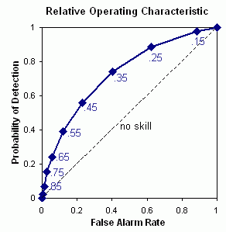
Construction of ROC curve
Determine bins
  There must be enough occurrences of the event to determine the conditional distribution given occurrences – may be difficult for rare events.
For each probability threshold, determine HR and FAR
Plot HR vs FAR to give empirical ROC.
Line of no discrimination
Probability thresholds

Slide 51
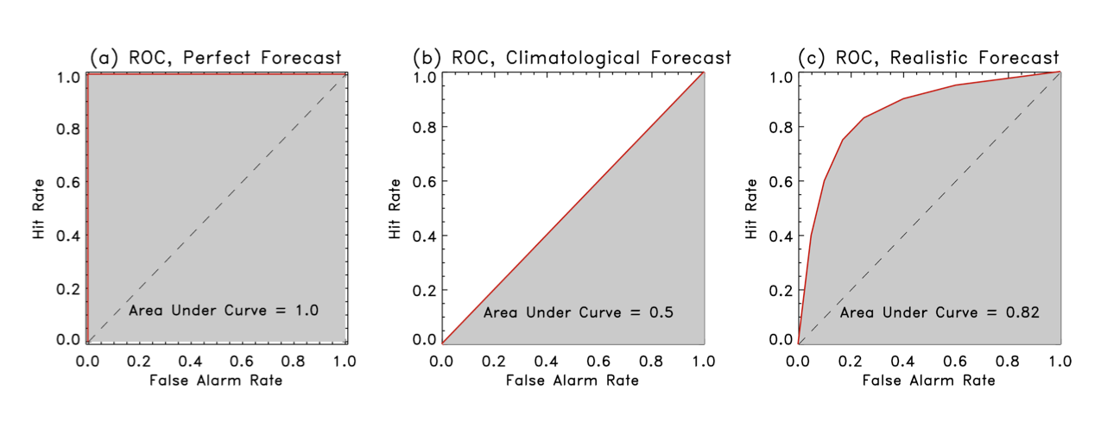
ROC - Interpretation
Area under ROC curve (A) used as a single quantitative measure. Area range: 0 to 1. Perfect =1. No Skill = 0.5
ROC Skill Score (ROCSS)
ROCSS = 2A – 1

Slide 52
Comments on ROC
Measures “discrimination”
The ROC is conditioned on the observations (i.e., given that Y occurred, what was the corresponding forecast?) It is therefore a good companion to the reliability diagram, which is conditioned on the forecasts.
Sensitive to sample climatology – careful about averaging over areas or time
Allows the performance comparison between probability and deterministic forecasts

Slide 53
Rank Probability Score
Observation
F(y)
1
Observation
f(y)
PDF
CDF
category
Measures the distance between the Observation and the Forecast probability distributions
category
R. Hagedorn, 2007

Slide 54
Rank Probability Score
Observation
F(y)
1
f(y)
PDF
CDF
category
Measures the quadratic distance between forecast and verification probabilities for several probability categories k. Range: 0 to 1. Perfect=0
Emphasizes accuracy by penalizing large errors more than “near misses”
Rewards sharp forecast if it is accurate
category

Slide 55
Rank Probability Score
f(y)
RPS=0.01
sharp & accurate
f(y)
RPS=0.15
sharp, but biased
PDF
PDF
category
category
f(y)
RPS=0.05
not very sharp,
slightly biased
f(y)
RPS=0.08
accurate,
but not sharp
PDF
PDF
climatology
category
category
R. Hagedorn, 2007

Slide 56
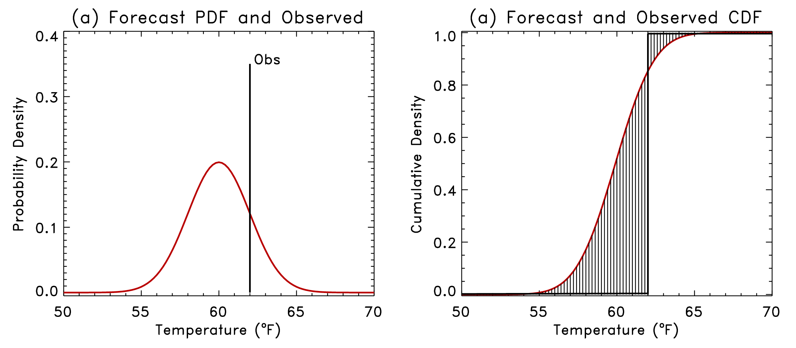
Continuous Rank Probability Score
CRPS
Area difference between CDF observation and CDF forecast
Defaults to MAE for deterministic forecast
Flexible, can accommodate uncertain observations

Slide 57
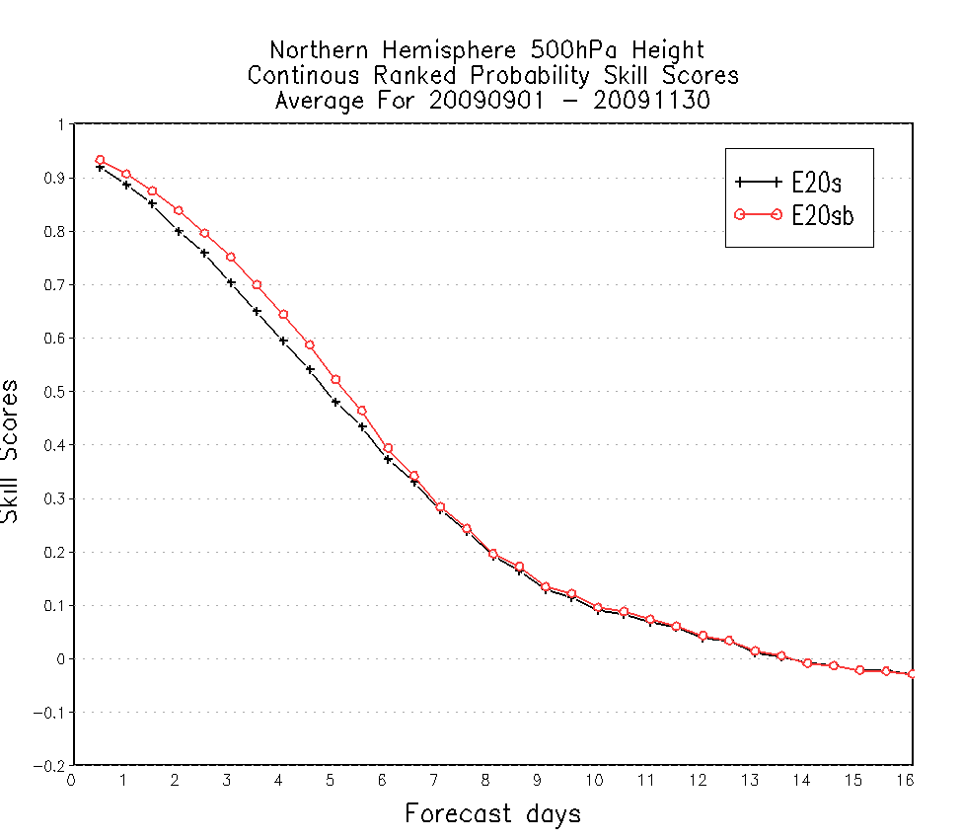
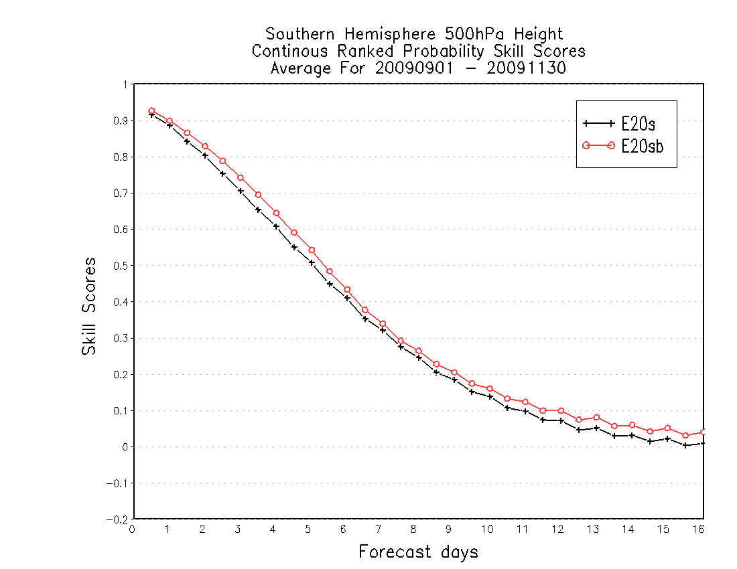
Continuous Rank Probability Skill Score
Example:
500hPa CRPS of operational GFS (2009; black) and new implementation (red)
Courtesy of Y. Zhu (EMC/NCEP)
Notes:
What is reference?

Slide 58
Rank Histogram (aka Talagrand Diagram)
Do the observations statistically belong to the distributions of the forecast ensembles?
nature
Deterministic model forecast
PDF_{verifying}
PDF_{initial}
Initial
Forecast time
Verify Time

Slide 59
Rank Histogram (aka Talagrand Diagram)
Do the observations statistically belong to the distributions of the forecast ensembles?
nature
Deterministic model forecast
PDF_{verifying}
PDF_{initial}
Initial
Forecast time
Observation is an outlier at this lead time. Is this a sign of poor ensemble prediction?

Slide 60
Rank Histogram
Rank Histograms asses whether the ensemble spread is consistent with the assumption that the observations are statistically just another member of the forecast distribution.
  Procedure: Sort ensemble members in increasing order and determine where the verifying observation lies with respect to the ensemble members
Rank 1 case
Rank 4 case
Observation
Ensemble forecasts
Temperature ->
Temperature ->

Slide 61
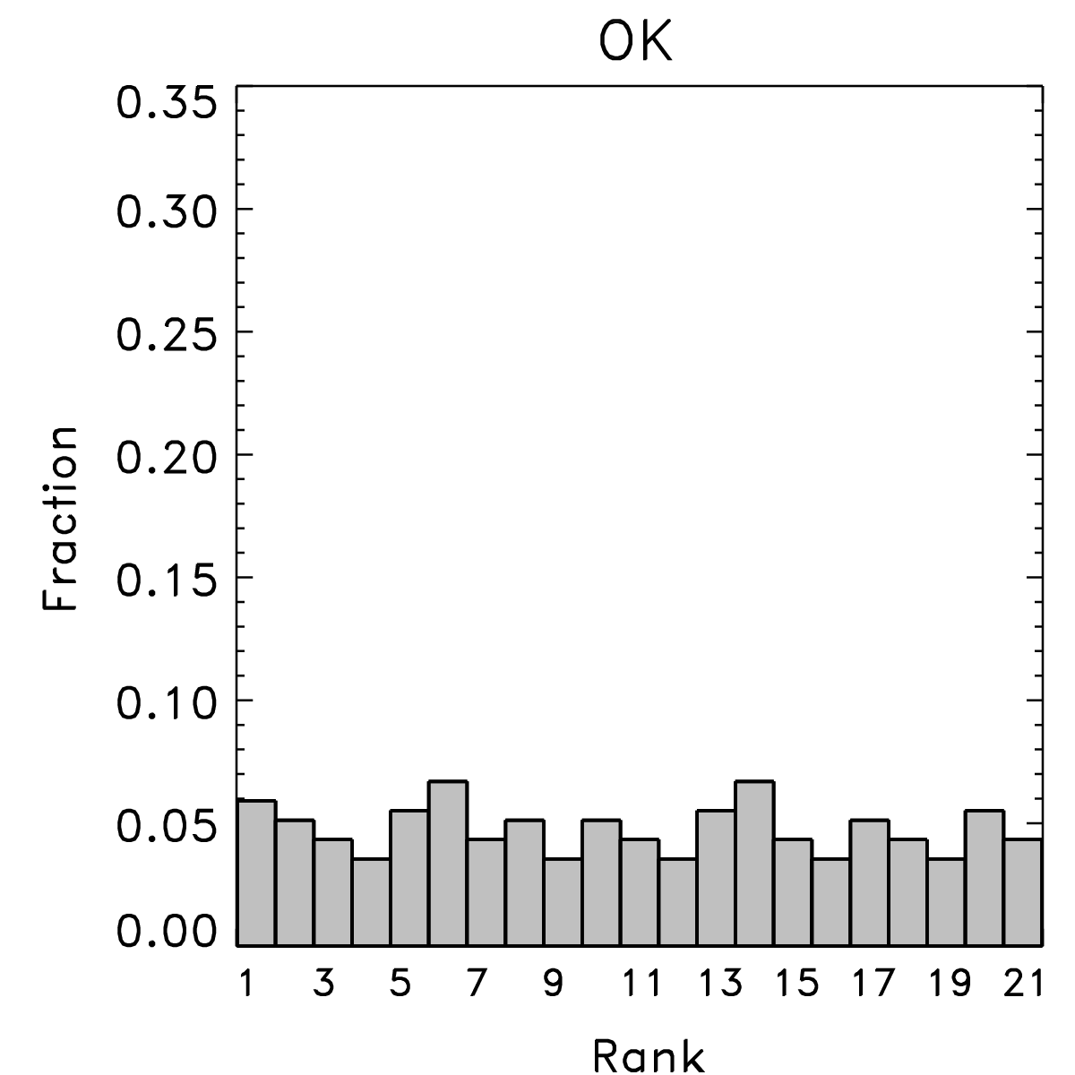
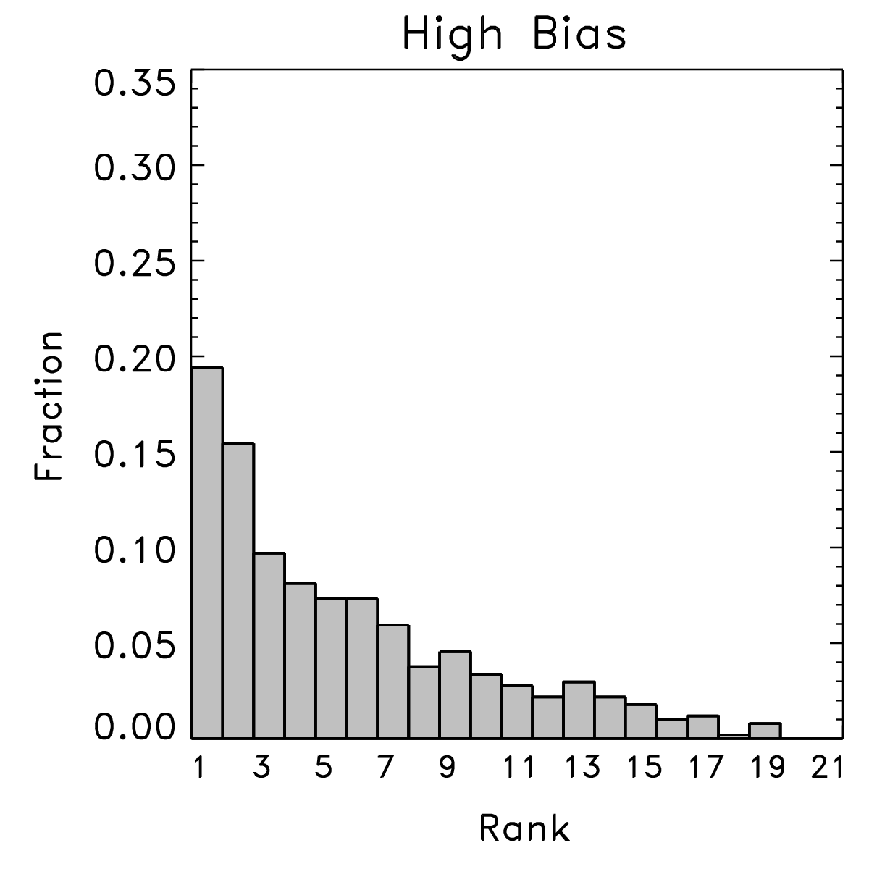
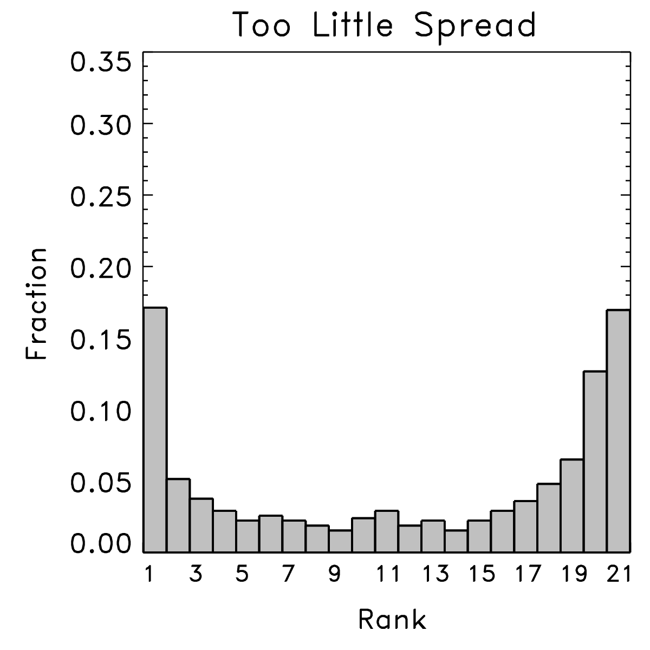
Rank Histograms
(“warm” or “wet” bias)
OBS is indistinguishable from any other ensemble member
OBS is too often below the ensemble members (biased forecast)
OBS is too often outside the ensemble spread
A uniform rank histogram is a necessary but not sufficient criterion for
determining that the ensemble is reliable (see also: T. Hamill, 2001, MWR)
Notes:
Too little spread: forecast is overconfident?

Slide 62
Comments on Rank Histograms
Not a real verification measure
Quantification of departure from flatness
where RMSD is the root-mean-square difference from flatness, expressed as number of cases, M is the total sample size on which the rank histogram is computed, N is the number of ensemble members, and S_{k} is the number of occurrences in the kth interval of the histogram.
Notes:
Corrected sk

Slide 63
Outline
Background
  Uncertainty in NWP systems
  Introduction to Ensemble Forecasts
Probabilistic forecast verification
  Attributes of forecast quality
  Performance metrics
Post-processing ensembles
  PDF Calibration
  Combination

Slide 64
Post-processing methods
Systematic error correction
Multiple implementation of deterministic MOS
Ensemble dressing
Bayesian model averaging
Non-homogenous Gaussian regression
Logistic regression

Slide 65
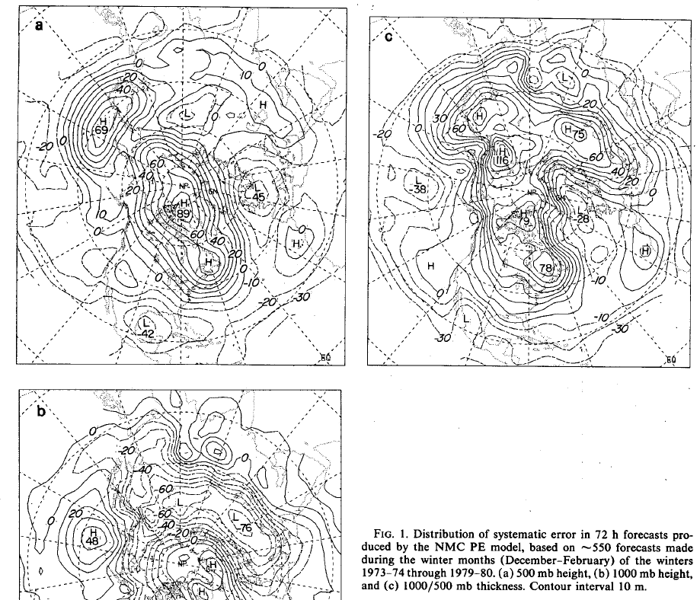
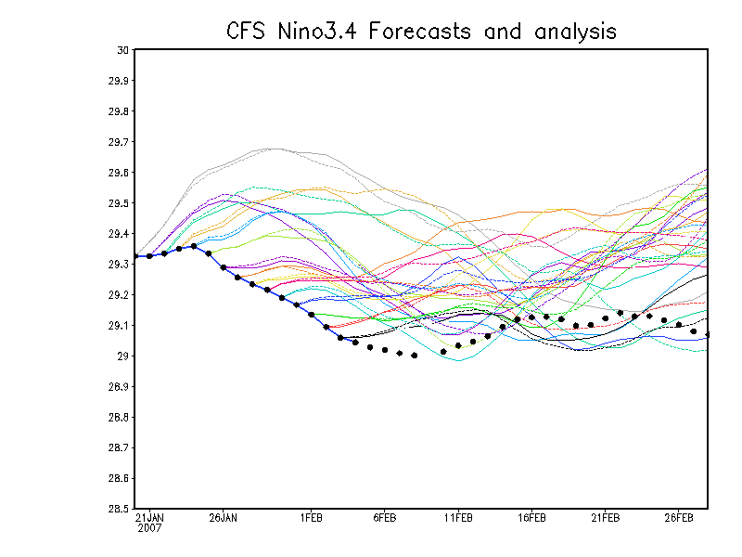
Examples of systematic errors
Lag ensemble
present
Note “Warm” tendency of the model

Slide 66
Bias correction
A first order bias correction approach is by computing the mean error from historical forecast-observation pairs archive:
This systematic error is removed from each ensemble member forecast. Notice that the spread is not affected
Particularly useful/successful at locations with features not resolved by model and causing significant bias
with: e_{i} = ensemble mean of the i^{th} forecast
o_{i} = value of i^{th} observation
N = number of observation-forecast pairs

Slide 67
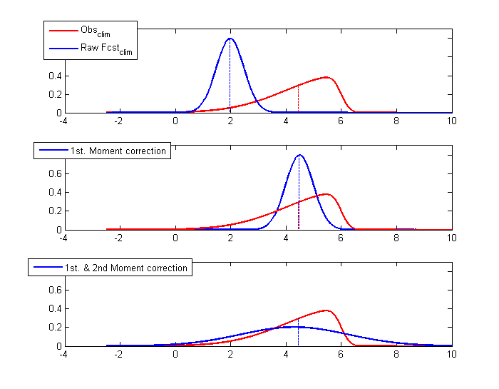
Illustration of first and second moment correction
Notes:
Nice, reference?

Slide 68
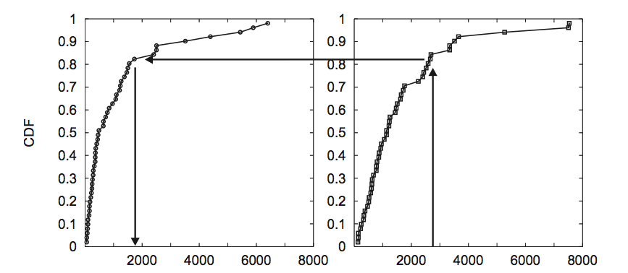
Quantile Mapping Method
Uses the empirical Cumulative Distribution Function for observed and corresponding forecast to remove the bias
Let G be the cdf of the observed quantity. Let F be the cdf of the corresponding historical forecast.
Observed Amount
Forecast Amount
The corrected ensemble forecast must satisfy:
x is the forecast amount.
x →
x →
In this example, a forecast amount of 2800 is transformed into 1800 for the 80 percentile

Slide 69
Ensemble dressing
Define a probability distribution around each ensemble member (“dressing”)
A number of methods exist to find appropriate dressing kernel (“best-member” dressing, “error” dressing, “second moment constraint” dressing, etc.)
Average the resulting n_{ens} distributions to obtain final pdf
R. Hagedorn, 2007
Notes:
Great!

Slide 70
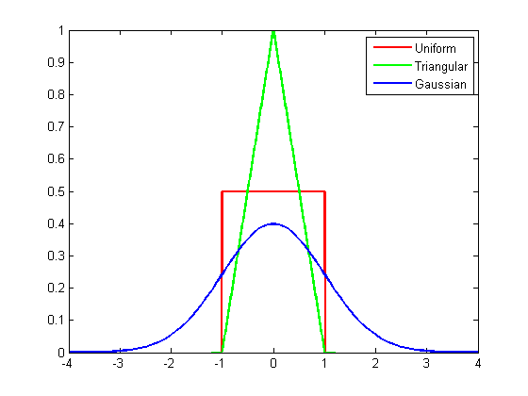
Definition of Kernel
Kernel is a weighting function satisfying the following two requirements:
1)
To ensure estimation results in a PDF
2)
To ensures that the average of the corresponding distribution is equal to that of the sample used
Examples:
Uniform
Triangular
Gaussian
Very often, the kernel is taken to be a Gaussian function with mean zero and variance 1. In this case, the density is controlled by one smoothing parameter h (bandwidth)
where x_{i} is an independent sample of a random variable f; thus the density is given as:

Slide 71
Training datasets
All calibration methods need a training dataset (hindcast), containing a large number historical pairs of forecast-observation fields
  A long training dataset is preferred to more accurately determine systematic errors and to include past extreme events
  Common approaches: a) generate a sufficiently long hindcast and freeze the model; b) compute a systematic error but the model is not frozen.
For research applications often only one dataset is used to develop and test the calibration method. In this case it is crucial to carry out cross-validation to prevent “artificial” skill.

Slide 72
Calibration
Forecasts of Ensemble Prediction System are subject to forecast bias and dispersion errors
Calibration aims at removing such known forecast deficiencies, i.e. to make statistical properties of the raw EPS forecasts similar to those from observations
Calibration is based on the behaviour of past EPS forecast distributions, therefore needs a record of historical prediction-observation pairs
Calibration is particularly successful at station locations with long historical data records
A growing number of calibration methods exist and are becoming necessary to process multi-model ensembles

Slide 73
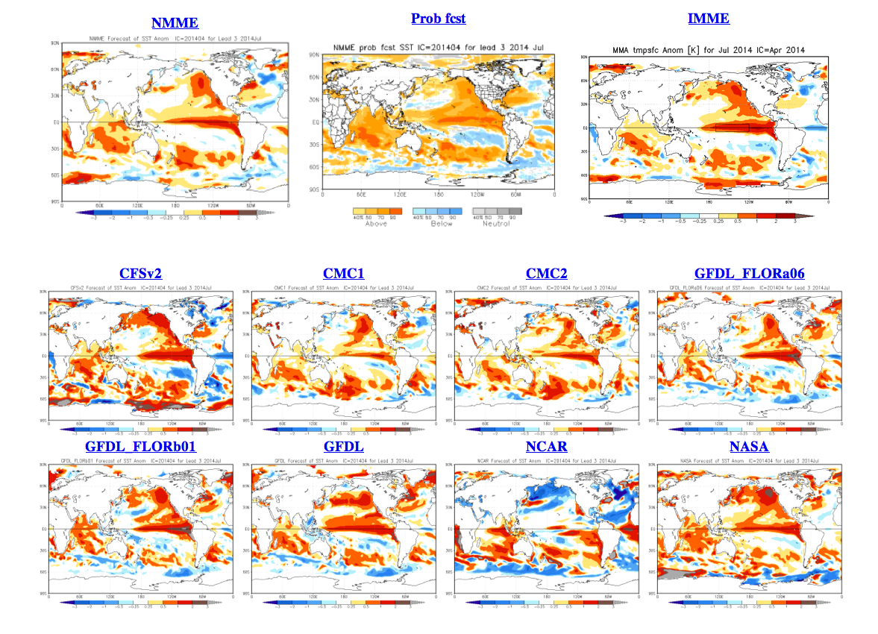
Multi-model ensembles
Next steps:
Calibration
Combination methods
Probabilistic Verification

Slide 74
Multi-Model Combination (Consolidation)
Making the best single forecast out of a number of forecast inputs
Necessary as large supply of forecasts available
Expressed as a linear combination of participant models:
K number of participating models
ζ input forecast at a particular initial month and lead time
Task: Finding K optimal weights, α_{k} , corresponding to each input model
Data: Nine ensemble prediction systems (DEMETER+CFS+CA)
      At least 9 ensemble members per model
      Hindcast length: Twenty-one years (1981-2001)
      Monthly mean forecasts; Leads 0 to 5 months
      Four initial month: Feb, May, Aug, Nov

Slide 75
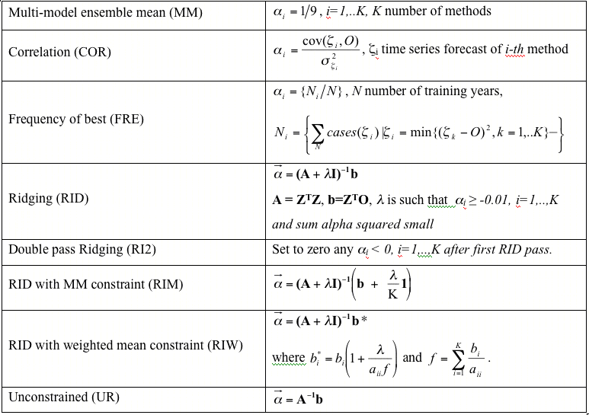
Examples of Consolidation methods
Notes:
Consolidation?

Slide 76
Effect of cross-validation on multi-model combination methods
D1, D2, ..D7 are distinct Ensemble predictions systems
CFS is the NCEP Climate Forecast System
CA is the statistical Constructed Analog
Evaluations with dependent data have much larger skill but a large portion of it is artificial
Artificial skill
Individual Ensemble Mean Forecasts
Notes:
CV-3RE? D1…D7
Write a conclusion…
Interesting!

Slide 77
References
Atger, F., 1999: The skill of Ensemble Prediction Systems. Mon. Wea. Rev. 127, 1941-1953.
Hamill, T., 2001: Interpretation of Rank Histograms for Verifying Ensemble Forecasts. Mon. Wea. Rev., 129, 550-560.
Silverman, B.W., 1986: Density Estimation for Statistical and Data Analysis, Chapman and Hall Ltd. 175
Toth, Z., O. Talagrand, G. Candille, and Y. Zhu, 2002: Probability and ensemble forecasts. In: Environmental Forecast Verification: A practitioner's guide in atmospheric science. Ed.: I. T. Jolliffe and D. B. Stephenson. Wiley, pp.137-164.
Vannitsem, S., 2009: A unified linear Model Output Statistics scheme for both deterministic and ensemble forecasts. Quarterly Journal of the Royal Meteorological Society, vol. 135, issue 644, pp. 1801-1815.
Wilks, D., 1995: Statistical Methods in the Atmospheric Sciences. Academic Press, 464pp.
Internet sites with more information:
http://wwwt.emc.ncep.noaa.gov/gmb/ens/index.html
http://www.cawcr.gov.au/projects/verification/#Methods_for_probabilistic_forecasts
http://www.ecmwf.int/newsevents/training/meteorological_presentations/MET_PR.html

