Slide 1
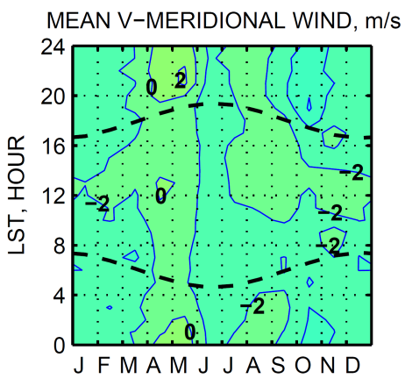
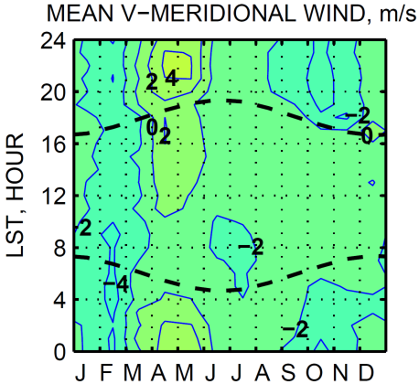
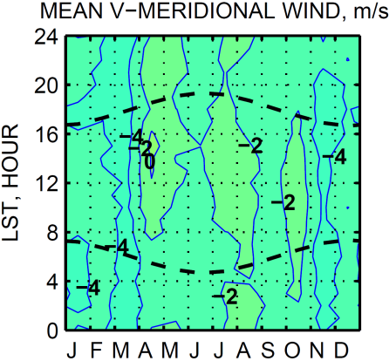
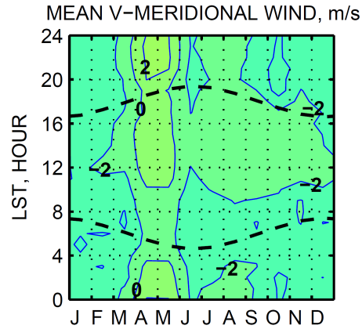
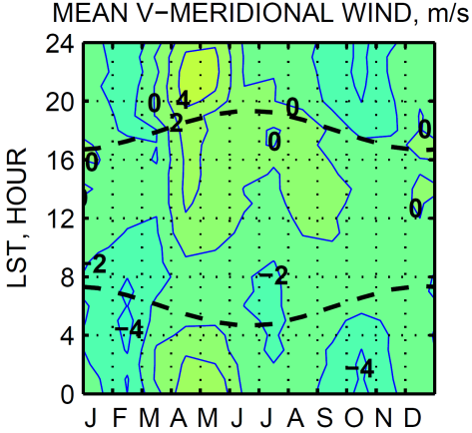
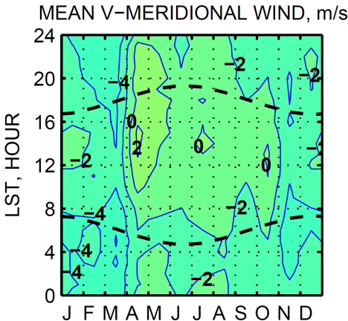
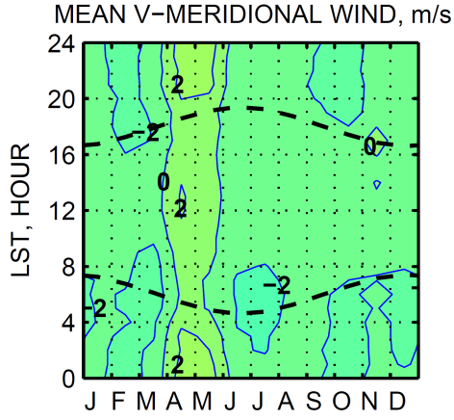
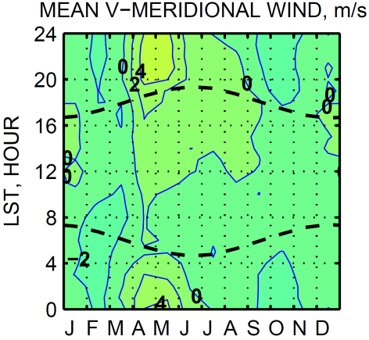
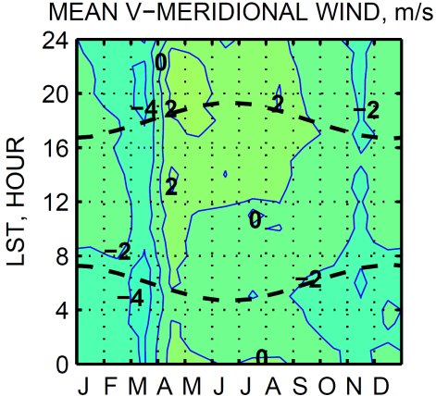
MD WIND PROFILERS 2010-2014 CLIMATOLOGY OF MERIDIONAL WIND COMPONENT
PINEY RUN, MD. 763 m a.s.l.
BELTSVILLE, MD. 53 m a.s.l.
HORN POINT, MD. 4 m a.s.l.
1.5 km
a.g.l.
1.0 km
a.g.l.
0.5 km
a.g.l.

