Slide 1
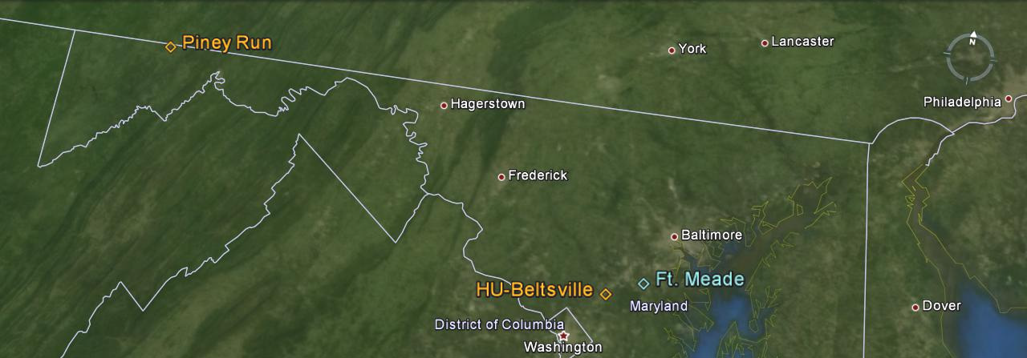
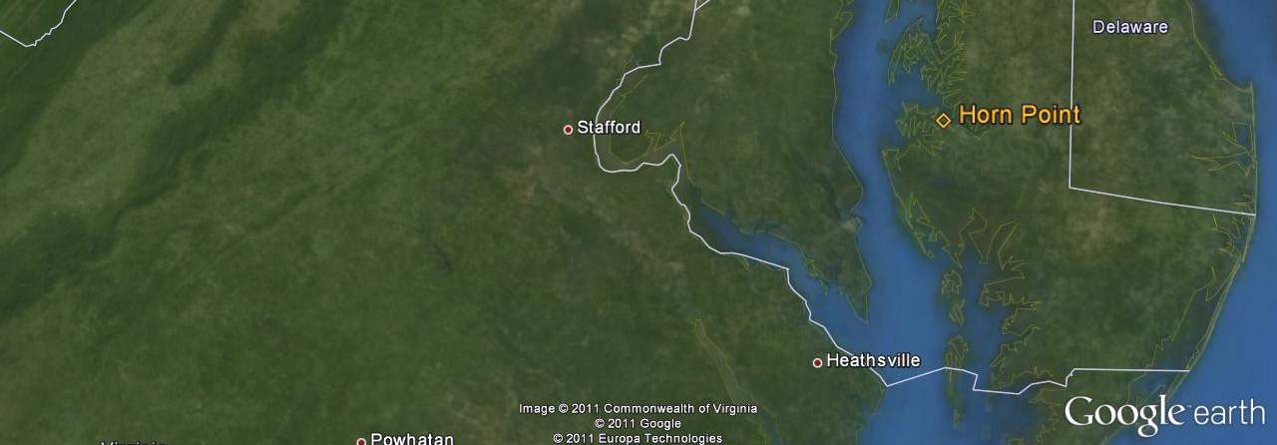
American Association of State Climatologists, 40th Annual Meeting, Cape May, NJ. June 23-26, 2015
MARYLAND WIND CLIMATOLOGY FROM WIND PROFILERS
Konstantin Vinnikov & Eric Hohman (Office of State Climatologist for Maryland)
Russell Dickerson (Atmospheric and Oceanic Science, University of Maryland)
Joel Dreessen (Maryland Department of the Environment)
MARYLAND WIND PROFILERS:
1. Fort Mede, MD 9/1998-5/2005.
2. Beltsville, MD: 5/2005 – now.
3. Piney Run, MD: 5/2005 – now.
4. Horn Point, MD: 4/2012 – now.
Observed variables are:
Wind speed S(t,z) and
Wind direction D(t,z)

Slide 2
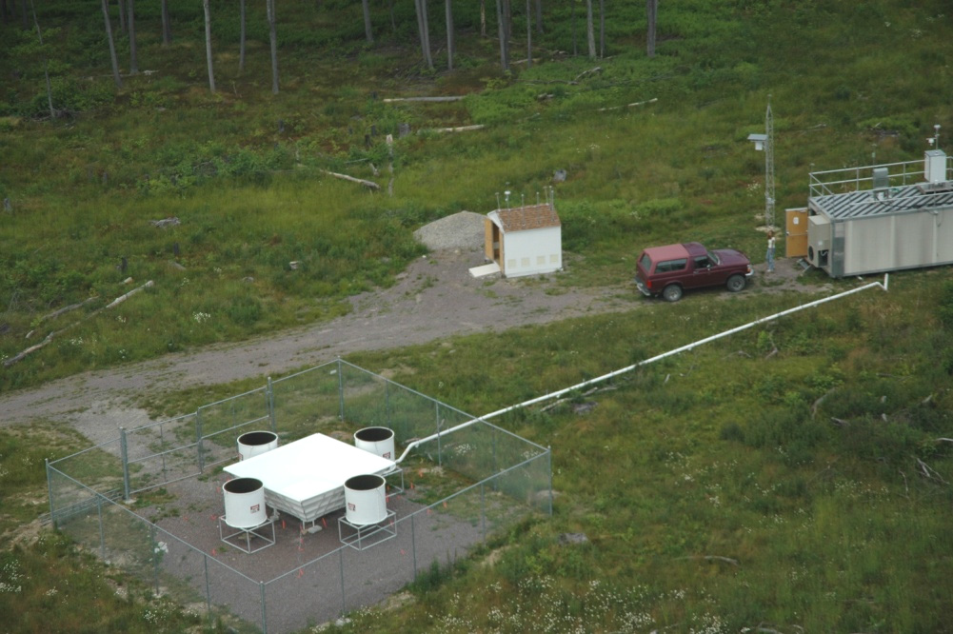
Image of Wind Profiler in PINEY RUN, MD.
The photo obtained from Krask (2013) – Maryland Department of Environment

Slide 3
NONHOMOGENIETIES IN THE OBSERVED DATA
BEFORE APRIL 2012
Vertical resolution: Data reported at 44 altitudes, 171 : 91.6 : 4,108 m.
Temporal resolution: 15-minute average reported every 15 minutes.
AFTER APRIL 2012
Vertical resolution: Data reported at 67 altitudes, 148 : 59.2 : 4056 m.
Temporal resolution: 30-minute average reported every 6 minutes.
HOMOGENIZATION of TIME SERIES
1. Compute U-zonal and V-meridional wind components.
2. Compute 30-minute averages of U and V wind components. Vectoral averaging.
3. Define standard altitudes: 39 altitudes, 200 : 100 : 4,000 m.
4. Linear interpolation U and V into standard altitudes. Extrapolation is forbidden.
U(t,z), V(t,z), S(t,z); t(Year, Month, Day, Hour, Minute).
Climatic Box-averaging 1 Month x 1 Hour. Results: U(Month, Hour, Altitude), V(Month, Hour, Altitude), and
Scalar box-averaged wind speed S(Month, Hour, Altitude)

Slide 4
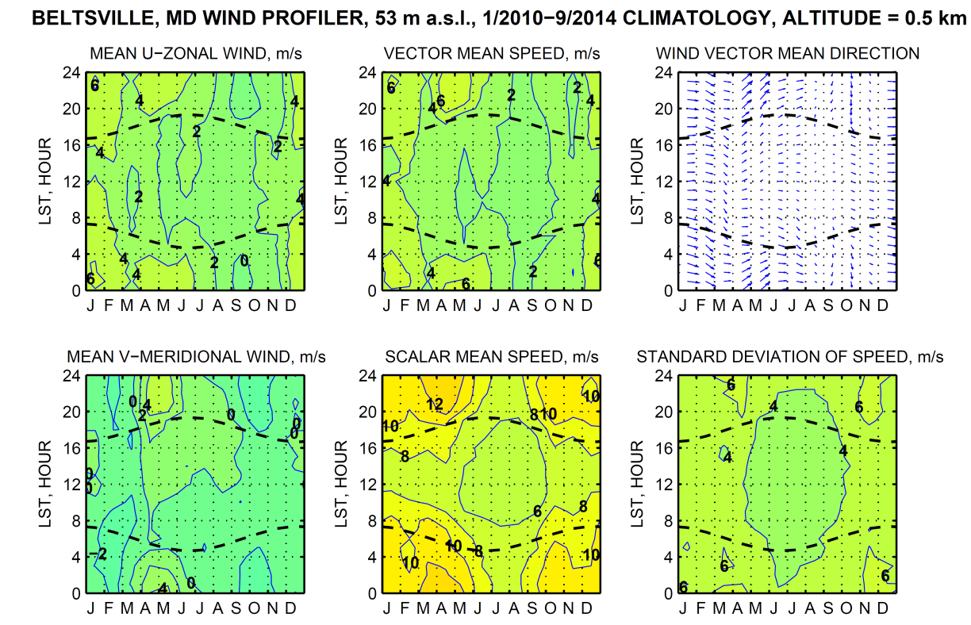
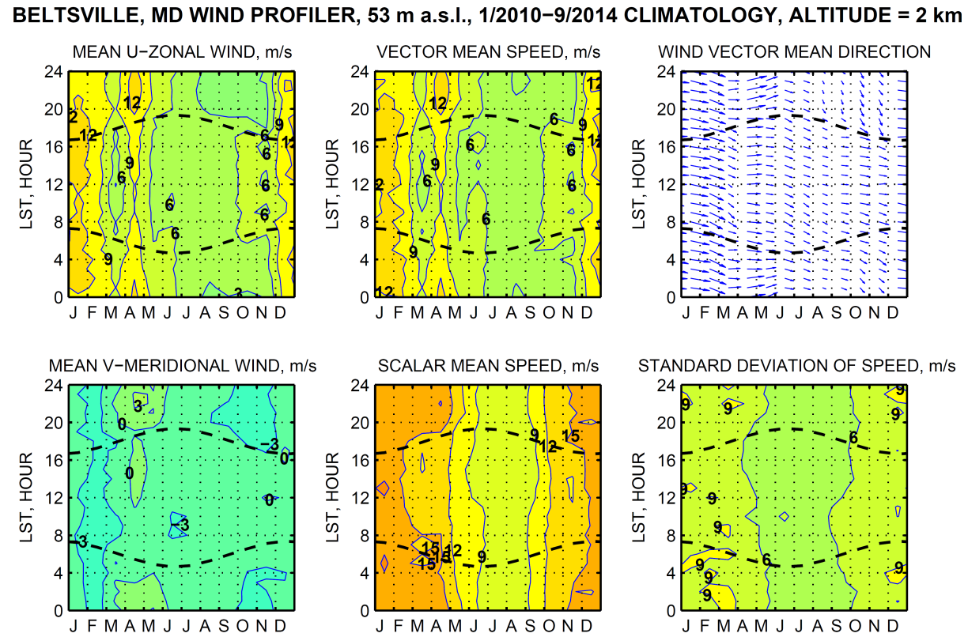
Diurnal/Seasonal
wind climatology
at different altitudes.
LST=EST

Slide 5
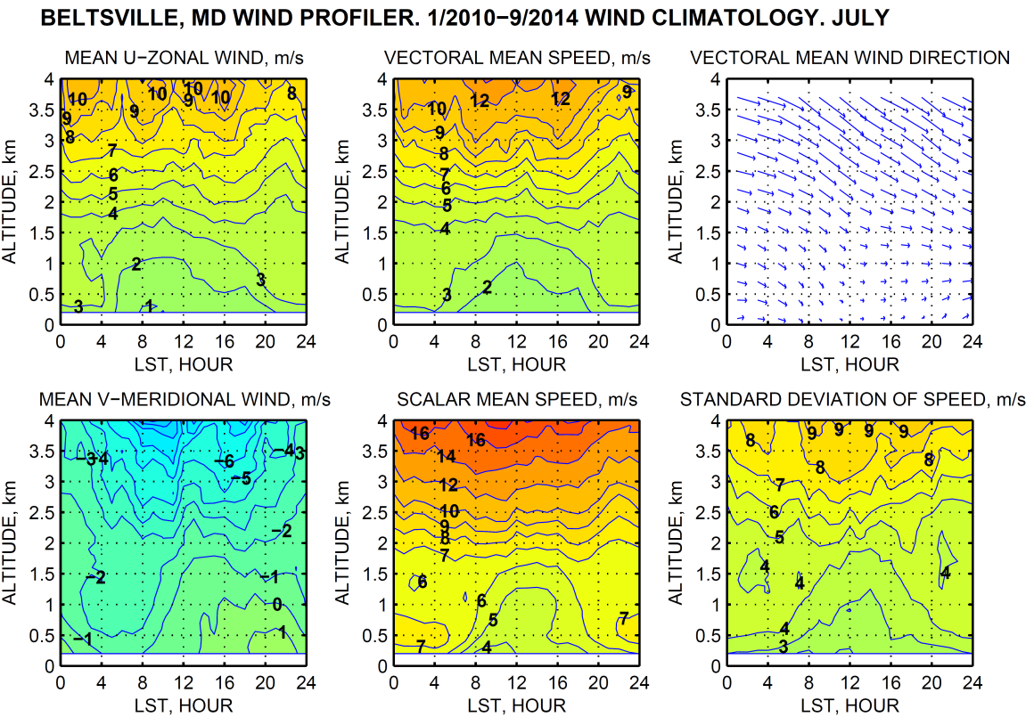
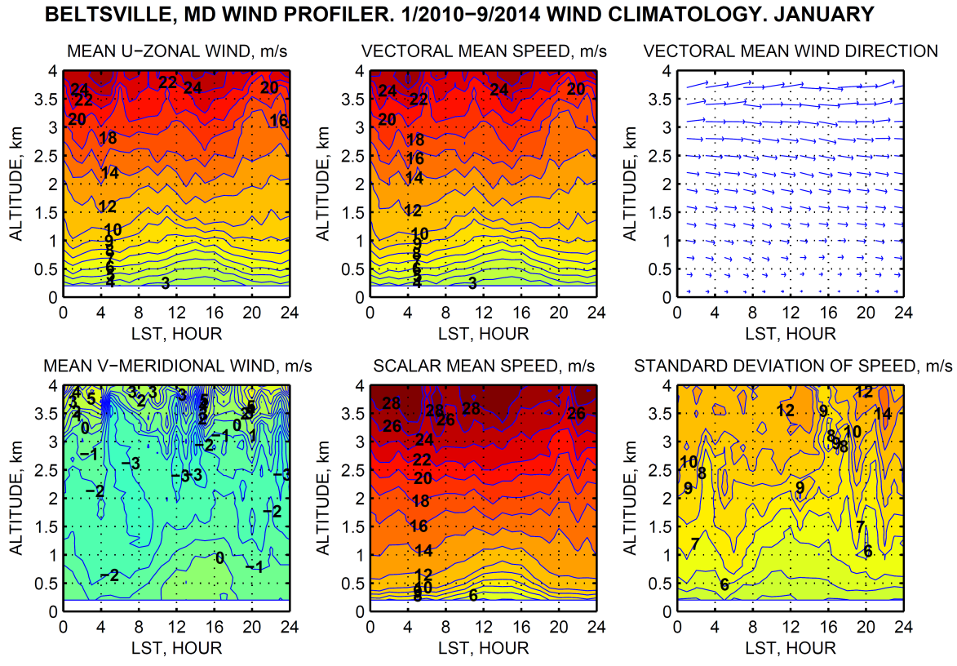
Diurnal/Altitudinal
wind climatology
at different months.
LST=EST

Slide 6
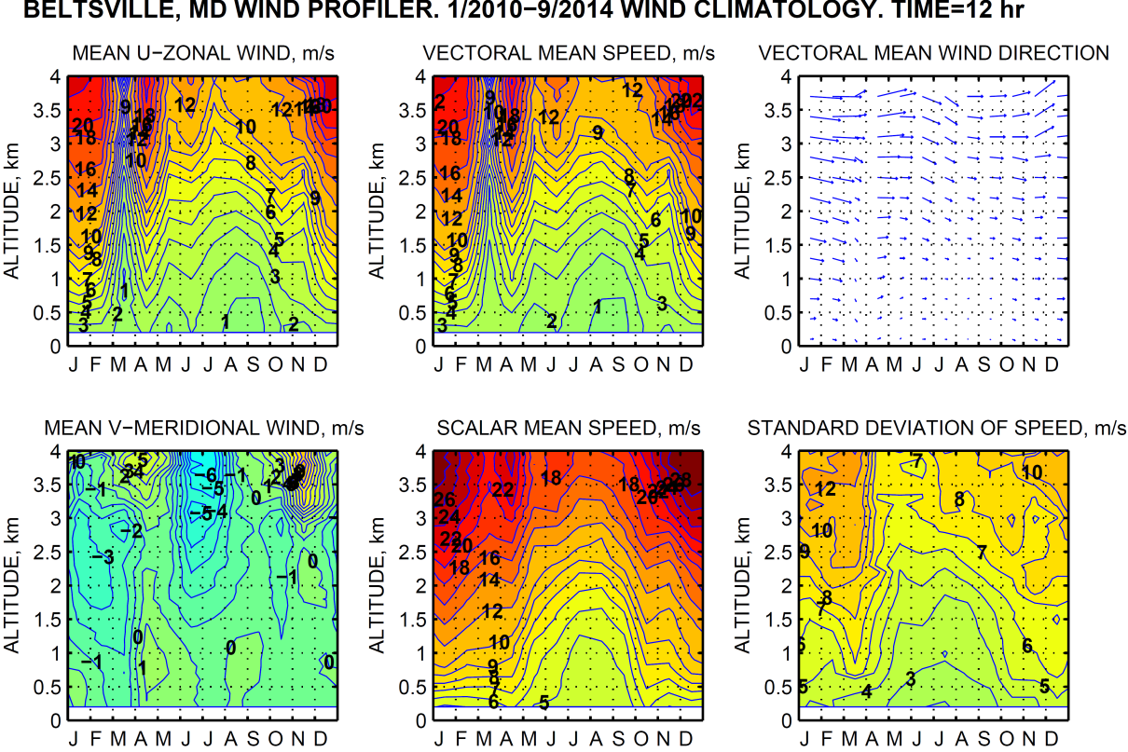
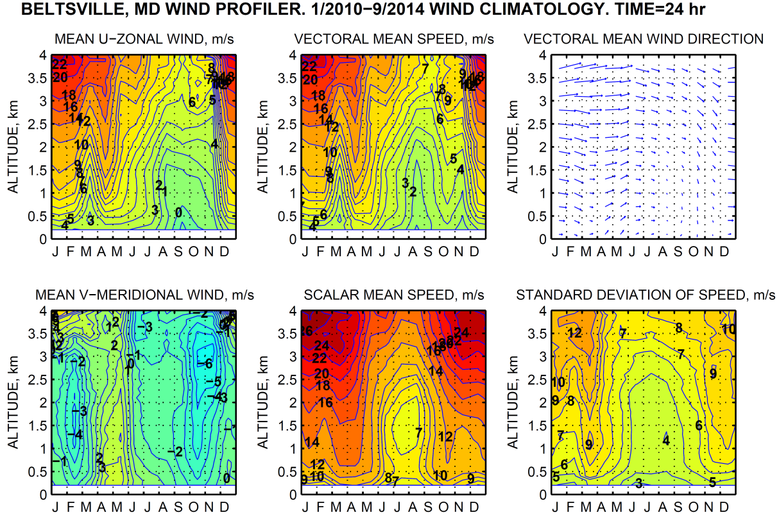
NOON, EST
Seasonal/Altitudinal wind climatology at different time of day
MIDNIGHT, EST

Slide 7
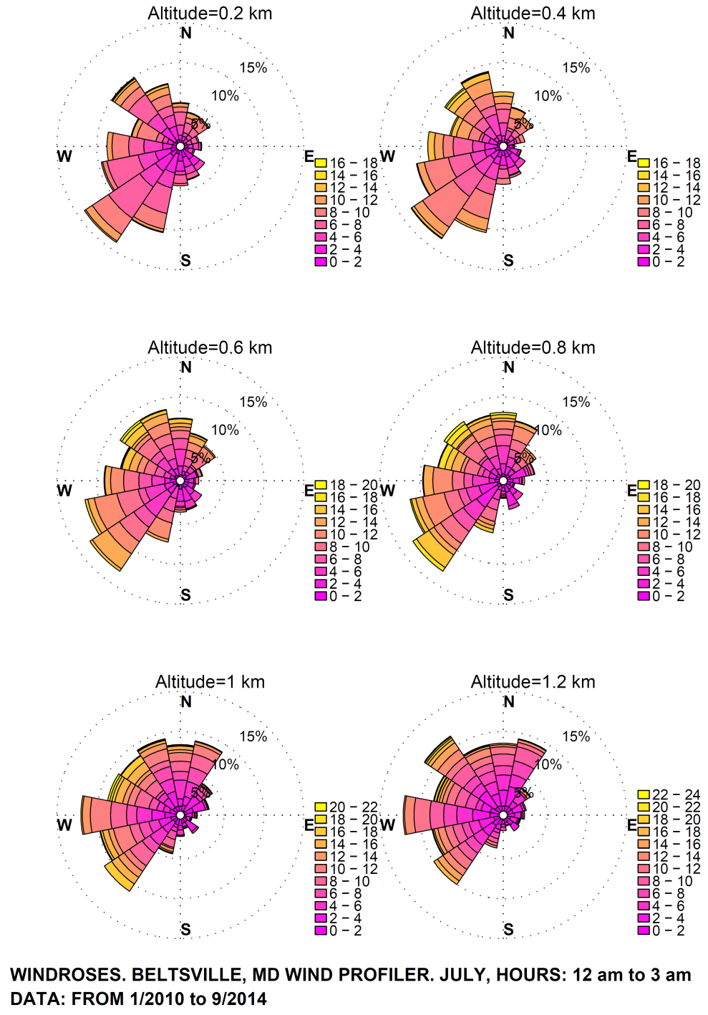
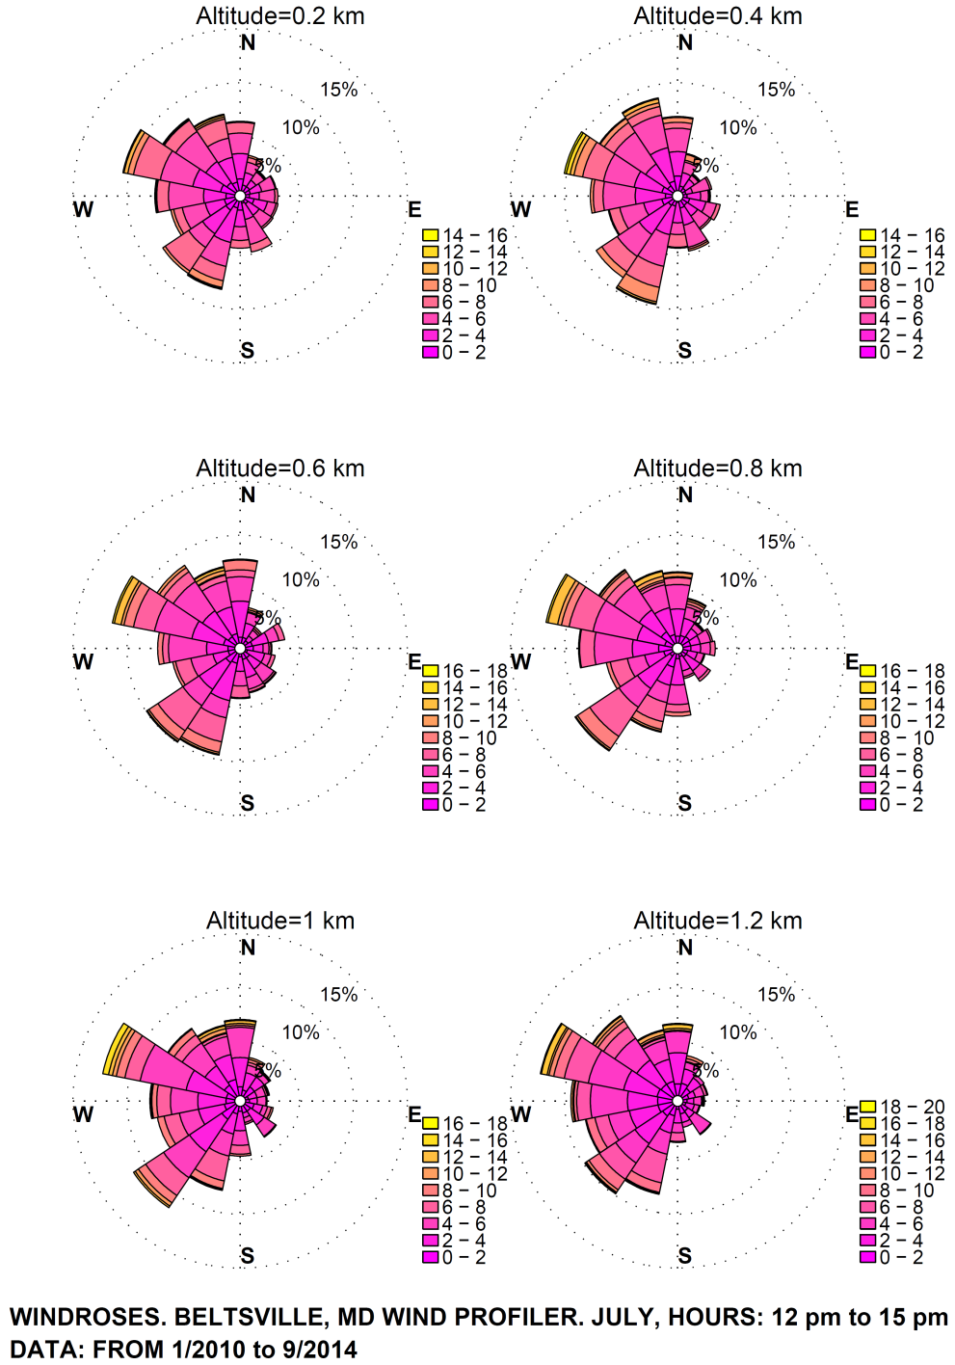
WINDROSES, BELTSVILLE (53 m ASL), MD, JULY
DIFFERENT TIMES OF DAY (EST), DIFFERENT ALTITUDES (AGL)

Slide 8
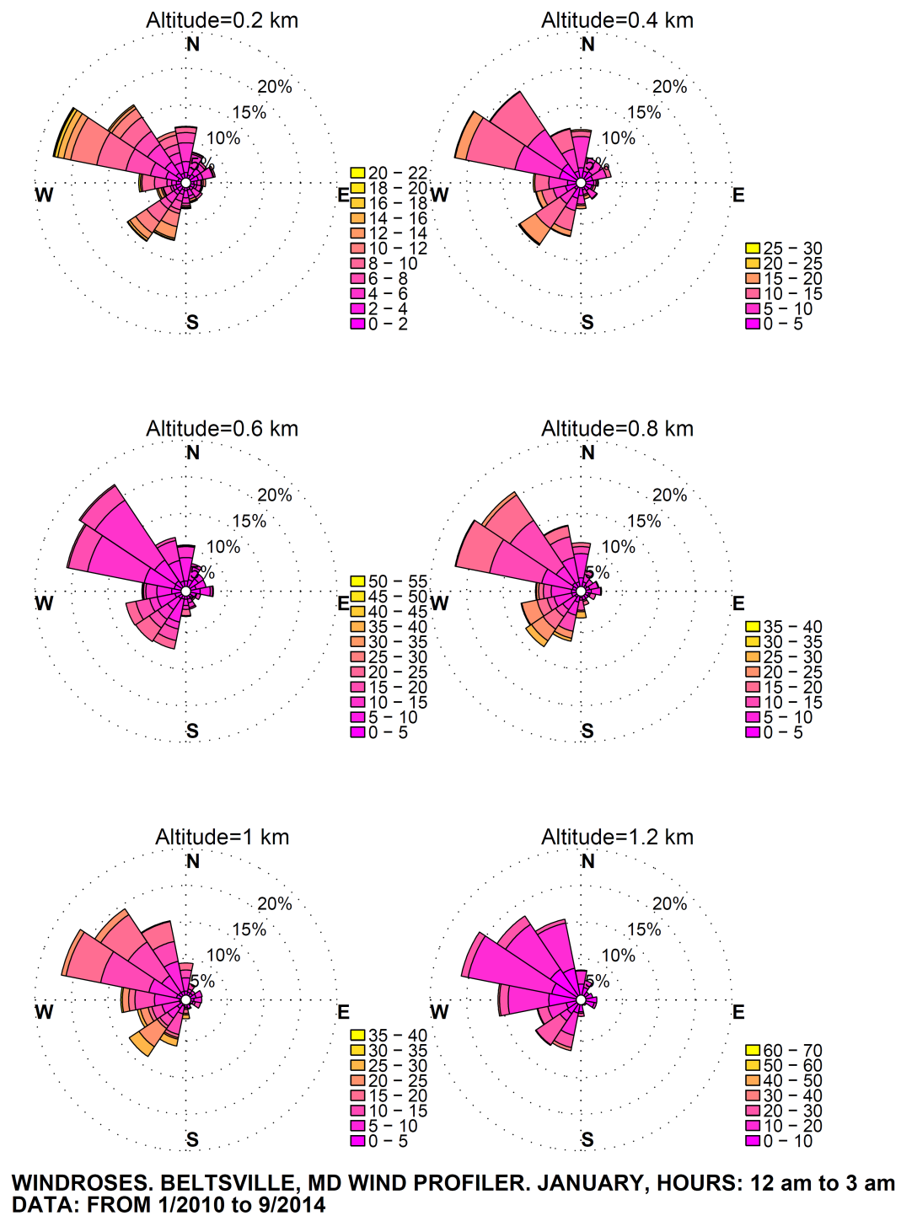
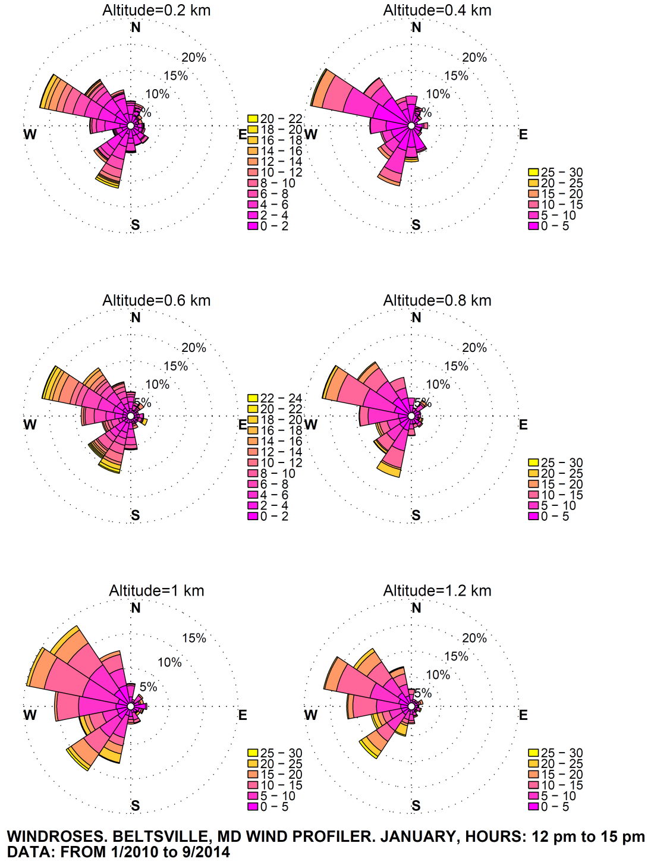
WINDROSES, BELTSVILLE (53 m ASL), MD, DECEMBER
DIFFERENT TIMES OF DAY (EST), DIFFERENT ALTITUDES (AGL)

Slide 9
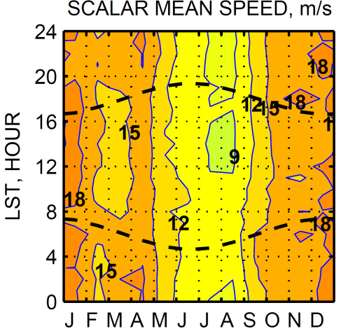
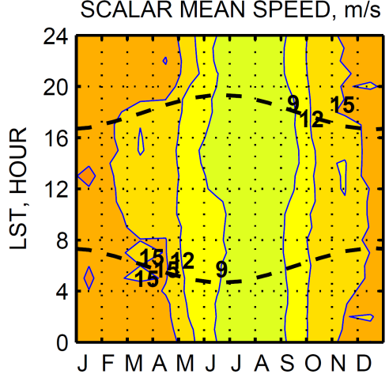
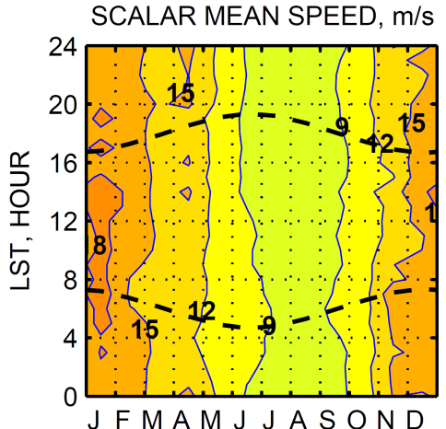
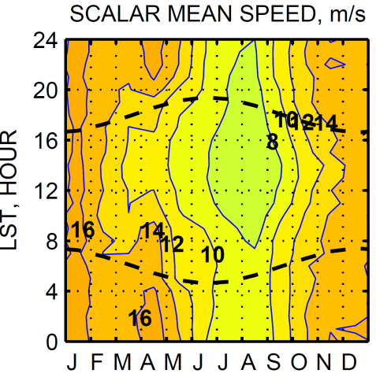
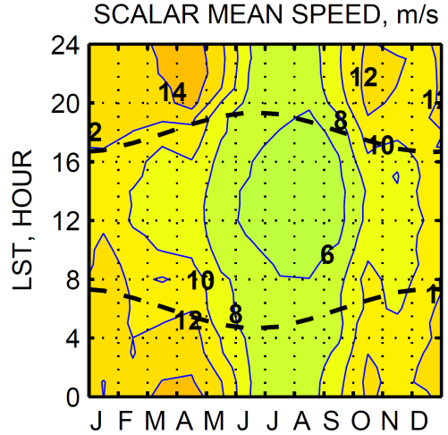
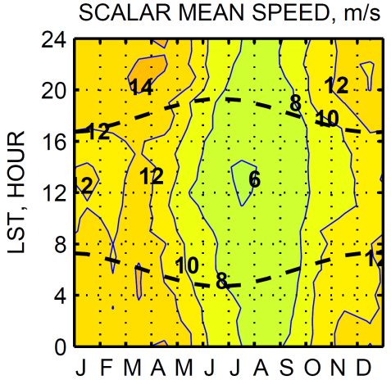
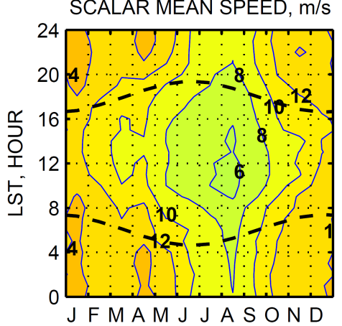
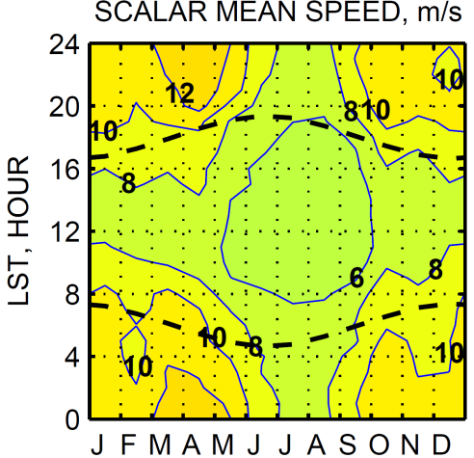
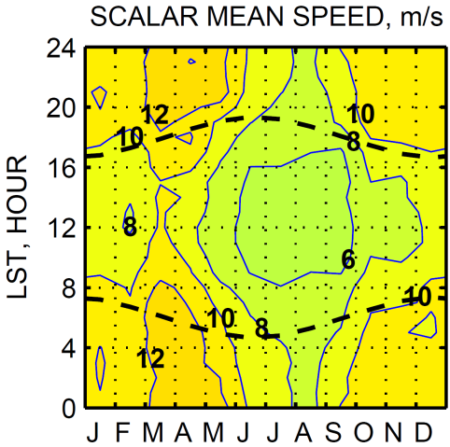
SCALAR MEAN WIND SPEED AT DIFFERENT ALTITUDES AT THREE STATIONS. LST=EST
Piney Run, MD. 763 m ASL
Beltsville, MD. 53 m ASL
Horn Point, MD. 4 m ASL
2 km AGL
1 km
AGL
0.5 km
AGL

Slide 10
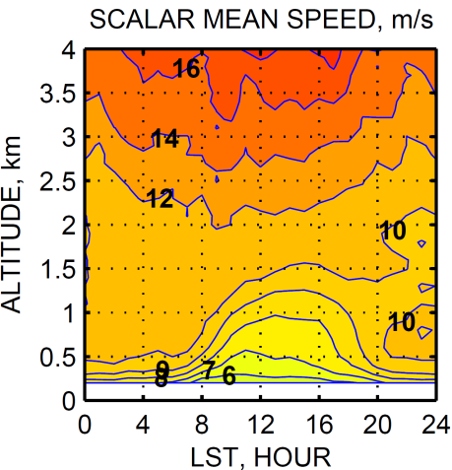
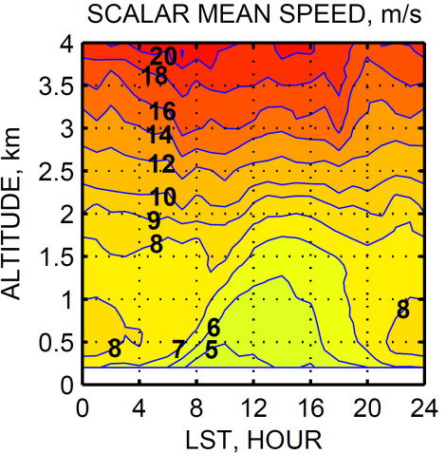
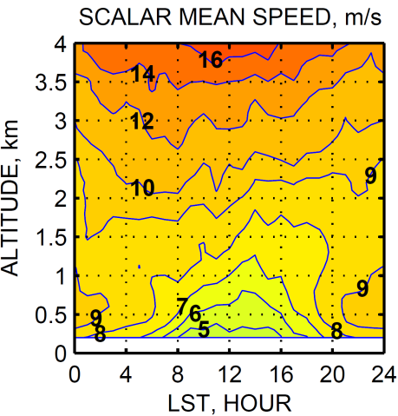
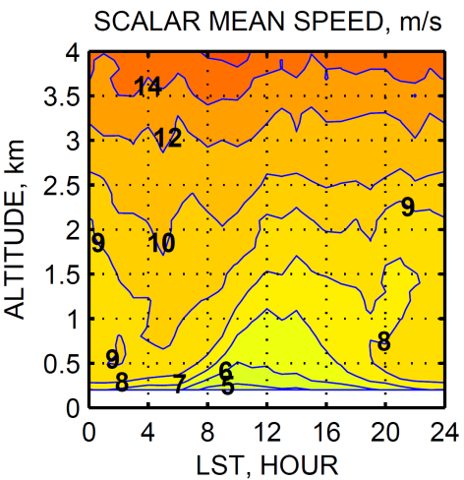
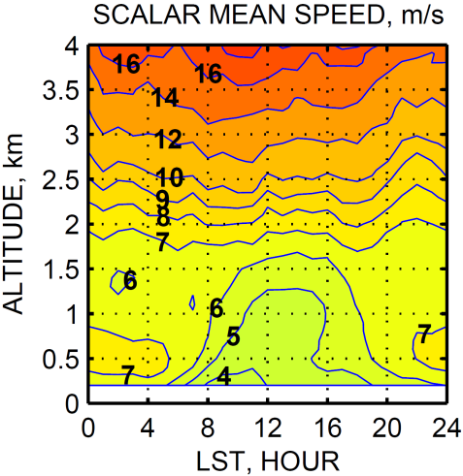
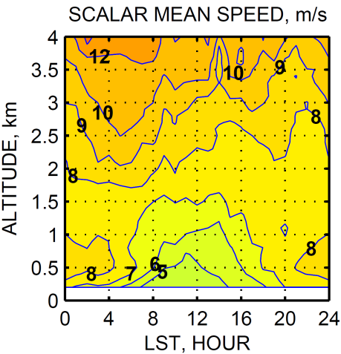
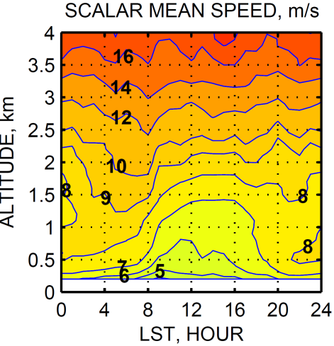
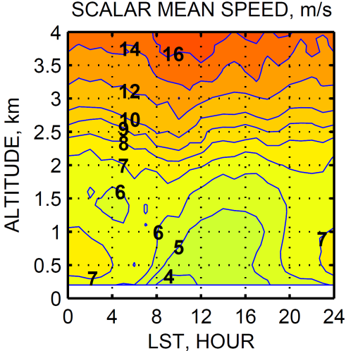
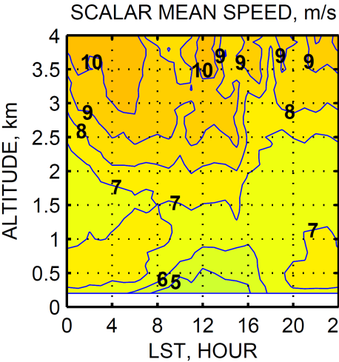
SCALAR MEAN WIND SPEED FOR JUNE, JULY, AUGUST MONTHS AT THREE STATIONS. LST=EST
Piney Run, MD. 763m
Beltsville, MD. 53m
Horn Point, MD. 4m
JUNE
JULY
AUGUST

Slide 11
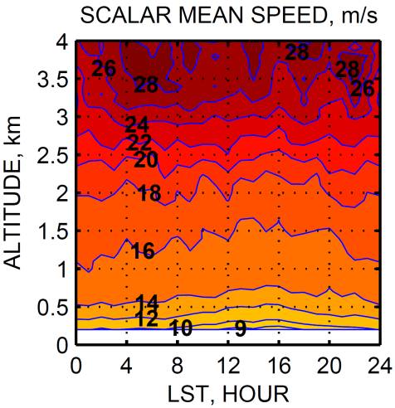
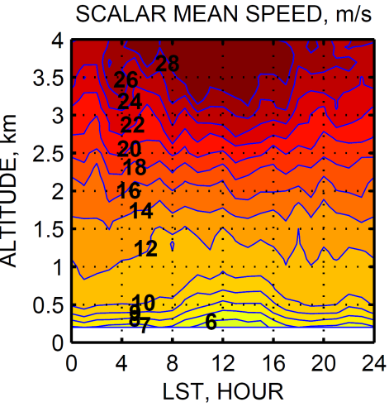
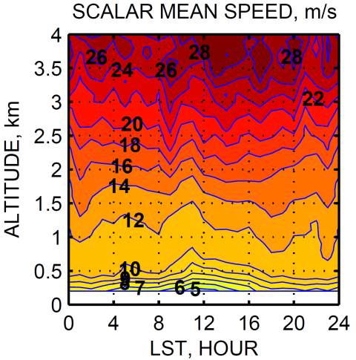
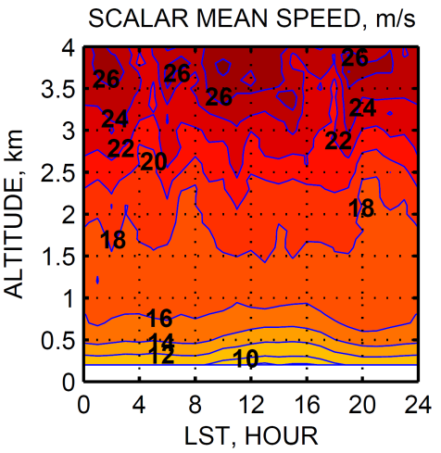
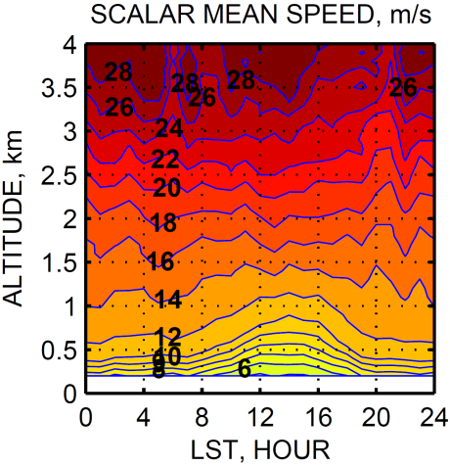
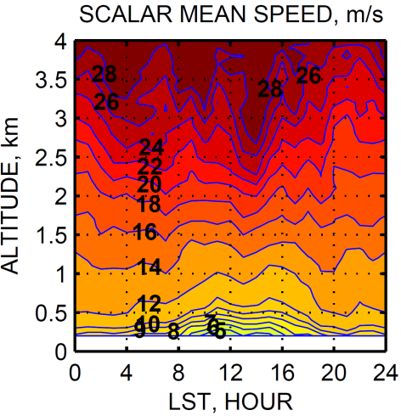
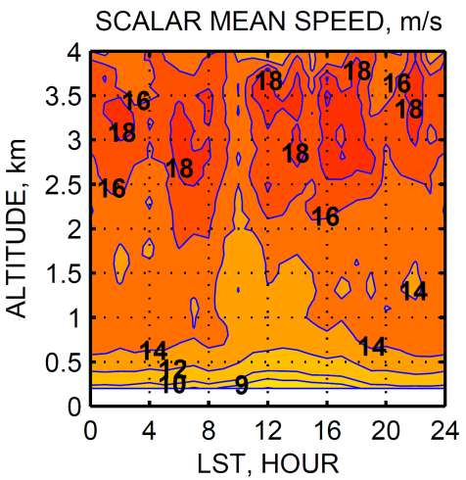
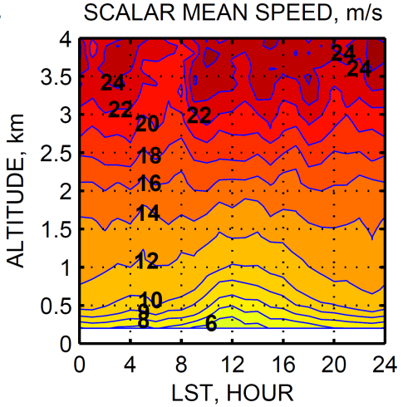
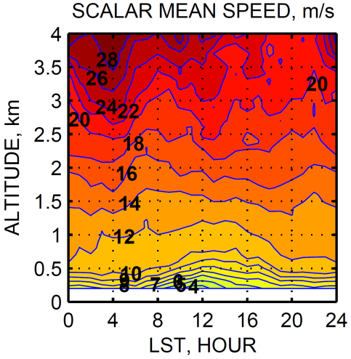
SCALAR MEAN WIND SPEED FOR DEC., JAN., FEB. MONTHS AT THREE STATIONS. LST=EST
Piney Run, MD. 763m
Beltsville, MD. 53m
Horn Point, MD. 4m
DEC.
JAN.
FEB.

Slide 12
SCALAR MEAN WIND SPEED FOR DEC. & JAN. MONTHS AT THREE STATIONS. LST=EST. ALTITUDE AGL.
December Piney Run, MD. 763m
Beltsville, MD. 53m
Horn Point, MD. 4m
January

Slide 13
CONCLUSIONS:
All our MD Wind Climatology estimates are in <http://www.atmos.umd.edu/~kostya/NIST/WIND/>.
Homogenization of wind profilers data includes interpolation of wind components U & V into standard levels above ground and temporal averaging of U & V wind components for 30-minute time intervals.
Selected Wind Statistics are: Means of wind speed (Scalar, U-zonal, V-meridional, Vectoral); Vectoral mean wind direction, Standard Deviation of wind speed. These Climatic Statistics depend on (1) Altitude, (2) Time of a day (Hour), & (3) Season (Month).
Windroses display very large variability of wind direction and this explains why vector mean wind speeds are significantly smaller compared to scalar mean wind velocities
Scalar mean wind speed increases with altitude, most dramatically in winter at night and minimally in summer at midday. This is due in part to loss of KE with the surface. Even at a minimum the change in scalar mean wind speed is 2 to 5 m/s between 200 and 2000 m.
There is a strong seasonal and daily cycle in winds aloft.
There is only a moderate trend in winds from west (Piney Run) to east (Horn Point).
In the diel cycle, there is a moderate midday mean wind speed minimum of 20-30%.
The daily cycle in winds weakens with altitude and is nearly absent by 2000 m AGL.
Wind Climatology for 2010-2014 is obtained for planning observation for evaluation of sources and sinks of greenhouse gases in the Washington-Baltimore Corridor
Below see some statistics for Low Level Jets (LLJ).

Slide 14
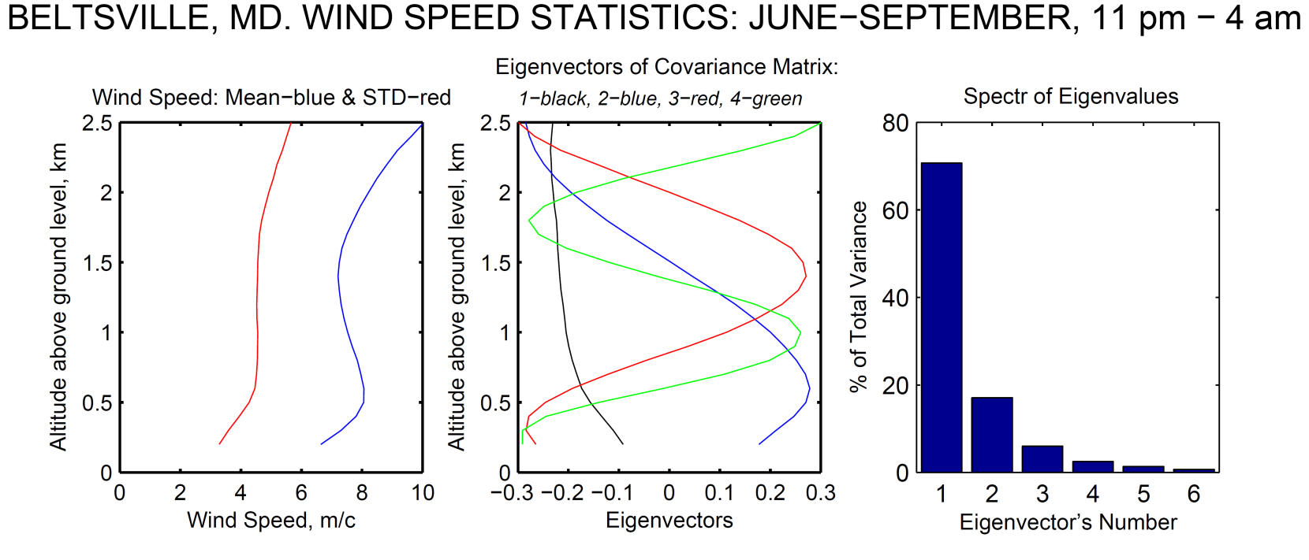
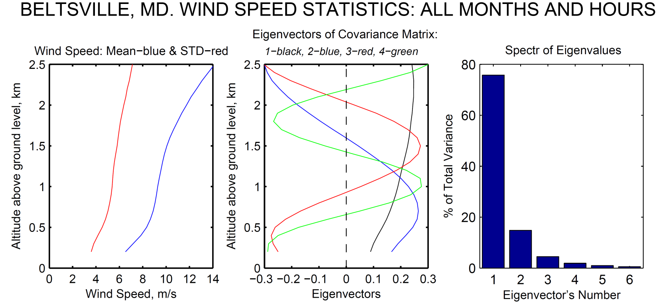
(EST)

Slide 15
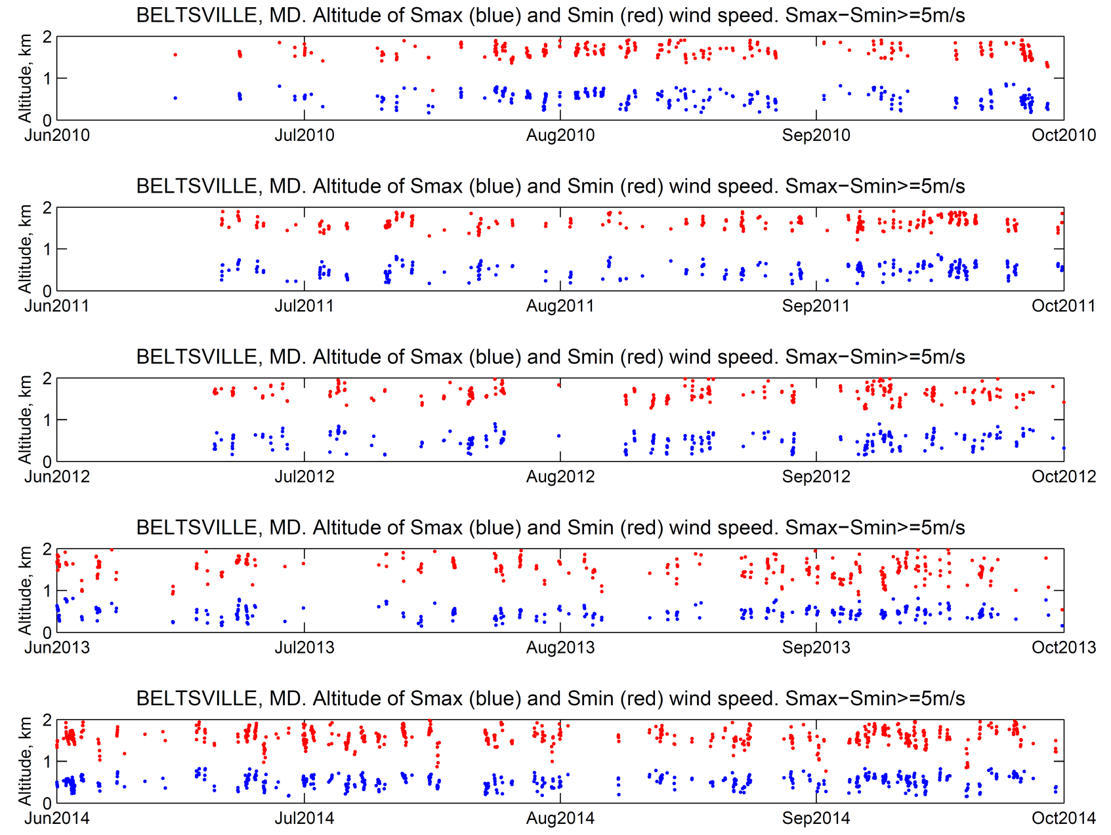
Approximate S(Z,t)= a(t)Z³+b(t)Z²+c(t)Z+d(t);
Compute altitudes Z_{1,2} for Wmax & Wmin from condition d(S,t)/dZ=0;
Find (Smax,Zmax) and (Smin,Zmin).
CRITERION OF LLJ: Zmin>Zmax & (Smax-Smin)>=5 m/s

Slide 16
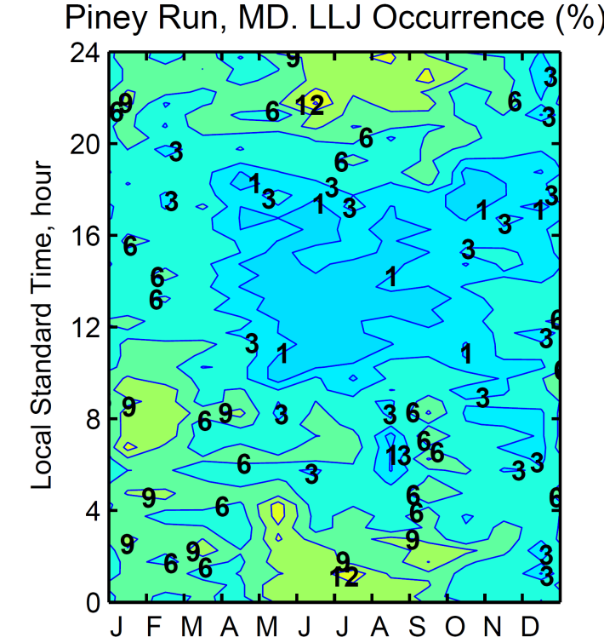
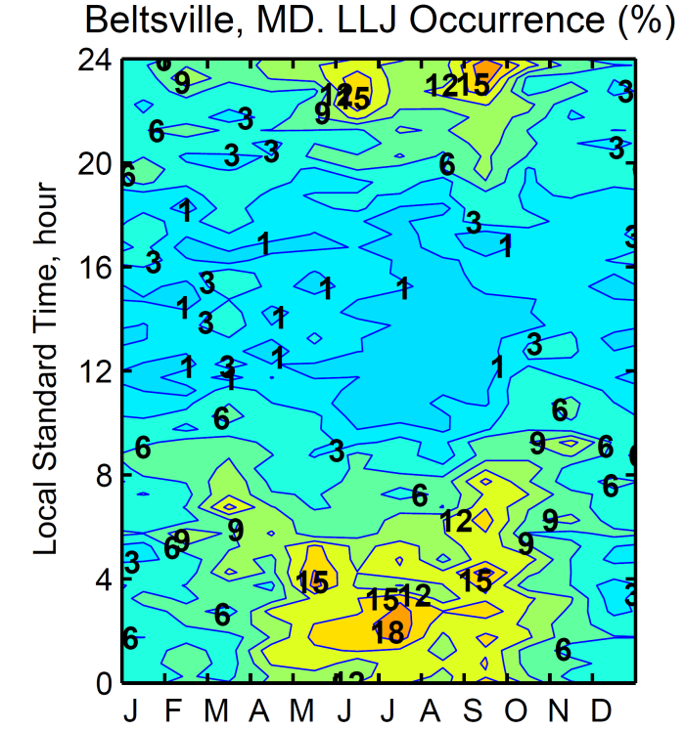
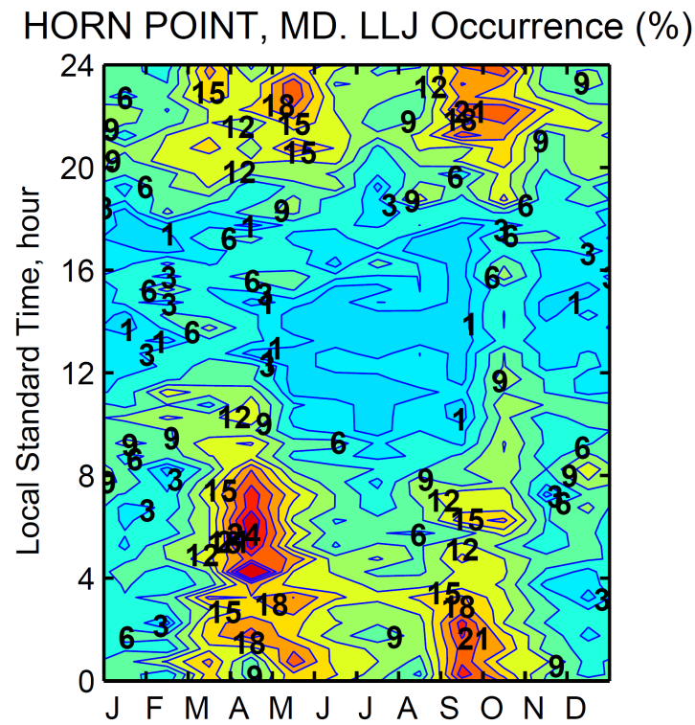
DIURNAL/SEASONAL PATTERN OF LLJ OCCURRENCE. LST=EST.
CRITERION OF LLJ: Zmin>Zmax & (Smax-Smin)>=5 m/s
The LLJ is a common, even persistent feature of nighttime flow.
The mean LLJ altitudes of wind speed maximum and minimum are
Piney Run: Zmax=0.57±0.15 km & Zmin= Zmax=1.61±0.20 km;
Beltsville: Zmax=0.54±0.15 km & Zmin= Zmax=1.60±0.19 km;
Horn Point: Zmax=0.57±0.16 km & Zmin= Zmax=1.63±0.19 km.
Altitude of LLJ AGL is very stable and does not depend on elevation of station ASL.

Slide 17
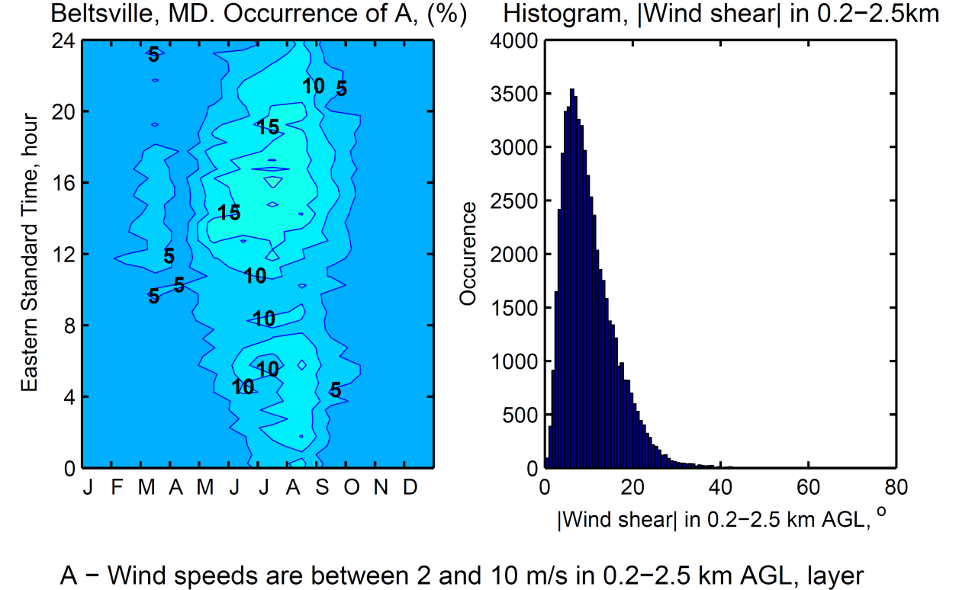
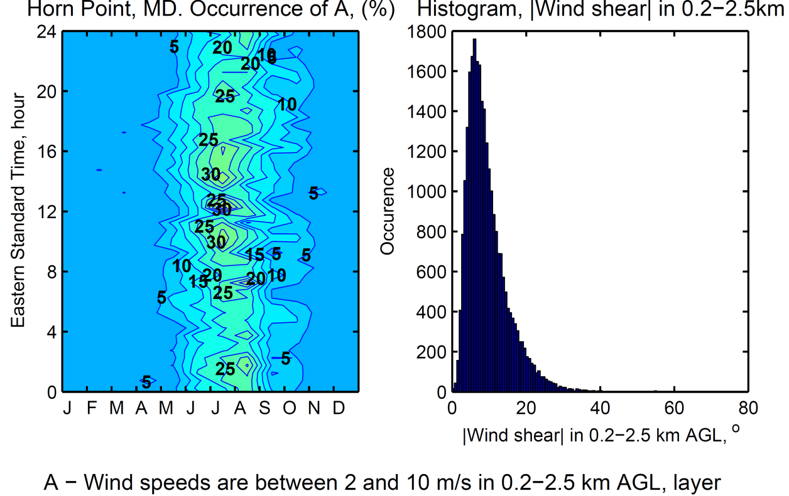
BELTSVILLE, MD
WIND STATISTICS
2010-2014
HORN POINT, MD
WIND STAISTICS
2012-2014

