Slide 1
When Did the Anthropocene Begin? Observations and Climate Model Simulations by John Kutzbach University of Wisconsin-Madison March 31, 2011
Colleagues: W. Ruddiman, S. Vavrus, G. Philippon-Berrthier

Slide 2
Main Points
Late interglacial CO₂ and CH₄ trends of previous interglacials differ from the Holocene trends. Why?
Simulations of 3 climate states with CCSM3 help describe earlier climates and explore possible feedbacks: PD=present day (NCAR control) PI =pre-industrial (Otto-Bliesner et al, J Climate, 2006) NA=no anthropogenic forcing (hypothetical GHG forcing for late interglacial conditions; Kutzbach et al, Climatic Change, 2010)
Partitioning of changes: NA – PD = (NA-PI) + (PI-PD)shows greater sensitivity of climate to increases of greenhouse gases in ‘cold climate states’

Slide 3
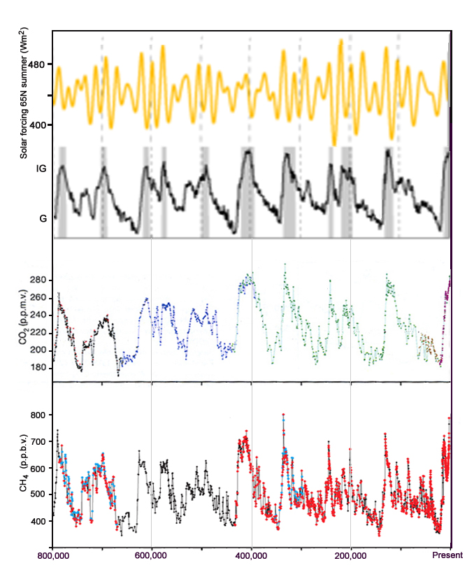
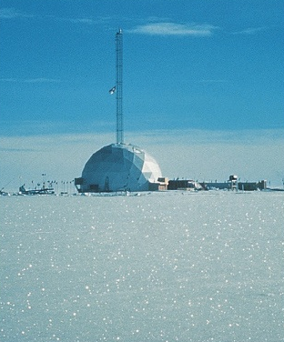
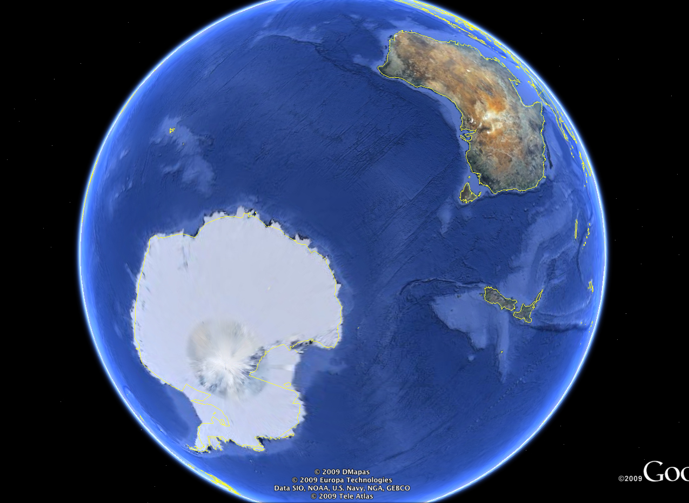
New Observations of Glacial, CO₂, and CH₄ Swings from Antarctic Ice Cores: Last 800,000 Years
Strong
Northern hemisphere summer solar radiation, 65°N
Weak
Interglacial
δ₁₈O
Glacial
Warm Earth: more CO₂ in atmosphere, less CO₂ dissolved in ocean.
CO₂
Cold Earth
Warm Earth: more wetlands, more methane in atmosphere
CH₄ (Methane)
Cold Earth

Slide 4
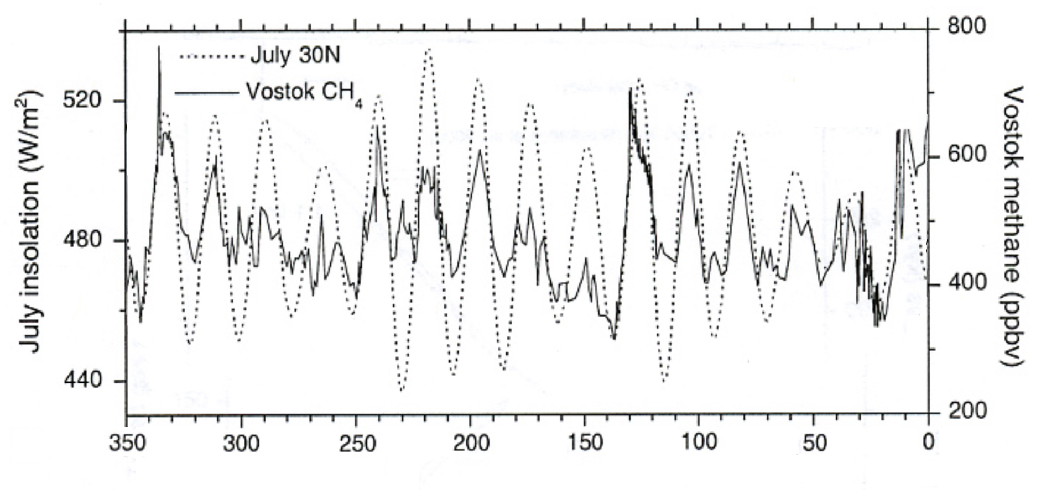
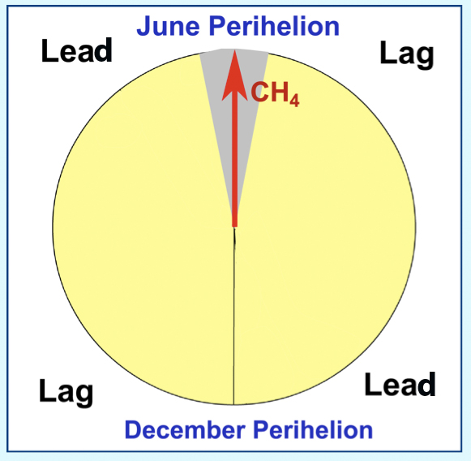
Orbital Forcing causes CH₄ changes: Antarctic ice core records of the last 350,000 Years
350,000 Year record of methane concentration from Vostock Ice Core and July insolation for 30°N - Methane concentration is index of tropical wetness
Ruddiman and Raymo, 2003

Slide 5
Insolation Trends (orbital forcing) and Greenhouse Gas Trends Composites of 7 insolation and GHG trends following 7 insolation maxima (circles)
Northern hemisphere summer, solar radiation for past 800,000 years – maxima circled
Composite of 7 solar radiation trends following insolation maxima
P_{min}
12,000 years apart

Slide 6
Insolation Trends and Greenhouse Gas Trends Composites following 7 Insolation maxima (circles)
1700 ppb
Northern hemisphere summer, solar radiation for past 800,000 years – maxima circled
CH₄
Composite of 7 solar radiation trends following insolation maxima
360 ppm
P_{min}
CO₂
P_{min}
12,000 years apart
P_{min}
Greenhouse gas trends during 7 interglacials
Notes:
JE Kutzbach, 2006
6

Slide 7
Summary of GHG Trends: Holocene trend differs from trends of 6 previous interglacials
CH₄
CO₂
Holocene (red) and composite of 6 previous interglacials (blue)
Ruddiman, 2003, 2007, 2011

Slide 8
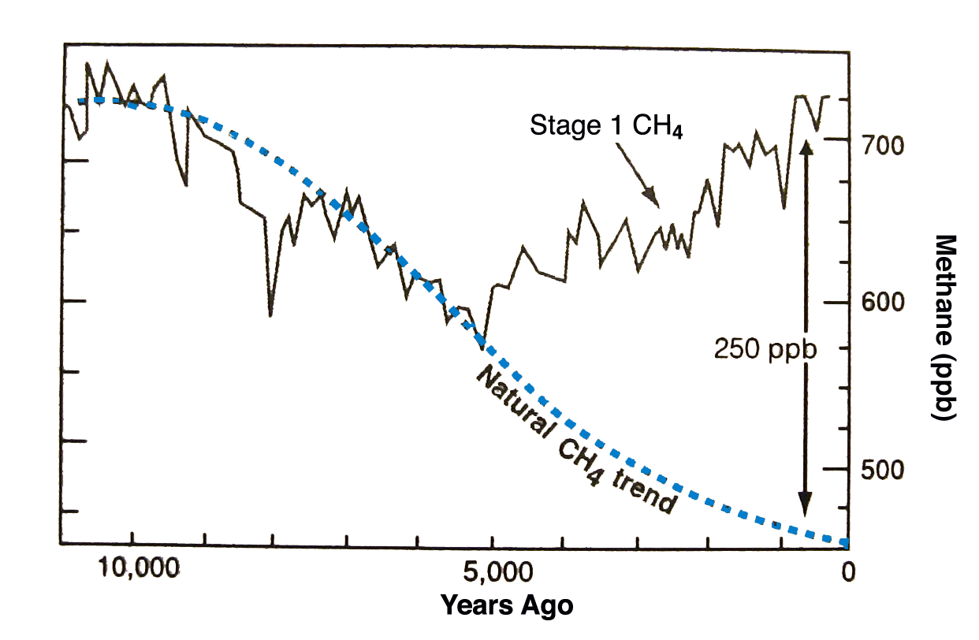
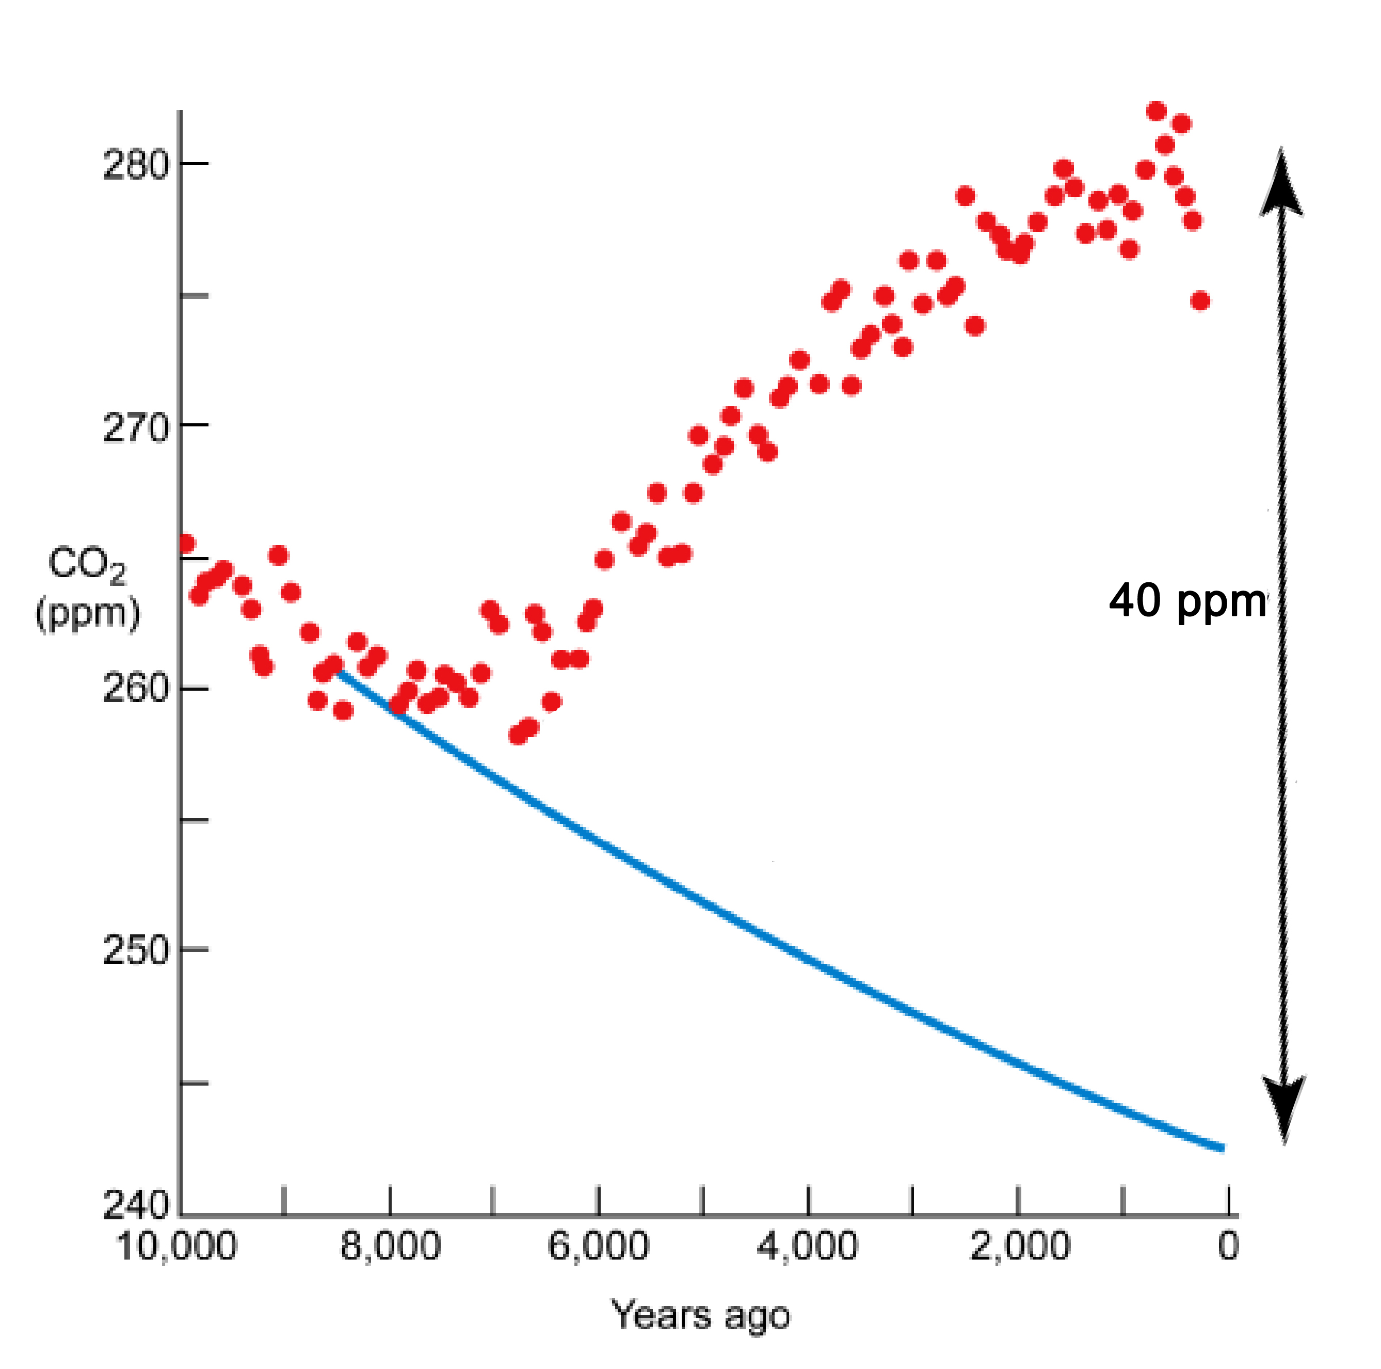
The Current Trend Differs from the Natural Trend!
1700 ppb
360 ppm
PD
PD
CH₄
CO₂
PI
Current Interglacial Trend
PI
Current Interglacial Trend
NA
Natural CO₂ trend
Bill Ruddiman
Author of “Early Anthropogenic” hypothesis
NA
Ruddiman, W. F. (2005). Plows, Plagues and Petroleum: How Humans Took Control of Climate. Princeton University Press
Ruddiman WF (2003) The anthropogenic greenhouse era began thousands of years ago. Clim. Change 61: 261-293

Slide 9
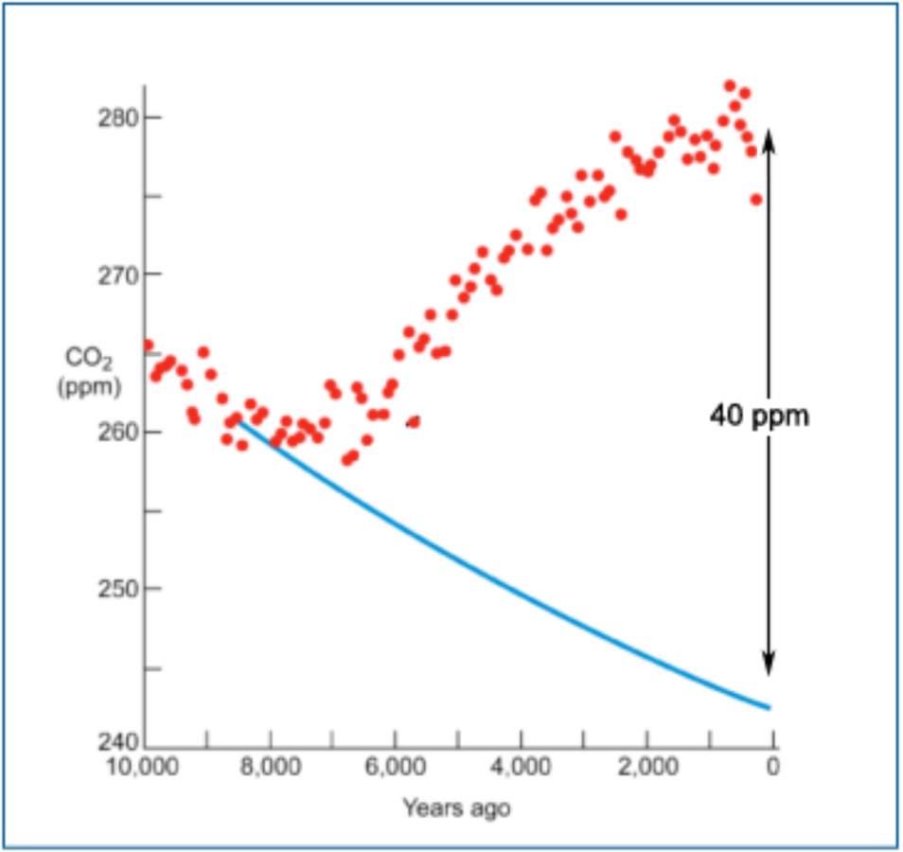
Why does the Current Trend differ from the Natural Trend? – two possibilities
PI
PI
CH₄
CO₂
NA
NA
1) Ruddiman’s hypothesis: Holocene trends are different because of early agriculture. (Ruddiman, 2003)
2) Ruddiman’s challenge: If trends are NOT due to early agriculture, then what is the natural explanation? (Ruddiman, 2007, 2011; Singarayer et al., 2010, Nature; Stocker et al., 2010, Biogeosci. Dicuss.)
(Orbital forcing is somewhat different in each case, perhaps different ice sheet sheet, ocean, and vegetation responses? Lack of detailed observations!)

Slide 10
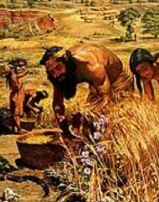
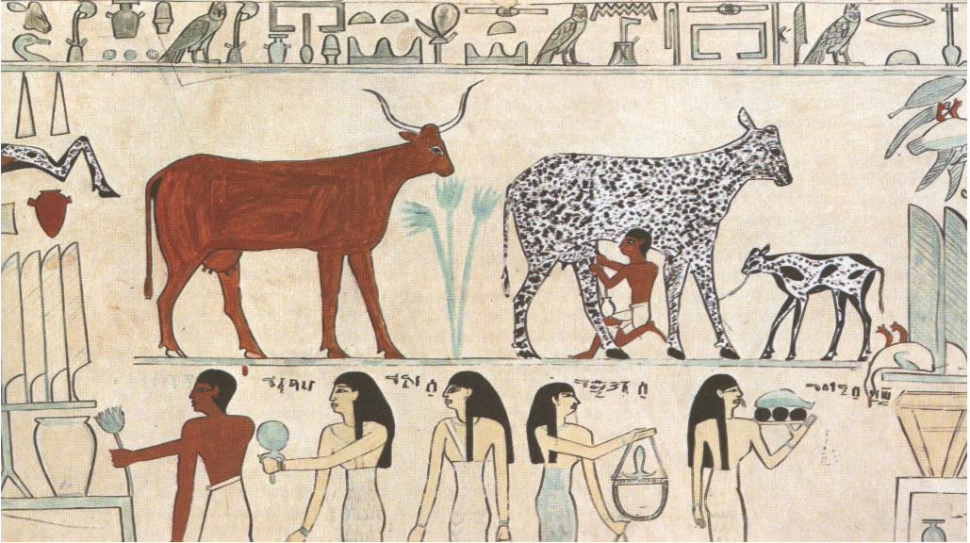
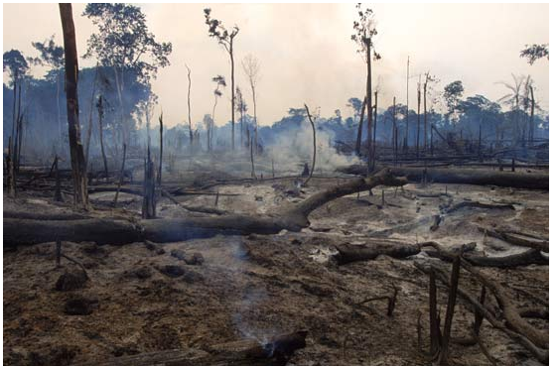
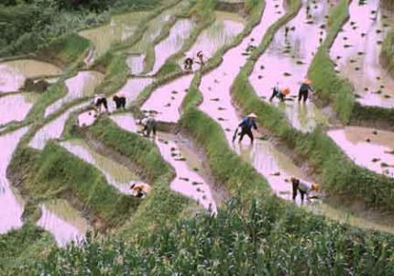
The Case for Early Agriculture
Early farming
Early domesticated animals
Forest clearance for farming
Rice paddies and rice cultivation

Slide 11
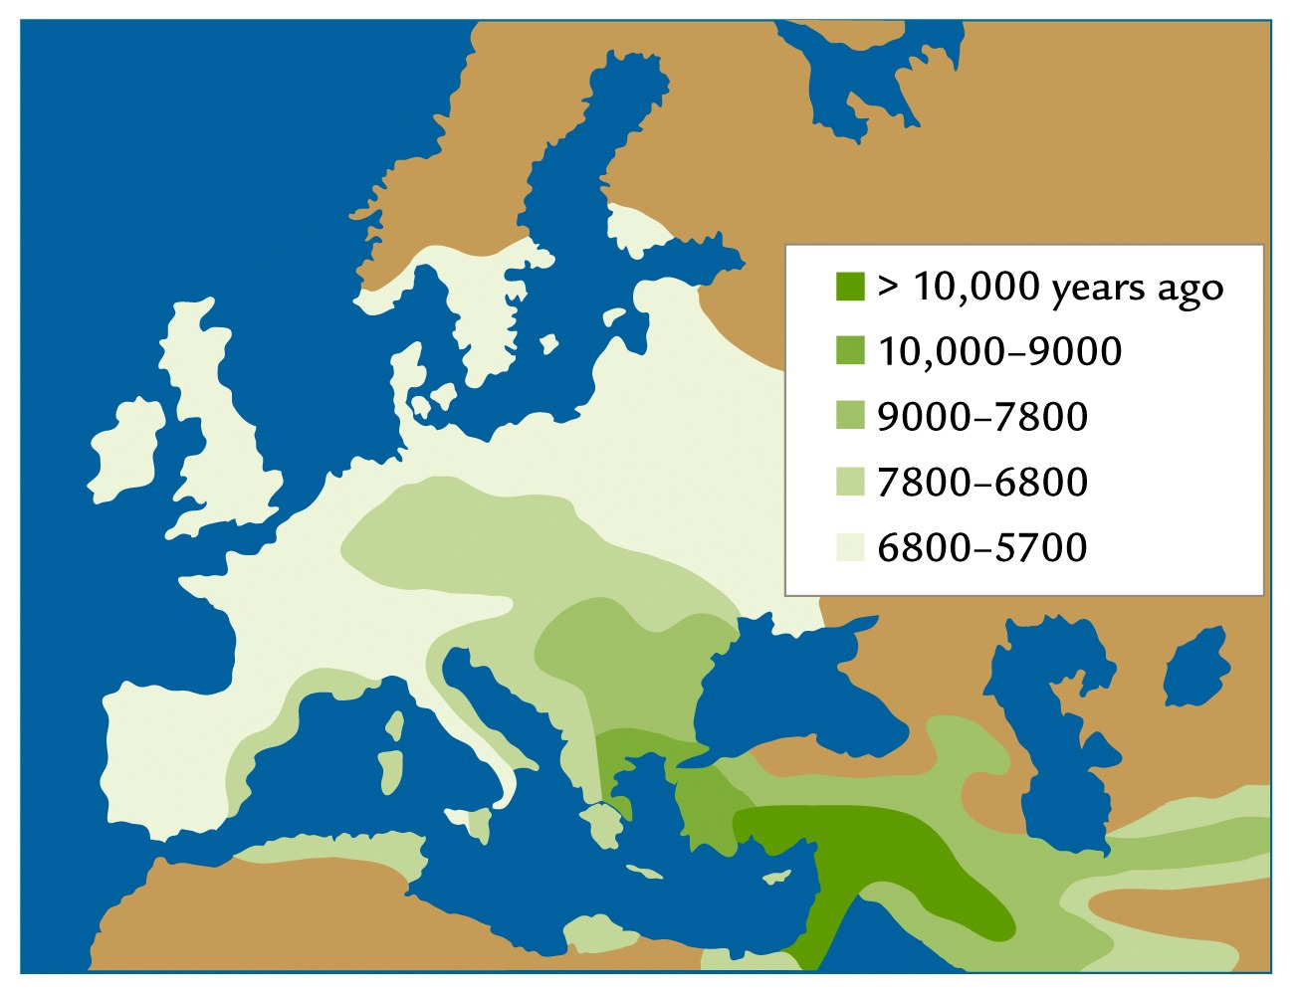
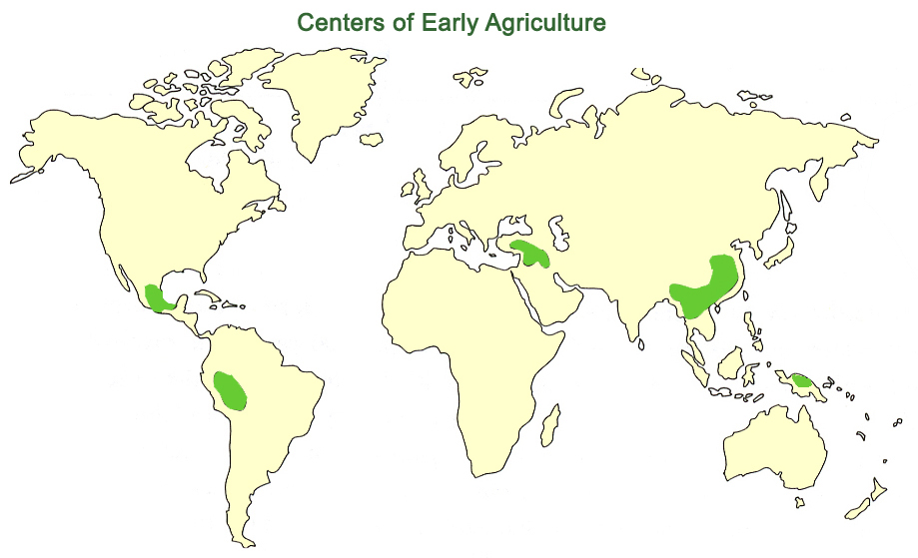
Timing of Spread of Early Agriculture agrees with timing of Holocene GHG Trends
Europe and Middle East
Centers of Early Agriculture
South Asia
Ruddiman, 2000
Li et al., 2008

Slide 12
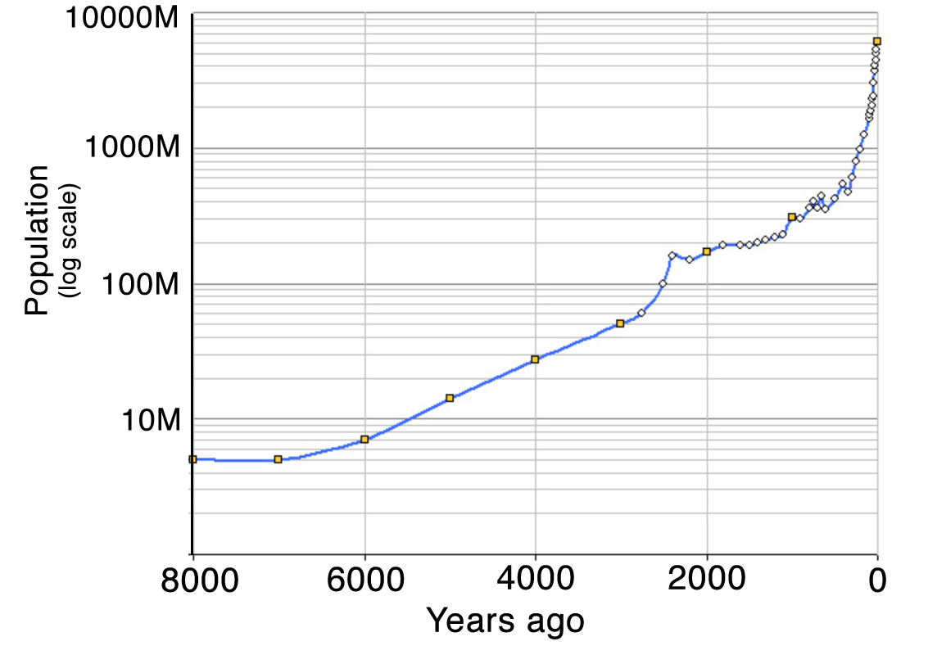
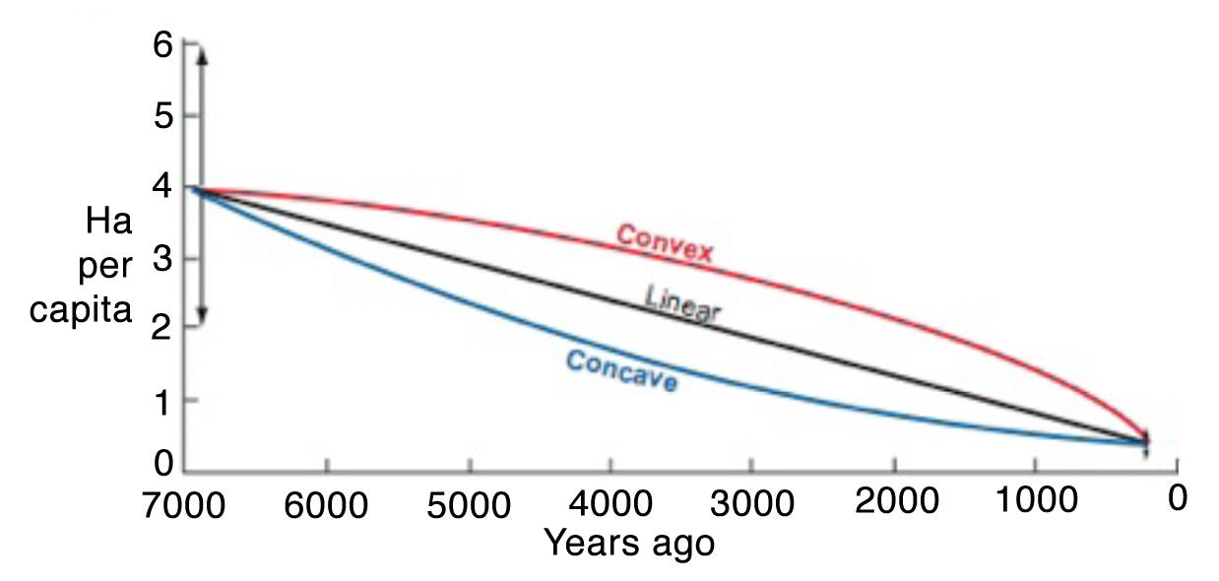
Are Land Use Changes Sufficient to Impact the Carbon Budget?
(Land use = Population X Land use/Capita)
Global land use Ellis, E, 2011
Population estimate
Land use/capita Ruddiman and Ellis, 2009
Early agriculture had a 10X larger “footprint “ than at PI
Result so far: Early agriculture could have contributed approximately 20ppm to ΔCO₂ (Kaplan et al, 2011)

Slide 13
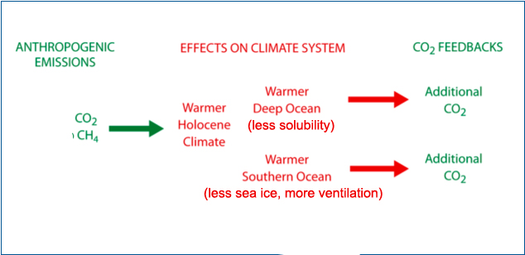
Modified Hypothesis (Ruddiman, 2007, 2011) The Holocene CO₂ trend may be a combination of direct anthropogenic emissions and internal climate feedbacks
Additional CO₂ (20ppm)
Additional CH₄ (250ppb)

Slide 14
Model Simulations (PD, PI, NA): Question – can models shed light on the kinds of feedbacks that might have amplified the climate response to early agriculture?
Use CCSM3 (Kutzbach et al, 2010, 2011)
Partition results: NA – PD = (NA – PI) + (PI – PD)
Examine changes and potential ocean feedbacks
Summary of GHG forcing changes
 | PD | PI | NA
CO₂(ppm) | 355 | 280 | 240
CH₄ (ppb) | 1714 | 760 | 450
Equiv. CO₂ (ppm) | 355 | 243* | 199*
Lowered radiative forcing (w/m²) | 0* | -2.05* | -3.06*
*referenced to PD GHG and GHG forcing
(includes reductions in N₂O, CFCs)

Slide 15
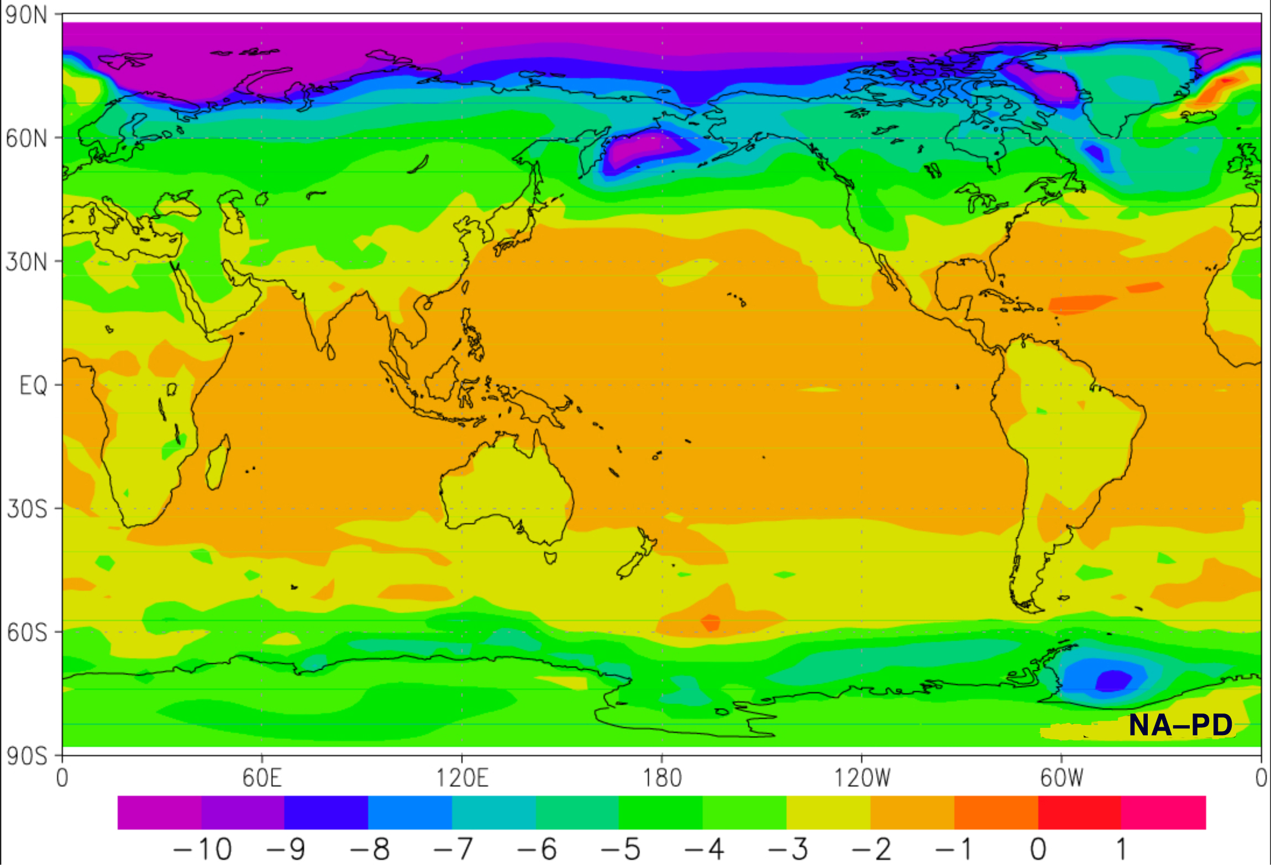
Annual Surface Temperature Difference (K), NA-PD CCSM3
ΔT_{S}(global) = –2.74K
Kutzbach et al, 2010

Slide 16
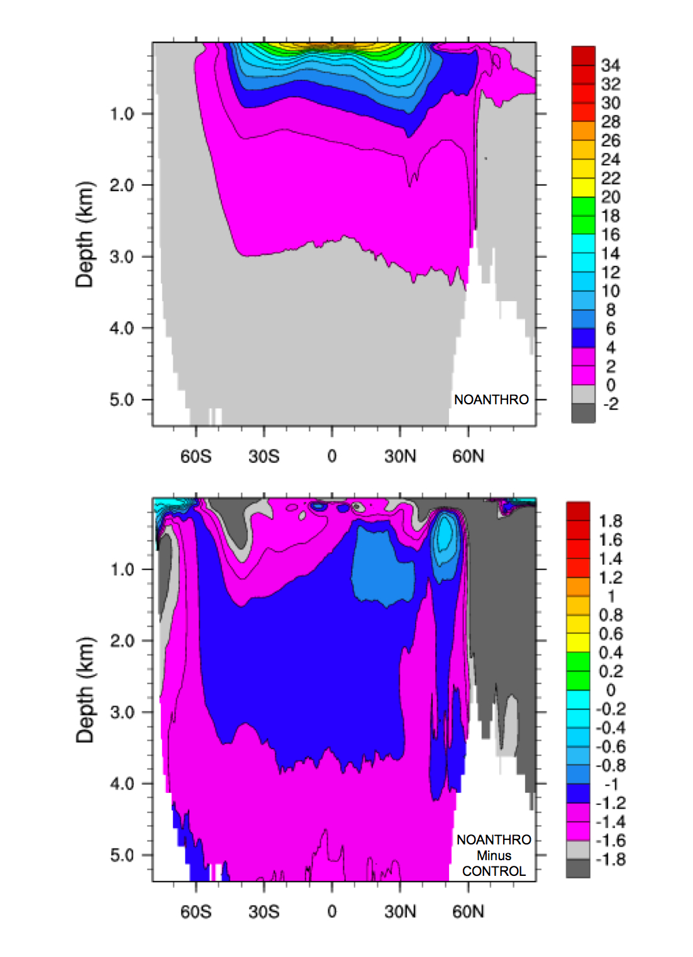
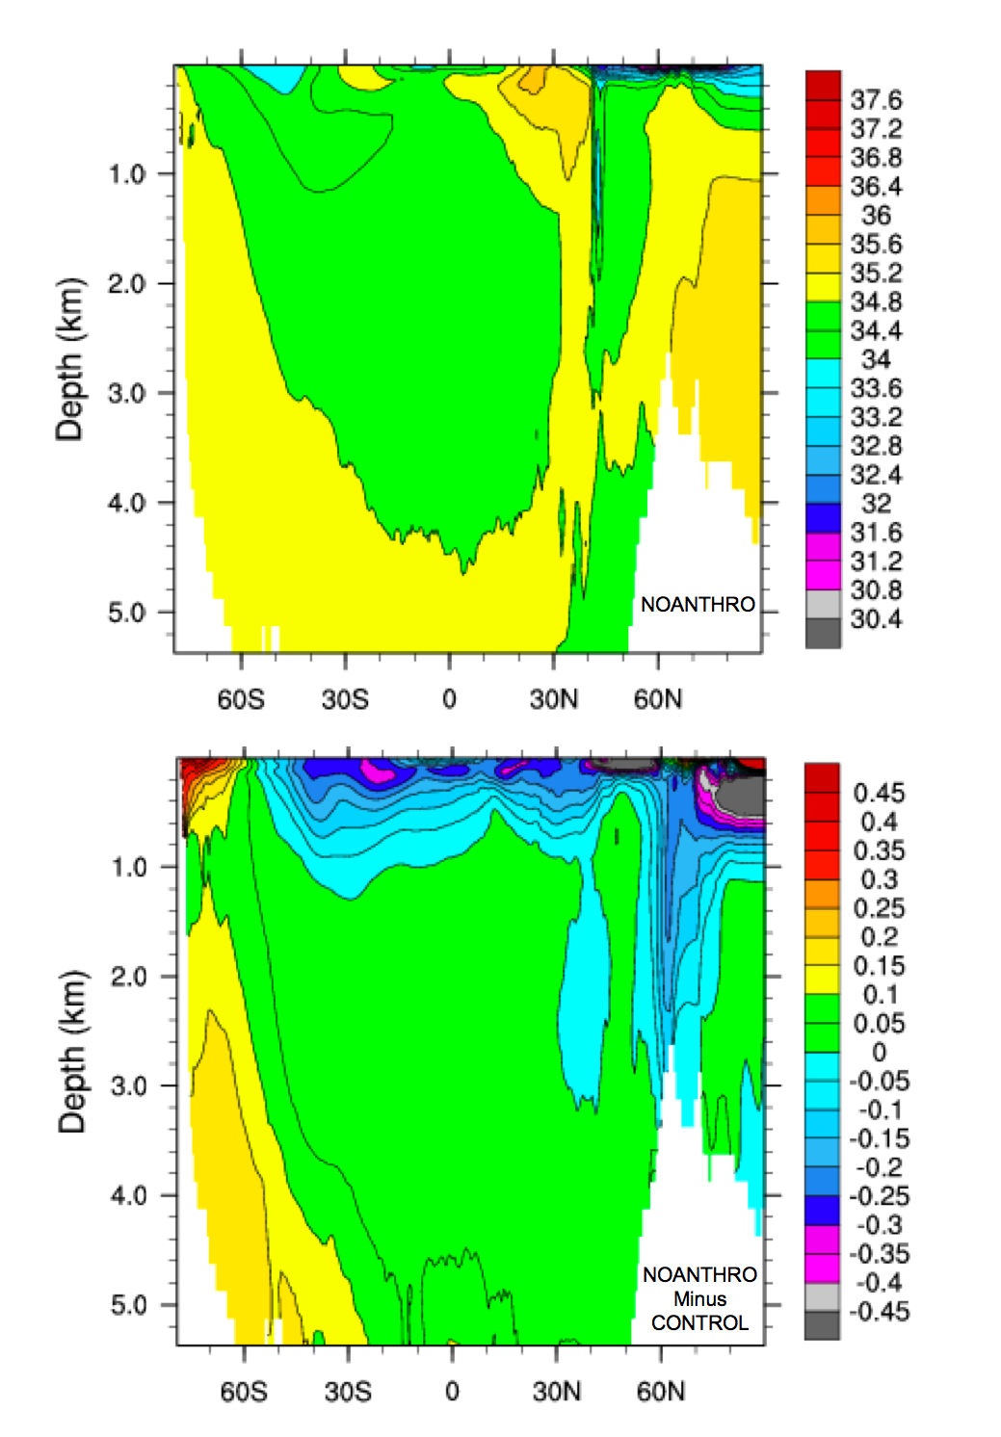
Zonal Average Ocean (latitude/depth) – CCSM3
Temperature
Salinity
NA
NA – PD
NA: colder, saltier
Kutzbach et al, 2010
Colder – greater CO₂ solubility; Saltier – more deep convection

Slide 17
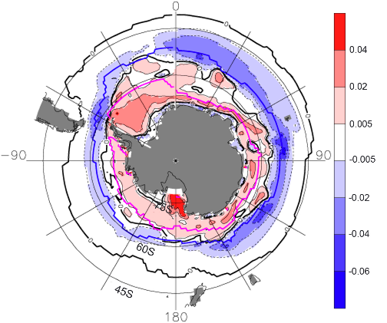
Increased SH Sea Ice Cover in Simulation NA (less ventilation)
50% Sea Ice Cover in NA; DJF (red line), JJA (blue line) Salt Flux Changes, NA – PD: increased salt flux to ocean (red), decreased (blue)
Kutzbach et al, 2010

Slide 18
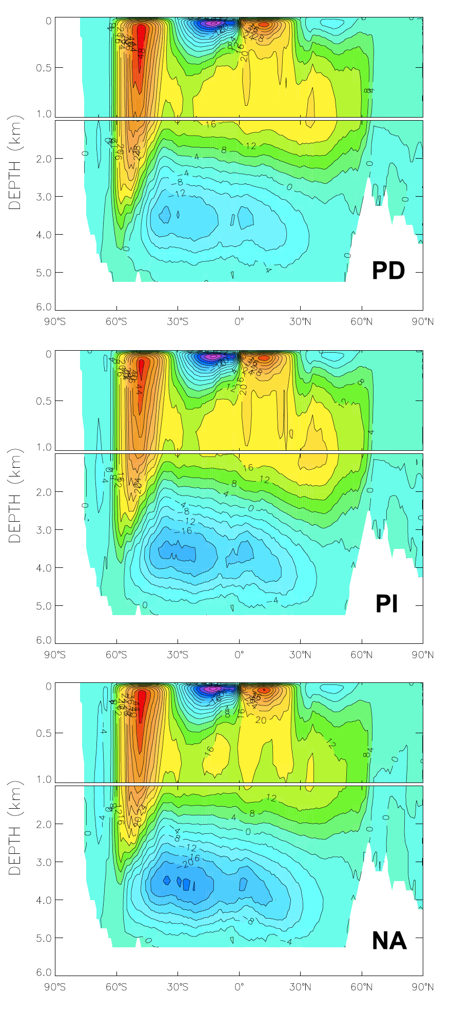
CCSM3: Zonal Average Overturning Circulation (Sv)
Stronger upwelling (stronger westerlies shifted south)
PD higher CO₂, warmer
Stronger NADW
Weaker Antarctic water sinking
Weaker AABW
Increasing greenhouse gases
Deeper extension of Deacon cell (more ventilation from deep ocean)
PI intermediate CO₂
NA lower CO₂, colder
The greater ventilation of the deep ocean as the climate warms might increase the flux of carbon dioxide to the atmosphere.
Kutzbach et al, 2011

Slide 19
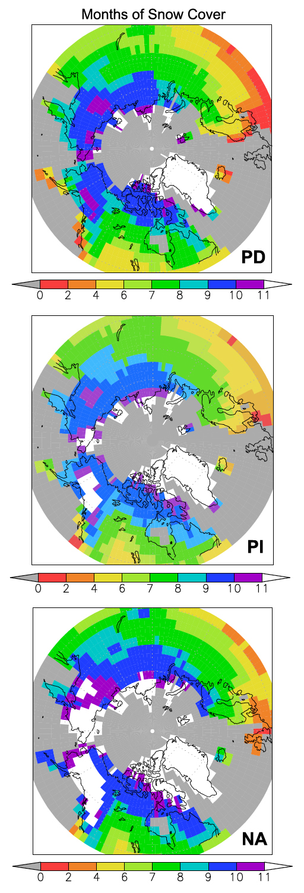
CCSM3: Months of Snow Cover (white=12 months)
PD higher CO₂, warmer
Less permanent snow cover (white)
Increasing greenhouse gases
PI intermediate CO₂
More permanent snow cover (white)
NA lower CO₂, colder
Note: white indicates year-round snow cover averaged over a grid cell, but sub-grid-scale topographic features imply non-uniform coverage within each cell
Kutzbach et al, 2011

Slide 20
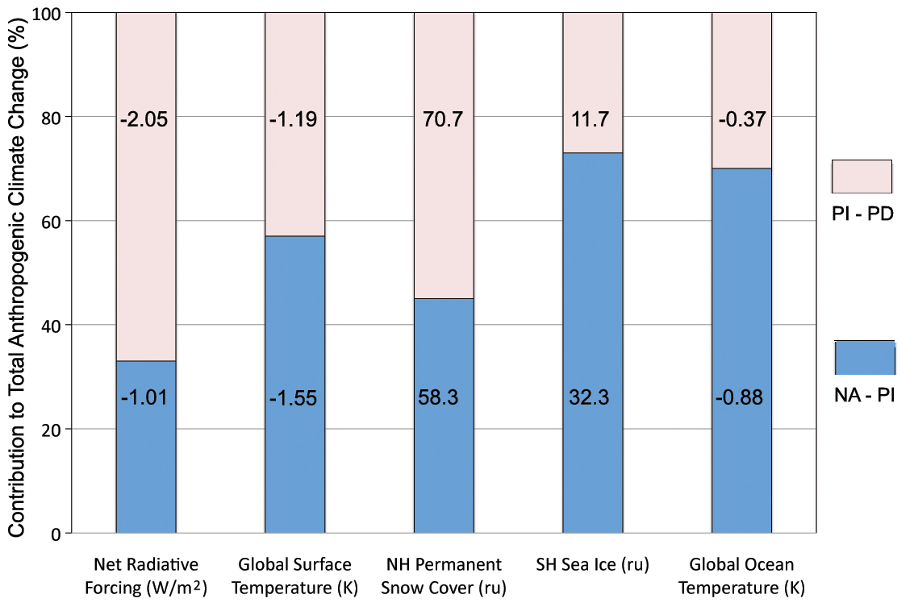
Larger Climate Response to GHG forcing for Colder Climate State: Partitioned results, (NA-PI) compared to (PI-PD)
Forcing Response
Larger climate response to GHG forcing for cold climate state
Enhanced response greater for CCSM3 than for CAM3 + SO
Agreement with limited number of observations:
ΔT_{s} , PI – PD , -.7 to -1.2K, Jones and Mann, 2004
ΔT₀ , NA –PI , -0.85K, Lisieki and Rayno, 2005
Kutzbach et al, 2011, Holocene

Slide 21
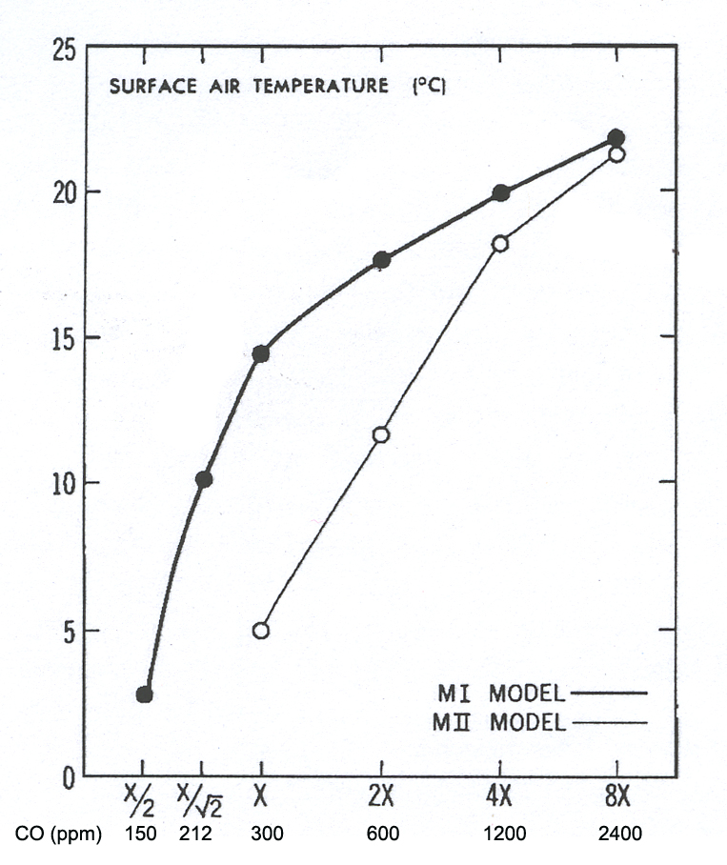
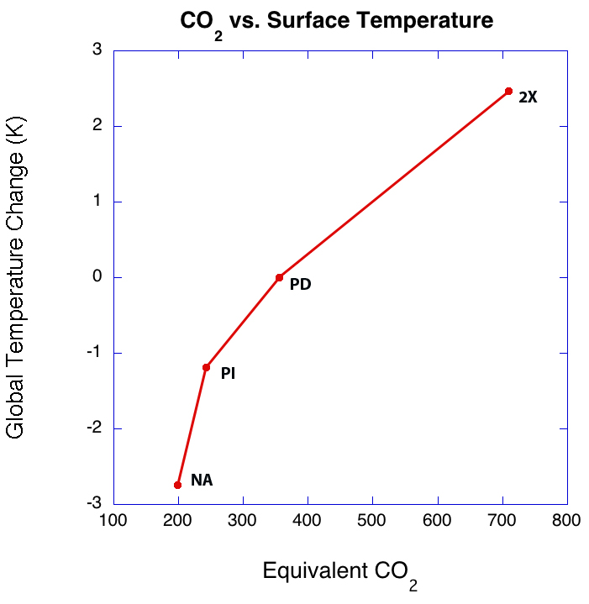
Larger Climate Response to GHG Forcing for Cold Climate States (results from two models, early GFDL model and CCSM3)
CO₂ (ppm)
Idealized land/ocean planet
M1: atmosphere – ocean model
M2: atmosphere – slab ocean model
Manabe and Bryan, 1985, JGR 90:11689-11707
CCSM3
Kutzbach et al, 2011, Holocene

Slide 22
Explaining the Difference Between Holocene CO₂ Trend and Trend of Six Previous Interglacials: Current Status!
PI
~20 ppm, direct anthropogenic effect of early agriculture – estimate based on observations (Kaplan et al, 2011)
~10 ppm, reduced ocean solubility – estimate based on CCSM3 ocean temperature increase, NA to PI, ~0.9K
~10 ppm, other ocean feedbacks (less sea ice, increased ventilation)??? – qualitative changes inferred from CCSM3 results; new experiments with ocean biogeochemistry will be needed for quantification
NA
Kutzbach et al., 2011
Ruddiman et al., 2011

Slide 23
Main points
Late interglacial CO₂ and CH₄ trends differ from Holocene trends
Early agriculture may explain the difference (and if not early ag, what?)
CCSM3 simulations (PD, PI, NA) explored climate trends/feedbacks
The partitioned changes, NA – PD = (NA-PI) + (PI-PD), show greater sensitivity of climate to greenhouse gas increases in ‘cold climate states’
There are potential ocean feedbacks from changes in solubility, sea ice, and deep ocean ventilation
The partitioned CCSM3 results are in general agreement with an earlier GFDL model study and with limited observations
Next steps: repeat experiments with CCSM4 with bio feedbacks and land use changes included; refine estimates of early agriculture impacts

