Slide 1
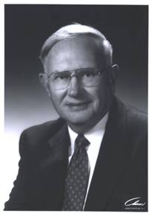
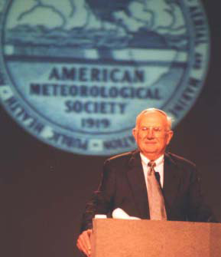
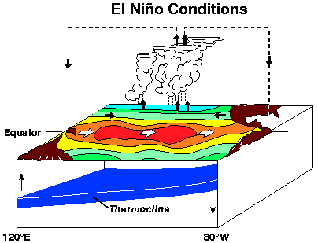
The Eugene Rasmusson
Lectures Fund
University of Maryland has established The Eugene Rasmusson Lectures Fund to support this annual lecture series. Your charitable contribution can be made at http://www.atmos.umd.edu/Rasmusson/ and is gratefully acknowledged.
Alternatively, checks can be mailed to
Rasmusson Lectures Fund (Attn: June Sherer)
Department of Atmospheric & Oceanic Science
3407 Computer & Space Science Bldg.
University of Maryland
College Park, MD 20742-2425
2011
Rasmusson Lecturer
Prof. John E. Kutzbach
University of Wisconsin, Madison
Member, NAS
Eugene Rasmusson
Lectures
Room 2400
Computer & Space Science Bldg.
Stadium Drive, University of Maryland
College Park, MD 20742
(301) 405 5391
31 March (Thursday), 2011
Lecture: 6:00pm
Reception: 5:00pm Auditorium (Rm 2400), CSS Bldg.
Gene addressing the 1998 annual meeting of the American Meteorological Society as President

Slide 2
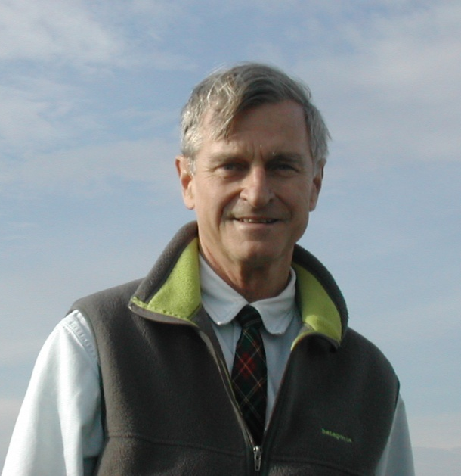
Eugene Rasmusson
Lectures
The Department of Atmospheric & Oceanic Science has launched these annual lectures to honor Emeritus Research Professor Eugene M. Rasmusson who joined the department in May 1986. Gene is known for his seminal analysis of the atmospheric hydrologic cycle, an effort begun during his doctoral studies at MIT under Victor Starr. Gene is, however, most well known for his observational description of ENSO. His characterization of the ocean-atmosphere state in the nascent, mature, and decaying ENSO phases fostered theoretical and numerical modeling of ENSO.
Gene has been honored with the Victor Starr lectureship at MIT, the George Benton lectureship at Johns Hopkins, and the Robert Horton lectureship at the American Meteorological Society. Gene received the Jule Charney award from the AMS in 1989. Gene is a member of the National Academy of Engineering, and an associate of the National Academy of Sciences.
Gene's community leadership (as AMS President) and scientific leadership at the National Research Council (including as CRC Chair) and NOAA has advanced climate monitoring, analysis, and prediction activities. The American Meteorological Society honored Gene with a named symposium in 2007.
2011
Rasmusson Lecturer
Prof. John E. Kutzbach
When did the Anthropocene begin? Observations and climate model simulations
Abstract:
The accelerating industrial revolution around 1800-1850 marked a major event in the role of humans in modifying earth’s climate through rising concentrations of greenhouse gases (GHGs). Ruddiman (2003) proposed that the early agricultural revolution (forest clearance, rice cultivation) caused discernible increases in GHGs beginning more than 5000 years ago.
The talk will review observational studies and then describe three climate model simulations made with the NCAR CCSM3 -- a coupled atmosphere-ocean model: the present-day climate, the pre-industrial climate, and a hypothetical (inferred) climate – termed Non-Anthropogenic which has the low GHG levels that occurred in the late stages of previous interglacials.
We find the expected trend toward colder climate as the GHG radiative forcing decreases. The simulated climates are in the ballpark of some of the limited observations, and indicate that changes in ocean CO₂ solubility, sea-ice cover, and deep ocean ventilation may have contributed to further increases in late Holocene atmospheric CO₂ – increases beyond those attributed to early agriculture alone (positive feedbacks).
Bascom-Plaenert Professor of Liberal Arts
Professor Emeritus, Atmos. & Oceanic Sci. University of Wisconsin, Madison
Member, National Academy of Sciences
31 March (Thursday), 2011
Lecture: 6:00pm; Reception: 5:00pm Auditorium (Rm 2400), CSS Bldg.

Slide 3
Eugene Rasmusson

