Slide 1




Methane Emissions from Marcellus Shale Natural Gas Operations: Results from Summer 2015 Aircraft Observations
Xinrong Ren, Dolly Hall, Timothy Vinciguerra, Sayantan Sahu, Hao He, Sheryl Ehrman, and Russell Dickerson

Slide 2
Motivation
Quantification of methane (CH₄) emissions from oil and gas operations is important for establishing scientifically sound and cost-effective policies for mitigating greenhouse gases (GHGs).
Discrepancies between observation-based (top-down) and inventory-based (bottom-up) CH₄ emissions suggests more observations are needed.

Slide 3
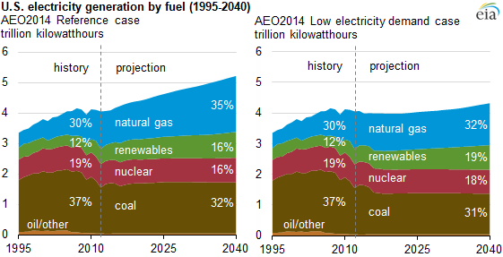
Motivation
Changing from coal to gas: less CO₂ emissions.
But CH₄ is 25 times more potent than CO₂ over a 100 year time horizon
In order to see the climate benefit of changing from coal to natural gas, the methane leak rate must be kept below3.2% [Alvarez et al., 2012].
Source: EIA

Slide 4
CH₄ Leakage from NG Production
Leakage as % of production | Region | Method | Reference
1.40% | Pennsylvania and West Virginia | Ground facility-level source sampling | [Omara et al., 2016]
0.18 – 0.41% | Northeast Pennsylvania | Aircraft sampling-based mass balance | [Peischl et al., 2015]
2.8 – 17.3% | southwest Pennsylvania | Aircraft sampling-based mass balance | [Caulton et al., 2014]
6.2% – 11.7% | Uintah, UT | Aircraft sampling-based mass balance | [Karion et al., 2013]
12% | Los Angeles Basin, CA | Aircraft CalNex field measurements, emissions inventory estimates | [Peischl et al., 2013]
3.6%-7.9% | US national | Estimates based on emission estimates from EPA and GAO reports | [Howarth et al., 2011]
2.3-7.7% | Northeastern Colorado | Ground level ambient tall tower and mobile sampling | [Petron et al., 2012]
1.42% | US national | Source sampling | [Kirchgessner et al., 1997]
0.42% | US National | Source sampling and national emission inventory estimates | [Allen et al., 2013]

Slide 5
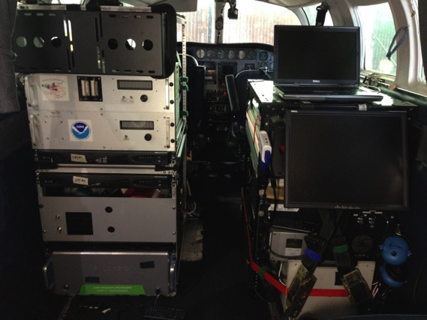
UMD Cessna 402B Research Aircraft
GPS Position (Lat, Long, Altitude)
Met (T, RH, P, wind speed/direction)
Trace gases:
O₃: UV Absorption, modified TECO
SO₂: Pulsed Fluorescence, modified TECO
CH₄/CO₂/CO/H₂O: Cavity Ringdown, Picarro
NO₂: Cavity Ring Down, Los Gatos
NO: Chemiluminescence, modified TECO
VOCs: grab canisters/GC-FID
Aerosol Optical Properties:
Scattering: b_{scat} (@450, 550, 700 nm), Nephelometer
Absorption: b_{ap} (565 nm), PSAP
Black Carbon: Aethalometer
Gas Inlet
Aerosol Inlet
Met Sensors

Slide 6
Marcellus Shall NG production and Area Surveyed
CH₄ production in September 2015
(thousand CF)
Latitude (°)
Prevailing
wind
Production data are from WV DEP (http://www.dep.wv.gov), PA DEP (www.paoilandgasreporting.state.pa.us ) and OH DNR (http://oilandgas.ohiodnr.gov/production)
Longitude (°)

Slide 7
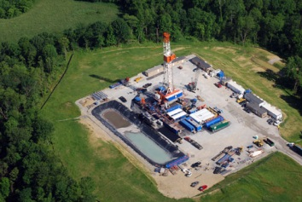
Estimation of CO₂, CH₄ and CO Fluxes
Mass Balance Experiment (MBE) approach:
Flux
[C] : concentrations (downwind)
[C]_{b} : concentration in background
U⊥ : perpendicular wind speed
wind
∆z
O&NG
operations
Background
[CH₄]
O&NG
[CH₄]
Background
∆x
∆y

Slide 8
CH₄ along Flight Track
8/25/2016

Slide 9
Time Series of Altitude, CH₄ and WD
8/25/2016

Slide 10
Time Series of Altitude, CH₄ and WD
8/25/2016
Mixing layer top

Slide 11
Total CH₄ Emissions
Flight Date | [CH₄]_{upwind} (ppbv) | [CH₄]_{downwind} (ppbv) | WS (m/s) | WD (deg) | PBL Height (m AGL) | CH₄ flux* (mol/s)
8/25/2015 | 1,967±22 | 2,024±78 | 8.5±1.4 | 251±11 | 2,250±200 | 4,036
8/29/2015 | 2,130±116 | 2,202±140 | 6.6±1.4 | 250±25 | 2,000±200 | 5,245
9/14/2015 | 1,960±28 | 2,018±39 | 9.4±1.2 | 282±12 | 1,500±200 | 3,201

Slide 12
CH₄ Loss Rate Estimate
Flight Date | Observed CH₄ flux (moles/s) | Other CH₄ emissions GHGRP (moles/s) | NG prod (moles/s) | CH₄ loss Obs
8/25/2015 | 4,036 | 1,395 | 80,900 | 3.8%
8/29/2015 | 5,245 | 1,395 | 80,900 | 5.5%
9/14/2015 | 3,201 | 1,395 | 81,100 | 2.6%

Slide 13
CH₄ Flux and Compared to Literature

Slide 14
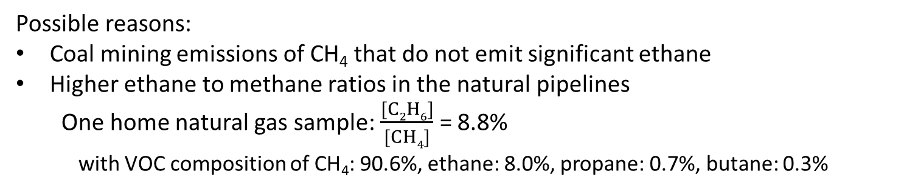
Ethane to CH₄ ratio (slope)
Areas of Oil & NG Operations
Baltimore-DC Area
Possible reasons:
Coal mining emissions of CH₄ that do not emit significant ethane
Higher ethane to methane ratios in the natural pipelines
  One home natural gas sample: $\frac{[C2H6]}{[CH4]}$ = 8.8%
  with VOC composition of CH₄: 90.6%, ethane: 8.0%, propane: 0.7%, butane: 0.3%

Slide 15
Summary
The averaged CH₄ flux from a 110x120 km area in the Marcellus Shale region in SW PA and Northern WV was estimated to be 4,160±1,030 moles s⁻¹.
CH₄_flux/NG_production = 4.7±1.8%.
The observed ethane/CH₄ = 2.4%, agrees with the USGS ethane/CH₄ composition ratio (2.3%) of for this region, but is smaller than what (3.3%) was obtained in the DC-Baltimore area in winter 2015.
Ongoing Work
Updated NEI CH₄ emissions (2014)
To obtain other CH₄ sources in the surveyed area to derive a more accurate CH₄ leak rate from O&NG operations.

