Slide 1






Greenhouse and Other Trace Gases from the Baltimore-Washington Area:
Results from the WINTER 2015 Aircraft Observations
FLAGG-MD
Fluxes of Greenhouse Gases in Maryland
Xinrong Ren, Sayantan Sahu, Dolly Hall, Courtney Grimm, Hao He, Doyeon Ahn, Ross Salawitch and Russell Dickerson
Dept. of Atmos. & Oceanic Sci., University of Maryland
Olivia Salmon, Alexie Heimburger, and Paul Shepson
Dept. of Chemistry, Purdue University

Slide 2
Motivation
Urban greenhouse gas (GHG) emissions contribute to the majority (~70%) of the anthropogenic GHG emissions.
Quantification of urban greenhouse gas (GHG) emissions is important for establishing scientifically sound and cost-effective policies for mitigating GHGs.
Discrepancies between observations and model simulations of GHGs suggests uncharacterized sources in urban environments.
Notes:
In this work, we quantified CO₂, CH₄, and CO emissions from the Baltimore-Washington Area using the mass balance approach from several flight experiments conducted in February 2015.

Slide 3
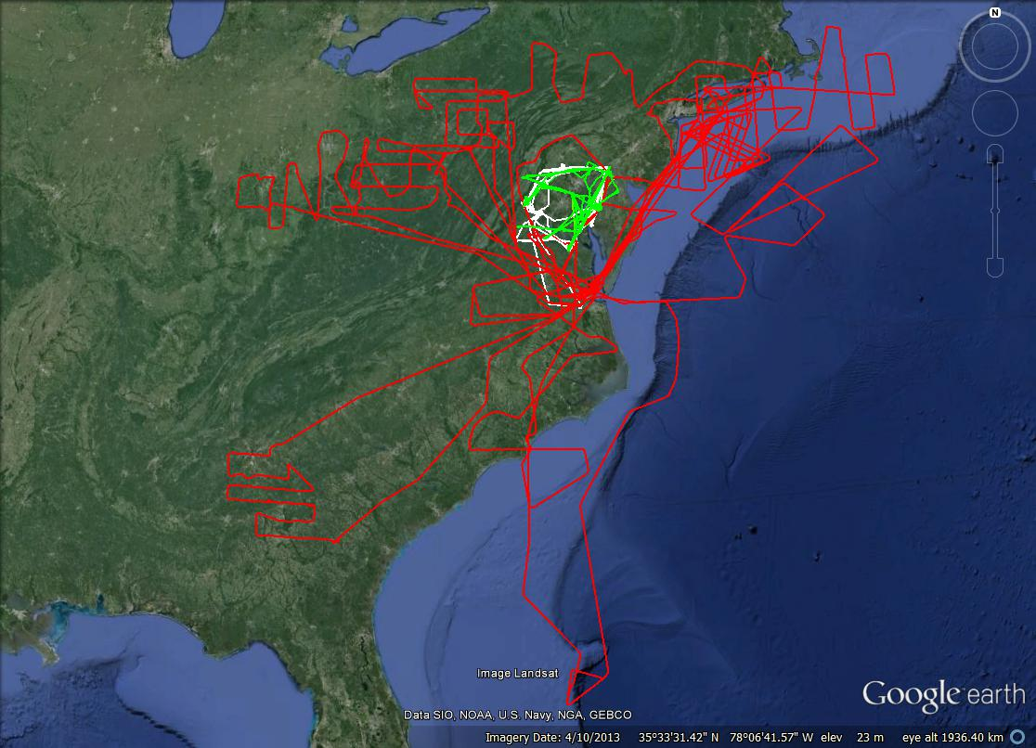
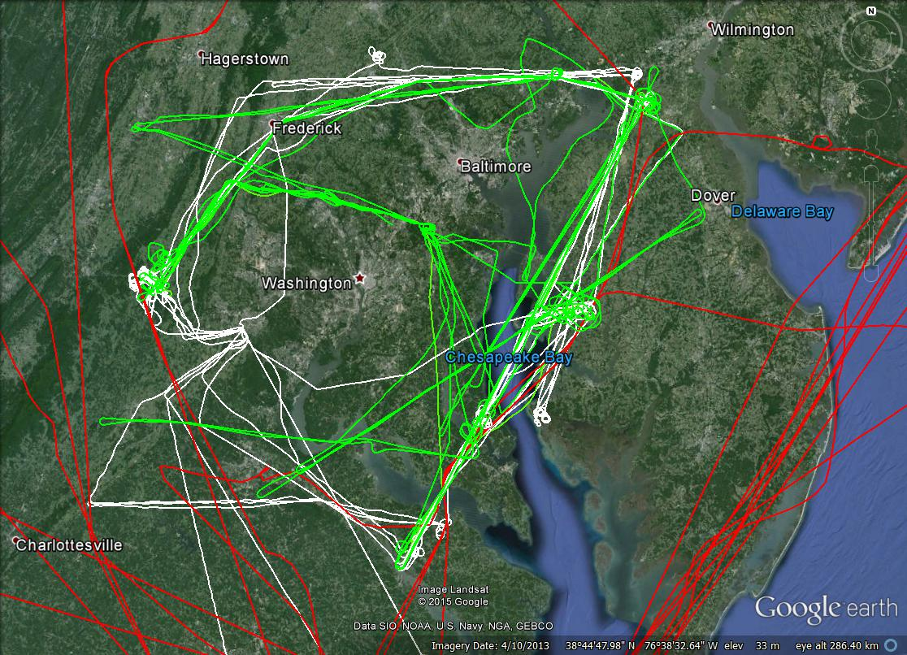
WINTER Campaign Flight Area
C-130
Cessna
Duchess
Where: the Baltimore-Washington Metropolitan Area
When: UMD Cessna: 2/6 – 2/26, 2015
  Purdue Duchess: 2/16-3/12, 2015
What: aircraft observations of GHGs, other trace gas, and aerosol scattering & absorption.

Slide 4
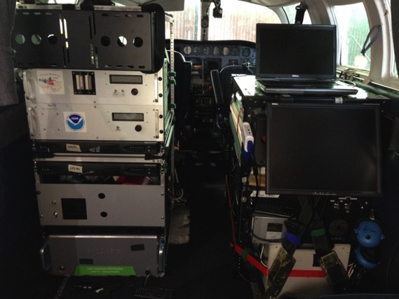
UMD Cessna 402B Research Aircraft
GPS Position (Lat, Long, Altitude)
Met (T, RH, P, wind speed/direction)
Trace gases:
O₃: UV Absorption, modified TECO
SO₂: Pulsed Fluorescence, modified TECO
CH₄/CO₂/CO/H₂O: Cavity Ringdown, Picarro
NO₂: Cavity Ring Down, Los Gatos
NO: Chemiluminescence, modified TECO
VOCs: grab canisters/GC-FID
Aerosol Optical Properties:
Scattering: b_{scat} (@450, 550, 700 nm), Nephelometer
Absorption: b_{ap} (565 nm), PSAP
Black Carbon: Aethalometer
Gas Inlet
Aerosol Inlet
Met Sensors

Slide 5
CO₂ along the Flight Track on 2/20/15
wind
Baltimore
Dickerson
Brandon Shores
Washington
Chalk Point
Morgantown
Power plant plumes clearly observed along the downwind transects.

Slide 6
CO₂ on 2 downwind transects along the latitude
Chalk Point
Morgantown
Brandon Shores
DC
plume
Baltimore
plume

Slide 7
CH₄ along flight track
wind
Brown
Station
Landfill
Significant CH4 emissions from Brown Station Landfill.
High CH₄ levels aloft along SW of the upwind leg: CH₄ emissions from fracking?

Slide 8
CH₄ on 2 downwind transects along the latitude
DC
plume
Baltimore
plume
Much larger CH₄ enhancement in the DC plume than in the Baltimore plume.

Slide 9

Estimation of CO₂, CH₄ and CO Fluxes
Mass Balance Experiment (MBE) approach:
Flux
E. R. : emission rate (flux)
[C] : concentrations (downwind)
[C]_{b} : concentration in background
U⊥ : perpendicular wind speed
∆z
Background
CO₂, CH₄, CO
Urban
CO₂, CH₄, CO
∆x
Background

Slide 10
Emissions of CO₂, CH₄ and CO from Baltimore-DC
CO₂: ~150 million tons/yr
Note: (1) Estimated CH₄ emissions from Brown Station Landfill: 73 ± 19 moles s⁻¹
(2) The population in the Balt–DC area is close to 10 million.
(3) In 2011, CO₂ emission per capita in MD is ~11 tons/yr.

Slide 11
VOC Canister Sample of Ethane
Ethane versus methane: the ethane-to-methane ratio (slope) could potentially be used for identification and quantification of methane sources.
Limited canister samples show an ethane-to-methane ratio (i.e., slope) of 3.3%.

Slide 12
CH₄ Emissions from Brown Station Landfill
wind
Brown Statin Landfill
Flight # CH₄ Emission Rate (moles s⁻¹)
RF1 57.4
RF2 68.1
RF4 105.9
RF5 83.8
RF6 65.3
RF8 56.2
-----------------------------------
Mean 72.8 ± 19.0
~11% of the total CH₄ emissions (670 moles s⁻¹) from the Balt-DC area.
E. R. : emission rate (flux)
[C] : concentrations (downwind)
[C]_{b} : concentration in background
U⊥ : perpendicular wind speed

Slide 13
CO₂ along the Flight Track on 2/20/15
wind
Brandon Shores
Dickerson
Chalk Point
Morgantown
Power plant plumes were clearly observed along the downwind transects.

Slide 14
Emissions from Chalk Point Power Plant
Reasonable agreement between the CEM emission rates and the emission rates derived from the aircraft observations.
Differences may be explained uncertainties in the CEM and obs.

Slide 15
Emission Ratios from Chalk Point Power Plant
Low enhancement of [SO₂] (mostly ~1-2 ppb) causes high uncertainty in the SO₂ emission rate estimation using the aircraft observations.

Slide 16
Summary
Estimated emissions from the Baltimore-Washington area:
F(CO₂): 110,000±20,000 moles s⁻¹ (or ~150 M tons/yr)
  F(CH₄): 700±330 moles s⁻¹
  F(CO): 540±188 moles s⁻¹
CH₄ emissions from Brown Station Landfill account for ~10% of total CH₄ emissions from the entire Baltimore-Washington area.
Limited VOC data show an ethane to methane ratio of 3.3%.
Good agreement between the CEM emissions and the emissions derived from aircraft observations.

Slide 17
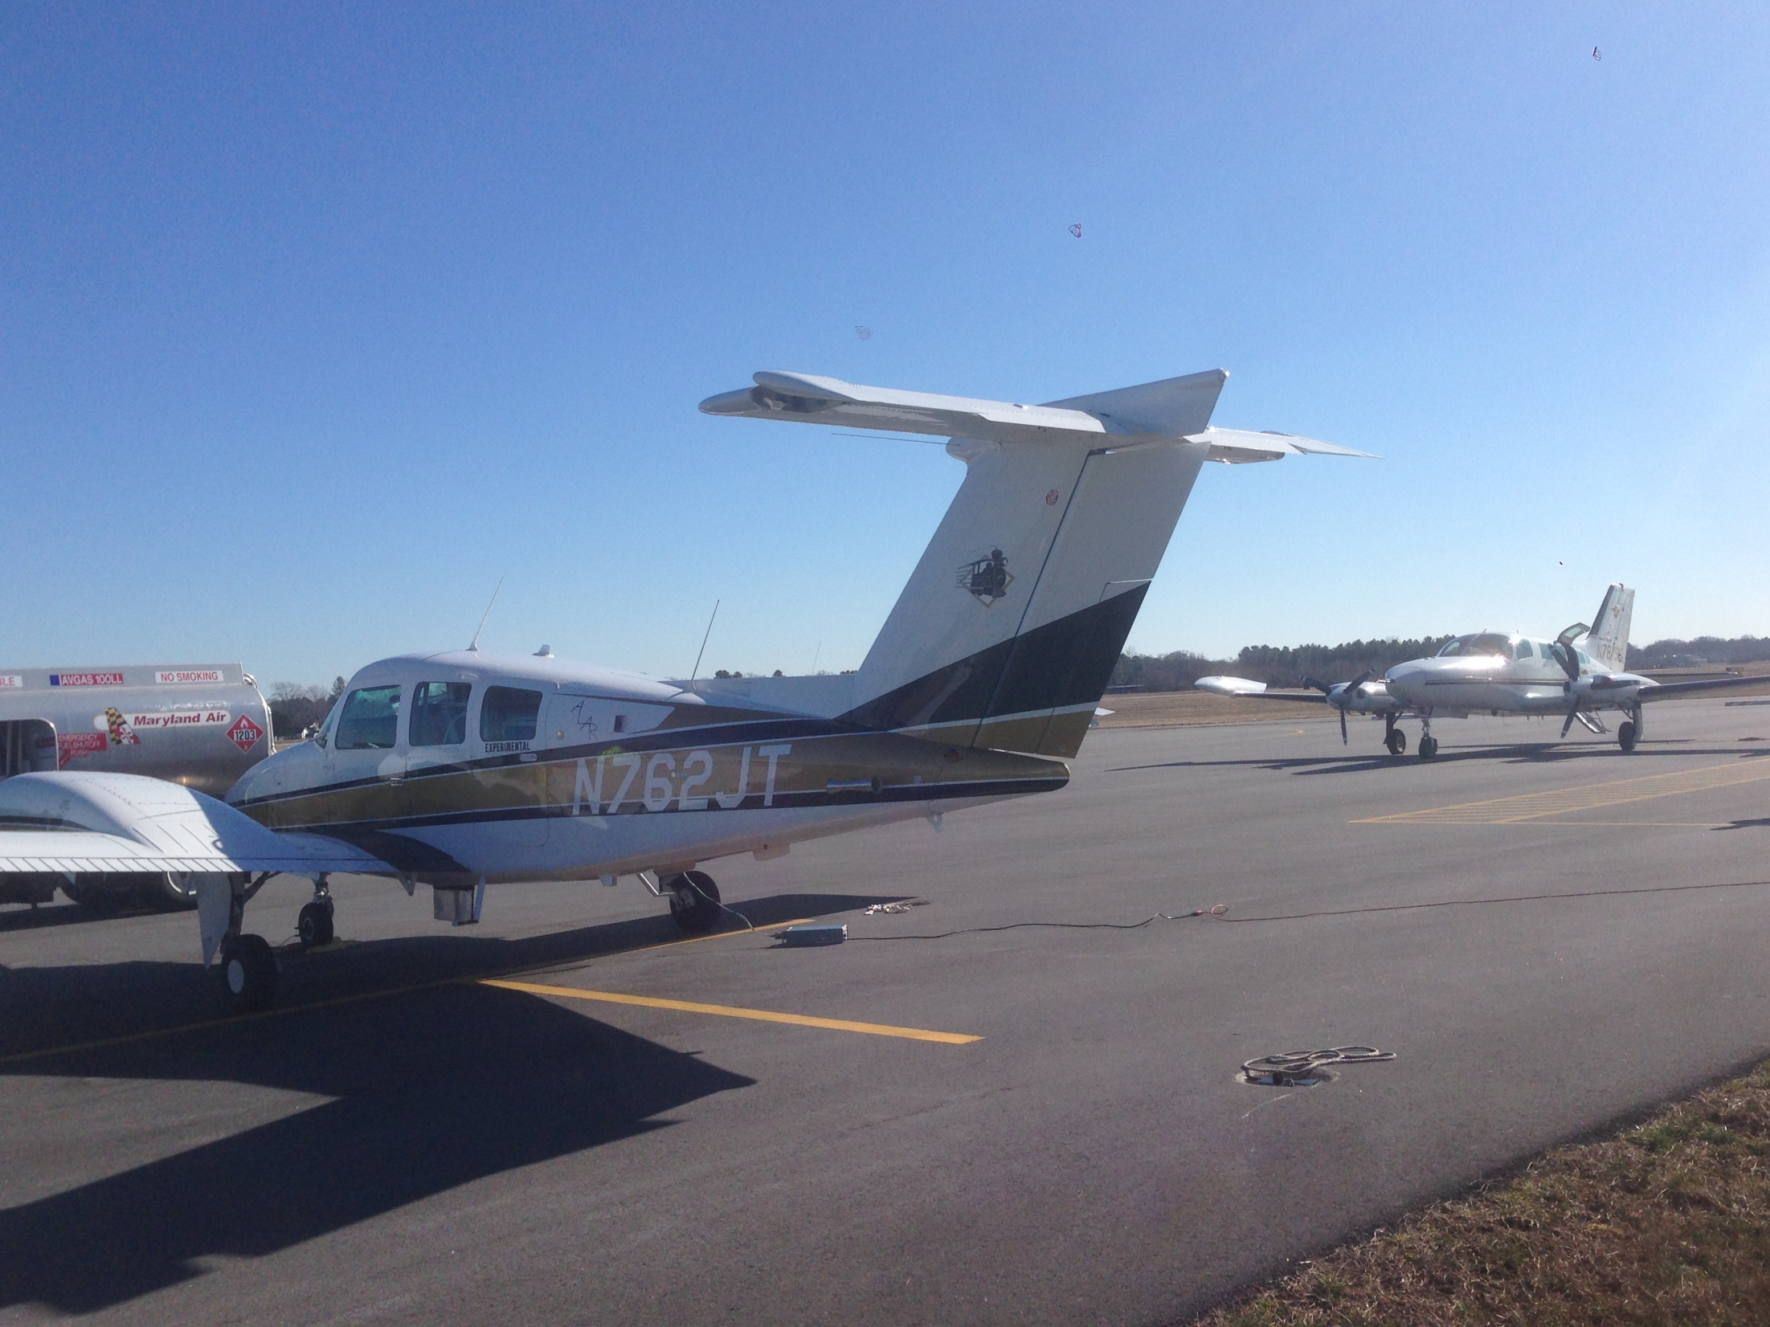
FLAGG-MD: Preliminary Results for Winter 2016 Aircraft Observations
Purdue Duchess
UMD Cessna
UMD/NIST FLAGG-MD Meeting
February 22, 2016

Slide 18
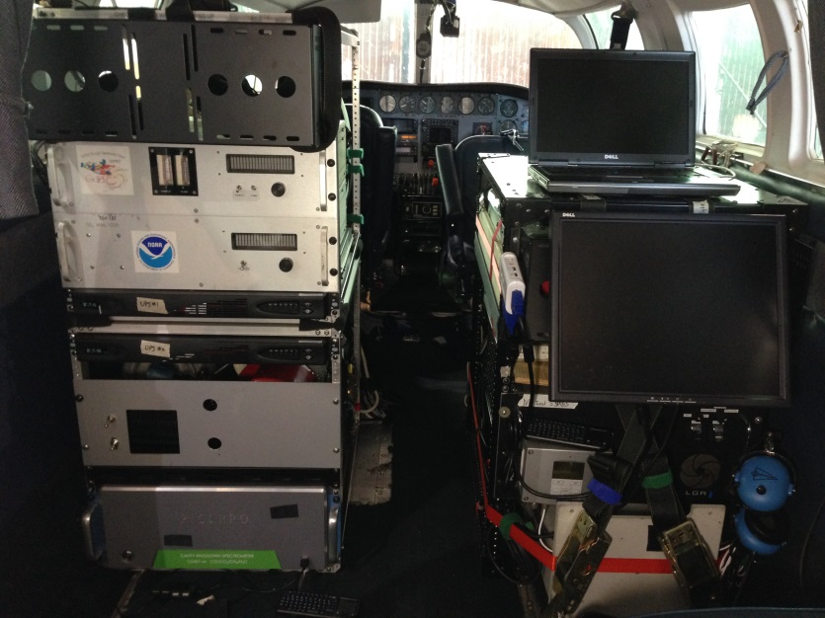
UMD Cessna 402B Research Aircraft
GPS Position (Lat, Long, Altitude, Speed)
Met (T, RH, P, wind speed/direction)
Trace gases:
CH₄/CO₂/CO/H₂O: Cavity Ring Down, Picarro
K30 CO₂ small sensor
O₃: UV Absorption, TECO
SO₂: Pulsed Fluorescence, modified TECO
NO₂: Cavity Ring Down, Los Gatos
VOCs: canister samples and GC-FID analysis
Aerosol Optical Properties:
Scattering: b_{scat} (@450, 550, 700 nm), Nephelometer
Absorption: b_{ap} (565 nm), PSAP
Black Carbon: Aethalometer (7-wavelengths)
Data Acquisition: 1 sec
Gas Inlet
Aerosol Inlet
Met Sensors

Slide 19
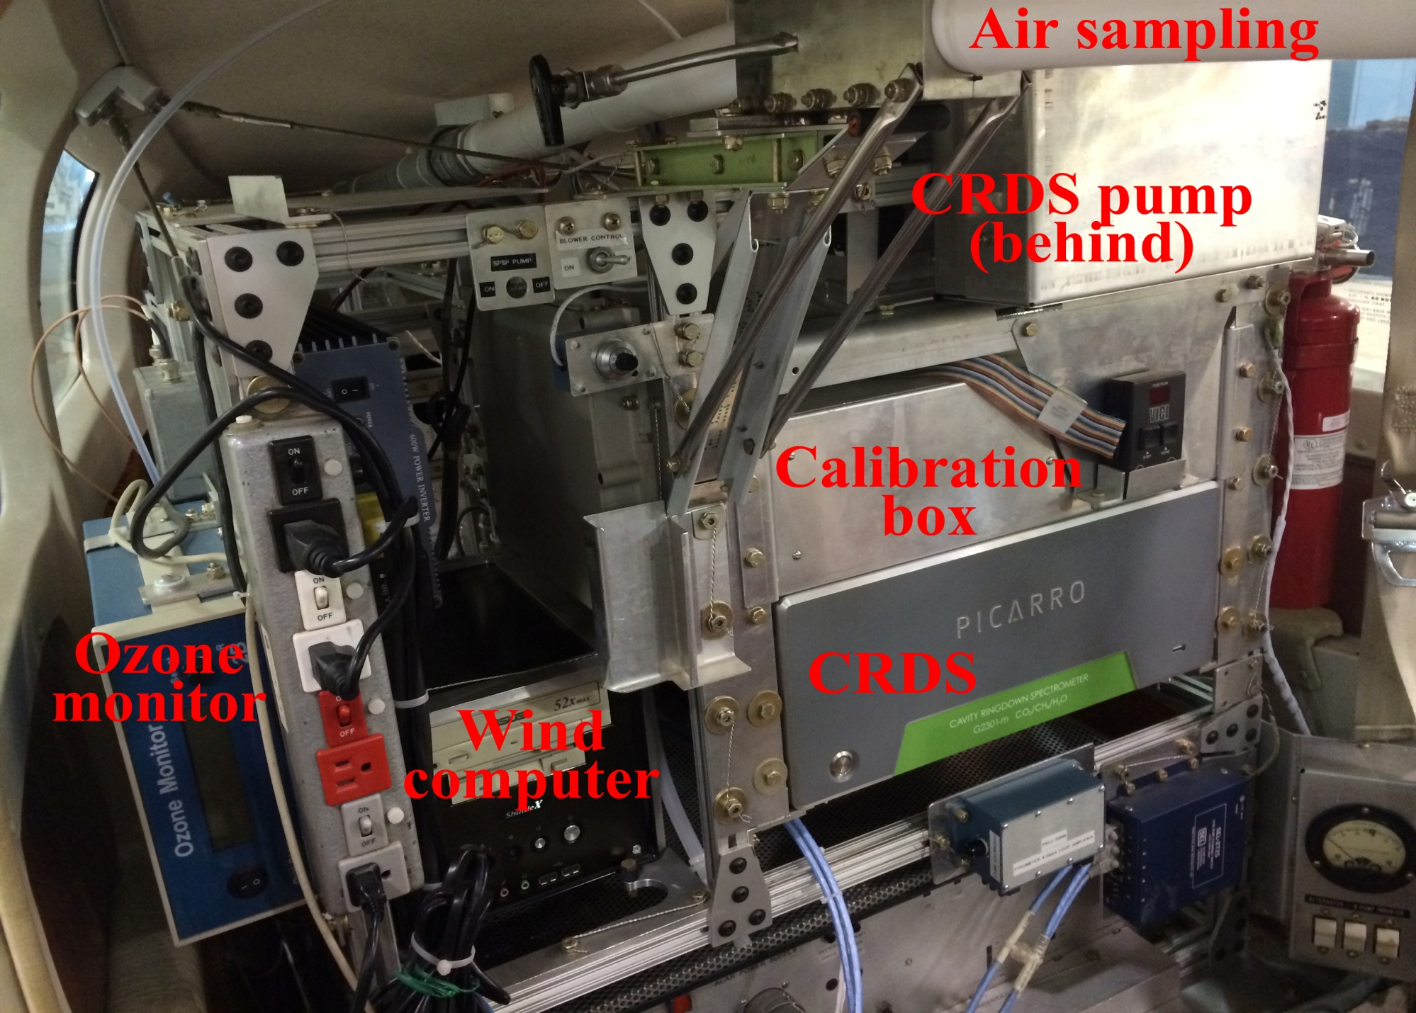
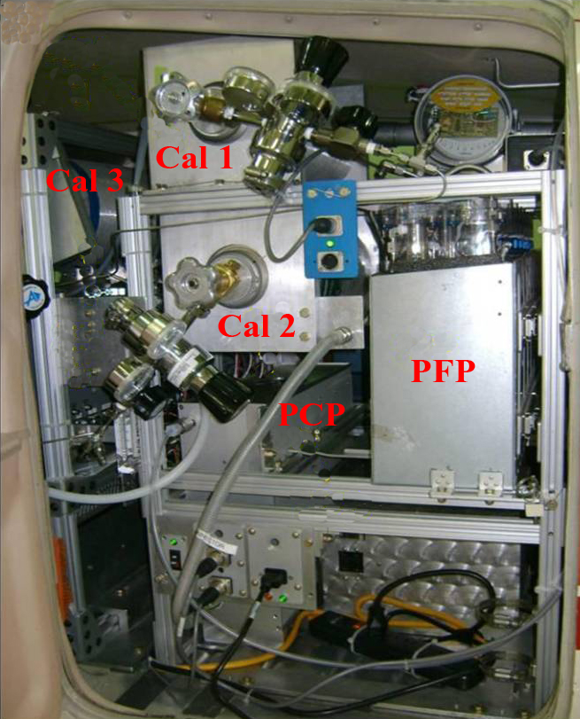
Purdue Duchess Research Aircraft
Front View
Back View
Trace gases:
CH₄/CO₂: Cavity Ring Down, Picarro
O₃: UV Absorption, 2B Technology
H₂O: Isotope measurement
GPS Position (Lat, Long, Altitude)
Met (T, RH, P, 3-D wind by BAT)

Slide 20
Flight Plan for Winter 2016
spiral
wind
spiral
Intercomp
spiral
spiral

Slide 21
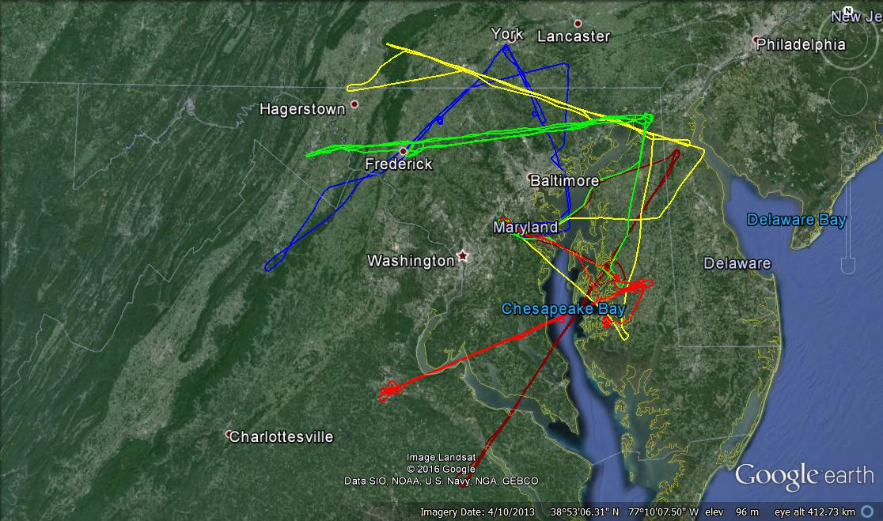
UMD Cessna Flight Track during FLAGG-MD 2016
The UMD Cessna focused on downwind vertical profiles.
Various wind directions on different flight days.

Slide 22
UMD Cessna Flights during FLAGG-MD 2016

Slide 23
Preliminary Results from Cessna RF5
02/19/2016

Slide 24
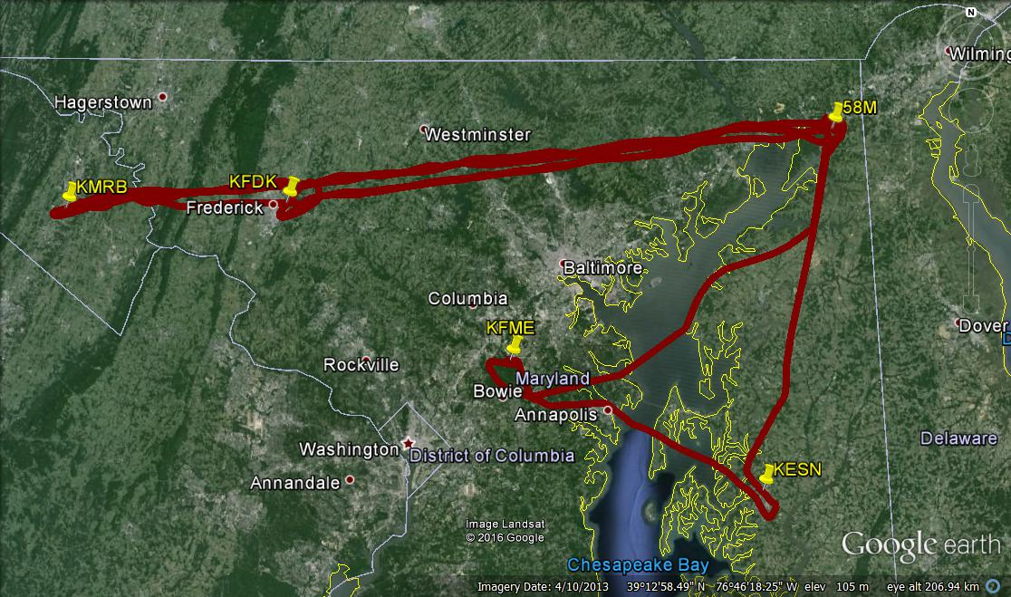
RF5 Flight Track
Surface wind

Slide 25
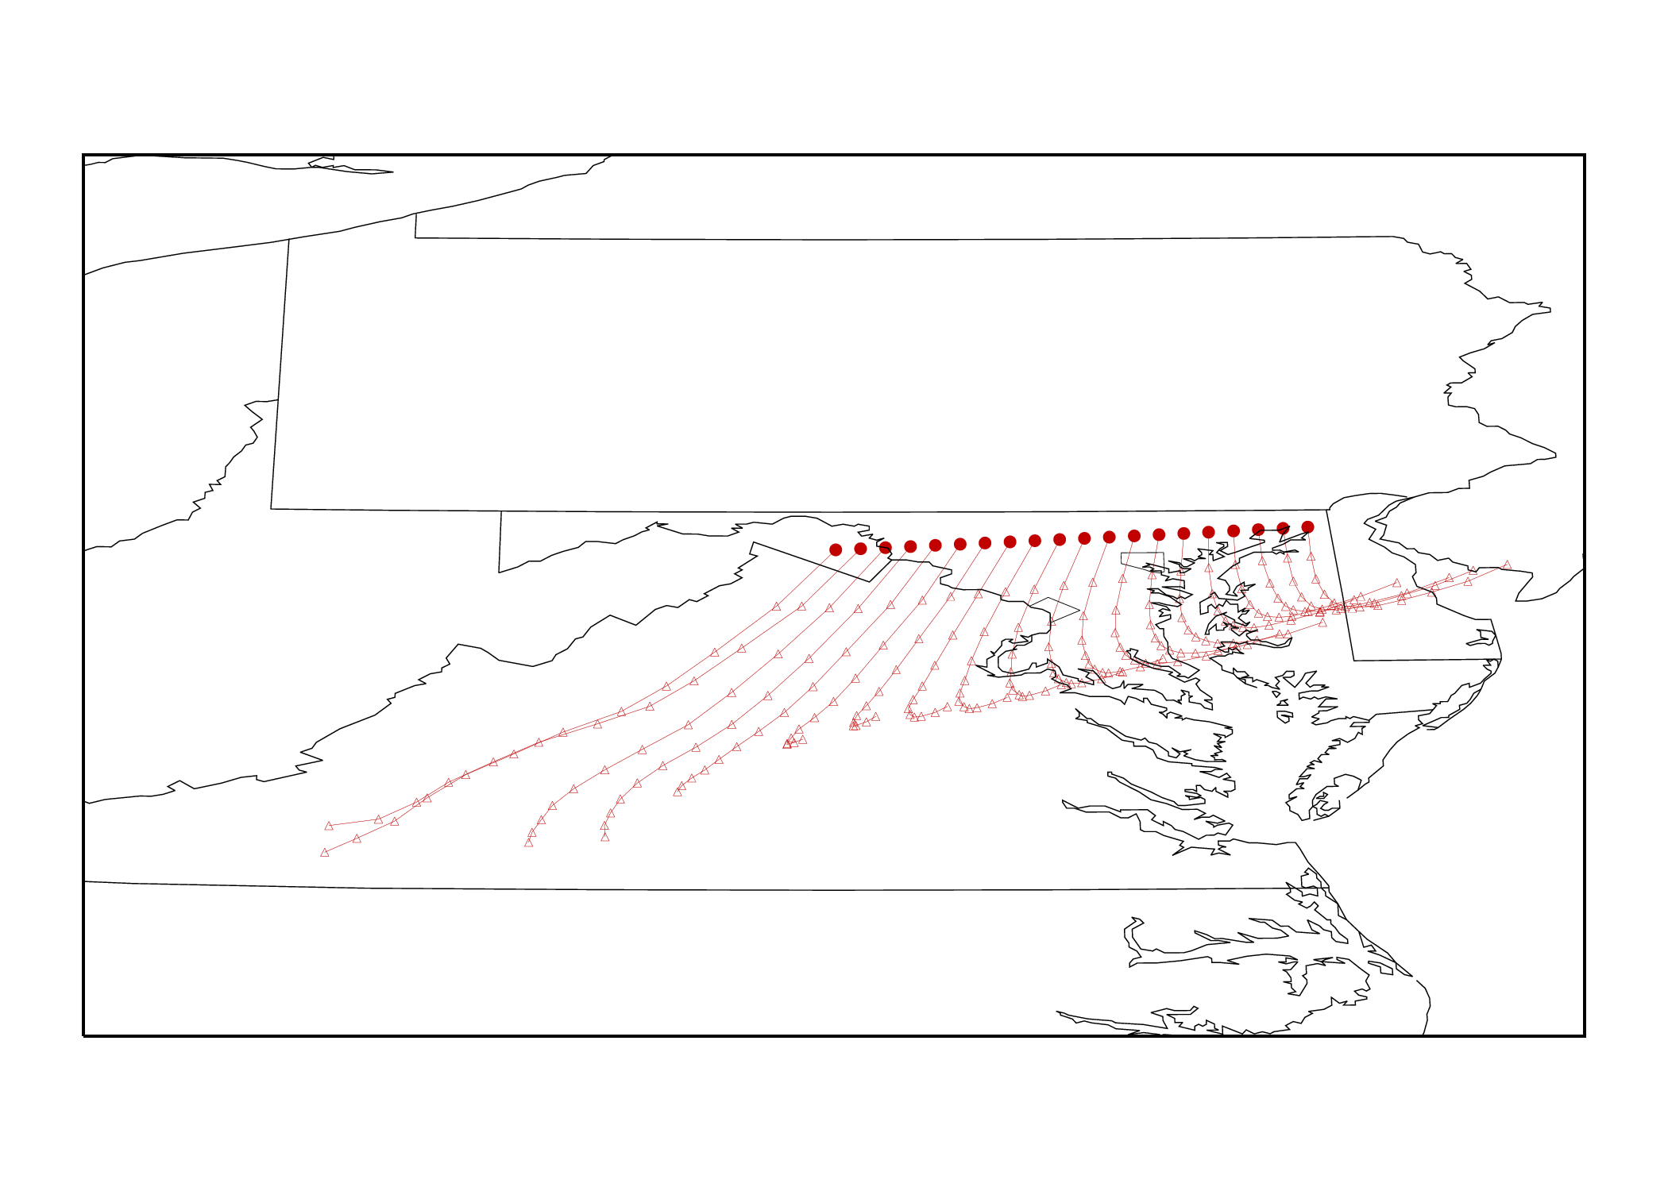
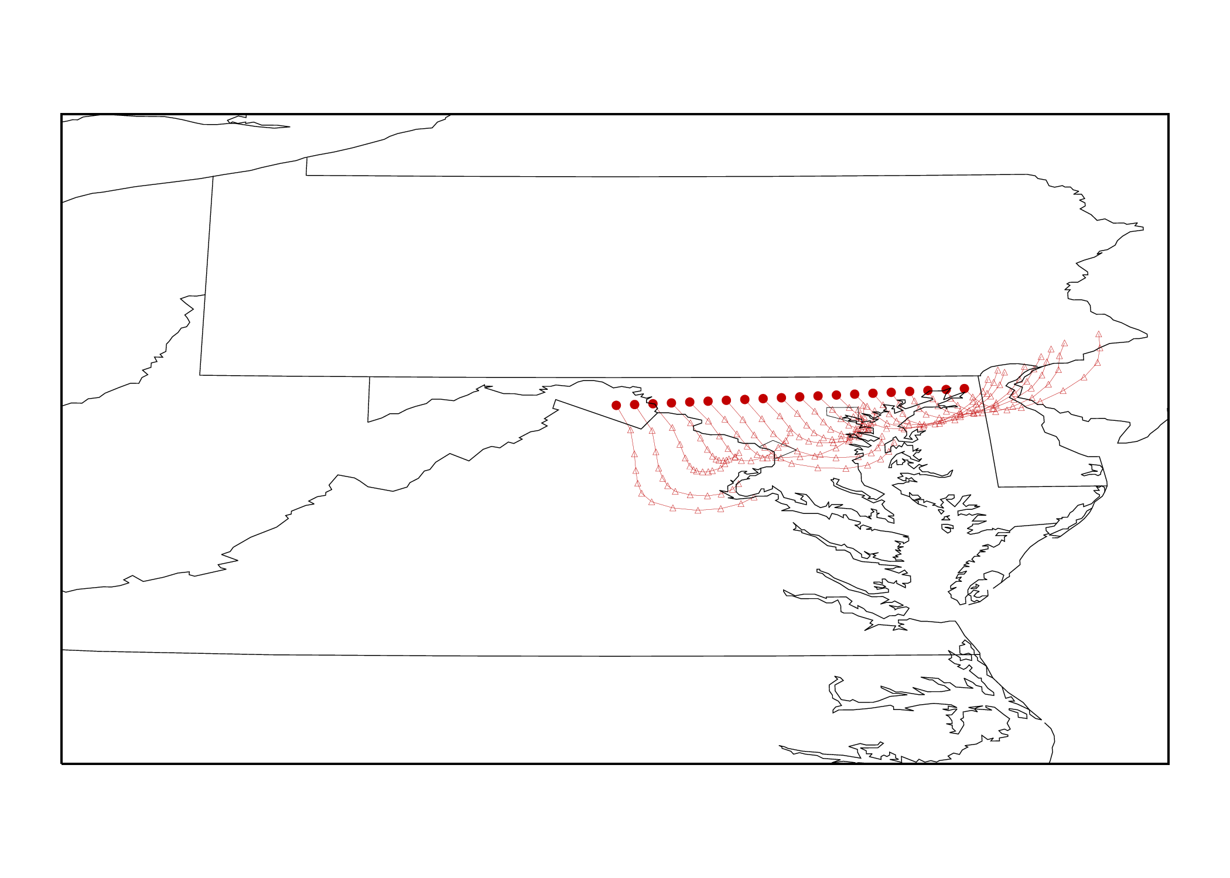
HYSPLIT 12-h Back Trajectory Runs
Start time:
19:00 Feb 19 2016 (UTC)
Start location:
lat, lon: Each red circles
Altitude: 700 m
Start time:
19:00 Feb 19 2016 (UTC)
Start location:
lat, lon: Each red circles
Altitude: 200 m
SSW winds aloft
SSE winds near surface
PA
PA
58M
58M
KMBR
KMBR
WV
WV
VA
VA
NC
Thanks to Doyeon!
NC

Slide 26
Three Vertical Profiles
Mixing layer depth ~800 m

Slide 27
Three Vertical Profiles
Mixing layer depth ~700-800 m

Slide 28
CO₂ along Downwind Transects
KMBR
58M

Slide 29
CO₂ along Downwind Transects
[CO₂] (ppmv)
DC and Baltimore plumes were observed separate.
Background [CO₂] ~413-415 ppm – need to combine Purdue’s data.

Slide 30
CO₂ on flight track
Dickerson
Brandon Shores
Chalk Point
Morgantown
Surface wind

Slide 31
CH₄ on flight track
Surface wind

Slide 32
CO on flight track

Slide 33
CH₄ vs. CO₂ colored with CO
Urban
plumes
Free troposphere

Slide 34
Preliminary Results from Cessna RF3
02/17/2016

Slide 35
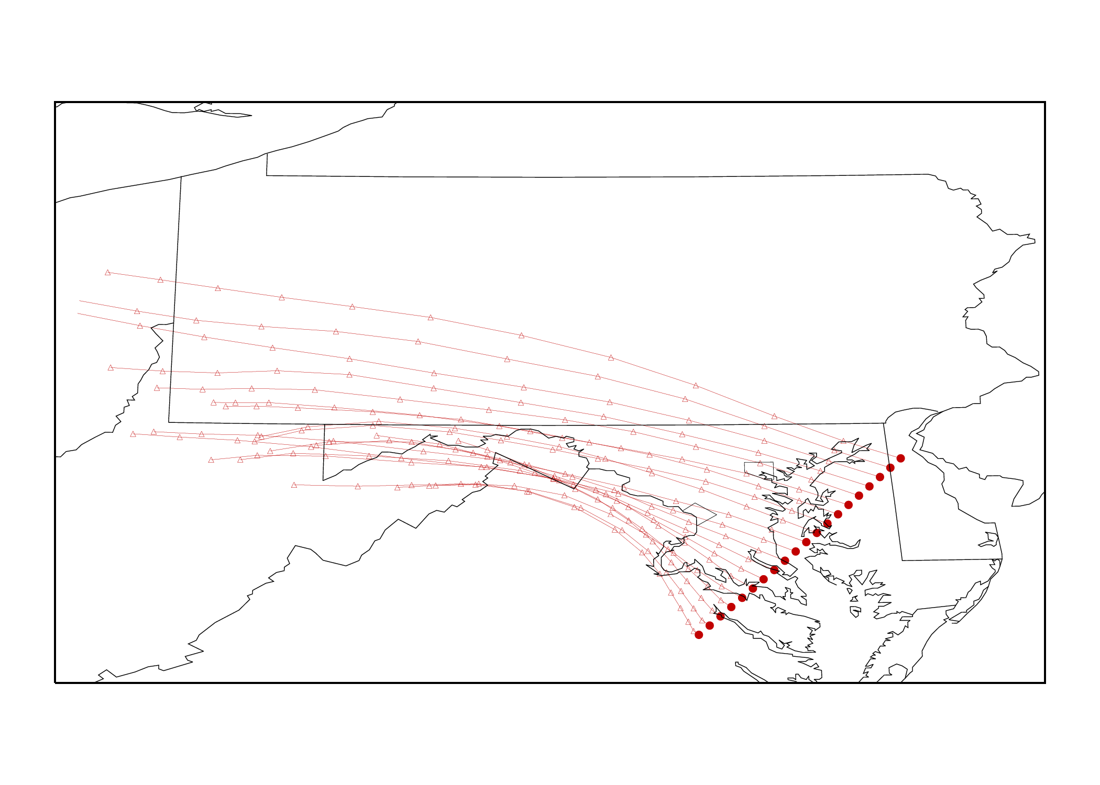
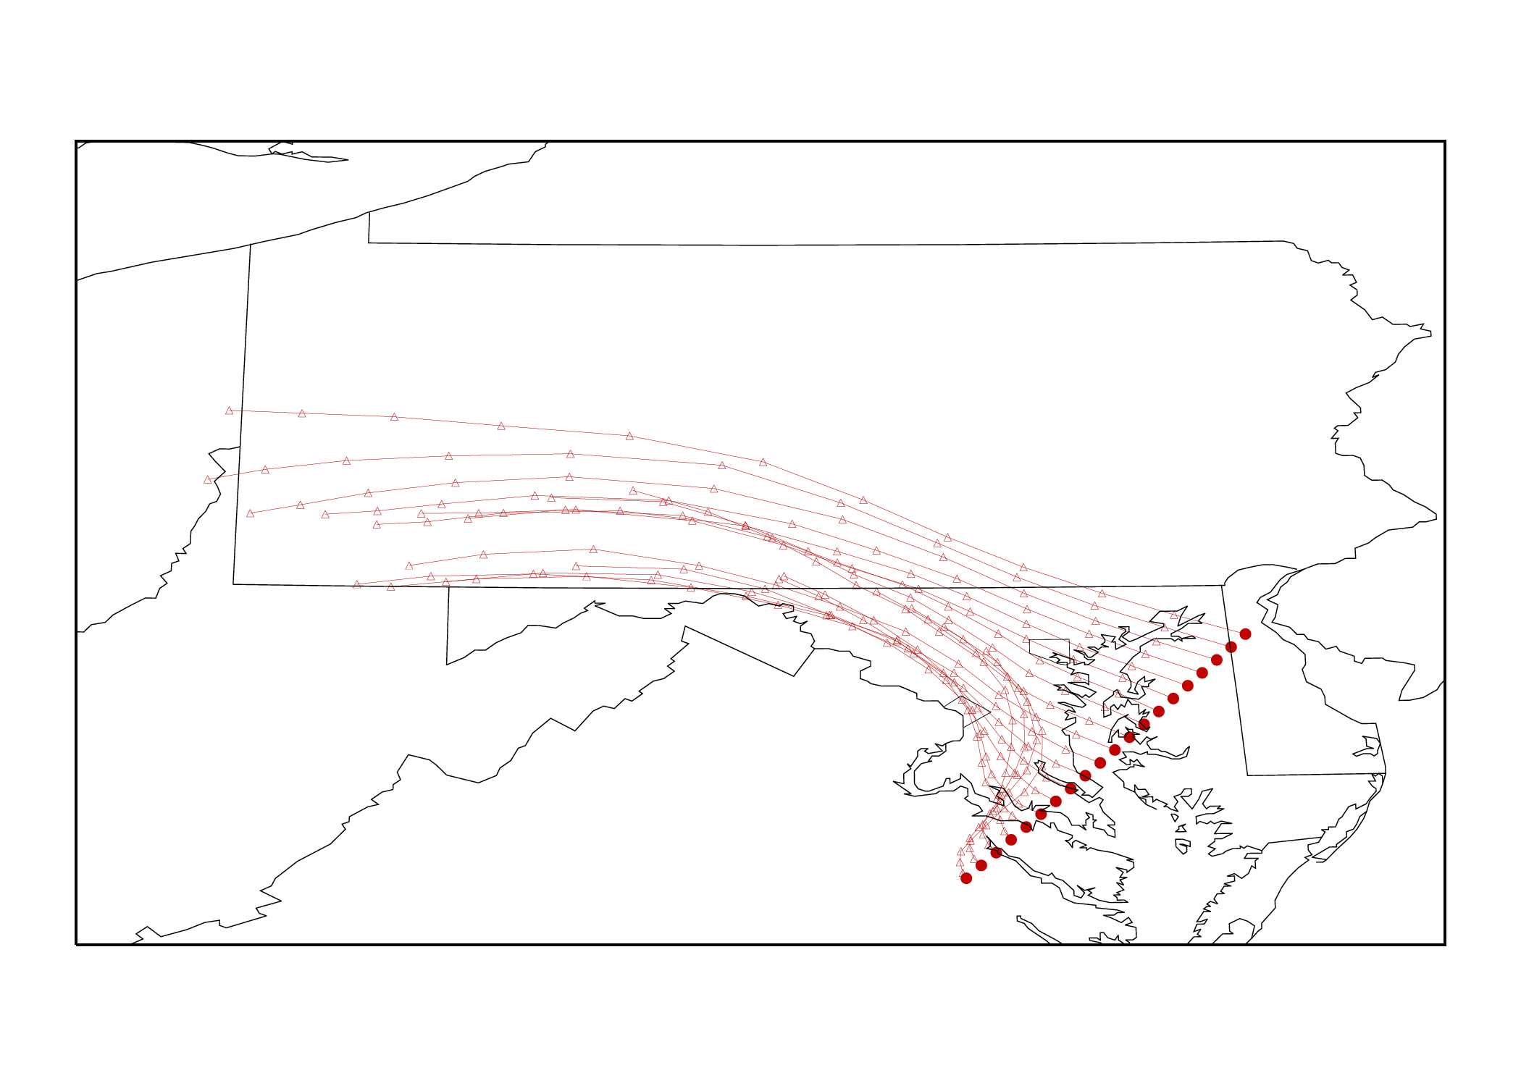
HYSPLIT 12-h Back Trajectory Runs
Start time:
18:00 Feb 12 2016 (UTC)
Start location:
lat, lon: Each red circles
Altitude: 700 m
Start time:
18:00 Feb 12 2016 (UTC)
Start location:
lat, lon: Each red circles
Altitude: 200 m
UKIEY
UKIEY
SVILL
SVILL

Slide 36
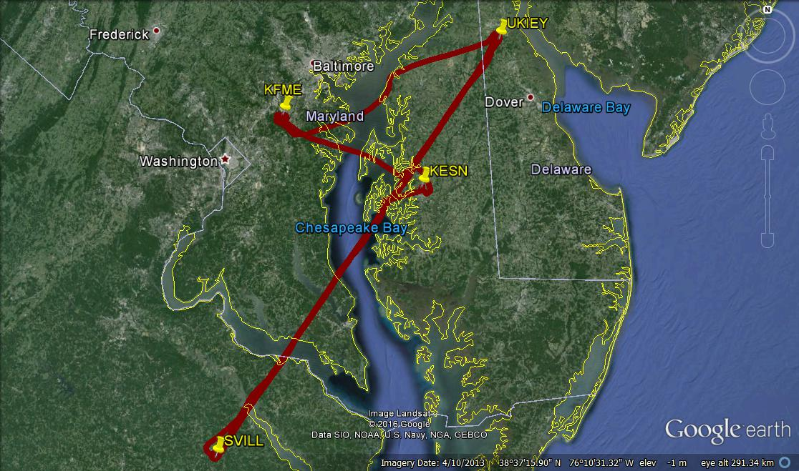
Cessna RF3 Flight Track

Slide 37
Three Vertical Profiles
Mixing layer depth ~1400 m

Slide 38
CO₂ along Downwind Transects

Slide 39
CO₂ along Downwind Transects

Slide 40
CH₄ on flight track
wind

Slide 41
CO₂ on flight track
Dickerson
Brandon Shores
Chalk Point
Morgantown

Slide 42
CH₄ vs. CO₂ colored with SO₂
Urban
plumes
Brandon Shores
Free troposphere
Significantly high background [CO₂] and [CH₄] in DC plume than in Baltimore plume.

Slide 43
Summary
UMD Cessna successfully conducted 11 flights on 5 flight days together Purdue Duchess.
4 of 5 flight days are good for mass balance calculation.
Continuous downwind vertical profiles by the Cessna captured vertical variations in GHG.
We will combine the Duchess’ data to determine the background GHG concentrations and mixing layer heights in order to calculate GHG fluxes from the Balt-DC area.
Tested a CO₂ small sensor during flight – Results to be analyzed.

Slide 44


Methane Emissions from Marcellus Shale Natural Gas Operations: Results from Summer 2015 Aircraft Observations
Xinrong Ren, Dolly Hall, Timothy Vinciguerra, Sayantan Sahu, Hao He, Sheryl Ehrman, and Russell Dickerson
MDE Quarterly Meeting
February 29, 2016

Slide 45
Motivation
Quantification of methane (CH₄) emissions from oil and gas operations is important for establishing scientifically sound and cost-effective policies for mitigating greenhouse gases (GHGs).
Discrepancies between observation-based (top-down) and inventory-based (bottom-up) CH₄ emissions suggests more observations are needed.

Slide 46
Marcellus Shall NG production and Area Surveyed
Prevailing
wind
September 2015
Production data are from WV DEP (http://www.dep.wv.gov), PA DEP (www.paoilandgasreporting.state.pa.us ) and OH DNR (http://oilandgas.ohiodnr.gov/production)

Slide 47
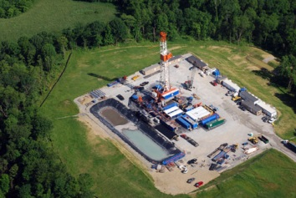
Estimation of CO₂, CH₄ and CO Fluxes
Mass Balance Experiment (MBE) approach:
Flux
[C] : concentrations (downwind)
[C]_{b} : concentration in background
U⊥ : perpendicular wind speed
wind
∆z
Background
CH₄
O&NG
CH₄
Background
∆x

Slide 48
CH₄ along Flight Track
8/25/2016

Slide 49
Time Series of Altitude, CH₄ and WD
8/25/2016

Slide 50
Time Series of Altitude, CH₄ and WD
8/25/2016
Mixing layer top

Slide 51
CH₄ Loss Rate Estimate

Slide 52
CH₄ Flux and Compared to Literature
Average flux = 4,160±1,030 moles s⁻¹ , or 5.0±1.2 g CH₄ km⁻² s⁻¹, consistent with the results (2.0-14 g CH₄ km⁻² s⁻¹) by Caulton et al. (2014) in SW PA, but larger than the results (1.2±0.6 g CH₄ km⁻² s⁻¹—measurements made in 2012) in SW PA by Swarthout et al. (2015) and an order of magnitude larger than the results (~0.4 g CH₄ km⁻² s⁻¹) by Peischl et al. (2015) in the Marcellus Shale region in NE PA.
CH₄_flux/NG_production = 4.7±1.8%, much greater than the loss rate (0.18–0.41%) estimated for the Marcellus region in northern PA by Peischl et al. (2015)

Slide 53
Ethane to CH₄ ratio (slope)
Areas of Oil & NG Operations
Baltimore-DC Area
Possible reason for a smaller ethane to CH₄ slope: Coal mining emissions of CH₄ that do not emit significant ethane

Slide 54
Summary
The averaged CH₄ flux from a 110x120 km area in the Marcellus Shale region in SW PA and Northern WV was estimated to be 4,160±1,030 moles s⁻¹.
CH₄_flux/NG_production = 4.7±1.8%.
The observed ethane/CH₄ = 2.4%, agrees with the USGS ethane/CH₄ composition ratio (2.3%) of for this region, but is smaller than what (3.3%) was obtained in the DC-Baltimore area in winter 2015.
Future Work
To obtain other CH₄ sources in the surveyed area to derive a more accurate CH₄ leak rate.

