Slide 1
Fluxes of Greenhouse Gases in Maryland (FLAGG-MD):
CO₂ emission in DC-Baltimore area
Doyeon Ahn¹, Jonathan R. Hansford⁵, X. Ren^{2,4}, R. J. Salawitch^{1,2,3}, R. R. Dickerson², M. Cohen⁶, Barbara Stunder⁶, Olivia Salmon⁷, Alexie Heimburrger⁶, Paul Shepson^{7,8}
1 . Department of Chemistry and Biochemistry University of Maryland, College Park, MD 20742, 2. Department of Atmospheric and Oceanic Science, University of Maryland, College Park, MD. 3. Earth System Science Interdisciplinary Center, University of Maryland, College Park, MD 20742, 4. National Oceanic and Atmospheric Administration Air Resource Laboratory, College Park, MD 20740, USA. 5. Department of Computer Science, University of Maryland, College Park, MD 20742. 5. National Oceanic and Atmospheric Administration Air Resource Laboratory, College Park, MD 20740, USA. 7. Department of Chemistry, Purdue University, West Lafayette, IN, USA. 8. Department of Earth, Atmospheric and Planetary Sciences, Purdue University, West Lafayette, IN, USA
FEB 13 2017

Slide 2
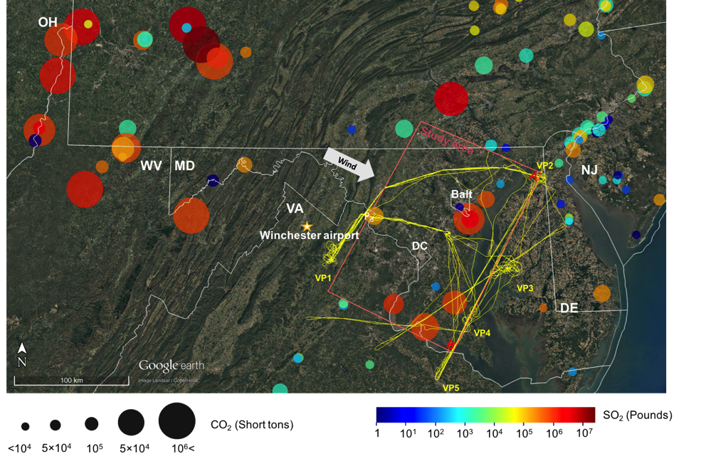
1. Introduction
Map showing FLAGG-MD aircraft flight tracks conducted during Feb 2015 (yellow lines). Point sources are shown as colored circles with the size of the symbol indicating the total CO₂ emitted from the source in Feb. 2015. The color of the symbol indicates the total SO₂ emitted during the same time period (Source: EPA AMPD). Wash/Balt area defined in this study is shown as red rectangle.
Notes:
1. Large CO₂ point sources are located inside and outside of the DC/Baltimore area.
2. Aircraft track was designed to capture CO₂ plumes emitted from the DC/Baltimore area.

Slide 3
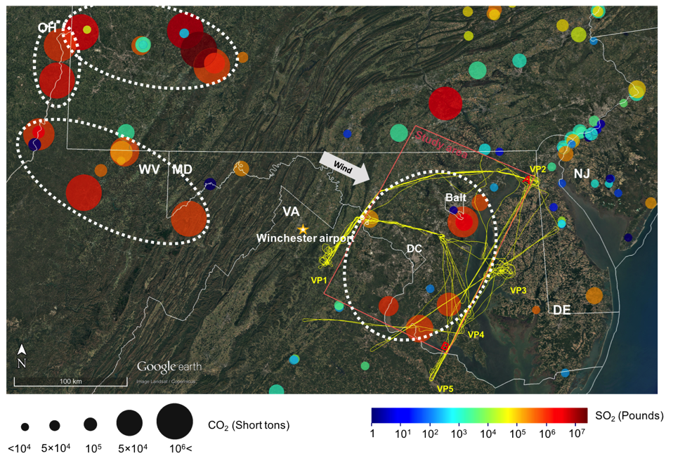
1. Introduction
Map showing FLAGG-MD aircraft flight tracks conducted during Feb 2015 (yellow lines). Point sources are shown as colored circles with the size of the symbol indicating the total CO₂ emitted from the source in Feb. 2015. The color of the symbol indicates the total SO₂ emitted during the same time period (Source: EPA AMPD). Wash/Balt area defined in this study is shown as red rectangle.
Notes:
1. Large CO₂ point sources are located inside and outside of the DC/Baltimore area.
2. Aircraft track was designed to capture CO₂ plumes emitted from the DC/Baltimore area.

Slide 4
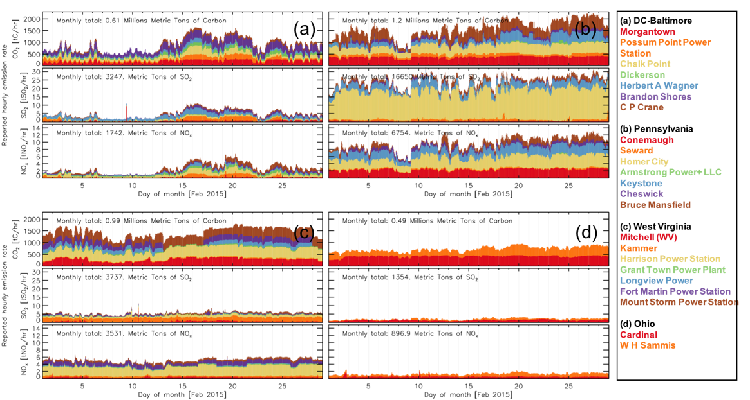
1. Introduction
S. Fig. 1. Stacked time series of reported hourly emission rate (CO₂, SO₂, and NO_{x}) from major point sources in white dashed boxes in Fig 1. (DC-Balt (a), PA (b), WV (c), OH (d)) during Feb 2015. Different colors in each plot represent different facilities. Name of facilities for (a)-(d) are listed in the right box. Monthly total values for each plot indicate the total sum of hourly emission rate thorughout the whole month.
Notes:
1. Large CO₂ point sources are located inside and outside of the DC/Baltimore area.
2. Aircraft track was designed to capture CO₂ plumes emitted from the DC/Baltimore area.

Slide 5
2-1. Source apportionment (DC-BALT)
Fig. 2. Maps showing HYSPLIT 4-hrs back trajectories started off from every 40 seconds of aircraft flight track downwind of Washington/Baltimore area during Feb. 20 2015 (a). Each of aircraft location and its back trajectory are colored by mixing ratio of CO₂ measured by aircraft. Locations of each trajectory at every hour are shown as triangles. Major power plants in DC/Baltimore area are shown as black circles. Average wind speed and wind direction derived from airborne measurements during the flight downwind of DC-Balt area are shown in the left of the plot. Time series of CO₂, SO₂, and NO₂ measured during the same time period are shown in (b). Green area in the time series plots indicate the spikes of trace gases which can be attributed to specific point sources in the region.
Notes:
Fig. 1. Map showing FLAGG-MD aircraft flight tracks conducted during Feb 2015 (yellow lines). Major wind direction is indicated by arrow symbol on right-bottom of the figure. Wind Point sources of CO₂ in the region are shown as colored circle symbol. Size of the symbol indicates the total amount of CO₂ emitted from the source during Feb 2015. Color of the symbol represents the total amount of SO₂ emitted during the same time period (Source: EPA AMPD). DC/Baltimore area defined in this study is shown as red rectangle.
Large CO₂ point sources are located inside and outside of the DC/Baltimore area.
Aircraft track was designed to capture CO₂ plumes emitted from the DC/Baltimore area.

Slide 6
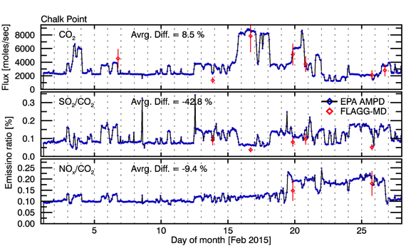
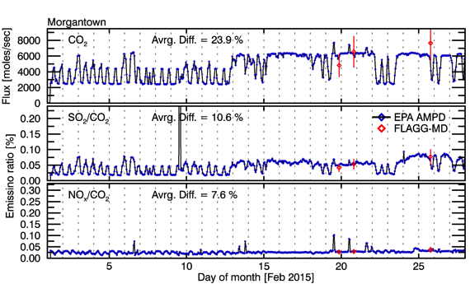
2-2. Source apportionment (DC-BALT)
Time series of hourly emission rate of CO₂ and emission ratios (SO₂ to CO₂ and NO_{x} to CO₂) from the Chalk Point (a) and Morgantown (b) power plant in the DC-Baltimore area. Blue lines indicate the values reported from each facility (Source: EPA AMPD). Red diamonds represents estimated emission rate/ratios from mass balance approach using FLAGG-MD campaign data. Vertical line on each red diamond indicates the uncertainty range of estimation.
Notes:
1. CO₂ emission rate and emission ratios for specific plants in DC/Baltimore area were estimated using aircraft measurement data.
2. Estimated emissions showed good agreement to each source’s reporting values.
3. CO₂ emissions and emission ratios showed significant fluctuations during Feb 2015. (Factor of 2~3)

Slide 7
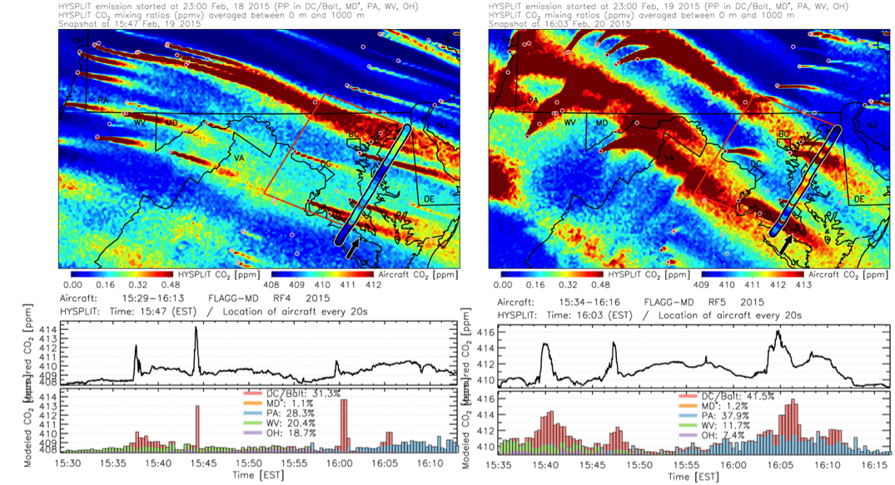
2-4. Source apportionment (DC/Balt, MD*, PA, WV, OH)
Fig. 5. Contour maps showing distribution of partial-column average CO₂ at the time when aircraft was flying downwind of the DC/Baltimore area for Feb. 19 (a1) and Feb. 20 (b1) 2015. The HYSPLIT particle dispersion model with NAM12 meteorological data and EPA AMPD facility-level hourly emission data were used to conduct forward dispersion modeling. The flight track of the UMD Cessna aircraft is also shown on the maps. Much of the sampling on this NIST-sponsored FLAGG-MD flight was conducted in the convectively mixed layer (i.e., below 1 km). Fig. 4. (a2) and (b2) shows CO₂ mixing ratio observed along the flight track downwind of Baltimore and DC, as well as the modeled contribution to CO₂ from power plants in each state.
Notes:
Fig. 4. Contour maps showing distribution of partial-column average CO₂ at the time when aircraft was flying downwind of the DC/Baltimore area for Feb 19 (a1) and Feb 20 (b1) 2015. The HYSPLIT particle dispersion model with NAM12 meteorological data and EPA AMPD facility-level hourly emission data were used to conduct forward dispersion modeling. The flight track of the UMD Cessna aircraft is also shown on the maps. Much of the sampling on this NIST-sponsored FLAGG-MD flight was conducted in the convectively mixed layer (i.e., below 1 km). Fig. 4. (a2) and (b2) shows CO₂ mixing ratio observed along the flight track downwind of Baltimore and DC, as well as the modeled contribution to CO₂ from power plants in each state.
Modeled CO₂ (point sources only) showed similar distributions to measured values.
Most sharp CO₂ spikes were attributed to point sources in the DC/Baltimore area.
Significant enhancement of CO₂ caused by transport from point sources in nearby states.
Background mixing ratio of CO₂ varies with location downwind of DC/Baltimore area.

Slide 8
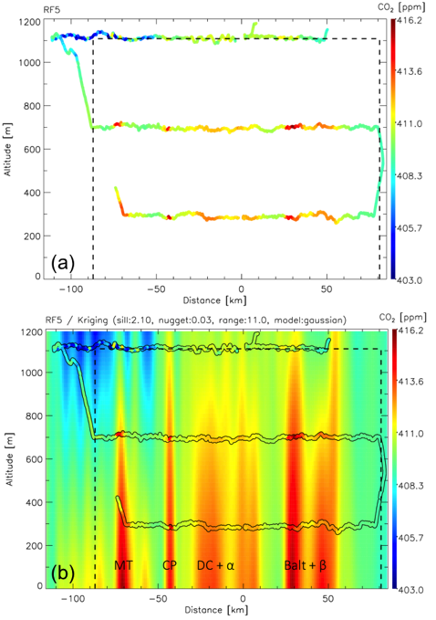
3-1. Mass balance approach: Kriging
Fig. 6. Curtain plots showing spatial distribution of CO₂ measured by the aircraft at the downwind of defined DC-Balt area (a). Distribution of CO₂ for the entire vertical curtain was estimated using Kriging method (b). Kriging parameters used are listed at the top of the plot. Horizontal and vertical boundary of 2D plane used for mass balance approach is indicated as dotted lines.
Notes:
Fig. 0. Curtain plot showing spatial distribution of CO2 in 2D vertical plane defined at the downwind of defined DC/Baltimore study area. (a). Distribution of CO2 in the same plane interpolated by Kriging method. Sill, Nugget, and Range values used to conduct kriging was indicated at the top. Horizontal and vertical boundary of 2D plane is shown as dotted line.

Slide 9
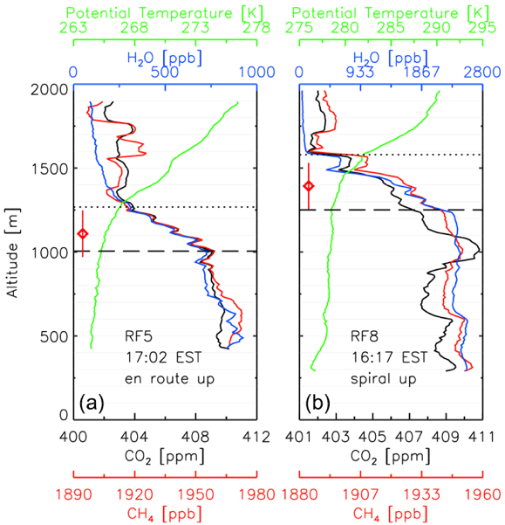
3-2. Mass balance approach: PBL
Fig. 7. Vertical profiles of CO₂, CH₄, H₂O and Potential temperature obtained at the downwind of DC-Balt area during Feb 20 (a) and Feb 25 (b). Specific locations of each vertical profile are indicated as VP3 and VP5 in Fig 1. Long-dashed line and dotted line represent well-mixed PBL depth and Entrainment height. Red diamond indicate adjusted mixing height used for mass balance calculation. Vertical line on each diamond shows the uncertainty range.

Slide 10
3-3. Mass balance approach: Sensitivity analysis
Error type |  | RF4 |  | RF5 |  | RF6 |  | RF8 |  | RF9
Unit: Flux [moles sec-1], Relative error [%] |  | Flux | ERR | Flux | ERR | Flux | ERR | Flux | ERR | Flux | ERR
 | Baseline Flux | 115,372 | 0.0 | 123,678 | 0.0 | 146,032 | 0.0 | 113,838 | 0.0 | 132,935 | 0.0
Measurements | CO₂, Temp., Pres.
 | Wind (NAM12) | 93,073 | -19.3 | 103,998 | -15.9 | 128,789 | -11.8 | 94,820 | -16.7 | 147,916 | 11.3
 | PBL heights (-1 sig) | 92,815 | -19.6 | 113,418 | -8.3 | 120,923 | -17.2 | 105,423 | -7.4 | 94,080 | -29.2
 | PBL heights (+1 sig) | 136,461 | 18.3 | 130,862 | 5.8 | 175,250 | 20.0 | 121,333 | 6.6 | 175,198 | 31.8
 | X_{i}, X_{f} | 115,352 | 0.0 | 123,285 | -0.3 | 145,928 | -0.1 | 111,388 | -2.2 | 130,872 | -1.6
Methodology | Background CO₂ | 99,871 | -13.4 | 118,615 | -4.1 | 158,914 | 8.8 | 179,933 | 58.1 | 110,855 | -16.6
 | Kriging | 115,419 | 0.0 | 120,930 | -2.2 | 143,444 | -1.8 | 105,429 | -7.4 | 134,301 | 1.0
Total uncertainty [%] | Positive |  | 18.3 |  | 5.8 |  | 21.9 |  | 58.4 |  | 33.7
 | Negative |  | -30.6 |  | -18.5 |  | -20.9 |  | -19.8 |  | -33.7
Uncertainty (Sensitivity) analysis methods
Wind: Baseline: Used wind speed and wind direction from aircraft measurements.
Sensitivity: Used wind speed and wind direction from NAM12.
PBL heights: Baseline: Used best estimate of PBL height (Peischl et al., 2016)
Sensitivity : ± 1 uncertainty of estimated PBL height is used. (Peischl et al., 2016)
X_{i}, X_{f}: Baseline: Determined by HYSPLIT back trajectory (NAM12)
Sensitivity : Determined by aircraft meausred wind direction.
Bg CO₂: Baseline: Used CO2 interpolated for either edges as [C]b.
Sensitivity : Used lowest CO₂ in upwind transect as [C]_{b}. Then, CO₂ flux from upper states subtracted afterwards
Kriging: Baseline: Used best fitting parameters (Sill, Nugget, Range)
Sensitivity : Used alternative set of parameters (Less smooth output)
Total Uncert.: Root sum square of each negative errors and positive errors
Notes:
Uncertainty (Sensitivity) analysis methods
Wind: Baseline: Used wind speed and wind direction from aircraft measurements.
Sensitivity: Used wind speed and wind direction from NAM12.
PBL heights: Baseline: Used best estimate of PBL height (Peischl et al., 2016)
Sensitivity : ± 1 uncertainty of estimated PBL height is used. (Peischl et al., 2016)
X_{i}, X_{f}: Baseline: Determined by HYSPLIT back trajectory (NAM12)
Sensitivity : Determined by aircraft meausred wind direction.
Bg CO₂: Baseline: Used CO2 interpolated for either edges as [C]b.
Sensitivity : Used lowest CO₂ in upwind transect as [C]_{b}. Then, CO₂ flux from upper states subtracted afterwards
Kriging: Baseline: Used best fitting parameters (Sill, Nugget, Range)
Sensitivity : Used alternative set of parameters (Less smooth output)
Total Uncert.: Root sum square of each negative errors and positive error

Slide 11
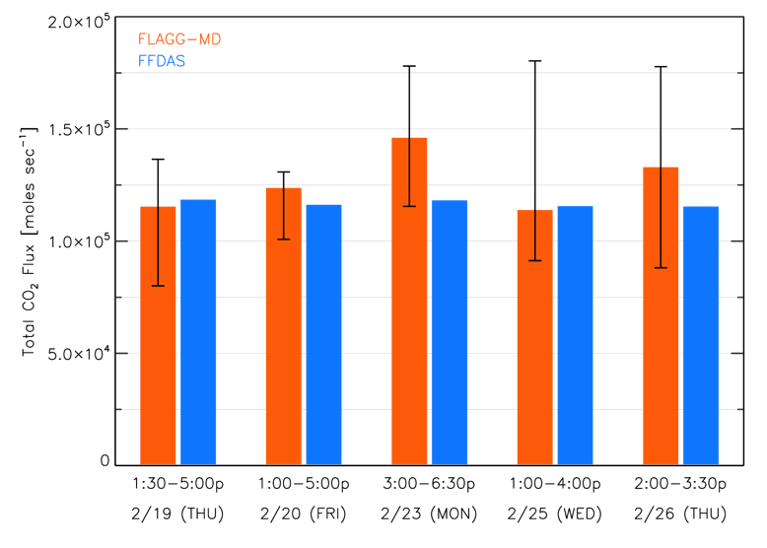
3-4. Mass balance approach: Flux comparison
Fig. 8. Bar plot showing total CO₂ flux of DC-Balt area estimated from FLAGG-MD aircraft missions in five different days (orange). Blue bars indicate the total CO2 flux for the same temporal/spatial range estimated from FFDAS. Black lines on FLAGG-MD bars represent the total uncertainty range obtained in the sensitivity analysis.
Notes:
Flux estimated from FLAGG-MD showed good agreement to Hourly FFDAS data
Larger variations of total CO2 flux observed in FLAGG-MD compared to the values estimated from FFDAS

Slide 12
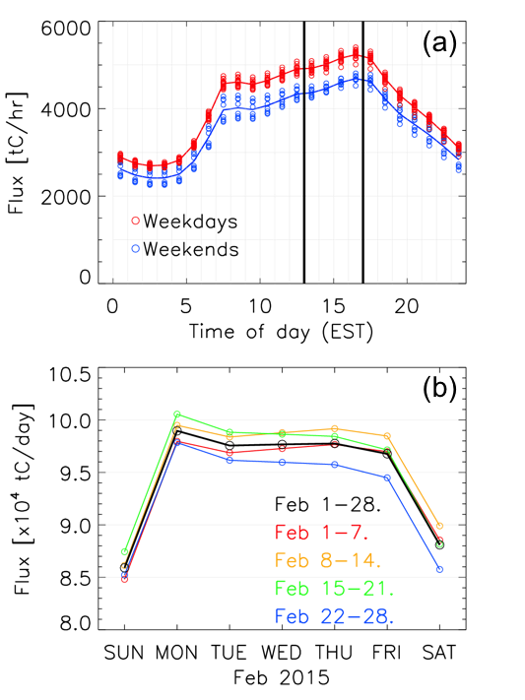
3-5. Diurnal/Weekly cycle of CO₂ flux in FFDAS
Fig. 9. Time series plots showing diurnal (a) and weekly (b) cycle of CO₂ flux estimated from FFDAS for DC-Balt area during Feb 2015. Circles in (a) indicates hourly CO₂ flux for twenty weekdays (red) and 8 days of weekends (Blue). Each of solid line connect the mean of hourly CO₂ flux for weekdays and weekends. Two vertical lines indicate the average starting and ending time of aircraft measurements at the downwind of DC/Baltimore area. Circles in (b) indicates the daily CO₂ flux during Feb 2015. Black lines indicate the mean of daily flux throughout the month.
Notes:
Diurnal cycle of CO2 flux is obvious in FFDAS. (Minimum at 2am and maximum at 4pm)
Weekdays have higher flux compared to weekends
FLAGG-MD campaign was conducted during the time of the day when CO2 flux supposed to be its highest.
Daily cycle of CO2 flux is also obvious. (Minimum at Sunday, Maximum at Monday)
FLAGG-MD campaign only occurred during weekdays (RF4-THU, RF5-FRI, RF6-MON, RF8-WED, RF9-THU)
Diurnal cycle and weekly cycle of CO2 flux should be accounted when estimating monthly flux from FLAGG-MD dataset. Otherwise, estimated number is likely to be overestimated.

Slide 13
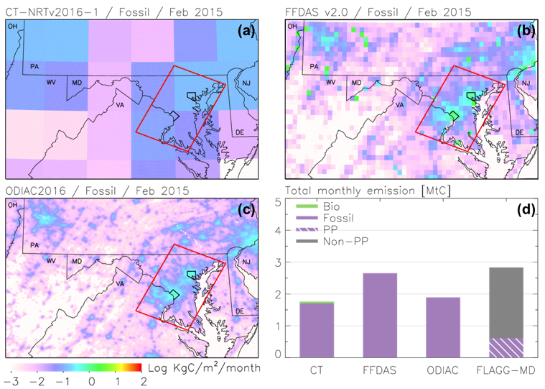
3-6. Flux comparison: Monthly total
We estimate ~ 2.8 Million tons of carbon emitted in DC-Baltimore are during February 2015 (~ 22% from power plants)
Total emission estimated from FFDAS (Fossil only) showed great agreement to our estimation
Total emission estimated from Carbon Tracker and ODIAC were ~ 1.9 Million tons of Carbon which is about 32 % lower than our estimation
Fig. 10. Maps showing carbon flux over Mid-Atlantic region derived from CarbonTracker (a), FFDAS (b), and ODIAC (c). DC-Baltimore area defined for this study is indicated as red rectangular box. Specific version and spatial/temporal resolution of each model is shown on the top of each map. Bar plot (d) shows comparison of carbon flux of DC-Balt area during during Feb 2015. Note that CarbonTracker output includes both biosphere and fossil fuel sector, while both FFDAS and ODIAC only include fossil fuel sector. Grey area of FLAGG-MD bar, which is described Non-PP, include emission from every possible sources other than power plants. (i.e., Biogenic, Transportation, Residential)
Notes:
This study estimates 2.8MtC emission from DC-Balt area during Feb 2015.
Emission estimated from FFDAS agree well to the results from this study.
Monthly total emission is underestimated in CarbonTracker and ODIAC but agreeing within the uncertainty range
Further study is needed to reduce uncertainty range and better understand different sources of CO₂ in this region.

Slide 14
Fluxes of Greenhouse Gases in Maryland (FLAGG-MD):
Validation of OCO-2 using FLAGG-MD
Doyeon Ahn, Russell R. Dickerson, Ross J. Salawitch, Xinrong Ren, Jonathan R. Hansford
University of Maryland
Olivia Salmon, Alexie Heimburger, Paul Shepson
Purdue University
FEB 13 2017

Slide 15
Validation of OCO-2 using FLAGG-MD: Spatial and temporal windows for validation
Winter 2015
Summer 2015
Winter 2016

Slide 16
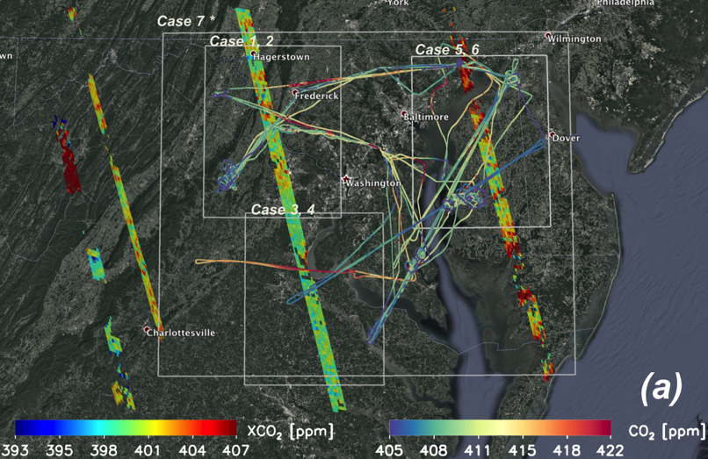
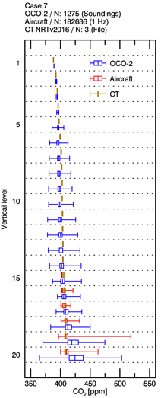
Validation of OCO-2 using FLAGG-MD: Spatial and temporal windows for validation
OCO-2 & FLAGG-MD, WINTER 2015

Slide 17
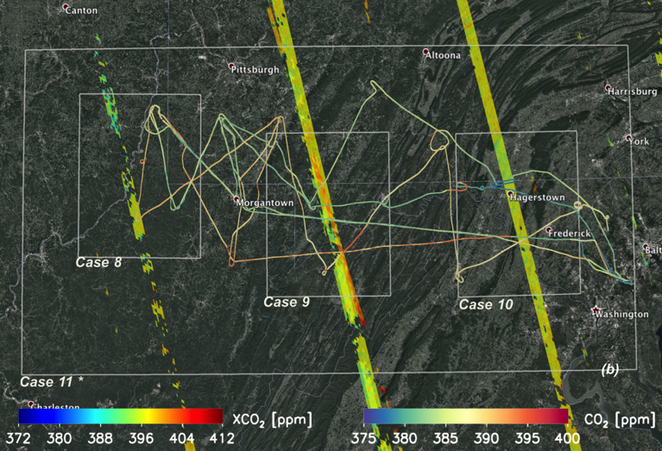
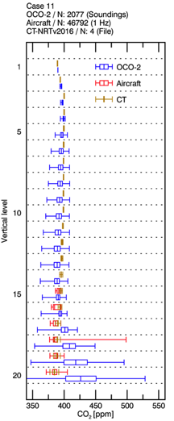
Validation of OCO-2 using FLAGG-MD: Spatial and temporal windows for validation
OCO-2 & FLAGG-MD, SUMMER 2015

Slide 18
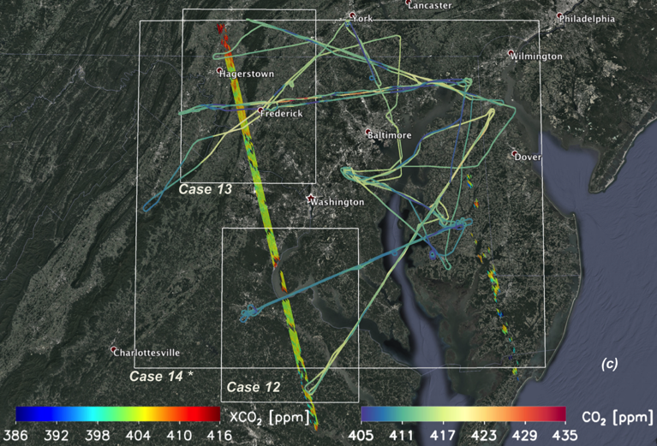
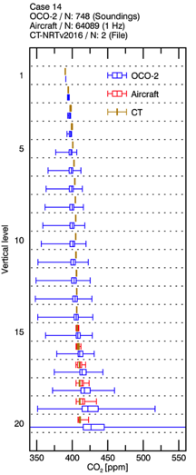
Validation of OCO-2 using FLAGG-MD: Spatial and temporal windows for validation
OCO-2 & FLAGG-MD, WINTER 2016

Slide 19
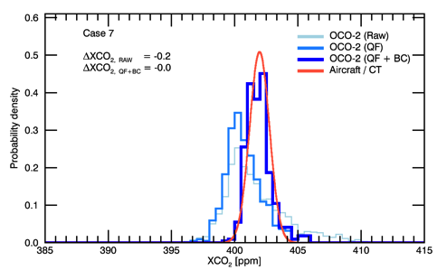
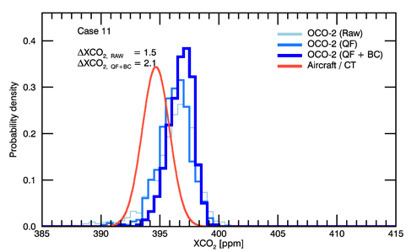
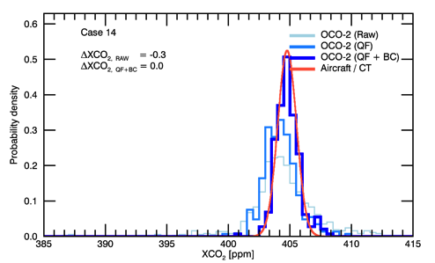
Validation of OCO-2 using FLAGG-MD: XCO₂ (OCO-2) compared to XCO₂ (Aircraft/CT)
OCO-2 & FLAGG-MD, WINTER 2015
OCO-2 & FLAGG-MD, SUMMER2016
OCO-2 & FLAGG-MD, WINTER 2016

Slide 20
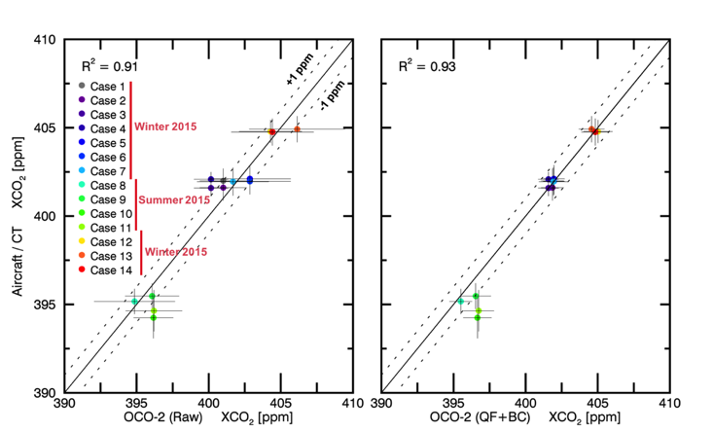
Validation of OCO-2 using FLAGG-MD: XCO₂ (OCO-2) compared to XCO₂ (Aircraft/CT)
Less than 1 ppm difference of XCO₂ were observed for most validation cases.
Quality filter (QF) and Bias correction (BC) in OCO-2 data product effectively reduced bias during winter period. However, bias of XCO₂ during Aug/Sep 2015 became larger after applying QF and BC.
Seasonal/Annual variation of XCO₂ was observed.
Approximate increase rate of ~ 2.5 ppmXCO₂/yr over Baltimore/Washington metropolitan area was observed by OCO-2 and validated using Aircraft/CT XCO₂.

Slide 21
Back up slides

Slide 22
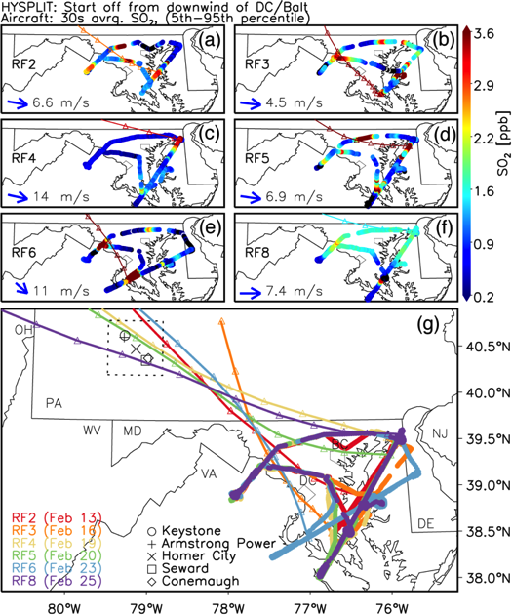
2-3. Source apportionment (PA)
Fig. 4. Maps showing SO₂ mixing ratio measured by aircraft during six different research flights in Feb 2015 ((a)-(f)). HYSPLIT back trajectory started from one of the SO₂ spikes observed downwind of DC-Baltimore area (a)-(f). Each back trajectory is colored by SO₂ mixing ratio measured at the starting location. Locations of each trajectory at every hour are shown as triangles on the trajectory. Red dashed circle indicates SO₂ spikes that are likely to be caused by the same air parcel based on back trajectory analysis. Average wind direction and speed calculated from airborne measurements over downwind of DC-Baltimore area is shown at the left-bottom of the plot (a)-(f). The same trajectories for each research plot are shown again in (g) with larger domain. Flight tracks of each research flight are shown in different colors. Back trajectories are shown as the same color of their research flights. Dashed box indicate the location where several large power plants are co-located.
Notes:
Aircraft captured several SO₂ spikes both upwind and downwind of the DC/Baltimore area.
Back trajectory analysis showed that the same plume was likely to be causing SO₂ spikes observed at upwind and downwind DC/Baltimore area. (RF2, RF3, RF5, RF6)
Back trajectory went nearby white box area in Fig. 1. (Homer city + other power plants)
Local enhancement of CO2 due to the same air parcel (from PA) should be addressed in flux calculation

Slide 23
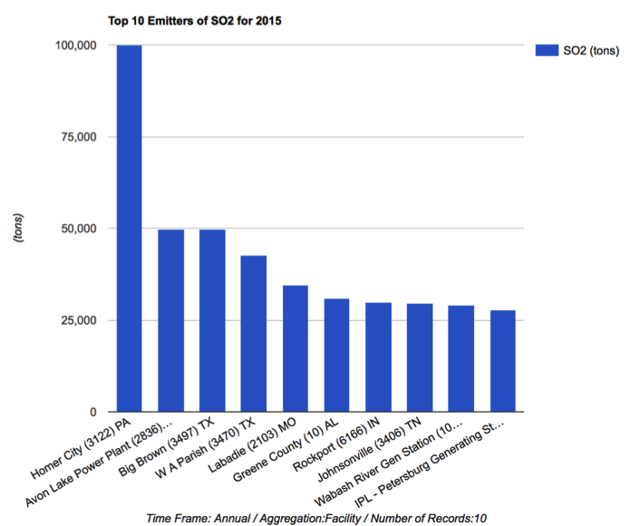
Annual top 10 emitters of SO2 in 2015

