Slide 1

Agenda
9:00 9:15 Introduction J. Whetstone
9:15 9:45 NIST activities and plans A. Karion
9:45 10:00 UMD/FLAGG-MD activities Overview R. Dickerson
10:00 10:15 WRF modeling and LETKF K. Ide
10:15 10:30 Discussion
10:30 10:45 Break
10:45 11:00 C-Cycle & Low Cost sensors N. Zeng
11:00 11:30 Modeling Discussion
11:30 12:30 Lunch
12:30 13:15 NIST activities and plans Cont. A. Karion
13:15 13:30 Methane Flux Measurements X. Ren
13:30 13:45 CO₂ Flux Measurements R. Salawitch
13:45 15:00 Open Discussion (Kalnay)

Slide 2




Flux of Atmospheric Greenhouse Gases in Maryland
Russell R. Dickerson,
Hao He, Kayo Ide, Eugenia Kalnay, Xinrong Ren, Ross J. Salawitch, YiXuan Shou (CMA), Ning Zeng, DaLin Zhang, and
Ariel Stein (New Director NOAA/ARL)
Monday February 13, 2017

Slide 3
Graduate Students 2017
Full Time
  Doyeon Ahn
  Courtney Grimes
  Cory Martin
Part Time
  Sarah Benish
  Shawn Howe
  Gina Mazzuca
  Phil Stratton

Slide 4
Context
MD Dept. Environment
  Aircraft
  Surface
  CMAQ/CAMx (Tim Canty)
  NESCAUM (Long Island Sound)
NSF
  Marcellus (SE)
  China
NASA
  OCO-2, INCA*, and Air Quality modeling (RJS)
  Policy Relevant Air Quality Modeling (TC)
*INCA = Climate Indicators and Data Products for Future National Climate Assessments

Slide 5
NE Corridor Overview and Coordination
Measurements
  Aircraft
  Towers
  Surface
  Low Cost arrays
Models
  WRF-Urban
  WRF- LETKF
  WRF-CHEM for Carbon

Slide 6
Big Picture and News for Baltimore/Washington
CH₄ emissions are higher than bottom up inventories by a factor of 2+
CO₂ passes sanity tests – uncertainty ~15%; working on first paper.
WRF–Urban gives the best met fields (PBL, U, V).
Ensembles gives precision in modeled met.
Large array of low cost sensors for Data Assimilation & WRF-CHEM.
Have agreed with Joe Hodges to develop a protocol to determine uncertainty in low cost sensors for O₃, CO, BC, etc.
MCCC meeting CH₄.
NOAA/ARL

Slide 7
Papers Submitted/in review
YiXuan Shou et al., Ensemble simulation of a northerly low-level jet and its impact on air quality over Indianapolis, submitted to J. Geophys. Res. Atmos., 2016.
Even though the circulation over Indianapolis is relative simple, there are surprises such as the Northerly Low Level Jet that carries GHG’s to Indy from Chicago.
Olivia Salmon et al., Urban Emissions of Water Vapor and Connections to the Urban Heat Island,, J. Geophys. Res., submitted, 2016.
Xinrong Ren et al., Methane Emissions from the Marcellus Shale in Southwestern Pennsylvania and Northern West Virginia Based on Airborne Measurements, J. Geophys. Res., submitted, 2016.
Cory Martin et al., Evaluation and enhancement of a low-cost NDIR CO₂ sensor, Atmos. Meas. Technol., submitted 2016.

Slide 8
Papers Pending
Grimes, C., C. Zangmeister, et al., Black Carbon Measurements and Calibration involving the Aethalometer Black Carbon Measurements and Calibration involving the Aethalometer, in preparation for Environ. Sci. Technol., 2017.
Ahn, D., J. R. Hansford, R. J. Salawitch, X. Ren, et al., “Fluxes of CO₂ from the Baltimore-Washington Area: Results from the Winter 2015 Aircraft Observations”, in preparation, to be submitted to J. Geophys. Res., 2017.
Ren, X., O. Salmon, D. Ahn, J. R. Hansford, R. et al., “Methane emissions from the Baltimore-Washington Area based on airborne observations,” in preparation, to be submitted to J. Geophys. Res., 2017.
Salmon, O., X. Ren, et al., Emissions of NOx, SO₂, CO from Baltimore and Washington, DC in winter 2015, in preparation, to be submitted to J. Geophys. Res., 2017.
Ahn, D., et al., Evaluation of satellite measurements of column CO2 using aircraft data, to be submitted to J. Geophys. Res., 2017.

Slide 9
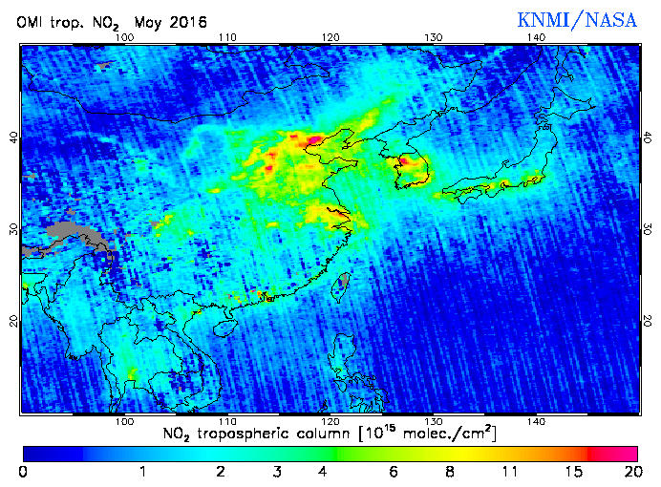
NO₂ columns from OMI over China
10 cm⁻² ~ 4 ppb in PBL
Hebei ➔

Slide 10
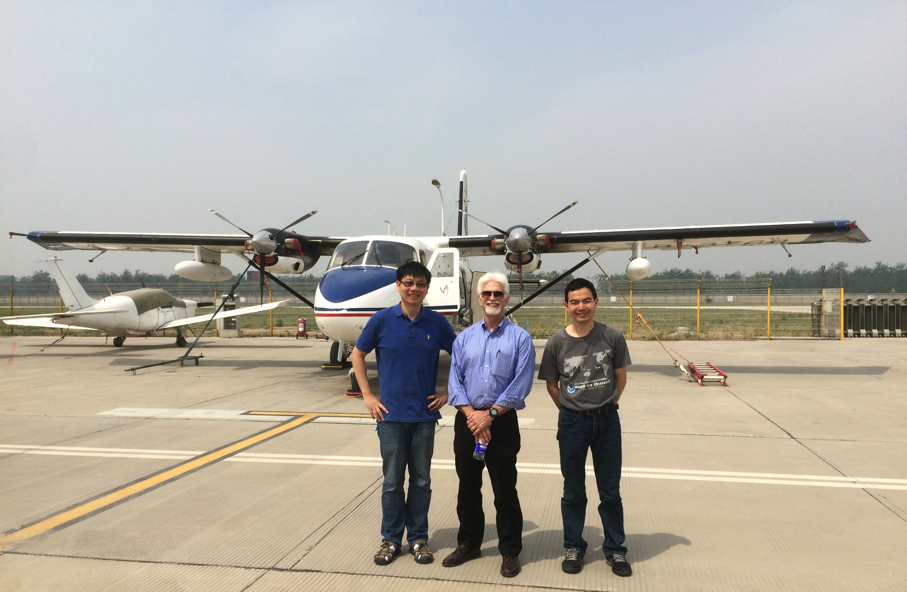

Slide 11
China 2016 CO to CO₂ ratio
ΔCO/ΔCO₂ = 6.0%
ΔCO/ΔCO₂ = 10.0%
ΔCO/ΔCO₂ = 2.0%

Slide 12
Balt/Wash CO to CO₂ Ratios
Observed and EDGAR Emissions
FLAGG-MD winter 2016
Linear fit:
Observed CO to CO₂ molar ratio = 0.53% (black line)
CO to CO₂ molar ratio in EDGAR 2010 emission inventory: 0.591% (red dashed line). May have fallen since 2010.
CO/CO₂ ratio in EDGAR 2010

Slide 13
Balt/Wash CH₄ vs. CO₂ colored with SO₂
Brown Station landfill
Urban/power plant plumes
Free troposphere

Slide 14
Goals
Quantification of emissions of urban greenhouse gases CO₂ and CH₄ to establish scientifically sound, cost-effective policies such as the Maryland Climate Change Plan and Regional Greenhouse Gas Initiative (RGGI).
Synergy between AQ obs GHG emissions.

Slide 15
Summary
Proposed Measurements:
  Profiles and transects of GHG’s and short lived pollutants such as NOx, SO₂, CO, BC, VOC’s including near towers.
  Background flights (major source of uncertainty).
  Dual aircraft simultaneous profiles and transects for better resolution.
  An array of low-cost sensors could provide superior monitoring.
Proposed Models:
  Most accurate winds come from the cutting edge models assimilating the best monitors and evaluated with the best measurements.
  Precision in met fields from ensemble of runs.
  Uncertainty from comparison of models for same domain with comparable gridding and resolution.

Slide 16
Agenda
9:00 9:15 Introduction J. Whetstone
9:15 9:45 NIST activities and plans A. Karion
9:45 10:00 UMD/FLAGG-MD activities Overview R. Dickerson
10:00 10:15 WRF modeling and LETKF K. Ide
10:15 10:30 Discussion
10:30 10:45 Break
10:45 11:00 C-Cycle & Low Cost sensors N. Zeng
11:00 11:30 Modeling Discussion
11:30 12:30 Lunch
12:30 13:15 NIST activities and plans Cont. A. Karion
13:15 13:30 Methane Flux Measurements X. Ren
13:30 13:45 CO₂ Flux Measurements R. Salawitch
13:45 15:00 Open Discussion (Kalnay)

Slide 17
Extra Slides

Slide 18
CH₄ Emission Estimate using CH₄/CO Ratio and CO Emissions
FLAGG-MD winter 2015
CH₄:CO = 1.94
CH₄:CO = 1.24
Total CO emissions from Balt-Wash in EDGAR v4.3 2010: 0.459 MMtons/yr
The total CH₄ emissions based on CH₄ to CO ratio: 10.3 kg CH₄ /s (7.0 – 16.1 kg CH₄/s)
CH₄:CO = 0.838

