Slide 1





Methane Emissions from the Baltimore-Washington Area: Airborne Observations and Comparison with Inventories
Xinrong Ren, Jonathan Hansford, Doyeon Ahn, Ross Salawitch, and Russ Dickerson (UMD)
Olivia Salmon and Paul Shepson (Purdue Univ.)
Outline
Aircraft measurements and mass balance approach for CH₄ emissions
Comparison with CH₄ Emission inventories
CH₄ emissions based on CO & CO₂ inventories and observed CH₄/CO & CH₄/CO₂ ratios

Slide 2
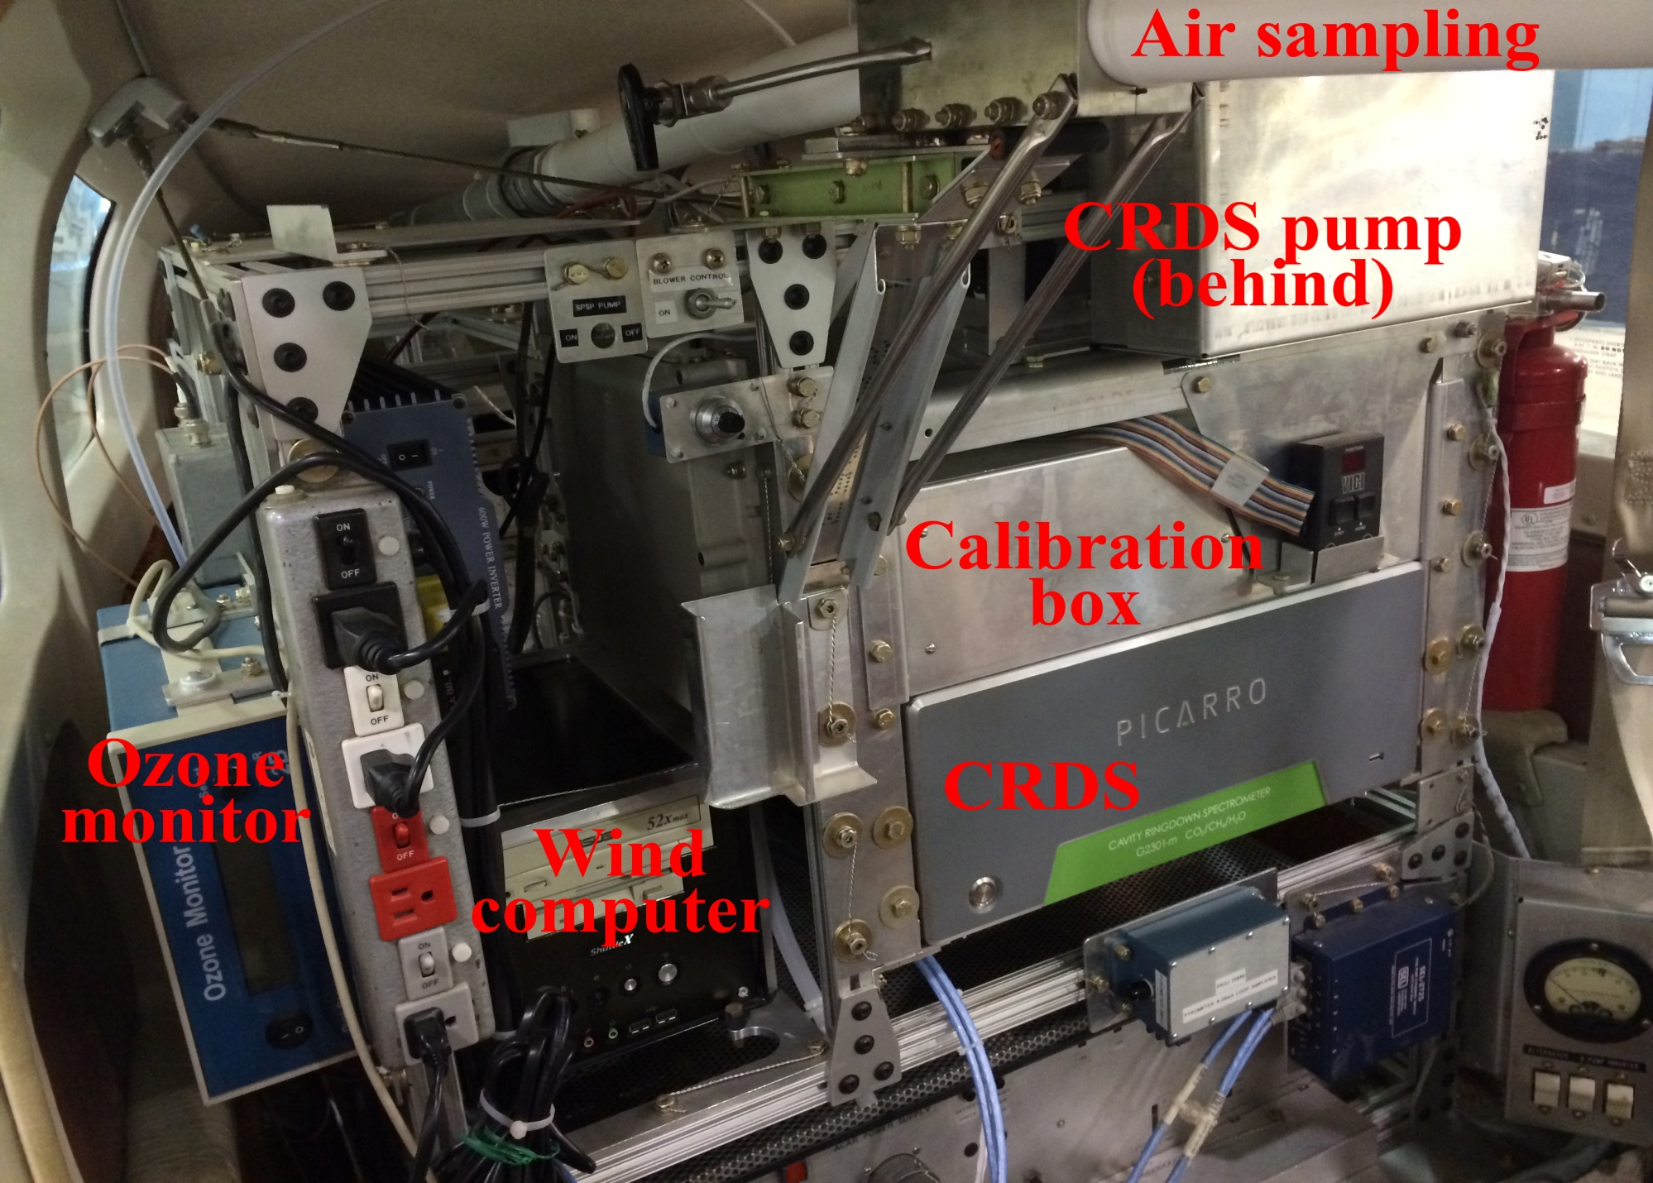
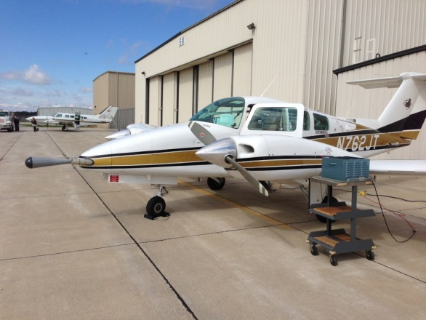
UMD Cessna & Purdue Duchess Research Aircraft
UMD Cessna
GPS Position (Lat, Long, Altitude)
Met (T, RH, P, wind speed/direction)
Trace gases:
O₃: UV Absorption, modified TECO
SO₂: Pulsed Fluorescence, modified TECO
CH₄/CO₂/CO/H₂O: Cavity Ringdown, Picarro
NO₂: Cavity Ring Down, Los Gatos
NO: Chemiluminescence, modified TECO
VOCs: grab canisters/GC-FID
Aerosol Optical Properties:
Scattering: b_{scat} (@450, 550, 700 nm), Nephelometer
Absorption: b_{ap} (565 nm), PSAP
Black Carbon: Aethalometer
Gas Inlet
Aerosol Inlet
Met Sensors
Purdue Duchess
GPS Position (Lat, Long, Altitude)
Met (T, RH, P, 3-D wind by BAT)
Trace gases:
O₃: UV Absorption, 2B Technology
CH₄/CO₂: Cavity Ring Down, Picarro
NO₂: Cavity Ring Down, Los Gatos
2

Slide 3
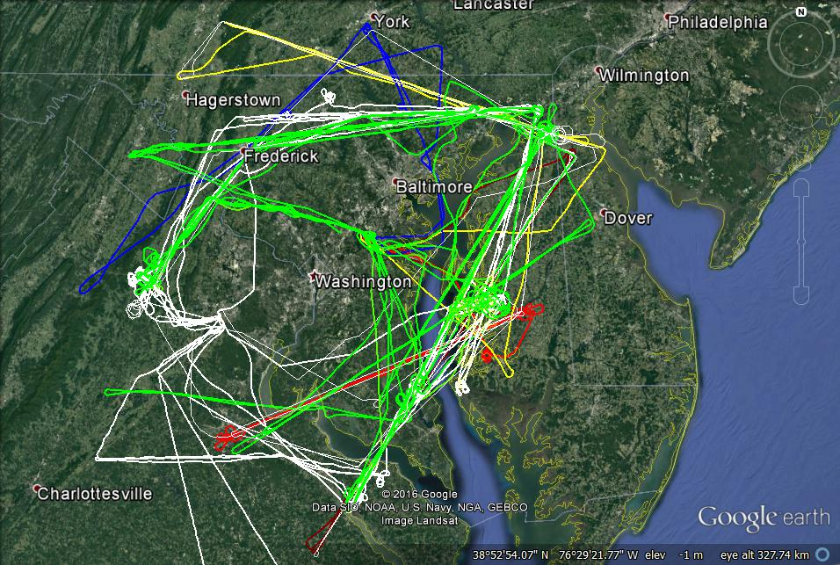
FLAGG-MD Flights during Winter 2015 and 2016

Slide 4
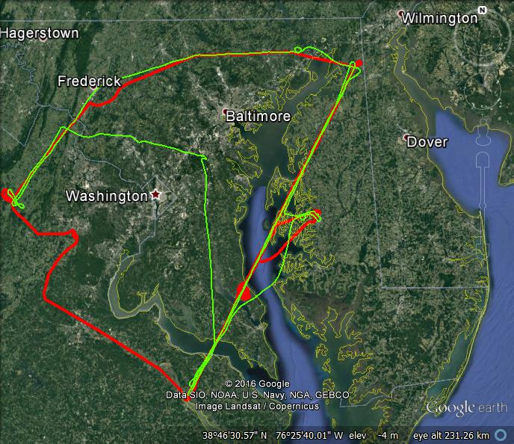
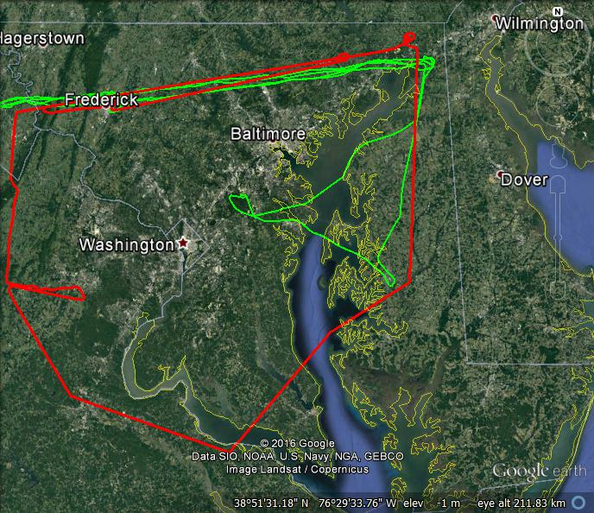
Different Flight Patterns in Winter 2015 and 2016
Flights on 2/19/2015
Flights on 2/19/2016
FLAGG-MD 2016:
The Cessna did continuous vertical profiles downwind.
The Duchess did upwind survey & leveled transects downwind.
wind
FLAGG-MD 2015:
Both aircraft did leveled transects
wind
Cessna
Cessna
Duchess
Duchess
Cessna
Duchess
Cessna
Duchess
Longitude (°)

Slide 5

Mass Balance Approach to Estimate Emission Rates
Mass Balance Experiment (MBE) approach:
E. R. : emission rate
[C] : concentrations (downwind)
[C]_{b} : concentration in background
U⊥ : perpendicular wind speed
∆z
Background
CO₂, CH₄, CO
Urban
CO₂, CH₄, CO
∆x
Background

Slide 6
Estimated GHG Emissions from the Baltimore-Washington Ares
FLAGG-MD winter 2015
FLAGG-MD winter 2016
Flight Date | Flux(CO₂) (moles s⁻¹) | Flux(CH₄) (moles s⁻¹) | Flux(CO) (moles s⁻¹)
2/6/15 | 94,500 | 557 | 521
2/13/15 | 71,000 | 290 | 281
2/18/15 | 91,200 | 795 | --
2/19/15 | 156,800 | 932 | 567
2/20/15 | 118,100 | 518 | 753
2/23/15 | 107,900 | 641 | 417
2/24/15 | 110,300 | 476 | 640
2/25/15 | 108,500 | 602 | 571
2/27/15 | 78,800 | 540 | --
Mean±1σ | 104,000 ±25,000 | 595±184 | 536±152
Date | Flux(CO₂) (moles s⁻¹) | Flux(CH₄) (moles s⁻¹) | Flux(CO) (moles s⁻¹)
02/08/16 | 73,200 | 418 | 430
02/12/16 | 93,000 | 350 | 510
02/17/16 | 107,800 | 1,078 | 365
02/18/16 | 98,100 | 373 | 611
02/19/16 | 142,800 | 722 | 688
Mean±1σ | 103,000 ±25,600 | 588±312 | 521±131
Mean CH₄ emission rate: 592 ± 248 moles s⁻¹

Slide 7
CH₄ Emissions from the SW Marcellus
Mass Balance Experiment (MBE) approach:
Prevailing
wind
Flight Date | [CH₄]_{upwind} (ppbv) | [CH₄]_{downwind} (ppbv) | WS (m s⁻¹) | WD (deg) | PBL Height (m AGL) | CH₄ E.R. (moles s⁻¹)
8/25/15 | 1,967±22 | 2,023±39 | 9.7±1.4 | 260±12 | 2,200 | 2,391
8/29/15 | 2,016±16 | 2,119±50 | 6.6±1.4 | 226±13 | 1,950 | 2,315
9/14/15 | 1,960±28 | 2,032±37 | 9.6±1.2 | 283±12 | 1,500 | 2,156
From Marcellus (55x77 km): 2,287 ± 120 moles CH₄ s⁻¹
From Balt-DC (75x95 km): 592 ± 248 moles CH₄ s⁻¹

Slide 8
Point Source: CH₄ Emissions from Brown Station Landfill
wind
Brown Statin Landfill
Flight # CH₄ Emission Rate (moles s⁻¹)
RF1 57.4
RF2 55.7
RF4 51.8
RF5 64.7
RF6 65.3
RF7 36.0
RF8 69.1
-----------------------------------
Mean 57.1 ± 11.1
EPA GHGRP CH₄ emission rate for this landfill: 15.5 moles s⁻¹
E. R. : emission rate
[C] : concentrations (plume peak)
[C]_{b} : concentration in background
U⊥ : perpendicular wind speed
A factor of 3.7 higher than the value in GHGRP

Slide 9
Mass Balance vs. Inventories
Landfill (# of transects/flights) | Mass Balance Flux Range** (moles CH₄ /s) - Average of all transects | 2015 EPA (moles CH₄/s) | 2014 MDE (moles CH₄/s) | 2012 Maasakkers (moles CH₄/s)
Brown Station (21/7) | 24.6 – 64.0 | 3.44 or 15.5* | 6.14 | 8.52
Eastern Sanitary (3/1) | 9.9 – 49.5 | 4.54 | 6.85 | 10.01
Quarantine Road (7/3) | 1.35 – 2.94 | 3.33 | 17.6 | 3.11
Harford Waste (2/2) | 2.22 – 8.50 | 5.42 | 3.52 | 5.52
Reichs Ford (3/2) | 12.8 – 26.2 | 5.88 | 1.83 | 4.96
Route 40 West (3/3) | 2.66 – 10.01 | 6.89 | 10.23 | 6.70
* EPA GHGRP requires landfills with a gas collection system (Brown Station has a gas collection system) to estimate their emissions in two ways. Typically, the higher of the two results is reported as the “official” value, but in Brown Station’s case, the lower number (3.44) was reported instead of the higher number (15.5).
**Flux range computed by varying horizontal transect width by 10% and PBL height by one-sigma.

Slide 10
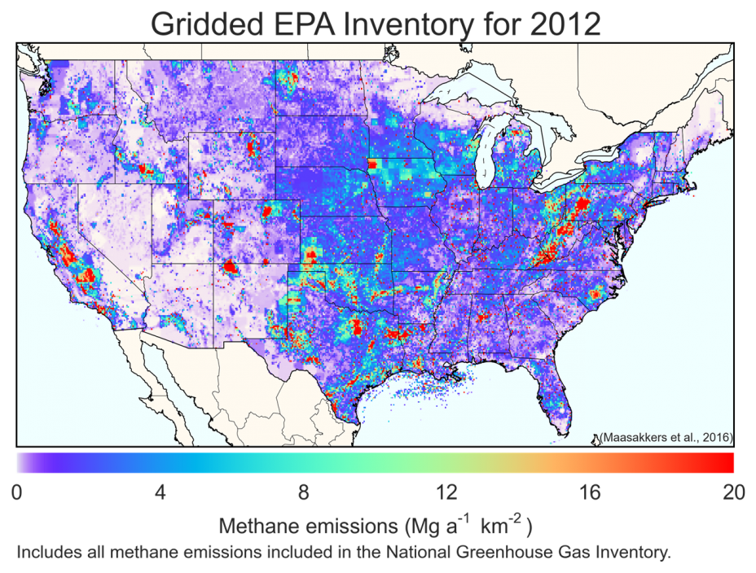
Gridded US CH₄ NEI for 2012 (0.1° x 0.1°)
196 moles CH₄/s
from Balt-DC

Slide 11
CH₄ Emissions from Sources in Balt-DC in CH₄ NEI 2012
2%, 0.07 kg/s
8%, 0.24 kg/s
8%, 0.24 kg/s
49%, 1.54 kg/s
Landfills are a major CH₄ source.
CH₄ emissions from NG system may be under-estimated.
10%, 0.30 kg/s
11%. 0.36 kg/s
12%, 0.39 kg/s

Slide 12
EDGAR4.2 Global 0.1° x 0.1° CH₄ Emission Inventory 2010
Data source: http://edgar.jrc.ec.europa.eu/gallery.php?release=v42FT2010&substance=CH4&sector=TOTALS
The total CH₄ emissions in the yellow rectangle (an approximately surveyed area) is 421 moles CH₄ s⁻¹.
Issues with EDGAR emissions: mainly allocated based on population instead of source locations.

Slide 13
CH₄ Emission Estimate using CH₄/CO Ratio and CO Emissions
FLAGG-MD winter 2015
CH₄:CO = 1.94
CH₄:CO = 1.24
Total CO emissions from Balt-DC in EDGAR v4.3 2010: 0.459 MMtons/yr
The total CH₄ emissions based on CH₄ to CO ratio: 642 moles CH₄ s⁻¹ (436 – 1,003 moles CH₄ s⁻¹)
CH₄:CO = 0.838

Slide 14
CH₄ Emission Estimate using CH₄/CO₂ Ratio and CO₂ NEI 2014
FLAGG-MD winter 2016
Total CO₂ emissions from Balt-DC in NEI2014: 89.0 MMtons/yr
The total CH₄ emissions based on CH₄ to CO₂ ratio: 583 moles CH₄ s⁻¹ (293 – 1,029 moles CH₄ s⁻¹)
CH₄:CO₂ = 0.909%
CH₄:CO₂ = 1.60%
CH₄:CO₂ = 0.465%

Slide 15
CO to CO₂ ratio: Observed vs. EDGAR Emissions
Obs. CO/CO₂
in winter 2016
Observed CO to CO₂ molar ratio = 0.53% (black line)
CO to CO₂ molar ratio in EDGAR 2010 emission inventory: 0.59% (red dashed line)
CO/CO₂ ratio in EDGAR 2010

Slide 16
CH₄ Emissions from the Balt-DC Area: Top-down vs. Bottom-up
Top-down & Bottom-up
Top-down
Bottom-up
VA
DC
MD
Maasakkers et al. [2016]
in DC-Balt

Slide 17
Summary
Successfully conducted mass balance flights for GHG in the Baltimore-Washington area in winter 2015 & 2016.
Estimated total emissions of CH₄ from this area:
595±184 moles CH₄ s⁻¹ in winter 2015
588±312 moles CH₄ s⁻¹ in winter 2016
Major CH₄ sources in the area: landfills and NG system.
Compared to CH₄ emission inventories:
  Observed CH₄ emissions are higher than the US NEI 2012 by a factor of 3
  higher than the state EI by a factor of ~2
  higher than the EDGAR 2010 by a factor of 1.4.
  Observed CH₄ emissions is similar to CH₄ emissions inferred from CO and CO₂
  NEI with observed CH₄/CO and CH₄/CO₂ ratios

Slide 18
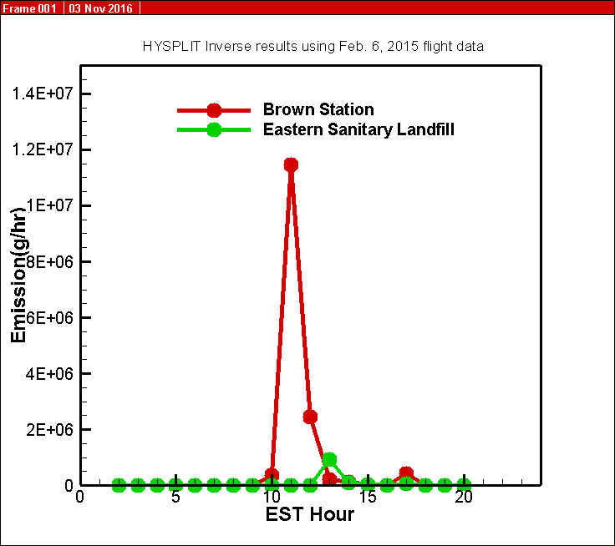
Date Assimulation Using HYSPLIT: Collaboration with NOAA/ARL
Method
A variational data assimilation method is used to find the sources with which HYSPLIT would reproduce concentrations that match best with the observations.
Assumptions
The two landfills causes for the measured excess CH₄.
The CH₄ emissions of the landfills vary each hour.
Two major limitations
There are other sources that contribute to the excess CH₄.
Meteorological fields in the HYSPLIT dispersion model has uncertainties.
Ongoing work
To add more sources + constant emissions from landfills
To use ensemble runs to include uncertainties of meteorological fields
Tianfeng Chai and Ariel Stein (NOAA/ARL)

Slide 19
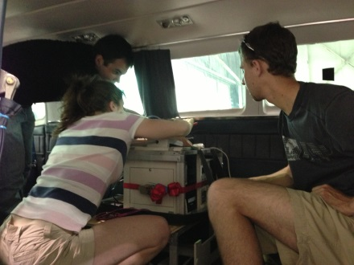
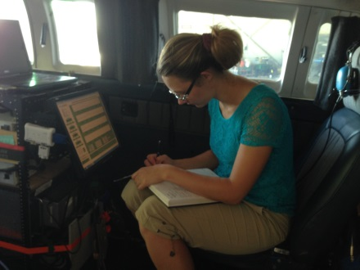
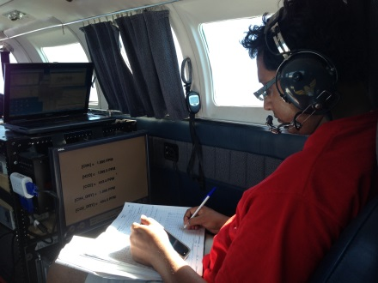
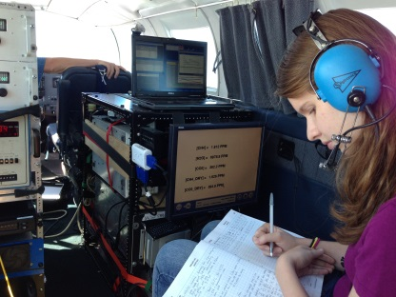
Acknowledgements
NIST for funding
The flight crew at University Research Foundation
Winston Luke and Paul Kelley at NOAA/ARL
Jerry Rhoderick, Bob Miller, and Kimberly Schuldt at NIST
Acefaw Belay and David Krask at MDE
Students who were involved in the study
Notes:
With that I would like to acknowledge the funding agencies for this projects as well as many people who helped including several students from UMD who helped to conduct flights.

Slide 21
Extra Slides

Slide 22
CH₄ Emission Estimate using CH₄/CO₂ Ratio and CO₂ NEI 2014
FLAGG-MD winter 2015
Total CO₂ emissions from Balt-DC in NEI2014: 89.0 MMtons/yr
The total CH₄ emissions based on CH₄ to CO₂ ratio: 6.6 kg CH₄ /s (3.5 – 11.6 kg CH₄/s)
Cold winter in 2015
expected more CO₂ emissions due to heating
A larger inferred CH₄ emission rate
CH₄:CO₂ = 0.635%
CH₄:CO₂ = 1.12%
CH₄:CO₂ = 0.336%

Slide 23
CH₄ Emission Estimate using CH₄/CO₂ Ratio and CO₂ NEI 2014
FLAGG-MD winter 2015
Total CO₂ emissions from Balt-DC in NEI2014: 89.0 MMtons/yr
The total CH₄ emissions based on CH₄ to CO₂ ratio: 6.6 kg CH₄ /s (3.5 – 11.6 kg CH₄/s)
Cold winter in 2015
expected more CO₂ emissions due to heating
A larger inferred CH₄ emission rate
CH₄:CO₂ = 1.12%
CH₄:CO₂ = 0.635%
CH₄:CO₂ = 0.336%

Slide 24
CH₄ Emission Estimate using CH₄/CO Ratio and CO Emissions
FLAGG-MD winter 2016
CH₄:CO = 2.58
CH₄:CO = 1.43
Total CO emissions from Balt-DC in EDGAR v4.3 2010: 0.459 MMtons/yr
The total CH₄ emissions based on CH₄ to CO ratio: 11.8 kg CH₄ /s (6.2– 21.4 kg CH₄/s)
CH₄:CO = 0.75

Slide 25
Observed C₂H₆-to-CH₄ Ratio
FLAGG-MD winter 2015
FLAGG-MD winter 2016
Mean C₂H₆-to-CH₄ ratio in natural gas of Baltimore Gas & Electric: 0.1045
Other major CH₄ sources (landfills, enteric fermentation, waste water treatment) has little ethane emissions.
Emissions from the NG system account for 32% (2015) and 41% (2016) of total CH₄ emissions.

Slide 26
CH₄ Emission Estimate from Unaccount-for NG
Total NG delivered to the Balt-DC area in February 2015: 54,495 million CF in Feb. 2015.
Lost & unaccounted-for (LAUF) NG : 3.34% of total NG delivered (PHMSA data)
Total lost & unaccounted for (LAUF) gas : 12.9 kg CH₄/s
Not all LAUF gas is leaked into the atmosphere because besides leaks, unaccounted-for gas is also due to gas theft, accounting & meter errors, etc.
The worth of the LAUF gas = 54,495 x 10⁶ CF x 3.34% x $0.012/CF
= $22 M in Feb. 2015

Slide 27
Facility level CH₄ Emissions in EPA’s GHGRP
(excluding emissions from Petroleum & NG System )
Mostly landfills
The total CH₄ emissions (other than the NG system) from the yellow rectangle is 1.21 kg/s
Based on the unaccounted-for natural gas and other CH₄ sources in GHGRP, the total CH₄ emission rate from the Balt-DC area:
12.86 + 1.21 = 14.07 kg/s
This may overestimate CH₄ emissions since not all LAUF gas is emitted into the atmosphere.

Slide 28
CH₄ Emissions from the Balt-DC Area: Top-down vs. Bottom-up
Top-down & Bottom-up
Top-down
Bottom-up
Maybe upper limit

Slide 29
Brown Station – Mass Balance Calculations
RF | Mass Balance Flux (moles / s) (Mean of flux calculated on each individual transect)
1 | 30.7
2 | 44.7
4 | 31.9
5 | 59.9
6 | 21.1
7 | 71.8
8 | 66.3
Mean ± St. Deviation | 46.6 ± 18.3

Slide 30
Mass Balance – CH₄ from DC/Baltimore
Flight Date | Emission Rate (moles CH₄ s⁻¹) | Emission Uncertainty Range – Horizontal Bounds* (moles CH₄ s⁻¹) | Flux Uncertainty Range – PBL Depth** (moles CH₄ s⁻¹) | Flux Uncertainty Range – Horizontal Bounds & PBL Depth Combined*** (moles CH₄ s⁻¹)
2/13/15 | 193 | 177 – 201 | 145 – 241 | 133 – 251
2/19/15 | 1260 | 1230 – 1270 | 853 – 1670 | 830 – 1680
2/20/15 | 509 | 452 – 509 | 351 – 667 | 311 – 667
2/23/15 | 157 | 141 – 169 | 110 – 204 | 99.0 – 219
2/24/15 | 951 | 857 – 1180 | 705 – 1200 | 633 – 1490
2/25/15 | 183 | 172 – 187 | 97.5 – 269 | 90.6 – 274
Mean | 542 | 505 – 586 (-6.8% / +8.1%) | 377 – 709 (-30.% / + 31%) | 349 – 764 (-36% / +41%)
*Flux range computed by varying horizontal transect width by 10%
**Flux range computed by varying PBL height by one-sigma
***Flux range computed by varying horizontal transect width by 10% and PBL height by one-sigma.

Slide 31
CH₄ emissions from King George Landfill
[CH₄] (ppbv)
Eastern Sanitary
Quarrantine Rd
Brown Station
11.5 km
King George

Slide 32
Estimate of CH₄ Emissions from King George Landfill
Mass Balance Experiment (MBE) approach:
[C] : concentrations (downwind)
[C]_{b} : concentration in background
U⊥ : perpendicular wind speed
CH₄ emission rate from King George landfill based on a single downwind transect:
24.0 moles CH₄ s⁻¹ , or 12,100 tons CH₄ yr⁻¹
This is close to EPA’s GHGRP CH₄ emission data for this landfill:
11,800 tons CH₄ yr⁻¹

