Slide 1

Northeast Corridor: Baltimore/Washington (NEC-bw)
NIST Activities and Plans
February 13, 2017
James Whetstone, Anna Karion, Tamae Wong, Kim Mueller, Kuldeep Prasad, Israel Lopez Coto, Sharon Gourdji, Subhomoy Ghosh, David Allen

Slide 2
Outline
General Remarks
Summary of status and work to date
  Network design study
  Background towers and locations study
  Current status of towers and data products
In progress and planned work
  Meteorological & Dispersion modeling
  Establishing background for observations
  Flux inversion analysis
  Other: Biospheric CO2 work, Inventory development, LES

Slide 3
General Remarks
Today’s Meeting Discussion & Some Longer Term Objectives
Review and discuss Baltimore/Washington portion of the NIST Northeast Corridor Testbed project
Seek ways to increase synergies between UMD and NIST efforts
Discuss, perhaps prioritize, ways to effectively close on assessment of most useful modeling and analysis approaches
Discuss efficiency of combined efforts, e.g., interoperability of WRF results
  Harmonize gridding – NIST and UMD produce results that can be used by the partner organization for further analysis
  WRF output parameter content/format that facilitates footprint analysis
  Planning of time period coverage & conditions in building ensembles
  Common data storage ?
Develop a common analysis objective for the B/W research effort
  Emphasize methods that reduce dependence on non-flux priors
  Identify areas where additional observations will improve analysis capabilities
Status of paths toward using well-instrumented urban regions for satellite calibration
Expand efforts to combine tower and aircraft and other upper atmosphere (aircraft and remote sensing) observations – Follow on to Aliso Canyon efforts

Slide 4
Previous work
Israel Lopez Coto et al., “Tower-Based Greenhouse Gas Measurement Network Design”, Atmospheric Environment, doi 10.1007/s00376-017-6094-6.
  Network design study (OSSE) to locate tower sites
  Clustering approach to place the towers (maximize the differences between signals)
Mueller et al., in prep: OSSE to identify optimal location for towers to characterize incoming air flow (i.e. background) for the 12 urban towers.
  4 have been identified
  Study showed the need for a more sophisticated background analysis than usual: large bias is introduced if the background tower data is used alone.

Slide 5
Network design for NEC
Design a network of stations for monitoring urban GHG emissions for the NE Corridor (Washington DC + Baltimore) and to assess the impact of using a very dense network of low-cost low-accuracy CO2 sensors (uncertainty + drift).
February and July sensitivity functions (footprints) for 98 potential observing points. (WRF – STILT)
Clustering approach to place the towers (maximize the differences between signals)
Evaluate the networks by using an OSSE (Observing system simulation experiment) → Synthetic inversions (assumed emissions + pseudo-observations + Kalman Filter)
Lopez Coto et al., accepted

Slide 6
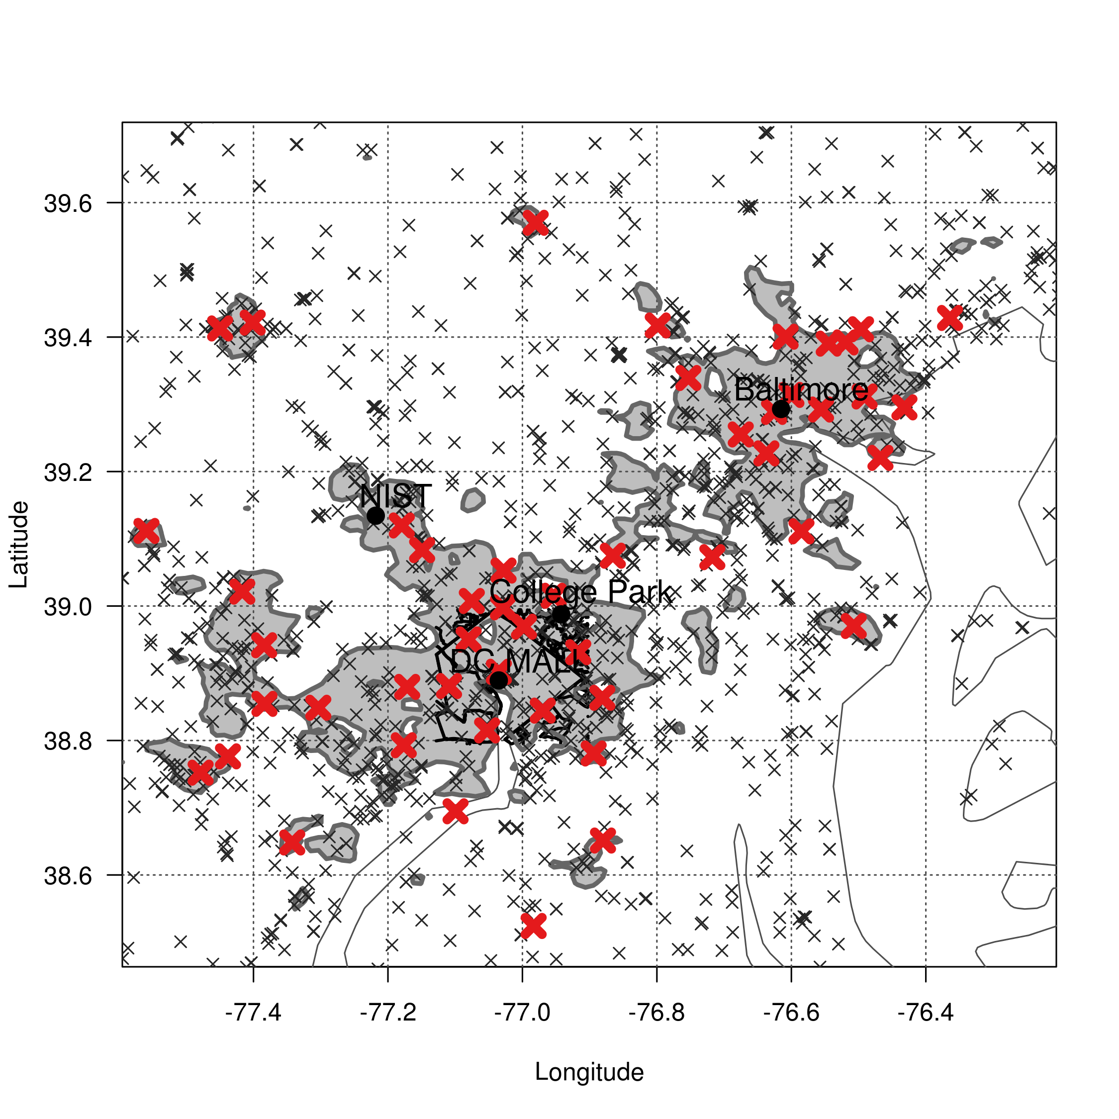
FCC Towers
120 km
98 preselected urban locations
50 – 100 magl
Placed on urban land use (or very close by)
Sparse across the domain
130 km
Lopez Coto et al., Atm. Env.
URBAN LAND USE FROM MODIS 2012
Notes:
This may become backup

Slide 7
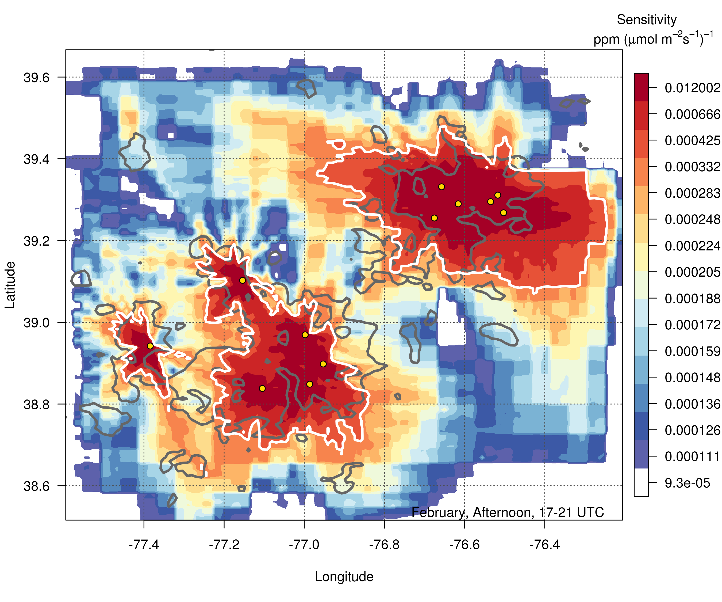
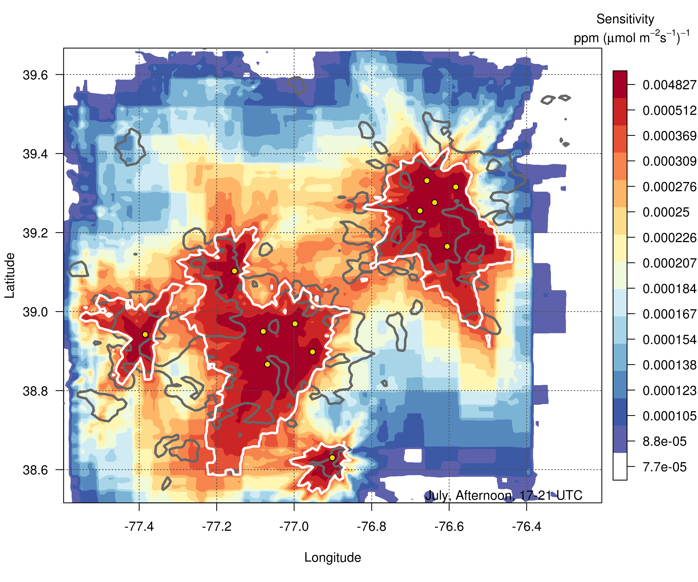
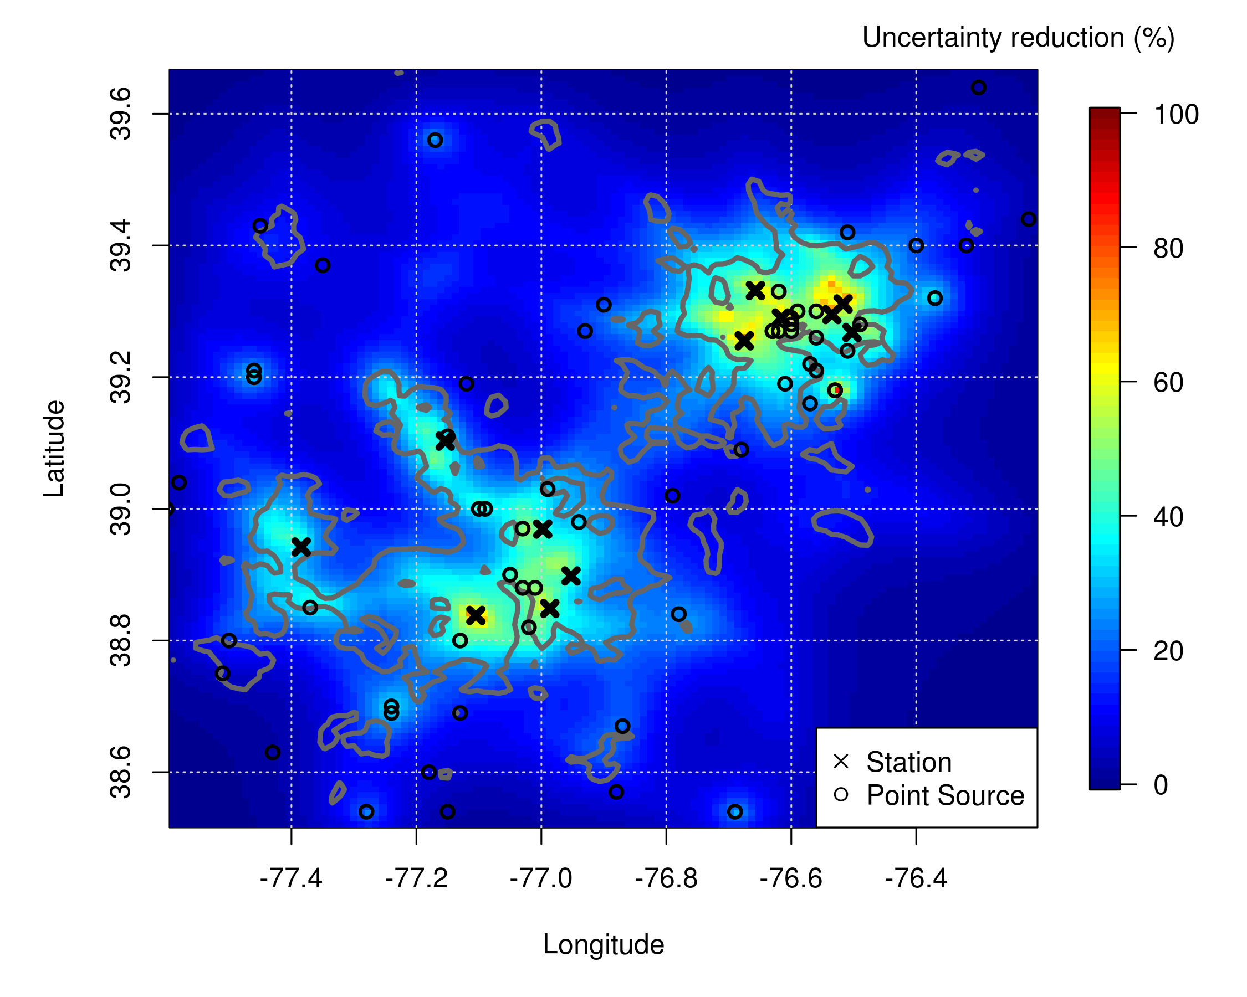
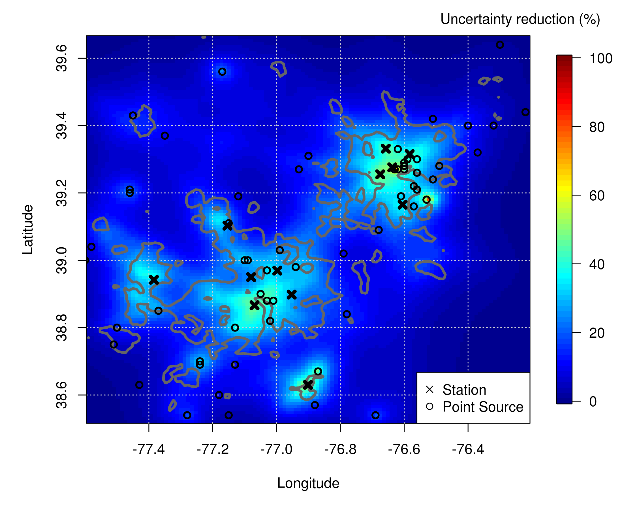
February
July
Sensitivity
Uncertainty reduction
Lopez Coto et al., Atm. Env.
Notes:
This may become backup

Slide 8
In Progress and Planned Activities
Tower data collection & status; time series analysis of tower observations
Met & dispersion modeling: Current evaluation effort, planned long-term runs
Large Eddy Simulations: validation & simulation of point sources
Background determination (incoming air)
Inventory development and status
Biospheric work on NIST campus (SIF measurements)
Flux inversions (CO₂, CH₄)

Slide 9
Tower-based network
In-situ CH₄, CO₂ (Earth Networks/Picarro CRDS)
4 NOAA flask sites planned (1 hour integrated samples; C-14 analysis; other gases (CFCs, hydrocarbons): 6 samples /month)
Weather stations (Earth Networks)
12 stations in urban region (Wash DC & Baltimore); 6 established, 6 in next year
4 planned background stations
2 sampling heights at each site (typically 50 & 90 magl)
Heights > 30 magl, but most 50+ m.

Slide 10
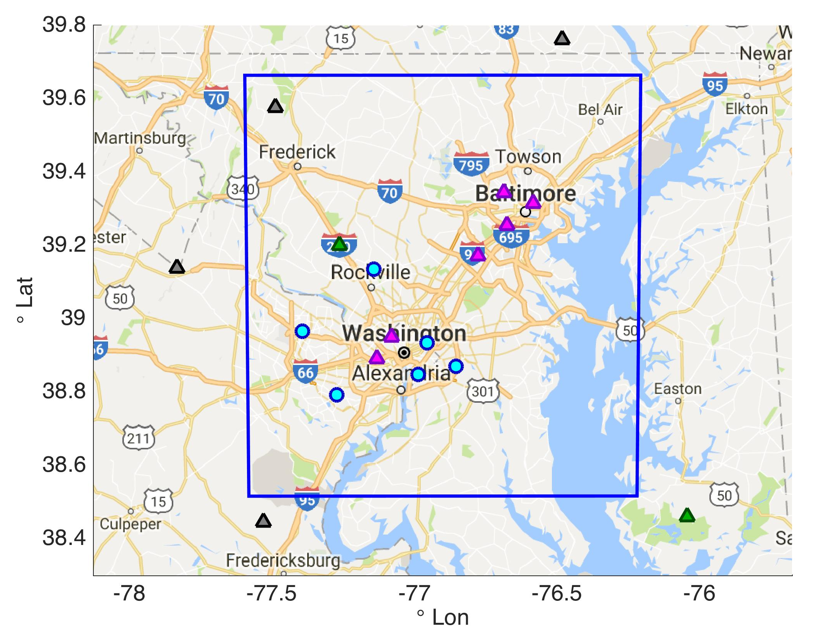
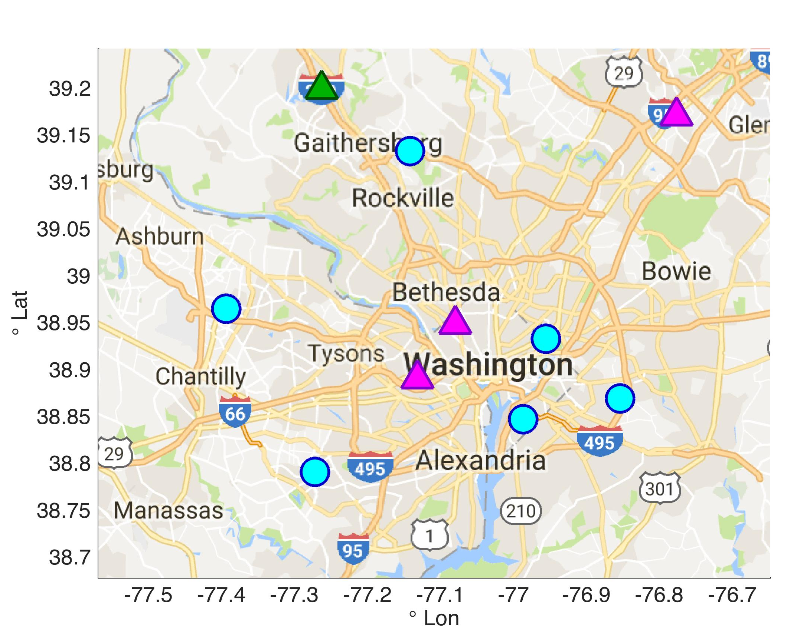
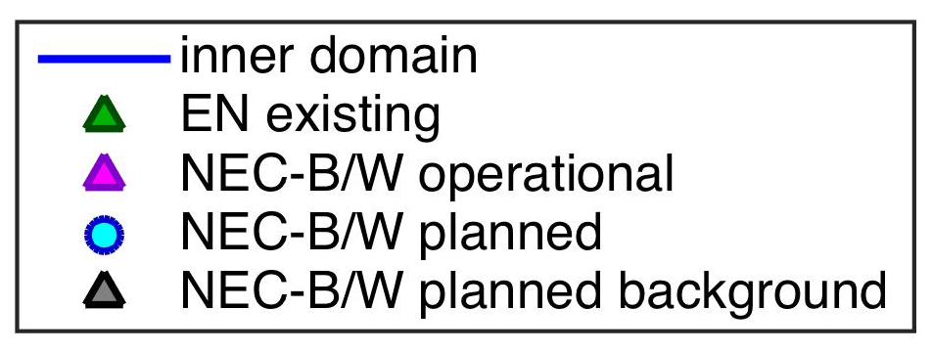
zoom on Washington DC
BG
BG
BG
BG
GHG01

Slide 11
Tower Data Status and Goals
Status:
  Processed using automated filters and calibrated with on-site tanks.
  Consistency with LA Megacities network and operations.
  20-minute and 1-minute averages of mole fractions and other auxiliary data, including weather.
  Verhulst et al., ACPD, “Carbon Dioxide and Methane Measurements from the Los Angeles Megacity Carbon Project: 1. Calibration, Urban Enhancements, and Uncertainty Estimates”, 2016. In Discussion for ACP.
  Data reported on WMO CO2 and CH4 scales.
In Progress:
  2-point calibration system (additional high-concentration tanks to be deployed)
  Produce versioned 1-hour average files, dated, for each sampling height for each molecule
  Include uncertainty estimate for each measurement.
  Make available on a website, password protected for now.

Slide 12
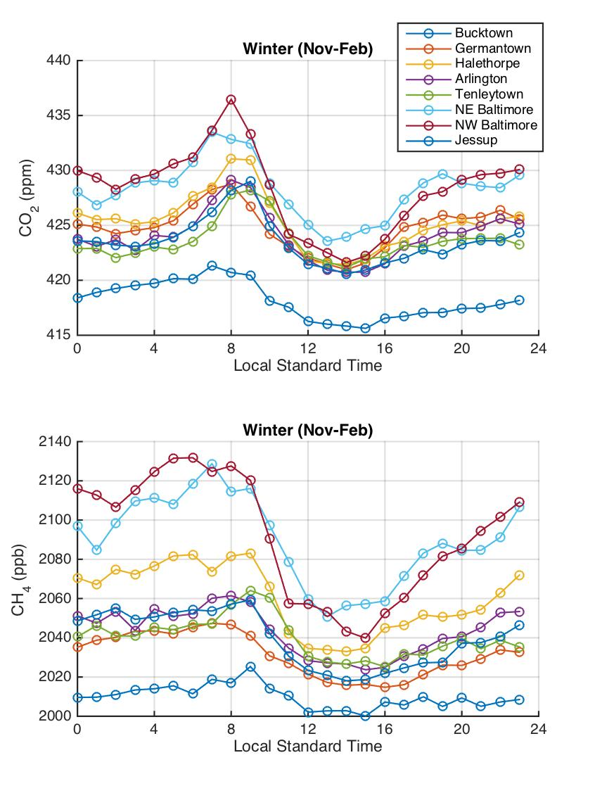
Future plans: time series analyses
Frequency analysis can give information as to scales of variability as function of location and height of tower (near or far from sources, etc.)
Vertical gradients can give an idea of meteorological information such as when the PBL is well-mixed, timing of PBL growth.
Analysis of enhancements over background from different sites can yield diurnal trends in emissions by location, and long-term trends eventually as more data is gathered.
NOAA flasks at 4 towers will allow for tracer/tracer analysis and CO2ff partitioning based on C-14.

Slide 13
Meteorological Modeling
NIST (Israel Lopez Coto) has run WRF for February 2016 and evaluated different parametrizations and different boundary conditions.
6 Ensemble Members
  IC/BC HRRR (5) or NARR (1)
  4 different PBL schemes: MYNN, YSU, BOUL, QNSE
  1 Urban Canopy Model
3 domains (9 km, 3 km, 1 km) for NARR-driven run; 2 domains for HRRR runs
60 levels
Evaluation of WS, WD, T, and PBLH against 33 MADIS stations & 1 radiosonde (Sterling, VA)
Lopez Coto et al. AGU 2016

Slide 14
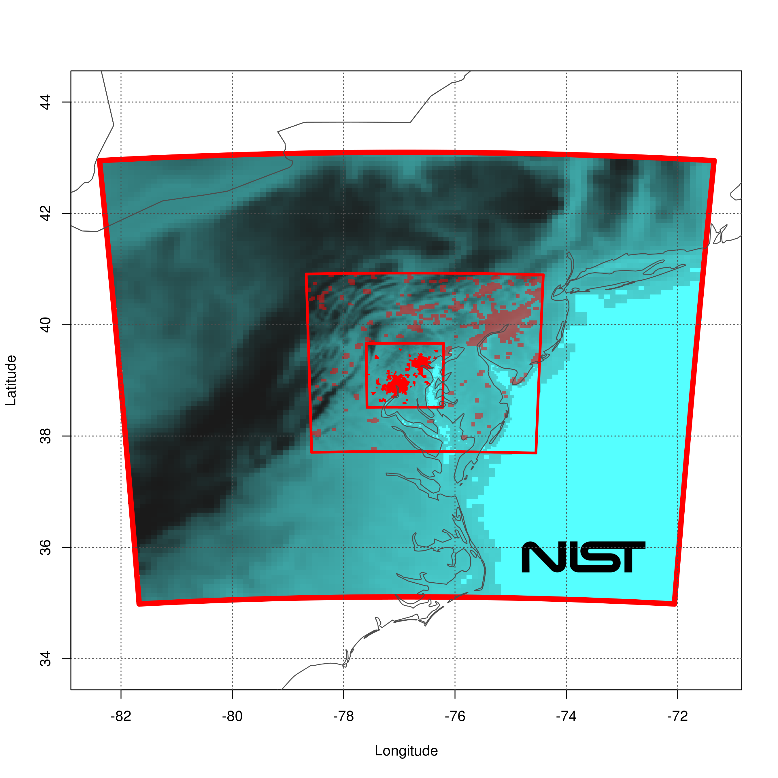
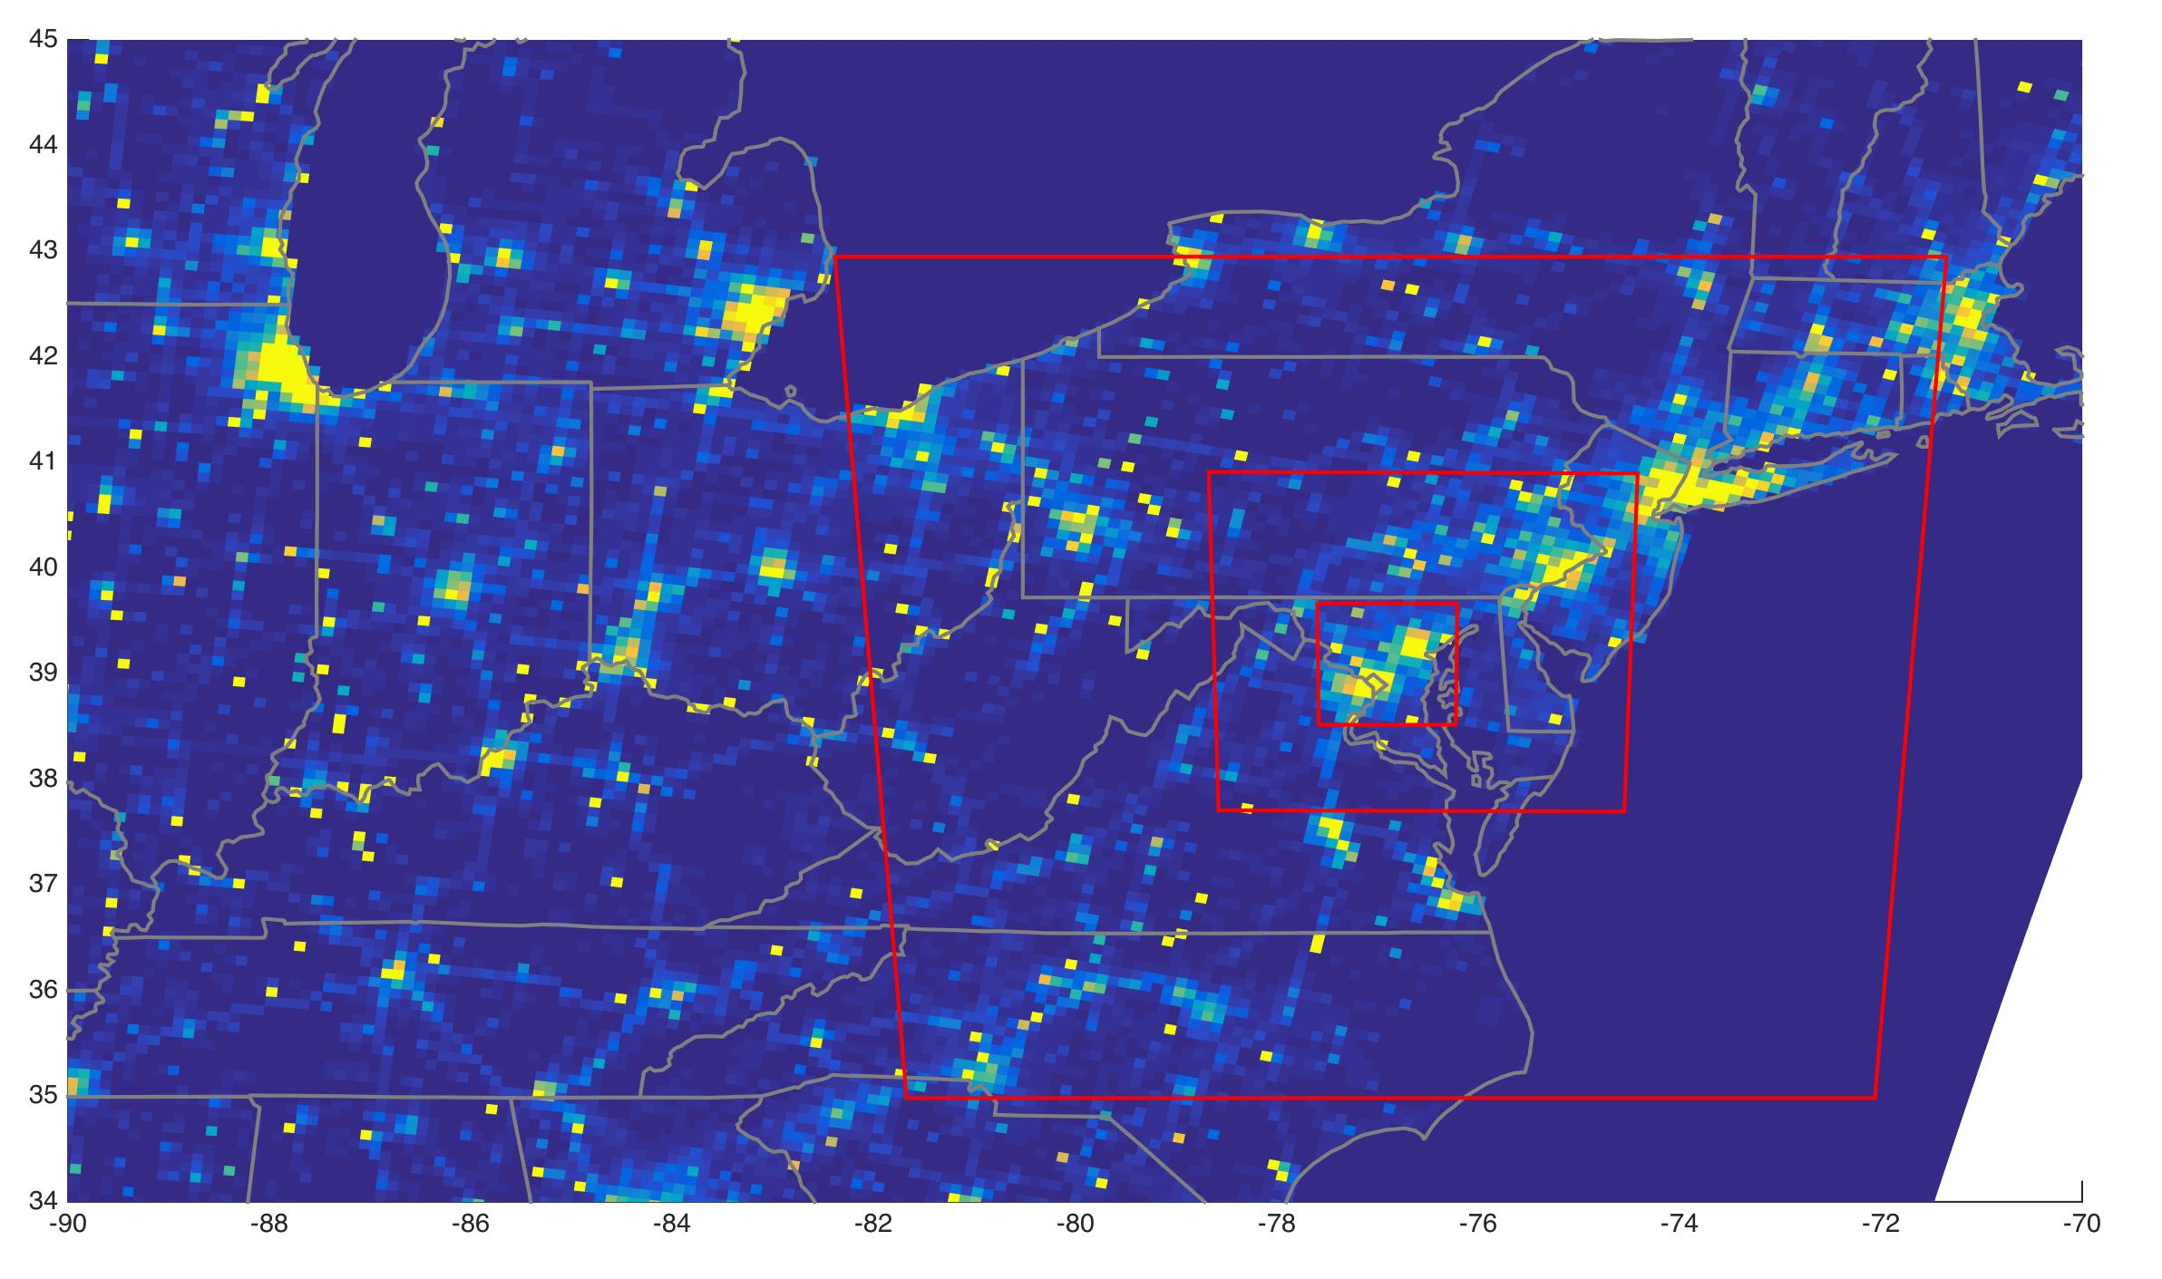
WRF domains & grids
Lopez Coto et al. AGU 2016
9 km
3 km
1 km

Slide 15
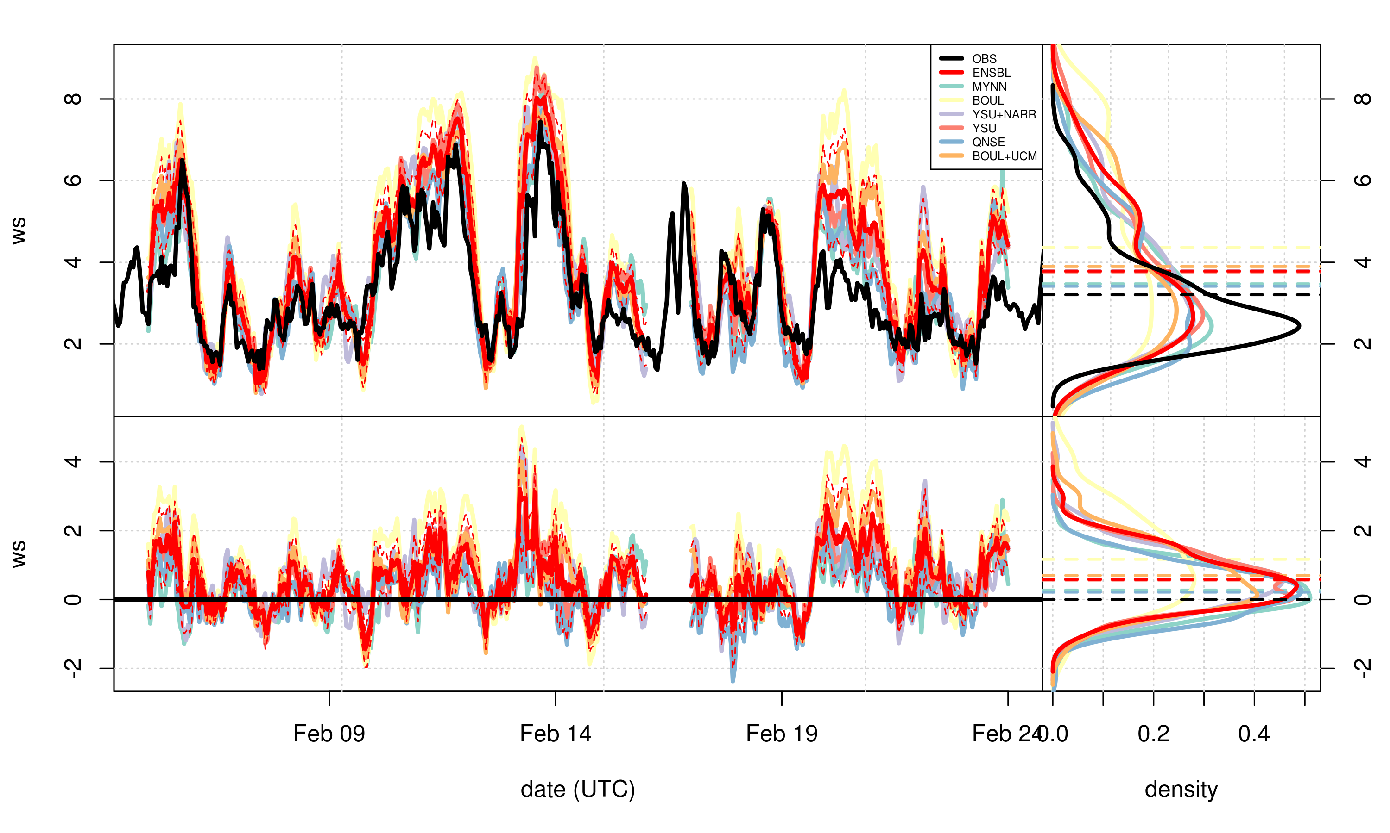
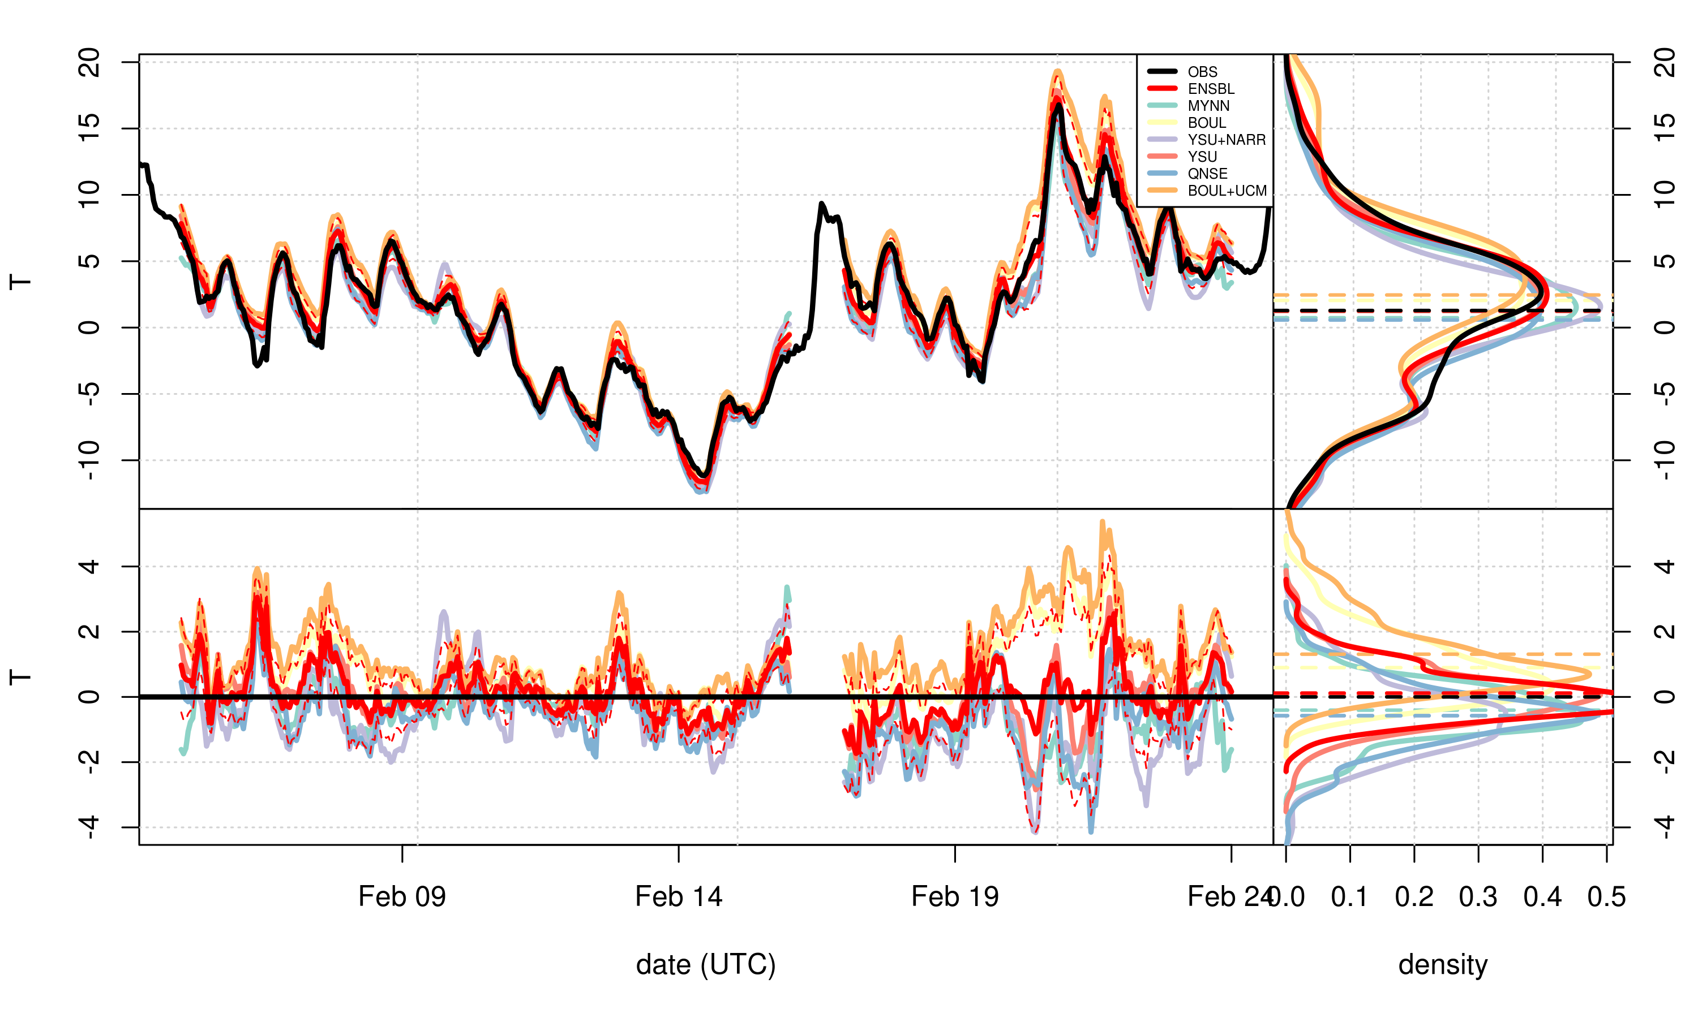
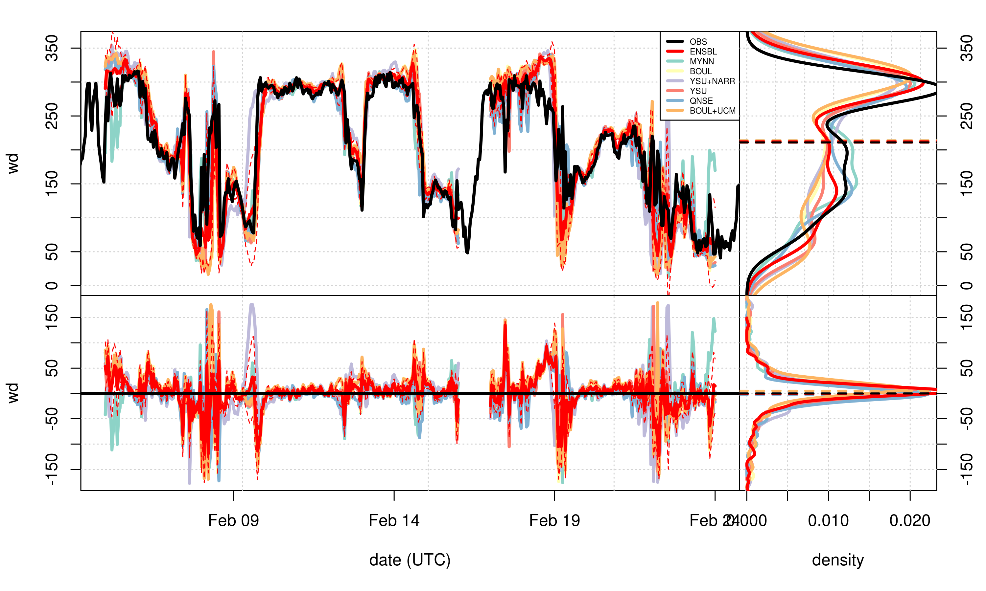
wind speed
temperature
ws m/s
T (deg C)
ws bias
T bias
wind direction
Hourly observed (black) and simulated (colors) values, averaged across the MADIS stations for each WRF configuration and ensemble mean (red).
WD
WD bias
Small global bias for WS, WD, and T, but can be large for specific stations and/or hours. The ensemble fails to include observations at some specific times.
Lopez Coto et al. AGU 2016

Slide 16
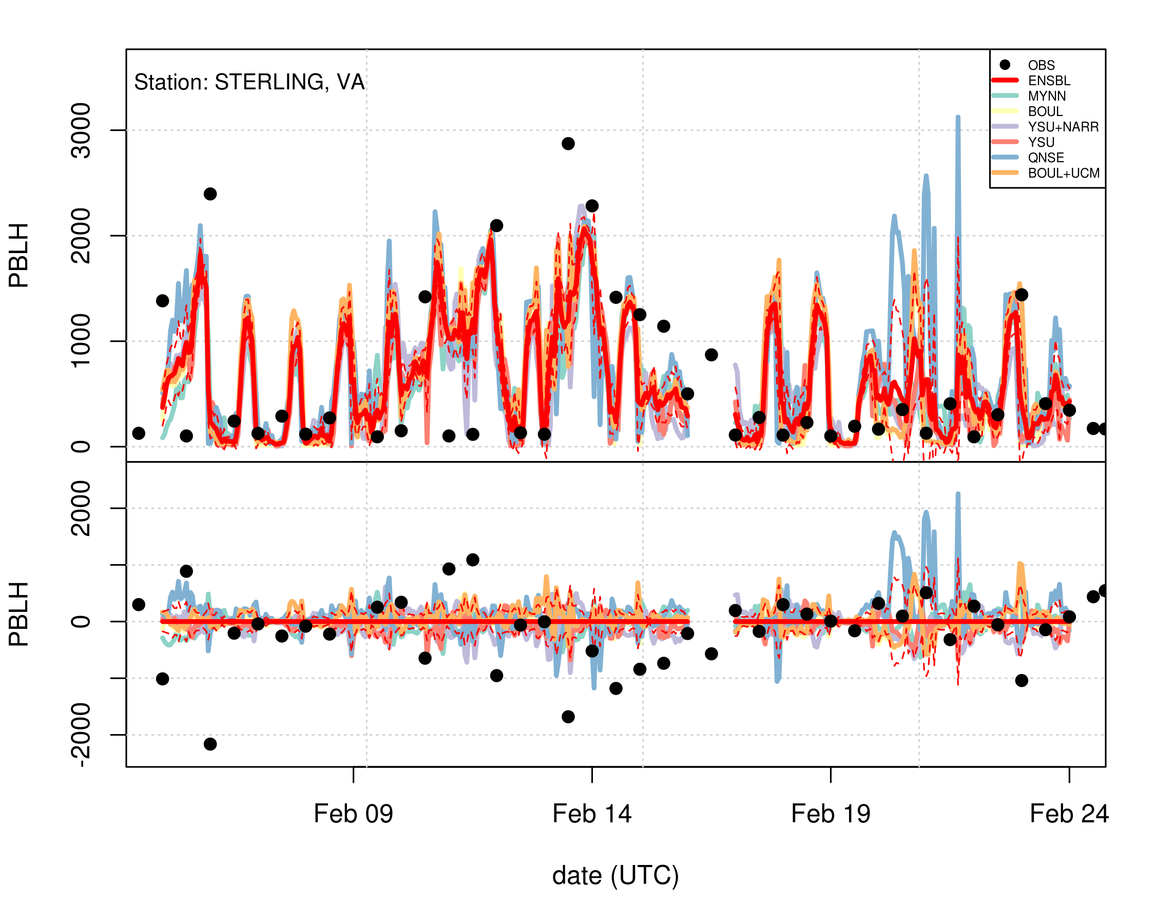
PBL depth
Black points: PBLH from radiosondes at Sterling, VA
Red: Ensemble mean
Difference from ensemble mean
Lopez Coto et al. AGU 2016

Slide 17
WRF Model Ensemble, Feb 2016
Small global BIAS for WS, WD, and T, but can be large for specific locations and/or hours.
No large differences between HRRR and NARR as drivers.
No clear winner for the PBL schemes
BOULAC is too windy and warm. QNSE provides the highest PBLH. UCM causes the temperature to be too warm and elevates the mean PBLH.
PBL and WS dominate as predictors of ensemble mean sensitivity to surface fluxes
In future, we plan to be able to use PBLH from a set of Mini-MPL instruments in the region providing PBLH continuously.
Evaluating meteorological variables against observations will give one measure of model/data mismatch for an inversion analysis.
Lopez Coto et al. AGU 2016
Notes:
LSM-Noah, K-F Cumulus scheme only at 9km, SW (and LW)-RRTMg

Slide 18
Lagrangian Particle Dispersion Modeling (LPDM*)
* e.g.: STILT, HYSPLIT, Flexpart
Mass-less particles are emitted from a receptor location, that is a location where a GHG observation has been made (lat, long, alt, time).
Particles are advected and tracked backwards in time based on wind fields input to the LPDM (i.e. many back trajectories from one observation point).
The residence time of the particles in the PBL over a specific grid cell (lat, lon) determines the influence of fluxes in that grid cell on the given observation (Lin et al., 2003).
Aggregating the particles gives a footprint over all the surrounding grid cells, i.e. a sensitivity or influence function.

Slide 19
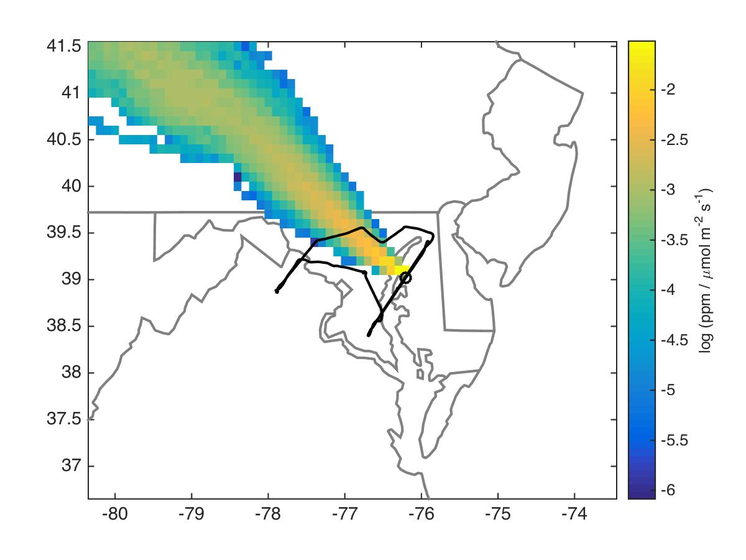
Example of a Footprint
Units of footprints are mole fraction enhancement per unit flux.
Multiplying (convolving) the footprint by the flux in a grid cell results in the fractional enhancement at the observation point that is caused by flux in that cell.
NAM-12/ HYSPLIT

Slide 20
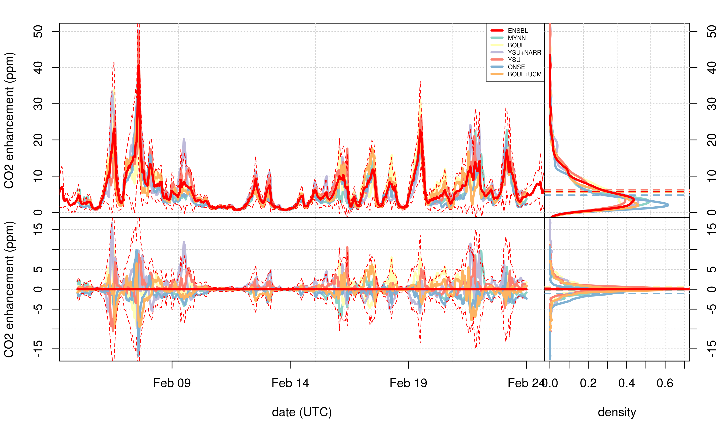
Convolution of WRF-Stilt footprints with simple CO_{2ff} inventory gives modeled CO₂ enhancements at the 12 tower locations.
Hourly modeled CO2 enhancement averaged across towers for each WRF configuration. Red line is ensemble mean.
Difference from ensemble mean. Dashed line is ensemble spread.
Lopez Coto et al. AGU 2016

Slide 21
Met & Dispersion Modeling: Planned work
NIST plans on running WRF for one to multiple years for a time period beginning when the first background site is operational.
Couple with STILT and Hysplit to calculate footprints (influence functions) for the tower, aircraft, and other observations.
Footprints will be convolved with flux maps (biogenic, Fossil CO2, or CH4) to calculate modeled enhancements at towers or along flight paths.
Compare:
  different meteorological and dispersion model combinations: WRF-STILT, WRF-Hysplit, HRRR-Hysplit (operational NOAA product).
  modeled enhancements with observations from towers and from aircraft campaigns.
Long-term goal: develop and share a library of footprints for the tower and aircraft observations.
This is an area of overlap/collaboration/coordination and discussion topic for afternoon.

Slide 22
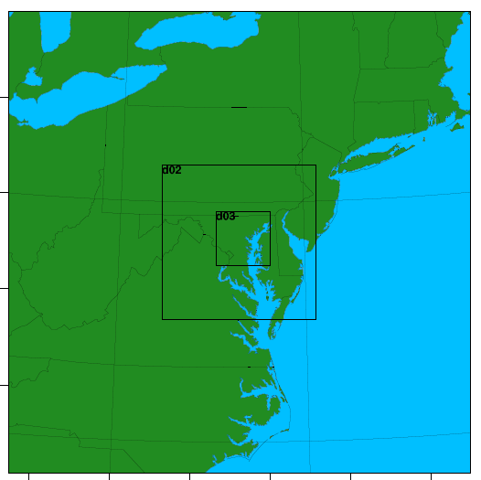
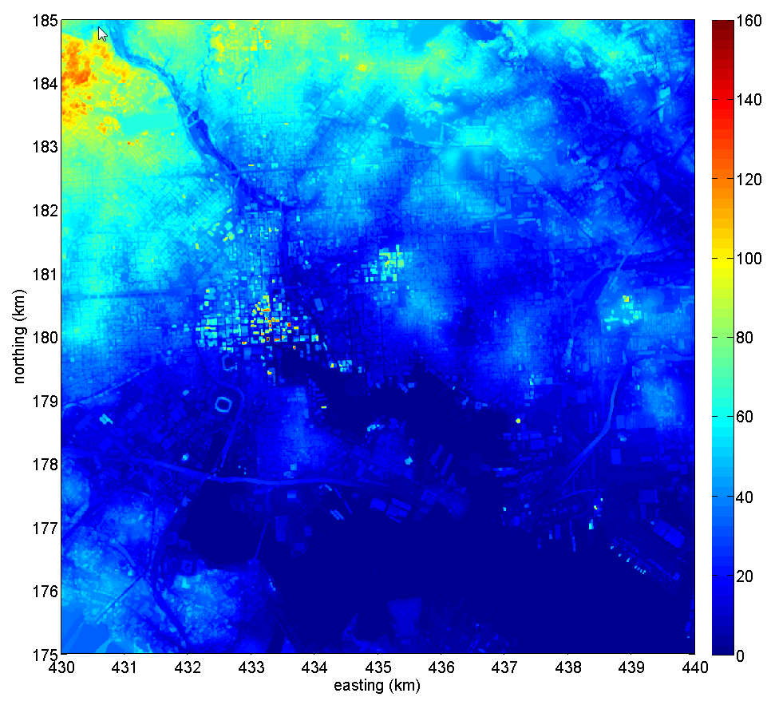
Coupling WRF and LES models – Technical Challenge
LES domain over Baltimore
WRF Domain 1
1000 km x 1000 km
18 km resolution
WRF Domain 2
300 km x 300 km
6 km resolution
WRF Domain 3
100 km x 100 km
2 km resolution
LES Domain:
12 km x 12 km
10 m resolution
  LES operated as a sub-grid scale model within WRF
  Status : One-way coupling. WRF → LES. Off-line. Sequential.
  Nudging algorithm to assimilate WRF met fields / observations

Slide 23
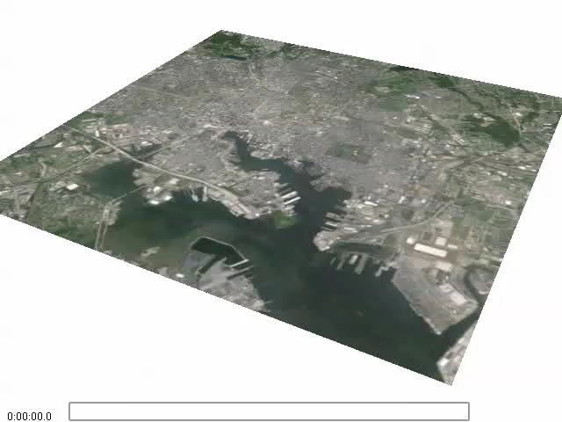
LES Simulations: CO₂ plumes over Baltimore MD
Application of coupling FDS with WRF simulations
Power plant emission data (2013)
http://ghgdata.epa.gov/
Need for Validation and Verification of Dispersion Modeling over an Urban Domain
Horizontal and Vertical mixing of CO₂ in the boundary layer?
Critical for estimating emissions through top-down modeling
Notes:
Prjection: stateplane 1900(Maryland)

Slide 24
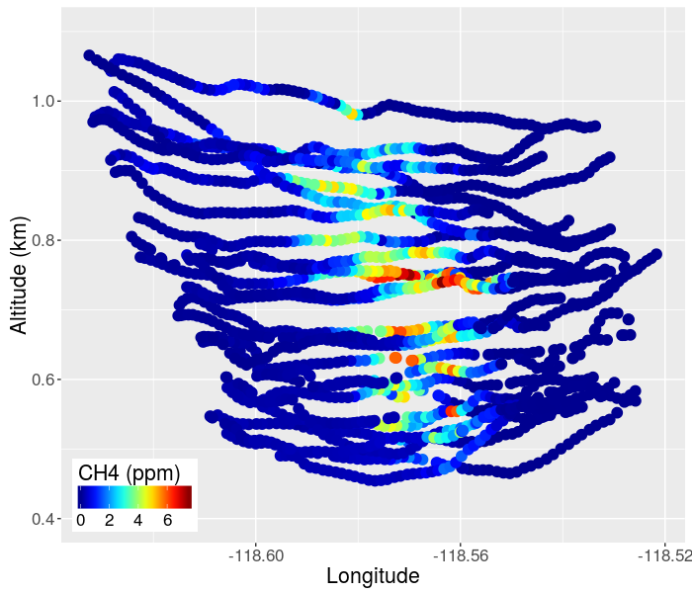
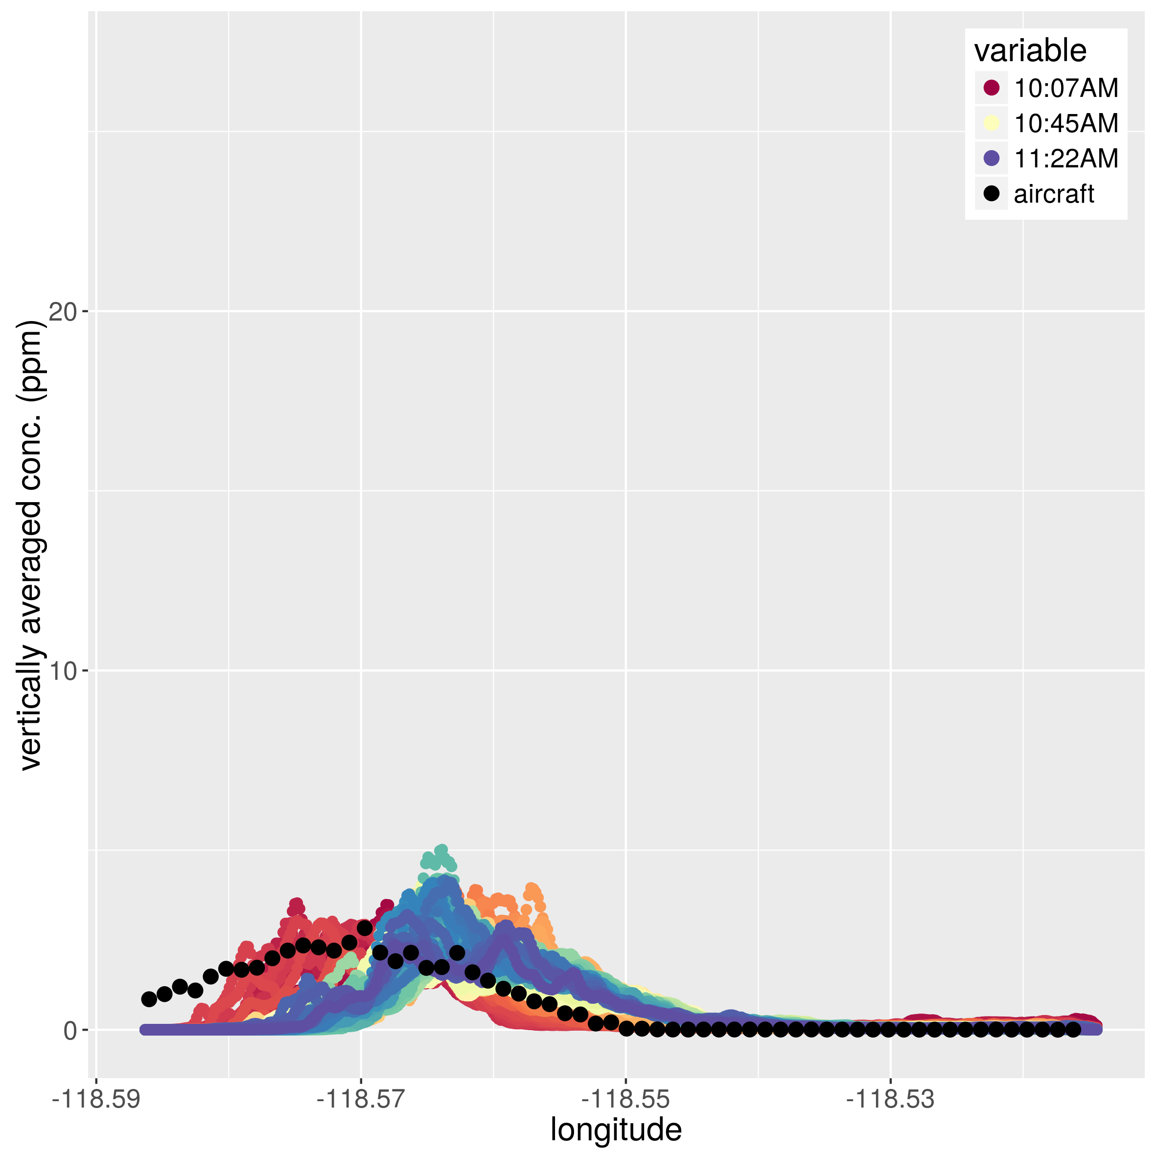
Large Eddy Simulations: Potential Collaboration
Performing LES simulations for FLAGG-MD flight days
Collaborate with UMD flight team
Inform mass balance analysis
Detailed modeling of point source plumes (landfills, powerplants, etc.)
Examples of LES modeling of aircraft data
Aliso Canyon Natural Gas Leak
Ghosh et al., AMS 2017 Poster

Slide 25
Background analysis
Analysis uses WRF-STILT footprints for the ideal NEC tower locations to identify locations for a set of 4 towers that would best represent incoming air.
Presented at AGU 2016 and in preparation for a publication.

Slide 26
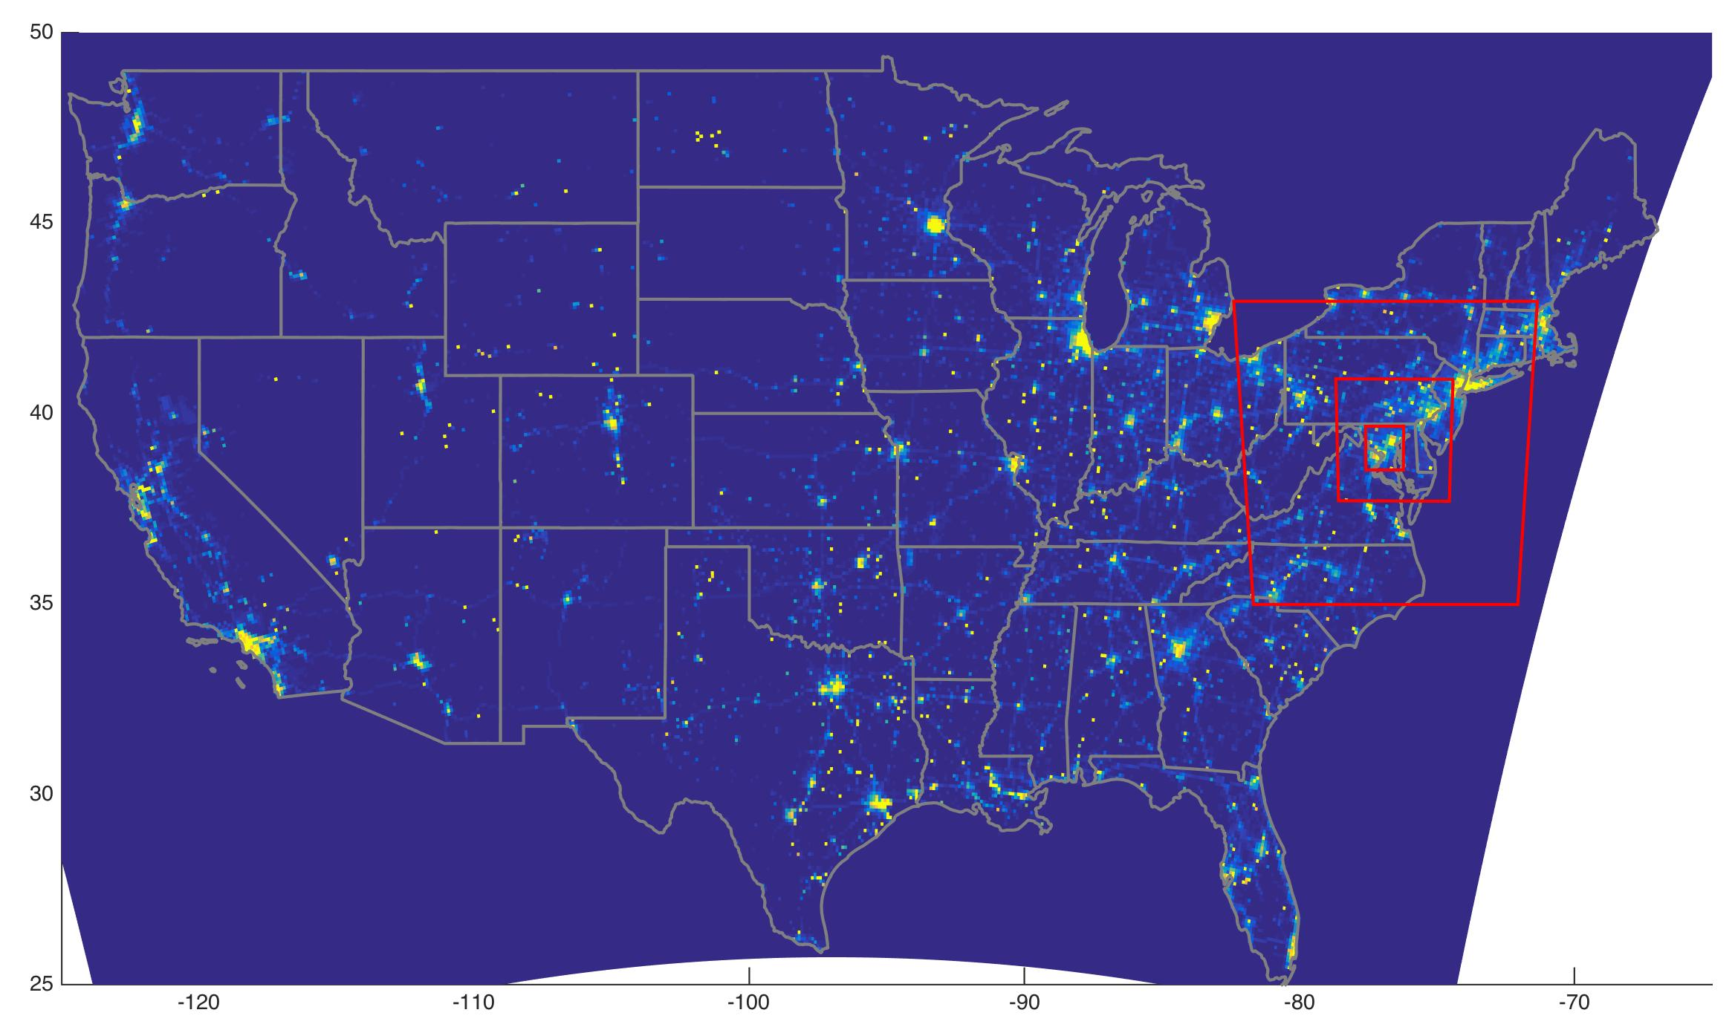
Vulcan CO_{2ff} Inventory
3 NEC model domains
K. Gurney, ASU
Notes:
Remake adding other domains

Slide 27

Vulcan 2002 CO_{2ff} Inventory
NEC outer domain
NEC inner domain
Notes:
Remake adding other domains

Slide 28
Background Site Determination:
Step 1: Create Trajectories, Footprints and Synthetic Observations for Feb and Jul
Create trajectories & footprints with WRF/STILT for 12 towers in NEC and 15 plausible BG towers;
Convolve with Vulcan emissions and Carbon Tracker (CT) biospheric fluxes to create afternoon synthetic observations at each of the locations for Feb and Jul 2013.
Step 2: Data Analysis
Analyze afternoon synthetic observations
Step 3: Statistical Analysis
Calculate the time it takes for a particle associated with each NEC obs. to leave the domain;
Use statistical regression to determine the obs. from which background towers best explain the incoming “background” mass; and,
Qualify the amount of mass seen from different directions and from the near and far field;
Create timeseries by associating obs. with background tower obs.;
Determine how well these towers explain overall incoming air mass (aka “background”)
Quantify ratio of mass seen at NEC observations from inside to outside NEC domain;
Look at correlations and RMSD between tower observations.
Separate signal from sources inside and outside the NEC domain.
CO₂ ONLY!
Answers: Why should we care about background mass?
If so, from where is the background mass primarily coming?
Do groups of towers seem to “see” the same type of incoming mass?
Tells us: Which background towers should we select to help isolate the amount of incoming air mass at our NEC tower observations.
How well background towers quantify incoming air mass and if we need more information.

Slide 29
Modeled CO₂ enhancement from sources in outer domain
(mid-afternoon hours only)
MD 1 = Jessup
VA 1 = Arlington
BA 1 = Halethorpe
ΔCO₂ (ppm)

Slide 30
February
(average over all 12 sites)
- From all sources (inner + outer)
ΔCO₂ (ppm)
-- From outer domain only
July
ΔCO₂ (ppm)
Mueller et al. (in prep)
Poster at AGU: A51K-0225: Background Air Mass Can Impact U.S. Northeastern Corridor Urban GHG Emission Analysis: A Study to Isolate Incoming CO2 Air Mass with Tower Measurements in the Washington DC/Baltimore Area

Slide 31
BIAS related to background subtraction

Slide 32
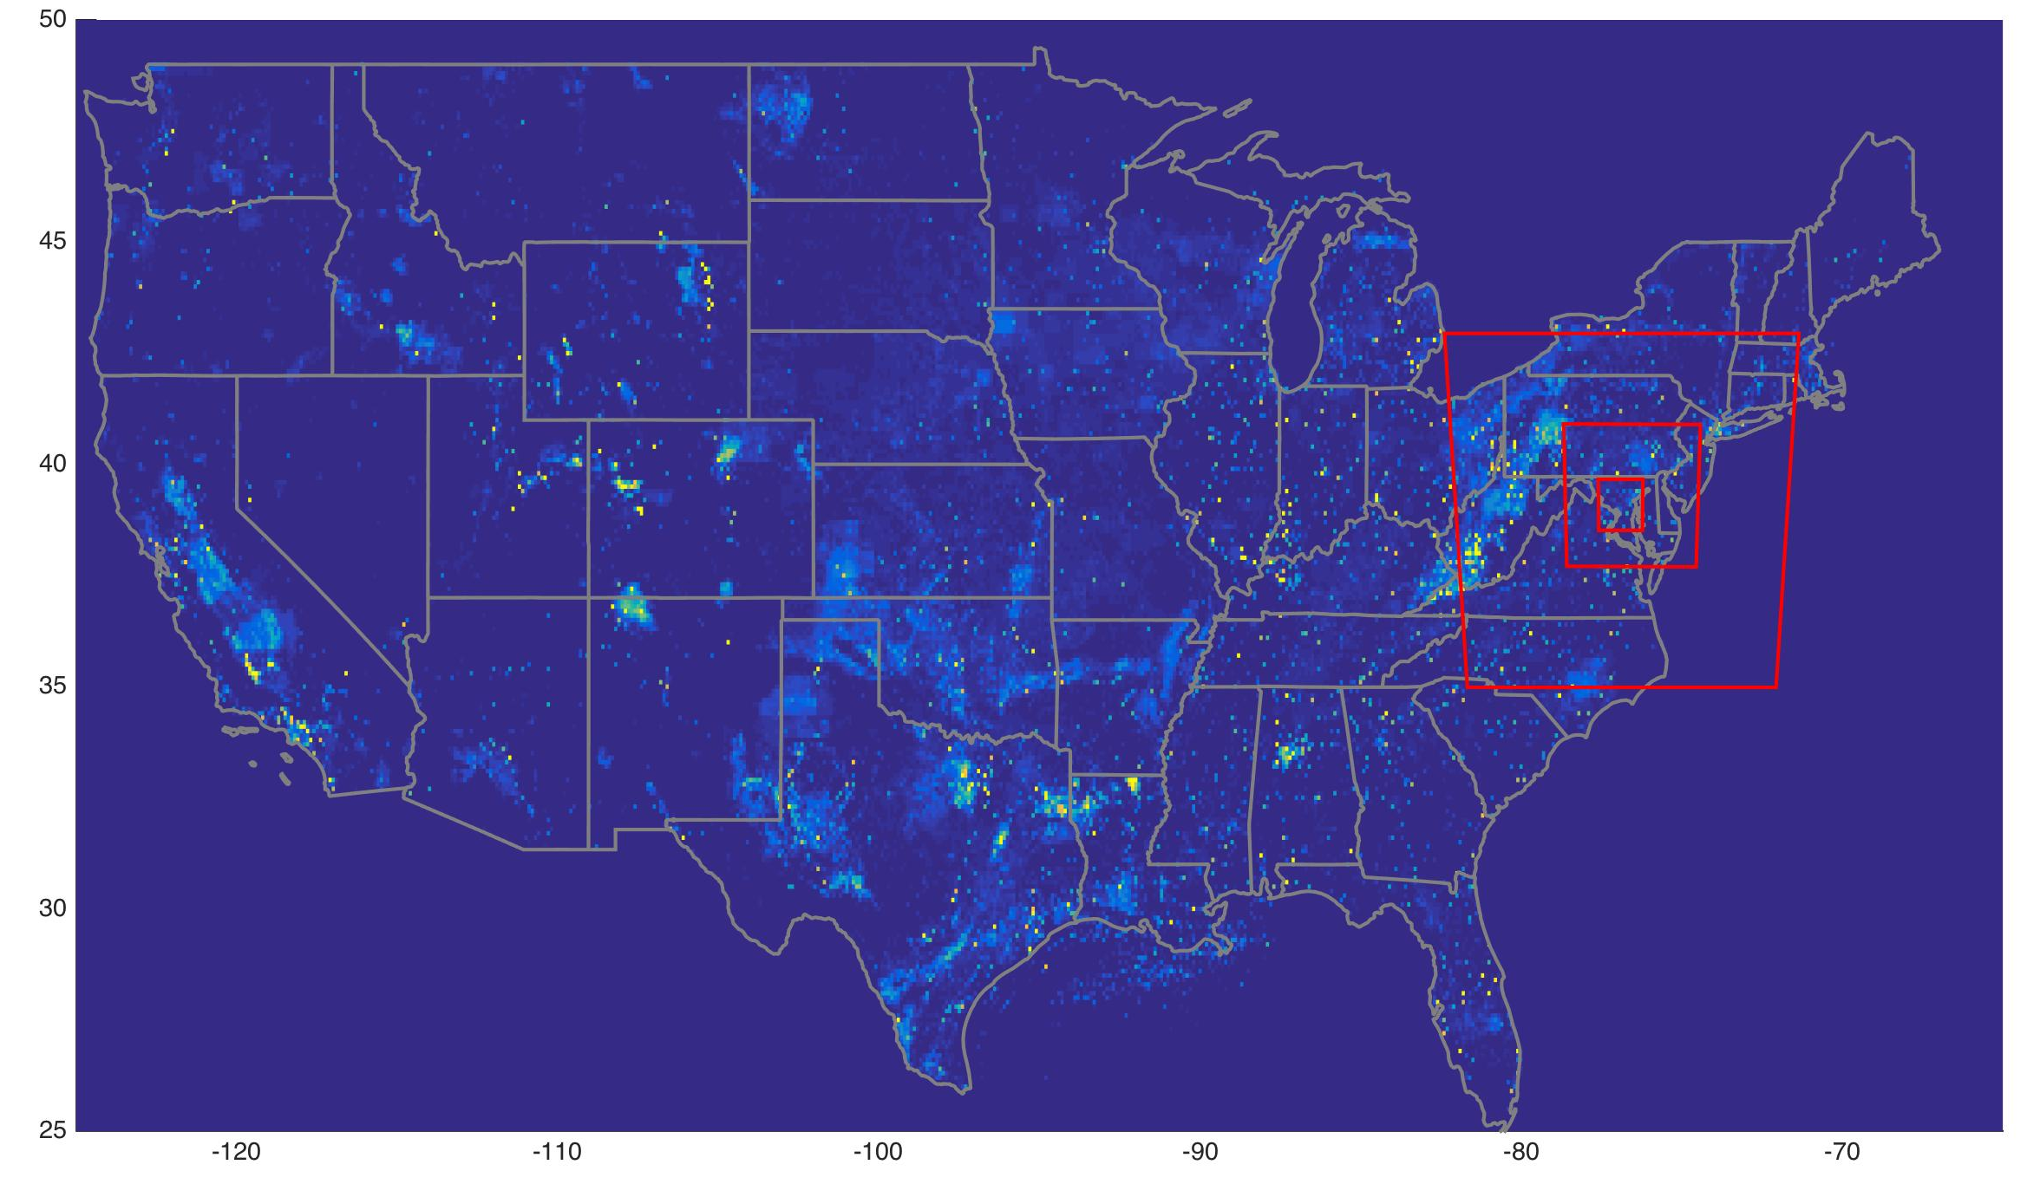
EPA 2012 Gridded CH₄ Inventory
3 NEC model domains
Maasakkers et al., 2016

Slide 33
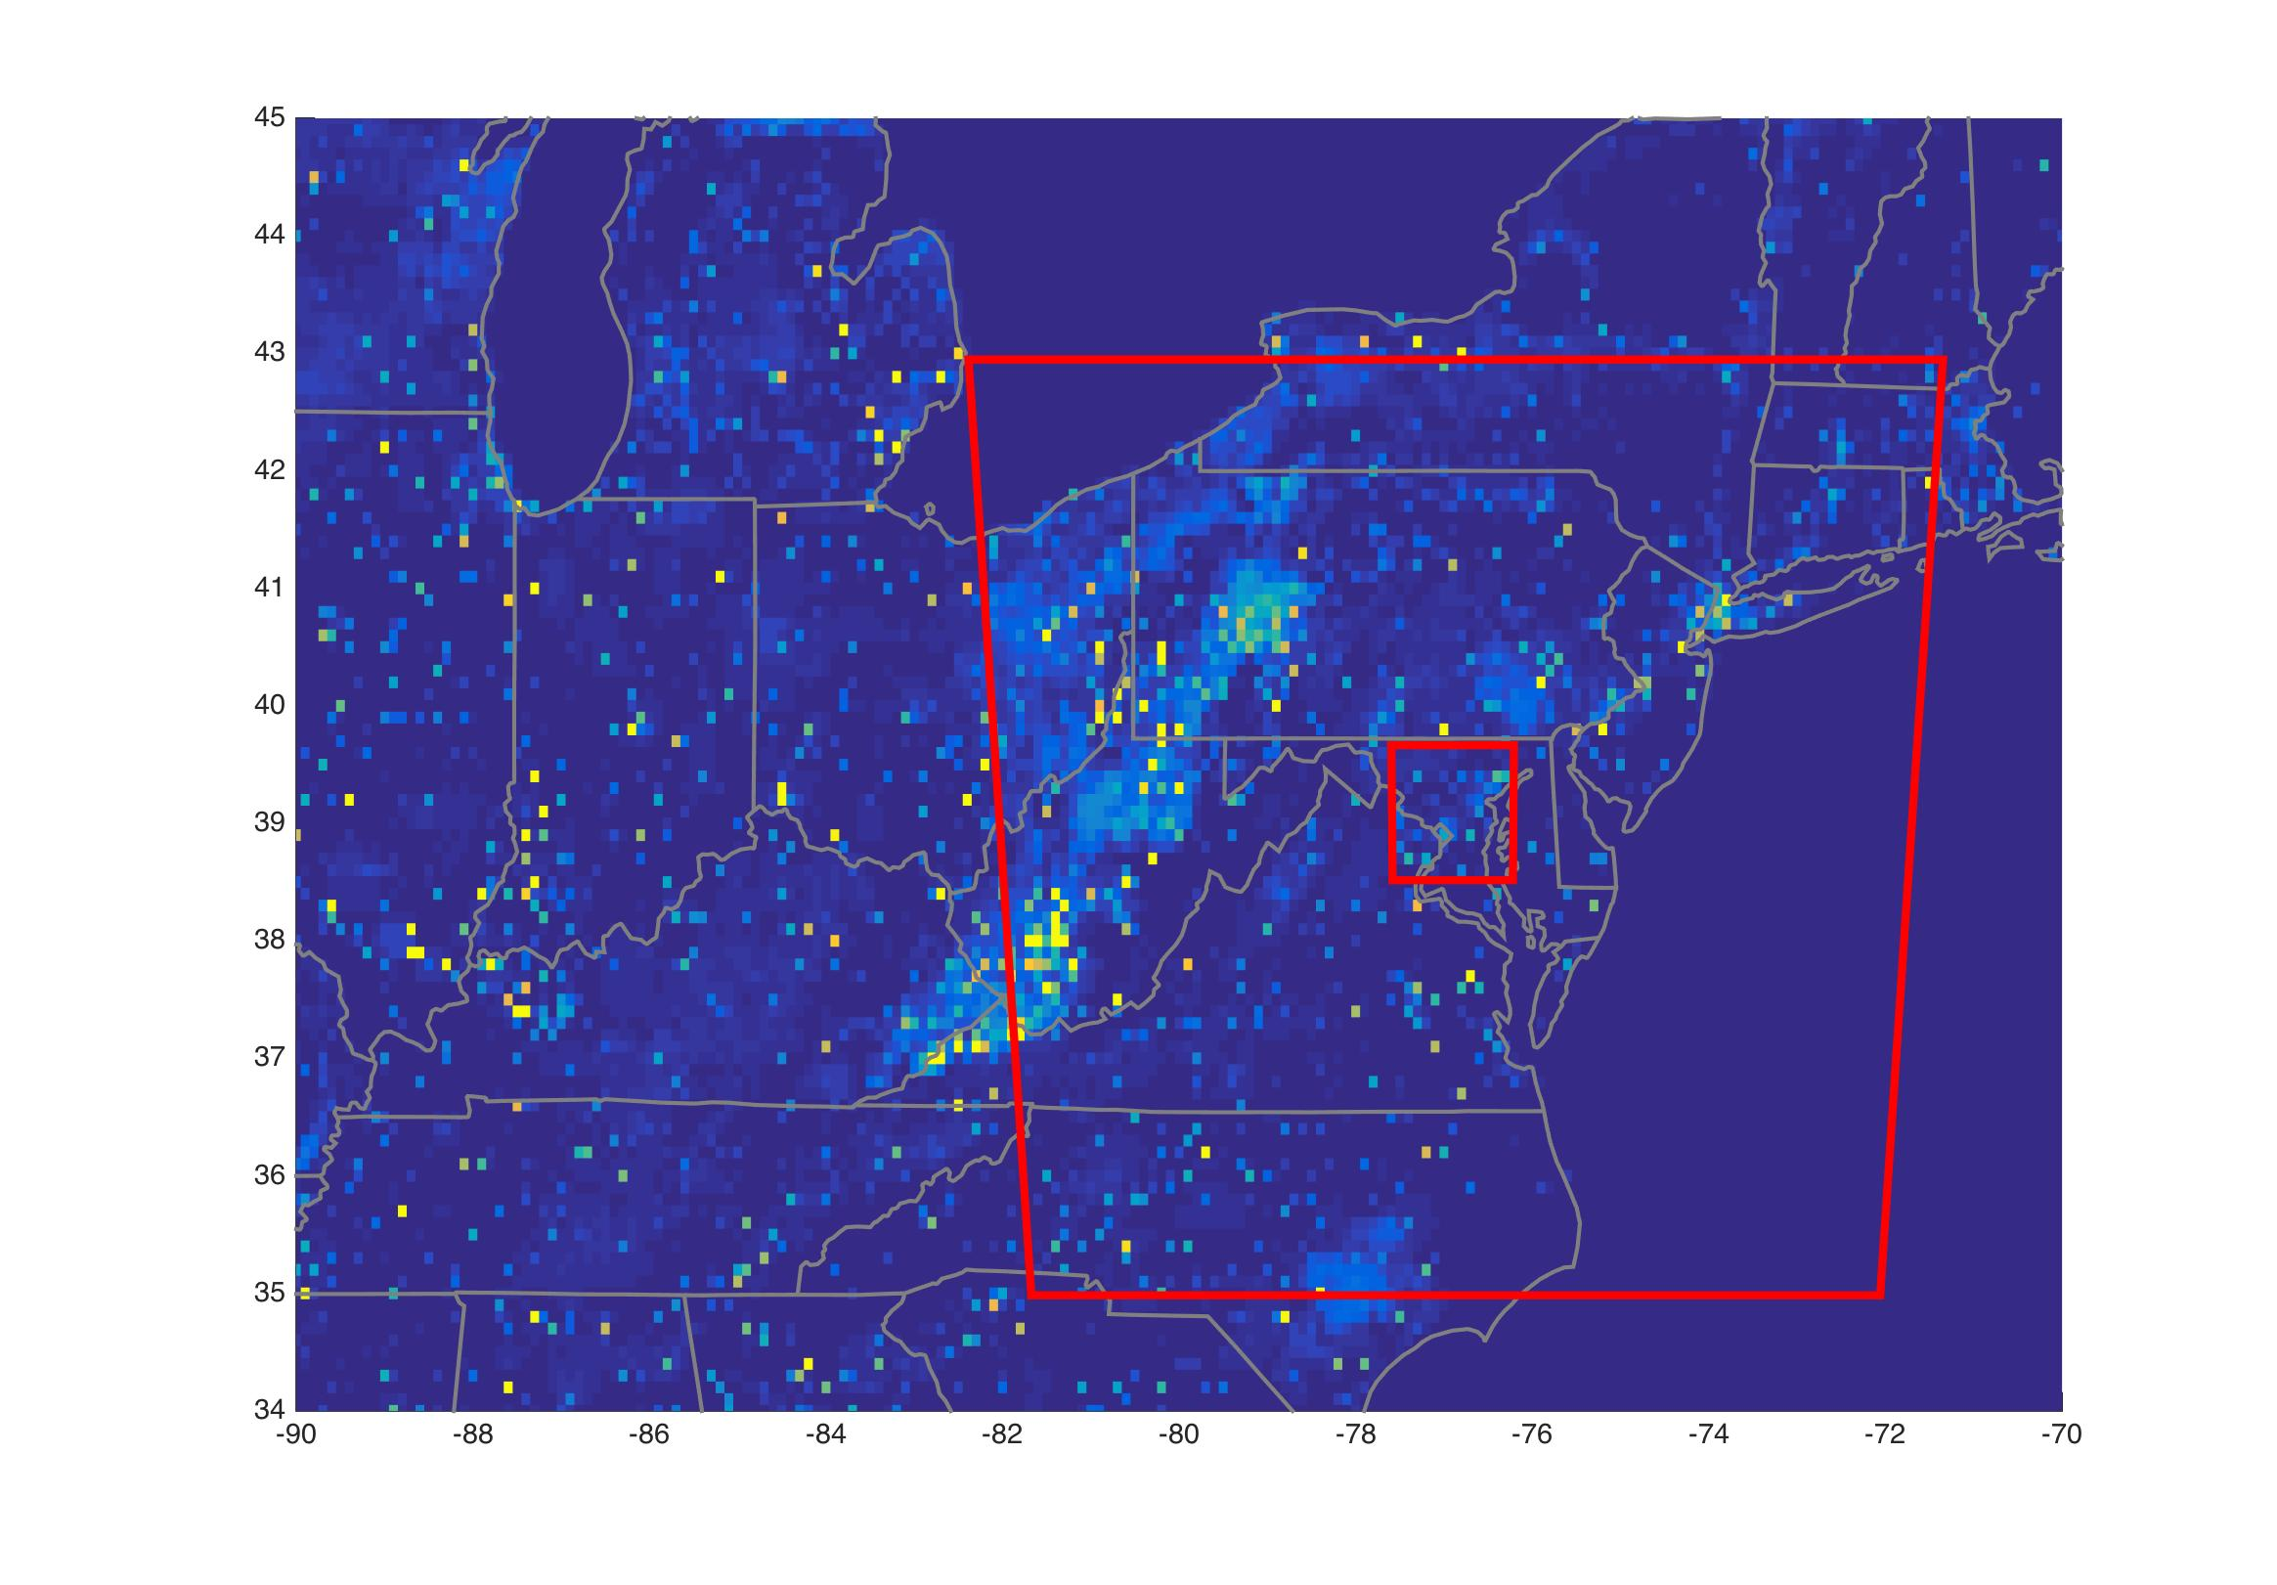
EPA 2012 Gridded CH₄ Inventory
NEC outer domain
NEC inner domain
CH₄ could be an even bigger problem, because emissions in the outer domain are large compared to inner domain (at least in this inventory).
Notes:
According to this inventory, we expect to be overwhelmed by background concentrations coming into our domain when the wind is from the W or NW.

Slide 34
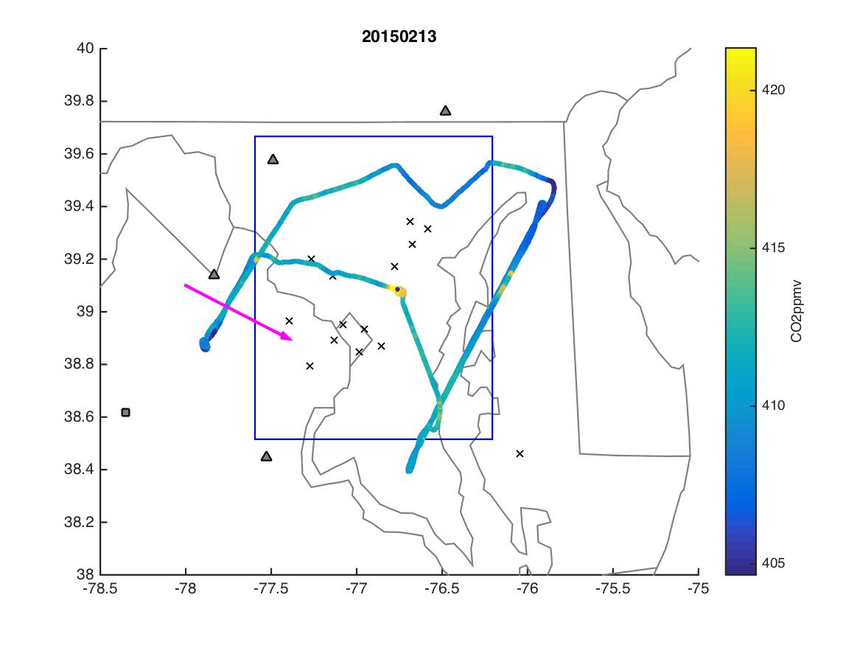
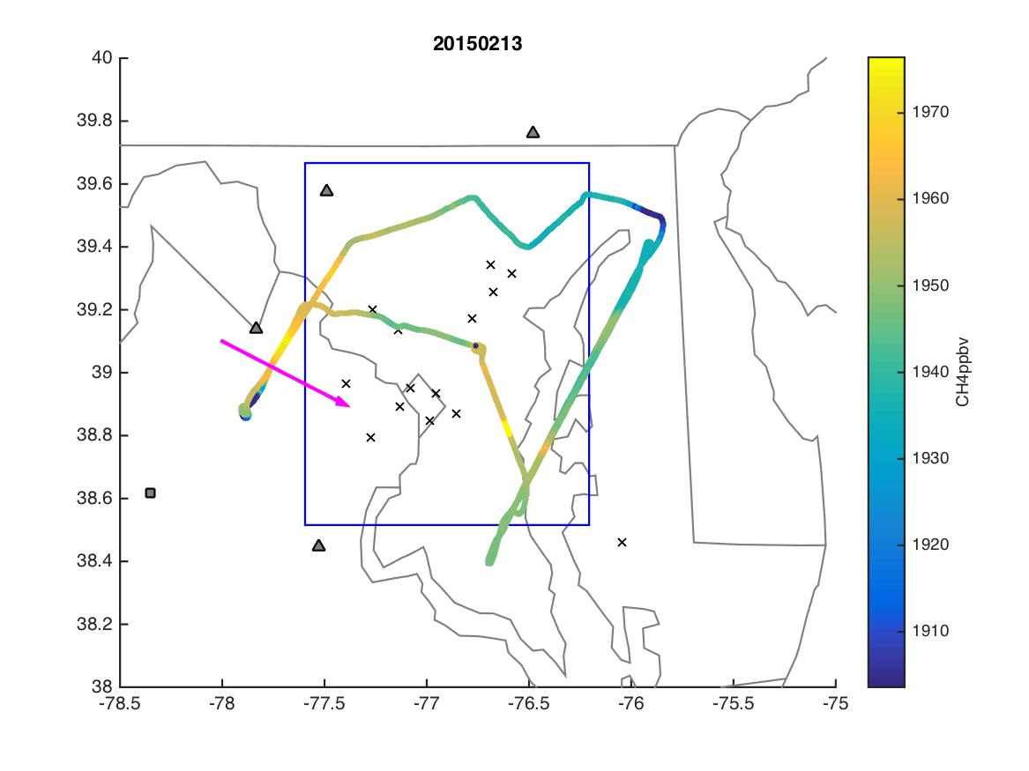
CO₂
CH₄
CO2
CH4
BG
BG
BG
SNP
GHG01
BG
FLAGG-MD Flight Observations, February 13 2015
Flight data courtesy Xinrong Ren, UMD/NOAA
Notes:
Example: FLAGG-MD data from Feb 2015 shown with CO2 (left) and CH4 (right) mole fraction and median wind direction. Blue box is the inner NEC domain. Towers shown as black x.

Slide 35
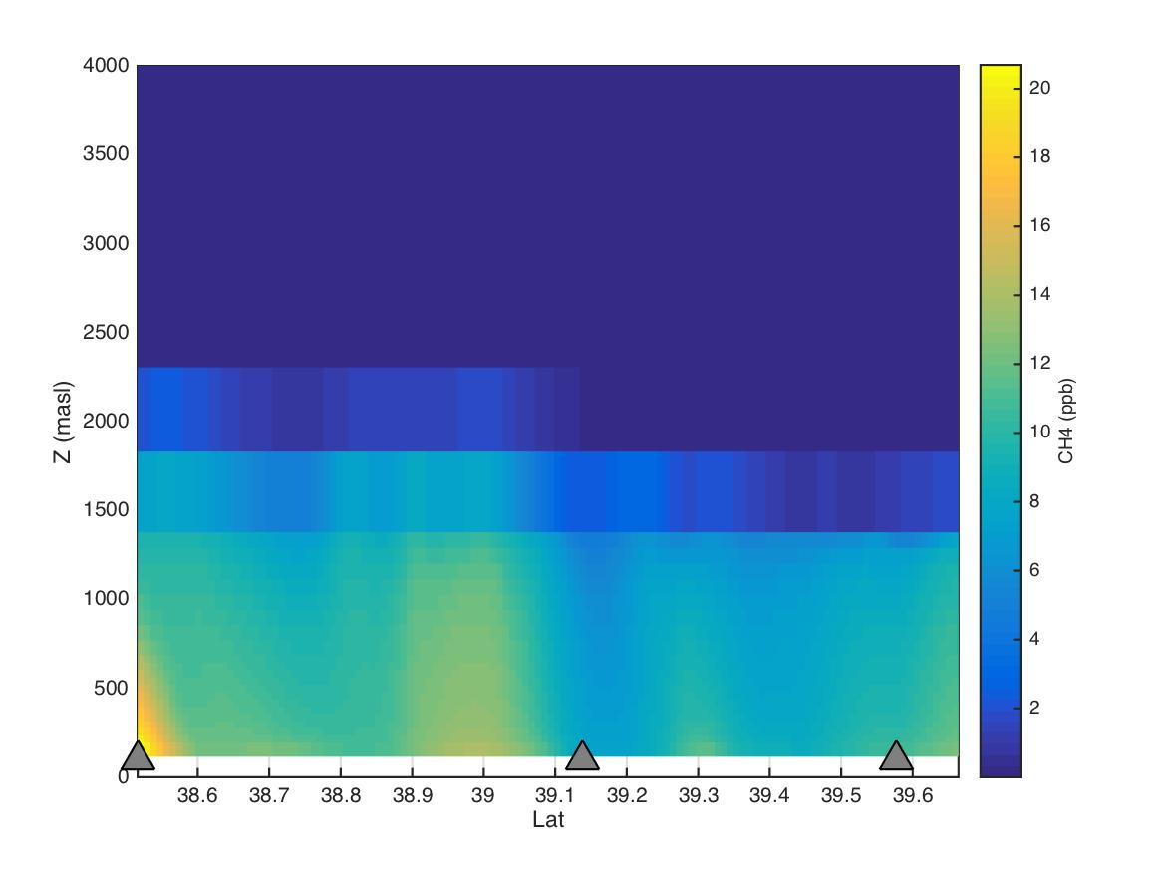
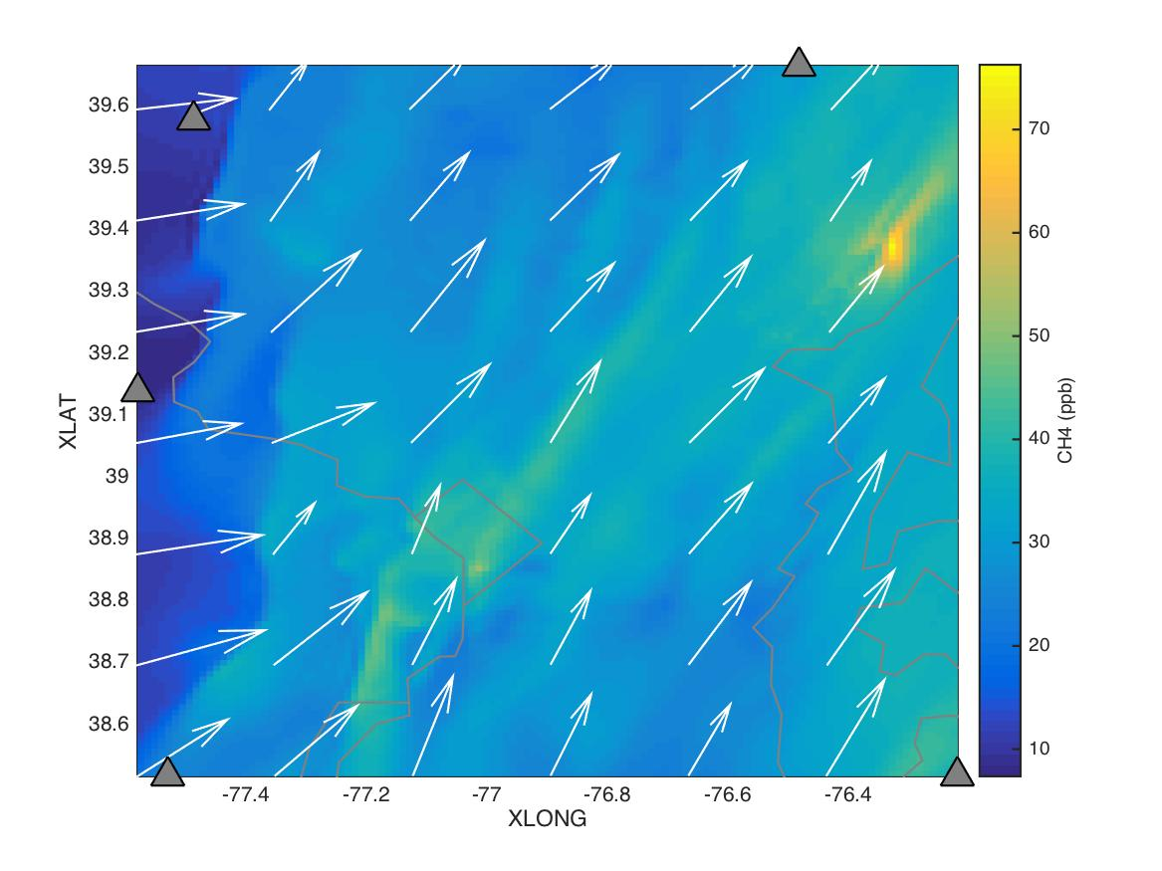
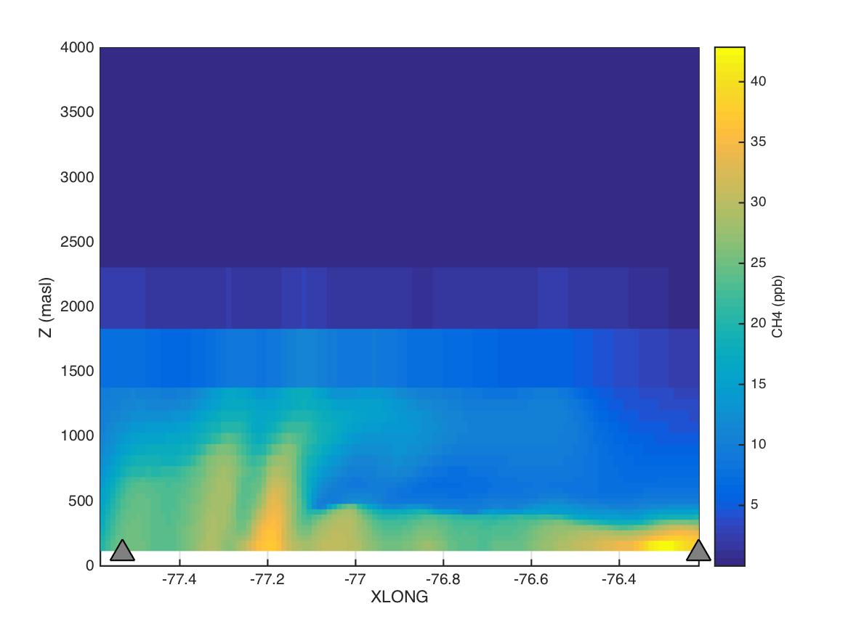
WRF-Chem simulated CH₄
BG Tower projected location
WRF-Chem courtesy of Cory Martin using EPA gridded inventory.
Example run 1/31/2017 @ 19:00 GMT
Notes:
Remake w/ different color towers; fix terrain thing.

Slide 36
Background / Upwind Concentrations
Aircraft data from Feb 2015, WRF-Chem runs, and WRF-STILT analysis all indicate that background conditions are variable and will require a more sophisticated approach than has been done in Indianapolis or Los Angeles.
We intend to investigate ways to estimate a background for each tower observation. These may include forward runs of WRF-Chem (or other) in the outer domain, which we can sample in our LPDM framework.
Background concentrations can be optimized against the background towers and flight data from FLAGG-MD.
This is an area of overlap/collaboration/coordination and discussion topic for afternoon.

Slide 37
Inventory status
ASU (Gurney) to develop Hestia (high-resolution anthropogenic CO2)
  Baltimore finished and available
  Washington DC in progress
Other inventories available publicly
  Vulcan 2.2
  EPA CH4 inventory
  Hutyra et al. will be releasing a VPRM-based biogenic CO2 flux and a CO2ff product for the NEC soon.

Slide 38
Solar-Induced Fluorescence and biospheric CO₂ fluxes
Collaboration between David Allen (NIST) and Lucy Hutyra’s group (BU)
Instrument NIST campus with SIF and other measurements of vegetative parameters
  Initial effort beginning now and focused on the ~67 acre forest on the NIST campus
Assess biogenic carbon fluxes in suburban area
Use biogenic process information and SIF correcltations to advance models that augment/replace VPRM/VEGAS/etc.

Slide 39
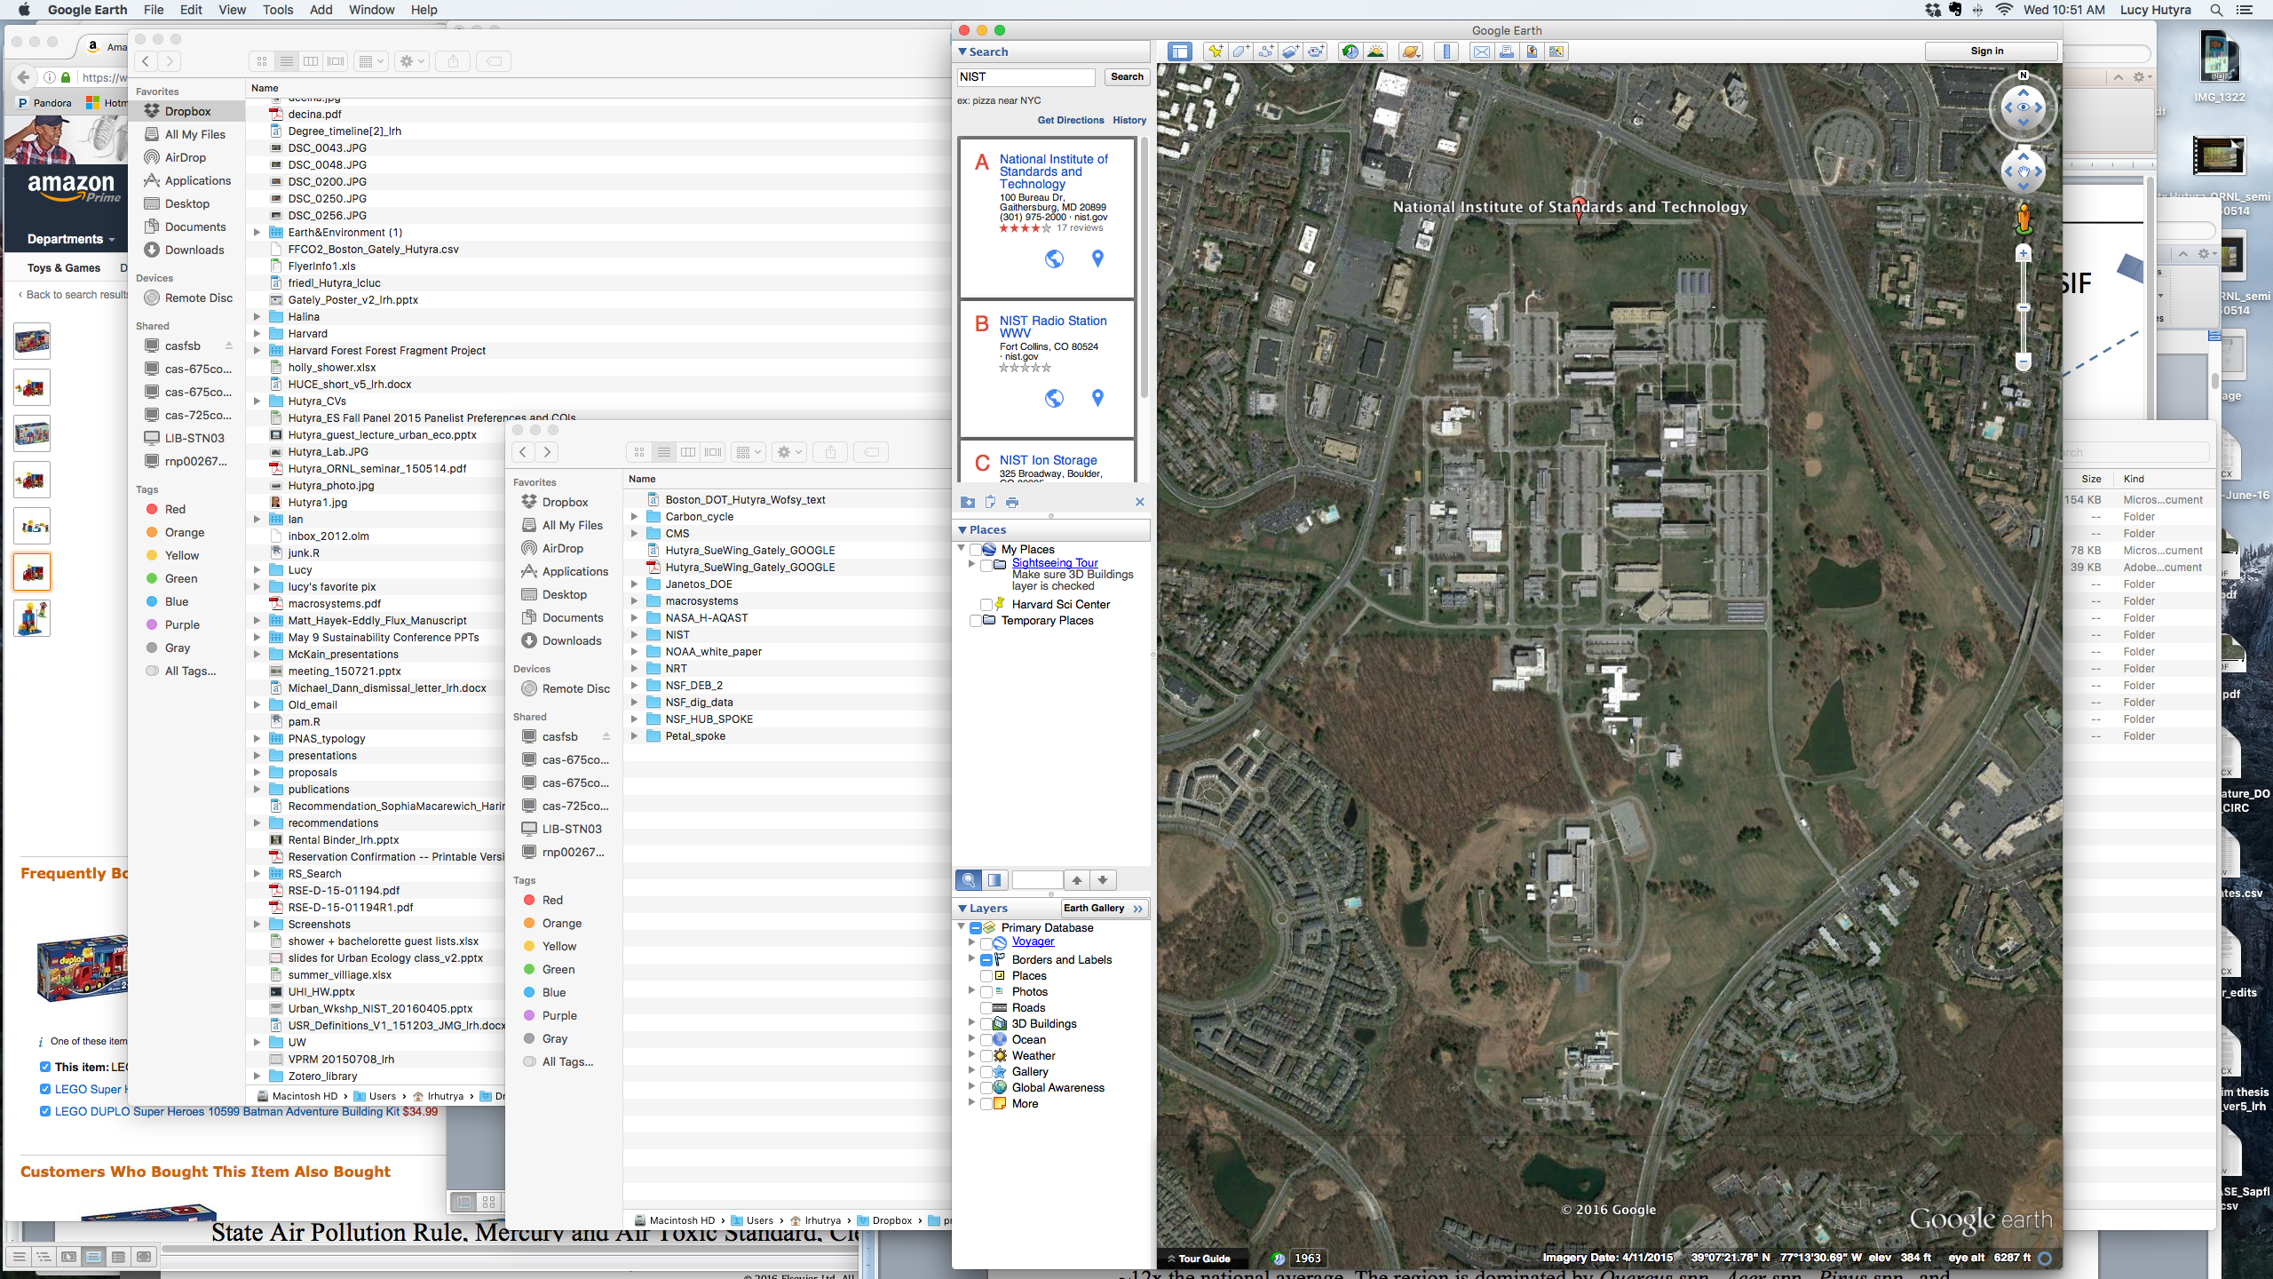

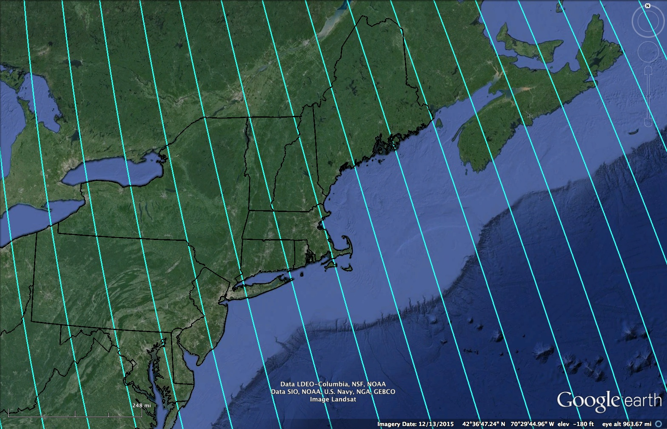




Experimental test bed on the NIST campus
The NIST Gaithersburg campus provides a mixed urban environment (buildings, roads, and vegetation). Overall, shares similarities with the NEC
NIST is leveraging the campus as a testbed for evaluating optical sensors
SIF has been demonstrated to provide improved GPP estimates but needs further investigation into senor use and characterization
Physical measurements will be tied to remotely sensed optical measurements to improve the understanding of the measurement phenomenology
Applications include, productivity estimates, detection, and classification of imagery based on spectral signatures
Data collections will begin in Spring 2017
OCO-2 SIF
Airborne SIF, hyperspectralLiDAR, etc.
Spectrometers/ Calibration panels
Ecosystem productivity & sap flow
Contact: David W. Allen, NIST
In collaboration with Lucy Hutyra, Boston U., and Barry Logan, Bowdoin College

Slide 40
Inversion analyses
Goal: NIST will conduct flux inversions for GHG emissions in NEC domain.
Inversion will use background, observations, and footprints. Usually will use prior inventory emissions information or other spatial proxy data.
Investigate combining aircraft and stationary (tower) data
Uncertainty in model transport – propagation to flux estimation
Testing of assumptions that go into inversion
  Prior error covariance matrices
  Developing metrics
[more input from Kim/Sharon/Subhomoy others]

Slide 41
Critical areas of collaborative efforts
Meteorological modeling
Background determination
Flight planning coordination

Slide 42
Additional slides
NEC-BW Meeting 2/13/2017

Slide 43
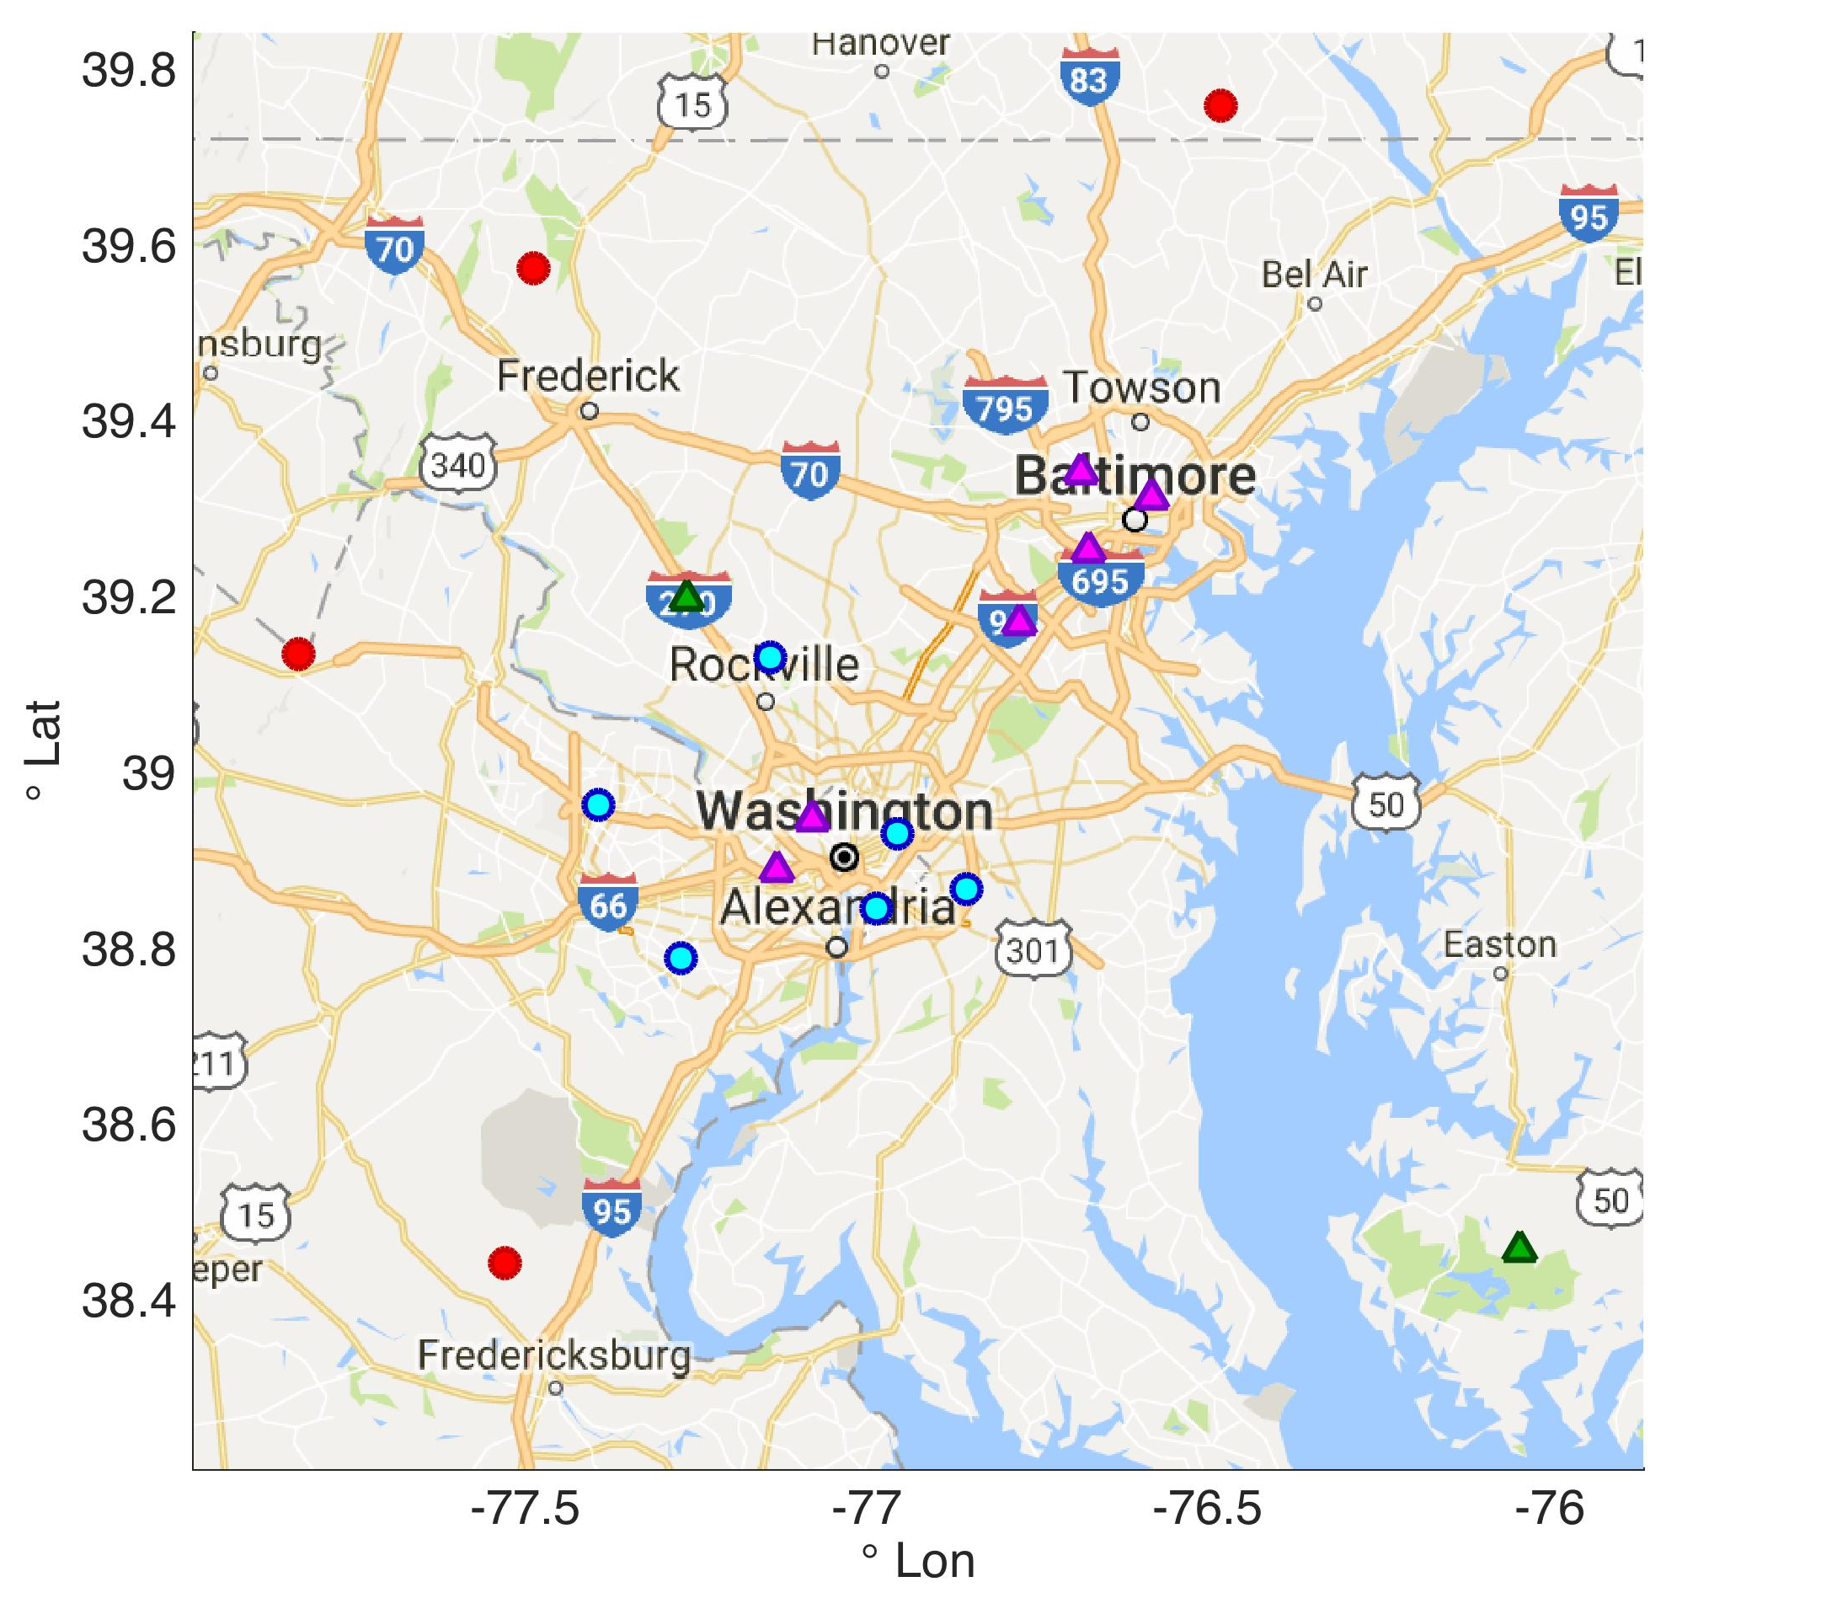
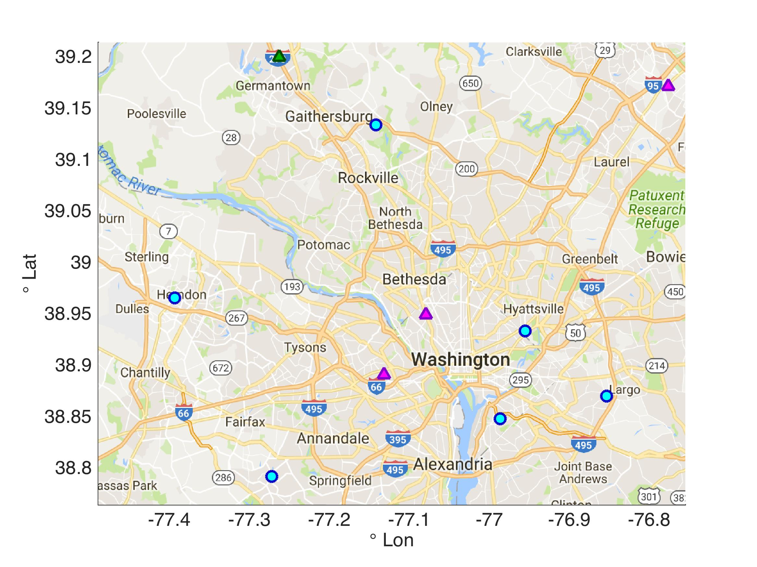
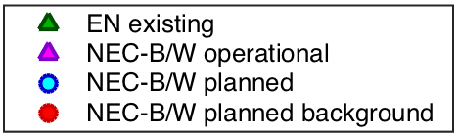
zoom on Washington DC
GHG01
Map of Northeast Corridor-Baltimore/Washington tower network

Slide 44
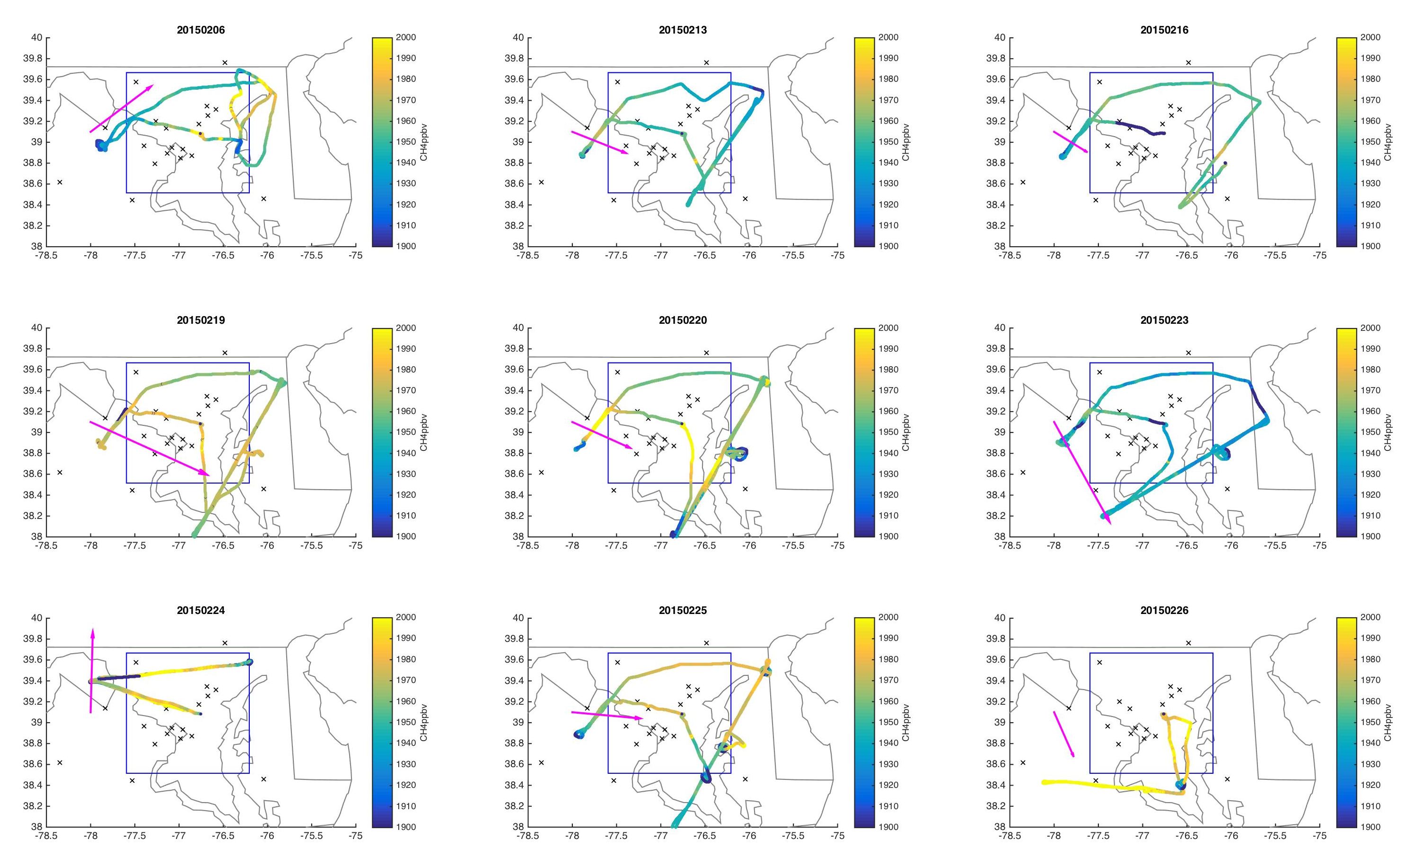
Notes:
Example: FLAGG-MD data from Feb 2015 shown with CH4 mole fraction and median wind direction. Blue box is the inner NEC domain. Towers shown as black x.

Slide 45
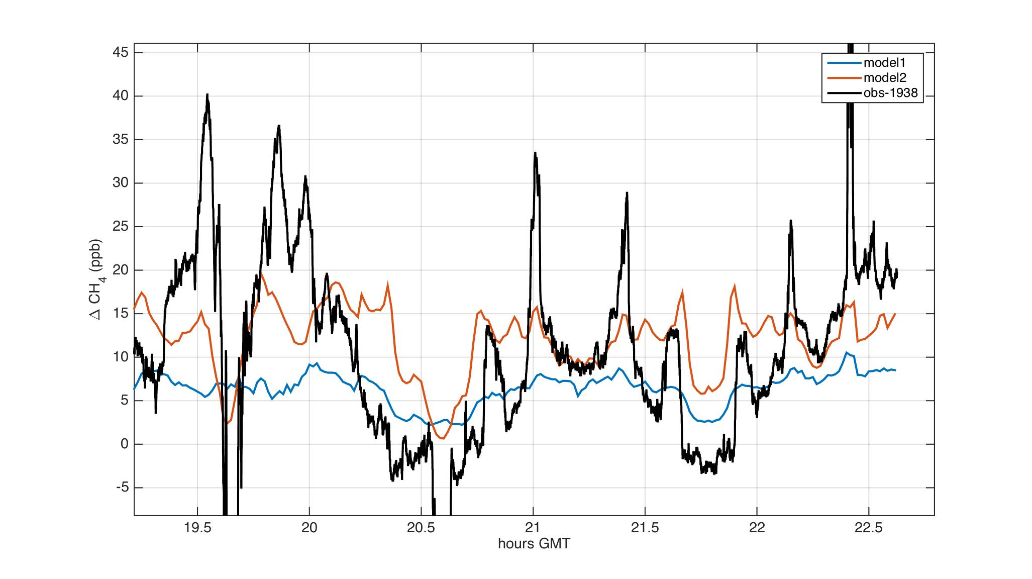
20150213
Nam-12/ HYSPLIT convolution with EPA CH4 inventory for arbitrary domain/ arbitrary BG.

