Slide 1
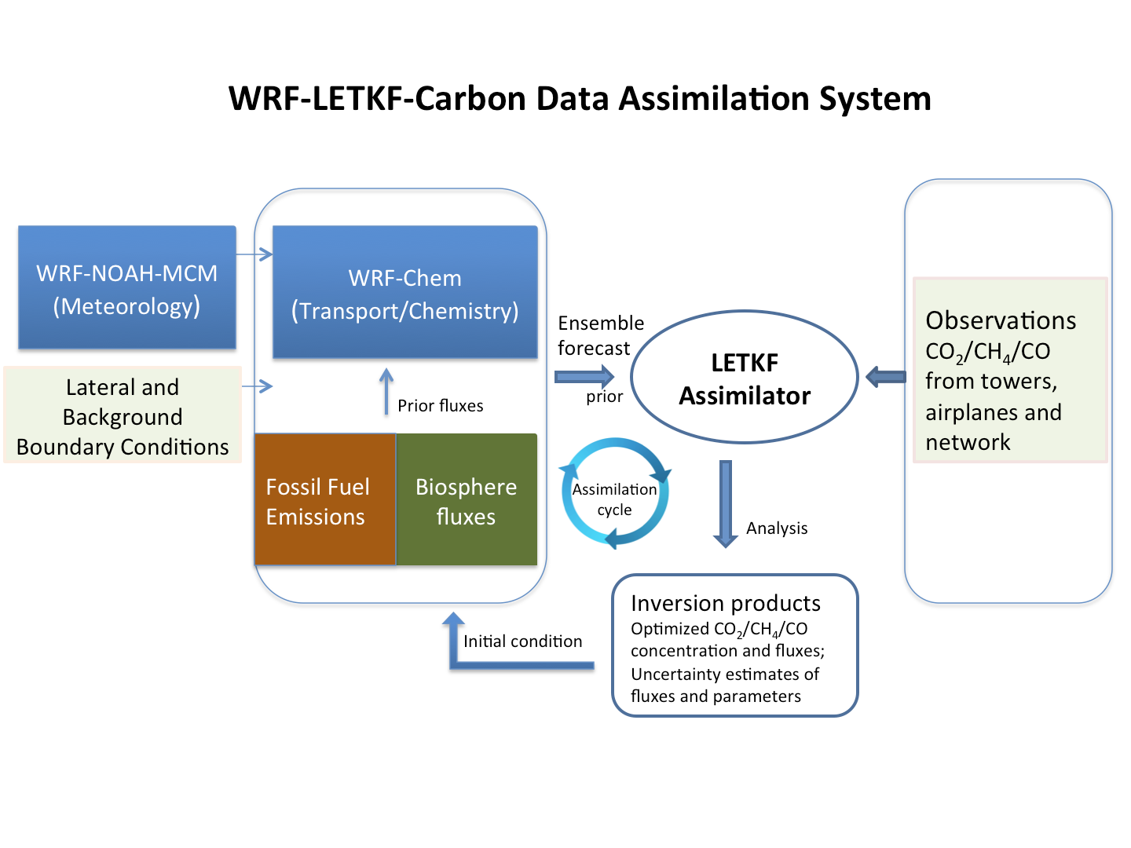
Carbon data assimilation strategy for urban GHG Monitoring
(Dickerson et al. 2014, proposal to NIST)
Model drivers Models Assimilation Observations

Slide 2
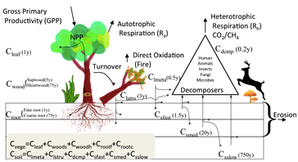
Components of urban carbon modeling/DA system Modeling
WRF-Chem for atmospheric CO₂ transport
WRF: GFS global boundary forcing + other info by WRF pre-prosessor (WFS)
WRF: Yonsei PBL scheme; Kain-Fritsch cumulus scheme (issue with mass flux? Sha Feng PSU), non 1km domain
Use ensemble for transport uncertainty
Improved meteorology model (parameterization, etc.) from Yixuan, Dalin, Kayo
Surface fluxes (a.k.a., prior)
Fossil fuel (FFDAS: global 10km; waiting for high-res from Gurney)
Bio-flux: currently from VEGAS running inside WRF;
VEGAS: part of IPCC 2001-2013 and Global Carbon Project
Lateral boundary conditions
Boundary CO₂ concentration from the global LETKF-Carbon DA product (assimilates flask, aircraft, satellite data). This system can also provide an alternative to the FFE/Bio fluxes, albeit at lower resolution but possibly better constrained.
Can also use other product such as CarbonTracker, subject to a delay

Slide 3
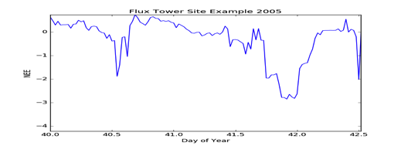
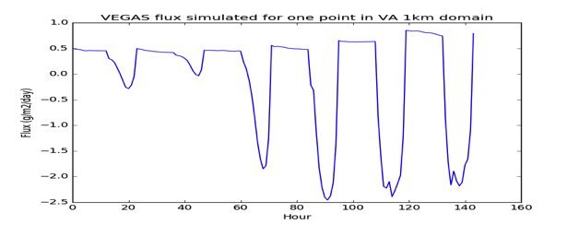
Forward transport of CO₂ with WRF-Chem
Operational forecast of CO₂ set up for DC/Baltimore
FF and bio fluxes as separate tracers; CO₂/CH₄
48 hour forecast takes around 5 hours on 4 nodes of Deepthought 2
3 domains: 9km,3km,1km
Flux comparison: flux tower vs model
Outer domain (9km)
2 days at AmeriFlux VA site
(Note daytime CO₂ uptake in Feb)
Inner domain (1km)
6 days WRF-VEGAS simulation

Slide 4
Components of urban carbon modeling/DA system Data assimilation: The Local Ensemble Transform Kalman Filter (LETKF-Carbon)
Development
Efficient algorithm by Hunt et al. (2007), following Kalnay, Ott, …
LETKF initial coding by T. Miyoshi (Ph.D thesis with E. Kalnay: global version LETKF-SPEEDY, LETKF-GFS; regional version LETKF-WRF)
Application to carbon by Kang (2009 thesis), Kang et al. (2011, 2012)
Coupled atmo-land carbon DA system (Jia et al. 2014; Liu et al. 2017; collaboration with CAS/IAP, UC Berkeley, DOE/PNNL, S. Penny, T. Sluka): can assimilate fluxes (not as prior); real-data GV/OCO2
Advanced DA techniques
Short assimilation window: capture fast atmo variations; accommodate continuous measurements from tower, ground, aircraft
Possible without prior (better with good prior)
DA-model outer-loop to allow easy model switching
Near real-time setup: LETKF-Carbon using GEOSChem-VEGAS-FFDAS currently running to Fall 2016 with ObsPack/OCO2

Slide 5
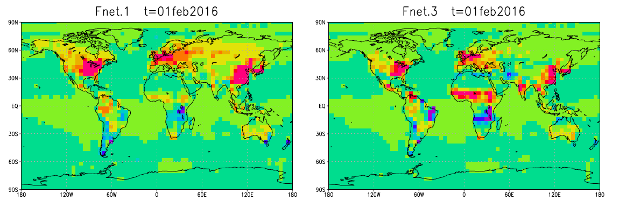
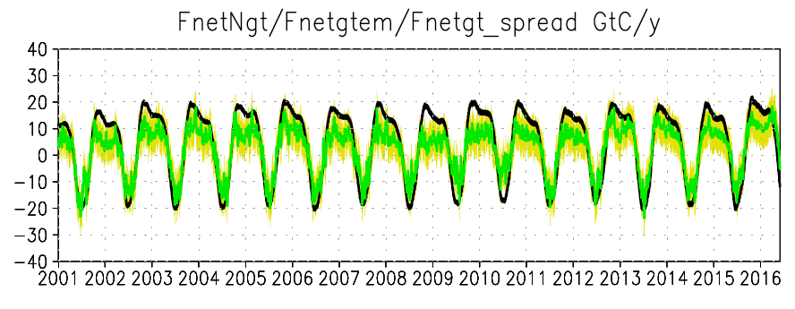
Sample results: Global LETKF-Carbon with GEOSChem
Surface carbon fluxes
Nature Assimilated (Ens.mean)
Experimental setup:
- GlobalView-CO2 flask network (2001-2015)
- OCO2 satellite column XCO2 (2014-2016)
- 6hr assimilation window
- 80 ensemble members
- Additive inflation
- Prior flux (FFE+land+ocean) = 0.01
Winter
Surface carbon fluxes 2001-2016
(global total; GtC/y)
Results
Captures seasonal cycles and interannual variability; amplitude a bit smaller compared to ‘Nature’: which is closer to truth?
Agreement in major emission centers of North America, Europe, East Asia
Larger differences in India, Africa
Black: ‘Nature’ (VEGAS model simulation)
Green: Assimilation result (ensemble mean)
Yellow: Uncertainty (ensemble spread)

Slide 6
Planned work LETKF-WRF-Carbon
WRF-CO₂ forward simulation
Comparison with tower, satellite and low-cost sensor data
Test CO₂ sensitivity to model parameterization choices (PBL scheme, PBL height, etc.)
Incorporate/use improved meteorology (parameterization choices, boundary conditions, etc.) from Yixuan
Couple WRF-CO₂ into the LETKF-Carbon framework (Cory with the support of Yun Liu?)
OSSE experiments with LETKF-WRF-Carbon
Carbon data assimilation with LWC for tower, satellite and low-cost sensor data

Slide 7
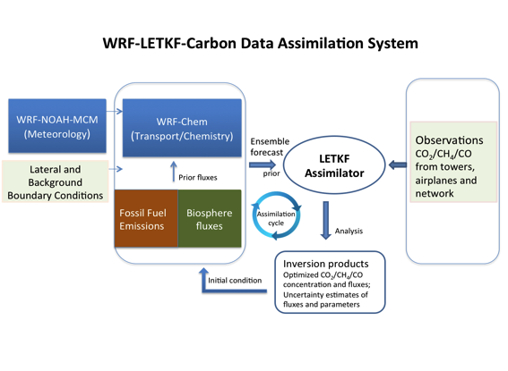
Slide from June 2015
Carbon data assimilation strategy for urban GHG Monitoring
Possibilities and considerations
Uncertainty in atmospheric transport quantified naturally by meteorology ensemble
Inter-model ensemble
Likely, also intra-model uncertainty, e.g., different versions of WRF
Varying type of uncertainty in different observations are accounted for and differentiated, e.g., continuous observation vs. intensive campaign; high-accuracy vs. low-precision sensors
Uncertainties in flux due to meteorology, CO2 observations, and prior emissions are simultaneously quantified
LETKF can also do back-trajectory to support field campaign, via ensemble tracer release
Work ahead
Forward transport modeling with WRF
boundary conditions: lateral CO2; emissions
First step of DA
useful for benchmarking airplane measurements
Emission prior
Bio prior: Carbon cycle modeling: bio flux
LETKF-WRF-Carbon DA
Model drivers Models Assimilation Observations

Slide 8
Low-cost sensors: plan
Network design, development and deployment
NIST OSSE simulation by Lopez-Coto et al.: ~100 low-cost sensors
Co-locating with EarthNetwork WeatherBug stations. Will make a software version that utilizes WIFI instead of SIM card, and a hardware package that can well integrate into WeatherBug station. Both based on our Raspberry-Pi package.
Expanding from our existing network of ~20 stations (currently ~10 sites) on rooftop, backyard, and tower of government agencies, schools, and private citizens
Beyond Raspberry-Pi: Model A

Slide 9
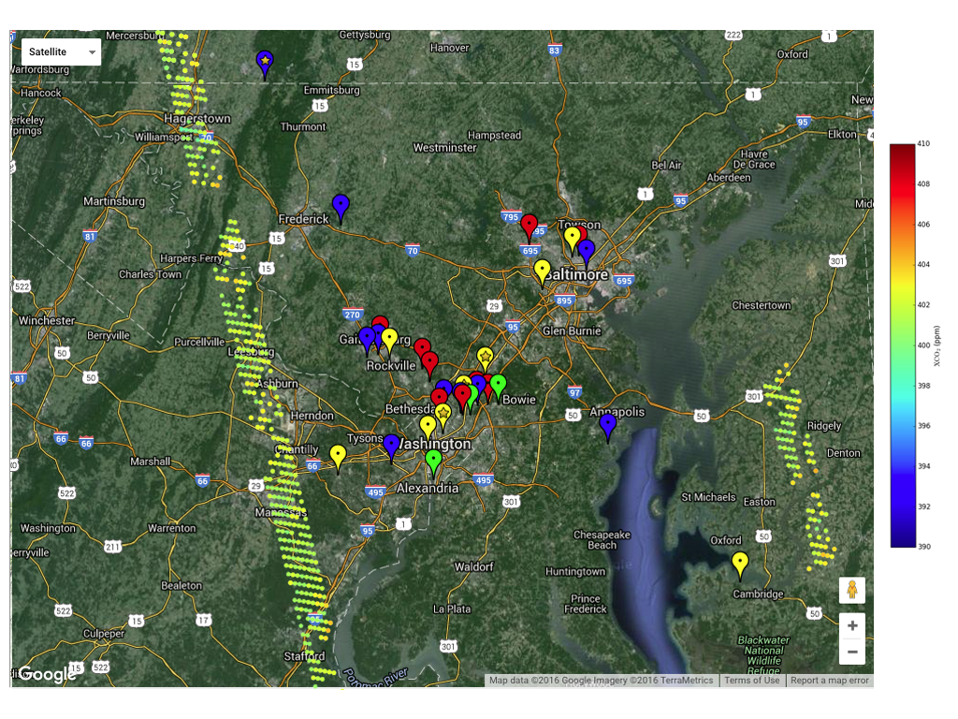
4
3
Mini-SENSE
Low-cost sensor array
The experimental mini-network of ~20 sensor packages being deployed as a testbed. Colored dots indicate OCO2 tracks. Sample data from numbered location are shown below.
Sensor locations
7 days of data (Mar2-Mar9, 2016) from 4 sensor stations identified in the map above. Vertical offsets exist; the variabilities are meaningful.
2
1

Slide 10
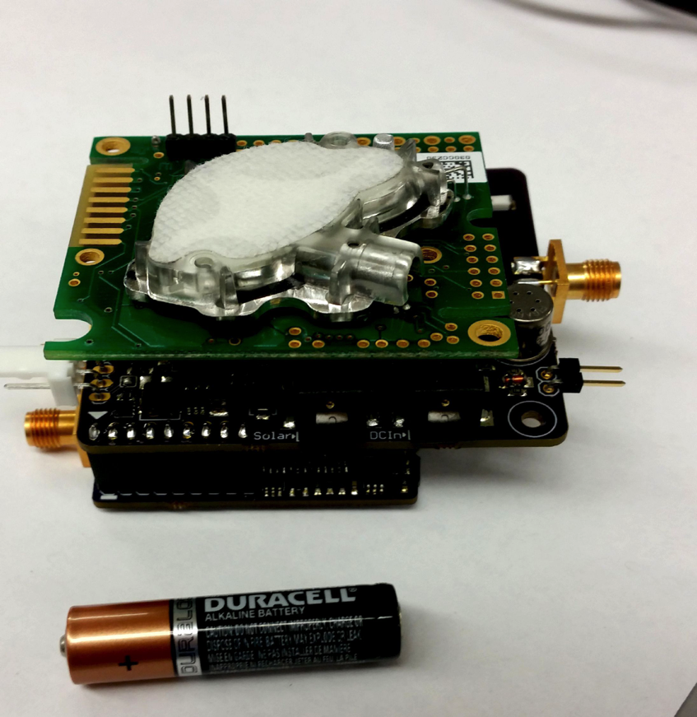
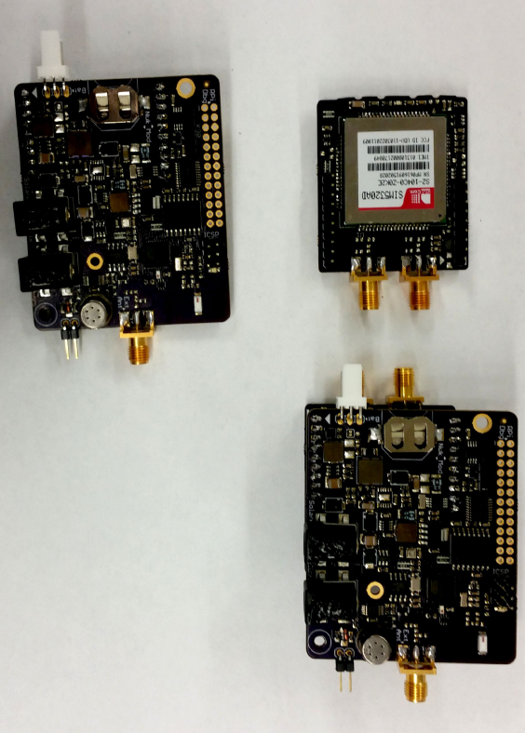
Model A: Revision 3

Slide 11
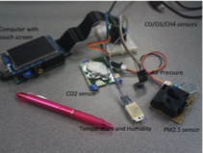
Low-cost sensors plan II
Sensor calibration
Co-location with WeatherBug, MDE, DOEE instruments
2-3 sensors at one site
Longer-term drift (> 1 month): Lab and site
Field calibration with small tank?
Software-based network calibration
Other sensors
We have done some testing of low-cost sensors for CH4 (Figaro), PM(Shinyei), Alphasense CO/O3/SO2/NO2
Working with Joe Hodges and others at NIST to establish the accuracy (Shaun Howe and undergrads?)

Slide 12
Low-cost sensors plan III
Data processing and analysis
algorithm and software enables low-accuracy (~30ppm) to medium-accuracy (5-10ppm)
automation of software to deal with the large number of sensors
Data Management
MYSQL database, web/phone display, user account, ease of download, server-side data service
We’d like to work with NIST on developing a modern computer science-based data management standard that would be particularly suitable for the management of large network of data, while allowing both interactive display and access to large-data quantity for the modeling and data assimilation needs

Slide 14
Carbon cycle modeling and data assimilation for NIST-UMD Baltimore-Washington Project
An update
People:
Ning Zeng, Eugenia Kalnay, Cory Martin
Collaborators: Yun Liu, Steve Penny, Travis Sluka, Ghassem Asrar, Inez Fung
Past contributions from: Ji-Sun Kang, Takemasa Miyoshi, B. Jian, Z. Chen

